Slide 1
El Paso County
Commissioner Redistricting
August 8, 2023 @ 1:00pm
El Paso County BOCC
Centennial Hall
200 S. Cascade Ave.
Colorado Springs, CO 80903
Presented By: Steve Schleiker, El Paso County Clerk & Recorder

Slide 2
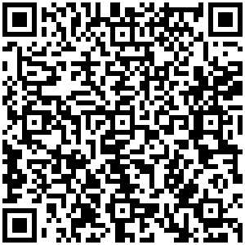
Redistricting (August 8th)
Presentation QR Code:

Slide 3
Redistricting Commission
Assigned Tasks from August 8th Meeting:
Review and Analyze
Final Map 1
Final Map 2
Final Map 3
Final Map 4
Final ‘NEW’ Map 5 (Proposed on 8/4/2023)
Final ‘NEW’ Map 6 (Proposed on 8/4/2023)

Slide 4
(FINAL MAP 1)

Slide 5
CREATION OF FINAL MAP 1:
Based on Map 8, which was presented on July 10th Commission Redistricting Meeting.
Precinct moves came from Commissioner Geitner’ s “Commission Direction Form”.
Precinct 445 moved from District 1 to adjust for population deviation.

Slide 6
(FINAL MAP 1):
FINAL MAP 1:
SE (30 Suggested Precincts) consolidated into one district? | NO
Fountain / Fort Carson / Security / Widefield / Hanover together? | NO

Slide 7
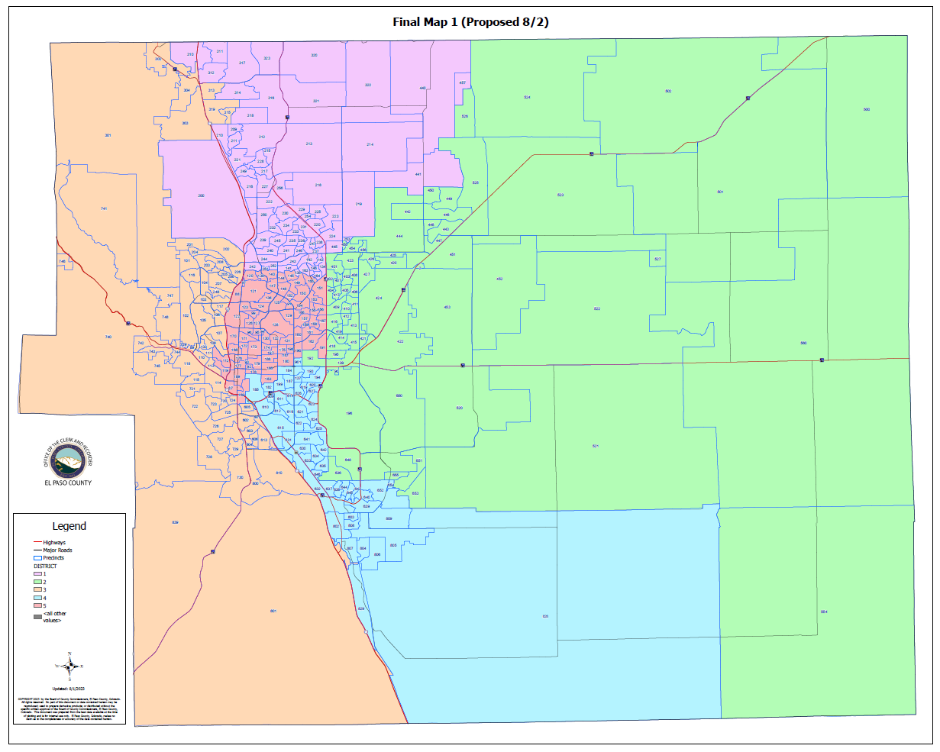
(FINAL MAP 1):

Slide 8
(FINAL MAP 1)
HOUSE BILL 21-1047:
(FINAL PROPOSED MAP 1):
Overall Range in Deviation: | 4.93%
Total Precincts Moved: | 73 (22.60%)
Total Affected Population: | 183,433
%: | 25.03%
Total Affected Active Voters: | 103,518
%: | 21.41%

Slide 9
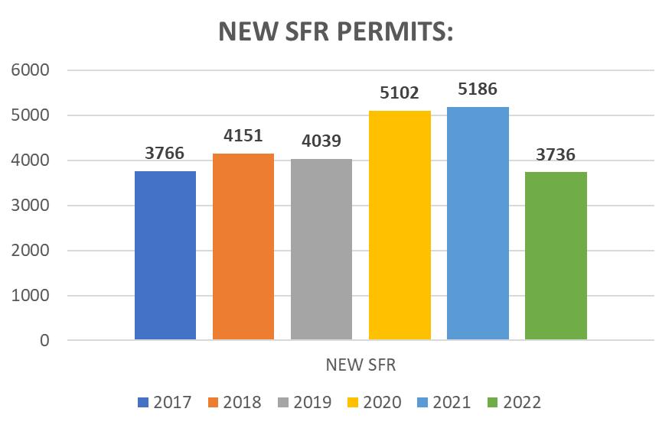
(FINAL MAP 1)
HOUSE BILL 21-1047:
District: | Total Population: | Target Deviation:
1 | 144,912 | -1,643
2 | 142,863 | -3,692
3 | 150,092 | 3,537
4 | 144,965 | -1,590
5 | 149,941 | 3,386

Slide 10
(FINAL MAP 1)
Precinct Moves:
DISTRICT: | PRECINCTS ADDED: | PRECINCTS DELETED: | IMPACT:
1 | 164-219-441-445 | 303-313-315-319 | 0
2 | 090-196-520-521-522-527-554-560-636-648-650-651-653-655 | 145-157-158-159-160-161-162-167-190-191-193-194-219-441-445 | -1
3 | 303-313-315-319-603-614-606-613-800-801-810 | 087-088-096-112-119-122-126-168-169-170-171-172-176-177-189 | -4
4 | 137-182-184-185-187-193-194-199-609-610-611-612-614-616-619-620-626-627-901 | 090-196-520-521-522-527-554-560-603-604-606-613-636-648-650-651-653-655-800-801-810 | -2
5 | 087-088-096-112-119-122-126-145-157-158-159-160-161-162-167-168-169-170-171-172-176-177-189-190-191 | 137-164-182-184-185-187-199-609-610-611-612-614-616-619-626-901 | +7

Slide 11
1st Criteria – Population Equality & VRA
(FINAL MAP 1) Total Population Racial Ethnicity:
Districts | Total / %: | Hispanic or Latino: | Black: | White: | Asian:
1 | TOTAL: | 15,595 | 4,365 | 108,558 | 6,261
 | %: | 10.76% | 3.01% | 74.91% | 4.32%
2 | TOTAL: | 25,318 | 7,800 | 92,560 | 4,626
 | %: | 17.72% | 5.46% | 64.79% | 3.24%
3 | TOTAL: | 20,849 | 6,343 | 108,350 | 3,913
 | %: | 13.89% | 4.23% | 72.19% | 2.61%
4 | TOTAL: | 43,016 | 15,533 | 69,570 | 3,858
 | %: | 29.67% | 10.72% | 47.99% | 2.66%
5 | TOTAL: | 25,715 | 7,278 | 102,643 | 3,011
 | %: | 17.15% | 4.85% | 68.46% | 2.01%

Slide 12
1st Criteria – Population Equality & VRA
(FINAL MAP 1) Total Population Racial Ethnicity:
Districts | Total % / Variance: | Hispanic or Latino: | Black: | White: | Asian:
1 | TOTAL: | +0.18% | +0.08% | -0.37% | +0.05%
2 | TOTAL: | -0.62% | +0.12% | +0.06% | +0.09%
3 | TOTAL: | +1.23% | +1.38% | -3.34% | +0.31%
4 | TOTAL: | +4.66% | +1.1% | -5.24% | -0.1%
5 | TOTAL: | -5.04% | -2.45% | +7.91% | -0.2%

Slide 13
1st Criteria – Population Equality & VRA
(FINAL MAP 1) Voting Age Population Racial Ethnicity:
Districts | Total / %: | Hispanic or Latino: | Black: | White: | Asian:
1 | TOTAL: | 10,235 | 3,428 | 84,719 | 4,848
 | %: | 7.06% | 2.37% | 58.46% | 3.35%
2 | TOTAL: | 15,662 | 5,740 | 69,989 | 3,754
 | %: | 10.96% | 4.02% | 48.99% | 2.63%
3 | TOTAL: | 14,504 | 5,030 | 89,569 | 3,270
 | %: | 9.66% | 3.35% | 59.68% | 2.18%
4 | TOTAL: | 27,956 | 11,836 | 55,766 | 3,266
 | %: | 19.28% | 8.16% | 38.47% | 2.25%
5 | TOTAL: | 18,007 | 5,880 | 88,198 | 2,685
 | %: | 12.01% | 3.92% | 58.82% | 1.79%

Slide 14
1st Criteria – Population Equality & VRA
(FINAL MAP 1) Voting Age Population Racial Ethnicity:
Districts | Total % / Variance: | Hispanic or Latino: | Black: | White: | Asian:
1 | TOTAL: | +0.12% | +0.08% | -0.08% | +0.04%
2 | TOTAL: | -0.66% | -0.03% | -1.23% | +0.05%
3 | TOTAL: | +0.56% | +1.03% | -4.83% | +0.2%
4 | TOTAL: | +3.24% | +0.89% | -2.81% | -0.06%
5 | TOTAL: | -3.14% | -1.82% | +7.49% | -0.14%

Slide 15
2nd Criteria - Communities of Interest & Compactness
(FINAL MAP 1):
COMMUNITIES OF INTEREST & COMPACTNESS (Towns & Cities):
City / Town: | Commissioner District:
Calhan | 2
Cascade | 3
Colorado Springs | 1, 2, 3, 4, 5
Elbert | 2
Fountain | 3, 4
Green Mtn. Falls | 3
Manitou Springs | 3
Monument | 3, 1
Palmer Lake | 3
Peyton | 2
Ramah | 2
Rush | 2
Yoder | 2
COMMUNITIES OF INTEREST & COMPACTNESS (Military):
Military Installations: | Commissioner District:
USAFA | 1
Fort Carson | 3
Peterson AFB | 2
Schriever SFB | 2
NORAD | 3

Slide 16
2nd Criteria - Communities of Interest & Compactness
(FINAL MAP 1):
COMMUNITIES OF INTEREST & COMPACTNESS (School Districts):
School District: | Commissioner District:
Academy School District 20 | 1, 2, 3
Big Sandy SD 110J | 2
Calhan SD RJ1 | 2
Cheyenne Mtn. SD 12 | 3
Edison SD 54 | 2
Ellicott SD 22 | 2
Falcon SD 49 | 1, 2
Fountain/Ft. Carson SD 8 | 3, 4
Hanover SD 28 | 3, 4
Harrison SD 2 | 2, 3, 4, 5
Lewis-Palmer SD 38 | 1, 3
Manitou Springs SD 14 | 3
COMMUNITIES OF INTEREST & COMPACTNESS (School Districts):
School District: | Commissioner District:
Miami-Yoder SD 60 | 2
Peyton SD 23 | 1, 2
RE-2 Fremont-Florence SD 39 | 3
Widefield SD 3 | 2, 4
Colorado Springs SD 11 | 1, 2, 3, 4, 5

Slide 17
2nd Criteria - Communities of Interest & Compactness
(FINAL MAP 1):
COMMUNITIES OF INTEREST & COMPACTNESS (Southeast Colorado Springs):
Southeast Colorado Springs (Precincts): | Commissioner District:
137 | 4
169 | 5
180 | 5
182 | 4
184 | 4
185 | 4
187 | 4
190 | 5
193 | 4
194 | 4
199 | 4
601 | 3
605 | 3
COMMUNITIES OF INTEREST & COMPACTNESS (Southeast Colorado Springs):
Southeast Colorado Springs (Precincts): | Commissioner District:
609 | 4
610 | 4
611 | 4
612 | 4
614 | 4
615 | 4
616 | 4
619 | 4
620 | 4
621 | 4
622 | 4
623 | 4
624 | 4
COMMUNITIES OF INTEREST & COMPACTNESS (Southeast Colorado Springs):
Southeast Colorado Springs (Precincts): | Commissioner District:
625 | 4
626 | 4
627 | 4
901 | 4
All 30 Precincts defined as Southeast Colorado Springs are in Commissioner Districts 3, 4, and 5.
District 3 = 2 Precincts (6.66%)
District 4 = 25 Precincts (83.33%)
District 5 = 3 Precincts (10.00%)
The Districts seem to be compact.

Slide 18
3rd Criteria - Political Competitiveness
(FINAL MAP 1):
District: | DEM: | DEM %: | REP: | REP %: | Total: | Deviation: | Deviation from Current:
US PRESIDENT:
1 | 31,657 | 35.95% | 53,570 | 60.83% | 88,067 | 24.88% | +0.13%
2 | 25,238 | 34.96% | 44,144 | 61.14% | 72,196 | 26.19% | +3.11%
3 | 38,143 | 46.88% | 40,605 | 49.90% | 81,369 | 3.03% | +7.59%
4 | 27,236 | 48.67% | 26,058 | 46.56% | 55,966 | 2.10% | +11.58%
5 | 39,667 | 48.82% | 38,451 | 47.32% | 81,253 | 1.50% | +0.62%

Slide 19
3rd Criteria - Political Competitiveness
(FINAL MAP 1):

Slide 20
3rd Criteria - Political Competitiveness
(FINAL MAP 1):
District: | DEM: | DEM %: | REP: | REP %: | Total: | Deviation: | Deviation from Current:
US SENATE:
1 | 25,559 | 35.61% | 43,975 | 61.27% | 71,772 | 25.66% | +0.06%
2 | 19,779 | 36.38% | 32,331 | 59.47% | 54,362 | 23.09% | +2.51%
3 | 29,976 | 47.52% | 31,193 | 49.45% | 63,080 | 1.93% | +8.13%
4 | 18,381 | 51.28% | 15,853 | 44.23% | 35,843 | 7.05% | +11.47%
5 | 30,329 | 51.18% | 26,643 | 44.96% | 59,259 | 6.22% | +0.02%

Slide 21
3rd Criteria - Political Competitiveness
(FINAL MAP 1):

Slide 22
3rd Criteria - Political Competitiveness
(FINAL MAP 1):
District: | DEM: | DEM %: | REP: | REP %: | Total: | Deviation: | Deviation from Current:
GOVERNOR:
1 | 28,383 | 39.46% | 42,138 | 58.57% | 71,934 | 19.12% | +0.05%
2 | 21,516 | 39.48% | 31,270 | 57.38% | 54,498 | 17.90% | +2.36%
3 | 32,265 | 51.00% | 29,676 | 46.91% | 63,267 | 4.09% | +7.61%
4 | 19,305 | 53.76% | 15,338 | 42.71% | 35,912 | 11.05% | +10.50%
5 | 31,978 | 53.82% | 25,965 | 43.70% | 59,415 | 10.12% | +0.17%

Slide 23
3rd Criteria - Political Competitiveness
(FINAL MAP 1):

Slide 24
3rd Criteria - Political Competitiveness
(FINAL MAP 1):
District: | DEM: | DEM %: | REP: | REP %: | Total: | Deviation: | Deviation from Current:
SECRETARY OF STATE:
1 | 25,552 | 35.83% | 43,932 | 61.60% | 71,323 | 25.77% | +0.07%
2 | 19,633 | 36.33% | 32,428 | 60.01% | 54,035 | 23.68% | +2.45%
3 | 29,472 | 47.05% | 31,426 | 50.17% | 62,643 | 3.12% | +7.83%
4 | 17,829 | 50.06% | 16,225 | 45.55% | 35,617 | 4.50% | +10.68%
5 | 29,505 | 50.16% | 27,334 | 46.47% | 58,817 | 3.69% | +0.32%

Slide 25
3rd Criteria - Political Competitiveness
(FINAL MAP 1):

Slide 26
3rd Criteria - Political Competitiveness
(FINAL MAP 1):
District: | DEM: | DEM %: | REP: | REP %: | Total: | Deviation: | Deviation from Current:
EL PASO COUNTY CLERK & RECORDER:
1 | 21,840 | 31.71% | 47,038 | 68.29% | 68,878 | 36.58% | +0.04%
2 | 17,646 | 33.45% | 35,113 | 66.55% | 52,759 | 33.11% | +2.36%
3 | 25,975 | 42.80% | 34,719 | 57.20% | 60,694 | 14.41% | +7.97%
4 | 16,844 | 48.47% | 17,906 | 51.53% | 34,750 | 3.06% | +12.13%
5 | 26,681 | 46.92% | 30,187 | 53.08% | 56,868 | 6.17% | +0.62%

Slide 27
3rd Criteria - Political Competitiveness
(FINAL MAP 1):

Slide 28
3rd Criteria - Political Competitiveness
(FINAL MAP 1):
District: | DEM: | DEM %: | REP: | REP %: | Total: | Deviation: | Deviation from Current:
EL PASO COUNTY SHERIFF:
1 | 22,534 | 32.51% | 46,774 | 67.49% | 69,308 | 34.97% | +0.07%
2 | 17,554 | 33.15% | 35,405 | 66.85% | 52,959 | 33.71% | +2.43%
3 | 26,551 | 43.68% | 34,236 | 56.32% | 60,787 | 12.64% | +7.92%
4 | 16,385 | 47.06% | 18,435 | 52.94% | 34,820 | 5.89% | +11.18%
5 | 26,776 | 46.94% | 30,266 | 53.06% | 57,042 | 6.12% | +0.07%

Slide 29
3rd Criteria - Political Competitiveness
(FINAL MAP 1):

Slide 30
3rd Criteria - Political Competitiveness
(FINAL MAP 1):
District: | Average Deviation of All Races:
1 | 27.83%
2 | 26.28%
3 | 5.17%
4 | 2.63%
5 | 1.54%
MAP 1 AVERAGE DEVIATION FOR OVERALL POLITICAL COMPETITIVENESS

Slide 31
QUESTIONS ON FINAL MAP 1?

Slide 32
(FINAL MAP 2)

Slide 33
CREATION OF FINAL MAP 2:
Based on combination of publicly submitted maps from Czukas (Version 1) and Waller-Martinez Maps.
Precinct 200 was added back to Commissioner District 1 based on Redistricting Commission request.

Slide 34
(FINAL MAP 2):
FINAL MAP 2:
SE (30 Suggested Precincts) consolidated into one district? | YES
Fountain / Fort Carson / Security / Widefield / Hanover together? | YES

Slide 35
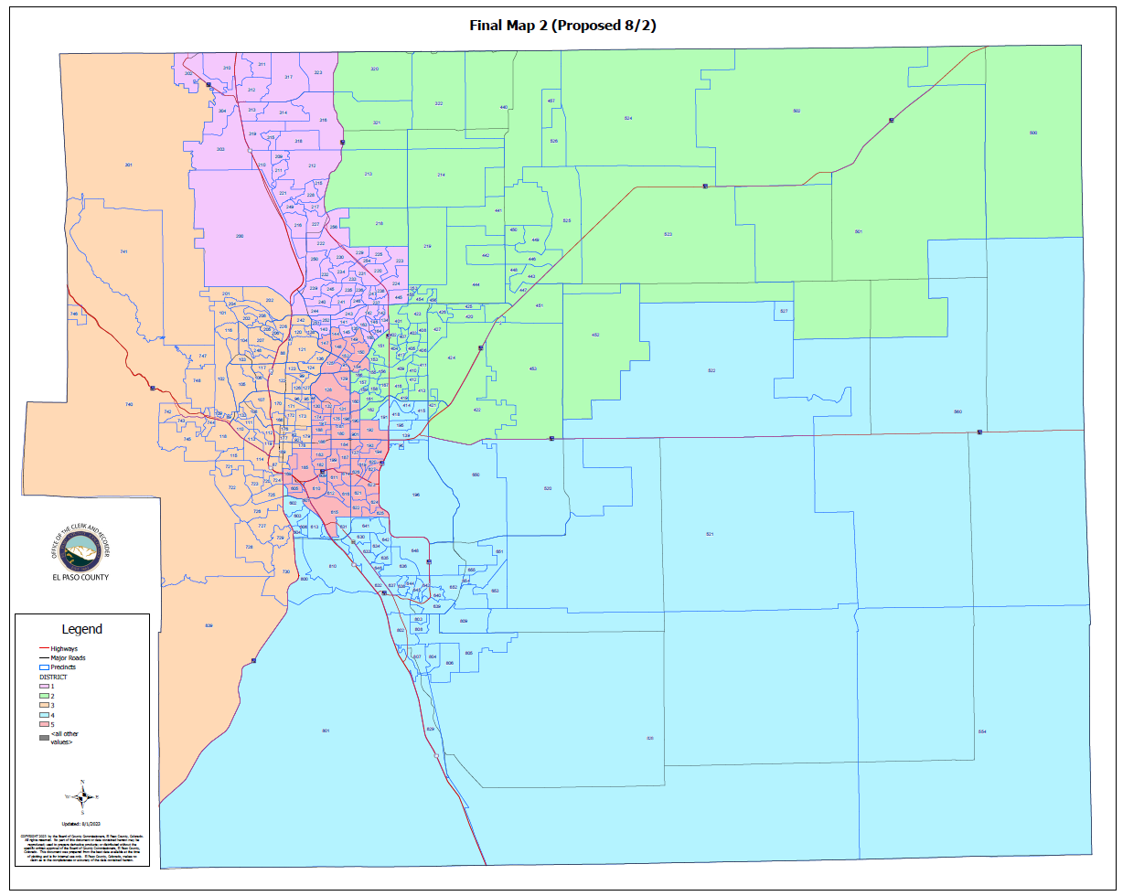
(FINAL MAP 2):

Slide 36
(FINAL MAP 2)
HOUSE BILL 21-1047:
(FINAL MAP 2):
Overall Range in Deviation: | 3.64%
Total Precincts Moved: | 59 (18.26%)
Total Affected Population: | 135,082
%: | 18.43%
Total Affected Active Voters: | 85,953
%: | 17.77%

Slide 37
(FINAL MAP 2)
HOUSE BILL 21-1047:
District: | Total Population: | Target Deviation:
1 | 147,849 | 1,294
2 | 143,566 | -2,989
3 | 147,926 | 1,371
4 | 144,536 | -2,019
5 | 148,896 | 2,341

Slide 38
(FINAL MAP 2)
Precinct Moves:
DISTRICT: | PRECINCTS ADDED: | PRECINCTS DELETED: | IMPACT:
1 | 140-164-165-302-304-445 | 213-214-218-242-253-320-321-322-440-457 | -4
2 | 151-153-155-156-166-213-214-218-253-320-321-322-440-457 | 139-160-190-191-192-193-194-195-414-415-418-445-620-627 | 0
3 | 092-093-095-097-099-120-121-123-124-127-136-138-173-178-179-242- | 169-302-304-601-602-605 | +10
4 | 139-191-195-414-415-418-602 | 615-621-622-623-624-625 | +1
5 | 160-169-190-192-193-194-601-605-615-620-621-622-623-624-625-627 | 092-093-095-097-099-120-121-123-124-127-136-138-140-151-153-155-156-164-165-166-173-178-179 | -7

Slide 39
1st Criteria – Population Equality & VRA
(FINAL MAP 2) Total Population Racial Ethnicity:
Districts | Total / %: | Hispanic or Latino: | Black: | White: | Asian:
1 | TOTAL: | 16,204 | 4,539 | 110,021 | 6,516
 | %: | 10.96% | 3.07% | 74.41% | 4.41%
2 | TOTAL: | 21,261 | 6,276 | 99,934 | 4,379
 | %: | 14.81% | 4.37% | 69.61% | 3.05%
3 | TOTAL: | 17,944 | 3,896 | 113,033 | 3,418
 | %: | 12.13% | 2.63% | 76.41% | 2.31%
4 | TOTAL: | 31,833 | 12,668 | 82,302 | 3,907
 | %: | 22.02% | 8.76% | 56.94% | 2.7%
5 | TOTAL: | 43,251 | 13,940 | 76,391 | 3,449
 | %: | 29.05% | 9.36% | 51.3% | 2.32%

Slide 40
1st Criteria – Population Equality & VRA
(FINAL MAP 2) Total Population Racial Ethnicity:
Districts | Total % / Variance: | Hispanic or Latino: | Black: | White: | Asian:
1 | TOTAL: | +0.38% | +0.14% | -0.87% | +0.14%
2 | TOTAL: | -3.53% | -0.97% | +4.88% | -0.06%
3 | TOTAL: | -0.53% | -0.22% | +0.88% | +0.01%
4 | TOTAL: | -2.99% | -0.86% | +3.71% | -0.06%
5 | TOTAL: | +6.86% | +2.06% | -9.25% | +.011%

Slide 41
1st Criteria – Population Equality & VRA
(FINAL MAP 2) Voting Age Population Racial Ethnicity:
Districts | Total / %: | Hispanic or Latino: | Black: | White: | Asian:
1 | TOTAL: | 10,627 | 3,551 | 85,421 | 5,068
 | %: | 7.19% | 2.4% | 57.78% | 3.43%
2 | TOTAL: | 13,423 | 4,719 | 77,427 | 3,549
 | %: | 9.35% | 3.29% | 53.93% | 2.47%
3 | TOTAL: | 12,987 | 3,247 | 97,065 | 2,935
 | %: | 8.78% | 2.2% | 65.62% | 1.98%
4 | TOTAL: | 20,638 | 9,596 | 64,099 | 3,270
 | %: | 14.28% | 6.64% | 44.35% | 2.26%
5 | TOTAL: | 28,689 | 10,801 | 64,229 | 3,001
 | %: | 19.27% | 7.25% | 43.14% | 2.02%

Slide 42
1st Criteria – Population Equality & VRA
(FINAL MAP 2) Voting Age Population Racial Ethnicity:
Districts | Total % / Variance: | Hispanic or Latino: | Black: | White: | Asian:
1 | TOTAL: | +0.25% | +0.11% | -0.76% | +0.12%
2 | TOTAL: | -2.27% | -0.76% | +3.71% | -0.11%
3 | TOTAL: | -0.32% | -0.12% | +1.11% | 0%
4 | TOTAL: | -1.76% | -0.63% | +3.07% | -0.05%
5 | TOTAL: | +4.12% | +1.51% | -8.19% | +0.09%

Slide 43
2nd Criteria - Communities of Interest & Compactness
(FINAL MAP 2):
COMMUNITIES OF INTEREST & COMPACTNESS (Towns & Cities):
City / Town: | Commissioner District:
Calhan | 2
Cascade | 3
Colorado Springs | 1, 2, 3, 4, 5
Elbert | 2
Fountain | 4
Green Mtn. Falls | 3
Manitou Springs | 3
Monument | 1
Palmer Lake | 1, 3
Peyton | 2, 4
Ramah | 2
Rush | 4
Yoder | 4
COMMUNITIES OF INTEREST & COMPACTNESS (Military):
Military Installations: | Commissioner District:
USAFA | 1
Fort Carson | 4
Peterson AFB | 4
Schriever SFB | 4
NORAD | 3

Slide 44
2nd Criteria - Communities of Interest & Compactness
(FINAL MAP 2):
COMMUNITIES OF INTEREST & COMPACTNESS (School Districts):
School District: | Commissioner District:
Academy School District 20 | 1, 2
Big Sandy SD 110J | 2, 4
Calhan SD RJ1 | 2
Cheyenne Mtn. SD 12 | 3
Edison SD 54 | 4
Ellicott SD 22 | 2, 4
Falcon SD 49 | 2, 4
Fountain/Ft. Carson SD 8 | 4
Hanover SD 28 | 4
Harrison SD 2 | 4, 5
Lewis-Palmer SD 38 | 1, 2, 3
Manitou Springs SD 14 | 3
COMMUNITIES OF INTEREST & COMPACTNESS (School Districts):
School District: | Commissioner District:
Miami-Yoder SD 60 | 2, 4
Peyton SD 23 | 2
RE-2 Fremont-Florence SD 39 | 3, 4
Widefield SD 3 | 4
Colorado Springs SD 11 | 1, 2, 3, 4, 5

Slide 45
2nd Criteria - Communities of Interest & Compactness
(FINAL MAP 2):
COMMUNITIES OF INTEREST & COMPACTNESS (Southeast Colorado Springs):
Southeast Colorado Springs (Precincts): | Commissioner District:
137 | 5
169 | 5
180 | 5
182 | 5
184 | 5
185 | 5
187 | 5
190 | 5
193 | 5
194 | 5
199 | 5
601 | 5
605 | 5
COMMUNITIES OF INTEREST & COMPACTNESS (Southeast Colorado Springs):
Southeast Colorado Springs (Precincts): | Commissioner District:
609 | 5
610 | 5
611 | 5
612 | 5
614 | 5
615 | 5
616 | 5
619 | 5
620 | 5
621 | 5
622 | 5
623 | 5
624 | 5
COMMUNITIES OF INTEREST & COMPACTNESS (Southeast Colorado Springs):
Southeast Colorado Springs (Precincts): | Commissioner District:
625 | 5
626 | 5
627 | 5
901 | 5
All 30 Precincts defined as Southeast Colorado Springs are in Commissioner District 5.
District 5 = 30 Precincts (100.00%)
The Districts seem to be compact.

Slide 46
3rd Criteria - Political Competitiveness
(FINAL MAP 2):
District: | DEM: | DEM %: | REP: | REP %: | Total: | Deviation: | Deviation from Current:
US PRESIDENT:
1 | 33,384 | 37.57% | 52,544 | 59.14% | 88,853 | 21.56% | +3.19%
2 | 27,794 | 33.81% | 51,445 | 62.59% | 82,195 | 28.77% | +5.70%
3 | 46,718 | 51.20% | 41,588 | 45.58% | 91,249 | 5.62% | +1.06%
4 | 23,309 | 41.31% | 30,555 | 54.15% | 56,424 | 12.84% | +3.37%
5 | 30,736 | 51.12% | 26,696 | 44.40% | 60,130 | 6.72% | +4.61%

Slide 47
3rd Criteria - Political Competitiveness
(FINAL MAP 2):

Slide 48
3rd Criteria - Political Competitiveness
(FINAL MAP 2):
District: | DEM: | DEM %: | REP: | REP %: | Total: | Deviation: | Deviation from Current:
US SENATE:
1 | 26,798 | 37.48% | 42,414 | 59.33% | 71,493 | 21.84% | +3.76%
2 | 22,491 | 34.86% | 39,560 | 61.32% | 64,519 | 26.46% | +5.87%
3 | 36,711 | 51.94% | 31,901 | 45.13% | 70,680 | 6.81% | +0.61%
4 | 16,154 | 43.93% | 19,013 | 51.70% | 36,774 | 7.77% | +3.36%
5 | 21,870 | 53.53% | 17,107 | 41.87% | 40,853 | 11.66% | +5.41%

Slide 49
3rd Criteria - Political Competitiveness
(FINAL MAP 2):

Slide 50
3rd Criteria - Political Competitiveness
(FINAL MAP 2):
District: | DEM: | DEM %: | REP: | REP %: | Total: | Deviation: | Deviation from Current:
GOVERNOR:
1 | 29,627 | 41.34% | 40,619 | 56.67% | 71,674 | 15.34% | +3.73%
2 | 24,572 | 37.97% | 38,348 | 59.26% | 64,710 | 21.29% | +5.75%
3 | 39,056 | 55.12% | 30,376 | 42.87% | 70,854 | 12.25% | +0.55%
4 | 17,293 | 46.96% | 18,285 | 49.62% | 36,851 | 2.69% | +3.24%
5 | 22,899 | 55.94% | 16,756 | 40.93% | 40,938 | 15.01% | +5.06%

Slide 51
3rd Criteria - Political Competitiveness
(FINAL MAP 2):

Slide 52
3rd Criteria - Political Competitiveness
(FINAL MAP 2):
District: | DEM: | DEM %: | REP: | REP %: | Total: | Deviation: | Deviation from Current:
SECRETARY OF STATE:
1 | 26,735 | 37.63% | 42,467 | 59.78% | 71,041 | 22.14% | +3.69%
2 | 22,327 | 34.82% | 39,624 | 61.80% | 64,118 | 26.98% | +5.74%
3 | 35,964 | 51.26% | 32,274 | 46.00% | 70,154 | 5.26% | +0.55%
4 | 15,837 | 43.30% | 19,266 | 52.68% | 36,571 | 9.38% | +3.20%
5 | 21,128 | 52.10% | 17,714 | 43.68% | 40,551 | 8.42% | +5.05%

Slide 53
3rd Criteria - Political Competitiveness
(FINAL MAP 2):

Slide 54
3rd Criteria - Political Competitiveness
(FINAL MAP 2):
District: | DEM: | DEM %: | REP: | REP %: | Total: | Deviation: | Deviation from Current:
EL PASO COUNTY CLERK & RECORDER:
1 | 23,009 | 33.55% | 45,563 | 66.45% | 68,572 | 32.89% | +3.65%
2 | 19,683 | 31.52% | 42,762 | 68.48% | 62,445 | 36.96% | +6.22%
3 | 31,888 | 46.98% | 35,983 | 53.02% | 67,871 | 6.03% | +0.41%
4 | 14,533 | 40.62% | 21,247 | 59.38% | 35,780 | 18.76% | +3.58%
5 | 19,873 | 50.59% | 19,408 | 49.41% | 39,281 | 1.18% | +6.73%

Slide 55
3rd Criteria - Political Competitiveness
(FINAL MAP 2):

Slide 56
3rd Criteria - Political Competitiveness
(FINAL MAP 2):
District: | DEM: | DEM %: | REP: | REP %: | Total: | Deviation: | Deviation from Current:
EL PASO COUNTY SHERIFF:
1 | 23,578 | 34.17% | 45,414 | 65.83% | 68,992 | 31.65% | +3.39%
2 | 19,784 | 31.57% | 42,891 | 68.43% | 62,675 | 36.87% | +5.59%
3 | 32,672 | 48.03% | 35,354 | 51.97% | 68,026 | 3.94% | +0.78%
4 | 14,243 | 39.84% | 21,505 | 60.16% | 35,748 | 20.31% | +3.25%
5 | 19,523 | 49.46% | 19,952 | 50.54% | 39,475 | 1.09% | +5.11%

Slide 57
3rd Criteria - Political Competitiveness
(FINAL MAP 2):

Slide 58
3rd Criteria - Political Competitiveness
(FINAL MAP 2):
District: | Average Deviation of All Races:
1 | 24.24%
2 | 29.55%
3 | 3.33%
4 | 11.96%
5 | 6.98%
MAP 2 AVERAGE DEVIATION FOR OVERALL POLITICAL COMPETITIVENESS

Slide 59
QUESTIONS ON FINAL MAP 2?

Slide 60
(FINAL MAP 3)

Slide 61
CREATION OF FINAL MAP 3:
Based on Map 10 with all 30 Southeast Precincts together.

Slide 62
(FINAL MAP 3):
FINAL MAP 3:
SE (30 Suggested Precincts) consolidated into one district? | YES
Fountain / Fort Carson / Security / Widefield / Hanover together? | YES

Slide 63
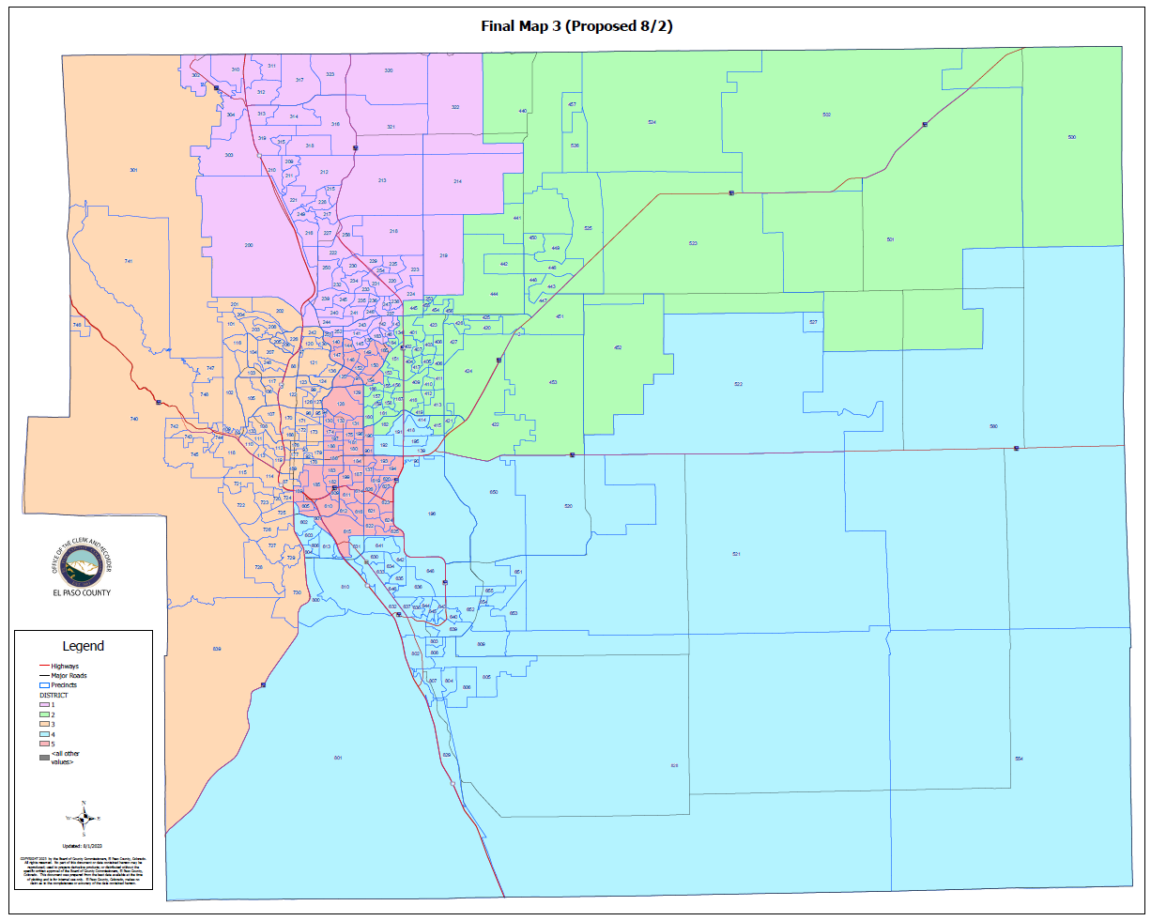
(FINAL MAP 3):

Slide 64
(FINAL MAP 3)
HOUSE BILL 21-1047:
(FINAL MAP 3):
Overall Range in Deviation: | 3.69%
Total Precincts Moved: | 51 (15.78%)
Total Affected Population: | 116,893
%: | 15.95%
Total Affected Active Voters: | 71,427
%: | 14.77%

Slide 65
(FINAL MAP 3)
HOUSE BILL 21-1047:
District: | Total Population: | Target Deviation:
1 | 148,387 | 1,832
2 | 143,111 | -3,444
3 | 147,946 | 1,391
4 | 144,805 | -1,750
5 | 148,524 | 1,969

Slide 66
(FINAL MAP 3)
Precinct Moves:
DISTRICT: | PRECINCTS ADDED: | PRECINCTS DELETED: | IMPACT:
1 | 219-302-304 | 134-242-251-253-440-457 | -3
2 | 134-151-153-155-156-164-166-253-440-457 | 139-190-191-192-193-194-195-219-414-418-620-627 | -2
3 | 092-093-095-097-099-120-121-123-124-127-136-138-173-178-179-242 | 169-302-304-601-602-605 | +10
4 | 139-191-192-195-414-418-602 | 615-621-622-623-624-625 | +1
5 | 169-190-193-194-251-601-605-615-620-621-622-623-624-625-627 | 092-093-095-097-099-120-121-123-124-127-136-138-151-153-155-156-164-166-173-178-179 | -6

Slide 67
1st Criteria – Population Equality & VRA
(FINAL MAP 3) Total Population Racial Ethnicity:
Districts | Total / %: | Hispanic or Latino: | Black: | White: | Asian:
1 | TOTAL: | 15,402 | 4,134 | 112,271 | 6,300
 | %: | 10.38% | 2.79% | 75.66% | 4.25%
2 | TOTAL: | 22,485 | 6,878 | 97,094 | 4,598
 | %: | 15.71% | 4.81% | 67.85% | 3.21%
3 | TOTAL: | 17,946 | 3,897 | 113,047 | 3,418
 | %: | 12.13% | 2.63% | 76.41% | 2.31%
4 | TOTAL: | 32,055 | 12,548 | 82,556 | 3,890
 | %: | 22.14% | 8.67% | 57.01% | 2.69%
5 | TOTAL: | 42,605 | 13,862 | 76,713 | 3,463
 | %: | 28.69% | 9.33% | 51.65% | 2.33%

Slide 68
1st Criteria – Population Equality & VRA
(FINAL MAP 3) Total Population Racial Ethnicity:
Districts | Total % / Variance: | Hispanic or Latino: | Black: | White: | Asian:
1 | TOTAL: | -0.2% | -0.14% | +0.38% | -0.02%
2 | TOTAL: | -2.63% | -0.53% | +3.12% | 0.06%
3 | TOTAL: | -0.53% | -0.22% | +0.88% | +0.01%
4 | TOTAL: | -2.87% | -0.95% | +3.78% | -0.07%
5 | TOTAL: | +6.5% | +2.03% | -8.9% | +0.12%

Slide 69
1st Criteria – Population Equality & VRA
(FINAL MAP 3) Voting Age Population Racial Ethnicity:
Districts | Total / %: | Hispanic or Latino: | Black: | White: | Asian:
1 | TOTAL: | 10,089 | 3,218 | 87,264 | 4,880
 | %: | 6.8% | 2.17% | 58.81% | 3.29%
2 | TOTAL: | 14,208 | 5,231 | 75,163 | 3,726
 | %: | 9.93% | 3.66% | 52.52% | 2.6%
3 | TOTAL: | 12,989 | 3,248 | 97,075 | 2,935
 | %: | 8.78% | 2.2% | 65.62% | 1.98%
4 | TOTAL: | 20,788 | 9,510 | 64,381 | 3,264
 | %: | 14.36% | 6.57% | 44.46% | 2.25%
5 | TOTAL: | 28,290 | 10,707 | 64,358 | 3,018
 | %: | 19.05% | 7.21% | 43.33% | 2.03%

Slide 70
1st Criteria – Population Equality & VRA
(FINAL MAP 3) Voting Age Population Racial Ethnicity:
Districts | Total % / Variance: | Hispanic or Latino: | Black: | White: | Asian:
1 | TOTAL: | -0.14% | -0.12% | +0.27% | -0.02%
2 | TOTAL: | -1.69% | -0.39% | +2.3% | +0.02%
3 | TOTAL: | -0.32% | -0.12% | +1.11% | 0%
4 | TOTAL: | -1.68% | -0.7% | +3.18% | -0.06%
5 | TOTAL: | +3.9% | +1.47% | -8% | +0.1%

Slide 71
2nd Criteria - Communities of Interest & Compactness
(FINAL MAP 3):
COMMUNITIES OF INTEREST & COMPACTNESS (Towns & Cities):
City / Town: | Commissioner District:
Calhan | 2
Cascade | 3
Colorado Springs | 1, 2, 3, 4, 5
Elbert | 2
Fountain | 4
Green Mtn. Falls | 3
Manitou Springs | 3
Monument | 1
Palmer Lake | 1, 3
Peyton | 2
Ramah | 2
Rush | 4
Yoder | 4
COMMUNITIES OF INTEREST & COMPACTNESS (Military):
Military Installations: | Commissioner District:
USAFA | 1
Fort Carson | 4
Peterson AFB | 4
Schriever SFB | 4
NORAD | 3

Slide 72
2nd Criteria - Communities of Interest & Compactness
(FINAL MAP 3):
COMMUNITIES OF INTEREST & COMPACTNESS (School Districts):
School District: | Commissioner District:
Academy School District 20 | 1, 3
Big Sandy SD 110J | 2, 4
Calhan SD RJ1 | 2
Cheyenne Mtn. SD 12 | 3
Edison SD 54 | 4
Ellicott SD 22 | 2, 4
Falcon SD 49 | 2, 4
Fountain/Ft. Carson SD 8 | 4
Hanover SD 28 | 4
Harrison SD 2 | 4, 5
Lewis-Palmer SD 38 | 1, 3
Manitou Springs SD 14 | 3
COMMUNITIES OF INTEREST & COMPACTNESS (School Districts):
School District: | Commissioner District:
Miami-Yoder SD 60 | 2, 4
Peyton SD 23 | 1, 2
RE-2 Fremont-Florence SD 39 | 3, 4
Widefield SD 3 | 4
Colorado Springs SD 11 | 1, 2, 3, 4, 5

Slide 73
2nd Criteria - Communities of Interest & Compactness
(FINAL MAP 3):
COMMUNITIES OF INTEREST & COMPACTNESS (Southeast Colorado Springs):
Southeast Colorado Springs (Precincts): | Commissioner District:
137 | 5
169 | 5
180 | 5
182 | 5
184 | 5
185 | 5
187 | 5
190 | 5
193 | 5
194 | 5
199 | 5
601 | 5
605 | 5
COMMUNITIES OF INTEREST & COMPACTNESS (Southeast Colorado Springs):
Southeast Colorado Springs (Precincts): | Commissioner District:
609 | 5
610 | 5
611 | 5
612 | 5
614 | 5
615 | 5
616 | 5
619 | 5
620 | 5
621 | 5
622 | 5
623 | 5
624 | 5
COMMUNITIES OF INTEREST & COMPACTNESS (Southeast Colorado Springs):
Southeast Colorado Springs (Precincts): | Commissioner District:
625 | 5
626 | 5
627 | 5
901 | 5
All 30 Precincts defined as Southeast Colorado Springs are in Commissioner District 5.
District 5 = 30 Precincts (100.00%)
The Districts seem to be compact.

Slide 74
3rd Criteria - Political Competitiveness
(FINAL MAP 3):
District: | DEM: | DEM %: | REP: | REP %: | Total: | Deviation: | Deviation from Current:
US PRESIDENT:
1 | 33,063 | 36.03% | 55,792 | 60.80% | 91,758 | 24.77% | +0.02%
2 | 28,263 | 35.77% | 47,765 | 60.45% | 79,016 | 24.68% | +1.60%
3 | 46,718 | 51.20% | 41,588 | 45.58% | 91,249 | 5.62% | +1.06%
4 | 23,428 | 41.31% | 30,731 | 54.19% | 56,714 | 12.88% | +3.40%
5 | 30,469 | 50.69% | 26,952 | 44.83% | 60,114 | 5.85% | +3.74%

Slide 75
3rd Criteria - Political Competitiveness
(FINAL MAP 3):

Slide 76
3rd Criteria - Political Competitiveness
(FINAL MAP 3):
District: | DEM: | DEM %: | REP: | REP %: | Total: | Deviation: | Deviation from Current:
US SENATE:
1 | 26,561 | 35.71% | 45,464 | 61.13% | 74,371 | 25.42% | +0.18%
2 | 22,595 | 37.10% | 35,899 | 58.94% | 60,908 | 21.84% | +1.26%
3 | 36,711 | 51.94% | 31,901 | 45.13% | 70,680 | 6.81% | +0.61%
4 | 16,237 | 43.88% | 19,146 | 51.75% | 37,000 | 7.86% | +3.45%
5 | 21,920 | 53.00% | 17,585 | 42.52% | 41,360 | 10.48% | +4.24%

Slide 77
3rd Criteria - Political Competitiveness
(FINAL MAP 3):

Slide 78
3rd Criteria - Political Competitiveness
(FINAL MAP 3):
District: | DEM: | DEM %: | REP: | REP %: | Total: | Deviation: | Deviation from Current:
GOVERNOR:
1 | 29,521 | 39.58% | 43,597 | 58.46% | 74,582 | 18.87% | +0.19%
2 | 24,517 | 40.15% | 34,782 | 56.96% | 61,060 | 16.81% | +1.27%
3 | 39,056 | 55.12% | 30,376 | 42.87% | 70,854 | 12.25% | +0.55%
4 | 17,401 | 46.92% | 18,410 | 49.65% | 37,083 | 2.72% | +3.27%
5 | 22,952 | 55.38% | 17,219 | 41.54% | 41,448 | 13.83% | +3.89%

Slide 79
3rd Criteria - Political Competitiveness
(FINAL MAP 3):

Slide 80
3rd Criteria - Political Competitiveness
(FINAL MAP 3):
District: | DEM: | DEM %: | REP: | REP %: | Total: | Deviation: | Deviation from Current:
SECRETARY OF STATE:
1 | 26,546 | 35.91% | 45,463 | 61.50% | 73,919 | 25.59% | +0.24%
2 | 22,374 | 36.99% | 36,005 | 59.52% | 60,493 | 22.53% | +1.30%
3 | 35,964 | 51.26% | 32,274 | 46.00% | 70,154 | 5.26% | +0.55%
4 | 15,937 | 43.31% | 19,389 | 52.69% | 36,801 | 9.38% | +3.20%
5 | 21,170 | 51.55% | 18,214 | 44.35% | 41,068 | 7.20% | +3.83%

Slide 81
3rd Criteria - Political Competitiveness
(FINAL MAP 3):

Slide 82
3rd Criteria - Political Competitiveness
(FINAL MAP 3):
District: | DEM: | DEM %: | REP: | REP %: | Total: | Deviation: | Deviation from Current:
EL PASO COUNTY CLERK & RECORDER:
1 | 22,706 | 31.82% | 48,660 | 68.18% | 71,366 | 36.38% | +0.18%
2 | 19,904 | 33.78% | 39,022 | 66.22% | 58,926 | 32.44% | +1.70%
3 | 31,888 | 46.98% | 35,983 | 53.02% | 67,871 | 6.03% | +0.41%
4 | 14,624 | 40.62% | 21,381 | 59.38% | 36,005 | 18.77% | +3.58%
5 | 19,864 | 49.93% | 19,917 | 50.07% | 39,781 | 0.13% | +5.42%

Slide 83
3rd Criteria - Political Competitiveness
(FINAL MAP 3):

Slide 84
3rd Criteria - Political Competitiveness
(FINAL MAP 3):
District: | DEM: | DEM %: | REP: | REP %: | Total: | Deviation: | Deviation from Current:
EL PASO COUNTY SHERIFF:
1 | 23,342 | 32.51% | 48,449 | 67.49% | 71,791 | 34.97% | +0.07%
2 | 19,920 | 33.68% | 39,221 | 66.32% | 59,141 | 32.64% | +1.36%
3 | 32,672 | 48.03% | 35,354 | 51.97% | 68,026 | 3.94% | +0.78%
4 | 14,331 | 39.84% | 21,644 | 60.16% | 35,975 | 20.33% | +3.26%
5 | 19,535 | 48.86% | 20,448 | 51.14% | 39,983 | 2.28% | +3.91%

Slide 85
3rd Criteria - Political Competitiveness
(FINAL MAP 3):

Slide 86
3rd Criteria - Political Competitiveness
(FINAL MAP 3):
District: | Average Deviation of All Races:
1 | 27.67%
2 | 25.16%
3 | 3.33%
4 | 11.99%
5 | 5.82%
MAP 3 AVERAGE DEVIATION FOR OVERALL POLITICAL COMPETITIVENESS

Slide 87
QUESTIONS ON FINAL MAP 3?

Slide 88
(FINAL MAP 4)
-Based on Original Map 4
Added Precincts 169, 190, 615 to Commissioner District 5.

Slide 89
CREATION OF FINAL MAP 4:
Based on Map 4.
Added Precincts 615, 190 and 169 to Commissioner District 5.

Slide 90
(FINAL MAP 4):
FINAL MAP 4:
SE (30 Suggested Precincts) consolidated into one district? | YES
Fountain / Fort Carson / Security / Widefield / Hanover together? | YES

Slide 91
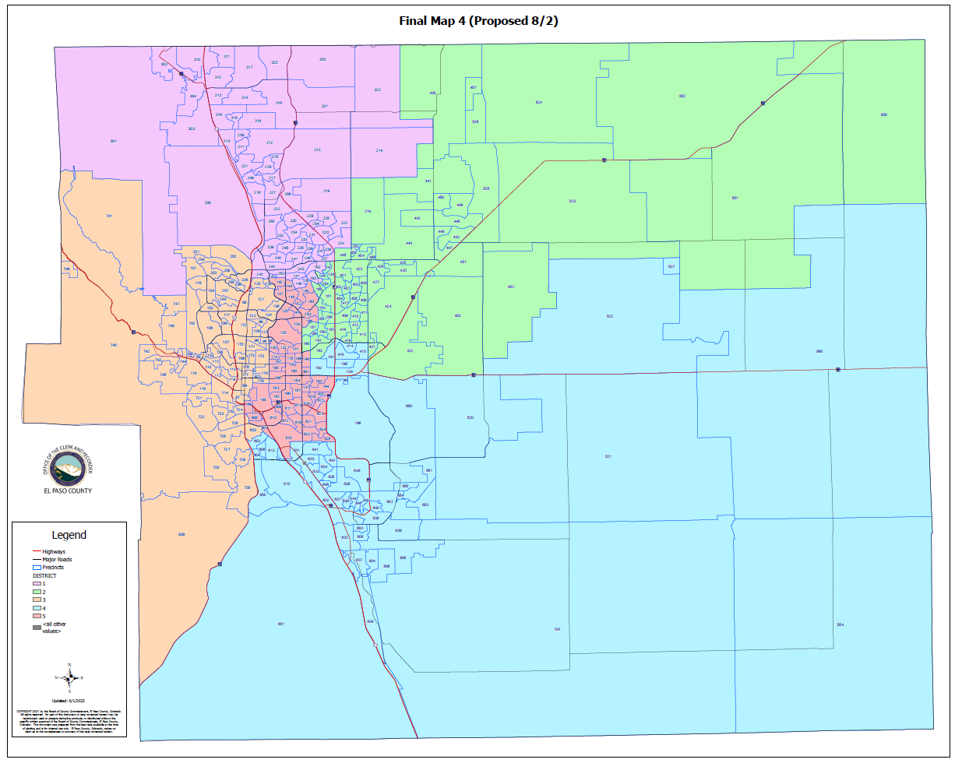
(FINAL MAP 4):

Slide 92
(FINAL MAP 4)
HOUSE BILL 21-1047:
(FINAL MAP 4):
Overall Range in Deviation: | 3.09%
Total Precincts Moved: | 51 (15.78%)
Total Affected Population: | 115,750
%: | 15.80%
Total Affected Active Voters: | 71,103
%: | 14.70%

Slide 93
(FINAL MAP 4)
HOUSE BILL 21-1047:
District: | Total Population: | Target Deviation:
1 | 146,263 | -292
2 | 144,383 | -2,172
3 | 148,665 | 2,110
4 | 144,547 | -2,008
5 | 148,915 | 2,360

Slide 94
(FINAL MAP 4)
Precinct Moves:
DISTRICT: | PRECINCTS ADDED: | PRECINCTS DELETED: | IMPACT:
1 | 301-302-304 | 134-143-146-253-440-457 | -3
2 | 134-143-146-151-153-155-156-164-165-253-440-457 | 139-190-191-192-193-194-195-414-415-418-620-627 | 0
3 | 092-093-095-097-099-120-121-123-124-127-136-138-173-178-179 | 169-301-302-304-601-605 | +9
4 | 139-191-192-193-194-195-414-415-418 | 615-621-622-623-624-625 | +3
5 | 169-190-601-605-615-620-621-622-623-624-625-627 | 092-093-095-097-099-120-121-123-124-127-136-138-151-153-155-156-164-165-173-178-179 | -9

Slide 95
1st Criteria – Population Equality & VRA
(FINAL MAP 4) Total Population Racial Ethnicity:
Districts | Total / %: | Hispanic or Latino: | Black: | White: | Asian:
1 | TOTAL: | 15,259 | 4,101 | 110,555 | 6,186
 | %: | 10.43% | 2.8% | 75.59% | 4.23%
2 | TOTAL: | 21,852 | 6,569 | 99,355 | 4,669
 | %: | 15.13% | 4.55% | 68.81% | 3.23%
3 | TOTAL: | 18,182 | 4,029 | 113,284 | 3,504
 | %: | 12.23% | 2.71% | 76.2% | 2.36%
4 | TOTAL: | 32,263 | 12,586 | 81,969 | 3,880
 | %: | 22.32% | 8.71% | 56.71% | 2.68%
5 | TOTAL: | 42,937 | 14,034 | 76,518 | 3,430
 | %: | 28.83% | 9.42% | 51.38% | 2.3%

Slide 96
1st Criteria – Population Equality & VRA
(FINAL MAP 4) Total Population Racial Ethnicity:
Districts | Total % / Variance: | Hispanic or Latino: | Black: | White: | Asian:
1 | TOTAL: | -0.15% | -0.13% | +0.31% | -0.04%
2 | TOTAL: | -3.21% | -0.79% | +4.08% | +0.08%
3 | TOTAL: | -0.43% | -0.14% | +0.67% | +0.06%
4 | TOTAL: | -2.69% | -0.91% | +3.48% | -0.08%
5 | TOTAL: | +6.64% | +2.12% | -9.17% | +0.09%

Slide 97
1st Criteria – Population Equality & VRA
(FINAL MAP 4) Voting Age Population Racial Ethnicity:
Districts | Total / %: | Hispanic or Latino: | Black: | White: | Asian:
1 | TOTAL: | 10,039 | 3,188 | 86,131 | 4,776
 | %: | 6.86% | 2.18% | 58.89% | 3.27%
2 | TOTAL: | 13,758 | 4,996 | 76,763 | 3,794
 | %: | 9.53% | 3.46% | 53.17% | 2.63%
3 | TOTAL: | 13,187 | 3,354 | 97,408 | 3,015
 | %: | 8.87% | 2.26% | 65.52% | 2.03%
4 | TOTAL: | 20,847 | 9,525 | 63,660 | 3,245
 | %: | 14.42% | 6.59% | 44.04% | 2.24%
5 | TOTAL: | 28,533 | 10,851 | 64,279 | 2,993
 | %: | 19.16% | 7.29% | 43.16% | 2.01%

Slide 98
1st Criteria – Population Equality & VRA
(FINAL MAP 4) Voting Age Population Racial Ethnicity:
Districts | Total % / Variance: | Hispanic or Latino: | Black: | White: | Asian:
1 | TOTAL: | -0.08% | -0.11% | +0.35% | -0.04%
2 | TOTAL: | -2.09% | -0.59% | +2.59% | +0.05%
3 | TOTAL: | -0.23% | -0.06% | +1.01% | +0.05%
4 | TOTAL: | -1.62% | -0.68% | +2.76% | -0.07%
5 | TOTAL: | +4.01% | +1.55% | -8.17% | +0.08%

Slide 99
2nd Criteria - Communities of Interest & Compactness
(FINAL MAP 4)
COMMUNITIES OF INTEREST & COMPACTNESS (Towns & Cities):
City / Town: | Commissioner District:
Calhan | 2
Cascade | 3
Colorado Springs | 1, 2, 3, 4, 5
Elbert | 2
Fountain | 4
Green Mtn. Falls | 3
Manitou Springs | 3
Monument | 1
Palmer Lake | 1
Peyton | 2
Ramah | 2
Rush | 4
Yoder | 4
COMMUNITIES OF INTEREST & COMPACTNESS (Military):
Military Installations: | Commissioner District:
USAFA | 1
Fort Carson | 4
Peterson AFB | 4
Schriever SFB | 4
NORAD | 3

Slide 100
2nd Criteria - Communities of Interest & Compactness
(FINAL MAP 4)
COMMUNITIES OF INTEREST & COMPACTNESS (School Districts):
School District: | Commissioner District:
Academy School District 20 | 1, 2, 3, 5
Big Sandy SD 110J | 2, 4
Calhan SD RJ1 | 2
Cheyenne Mtn. SD 12 | 3
Edison SD 54 | 4
Ellicott SD 22 | 2, 4
Falcon SD 49 | 2, 4
Fountain/Ft. Carson SD 8 | 4
Hanover SD 28 | 4
Harrison SD 2 | 3, 4, 5
Lewis-Palmer SD 38 | 1
Manitou Springs SD 14 | 3
COMMUNITIES OF INTEREST & COMPACTNESS (School Districts):
School District: | Commissioner District:
Miami-Yoder SD 60 | 2, 4
Peyton SD 23 | 2
RE-2 Fremont-Florence SD 39 | 3, 4
Widefield SD 3 | 4
Colorado Springs SD 11 | 1, 2, 3, 4, 5

Slide 101
2nd Criteria - Communities of Interest & Compactness
(FINAL MAP 4)
COMMUNITIES OF INTEREST & COMPACTNESS (Southeast Colorado Springs):
Southeast Colorado Springs (Precincts): | Commissioner District:
137 | 5
169 | 5
180 | 5
182 | 5
184 | 5
185 | 5
187 | 5
190 | 5
193 | 5
194 | 5
199 | 5
601 | 5
605 | 5
COMMUNITIES OF INTEREST & COMPACTNESS (Southeast Colorado Springs):
Southeast Colorado Springs (Precincts): | Commissioner District:
609 | 5
610 | 5
611 | 5
612 | 5
614 | 5
615 | 5
616 | 5
619 | 5
620 | 5
621 | 5
622 | 5
623 | 5
624 | 5
COMMUNITIES OF INTEREST & COMPACTNESS (Southeast Colorado Springs):
Southeast Colorado Springs (Precincts): | Commissioner District:
625 | 5
626 | 5
627 | 5
901 | 5
All 30 Precincts defined as Southeast Colorado Springs are in Commissioner District 5.
District 5 = 30 Precincts (100.00%)
The Districts seem to be compact.

Slide 102
3rd Criteria - Political Competitiveness
(FINAL MAP 4):
District: | DEM: | DEM %: | REP: | REP %: | Total: | Deviation: | Deviation from Current:
US PRESIDENT:
1 | 33,001 | 36.25% | 55,173 | 60.61% | 61,027 | 24.36% | +0.40%
2 | 28,717 | 35.31% | 49,613 | 61.01% | 81,322 | 25.70% | +2.62%
3 | 46,853 | 51.58% | 41,035 | 45.17% | 90,837 | 6.40% | +1.84%
4 | 22,838 | 40.95% | 30,376 | 54.47% | 55,767 | 13.52% | +4.04%
5 | 30,532 | 50.97% | 26,631 | 44.46% | 59,898 | 6.51% | +4.40%

Slide 103
3rd Criteria - Political Competitiveness
(FINAL MAP 4):

Slide 104
3rd Criteria - Political Competitiveness
(FINAL MAP 4):
District: | DEM: | DEM %: | REP: | REP %: | Total: | Deviation: | Deviation from Current:
US SENATE:
1 | 26,213 | 35.92% | 44,437 | 60.90% | 72,971 | 24.97% | +0.63%
2 | 23,177 | 36.57% | 37,760 | 59.58% | 63,374 | 23.01% | +2.43%
3 | 36,878 | 52.14% | 31,778 | 44.93% | 40,729 | 7.21% | +1.01%
4 | 15,993 | 43.73% | 18,965 | 51.86% | 36,569 | 8.13% | +3.71%
5 | 21,763 | 53.50% | 17,055 | 41.93% | 40,676 | 11.57% | +5.33%

Slide 105
3rd Criteria - Political Competitiveness
(FINAL MAP 4):

Slide 106
3rd Criteria - Political Competitiveness
(FINAL MAP 4):
District: | DEM: | DEM %: | REP: | REP %: | Total: | Deviation: | Deviation from Current:
GOVERNOR:
1 | 29,106 | 39.78% | 42,631 | 58.26% | 73,174 | 18.48% | +0.58%
2 | 25,223 | 39.70% | 36,533 | 57.50% | 63,540 | 17.80% | +2.26%
3 | 39,217 | 55.31% | 30,261 | 42.68% | 70,904 | 12.63% | +0.93%
4 | 17,139 | 46.77% | 18,233 | 49.76% | 36,645 | 2.99% | +3.53%
5 | 22,762 | 55.84% | 16,726 | 41.03% | 40,764 | 14.81% | +4.86%

Slide 107
3rd Criteria - Political Competitiveness
(FINAL MAP 4):

Slide 108
3rd Criteria - Political Competitiveness
(FINAL MAP 4):
District: | DEM: | DEM %: | REP: | REP %: | Total: | Deviation: | Deviation from Current:
SECRETARY OF STATE:
1 | 26,159 | 36.07% | 44,504 | 61.37% | 72,520 | 25.30% | +0.54%
2 | 23,022 | 36.55% | 37,796 | 60.01% | 62,980 | 23.46% | +2.23%
3 | 36,149 | 51.49% | 32,135 | 45.78% | 70,200 | 5.72% | +1.00%
4 | 15,679 | 43.12% | 19,210 | 52.83% | 36,364 | 9.71% | +3.53%
5 | 20,982 | 51.97% | 17,700 | 43.84% | 40,371 | 8.13% | +4.76%

Slide 109
3rd Criteria - Political Competitiveness
(FINAL MAP 4):

Slide 110
3rd Criteria - Political Competitiveness
(FINAL MAP 4):
District: | DEM: | DEM %: | REP: | REP %: | Total: | Deviation: | Deviation from Current:
EL PASO COUNTY CLERK & RECORDER:
1 | 22,406 | 32.01% | 47,600 | 67.99% | 70,006 | 35.99% | +0.56%
2 | 20,368 | 33.21% | 40,961 | 66.79% | 61,329 | 33.58% | +2.84%
3 | 32,064 | 47.21% | 35,861 | 52.79% | 67,925 | 5.59% | +0.85%
4 | 14,397 | 40.47% | 21,179 | 59.53% | 35,576 | 19.06% | +3.88%
5 | 19,751 | 50.50% | 19,362 | 49.50% | 39,113 | 0.99% | +6.54%

Slide 111
3rd Criteria - Political Competitiveness
(FINAL MAP 4):

Slide 112
3rd Criteria - Political Competitiveness
(FINAL MAP 4):
District: | DEM: | DEM %: | REP: | REP %: | Total: | Deviation: | Deviation from Current:
EL PASO COUNTY SHERIFF:
1 | 23,018 | 32.68% | 47,414 | 67.32% | 70,432 | 34.64% | +0.40%
2 | 20,464 | 33.24% | 41,104 | 66.76% | 61,568 | 33.52% | +2.25%
3 | 32,829 | 48.24% | 35,229 | 51.76% | 68,058 | 3.53% | +1.20%
4 | 14,109 | 39.69% | 21,441 | 60.31% | 35,551 | 20.62% | +3.56%
5 | 19,380 | 49.30% | 19,928 | 50.70% | 39,308 | 1.39% | +4.80%

Slide 113
3rd Criteria - Political Competitiveness
(FINAL MAP 4):

Slide 114
3rd Criteria - Political Competitiveness
(FINAL MAP 4):
District: | Average Deviation of All Races:
1 | 27.29%
2 | 26.18%
3 | 3.81%
4 | 12.34%
5 | 6.77%
MAP 4 AVERAGE DEVIATION FOR OVERALL POLITICAL COMPETITIVENESS

Slide 115
QUESTIONS ON FINAL MAP 4?

Slide 116
(FINAL MAP 5 (PROPOSED 08/04)
-PROPOSED DURING COMMISSION REDISTRICTING MEETING 8/4/2023

Slide 117
CREATION OF FINAL MAP 5
(Proposed 08/04):
Based on Final Map 3.
Renamed Original Map 3-31 to Final Map 5 (proposed 08/04/2023).
Archived Original Final Map 5.

Slide 118
(FINAL MAP 5 (Proposed 08/04/):
FINAL MAP 5 (Proposed 08/04):
SE (30 Suggested Precincts) consolidated into one district? | YES
Fountain / Fort Carson / Security / Widefield / Hanover together? | YES

Slide 119
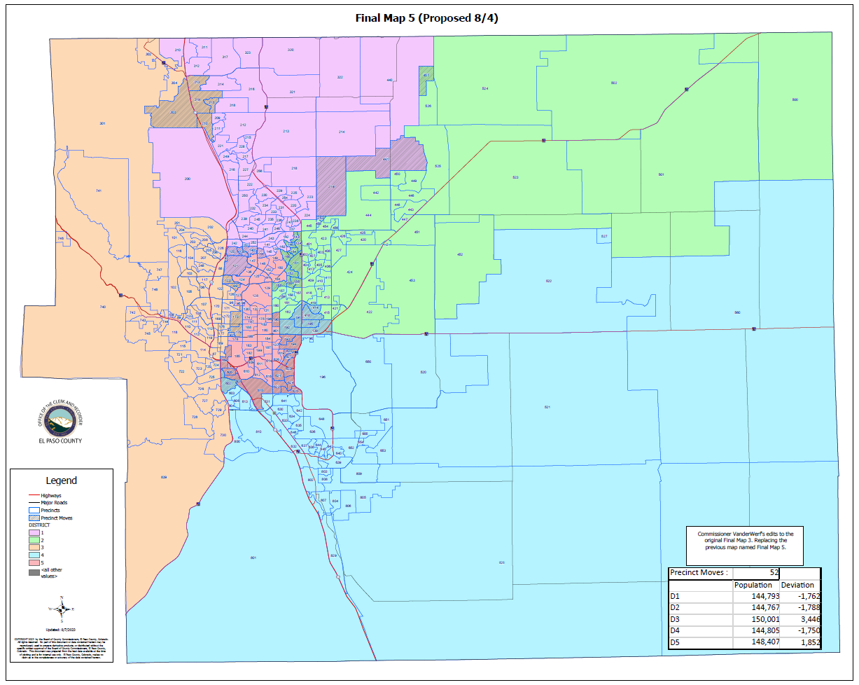
(FINAL MAP 5 (Proposed 08/04):

Slide 120
(FINAL MAP 5 (Proposed 08/04)
HOUSE BILL 21-1047:
(FINAL MAP 5 (Proposed 08/04):
Overall Range in Deviation: | 3.57%
Total Precincts Moved: | 52 (16.09%)
Total Affected Population: | 79,136
%: | 10.80%
Total Affected Active Voters: | 75,340
%: | 15.58%

Slide 121
(FINAL MAP 5 (Proposed 08/04)
HOUSE BILL 21-1047:
District: | Total Population: | Target Deviation:
1 | 144,793 | -1,762
2 | 144,767 | -1,788
3 | 150,001 | 3,446
4 | 144,805 | -1,750
5 | 148,407 | 1,852

Slide 122
(FINAL MAP 5 (Proposed 08/04)
Precinct Moves:
DISTRICT: | PRECINCTS ADDED: | PRECINCTS DELETED: | IMPACT:
1 | 97-120-121-138-140-144-219-441 | 134-143-146-457-253-210-303-313-315-319 | -2
2 | 134-143-146-457-253-151-153-155-156-164-165-166 | 219-441-139-191-192-195-414-418-190-193-194-620-627 | -1
3 | 092-093-099-123-173-179-210-303-313-315-319 | 602-169-601-605 | +7
4 | 139-191-192-195-414-418-602 | 615-621-622-623-624-625 | +1
5 | 190-193-194-620-627-169-601-605-615-621-622-623-624-625 | 097-120-121-138-140-144-151-153-155-156-164-165-166-092-093-099-123-173-179 | -5

Slide 123
1st Criteria – Population Equality & VRA
(FINAL MAP 5 (Proposed 08/04) Total Population Racial Ethnicity:
Districts | Total / %: | Hispanic or Latino: | Black: | White: | Asian:
1 | TOTAL: | 15,500 | 4,306 | 108,701 | 6,148
 | %: | 10.7% | 2.97% | 75.07% | 4.25%
2 | TOTAL: | 22,846 | 7,023 | 97,976 | 4,767
 | %: | 15.78% | 4.85% | 67.68% | 3.29%
3 | TOTAL: | 17,297 | 3,648 | 115,735 | 3,438
 | %: | 11.53% | 2.43% | 77.16% | 2.29%
4 | TOTAL: | 32,022 | 12,548 | 82,556 | 3,890
 | %: | 22.14% | 8.67% | 57.01% | 2.69%
5 | TOTAL: | 42,795 | 13,794 | 76,713 | 3,426
 | %: | 28.84% | 9.29% | 51.69% | 2.31%

Slide 124
1st Criteria – Population Equality & VRA
(FINAL MAP 5 (Proposed 08/04) Total Population Racial Ethnicity:
Districts | Total % / Variance: | Hispanic or Latino: | Black: | White: | Asian:
1 | TOTAL: | +0.12% | +0.04% | -0.21% | -0.02%
2 | TOTAL: | -2.56% | -0.49% | +2.95% | +0.14%
3 | TOTAL: | -1.13% | -0.42% | +1.63% | -0.01%
4 | TOTAL: | -2.87% | -0.95% | +3.78% | -0.07%
5 | TOTAL: | +6.65% | +1.99% | -8.86% | +0.1%

Slide 125
1st Criteria – Population Equality & VRA
(FINAL MAP 5 (Proposed 08/04) Voting Age Population Racial Ethnicity:
Districts | Total / %: | Hispanic or Latino: | Black: | White: | Asian:
1 | TOTAL: | 10,277 | 3,397 | 85,612 | 4,774
 | %: | 7.1% | 2.34% | 59.13% | 3.3%
2 | TOTAL: | 14,417 | 5,341 | 75,671 | 3,872
 | %: | 9.96% | 3.69% | 52.27% | 2.67%
3 | TOTAL: | 12,390 | 2,984 | 97,804 | 2,906
 | %: | 8.26% | 1.99% | 65.2% | 1.94%
4 | TOTAL: | 20,788 | 9,510 | 64,381 | 3,264
 | %: | 14.36% | 6.57% | 44.46% | 2.25%
5 | TOTAL: | 28,492 | 10,688 | 64,773 | 3,007
 | %: | 19.2% | 7.2% | 43.65% | 2.03%

Slide 126
1st Criteria – Population Equality & VRA
(FINAL MAP 5 (Proposed 08/04) Voting Age Population Racial Ethnicity:
Districts | Total % / Variance: | Hispanic or Latino: | Black: | White: | Asian:
1 | TOTAL: | +0.16% | +0.05% | +0.59% | -0.01%
2 | TOTAL: | -1.66% | -0.36% | +2.05% | +0.09%
3 | TOTAL: | -0.84% | -0.33% | +0.69% | -0.04%
4 | TOTAL: | -1.68% | -0.7% | +3.18% | -0.06%
5 | TOTAL: | +4.05% | +1.46% | -7.68% | +0.1%

Slide 127
2nd Criteria - Communities of Interest & Compactness
(FINAL MAP 5 (Proposed 08/04):
COMMUNITIES OF INTEREST & COMPACTNESS (Towns & Cities):
City / Town: | Commissioner District:
Calhan | 2
Cascade | 3
Colorado Springs | 1, 2, 3, 4, 5
Elbert | 2
Fountain | 4
Green Mtn. Falls | 3
Manitou Springs | 3
Monument | 1, 3
Palmer Lake | 3
Peyton | 2
Ramah | 2
Rush | 4
Yoder | 4
COMMUNITIES OF INTEREST & COMPACTNESS (Military):
Military Installations: | Commissioner District:
USAFA | 1
Fort Carson | 4
Peterson AFB | 4
Schriever SFB | 4
NORAD | 3

Slide 128
2nd Criteria - Communities of Interest & Compactness
(FINAL MAP 5 (Proposed 08/04):
COMMUNITIES OF INTEREST & COMPACTNESS (School Districts):
School District: | Commissioner District:
Academy School District 20 | 1, 3
Big Sandy SD 110J | 2, 4
Calhan SD RJ1 | 2
Cheyenne Mtn. SD 12 | 3
Edison SD 54 | 4
Ellicott SD 22 | 2, 4
Falcon SD 49 | 1, 2, 4
Fountain/Ft. Carson SD 8 | 3, 4
Hanover SD 28 | 4
Harrison SD 2 | 3, 5
Lewis-Palmer SD 38 | 1, 3
Manitou Springs SD 14 | 3
COMMUNITIES OF INTEREST & COMPACTNESS (School Districts):
School District: | Commissioner District:
Miami-Yoder SD 60 | 4
Peyton SD 23 | 2
RE-2 Fremont-Florence SD 39 | 3, 4
Widefield SD 3 | 4
Colorado Springs SD 11 | 1, 2, 3, 5

Slide 129
2nd Criteria - Communities of Interest & Compactness
(FINAL MAP 5 (Proposed 08/04):
COMMUNITIES OF INTEREST & COMPACTNESS (Southeast Colorado Springs):
Southeast Colorado Springs (Precincts): | Commissioner District:
137 | 5
169 | 5
180 | 5
182 | 5
184 | 5
185 | 5
187 | 5
190 | 5
193 | 5
194 | 5
199 | 5
601 | 5
605 | 5
COMMUNITIES OF INTEREST & COMPACTNESS (Southeast Colorado Springs):
Southeast Colorado Springs (Precincts): | Commissioner District:
609 | 5
610 | 5
611 | 5
612 | 5
614 | 5
615 | 5
616 | 5
619 | 5
620 | 5
621 | 5
622 | 5
623 | 5
624 | 5
COMMUNITIES OF INTEREST & COMPACTNESS (Southeast Colorado Springs):
Southeast Colorado Springs (Precincts): | Commissioner District:
625 | 5
626 | 5
627 | 5
901 | 5
All 30 Precincts defined as Southeast Colorado Springs are in Commissioner District 5.
District 5 = 30 Precincts (100.00%)
The Districts seem to be compact.

Slide 130
3rd Criteria - Political Competitiveness
(FINAL MAP 5 (Proposed 08/04):
District: | DEM: | DEM %: | REP: | REP %: | Total: | Deviation: | Deviation from Current:
US PRESIDENT:
1 | 31,979 | 36.10% | 53,765 | 60.70% | 88,573 | 24.60% | +0.16%
2 | 28,841 | 36.24% | 47,739 | 59.98% | 79,590 | 23.74% | +0.67%
3 | 46,420 | 49.72% | 43,990 | 47.12% | 93,355 | 2.60% | +1.96%
4 | 23,428 | 41.31% | 30,731 | 54.19% | 56,714 | 12.88% | +3.40%
5 | 31,273 | 51.59% | 26,603 | 43.89% | 60,619 | 7.70% | +5.59%

Slide 131
3rd Criteria - Political Competitiveness
(FINAL MAP 5 (Proposed 08/04):

Slide 132
3rd Criteria - Political Competitiveness
(FINAL MAP 5 (Proposed 08/04):
District: | DEM: | DEM %: | REP: | REP %: | Total: | Deviation: | Deviation from Current:
US SENATE:
1 | 25,748 | 35.74% | 44,009 | 61.09% | 72,040 | 25.35% | +0.25%
2 | 23,072 | 37.66% | 35,788 | 58.41% | 61,272 | 20.75% | +0.17%
3 | 36,905 | 50.48% | 34,048 | 46.57% | 73,113 | 3.91% | +2.29%
4 | 16,237 | 43.88% | 19,146 | 51.75% | 37,000 | 7.86% | +3.45%
5 | 22,062 | 53.95% | 17,004 | 41.57% | 40,894 | 12.37% | +6.12%

Slide 133
3rd Criteria - Political Competitiveness
(FINAL MAP 5 (Proposed 08/04):

Slide 134
3rd Criteria - Political Competitiveness
(FINAL MAP 5 (Proposed 08/04):
District: | DEM: | DEM %: | REP: | REP %: | Total: | Deviation: | Deviation from Current:
GOVERNOR:
1 | 28,507 | 39.47% | 42,283 | 58.54% | 72,224 | 19.07% | 0.01%
2 | 25,039 | 40.76% | 34,639 | 56.39% | 61,433 | 15.63% | 0.09%
3 | 39,385 | 53.72% | 32,441 | 44.25% | 73,310 | 9.47% | 2.23%
4 | 17,401 | 46.92% | 18,410 | 49.65% | 37,083 | 2.72% | 3.27%
5 | 23,115 | 56.41% | 16,611 | 40.54% | 40,977 | 15.87% | 5.93%

Slide 135
3rd Criteria - Political Competitiveness
(FINAL MAP 5 (Proposed 08/04):

Slide 136
3rd Criteria - Political Competitiveness
(FINAL MAP 5 (Proposed 08/04):
District: | DEM: | DEM %: | REP: | REP %: | Total: | Deviation: | Deviation from Current:
SECRETARY OF STATE:
1 | 25,660 | 35.85% | 44,067 | 61.56% | 71,585 | 25.71% | +0.12%
2 | 22,857 | 37.55% | 35,904 | 58.98% | 60,871 | 21.43% | +0.20%
3 | 36,182 | 49.86% | 34,402 | 47.40% | 72,573 | 2.45% | +2.26%
4 | 15,937 | 43.31% | 19,389 | 52.69% | 36,801 | 9.38% | +3.20%
5 | 21,355 | 52.59% | 17,583 | 43.30% | 40,605 | 9.29% | +5.92%

Slide 137
3rd Criteria - Political Competitiveness
(FINAL MAP 5 (Proposed 08/04):

Slide 138
3rd Criteria - Political Competitiveness
(FINAL MAP 5 (Proposed 08/04):
District: | DEM: | DEM %: | REP: | REP %: | Total: | Deviation: | Deviation from Current:
EL PASO COUNTY CLERK & RECORDER:
1 | 21,989 | 31.82% | 47,124 | 68.18% | 69,113 | 36.37% | +0.18%
2 | 20,320 | 34.29% | 38,946 | 65.71% | 59,266 | 31.43% | +0.69%
3 | 32,054 | 45.64% | 38,180 | 54.36% | 70,234 | 8.72% | +2.28%
4 | 14,624 | 40.62% | 21,381 | 59.38% | 36,005 | 18.77% | +3.58%
5 | 19,999 | 50.85% | 19,332 | 49.15% | 39,331 | 1.70% | +7.24%

Slide 139
3rd Criteria - Political Competitiveness
(FINAL MAP 5 (Proposed 08/04):

Slide 140
3rd Criteria - Political Competitiveness
(FINAL MAP 5 (Proposed 08/04):
District: | DEM: | DEM %: | REP: | REP %: | Total: | Deviation: | Deviation from Current:
EL PASO COUNTY SHERIFF:
1 | 22,640 | 32.55% | 46,908 | 67.45% | 69,548 | 34.89% | +0.15%
2 | 20,310 | 34.15% | 39,165 | 65.85% | 59,475 | 31.70% | +0.43%
3 | 32,798 | 46.61% | 37,569 | 53.39% | 70,367 | 6.78% | +2.06%
4 | 14,331 | 39.84% | 21,644 | 60.16% | 35,975 | 20.33% | +3.26%
5 | 19,721 | 49.86% | 19,830 | 50.14% | 39,551 | 0.28% | +5.92%

Slide 141
3rd Criteria - Political Competitiveness
(FINAL MAP 5 (Proposed 08/04):

Slide 142
3rd Criteria - Political Competitiveness
(FINAL MAP 5 (Proposed 08/04):
District: | Average Deviation of All Races:
1 | 27.67%
2 | 24.11%
3 | 0.49%
4 | 11.99%
5 | 7.78%
MAP 5 AVERAGE DEVIATION FOR OVERALL POLITICAL COMPETITIVENESS

Slide 143
QUESTIONS ON FINAL MAP 5?

Slide 144
(FINAL MAP 6 (PROPOSED 08/04/)
-PROPOSED DURING COMMISSION REDISTRICTING MEETING 8/4/2023

Slide 145
CREATION OF FINAL MAP 6
(Proposed 08/04/):
Proposed during Commission Redistricting Meeting 08/04/2023.
Based on the "new" Final Map 5 submitted in the same meeting.

Slide 146
(FINAL MAP 6 (Proposed 08/04/):
FINAL MAP 6 (Proposed 08/04):
SE (30 Suggested Precincts) consolidated into one district? | YES
Fountain / Fort Carson / Security / Widefield / Hanover together? | YES

Slide 147
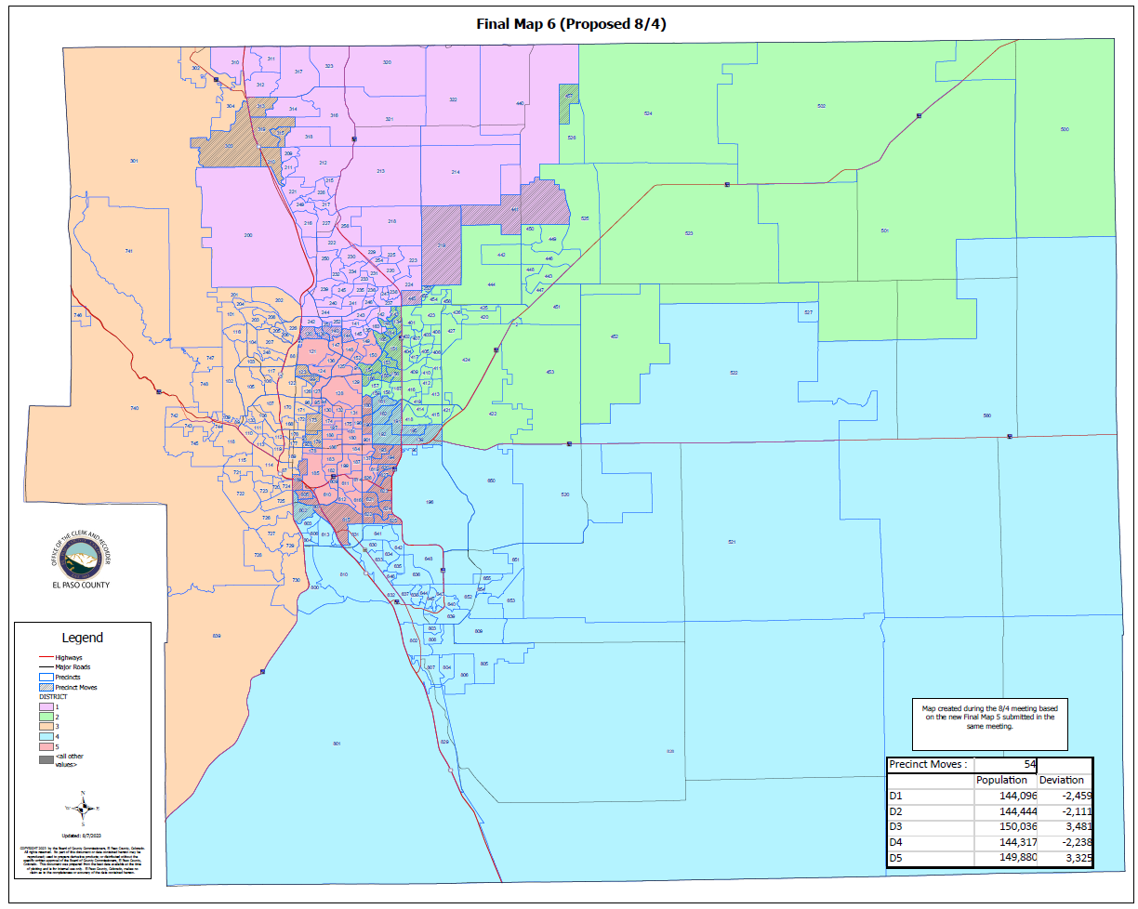
(FINAL MAP 6 (Proposed 08/04):

Slide 148
(FINAL MAP 6 (Proposed 08/04)
HOUSE BILL 21-1047:
(FINAL MAP 6 (Proposed 08/04):
Overall Range in Deviation: | 4.05%
Total Precincts Moved: | 54 (16.46%)
Total Affected Population: | 125,903
%: | 17.18%
Total Affected Active Voters: | 79,502
%: | 16.44%

Slide 149
(FINAL MAP 6 (Proposed 08/04)
HOUSE BILL 21-1047:
District: | Total Population: | Target Deviation:
1 | 144,096 | -2,459
2 | 144,444 | -2,111
3 | 150,036 | 3,481
4 | 144,317 | -2,238
5 | 149,880 | 3,325

Slide 150
(FINAL MAP 6 (Proposed 08/04)
Precinct Moves:
DISTRICT: | PRECINCTS ADDED: | PRECINCTS DELETED: | IMPACT:
1 | 097-120-138-140-144-219-441-445 | 143-134-146-253-457-210-303-313-315-319 | -2
2 | 143-134-146-253-457-151-153-154-155-156-164-165-166 | 219-441-445-139-161-162-191-192-195-160-190-193-194-620-627 | -2
3 | 210-303-313-315-319-092-093-099-123-173-179 | 602-169-601-605 | +7
4 | 139-161-162-191-192-195-602 | 615-621-622-623-624-625 | +1
5 | 160-190-193-194-620-627-169-601-605-615-621-622-623-624-625 | 097-120-138-140-144-151-153-154-155-156-164-165-166-092-093-099-123-173-179 | -4

Slide 151
1st Criteria – Population Equality & VRA
(FINAL MAP 6 (Proposed 08/04) Total Population Racial Ethnicity:
Districts | Total / %: | Hispanic or Latino: | Black: | White: | Asian:
1 | TOTAL: | 15,317 | 4,352 | 108,101 | 6,185
 | %: | 10.63% | 3.02% | 75.02% | 4.29%
2 | TOTAL: | 23,547 | 7,145 | 96,851 | 4,714
 | %: | 16.3% | 4.95% | 67.05% | 3.26%
3 | TOTAL: | 17,309 | 3,648 | 115,750 | 3,438
 | %: | 11.54% | 2.43% | 77.15% | 2.29%
4 | TOTAL: | 31,683 | 12,391 | 82,738 | 3,840
 | %: | 21.95% | 8.59% | 57.33% | 2.66%
5 | TOTAL: | 42,637 | 13,783 | 78,241 | 3,492
 | %: | 28.45% | 9.2% | 52.2% | 2.33%

Slide 152
1st Criteria – Population Equality & VRA
(FINAL MAP 6 (Proposed 08/04) Total Population Racial Ethnicity:
Districts | Total % / Variance: | Hispanic or Latino: | Black: | White: | Asian:
1 | TOTAL: | +0.05% | +0.09% | -0.26% | +0.02%
2 | TOTAL: | -2.04% | -0.39% | +2.32% | +0.11%
3 | TOTAL: | -1.12% | -0.42% | +1.62% | -0.01%
4 | TOTAL: | -3.06% | -1.03% | +4.1% | -0.1%
5 | TOTAL: | +6.26% | +1.9% | -8.35% | +0.12%

Slide 153
1st Criteria – Population Equality & VRA
(FINAL MAP 6 (Proposed 08/04) Voting Age Population Racial Ethnicity:
Districts | Total / %: | Hispanic or Latino: | Black: | White: | Asian:
1 | TOTAL: | 10,120 | 3,417 | 84,960 | 4,793
 | %: | 7.02% | 2.37% | 58.96% | 3.33%
2 | TOTAL: | 14,880 | 5,421 | 74,644 | 3,859
 | %: | 10.3% | 3.75% | 51.68% | 2.67%
3 | TOTAL: | 12,399 | 2,984 | 97,819 | 2,906
 | %: | 8.26% | 1.99% | 65.2% | 1.94%
4 | TOTAL: | 20,559 | 9,393 | 64,638 | 3,215
 | %: | 14.25% | 6.51% | 44.79% | 2.23%
5 | TOTAL: | 28,406 | 10,699 | 66,180 | 3,050
 | %: | 18.95% | 7.14% | 44.16% | 2.03%

Slide 154
1st Criteria – Population Equality & VRA
(FINAL MAP 6 (Proposed 08/04) Voting Age Population Racial Ethnicity:
Districts | Total % / Variance: | Hispanic or Latino: | Black: | White: | Asian:
1 | TOTAL: | +0.08% | +0.08% | +0.42% | +0.02%
2 | TOTAL: | -1.32% | -0.3% | +1.46% | +0.09%
3 | TOTAL: | -0.84% | -0.33% | +0.69% | -0.04%
4 | TOTAL: | -1.79% | -0.76% | +3.51% | -0.08%
5 | TOTAL: | +3.8% | +1.4% | -7.17% | +0.1%

Slide 155
2nd Criteria - Communities of Interest & Compactness
(FINAL MAP 6 (Proposed 08/04):
COMMUNITIES OF INTEREST & COMPACTNESS (Towns & Cities):
City / Town: | Commissioner District:
Calhan | 2
Cascade | 3
Colorado Springs | 1, 2, 3, 4, 4
Elbert | 2
Fountain | 4
Green Mtn. Falls | 3
Manitou Springs | 3
Monument | 1, 3
Palmer Lake | 3
Peyton | 2
Ramah | 2
Rush | 4
Yoder | 4
COMMUNITIES OF INTEREST & COMPACTNESS (Military):
Military Installations: | Commissioner District:
USAFA | 1
Fort Carson | 4
Peterson AFB | 4
Schriever SFB | 4
NORAD | 3

Slide 156
2nd Criteria - Communities of Interest & Compactness
(FINAL MAP 6 (Proposed 08/04):
COMMUNITIES OF INTEREST & COMPACTNESS (School Districts):
School District: | Commissioner District:
Academy School District 20 | 1, 3
Big Sandy SD 110J | 2
Calhan SD RJ1 | 2
Cheyenne Mtn. SD 12 | 3
Edison SD 54 | 4
Ellicott SD 22 | 2, 4
Falcon SD 49 | 1, 2
Fountain/Ft. Carson SD 8 | 4
Hanover SD 28 | 4
Harrison SD 2 | 4, 5
Lewis-Palmer SD 38 | 1, 3
Manitou Springs SD 14 | 3
COMMUNITIES OF INTEREST & COMPACTNESS (School Districts):
School District: | Commissioner District:
Miami-Yoder SD 60 | 2, 4
Peyton SD 23 | 2
RE-2 Fremont-Florence SD 39 | 3, 4
Widefield SD 3 | 4
Colorado Springs SD 11 | 1, 2, 3, 4, 5

Slide 157
2nd Criteria - Communities of Interest & Compactness
(FINAL MAP 6 (Proposed 08/04):
COMMUNITIES OF INTEREST & COMPACTNESS (Southeast Colorado Springs):
Southeast Colorado Springs (Precincts): | Commissioner District:
137 | 5
169 | 5
180 | 5
182 | 5
184 | 5
185 | 5
187 | 5
190 | 5
193 | 5
194 | 5
199 | 5
601 | 5
605 | 5
COMMUNITIES OF INTEREST & COMPACTNESS (Southeast Colorado Springs):
Southeast Colorado Springs (Precincts): | Commissioner District:
609 | 5
610 | 5
611 | 5
612 | 5
614 | 5
615 | 5
616 | 5
619 | 5
620 | 5
621 | 5
622 | 5
623 | 5
624 | 5
COMMUNITIES OF INTEREST & COMPACTNESS (Southeast Colorado Springs):
Southeast Colorado Springs (Precincts): | Commissioner District:
625 | 5
626 | 5
627 | 5
901 | 5
All 30 Precincts defined as Southeast Colorado Springs are in Commissioner District 5.
District 5 = 30 Precincts (100.00%)
The Districts seem to be compact.

Slide 158
3rd Criteria - Political Competitiveness
(FINAL MAP 6 (Proposed 08/04):
District: | DEM: | DEM %: | REP: | REP %: | Total: | Deviation: | Deviation from Current:
US PRESIDENT:
1 | 31,898 | 36.06% | 53,736 | 60.75% | 88,454 | 24.69% | +0.06%
2 | 28,099 | 36.25% | 46,452 | 59.92% | 77,520 | 23.68% | +0.60%
3 | 46,420 | 49.72% | 43,990 | 47.12% | 93,355 | 2.60% | +1.96%
4 | 23,513 | 41.12% | 31,117 | 54.42% | 57,183 | 13.30% | +3.82%
5 | 32,011 | 51.35% | 27,533 | 44.18% | 62,339 | 7.18% | +5.07%

Slide 159
3rd Criteria - Political Competitiveness
(FINAL MAP 6 (Proposed 08/04):

Slide 160
3rd Criteria - Political Competitiveness
(FINAL MAP 6 (Proposed 08/04):
District: | DEM: | DEM %: | REP: | REP %: | Total: | Deviation: | Deviation from Current:
US SENATE:
1 | 25,719 | 35.84% | 43,768 | 60.99% | 71,768 | 25.15% | +0.45%
2 | 22,425 | 37.65% | 34,775 | 58.39% | 59,557 | 20.74% | +0.15%
3 | 36,905 | 50.48% | 34,048 | 46.57% | 73,113 | 3.91% | +2.29%
4 | 16,400 | 43.61% | 19,568 | 52.04% | 37,604 | 8.42% | +4.01%
5 | 22,575 | 53.40% | 17,836 | 42.19% | 42,277 | 11.21% | +4.96%

Slide 161
3rd Criteria - Political Competitiveness
(FINAL MAP 6 (Proposed 08/04):

Slide 162
3rd Criteria - Political Competitiveness
(FINAL MAP 6 (Proposed 08/04):
District: | DEM: | DEM %: | REP: | REP %: | Total: | Deviation: | Deviation from Current:
GOVERNOR:
1 | 28,477 | 39.58% | 42,025 | 58.41% | 71,945 | 18.83% | +0.23%
2 | 24,357 | 40.78% | 33,635 | 56.32% | 59,725 | 15.53% | +0.01%
3 | 39,385 | 53.72% | 32,441 | 44.25% | 73,310 | 9.47% | +2.23%
4 | 17,572 | 46.63% | 18,840 | 49.99% | 37,687 | 3.36% | +3.91%
5 | 23,656 | 55.85% | 17,443 | 41.18% | 42,360 | 14.67% | +4.72%

Slide 163
3rd Criteria - Political Competitiveness
(FINAL MAP 6 (Proposed 08/04):

Slide 164
3rd Criteria - Political Competitiveness
(FINAL MAP 6 (Proposed 08/04):
District: | DEM: | DEM %: | REP: | REP %: | Total: | Deviation: | Deviation from Current:
SECRETARY OF STATE:
1 | 25,644 | 35.96% | 43,826 | 61.45% | 71,318 | 25.49% | +0.34%
2 | 22,225 | 37.57% | 34,868 | 58.94% | 59,160 | 21.37% | +0.14%
3 | 36,182 | 49.86% | 34,402 | 47.40% | 72,573 | 2.45% | +2.26%
4 | 16,084 | 43.01% | 19,839 | 53.05% | 37,400 | 10.04% | +3.86%
5 | 21,856 | 52.06% | 18,410 | 43.85% | 41,984 | 8.21% | +4.84%

Slide 165
3rd Criteria - Political Competitiveness
(FINAL MAP 6 (Proposed 08/04):

Slide 166
3rd Criteria - Political Competitiveness
(FINAL MAP 6 (Proposed 08/04):
District: | DEM: | DEM %: | REP: | REP %: | Total: | Deviation: | Deviation from Current:
EL PASO COUNTY CLERK & RECORDER:
1 | 21,990 | 31.94% | 46,858 | 68.06% | 68,848 | 36.12% | +0.42%
2 | 19,804 | 34.36% | 37,840 | 65.64% | 57,644 | 31.29% | +0.55%
3 | 32,054 | 45.64% | 38,180 | 54.36% | 70,234 | 8.72% | +2.28%
4 | 14,723 | 40.26% | 21,849 | 59.74% | 36,572 | 19.48% | +4.30%
5 | 20,415 | 50.22% | 20,236 | 49.78% | 40,651 | 0.44% | +5.99%

Slide 167
3rd Criteria - Political Competitiveness
(FINAL MAP 6 (Proposed 08/04):

Slide 168
3rd Criteria - Political Competitiveness
(FINAL MAP 6 (Proposed 08/04):
District: | DEM: | DEM %: | REP: | REP %: | Total: | Deviation: | Deviation from Current:
EL PASO COUNTY SHERIFF:
1 | 22,611 | 32.64% | 46,668 | 67.36% | 69,279 | 34.72% | +0.32%
2 | 19,804 | 34.23% | 38,058 | 65.77% | 57,862 | 31.55% | +0.27%
3 | 32,798 | 46.61% | 37,569 | 53.39% | 70,367 | 6.78% | +2.06%
4 | 14,435 | 39.51% | 22,098 | 60.49% | 36,533 | 20.98% | +3.91%
5 | 20,152 | 49.30% | 20,723 | 50.70% | 40,875 | 1.40% | +4.80%

Slide 169
3rd Criteria - Political Competitiveness
(FINAL MAP 6 (Proposed 08/04):

Slide 170
3rd Criteria - Political Competitiveness
(FINAL MAP 6):
District: | Average Deviation of All Races:
1 | 27.50%
2 | 24.03%
3 | 0.49%
4 | 12.60%
5 | 6.72%
MAP 6 AVERAGE DEVIATION FOR OVERALL POLITICAL COMPETITIVENESS

Slide 171
QUESTIONS ON FINAL MAP 6?

