Slide 1
El Paso County
Commissioner Redistricting
August 15, 2023 @ 1:00pm
El Paso County BOCC
Centennial Hall
200 S. Cascade Ave.
Colorado Springs, CO 80903
Presented By: Steve Schleiker, El Paso County Clerk & Recorder

Slide 2
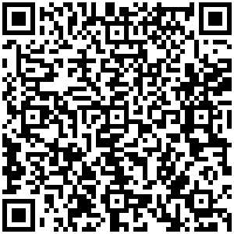
Redistricting (August 15th)
Presentation QR Code:

Slide 3
Redistricting Commission
Assigned Tasks from August 11th Meeting:
Review and Analyze
Final Map 1 (Version 2)
Submitted during August 8th Redistricting Meeting
Final Map 6 (Version 2)
Submitted during August 8th Redistricting Meeting
Final Map 6 (Version 3)
Submitted during August 8th Redistricting Meeting

Slide 4
FINAL MAP 1 (Version 2)

Slide 5
CREATION OF FINAL MAP 1 (Version 2):
This Map was submitted during the August 8th Commissioner Redistricting Meeting and was based from Final Map 1.
Edits were made to this Map within the Public Meeting
Precinct 560 is split along State Highway 94
Precinct 444 is split
Precinct 180 is split
Precinct 312 is split

Slide 6
FINAL MAP 1 (Version 2):
FINAL MAP 1 (Version 2):
SE (30 Suggested Precincts) consolidated into one district? | NO
Fountain / Fort Carson / Security / Widefield / Hanover together? | NO

Slide 7
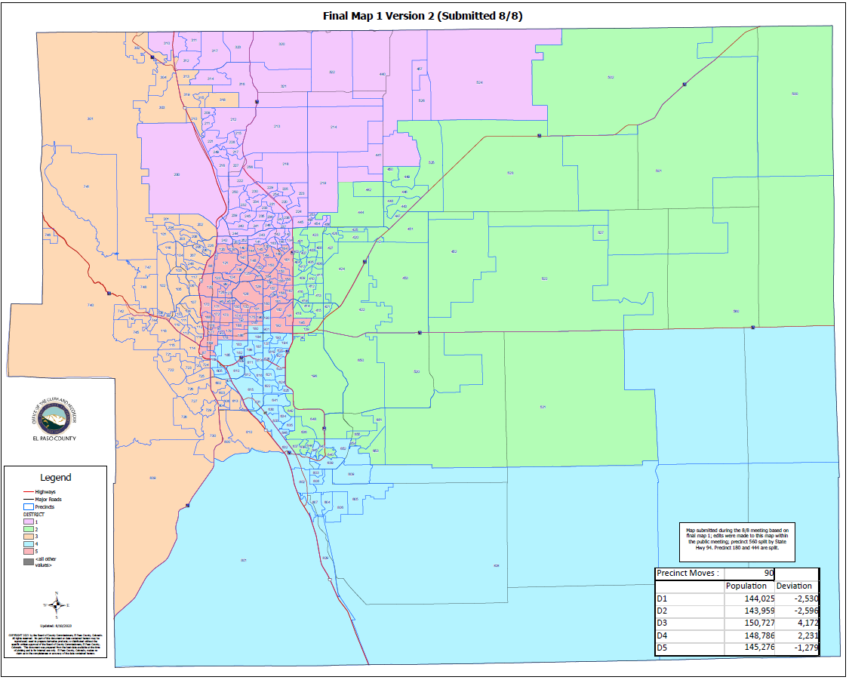
FINAL MAP 1 (Version 2):

Slide 8
FINAL MAP 1 (Version 2)
HOUSE BILL 21-1047:
FINAL MAP 1 (VERSION 2):
Overall Range in Deviation: | 4.62%
Total Precincts Moved: | 90 (27.86%)
Total Affected Population: | 104,236
%: | (14.22%)
Total Affected Active Voters: | 69,125
%: | 14.29%

Slide 9
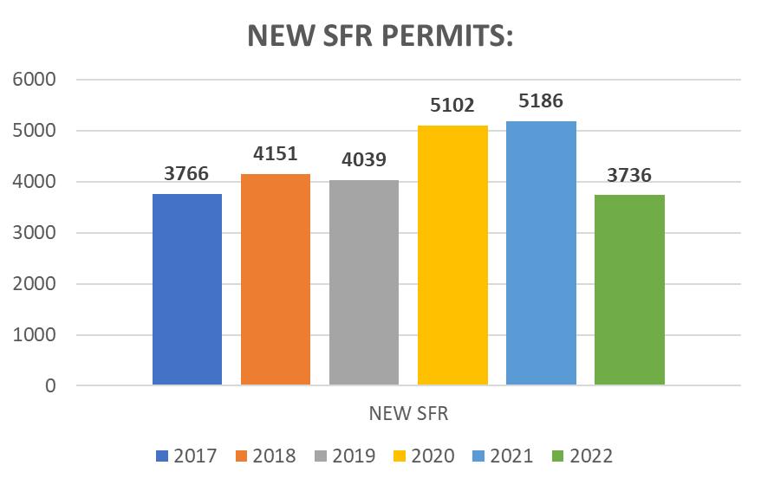
FINAL MAP 1 (VERSION 2)
HOUSE BILL 21-1047:
District: | Total Population: | Target Deviation:
1 | 144,025 | -2,530
2 | 143,959 | -2,596
3 | 150,727 | 4,172
4 | 148,786 | 2,231
5 | 145,276 | -1,279

Slide 10
FINAL MAP 1 (VERSION 2)
Precinct Moves:
DISTRICT: | PRECINCTS ADDED: | PRECINCTS DELETED: | IMPACT:
1 | 219-441-444-445-454-455-456-524-526 *Precinct 444 is Split* | 210-303-313-315-318-319-135-145-312 *Precinct 312 is Split* | 0
2 | 090-196-520-521-522-527-560-636-637-638-640-642-643-644-648-650-651-653-654-655 *Precinct 560 is Split* | 219-441-444-445-454-455-456-524-526-190-193-194-620-627-157-158-159-160-161-162-167-191-192-195 *Precinct 444 is Split* | -4
3 | 210-303-313-315-318-319-603-604-606-613-800-810-312 *Precinct 312 is Split* | 169-601-605-087-088-096-122-126-168-170-171-172-176-177-189 | -2
4 | 190-193-194-620-627-169-601-605-137-180-182-183-184-185-187-199-609-610-611-612-614-616-619-626-901 *Precinct 180 is Split* | 090-196-520-521-522-527-560-636-637-638-640-642-643-644-648-650-651-653-654-655-603-604-606-613-800-810 *Precinct 560 is Split* | -1
5 | 135-145-157-158-159-160-161-162-167-191-192-195-087-088-096-122-126-168-170-171-172-176-177-189 | 137-180-182-183-184-185-187-199-609-610-611-612-614-616-619-626-901 *Precinct 180 is Split* | +7

Slide 11
1st Criteria – Population Equality & VRA
FINAL MAP 1 (VERSION 2) Total Population Racial Ethnicity:
Districts | Total / %: | Hispanic or Latino: | Black: | White: | Asian:
1 | TOTAL: | 15,708 | 4,452 | 107,356 | 6,234
 | %: | 10.91% | 3.09% | 74.54% | 4.33%
2 | TOTAL: | 25,699 | 8,560 | 92,028 | 4,707
 | %: | 17.85% | 5.95% | 63.93% | 3.27%
3 | TOTAL: | 19,529 | 5,812 | 111,003 | 3,958
 | %: | 12.96% | 3.86% | 73.65% | 2.63%
4 | TOTAL: | 45,118 | 15,846 | 71,098 | 3,762
 | %: | 30.32% | 10.65% | 47.79% | 2.53%
5 | TOTAL: | 24,439 | 6,649 | 100,196 | 3,008
 | %: | 16.82% | 4.58% | 68.97% | 2.07%

Slide 12
1st Criteria – Population Equality & VRA
FINAL MAP 1 (VERSION 2) Total Population Racial Ethnicity:
Districts | Total % / Variance: | Hispanic or Latino: | Black: | White: | Asian:
1 | TOTAL: | +0.33% | +0.16% | -0.74% | +0.06%
2 | TOTAL: | -0.49% | +0.61% | -0.8% | +0.12%
3 | TOTAL: | +0.3% | +1.01% | -1.88% | +0.33%
4 | TOTAL: | +5.31% | +1.03% | -5.44% | -0.23%
5 | TOTAL: | -5.37% | -2.72% | +8.42% | -0.14%

Slide 13
1st Criteria – Population Equality & VRA
FINAL MAP 1 (VERSION 2) Total Population Racial Ethnicity:

Slide 14
1st Criteria – Population Equality & VRA
FINAL MAP 1 (VERSION 2) Voting Age Population Racial Ethnicity:
Districts | Total / %: | Hispanic or Latino: | Black: | White: | Asian:
1 | TOTAL: | 10,271 | 3,456 | 83,732 | 4,811
 | %: | 7.13% | 2.4% | 58.14% | 3.34%
2 | TOTAL: | 15,989 | 6,362 | 69,638 | 3,851
 | %: | 11.11% | 4.42% | 48.37% | 2.68%
3 | TOTAL: | 13,637 | 4,634 | 91,818 | 3,308
 | %: | 9.05% | 3.07% | 60.92% | 2.19%
4 | TOTAL: | 29,415 | 12,111 | 57,469 | 3,196
 | %: | 19.77% | 8.14% | 38.63% | 2.15%
5 | TOTAL: | 17,052 | 5,351 | 85,584 | 2,657
 | %: | 11.74% | 3.68% | 58.91% | 1.83%

Slide 15
1st Criteria – Population Equality & VRA
FINAL MAP 1 (VERSION 2) Voting Age Population Racial Ethnicity:
Districts | Total % / Variance: | Hispanic or Latino: | Black: | White: | Asian:
1 | TOTAL: | +0.19% | +0.11% | -0.4% | +0.03%
2 | TOTAL: | -0.51% | +0.37% | -1.85% | +0.1%
3 | TOTAL: | -0.05% | +0.75% | -3.59% | +0.21%
4 | TOTAL: | +3.73% | +0.87% | -2.65% | -0.16%
5 | TOTAL: | -3.41% | -2.06% | +7.58% | -0.1%

Slide 16
1st Criteria – Population Equality & VRA
FINAL MAP 1 (VERSION 2) Voting Age Population Racial Ethnicity:

Slide 17
2nd Criteria - Communities of Interest & Compactness
FINAL MAP 1 (VERSION 2):
COMMUNITIES OF INTEREST & COMPACTNESS (Towns & Cities):
City / Town: | Commissioner District:
Calhan | 2
Cascade | 3
Colorado Springs | 1, 2, 3, 4, 5
Fountain | 4
Green Mtn. Falls | 3
Manitou Springs | 3
Monument | 3
Palmer Lake | 3
Peyton | 1, 2
Ramah | 2
Rush | 2, 4
Yoder | 2, 4
COMMUNITIES OF INTEREST & COMPACTNESS (Military):
Military Installations: | Commissioner District:
USAFA | 1
Fort Carson | 3
Peterson AFB | 2
Schriever SFB | 2
NORAD | 3

Slide 18
2nd Criteria - Communities of Interest & Compactness
FINAL MAP 1 (VERSION 2):
COMMUNITIES OF INTEREST & COMPACTNESS (School Districts):
School District: | Commissioner District:
Academy School District 20 | 1, 3
Big Sandy SD 110J | 2
Calhan SD RJ1 | 2
Cheyenne Mtn. SD 12 | 3
Edison SD 54 | 4
Ellicott SD 22 | 2
Falcon SD 49 | 1, 2
Fountain/Ft. Carson SD 8 | 3, 4
Hanover SD 28 | 4
Harrison SD 2 | 3, 4
Lewis-Palmer SD 38 | 1, 3
Manitou Springs SD 14 | 3
COMMUNITIES OF INTEREST & COMPACTNESS (School Districts):
School District: | Commissioner District:
Miami-Yoder SD 60 | 3, 4
Peyton SD 23 | 1, 2
RE-2 Fremont-Florence SD 39 | 3, 4
Widefield SD 3 | 2, 3, 4
Colorado Springs SD 11 | 1, 2, 3, 4, 5

Slide 19
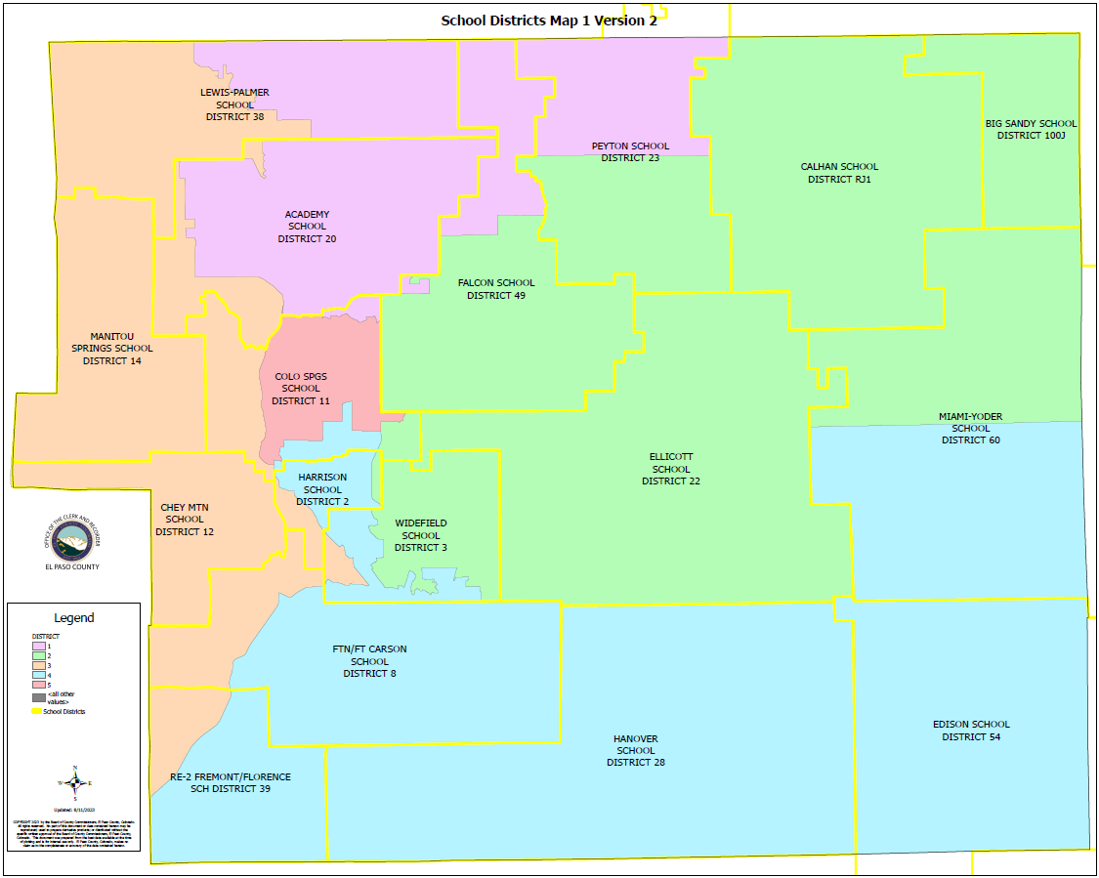

Slide 20
2nd Criteria - Communities of Interest & Compactness
FINAL MAP 1 (VERSION 2):
COMMUNITIES OF INTEREST & COMPACTNESS (Southeast Colorado Springs):
Southeast Colorado Springs (Precincts): | Commissioner District:
137 | 4
169 | 4
180 | 4 (Split)
182 | 4
184 | 4
185 | 4
187 | 4
190 | 4
193 | 4
194 | 4
199 | 4
601 | 4
605 | 4
COMMUNITIES OF INTEREST & COMPACTNESS (Southeast Colorado Springs):
Southeast Colorado Springs (Precincts): | Commissioner District:
609 | 4
610 | 4
611 | 4
612 | 4
614 | 4
615 | 4
616 | 4
619 | 4
620 | 4
621 | 4
622 | 4
623 | 4
624 | 4
COMMUNITIES OF INTEREST & COMPACTNESS (Southeast Colorado Springs):
Southeast Colorado Springs (Precincts): | Commissioner District:
625 | 4
626 | 4
627 | 4
901 | 4
All 30 Precincts defined as Southeast Colorado Springs are in Commissioner Districts 4, and 5.
District 4 = 29.5 Precincts (98.33%)
District 5 = 0.5 Precincts (1.67%)
The Districts seem to be compact.

Slide 21
3rd Criteria - Political Competitiveness
FINAL MAP 1 (VERSION 2):
District: | DEM: | DEM %: | REP: | REP %: | Total: | Deviation: | Deviation from Current:
US PRESIDENT:
1 | 30,564 | 35.55% | 52,652 | 61.24% | 85,973 | +25.69% | +0.94%
2 | 25,957 | 35.97% | 43,318 | 60.02% | 72,168 | +24.06% | +0.98%
3 | 40,038 | 46.93% | 42,567 | 49.89% | 85,322 | +2.96% | +7.53%
4 | 26,893 | 48.76% | 25,631 | 46.47% | 55,153 | +2.29% | +11.76%
5 | 38,489 | 47.97% | 38,660 | 48.18% | 80,235 | +0.21% | +2.32%

Slide 22
3rd Criteria - Political Competitiveness
FINAL MAP 1 (VERSION 2):

Slide 23
3rd Criteria - Political Competitiveness
FINAL MAP 1 (VERSION 2):
District: | DEM: | DEM %: | REP: | REP %: | Total: | Deviation: | Deviation from Current:
US SENATE:
1 | 24,834 | 35.33% | 43,229 | 61.51% | 70,284 | +26.17% | +0.57%
2 | 20,134 | 37.68% | 31,113 | 58.23% | 53,435 | +20.55% | +0.04%
3 | 31,381 | 47.19% | 33,154 | 49.86% | 66,500 | +2.67% | +8.87%
4 | 18,662 | 51.58% | 15,831 | 43.76% | 36,180 | +7.82% | +12.24%
5 | 29,013 | 50.09% | 26,668 | 46.04% | 57,920 | +4.05% | +2.20%

Slide 24
3rd Criteria - Political Competitiveness
FINAL MAP 1 (VERSION 2):

Slide 25
3rd Criteria - Political Competitiveness
FINAL MAP 1 (VERSION 2):
District: | DEM: | DEM %: | REP: | REP %: | Total: | Deviation: | Deviation from Current:
GOVERNOR:
1 | 27,563 | 39.12% | 41,464 | 58.86% | 70,451 | +19.73% | +0.67%
2 | 21,839 | 40.77% | 30,045 | 56.08% | 53,571 | +15.32% | +0.22%
3 | 33,815 | 50.71% | 31,509 | 47.25% | 66,688 | +3.46% | +8.24%
4 | 19,599 | 54.08% | 15,327 | 42.29% | 36,243 | +11.79% | +11.24%
5 | 30,631 | 52.74% | 26,039 | 44.84% | 58,074 | +7.91% | +2.04%

Slide 26
3rd Criteria - Political Competitiveness
FINAL MAP 1 (VERSION 2):

Slide 27
3rd Criteria - Political Competitiveness
FINAL MAP 1 (VERSION 2):
District: | DEM: | DEM %: | REP: | REP %: | Total: | Deviation: | Deviation from Current:
SECRETARY OF STATE:
1 | 24,825 | 35.54% | 43,185 | 61.82% | 69,856 | +26.28% | +0.45%
2 | 19,915 | 37.51% | 31,261 | 58.88% | 53,096 | +21.37% | +0.14%
3 | 30,904 | 46.80% | 33,344 | 50.50% | 66,033 | +3.70% | +8.41%
4 | 18,123 | 50.37% | 16,200 | 45.03% | 35,980 | +5.34% | +11.53%
5 | 28,224 | 49.11% | 27,355 | 47.60% | 57,470 | +1.51% | +1.86%

Slide 28
3rd Criteria - Political Competitiveness
FINAL MAP 1 (VERSION 2):

Slide 29
3rd Criteria - Political Competitiveness
FINAL MAP 1 (VERSION 2):
District: | DEM: | DEM %: | REP: | REP %: | Total: | Deviation: | Deviation from Current:
EL PASO COUNTY CLERK & RECORDER:
1 | 21,262 | 31.50% | 46,237 | 68.50% | 67,499 | +37.00% | +0.46%
2 | 17,902 | 34.53% | 33,947 | 65.47% | 51,849 | +30.95% | +0.20%
3 | 27,163 | 42.47% | 36,794 | 57.53% | 63,957 | +15.06% | +8.62%
4 | 17,234 | 49.13% | 17,841 | 50.87% | 35,075 | +1.73% | +13.46%
5 | 25,425 | 45.75% | 30,144 | 54.24% | 55,569 | +8.49% | +2.94%

Slide 30
3rd Criteria - Political Competitiveness
FINAL MAP 1 (VERSION 2):

Slide 31
3rd Criteria - Political Competitiveness
FINAL MAP 1 (VERSION 2):
District: | DEM: | DEM %: | REP: | REP %: | Total: | Deviation: | Deviation from Current:
EL PASO COUNTY SHERIFF:
1 | 21,916 | 32.28% | 45,970 | 67.72% | 67,886 | +35.43% | +0.39%
2 | 17,821 | 34.26% | 34,199 | 65.74% | 52,020 | +31.48% | +0.21%
3 | 27,780 | 43.35% | 36,298 | 56.65% | 64,078 | +13.29% | +8.57%
4 | 16,712 | 47.51% | 18,464 | 52.49% | 35,176 | +4.98% | +12.09%
5 | 25,571 | 45.86% | 30,185 | 54.14% | 55,756 | +8.28% | +2.08%

Slide 32
3rd Criteria - Political Competitiveness
FINAL MAP 1 (VERSION 2):

Slide 33
3rd Criteria - Political Competitiveness
FINAL MAP 1 (VERSION 2):
District: | Average Deviation of All Races:
1 | +28.39%
2 | +23.95%
3 | +5.70%
4 | +3.42%
5 | +0.59%
MAP 1 (V2) AVERAGE DEVIATION FOR OVERALL POLITICAL COMPETITIVENESS

Slide 34
3rd Criteria - Political Competitiveness
FINAL MAP 1 (VERSION 2):

Slide 35
3rd Criteria - Political Competitiveness
FINAL MAP 1 (VERSION 2):
30.74%

Slide 36
QUESTIONS ON FINAL MAP 1 (VERSION 2)

Slide 37
FINAL MAP 6 (Version 2)

Slide 38
CREATION OF FINAL MAP 6 (Version 2):
This Map was submitted during the August 8th Commissioner Redistricting Meeting and was based from Final Map 6.
Precinct 560 is split along State Highway 94.

Slide 39
FINAL MAP 6 (Version 2):
FINAL MAP 6 (Version 2):
SE (30 Suggested Precincts) consolidated into one district? | YES
Fountain / Fort Carson / Security / Widefield / Hanover together? | YES

Slide 40
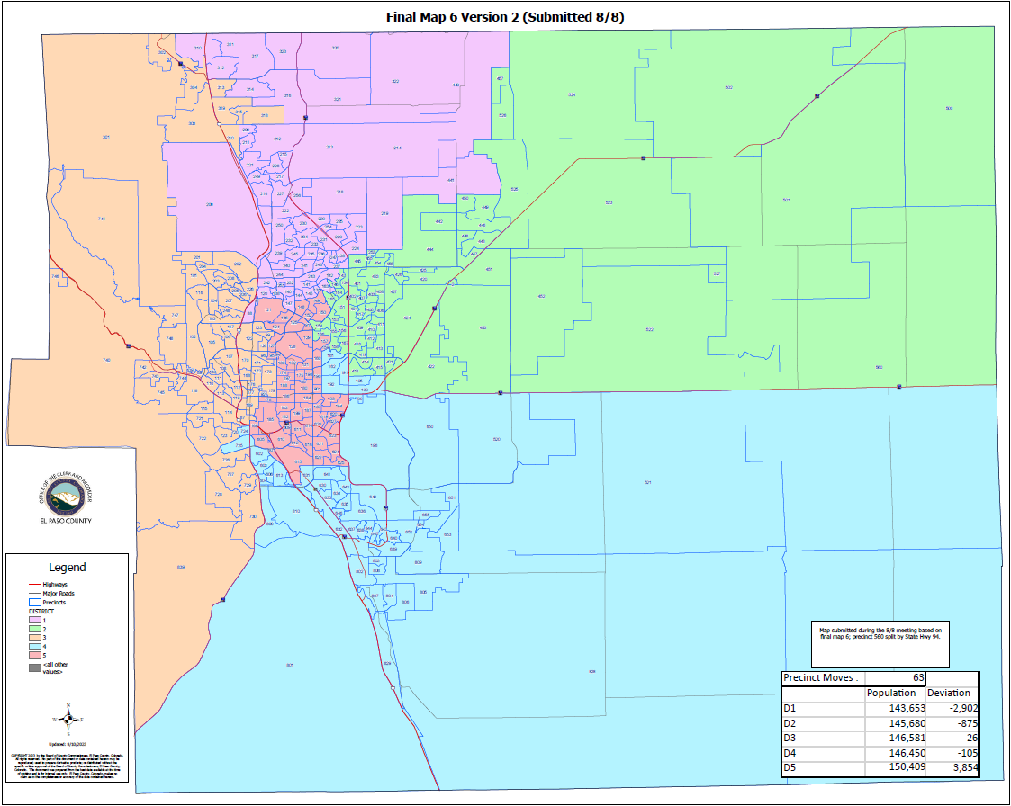
FINAL MAP 6 (Version 2):

Slide 41
FINAL MAP 6 (Version 2)
HOUSE BILL 21-1047:
FINAL MAP 6 (VERSION 2):
Overall Range in Deviation: | 4.61%
Total Precincts Moved: | 63 (19.50%)
Total Affected Population: | 112,914
%: | 15.41%
Total Affected Active Voters: | 71,134
%: | 14.71%

Slide 42
FINAL MAP 6 (VERSION 2)
HOUSE BILL 21-1047:
District: | Total Population: | Target Deviation:
1 | 143,653 | -2,902
2 | 145,680 | -875
3 | 146,581 | 26
4 | 146,450 | -105
5 | 150,409 | 3,854

Slide 43
FINAL MAP 6 (VERSION 2)
Precinct Moves:
DISTRICT: | PRECINCTS ADDED: | PRECINCTS DELETED: | IMPACT:
1 | 088-120-138-140-144-147-097 | 134-143-146-253-457-210-303-313-315-318-319 | -4
2 | 134-143-146-253-457-522-527-560-151-153-154-155-156-164-165-166 *Precinct 560 is Split* | 219-441-139-161-162-191-192-195-157-159-160-190-193-194-620-627 | 0
3 | 210-303-313-315-318-319-219-441-092-093-099-123-173-179 | 088-602-724-725-169-601-605 | +7
4 | 139-161-162-191-192-195-602-724-725 | 522-527-560-615-621-622-623-624-625 *Precinct 560 is Split* | 0
5 | 157-159-160-190-193-194-620-627-169-601-605-615-621-622-623-624-625 | 120-138-140-144-147-151-153-154-155-156-164-165-166-092-093-097-099-123-173-179 | -3

Slide 44
1st Criteria – Population Equality & VRA
FINAL MAP 6 (VERSION 2) Total Population Racial Ethnicity:
Districts | Total / %: | Hispanic or Latino: | Black: | White: | Asian:
1 | TOTAL: | 15,671 | 4,433 | 107,347 | 6,089
 | %: | 10.91% | 3.09% | 74.73% | 4.24%
2 | TOTAL: | 23,687 | 7,168 | 98,737 | 4,795
 | %: | 16.13% | 4.88% | 67.25% | 3.27%
3 | TOTAL: | 16,521 | 3,435 | 113,646 | 3,359
 | %: | 11.27% | 2.34% | 77.53% | 2.29%
4 | TOTAL: | 31,795 | 12,482 | 83,385 | 3,923
 | %: | 21.88% | 8.59% | 57.38% | 2.7%
5 | TOTAL: | 42,819 | 13,801 | 78,566 | 3,503
 | %: | 28.47% | 9.18% | 52.23% | 2.33%

Slide 45
1st Criteria – Population Equality & VRA
FINAL MAP 6 (VERSION 2) Total Population Racial Ethnicity:
Districts | Total % / Variance: | Hispanic or Latino: | Black: | White: | Asian:
1 | TOTAL: | +0.33% | +0.16% | -0.55% | -0.03%
2 | TOTAL: | -2.21% | -0.46% | +2.52% | +0.12%
3 | TOTAL: | -1.39% | -0.51% | +2.0% | -0.01%
4 | TOTAL: | -3.13% | -1.03% | +4.15% | -0.06%
5 | TOTAL: | +6.28% | +1.88% | -8.32% | +0.12%

Slide 46
1st Criteria – Population Equality & VRA
FINAL MAP 6 (VERSION 2) Total Population Racial Ethnicity:

Slide 47
1st Criteria – Population Equality & VRA
FINAL MAP 6 (VERSION 2) Voting Age Population Racial Ethnicity:
Districts | Total / %: | Hispanic or Latino: | Black: | White: | Asian:
1 | TOTAL: | 10,382 | 3,453 | 84,515 | 4,726
 | %: | 7.23% | 2.4% | 58.83% | 3.29%
2 | TOTAL: | 14,941 | 5,431 | 76,088 | 3,923
 | %: | 10.18% | 3.7% | 51.83% | 2.67%
3 | TOTAL: | 11,850 | 2,817 | 95,928 | 2,835
 | %: | 8.08% | 1.92% | 65.44% | 1.93%
4 | TOTAL: | 20,671 | 9,477 | 65,305 | 3,286
 | %: | 14.22% | 6.52% | 44.94% | 2.26%
5 | TOTAL: | 28,520 | 10,736 | 66,405 | 3,053
 | %: | 18.96% | 7.14% | 44.15% | 2.03%

Slide 48
1st Criteria – Population Equality & VRA
FINAL MAP 6 (VERSION 2) Voting Age Population Racial Ethnicity:
Districts | Total % / Variance: | Hispanic or Latino: | Black: | White: | Asian:
1 | TOTAL: | +0.29% | +0.11% | +0.29% | -0.02%
2 | TOTAL: | -1.44% | -0.35% | +1.61% | +0.09%
3 | TOTAL: | -1.02% | -0.4% | +0.93% | -0.05%
4 | TOTAL: | -1.82% | -0.75% | +3.66% | -0.05%
5 | TOTAL: | +3.81% | +1.4% | -7.18% | +0.1%

Slide 49
1st Criteria – Population Equality & VRA
FINAL MAP 6 (VERSION 2) Voting Age Population Racial Ethnicity:

Slide 50
2nd Criteria - Communities of Interest & Compactness
FINAL MAP 6 (VERSION 2):
COMMUNITIES OF INTEREST & COMPACTNESS (Towns & Cities):
City / Town: | Commissioner District:
Calhan | 2
Cascade | 3
Colorado Springs | 1, 2, 3, 4, 5
Fountain | 4
Green Mtn. Falls | 3
Manitou Springs | 3
Monument | 3
Palmer Lake | 3
Peyton | 2
Ramah | 2
Rush | 2, 4
Yoder | 2, 4
COMMUNITIES OF INTEREST & COMPACTNESS (Military):
Military Installations: | Commissioner District:
USAFA | 1
Fort Carson | 4
Peterson AFB | 4
Schriever SFB | 4
NORAD | 3

Slide 51
2nd Criteria - Communities of Interest & Compactness
FINAL MAP 5 (VERSION 2):
COMMUNITIES OF INTEREST & COMPACTNESS (School Districts):
School District: | Commissioner District:
Academy School District 20 | 1, 3
Big Sandy SD 110J | 2
Calhan SD RJ1 | 2
Cheyenne Mtn. SD 12 | 2, 3
Edison SD 54 | 4
Ellicott SD 22 | 2, 4
Falcon SD 49 | 1, 2
Fountain/Ft. Carson SD 8 | 3, 4
Hanover SD 28 | 4
Harrison SD 2 | 4, 5
Lewis-Palmer SD 38 | 1, 3
Manitou Springs SD 14 | 3
COMMUNITIES OF INTEREST & COMPACTNESS (School Districts):
School District: | Commissioner District:
Miami-Yoder SD 60 | 2, 4
Peyton SD 23 | 1, 2
RE-2 Fremont-Florence SD 39 | 3, 4
Widefield SD 3 | 4
Colorado Springs SD 11 | 1, 2, 3, 4, 5

Slide 52
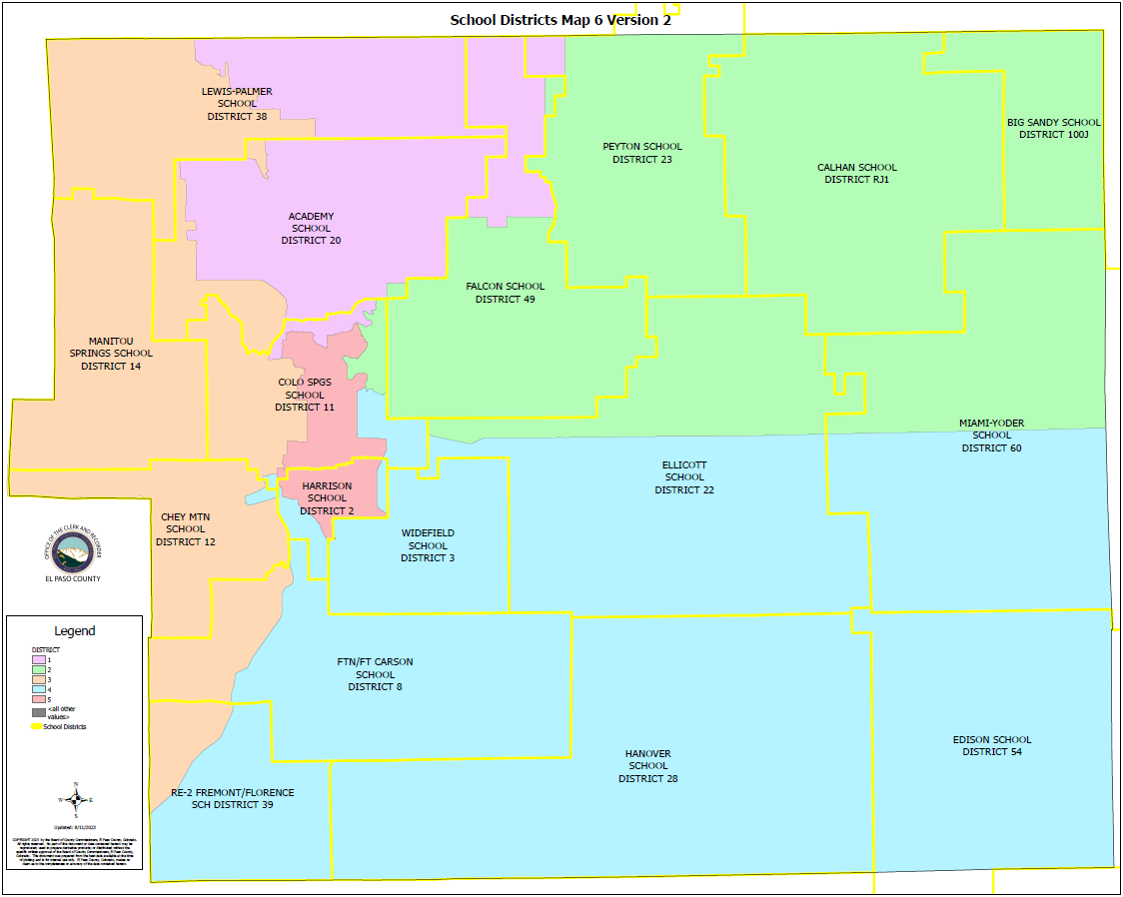

Slide 53
2nd Criteria - Communities of Interest & Compactness
FINAL MAP 6 (VERSION 2):
COMMUNITIES OF INTEREST & COMPACTNESS (Southeast Colorado Springs):
Southeast Colorado Springs (Precincts): | Commissioner District:
137 | 5
169 | 5
180 | 5
182 | 5
184 | 5
185 | 5
187 | 5
190 | 5
193 | 5
194 | 5
199 | 5
601 | 5
605 | 5
COMMUNITIES OF INTEREST & COMPACTNESS (Southeast Colorado Springs):
Southeast Colorado Springs (Precincts): | Commissioner District:
609 | 5
610 | 5
611 | 5
612 | 5
614 | 5
615 | 5
616 | 5
619 | 5
620 | 5
621 | 5
622 | 5
623 | 5
624 | 5
COMMUNITIES OF INTEREST & COMPACTNESS (Southeast Colorado Springs):
Southeast Colorado Springs (Precincts): | Commissioner District:
625 | 5
626 | 5
627 | 5
901 | 5
All 30 Precincts defined as Southeast Colorado Springs are in Commissioner District 5.
District 5 = 30 Precincts (100.00%)
The Districts seem to be compact.

Slide 54
3rd Criteria - Political Competitiveness
FINAL MAP 6 (VERSION 2):
District: | DEM: | DEM %: | REP: | REP %: | Total: | Deviation: | Deviation from Current:
US PRESIDENT:
1 | 31,226 | 36.14% | 52,400 | 60.64% | 86,412 | +24.50% | +0.25%
2 | 28,371 | 35.99% | 47,452 | 60.19% | 78,841 | +24.20% | +1.12%
3 | 45,731 | 49.38% | 43,975 | 47.49% | 92,602 | +1.90% | +2.67%
4 | 24,536 | 42.02% | 31,268 | 53.55% | 58,389 | +11.53% | +2.06%
5 | 32,077 | 51.24% | 27,733 | 44.30% | 62,607 | +6.94% | +4.83%

Slide 55
3rd Criteria - Political Competitiveness
FINAL MAP 6 (VERSION 2):

Slide 56
3rd Criteria - Political Competitiveness
FINAL MAP 6 (VERSION 2):
District: | DEM: | DEM %: | REP: | REP %: | Total: | Deviation: | Deviation from Current:
US SENATE:
1 | 25,290 | 36.08% | 42,563 | 60.72% | 70,102 | +24.64% | +0.96%
2 | 22,569 | 37.44% | 35,322 | 58.60% | 60,281 | +21.16% | +0.57%
3 | 36,374 | 49.94% | 34,329 | 47.13% | 72,842 | +2.81% | +3.39%
4 | 17,140 | 44.54% | 19,713 | 51.22% | 38,485 | +6.69% | +2.27%
5 | 22,651 | 53.16% | 18,068 | 42.40% | 42,609 | +10.76% | +4.51%

Slide 57
3rd Criteria - Political Competitiveness
FINAL MAP 6 (VERSION 2):

Slide 58
3rd Criteria - Political Competitiveness
FINAL MAP 6 (VERSION 2):
District: | DEM: | DEM %: | REP: | REP %: | Total: | Deviation: | Deviation from Current:
GOVERNOR:
1 | 27,938 | 39.75% | 40,933 | 58.24% | 70,287 | +18.49% | +0.58%
2 | 24,518 | 40.56% | 34,151 | 56.49% | 60,451 | +15.94% | +0.39%
3 | 38,874 | 53.22% | 32,700 | 44.77% | 73,040 | +8.45% | +3.25%
4 | 18,362 | 47.62% | 18,940 | 49.12% | 38,560 | +1.50% | +2.05%
5 | 23,755 | 55.65% | 17,660 | 41.37% | 42,689 | +14.28% | +4.33%

Slide 59
3rd Criteria - Political Competitiveness
FINAL MAP 6 (VERSION 2):

Slide 60
3rd Criteria - Political Competitiveness
FINAL MAP 6 (VERSION 2):
District: | DEM: | DEM %: | REP: | REP %: | Total: | Deviation: | Deviation from Current:
SECRETARY OF STATE:
1 | 25,186 | 36.15% | 42,660 | 61.23% | 69,670 | +25.08% | +0.75%
2 | 22,376 | 37.36% | 35,423 | 59.15% | 59,889 | +21.79% | +0.55%
3 | 35,703 | 49.37% | 34,665 | 47.94% | 72,315 | +1.44% | +3.28%
4 | 16,781 | 43.87% | 19,979 | 52.23% | 38,249 | +8.36% | +2.18%
5 | 21,945 | 51.86% | 18,618 | 44.00% | 42,312 | +7.86% | +4.49%

Slide 61
3rd Criteria - Political Competitiveness
FINAL MAP 6 (VERSION 2):

Slide 62
3rd Criteria - Political Competitiveness
FINAL MAP 6 (VERSION 2):
District: | DEM: | DEM %: | REP: | REP %: | Total: | Deviation: | Deviation from Current:
EL PASO COUNTY CLERK & RECORDER:
1 | 21,612 | 32.13% | 45,652 | 67.87% | 67,264 | +35.74% | +0.80%
2 | 19,920 | 34.13% | 38,447 | 65.87% | 58,367 | +31.74% | +1.00%
3 | 31,571 | 45.11% | 38,415 | 54.89% | 69,986 | +9.78% | +3.34%
4 | 15,369 | 41.13% | 22,001 | 58.87% | 37,370 | +17.75% | +2.56%
5 | 20,514 | 50.08% | 20,448 | 49.92% | 40,962 | +0.16% | +5.71%

Slide 63
3rd Criteria - Political Competitiveness
FINAL MAP 6 (VERSION 2):

Slide 64
3rd Criteria - Political Competitiveness
FINAL MAP 6 (VERSION 2):
District: | DEM: | DEM %: | REP: | REP %: | Total: | Deviation: | Deviation from Current:
EL PASO COUNTY SHERIFF:
1 | 22,248 | 32.87% | 45,441 | 67.13% | 37,689 | +34.26% | +0.78%
2 | 19,909 | 33.98% | 38,689 | 66.02% | 58,598 | +32.05% | +0.77%
3 | 32,298 | 46.06% | 37,828 | 53.94% | 70,126 | +7.89% | +3.16%
4 | 15,120 | 40.51% | 22,204 | 59.49% | 37,324 | +18.98% | +1.91%
5 | 20,225 | 49.11% | 20,954 | 50.89% | 41,179 | +1.77% | +4.42%

Slide 65
3rd Criteria - Political Competitiveness
FINAL MAP 6 (VERSION 2):

Slide 66
3rd Criteria - Political Competitiveness
FINAL MAP 6 (VERSION 2):
District: | Average Deviation of All Races:
1 | +27.12%
2 | +24.48%
3 | +0.51%
4 | +10.80%
5 | +6.37%
MAP 6 (V2) AVERAGE DEVIATION FOR OVERALL POLITICAL COMPETITIVENESS
(CLOSEST TO ZERO IS MOST COMPETITIVE)

Slide 67
3rd Criteria - Political Competitiveness
FINAL MAP 6 (VERSION 2):

Slide 68
3rd Criteria - Political Competitiveness
FINAL MAP 6 (VERSION 2):
30.74%

Slide 69
QUESTIONS ON FINAL MAP 6 (VERSION 2)

Slide 70
FINAL MAP 6 (Version 3)

Slide 71
CREATION OF FINAL MAP 6 (Version 3):
This Map was submitted during the August 8th Commissioner Redistricting Meeting and was based on Final Map 6 (Version 2).
Precinct 560 is split along State Highway 94.

Slide 72
FINAL MAP 6 (Version 3):
FINAL MAP 6 (Version 3):
SE (30 Suggested Precincts) consolidated into one district? | YES
Fountain / Fort Carson / Security / Widefield / Hanover together? | YES

Slide 73
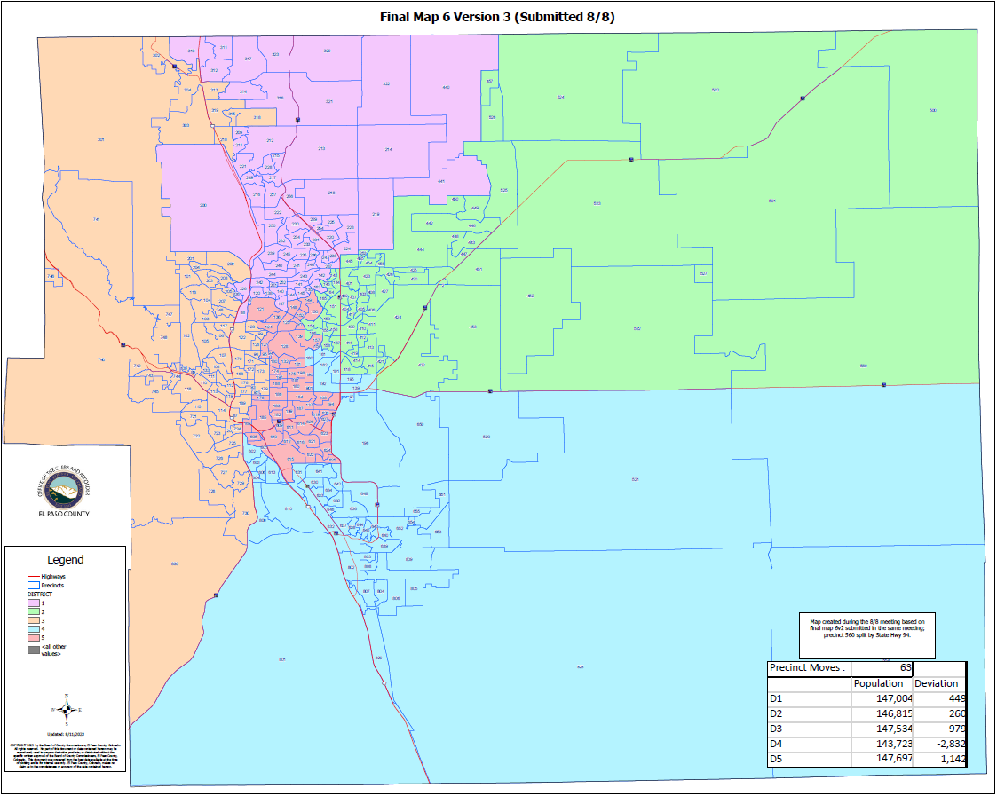
FINAL MAP 6 (Version 3):

Slide 74
FINAL MAP 6 (Version 3)
HOUSE BILL 21-1047:
FINAL MAP 6 (VERSION 3):
Overall Range in Deviation: | 2.71%
Total Precincts Moved: | 63 (19.50%)
Total Affected Population: | 138,664
%: | 18.92%
Total Affected Active Voters: | 87,827
%: | 18.16%

Slide 75
FINAL MAP 6 (VERSION 3)
HOUSE BILL 21-1047:
District: | Total Population: | Target Deviation:
1 | 147,004 | 449
2 | 146,815 | 260
3 | 147,534 | 979
4 | 143,723 | -2,832
5 | 147,697 | 1,142

Slide 76
FINAL MAP 6 (VERSION 3)
Precinct Moves:
DISTRICT: | PRECINCTS ADDED: | PRECINCTS DELETED: | IMPACT:
1 | 219-441-088-206-226-097-120-138-140-144-147 | 134-143-146-253-457-210-303-313-315-318-319 | 0
2 | 134-143-146-253-457-522-527-560-151-153-154-155-156-164-165-166 *Precinct 560 is Split* | 219-441-139-160-161-162-191-192-195-157-159-190-193-194-620-627 | 0
3 | 210-303-313-315-318-319-092-093-099-123-173-179 | 088-206-226-169-601-602-605 | +5
4 | 139-160-161-162-191-192-195-602 | 522-527-560-615-621-622-623-624-625 *Precinct 560 is Split* | -1
5 | 157-159-190-193-194-620-627-169-601-605-615-621-622-623-624-625 | 097-120-138-140-144-147-151-153-154-155-156-164-165-166-092-093-099-123-173-179 | -4

Slide 77
1st Criteria – Population Equality & VRA
FINAL MAP 6 (VERSION 3) Total Population Racial Ethnicity:
Districts | Total / %: | Hispanic or Latino: | Black: | White: | Asian:
1 | TOTAL: | 16,053 | 4,567 | 109,879 | 6,162
 | %: | 10.92% | 3.11% | 74.75% | 4.19%
2 | TOTAL: | 23,687 | 7,168 | 98,737 | 4,795
 | %: | 16.13% | 4.88% | 67.25% | 3.27%
3 | TOTAL: | 16,715 | 3,417 | 114,323 | 3,395
 | %: | 11.33% | 2.32% | 77.49% | 2.3%
4 | TOTAL: | 31,598 | 12,521 | 82,057 | 3,903
 | %: | 21.99% | 8.71% | 57.09% | 2.72%
5 | TOTAL: | 42,440 | 13,646 | 76,685 | 3,414
 | %: | 28.73% | 9.24% | 51.92% | 2.31%

Slide 78
1st Criteria – Population Equality & VRA
FINAL MAP 6 (VERSION 3) Total Population Racial Ethnicity:
Districts | Total % / Variance: | Hispanic or Latino: | Black: | White: | Asian:
1 | TOTAL: | +0.34% | +0.18% | -0.53% | -0.08%
2 | TOTAL: | -2.21% | -0.46% | +2.52% | +0.12%
3 | TOTAL: | -1.33% | -0.53% | +1.96% | 0.0%
4 | TOTAL: | -3.02% | -0.91% | +3.86% | -0.04%
5 | TOTAL: | +6.54% | +1.94% | -8.63% | +0.1%

Slide 79
1st Criteria – Population Equality & VRA
FINAL MAP 6 (VERSION 3) Total Population Racial Ethnicity:

Slide 80
1st Criteria – Population Equality & VRA
FINAL MAP 6 (VERSION 3) Voting Age Population Racial Ethnicity:
Districts | Total / %: | Hispanic or Latino: | Black: | White: | Asian:
1 | TOTAL: | 10,655 | 3,558 | 86,563 | 4,787
 | %: | 7.25% | 2.42% | 58.88% | 3.26%
2 | TOTAL: | 14,941 | 5,431 | 76,088 | 3,923
 | %: | 10.18% | 3.7% | 51.83% | 2.67%
3 | TOTAL: | 11,984 | 2,815 | 96,629 | 2,870
 | %: | 8.12% | 1.91% | 65.5% | 1.95%
4 | TOTAL: | 20,513 | 9,511 | 64,169 | 3,249
 | %: | 14.27% | 6.62% | 44.65% | 2.26%
5 | TOTAL: | 28,271 | 10,599 | 64,792 | 2,994
 | %: | 19.14% | 7.18% | 43.87% | 2.03%

Slide 81
1st Criteria – Population Equality & VRA
FINAL MAP 6 (VERSION 3) Voting Age Population Racial Ethnicity:
Districts | Total % / Variance: | Hispanic or Latino: | Black: | White: | Asian:
1 | TOTAL: | +0.31% | +0.13% | +0.34% | -0.05%
2 | TOTAL: | -1.44% | -0.35% | +1.61% | +0.09%
3 | TOTAL: | -0.98% | -0.41% | +0.99% | -0.03%
4 | TOTAL: | -1.77% | -0.65% | +3.37% | -0.05%
5 | TOTAL: | +3.99% | +1.44% | -7.46% | +0.1%

Slide 82
1st Criteria – Population Equality & VRA
FINAL MAP 6 (VERSION 3) Voting Age Population Racial Ethnicity:

Slide 83
2nd Criteria - Communities of Interest & Compactness
FINAL MAP 6 (VERSION 3):
COMMUNITIES OF INTEREST & COMPACTNESS (Towns & Cities):
City / Town: | Commissioner District:
Calhan | 2
Cascade | 3
Colorado Springs | 1, 2, 3, 4, 5
Fountain | 4
Green Mtn. Falls | 3
Manitou Springs | 3
Monument | 3
Palmer Lake | 3
Peyton | 2
Ramah | 2
Rush | 2, 4
Yoder | 2, 4
COMMUNITIES OF INTEREST & COMPACTNESS (Military):
Military Installations: | Commissioner District:
USAFA | 1
Fort Carson | 4
Peterson AFB | 4
Schriever SFB | 4
NORAD | 3

Slide 84
2nd Criteria - Communities of Interest & Compactness
FINAL MAP 5 (VERSION 3):
COMMUNITIES OF INTEREST & COMPACTNESS (School Districts):
School District: | Commissioner District:
Academy School District 20 | 1, 3
Big Sandy SD 110J | 2
Calhan SD RJ1 | 2
Cheyenne Mtn. SD 12 | 3
Edison SD 54 | 4
Ellicott SD 22 | 2, 4
Falcon SD 49 | 1, 2
Fountain/Ft. Carson SD 8 | 3, 4
Hanover SD 28 | 4
Harrison SD 2 | 4, 5
Lewis-Palmer SD 38 | 1, 3
Manitou Springs SD 14 | 3
COMMUNITIES OF INTEREST & COMPACTNESS (School Districts):
School District: | Commissioner District:
Miami-Yoder SD 60 | 2, 4
Peyton SD 23 | 1, 2
RE-2 Fremont-Florence SD 39 | 3, 4
Widefield SD 3 | 4
Colorado Springs SD 11 | 1, 2, 3, 4, 5

Slide 85
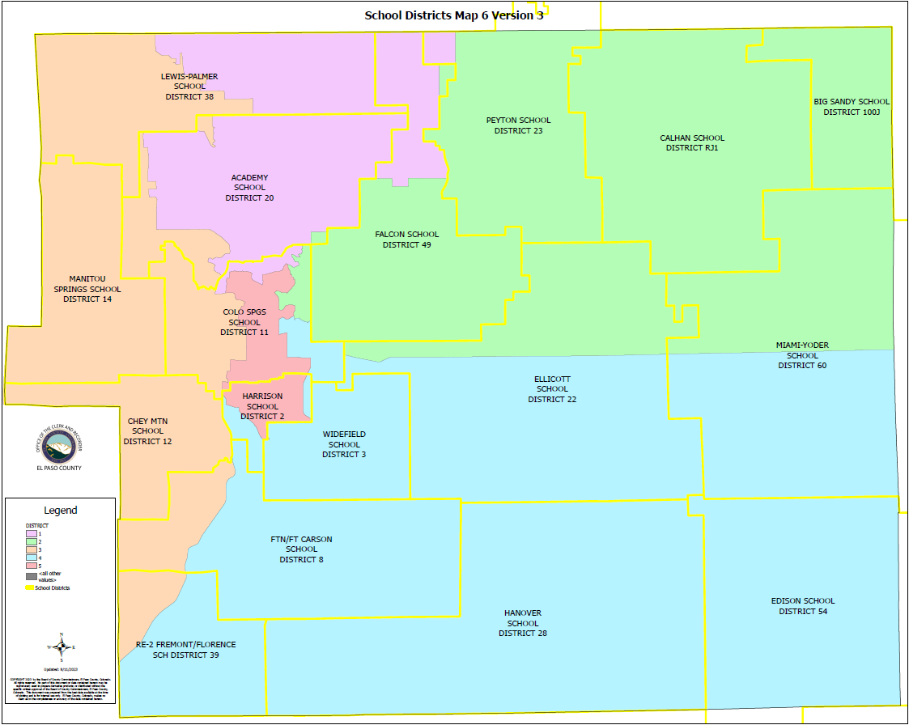

Slide 86
2nd Criteria - Communities of Interest & Compactness
FINAL MAP 6 (VERSION 3):
COMMUNITIES OF INTEREST & COMPACTNESS (Southeast Colorado Springs):
Southeast Colorado Springs (Precincts): | Commissioner District:
137 | 4
169 | 4
180 | 4
182 | 4
184 | 4
185 | 4
187 | 4
190 | 4
193 | 4
194 | 4
199 | 4
601 | 4
605 | 4
COMMUNITIES OF INTEREST & COMPACTNESS (Southeast Colorado Springs):
Southeast Colorado Springs (Precincts): | Commissioner District:
609 | 4
610 | 4
611 | 4
612 | 4
614 | 4
615 | 4
616 | 4
619 | 4
620 | 4
621 | 4
622 | 4
623 | 4
624 | 4
COMMUNITIES OF INTEREST & COMPACTNESS (Southeast Colorado Springs):
Southeast Colorado Springs (Precincts): | Commissioner District:
625 | 4
626 | 4
627 | 4
901 | 4
All 30 Precincts defined as Southeast Colorado Springs are in Commissioner District 4.
District 4 = 30 Precincts (100.00%)
The Districts seem to be compact.

Slide 87
3rd Criteria - Political Competitiveness
FINAL MAP 6 (VERSION 3):
District: | DEM: | DEM %: | REP: | REP %: | Total: | Deviation: | Deviation from Current:
US PRESIDENT:
1 | 32,156 | 36.35% | 53,427 | 60.40% | 88,453 | +24.05% | +0.70%
2 | 28,371 | 35.99% | 47,452 | 60.19% | 78,841 | +24.20% | +1.12%
3 | 46,074 | 49.50% | 44,106 | 47.39% | 93,076 | +2.11% | +2.45%
4 | 24,001 | 41.79% | 30,871 | 53.75% | 57,431 | +11.96% | +2.49%
5 | 31,339 | 51.33% | 26,972 | 44.18% | 61,050 | +7.15% | +5.04%

Slide 88
3rd Criteria - Political Competitiveness
FINAL MAP 6 (VERSION 3):

Slide 89
3rd Criteria - Political Competitiveness
FINAL MAP 6 (VERSION 3):
District: | DEM: | DEM %: | REP: | REP %: | Total: | Deviation: | Deviation from Current:
US SENATE:
1 | 26,025 | 36.35% | 43,281 | 60.45% | 71,598 | +24.10% | +1.50%
2 | 22,569 | 37.44% | 35,322 | 58.60% | 60,281 | +21.16% | +0.57%
3 | 36,593 | 49.97% | 34,499 | 47.11% | 73,237 | +2.86% | +3.34%
4 | 16,720 | 44.34% | 19,348 | 51.31% | 37,705 | +6.97% | +2.56%
5 | 22,117 | 53.30% | 17,545 | 42.28% | 41,498 | +11.02% | +4.77%

Slide 90
3rd Criteria - Political Competitiveness
FINAL MAP 6 (VERSION 3):

Slide 91
3rd Criteria - Political Competitiveness
FINAL MAP 6 (VERSION 3):
District: | DEM: | DEM %: | REP: | REP %: | Total: | Deviation: | Deviation from Current:
GOVERNOR:
1 | 28,724 | 40.01% | 41,614 | 57.97% | 71,789 | +17.96% | +1.11%
2 | 24,518 | 40.56% | 34,151 | 56.49% | 60,451 | +15.94% | +0.39%
3 | 39,119 | 53.28% | 32,842 | 44.73% | 73,428 | +8.55% | +3.15%
4 | 17,897 | 47.37% | 18,636 | 49.32% | 37,785 | +1.96% | +2.50%
5 | 23,189 | 55.78% | 17,141 | 41.23% | 41,574 | +14.55% | +4.60%

Slide 92
3rd Criteria - Political Competitiveness
FINAL MAP 6 (VERSION 3):

Slide 93
3rd Criteria - Political Competitiveness
FINAL MAP 6 (VERSION 3):
District: | DEM: | DEM %: | REP: | REP %: | Total: | Deviation: | Deviation from Current:
SECRETARY OF STATE:
1 | 25,907 | 36.41% | 43,378 | 60.96% | 71,154 | +24.55% | +1.28%
2 | 22,376 | 37.36% | 35,423 | 59.15% | 59,889 | +21.79% | +0.55%
3 | 35,906 | 49.40% | 34,825 | 47.91% | 72,689 | +1.49% | +3.23%
4 | 16,380 | 43.68% | 19,635 | 52.36% | 37,498 | +8.68% | +2.50%
5 | 21,422 | 51.99% | 18,084 | 43.89% | 41,205 | +8.10% | +4.73%

Slide 94
3rd Criteria - Political Competitiveness
FINAL MAP 6 (VERSION 3):

Slide 95
3rd Criteria - Political Competitiveness
FINAL MAP 6 (VERSION 3):
District: | DEM: | DEM %: | REP: | REP %: | Total: | Deviation: | Deviation from Current:
EL PASO COUNTY CLERK & RECORDER:
1 | 22,269 | 32.41% | 46,444 | 67.59% | 68,713 | +35.18% | +1.36%
2 | 19,920 | 34.13% | 38,447 | 65.87% | 58,367 | +31.74% | +1.00%
3 | 31,736 | 45.13% | 38,586 | 54.87% | 70,322 | +9.74% | +3.30%
4 | 15,003 | 40.95% | 21,635 | 59.05% | 36,638 | +18.10% | +2.91%
5 | 20,058 | 50.26% | 19,851 | 49.74% | 39,909 | +0.52% | +6.07%

Slide 96
3rd Criteria - Political Competitiveness
FINAL MAP 6 (VERSION 3):

Slide 97
3rd Criteria - Political Competitiveness
FINAL MAP 6 (VERSION 3):
District: | DEM: | DEM %: | REP: | REP %: | Total: | Deviation: | Deviation from Current:
EL PASO COUNTY SHERIFF:
1 | 22,892 | 33.11% | 46,245 | 66.89% | 69,137 | +33.78% | +1.26%
2 | 19,909 | 33.98% | 38,689 | 66.02% | 58,598 | +32.05% | +0.77%
3 | 32,509 | 46.13% | 37,969 | 53.87% | 70,478 | +7.75% | +3.03%
4 | 14,725 | 40.25% | 21,861 | 59.75% | 36,586 | +19.50% | +2.44%
5 | 19,765 | 49.27% | 20,352 | 50.73% | 40,117 | +1.46% | +4.73%

Slide 98
3rd Criteria - Political Competitiveness
FINAL MAP 6 (VERSION 3):

Slide 99
3rd Criteria - Political Competitiveness
FINAL MAP 6 (VERSION 3):
District: | Average Deviation of All Races:
1 | +26.60%
2 | +24.48%
3 | +0.41%
4 | +11.20%
5 | +6.65%
MAP 6 (V3) AVERAGE DEVIATION FOR OVERALL POLITICAL COMPETITIVENESS
(CLOSEST TO ZERO IS MOST COMPETITIVE)

Slide 100
3rd Criteria - Political Competitiveness
FINAL MAP 6 (VERSION 3):

Slide 101
3rd Criteria - Political Competitiveness
FINAL MAP 6 (VERSION 3):
30.74%

Slide 102
QUESTIONS ON FINAL MAP 6 (VERSION 3)

