Slide 1
Final Report
August 15, 2023

Slide 2
Agenda
Deadline Status
Final Recap
Competitiveness

Slide 3
Deadline Status

Slide 4
Deadline Status
May 12, 2023
Create website for residents
to submit testimony & proposed maps
July 24, 2023
Last day for public to submit plans via website
Aug 4, 2023
All five public hearings held (one in each Commissioner district)
Completed
Completed
Completed

Slide 5
Deadline Status
August 8, 2023
Deadline for additional plans by redistricting commission
August 11, 2023
Last date for written public comment on proposals
August 15, 2023
Proposed date of
final adoption of plan
Completed
Completed
Pending

Slide 6
Final Recap

Slide 7
Final Recap
April 18, 2023 – Redistricting Commission authorized
May 8, 2023 – Introductory meeting held
May 12, 2023 – Redistricting website completed
June 12, 2023 – District 1 meeting held
June 21, 2023 – District 2 meeting held
July 6, 2023 – District 4 meeting held
July 10, 2023 – District 3 meeting held

Slide 8
Final Recap
July 17, 2023 – District 5 meeting held
July 24, 2023 – Last day for public to submit plans
August 2, 2023 – General redistricting meeting held
August 4, 2023 – General redistricting meeting held
August 8, 2023 – Finalist maps designated
August 11, 2023 – Last day for written public comment on finalist maps
August 15, 2023 – Adoption of final plan

Slide 9
Final Recap
6
3
3
Meetings starting at
5:30 pm
Meetings starting at
1:00 pm
Meetings starting at
9:00 am

Slide 10
Final Recap
31
100
7
Maps
Created or Analyzed
Citizen
Comments
Online
Citizen
Maps

Slide 11
Competitiveness
Measurements

Slide 12
Competitiveness Measurements
=
Mathematical population equality within 5% deviation
Compliance with “Voting Rights Act of 1965”, 52 U.S.C. sec, 10301,
as amended
As much as possible, preserve communities of interest and political subdivisions
Thereafter, to the extent reasonably possible, maximize number of politically competitive districts

Slide 13
Competitiveness Measurements
30-10-306.3(d) says “For purposes of this subsection (3), ‘competitive’ means having a reasonable potential for the party affiliation of the district’s county commissioner to change at least once between federal decennial censuses. Competitiveness may be measured by factors such as a proposed district’s past election results, a proposed district’s political party registration data, and evidence-based analyses of proposed districts.”

Slide 14
Competitiveness Measurements
Cook PVI SM
“First introduced in 1997, the Cook Partisan Voting Index (Cook PVI) measures how each state and district performs at the presidential level compared to the nation as a whole.”
“A Cook PVI score of D+2, for example, means that in the 2016 and 2020 presidential elections, that district performed an average of two points more Democratic than the nation did as a whole…”

Slide 15
Competitiveness Measurements
Arizona
R+2
Colorado
D+4
Georgia
R+3
Maine
D+2
Pennsylvania
R+2

Slide 16
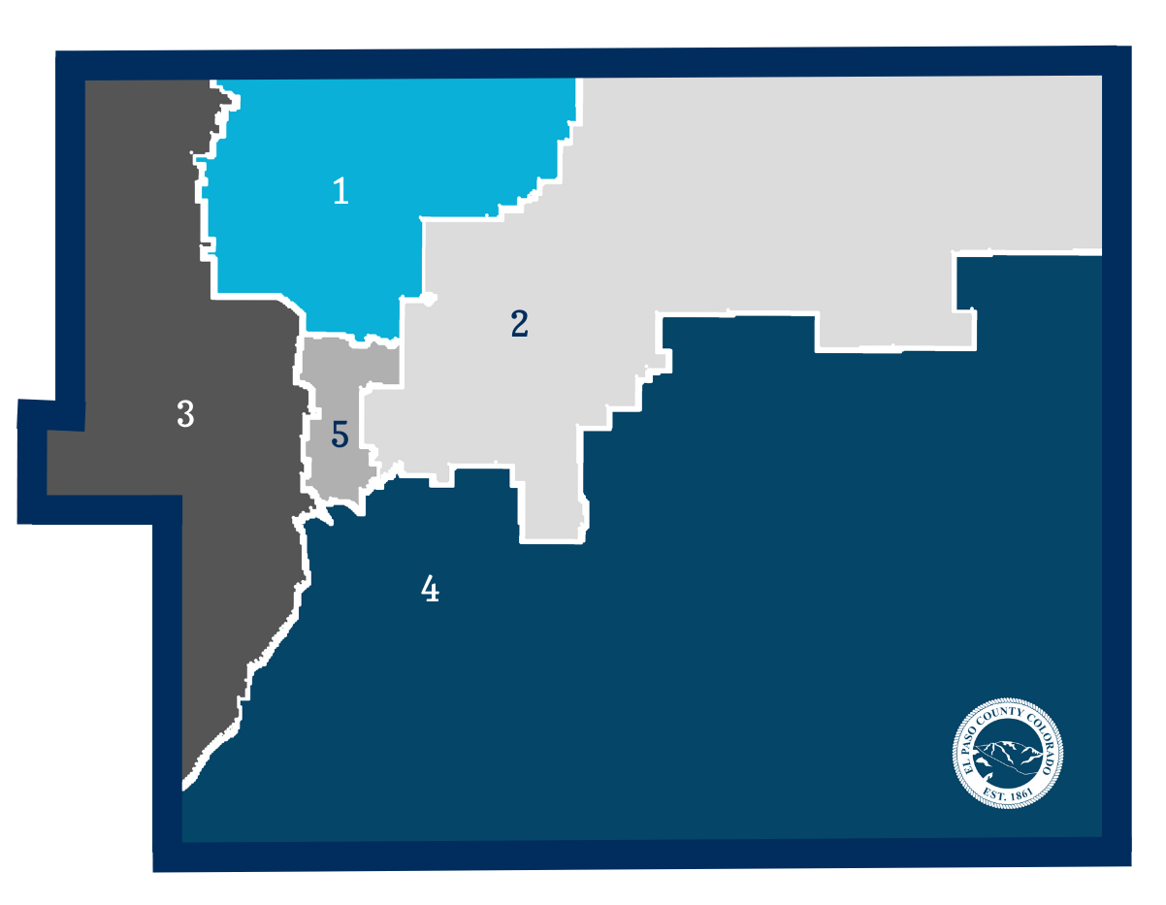
Competitiveness Measurements
Current Districts
EPC | 2020 (%) | 2016 (%) | PVI
Countywide | 54-43 | 56-34 | R+9

Slide 17
Next Steps & Competitiveness Measurements

Slide 18
Next Steps & Competitiveness Measurements

Slide 19
Next Steps & Competitiveness Measurements

Slide 20
Competitiveness Measurements
Current Districts
District | 2020 (%) | 2016 (%) | PVI
1 | 61-36 | 64-26 | R+16
2 | 60-37 | 63-28 | R+15
3 | 46-51 | 48-42 | Even
4 | 52-43 | 55-35 | R+8
5 | 47-49 | 50-39 | R+3

Slide 21
Map 1 V2

Slide 22
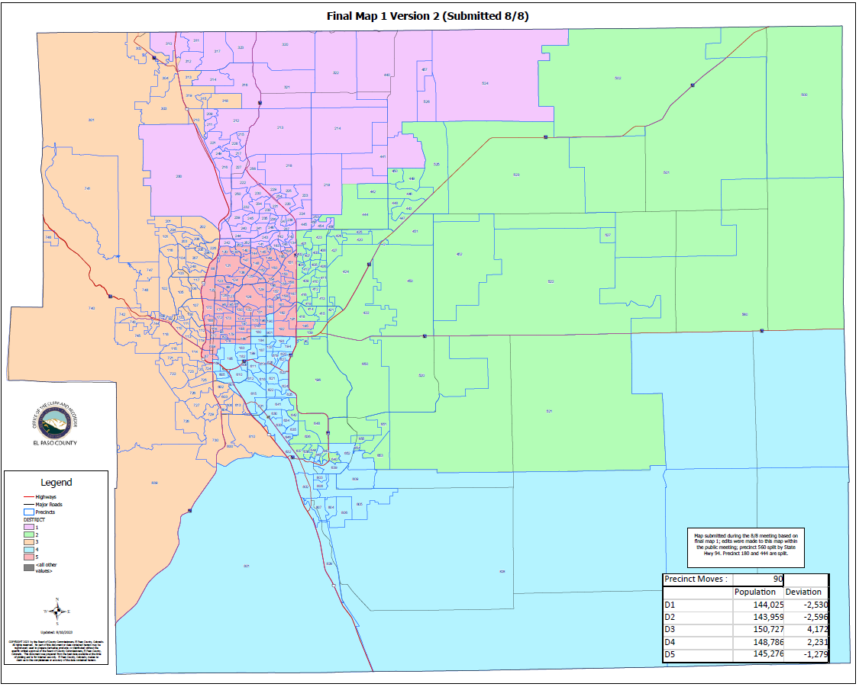
Competitiveness Measurements
Map 1 V2
District | 2020 (%) | 2016 (%) | PVI
1 | 61-36 | 64-26 | R+16
2 | 60-36 | 63-27 | R+14
3 | 47-50 | 53-38 | R+4
4 | 49-46 | 49-41 | R+3
5 | 48-48 | 51-38 | R+3

Slide 23
Voter Registration
Map 1 V2
District | Republican | Democratic | Unaffiliated | Other
1 | 40,753 | 14,255 | 51,483 | 1,758
2 | 32,796 | 15,101 | 50,117 | 2,205
3 | 30,780 | 19,213 | 50,469 | 1,990
4 | 17,839 | 18,082 | 44,480 | 2,215
5 | 26,562 | 19,930 | 47,078 | 2,186

Slide 24
Map 6 V2

Slide 25
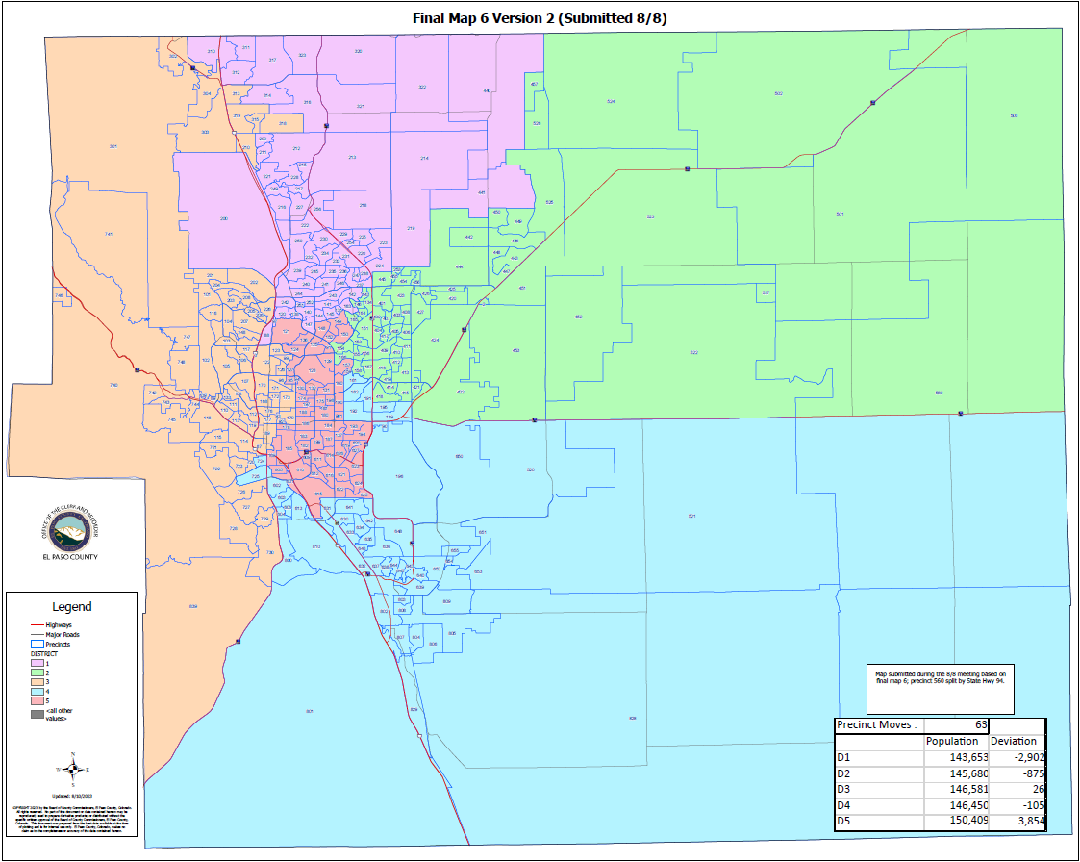
Competitiveness Measurements
Map 6 V2
District | 2020 (%) | 2016 (%) | PVI
1 | 61-36 | 64-27 | R+16
2 | 60-36 | 63-26 | R+15
3 | 47-49 | 50-41 | R+2
4 | 54-42 | 57-33 | R+9
5 | 44-51 | 48-42 | Even

Slide 26
Voter Registration
Map 6 V2
District | Republican | Democratic | Unaffiliated | Other
1 | 40,058 | 14,466 | 51,008 | 1,774
2 | 36,344 | 15,625 | 51,663 | 2,230
3 | 31,815 | 22,593 | 52,341 | 2,168
4 | 21,222 | 14,336 | 43,801 | 1,976
5 | 19,291 | 19,561 | 44,814 | 2,206

Slide 27
Map 6 V3

Slide 28
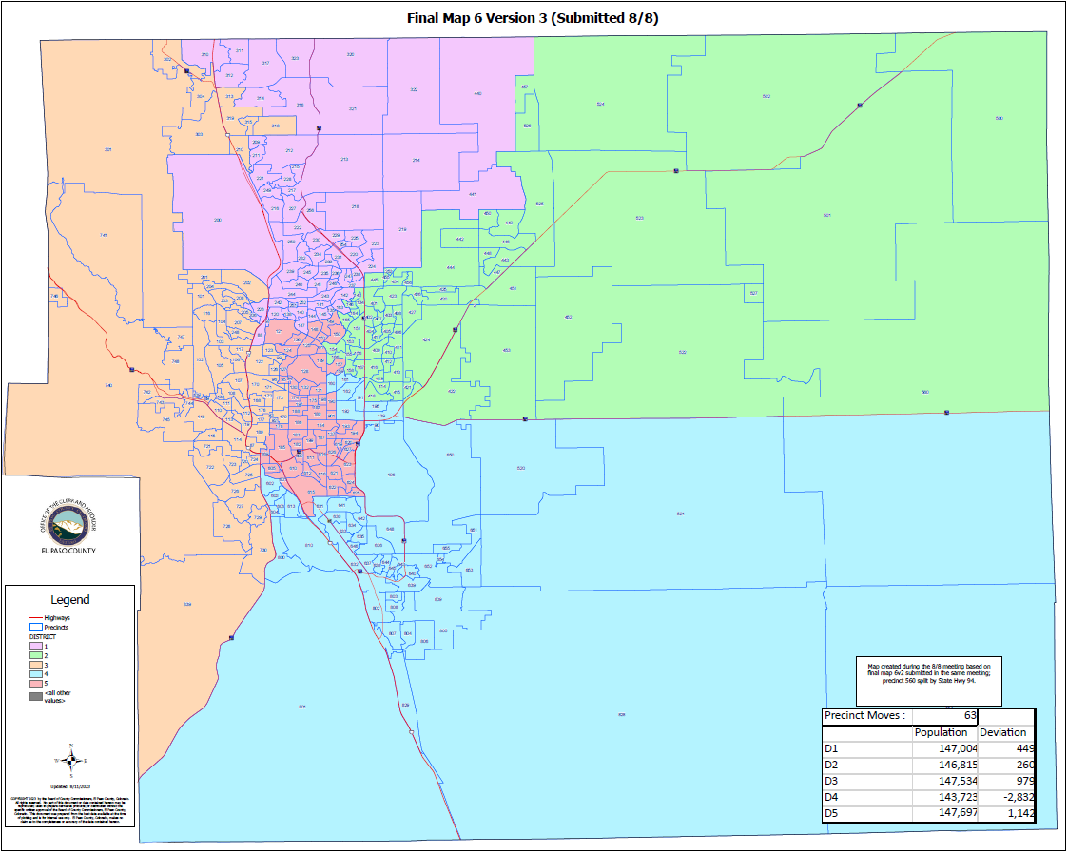
Competitiveness Measurements
Map 6 V3
District | 2020 (%) | 2016 (%) | PVI
1 | 60-36 | 64-27 | R+16
2 | 60-36 | 63-26 | R+15
3 | 47-50 | 50-41 | R+2
4 | 54-42 | 57-33 | R+9
5 | 44-51 | 48-42 | Even

Slide 29
Voter Registration
Map 6 V3
District | Republican | Democratic | Unaffiliated | Other
1 | 40,733 | 14,899 | 52,279 | 1,823
2 | 36,344 | 15,625 | 51,663 | 2,230
3 | 31,967 | 22,758 | 52,501 | 1,954
4 | 20,922 | 14,104 | 43,333 | 1,954
5 | 18,764 | 19,195 | 43,851 | 2,157

Slide 30
Observations

Slide 31
Competitiveness Measurements
PVI Across Plans
District | Base PVI | Map 1 V2 | Map 6 V2 | Map 6 V3
1 | R+16 | R+16 | R+16 | R+16
2 | R+15 | R+15 | R+15 | R+15
3 | Even | R+4 | R+2 | R+2
4 | R+8 | R+3 | R+9 | R+9
5 | R+3 | R+3 | Even | Even

Slide 32
Competitiveness Measurements
Observations
Under the current map, districts 3 (Even) and 5 (R+3) firmly fall within the competitive range as defined by Cook PVI.
Under Map 6 V2 and Map 6 V3, districts 3 (R+2) and 5 (Even) firmly fall within the competitive range as defined by Cook PVI.
Under Map 1 V2, districts 4 (R+3) and 5 (R+3) fall within the competitive range as defined by Cook PVI.
Maps under final consideration are especially competitive when 2022 election results are considered.

Slide 33
Questions?

