Slide 1
General Updates
August 4, 2023

Slide 2
Agenda
Upcoming Redistricting Meeting Dates
Deadline Status
Next Steps & Competitiveness Measurements

Slide 3
Next Redistricting Commission Meeting Dates

Slide 4
Next Redistricting
Commission Meeting Dates
Tuesday, August 8, 2023; 1:00 pm
Purpose: designate finalist map options
Tuesday, August 15, 2023; 1:00 pm
Purpose: adopt final map from among the finalists
Centennial Hall, 200 S. Cascade Ave.,
Colorado Springs, CO 80903

Slide 5
Deadline Status

Slide 6
Deadline Status
May 12, 2023
Create website for residents
to submit testimony & proposed maps
July 24, 2023
Last day for public to submit plans via website
Aug 4, 2023
All five public hearings held (one in each Commissioner district)
Completed
Completed
Completed

Slide 7
Deadline Status
August 8, 2023
Deadline for additional plans by redistricting commission
August 11, 2023
Last date for written public comment on proposals
August 15, 2023
Proposed date of
final adoption of plan

Slide 8
Next Steps & Competitiveness
Measurements

Slide 9
Next Steps & Competitiveness Measurements
Today’s meeting will be slightly different during the “Direction to Staff” portion.
As was always our plan for this meeting, staff will make any directed changes in the Esri tool immediately after direction is received.
There may be more time without someone speaking to allow for changes to be made and for the Commission to verify the intent has been captured correctly.

Slide 10
Next Steps & Competitiveness Measurements
On August 8, 2023, this Redistricting Commission will designate a number of finalist maps.
With all changes locked in, staff can measure additional indicators of competitiveness, including party registration and Cook PVI.
Cook PVI hasn’t been measured up until this point because it will take some time to align new precinct lines with precinct lines from 2016.

Slide 11
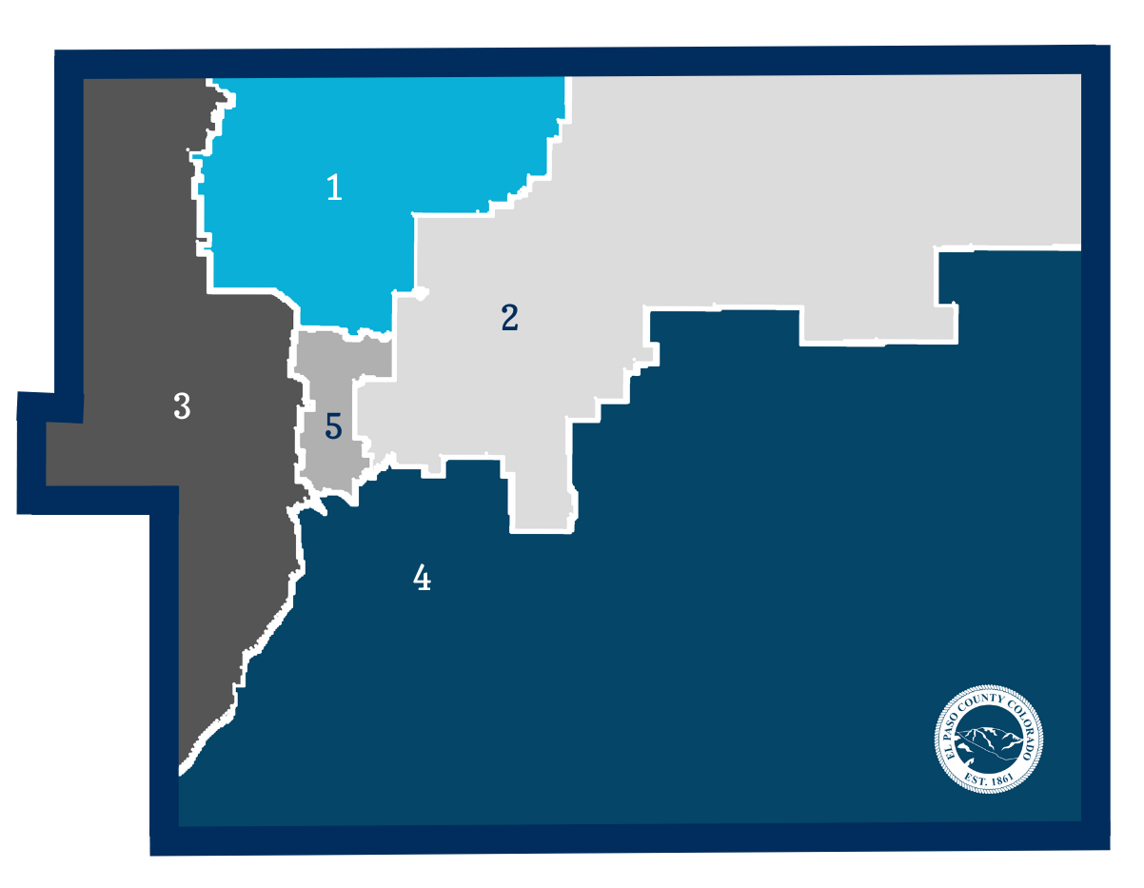
Competitiveness Measurements
District | 2020 (%) | 2016 (%) | PVI
1 | 61-36 | 64-26 | R+15
2 | 60-37 | 63-28 | R+14
3 | 46-51 | 48-42 | Even
4 | 52-43 | 55-35 | R+8
5 | 47-49 | 50-39 | R+3

Slide 12
Competitiveness Measurements
District | 2020 (%) | 2016 (%) | PVI
1 | 61-36 | 64-26 | R+15
2 | 60-37 | 63-28 | R+14
3 | 46-51 | 48-42 | Even
4 | 52-43 | 55-35 | R+8
5 | 47-49 | 50-39 | R+3

Slide 13
Competitiveness Measurements
District | 2020 (%) | 2016 (%) | PVI
1 | 61-36 | 64-26 | R+15
2 | 60-37 | 63-28 | R+14
3 | 46-51 | 48-42 | Even
4 | 52-43 | 55-35 | R+8
5 | 47-49 | 50-39 | R+3

Slide 14
Next Steps & Competitiveness Measurements
District | Base PVI | Map 1 | Map 2 | Map 3 | Etc...
1 | R+15
2 | R+14
3 | Even
4 | R+8
5 | R+3

Slide 15
Questions?

