Slide 1
El Paso County
Commissioner Redistricting
July 27, 2023 @ 5:30pm
El Paso County BOCC
Centennial Hall
200 S. Cascade Ave.
Colorado Springs, CO 80903
Presented By: Steve Schleiker, El Paso County Clerk & Recorder

Slide 2
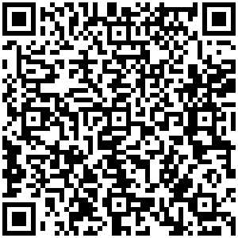
Redistricting (July 27th )
Presentation QR Code:

Slide 3
Redistricting Commission
Assigned Tasks from July 17th Meeting:
1
Provide full analysis on all Citizen submitted maps.
Ensure July 24th @ 11:59pm is the deadline for the public to submit maps.
Google Drive update 24-hours before next meeting via public comment? This is not authorized per 1047.
Annotate tweaks to Map 8 that may affect Tri-Lakes area.
Map E
USAFA to Commissioner District 1
Unite Southeast Colorado Springs (30 Precincts)
Commissioner Holly Williams:

Slide 4
Redistricting Commission
Assigned Tasks from July 17th Meeting:
2
Eliminate maps that don’t accommodate ongoing guidance.
Provide graphics of deviation for political competitiveness.
Map E
USAFA to Commissioner District 1
Unite Southeast Colorado Springs (30 Precincts)
Commissioner Carrie Geitner:

Slide 5
Redistricting Commission
Assigned Tasks from July 17th Meeting:
Provide analysis or Mr. Perez map.
Eliminate maps:
Map A
(Minimize Changes to Election Cycle) (6/12)
Map B
(Minimize Precinct Moves) (6/12)
Map C
(Keep Security/Widefield/Hanover/ and Fountain together) (6/12)
Map D
(I-25 Boundary – Keep Monument & Black Forest together) (6/12)
Map 2
(Use Map B as a base / Precincts 800 & 810 stay in Commissioner District 4 / Town of Palmer Lake, and Town of Monument move from Commissioner District 3 to Commissioner District 1 / USAFA move from Commissioner District 1 to Commissioner District 3 / Minimal Precinct moves and voter impact / Commissioner District 3 and Commissioner District 5 heavier population) (6/21)
Map E
USAFA to Commissioner District 1
Unite Southeast Colorado Springs (30 Precincts
3
Commissioner Stan VanderWerf:

Slide 6
Redistricting Commission
Assigned Tasks from July 17th Meeting:
4
Would like to see Citizen map (Landgraf) revisions to join Southeast Colorado Springs.
Analyze, review and provide input on all Citizen submitted maps.
Map E
USAFA to Commissioner District 1
Unite Southeast Colorado Springs (30 Precincts)
Commissioner Longinos Gonzalez:

Slide 7
Redistricting Commission
Assigned Tasks from July 17th Meeting:
5
Likes Mr. Perez map but would like to see Powers Boulevard as the Commissioner District 5 boundary.
Wants Precinct (169) to stay in Commissioner District 5.
Map E
USAFA to Commissioner District 1
Unite Southeast Colorado Springs (30 Precincts)
Commissioner Cami Bremer:

Slide 8
CURRENT County Commissioner District Data Reminder:

Slide 9
2023 Current Commissioner Districts:

Slide 10
CURRENT County Commissioner Districts Data Reminder:
District: | Total Population: | Target Deviation: | Target Deviation %:
County | 732,773
District 1 | 148,369 | 1,814 | 1.24%
District 2 | 153,741 | 7,186 | 4.9%
District 3 | 138,723 | -7,832 | -5.34%
District 4 | 151,113 | 4,558 | 3.11%
District 5 | 140,827 | -5,728 | -3.91%
Metric: | Data:
TOTAL Population | 732,773
Mean Target Population | 146,555
Mean Deviation | 5,424
Mean % Deviation | 3.7%
Largest (+) Deviation | 7,186
Largest (–) Deviation | -7,832
Overall Range in Deviation | 15,018
Overall Range in Deviation %: | 10.25%

Slide 11
CURRENT County Commissioner Districts
Data Reminder (Total Population):
Districts | Total % / Variance: | Hispanic or Latino: | Black: | White: | Asian:
1 | TOTAL: | 15,691 | 4,341 | 111,688 | 6,342
 | %: | 10.58% | 2.93% | 75.28% | 4.27%
2 | TOTAL: | 28,197 | 8,206 | 99,510 | 4,849
 | %: | 18.34% | 5.34% | 64.73% | 3.15%
3 | TOTAL: | 17,558 | 3,951 | 104,778 | 3,194
 | %: | 12.66% | 2.85% | 75.53% | 2.3%
4 | TOTAL: | 37,792 | 14,534 | 80,438 | 4,174
 | %: | 25.01% | 9.62% | 53.23% | 2.76%
5 | TOTAL: | 31,255 | 10,287 | 85,267 | 3,110
 | %: | 22.19% | 7.3% | 60.55% | 2.21%

Slide 12
CURRENT County Commissioner Districts
Data Reminder (Voting Age Population):
Districts | Total % / Variance: | Hispanic or Latino: | Black: | White: | Asian:
1 | TOTAL: | 10,293 | 3,405 | 86,855 | 4,913
 | %: | 6.94% | 2.29% | 58.54% | 3.31%
2 | TOTAL: | 17,866 | 6,226 | 77,215 | 3,963
 | %: | 11.62% | 4.05% | 50.22% | 2.58%
3 | TOTAL: | 12,630 | 3,214 | 89,495 | 2,741
 | %: | 9.1% | 2.32% | 64.51% | 1.98%
4 | TOTAL: | 24,234 | 10,982 | 62,384 | 3,490
 | %: | 16.04% | 7.27% | 41.28% | 2.31%
5 | TOTAL: | 21,341 | 8,087 | 72,292 | 2,716
 | %: | 15.15% | 5.74% | 51.33% | 1.93%

Slide 13
CURRENT County Commissioner Districts
Data Reminder:
District: | DEM: | DEM %: | REP: | REP %: | Total: | Deviation:
US PRESIDENT:
1 | 32,311 | 36.03% | 54,508 | 60.78% | 89,675 | 24.75%
2 | 29,768 | 36.58% | 48,548 | 59.66% | 81,378 | 23.08%
3 | 42,842 | 50.71% | 38,987 | 46.15% | 84,484 | 4.56%
4 | 23,571 | 42.87% | 28,779 | 52.35% | 54,978 | 9.47%
5 | 33,449 | 48.95% | 32,006 | 46.84% | 68,336 | 2.11%

Slide 14
CURRENT County Commissioner Districts
Data Reminder:
District: | DEM: | DEM %: | REP: | REP %: | Total: | Deviation:
US SENATE:
1 | 26,178 | 35.62% | 44,995 | 61.22% | 73,498 | 25.60%
2 | 23,218 | 37.73% | 35,885 | 58.31% | 61,545 | 20.58%
3 | 34,107 | 51.64% | 30,012 | 45.44% | 66,050 | 6.20%
4 | 16,146 | 45.54% | 17,711 | 49.95% | 35,457 | 4.41%
5 | 24,375 | 51.03% | 21,392 | 44.78% | 47,769 | 6.24%

Slide 15
CURRENT County Commissioner Districts
Data Reminder:
District: | DEM: | DEM %: | REP: | REP %: | Total: | Deviation:
GOVERNOR:
1 | 29,093 | 39.48% | 43,143 | 58.54% | 73,696 | 19.06%
2 | 25,174 | 40.80% | 34,764 | 56.34% | 61,708 | 15.54%
3 | 36,310 | 54.83% | 28,563 | 43.13% | 66,222 | 11.70%
4 | 17,212 | 48.45% | 17,018 | 47.90% | 35,525 | 0.55%
5 | 25,658 | 53.59% | 20,896 | 43.65% | 47,876 | 9.95%

Slide 16
CURRENT County Commissioner Districts
Data Reminder:
District: | DEM: | DEM %: | REP: | REP %: | Total: | Deviation:
SECRETARY OF STATE:
1 | 26,151 | 35.80% | 45,024 | 61.63% | 73,050 | 25.84%
2 | 23,007 | 37.61% | 35,995 | 58.84% | 61,170 | 21.23%
3 | 33,429 | 50.99% | 30,338 | 46.28% | 65,559 | 4.71%
4 | 15,796 | 44.78% | 17,976 | 50.97% | 35,271 | 6.18%
5 | 23,608 | 49.82% | 22,012 | 46.45% | 47,385 | 3.37%

Slide 17
CURRENT County Commissioner Districts
Data Reminder:
District: | DEM: | DEM %: | REP: | REP %: | Total: | Deviation:
EL PASO COUNTY CLERK & RECORDER:
1 | 22,375 | 31.73% | 48,147 | 68.27% | 70,522 | 36.54%
2 | 20,647 | 34.63% | 38,977 | 65.37% | 59,624 | 30.74%
3 | 29,704 | 46.78% | 33,793 | 53.22% | 63,497 | 6.44%
4 | 14,651 | 42.41% | 19,898 | 57.59% | 34,549 | 15.19%
5 | 21,609 | 47.23% | 24,148 | 52.77% | 45,757 | 5.55%

Slide 18
CURRENT County Commissioner Districts
Data Reminder:
District: | DEM: | DEM %: | REP: | REP %: | Total: | Deviation:
EL PASO COUNTY SHERIFF:
1 | 23,047 | 32.48% | 47,911 | 67.52% | 70,958 | 35.04%
2 | 20,557 | 34.36% | 39,267 | 65.64% | 59,824 | 31.28%
3 | 30,288 | 47.64% | 33,290 | 52.36% | 63,578 | 4.72%
4 | 14,307 | 41.47% | 20,195 | 58.53% | 34,502 | 17.07%
5 | 21,601 | 46.90% | 24,453 | 53.10% | 46,054 | 6.19%

Slide 19
CITIZEN SUBMITTED MAP
(Czukas):

Slide 20
(Czukas Map) :
Czukas Map:
SE (30 Suggested Precincts) consolidated into one district? | YES
Powers as Eastern boundary for Commissioner District 5 | NO
Fountain / Fort Carson / Security / Widefield / Hanover together? | YES
Czukas Map: Submitted through public comment 6/2.

Slide 21
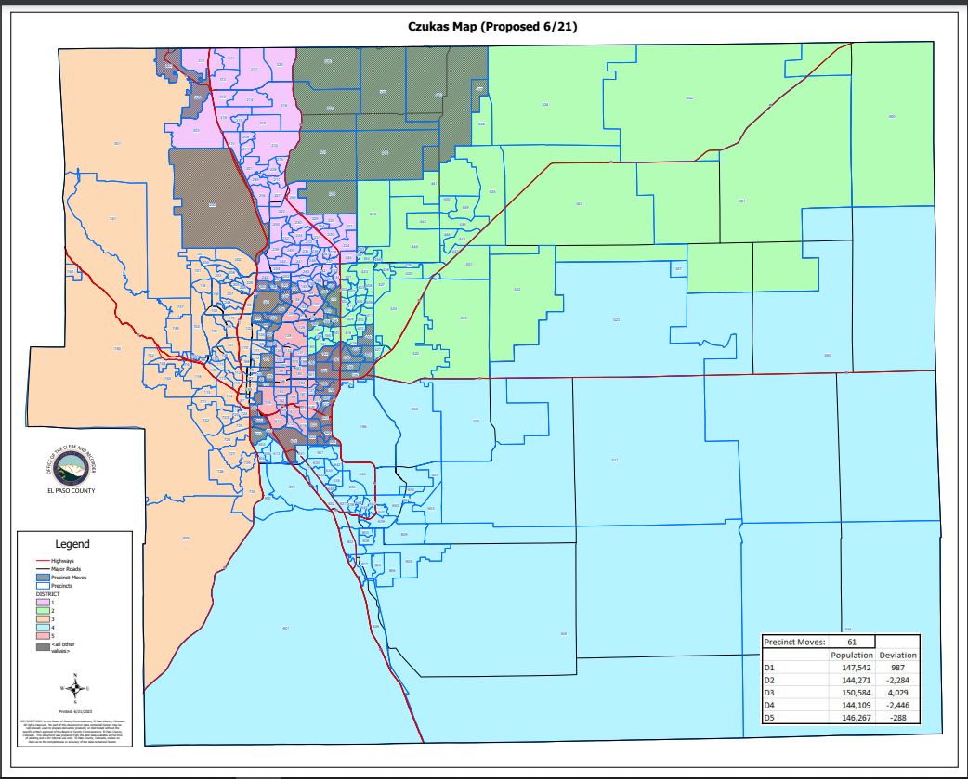
Czukas Map:

Slide 22
(Czukas)
HOUSE BILL 21-1047:
Czukas Map:
Overall Range in Deviation: | 4.42%
Total Precincts Moved: | 61 (18.88%)
Total Affected Population: | 144,804
%: | 19.76%
Total Affected Active Voters: | 88,699
%: | 18.34%

Slide 23
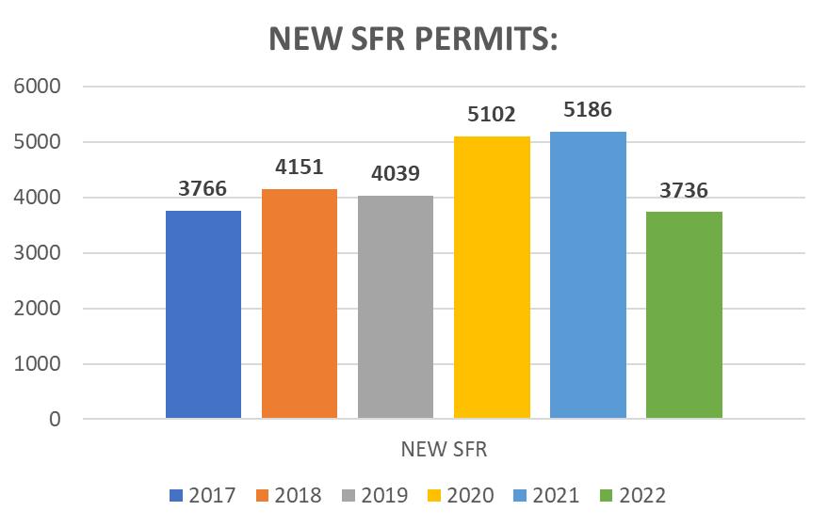
(Czukas)
HOUSE BILL 21-1047:
District: | Total Population: | Target Deviation:
1 | 147,542 | 987
2 | 144,271 | -2,284
3 | 150,584 | 4029
4 | 144,109 | -2,446
5 | 146,267 | -288

Slide 24
(Czukas)
Precinct Moves:
DISTRICT: | PRECINCTS ADDED: | PRECINCTS DELETED: | IMPACT:
1 | 302-304-120-138-140-144-147-164 | 200-213-214-218-253-320-321-322-440-457 | -2
2 | 213-214-218-253-320-321-322-440-457-151-153-155-156-165-166 | 139-162-190-191-192-193-194-195-413-414-415-418-620-627 | +1
3 | 200-092-093-095-097-099-121-123-124-127-136-173-178-179 | 169-302-304-601-602-605 | +8
4 | 195-413-414-415-418-602 | 615-621-622-623-624-625 | 0
5 | 139-162-190-191-192-193-194-620-627-169-601-605-615-621-622-623-624-625 | 092-093-095-097-099-120-121-123-124-127-136-138-140-144-147-151-153-155-156-164-165-166-173-178-179 | -7

Slide 25
1st Criteria – Population Equality & VRA
(Czukas) Total Population Racial Ethnicity:
Districts | Total / %: | Hispanic or Latino: | Black: | White: | Asian:
1 | TOTAL: | 16,177 | 4,330 | 110,218 | 6,201
 | %: | 10.96% | 2.93% | 74.7% | 4.2%
2 | TOTAL: | 21,045 | 6,256 | 100,873 | 4,426
 | %: | 14.59% | 4.34% | 69.92% | 3.07%
3 | TOTAL: | 18,442 | 4,224 | 114,395 | 3,709
 | %: | 12.25% | 2.81% | 75.97% | 2.46%
4 | TOTAL: | 31,739 | 12,662 | 81,982 | 3,956
 | %: | 22.02% | 8.79% | 56.89% | 2.75%
5 | TOTAL: | 43,090 | 13,847 | 74,213 | 3,377
 | %: | 29.46% | 9.47% | 50.74% | 2.31%

Slide 26
1st Criteria – Population Equality & VRA
(Czukas) Total Population Racial Ethnicity:
Districts | Total % / Variance: | Hispanic or Latino: | Black: | White: | Asian:
1 | TOTAL: | +0.38 | 0% | -0.58% | -0.07%
2 | TOTAL: | -3.75% | -1% | +5.19% | -0.08%
3 | TOTAL: | -0.41% | -0.04% | +0.44% | +0.16%
4 | TOTAL: | -2.99% | -0.83% | +3.66% | -0.01%
5 | TOTAL: | +7.27% | +2.17% | -9.81% | +0.1%

Slide 27
1st Criteria – Population Equality & VRA
(Czukas) Voting Age Population Racial Ethnicity:
Districts | Total / %: | Hispanic or Latino: | Black: | White: | Asian:
1 | TOTAL: | 10,508 | 3,333 | 85,460 | 4,773
 | %: | 7.12% | 2.26% | 57.92% | 3.24%
2 | TOTAL: | 13,310 | 4,721 | 78,288 | 3,565
 | %: | 9.23% | 3.27% | 54.26% | 2.47%
3 | TOTAL: | 13,426 | 3,552 | 98,377 | 3,221
 | %: | 8.92% | 2.36% | 65.33% | 2.14%
4 | TOTAL: | 20,540 | 9,592 | 63,696 | 3,308
 | %: | 14.25% | 6.66% | 44.2% | 2.3%
5 | TOTAL: | 28,580 | 10,716 | 62,420 | 2,956
 | %: | 19.54% | 7.33% | 42.68% | 2.02%

Slide 28
1st Criteria – Population Equality & VRA
(Czukas) Voting Age Population Racial Ethnicity:
Districts | Total % / Variance: | Hispanic or Latino: | Black: | White: | Asian:
1 | TOTAL: | +0.18% | -0.03% | -0.62% | -0.07%
2 | TOTAL: | -2.39% | -0.78% | +4.04% | -0.11%
3 | TOTAL: | -0.18% | +0.04% | +0.82% | +0.16%
4 | TOTAL: | -1.79% | +0.61% | +2.92% | -0.01%
5 | TOTAL: | +4.39% | +1.59% | -8.65% | +0.09%

Slide 29
2nd Criteria - Communities of Interest & Compactness
(Czukas)
COMMUNITIES OF INTEREST & COMPACTNESS (Towns & Cities):
City / Town: | Commissioner District:
Calhan | 1
Cascade | 3
Colorado Springs | 1 – 5
Elbert | 2
Fountain | 4
Green Mtn. Falls | 3
Manitou Springs | 3
Monument | 1
Palmer Lake | 1
Peyton | 2
Ramah | 2
Rush | 4
Yoder | 4
COMMUNITIES OF INTEREST & COMPACTNESS (Military):
Military Installations: | Commissioner District:
USAFA | 1
Fort Carson | 4
Peterson AFB | 4
Schriever SFB | 4
NORAD | 3

Slide 30
2nd Criteria - Communities of Interest & Compactness
(Czukas)
COMMUNITIES OF INTEREST & COMPACTNESS (School Districts):
School District: | Commissioner District:
Academy School District 20 | 1-3
Big Sandy SD 110J | 4
Calhan SD RJ1 | 2
Cheyenne Mtn. SD 12 | 3
Edison SD 54 | 2
Ellicott SD 22 | 4
Falcon SD 49 | 2, 4
Fountain/Ft. Carson SD 8 | 3, 4
Hanover SD 28 | 4
Harrison SD 2 | 3-5
Lewis-Palmer SD 38 | 1-3
Manitou Springs SD 14 | 1, 3
COMMUNITIES OF INTEREST & COMPACTNESS (School Districts):
School District: | Commissioner District:
Miami-Yoder SD 60 | 2
Peyton SD 23 | 2
RE-2 Fremont-Florence SD 39 | 3-4
Widefield SD 3 | 4
Colorado Springs SD 11 | 1, 2, 3, 5

Slide 31
2nd Criteria - Communities of Interest & Compactness
(Czukas)
COMMUNITIES OF INTEREST & COMPACTNESS (Southeast Colorado Springs):
Southeast Colorado Springs (Precincts): | Commissioner District:
137 | 5
169 | 5
180 | 5
182 | 5
184 | 5
185 | 5
187 | 5
190 | 5
193 | 5
194 | 5
199 | 5
601 | 5
605 | 5
COMMUNITIES OF INTEREST & COMPACTNESS (Southeast Colorado Springs):
Southeast Colorado Springs (Precincts): | Commissioner District:
609 | 5
610 | 5
611 | 5
612 | 5
614 | 5
615 | 5
616 | 5
619 | 5
620 | 5
621 | 5
622 | 5
623 | 5
624 | 5
COMMUNITIES OF INTEREST & COMPACTNESS (Southeast Colorado Springs):
Southeast Colorado Springs (Precincts): | Commissioner District:
625 | 5
626 | 5
627 | 5
901 | 5
All 30 Precincts defined as Southeast Colorado Springs are in Commissioner District 5.
The Districts are compact.

Slide 32
3rd Criteria - Political Competitiveness
(Czukas):
District: | DEM: | DEM %: | REP: | REP %: | Total: | Deviation: | Deviation from Current:
US PRESIDENT:
1 | 34,523 | 37.85% | 53,688 | 58.85% | 91,221 | 21.01% | +3.74%
2 | 28,077 | 33.92% | 51,755 | 62.52% | 82,781 | 28.60% | +5.53%
3 | 46,131 | 51.28% | 40,911 | 45.48% | 89,958 | 5.80% | +1.24%
4 | 23,250 | 41.36% | 30,401 | 54.08% | 56,217 | 12.72% | +3.25%
5 | 29,960 | 51.06% | 26,073 | 44.44% | 58,674 | 6.62% | +4.51%

Slide 33
3rd Criteria - Political Competitiveness
(Czukas):

Slide 34
3rd Criteria - Political Competitiveness
(Czukas):
District: | DEM: | DEM %: | REP: | REP %: | Total: | Deviation: | Deviation from Current:
US SENATE:
1 | 27,908 | 37.85% | 43,440 | 58.91% | 73,739 | 21.06% | +4.54%
2 | 22,647 | 34.83% | 39,907 | 61.38% | 65,015 | 26.55% | +5.97%
3 | 35,985 | 52.12% | 31,055 | 44.98% | 69,043 | 7.14% | +0.94%
4 | 16,257 | 44.17% | 18,921 | 51.41% | 36,802 | 7.24% | +2.82%
5 | 21,227 | 53.44% | 16,672 | 41.97% | 39,720 | 11.47% | +5.22%

Slide 35
3rd Criteria - Political Competitiveness
(Czukas):

Slide 36
3rd Criteria - Political Competitiveness
(Czukas):
District: | DEM: | DEM %: | REP: | REP %: | Total: | Deviation: | Deviation from Current:
GOVERNOR:
1 | 30,752 | 41.60% | 41,674 | 56.37% | 73,931 | 14.77% | +4.29%
2 | 24,755 | 37.97% | 38,658 | 59.29% | 65,204 | 21.32% | +5.78%
3 | 38,288 | 55.33% | 29,536 | 42.68% | 69,205 | 12.65% | +0.95%
4 | 17,392 | 47.15% | 18,223 | 49.40% | 36,887 | 2.25% | +2.80%
5 | 22,260 | 55.93% | 16,293 | 40.94% | 39,800 | 14.99% | +5.05%

Slide 37
3rd Criteria - Political Competitiveness
(Czukas):

Slide 38
3rd Criteria - Political Competitiveness
(Czukas):
District: | DEM: | DEM %: | REP: | REP %: | Total: | Deviation: | Deviation from Current:
SECRETARY OF STATE:
1 | 27,772 | 37.91% | 43,564 | 59.47% | 73,250 | 21.56% | +4.25%
2 | 22,493 | 34.81% | 39,936 | 61.81% | 64,616 | 26.99% | +5.76%
3 | 35,254 | 51.45% | 31,398 | 45.82% | 68,525 | 5.63% | +0.91%
4 | 15,946 | 43.56% | 19,197 | 52.44% | 36,605 | 8.88% | +2.70%
5 | 20,526 | 52.04% | 17,250 | 43.71% | 39,439 | 8.31% | +4.94%

Slide 39
3rd Criteria - Political Competitiveness
(Czukas):

Slide 40
3rd Criteria - Political Competitiveness
(Czukas):
District: | DEM: | DEM %: | REP: | REP %: | Total: | Deviation: | Deviation from Current:
EL PASO COUNTY CLERK & RECORDER:
1 | 23,973 | 33.91% | 46,731 | 66.09% | 70,704 | 32.19% | +4.36%
2 | 19,797 | 31.47% | 43,106 | 68.53% | 62,903 | 37.06% | +6.31%
3 | 31,266 | 47.16% | 35,038 | 52.74% | 66,304 | 5.69% | +0.75%
4 | 14,624 | 40.84% | 21,184 | 59.16% | 35,808 | 18.32% | +3.13%
5 | 19,326 | 50.55% | 18,904 | 49.45% | 38,230 | 1.10% | +6.65%

Slide 41
3rd Criteria - Political Competitiveness
(Czukas):

Slide 42
3rd Criteria - Political Competitiveness
(Czukas):
District: | DEM: | DEM %: | REP: | REP %: | Total: | Deviation: | Deviation from Current:
EL PASO COUNTY SHERIFF:
1 | 24,535 | 34.48% | 46,625 | 65.52% | 71,160 | 31.04% | +4.00%
2 | 19,915 | 31.54% | 43,222 | 68.46% | 63,137 | 36.91% | +5.64%
3 | 32,049 | 48.24% | 34,383 | 51.76% | 66,432 | 3.51% | +1.21%
4 | 14,341 | 40.07% | 21,446 | 59.93% | 35,787 | 19.85% | +2.79%
5 | 18,960 | 49.38% | 19,440 | 50.63% | 38,400 | 1.25% | +4.94%

Slide 43
3rd Criteria - Political Competitiveness
(Czukas):

Slide 44
CITIZEN SUBMITTED MAP
(Landgraf V1):

Slide 45
(Landgraf V1 Map) :
Landgraf V1 Map:
SE (30 Suggested Precincts) consolidated into one district? | NO
Powers as Eastern boundary for Commissioner District 5 | YES
Fountain / Fort Carson / Security / Widefield / Hanover together? | YES
Landgraf Map: Submitted through public 7/7.

Slide 46
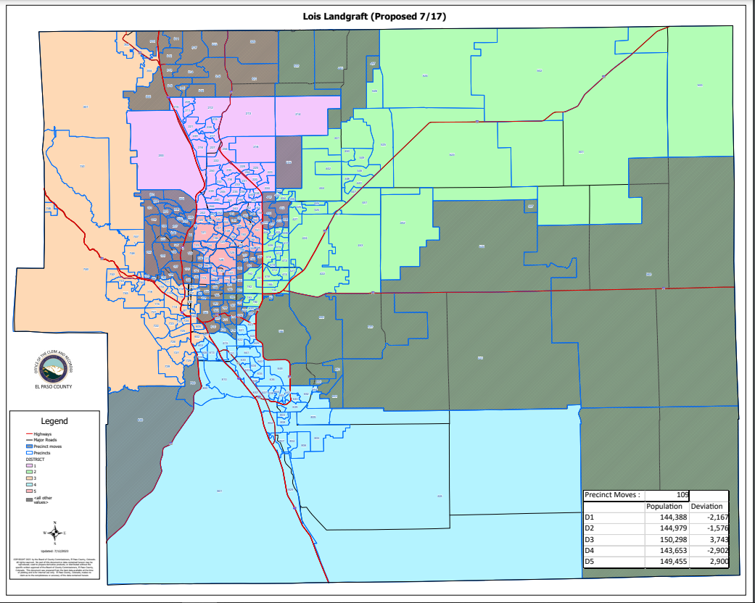
Landgraf V1 Map:

Slide 47
(Landgraf V1)
HOUSE BILL 21-1047:
Landgraf V1 Map:
Overall Range in Deviation: | 4.53%
Total Precincts Moved: | 109 (33.74%)
Total Affected Population: | 170,195
%: | 23.23%
Total Affected Active Voters: | 108,260
%: | 22.39%

Slide 48
(Landgraf V1)
HOUSE BILL 21-1047:
District: | Total Population: | Target Deviation:
1 | 144,388 | -2,167
2 | 144,979 | -1,576
3 | 150,298 | 3,743
4 | 143,653 | -2,902
5 | 149,455 | 2,900

Slide 49
(Landgraf V1)
Precinct Moves:
DISTRICT: | PRECINCTS ADDED: | PRECINCTS DELETED: | IMPACT:
1 | 219-445-401-402-403-407-408-423-201-202-203-204-205-206-207-208-226-248 | 310-303-311-312-313-314-315-316-317-318-319-320-321-323-322-440-457-253-135-141-145-146-163 | -5
2 | 322-440-457-253-184-901-090-196-520-521-522-527-554-560-651-653-650-655-627 | 219-445-401-402-403-407-408-423-157-158-159-160-161-167-168-170-171-172-190 | 0
3 | 310-303-311-312-313-314-315-316-317-318-319-320-321-092-093-137-178-179-180-181-182-183-185-186-187-188-199-609-610-611-614-619-626 | 201-202-203-204-205-206-207-208-226-248-730-839-003-088-089-096-101-102-103-104-105-106-107-108-109-116-117-122-126-133 | +3
4 | 627-730-839-612-616 | 090-196-520-521-522-527-554-560-651-653-650-655 | -7
5 | 003-088-089-096-101-102-103-104-105-106-107-108-109-116-117-122-126-133-157-158-159-160-161-167-168-170-171-172-190-135-141-145-146-163 | 184-901-092-093-137-178-179-180-181-182-183-185-186-187-188-199-609-610-611-614-619-626-612-616 | +10

Slide 50
1st Criteria – Population Equality & VRA
(Landgraf V1) Total Population Racial Ethnicity:
Districts | Total / %: | Hispanic or Latino: | Black: | White: | Asian:
1 | TOTAL: | 16,582 | 4,776 | 105,695 | 6,907
 | %: | 11.48% | 3.31% | 73.2% | 4.78%
2 | TOTAL: | 27,625 | 7,976 | 92,839 | 4,064
 | %: | 19.05% | 5.5% | 64.04% | 2.8%
3 | TOTAL: | 25,335 | 8,007 | 102,915 | 3,350
 | %: | 16.86% | 5.33% | 68.47% | 0.59%
4 | TOTAL: | 37,455 | 14,384 | 74,350 | 4,174
 | %: | 26.07% | 10.01% | 51.76% | 2.91%
5 | TOTAL: | 23,496 | 6,176 | 105,882 | 3,174
 | %: | 15.72% | 4.13% | 70.85% | 2.12%

Slide 51
1st Criteria – Population Equality & VRA
(Landgraf V1) Total Population Racial Ethnicity:
Districts | Total % / Variance: | Hispanic or Latino: | Black: | White: | Asian:
1 | TOTAL: | +0.9 | +0.38 | -2.08 | +0.51
2 | TOTAL: | +0.71 | +0.16 | -0.69 | -0.35
3 | TOTAL: | +4.2 | +2.48 | -7.06 | -0.07
4 | TOTAL: | +1.06 | +0.39 | -1.47 | +0.15
5 | TOTAL: | -6.47 | -3.17 | +10.3 | -0.09

Slide 52
1st Criteria – Population Equality & VRA
(Landgraf V1) Voting Age Population Racial Ethnicity:
Districts | Total / %: | Hispanic or Latino: | Black: | White: | Asian:
1 | TOTAL: | 10,961 | 3,765 | 82,440 | 5,400
 | %: | 7.59% | 2.61% | 57.1% | 3.74%
2 | TOTAL: | 17,278 | 5,902 | 71,165 | 3,296
 | %: | 11.92% | 4.07% | 49.09% | 2.27%
3 | TOTAL: | 17,684 | 6,362 | 86,624 | 2,887
 | %: | 11.77% | 4.23% | 57.63% | 1.92%
4 | TOTAL: | 24,295 | 10,985 | 58,435 | 3,512
 | %: | 16.91% | 7.65% | 40.68% | 2.44%
5 | TOTAL: | 16,146 | 4,900 | 89,577 | 2,728
 | %: | 10.8% | 3.28% | 59.94% | 1.83%

Slide 53
1st Criteria – Population Equality & VRA
(Landgraf V1) Voting Age Population Racial Ethnicity:
Districts | Total % / Variance: | Hispanic or Latino: | Black: | White: | Asian:
1 | TOTAL: | +0.65 | +0.32 | -1.44 | +0.43
2 | TOTAL: | +0.3 | +0.02 | -1.13 | -0.31
3 | TOTAL: | +2.67 | -1.91 | -6.88 | -0.06
4 | TOTAL: | +0.87 | +0.38 | -0.6 | +0.13
5 | TOTAL: | -4.35 | -2.46 | +8.61 | -0.1

Slide 54
2nd Criteria - Communities of Interest & Compactness
(Landgraf V1)
COMMUNITIES OF INTEREST & COMPACTNESS (Towns & Cities):
City / Town: | Commissioner District:
Calhan | 2
Cascade | 3
Colorado Springs | 1 – 5
Elbert | 2
Fountain | 4
Green Mtn. Falls | 3
Manitou Springs | 3
Monument | 2-3
Palmer Lake | 3
Peyton | 1
Ramah | 1
Rush | 1
Yoder | 1
COMMUNITIES OF INTEREST & COMPACTNESS (Military):
Military Installations: | Commissioner District:
USAFA | 1
Fort Carson | 4
Peterson AFB | 2
Schriever SFB | 2
NORAD | 4

Slide 55
2nd Criteria - Communities of Interest & Compactness
(Landgraf V1)
COMMUNITIES OF INTEREST & COMPACTNESS (School Districts):
School District: | Commissioner District:
Academy School District 20 | 1-3
Big Sandy SD 110J | 1
Calhan SD RJ1 | 1
Cheyenne Mtn. SD 12 | 3, 4
Edison SD 54 | 4
Ellicott SD 22 | 1, 2
Falcon SD 49 | 1, 2
Fountain/Ft. Carson SD 8 | 2, 3, 4
Hanover SD 28 | 4
Harrison SD 2 | 2, 3
Lewis-Palmer SD 38 | 1, 3
Manitou Springs SD 14 | 3
COMMUNITIES OF INTEREST & COMPACTNESS (School Districts):
School District: | Commissioner District:
Miami-Yoder SD 60 | 1
Peyton SD 23 | 1
RE-2 Fremont-Florence SD 39 | 4
Widefield SD 3 | 2, 4

Slide 56
2nd Criteria - Communities of Interest & Compactness
(Landgraf V1)
COMMUNITIES OF INTEREST & COMPACTNESS (Southeast Colorado Springs):
Southeast Colorado Springs (Precincts): | Commissioner District:
137 | 3
169 | 3
180 | 3
182 | 3
184 | 3
185 | 3
187 | 3
190 | 5
193 | 2
194 | 2
199 | 3
601 | 3
605 | 3
COMMUNITIES OF INTEREST & COMPACTNESS (Southeast Colorado Springs):
Southeast Colorado Springs (Precincts): | Commissioner District:
609 | 3
610 | 3
611 | 3
612 | 4
614 | 3
615 | 4
616 | 4
619 | 3
620 | 2
621 | 4
622 | 4
623 | 3
624 | 4
COMMUNITIES OF INTEREST & COMPACTNESS (Southeast Colorado Springs):
Southeast Colorado Springs (Precincts): | Commissioner District:
625 | 4
626 | 3
627 | 3
901 | 3
All 30 Precincts defined as Southeast Colorado Springs are in Commissioner Districts 2, 3, 4, and 5.
The Districts are compact.

Slide 57
3rd Criteria - Political Competitiveness
(Landgraf V1):
District: | DEM: | DEM %: | REP: | REP %: | Total: | Deviation: | Deviation from Current:
US PRESIDENT:
1 | 32,289 | 38.25% | 49,289 | 58.40% | 84,405 | 20.14% | +4.61%
2 | 24,902 | 34.54% | 44,433 | 61.63% | 72,095 | 27.09% | +4.01%
3 | 41,547 | 48.74% | 40,856 | 47.93% | 85,249 | 0.81% | +3.75%
4 | 24,029 | 45.72% | 26,040 | 49.54% | 52,559 | 3.83% | +5.65%
5 | 39,174 | 46.34% | 42,210 | 49.93% | 84,543 | 3.59% | +5.70%

Slide 58
3rd Criteria - Political Competitiveness
(Landgraf V1):

Slide 59
3rd Criteria - Political Competitiveness
(Landgraf V1):
District: | DEM: | DEM %: | REP: | REP %: | Total: | Deviation: | Deviation from Current:
US SENATE:
1 | 26,014 | 38.05% | 40,171 | 58.76% | 68,360 | 20.71% | +4.89%
2 | 19,544 | 35.75% | 32,901 | 60.18% | 54,672 | 24.43% | +3.85%
3 | 31,509 | 49.22% | 30,460 | 47.58% | 64,019 | 1.64% | +4.56%
4 | 16,176 | 48.29% | 15,854 | 47.32% | 33,501 | 0.96% | +5.37%
5 | 30,781 | 48.27% | 30,609 | 48.00% | 63,767 | 0.27% | +5.97%

Slide 60
3rd Criteria - Political Competitiveness
(Landgraf V1):

Slide 61
3rd Criteria - Political Competitiveness
(Landgraf V1):
District: | DEM: | DEM %: | REP: | REP %: | Total: | Deviation: | Deviation from Current:
GOVERNOR:
1 | 28,796 | 42.02% | 38,298 | 55.89% | 68,527 | 13.87% | +5.20%
2 | 21,199 | 38.68% | 31,901 | 58.21% | 54,800 | 19.53% | +3.99%
3 | 33,619 | 52.37% | 29,162 | 45.43% | 64,196 | 6.94% | +4.76%
4 | 17,197 | 51.22% | 15,222 | 45.34% | 33,573 | 5.88% | +5.34%
5 | 32,636 | 51.05% | 29,801 | 46.61% | 63,931 | 4.43% | +5.51%

Slide 62
3rd Criteria - Political Competitiveness
(Landgraf V1):

Slide 63
3rd Criteria - Political Competitiveness
(Landgraf V1):
District: | DEM: | DEM %: | REP: | REP %: | Total: | Deviation: | Deviation from Current:
SECRETARY OF STATE:
1 | 25,904 | 38.13% | 40,202 | 59.18% | 67,933 | 51.05% | +4.79%
2 | 19,418 | 35.71% | 32,967 | 60.63% | 54,370 | 24.92% | +3.69%
3 | 30,830 | 48.53% | 30,803 | 48.48% | 63,531 | 0.04% | +4.67%
4 | 15,800 | 47.41% | 16,148 | 48.45% | 33,327 | 1.04% | +5.14%
5 | 30,039 | 47.47% | 31,225 | 49.35% | 63,274 | 1.87% | +5.24%

Slide 64
3rd Criteria - Political Competitiveness
(Landgraf V1):

Slide 65
3rd Criteria - Political Competitiveness
(Landgraf V1):
District: | DEM: | DEM %: | REP: | REP %: | Total: | Deviation: | Deviation from Current:
EL PASO COUNTY CLERK & RECORDER:
1 | 22,331 | 34.04% | 43,263 | 65.96% | 65,594 | 31.91% | +4.63%
2 | 17,439 | 32.86% | 35,637 | 67.14% | 53,076 | 34.29% | +3.54%
3 | 27,893 | 45.43% | 33,506 | 54.57% | 61,399 | 9.14% | +2.70%
4 | 14,683 | 45.04% | 17,917 | 54.96% | 32,600 | 9.92% | +5.27%
5 | 26,640 | 43.47% | 34,640 | 56.53% | 61,280 | 13.05% | +7.51%

Slide 66
3rd Criteria - Political Competitiveness
(Landgraf V1):

Slide 67
3rd Criteria - Political Competitiveness
(Landgraf V1):
District: | DEM: | DEM %: | REP: | REP %: | Total: | Deviation: | Deviation from Current:
EL PASO COUNTY SHERIFF:
1 | 23,028 | 34.90% | 42,960 | 65.10% | 65,988 | 30.21% | +4.83%
2 | 17,333 | 32.55% | 35,924 | 67.45% | 53,257 | 34.91% | +3.63%
3 | 28,120 | 45.54% | 33,632 | 54.46% | 61,752 | 8.93% | +4.20%
4 | 14,343 | 44.07% | 18,204 | 55.93% | 32,547 | 11.86% | +5.20%
5 | 26,976 | 43.95% | 34,396 | 56.05% | 61,372 | 12.09% | +5.90%

Slide 68
3rd Criteria - Political Competitiveness
(Landgraf V1):

Slide 69
CITIZEN SUBMITTED MAP
(Perez):

Slide 70
(Perez Map) :
Perez Map:
SE (30 Suggested Precincts) consolidated into one district? | YES
Powers as Eastern boundary for Commissioner District 5 | NO
Fountain / Fort Carson / Security / Widefield / Hanover together? | YES
Perez Map: Submitted through public 7/12.

Slide 71
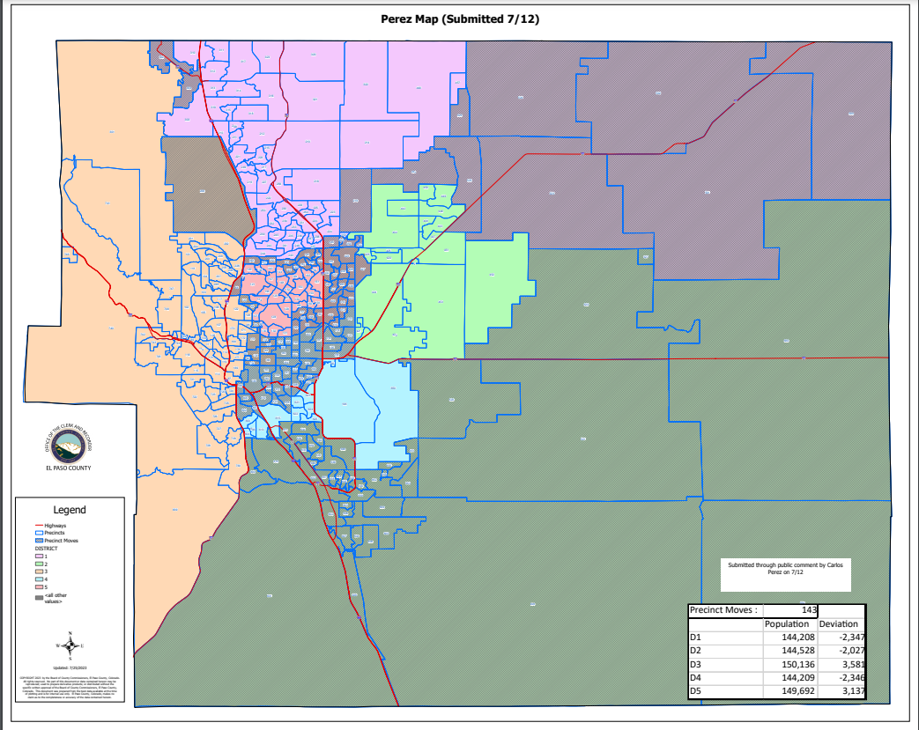
Perez Map:

Slide 72
(Perez)
HOUSE BILL 21-1047:
Perez Map:
Overall Range in Deviation: | 4.04%
Total Precincts Moved: | 143 (44.27%)
Total Affected Population: | 382,638
%: | 52.22%
Total Affected Active Voters: | 222,895
%: | 46.09%

Slide 73
(Perez)
HOUSE BILL 21-1047:
District: | Total Population: | Target Deviation:
1 | 144,208 | -2,347
2 | 144,528 | -2,027
3 | 150,136 | 3,581
4 | 144,209 | -2,346
5 | 149,692 | 3,137

Slide 74
(Perez)
Precinct Moves:
DISTRICT: | PRECINCTS ADDED: | PRECINCTS DELETED: | IMPACT:
1 | 088-219-302-304-441-445-454-455-456-500-501-502-523-524-525-526 | 134-135-141-142-143-145-146-163-186-200-242-251-252 | +3
2 | 527-554-560-630-631-632-633-634-635-636-637-638-639-640-641-642-643-644-645-646-648-651-652-653-654-655-800-801-802-803-804-805-806-807-808-809-810-828-829-901 | 139-157-157-158-159-160-161-162-167-190-191-192-193-194-195-219-401-402-403-404-405-406-407-408-409-410-411-412-413-414-415-416-417-418-419-423-427-441-445-454-455-456-500-501-502-520-521-522-523-524-525-526-620-627 | -14
3 | 092-093-095-099-123-173-174-178-188-197-200 | 088-169-179-186-302-304-601-602-605 | +2
4 | 137-139-162-169-175-180-181-182-183-184-185-187-190-191-192-193-194-195-198-199-413-414-415-418-520-521-522-601-602-605-609-610-611-612-614-616-619-620-626-627 | 527-554-560-630-631-632-633-634-635-636-637-638-639-640-641-642-643-644-645-646-648-651-652-653-654-655-800-801-802-803-804-805-806-807-808-809-810-828-829-901 | 0
5 | 134-135-141-142-143-145-146-157-158-159-160-161-163-167-179-242-251-252-401-402-403-404-405-406-407-408-409-410-411-412-416-417-419-423-427 | 092-093-095-099-123-137-173-174-175-178-180-181-182-183-184-185-187-188-197-198-199-609-610-611-612-614-616-619-626 | +6

Slide 75
1st Criteria – Population Equality & VRA
(Perez) Total Population Racial Ethnicity:
Districts | Total / %: | Hispanic or Latino: | Black: | White: | Asian:
1 | TOTAL: | 14,189 | 3,445 | 110,638 | 5,740
 | %: | 9.84% | 2.39% | 76.72% | 3.98%
2 | TOTAL: | 28,916 | 11,221 | 87,169 | 3,610
 | %: | 20.01% | 7.76% | 60.31% | 2.5%
3 | TOTAL: | 18,711 | 4,532 | 113,337 | 3,533
 | %: | 12.46% | 3.02% | 75.49% | 2.35%
4 | TOTAL: | 44,435 | 14,856 | 68,810 | 4,064
 | %: | 16.19% | 4.85% | 67.96% | 3.15%
5 | TOTAL: | 24,242 | 7,265 | 101,727 | 4,722
 | %: | 16.19% | 4.85% | 67.96% | 3.15%

Slide 76
1st Criteria – Population Equality & VRA
(Perez) Total Population Racial Ethnicity:
Districts | Total % / Variance: | Hispanic or Latino: | Black: | White: | Asian:
1 | TOTAL: | -0.74 | -0.54 | +1.44 | -0.29
2 | TOTAL: | +1.67 | +2.42 | -4.42 | -0.65
3 | TOTAL: | -0.2 | +0.17 | -0.04 | +0.05
4 | TOTAL: | +5.8 | +0.68 | -5.51 | +0.06
5 | TOTAL: | -6 | -2.45 | +7.41 | +0.94

Slide 77
1st Criteria – Population Equality & VRA
(Perez) Voting Age Population Racial Ethnicity:
Districts | Total / %: | Hispanic or Latino: | Black: | White: | Asian:
1 | TOTAL: | 9,098 | 2,555 | 85,360 | 4,327
 | %: | 6.31% | 1.77% | 59.19% | 3%
2 | TOTAL: | 18,319 | 8,441 | 66,009 | 2,954
 | %: | 12.68% | 5.84% | 45.67% | 2.04%
3 | TOTAL: | 13,656 | 3,766 | 97,451 | 3,063
 | %: | 9.1% | 2.51% | 64.91% | 2.04%
4 | TOTAL: | 29,174 | 11,426 | 56,885 | 3,497
 | %: | 20.23% | 7.92% | 39.45% | 2.42%
5 | TOTAL: | 16,117 | 5,726 | 82,536 | 3,982
 | %: | 10.77% | 3.83% | 55.14% | 2.66%

Slide 78
1st Criteria – Population Equality & VRA
(Perez) Voting Age Population Racial Ethnicity:
Districts | Total % / Variance: | Hispanic or Latino: | Black: | White: | Asian:
1 | TOTAL: | -0.63% | -0.52% | +0.65% | -0.31%
2 | TOTAL: | +1.06% | +1.79% | -4.55% | -0.54%
3 | TOTAL: | 0% | +0.19% | +0.4% | +0.06%
4 | TOTAL: | +4.19% | +0.65% | -1.83% | +0.11%
5 | TOTAL: | -4.83% | -1.91% | +3.81% | +0.73%

Slide 79
2nd Criteria - Communities of Interest & Compactness
(Perez)
COMMUNITIES OF INTEREST & COMPACTNESS (Towns & Cities):
City / Town: | Commissioner District:
Calhan | 1
Cascade | 3
Colorado Springs | 1 – 5
Elbert | 1
Fountain | 2
Green Mtn. Falls | 3
Manitou Springs | 3
Monument | 1
Palmer Lake | 1, 3
Peyton | 1
Ramah | 1
Rush | 2
Yoder | 2
COMMUNITIES OF INTEREST & COMPACTNESS (Military):
Military Installations: | Commissioner District:
USAFA | 3
Fort Carson | 2
Peterson AFB | 4
Schriever SFB | 2
NORAD | 3

Slide 80
2nd Criteria - Communities of Interest & Compactness
(Perez)
COMMUNITIES OF INTEREST & COMPACTNESS (School Districts):
School District: | Commissioner District:
Academy School District 20 | 1, 3, 5
Big Sandy SD 110J | 1
Calhan SD RJ1 | 1
Cheyenne Mtn. SD 12 | 3
Edison SD 54 | 2
Ellicott SD 22 | 1, 2
Falcon SD 49 | 1, 2, 4, 5
Fountain/Ft. Carson SD 8 | 2, 3
Hanover SD 28 | 2
Harrison SD 2 | 1, 2
Lewis-Palmer SD 38 | 1, 3
Manitou Springs SD 14 | 3
COMMUNITIES OF INTEREST & COMPACTNESS (School Districts):
School District: | Commissioner District:
Miami-Yoder SD 60 | 2
Peyton SD 23 | 1
RE-2 Fremont-Florence SD 39 | 2, 3
Widefield SD 3 | 2, 4

Slide 81
2nd Criteria - Communities of Interest & Compactness
(Perez)
COMMUNITIES OF INTEREST & COMPACTNESS (Southeast Colorado Springs):
Southeast Colorado Springs (Precincts): | Commissioner District:
137 | 4
169 | 4
180 | 4
182 | 4
184 | 4
185 | 4
187 | 4
190 | 4
193 | 4
194 | 4
199 | 4
601 | 4
605 | 4
COMMUNITIES OF INTEREST & COMPACTNESS (Southeast Colorado Springs):
Southeast Colorado Springs (Precincts): | Commissioner District:
609 | 4
610 | 4
611 | 4
612 | 4
614 | 4
615 | 4
616 | 4
619 | 4
620 | 4
621 | 4
622 | 4
623 | 4
624 | 4
COMMUNITIES OF INTEREST & COMPACTNESS (Southeast Colorado Springs):
Southeast Colorado Springs (Precincts): | Commissioner District:
625 | 4
626 | 4
627 | 4
901 | 4
All 30 Precincts defined as Southeast Colorado Springs are in Commissioner District 4..
The Districts are compact.

Slide 82
3rd Criteria - Political Competitiveness
(Perez):
District: | DEM: | DEM %: | REP: | REP %: | Total: | Deviation: | Deviation from Current:
US PRESIDENT:
1 | 32,321 | 34.32% | 58,950 | 62.60% | 94,172 | 28.28% | +3.52%
2 | 22,770 | 36.04% | 37,678 | 59.64% | 63,181 | 23.60% | +0.52%
3 | 46,191 | 51.82% | 40,021 | 44.90% | 89,140 | 6.92% | +2.36%
4 | 27,238 | 51.31% | 23,396 | 44.08% | 53,080 | 7.24% | +16.71%
5 | 33,421 | 42.16% | 42,783 | 53.87% | 79,278 | 11.81% | +13.92%

Slide 83
3rd Criteria - Political Competitiveness
(Perez):

Slide 84
3rd Criteria - Political Competitiveness
(Perez):
District: | DEM: | DEM %: | REP: | REP %: | Total: | Deviation: | Deviation from Current:
US SENATE:
1 | 26,108 | 34.06% | 48,111 | 62.77% | 76,643 | 28.71% | +3.11%
2 | 16,343 | 38.01% | 24,842 | 57.78% | 42,992 | 19.77% | +0.81%
3 | 36,126 | 52.85% | 30,197 | 44.17% | 68,360 | 8.67% | +2.47%
4 | 19,147 | 53.71% | 14,846 | 41.65% | 35,647 | 12.07% | +16.48%
5 | 26,300 | 43.34% | 31,999 | 52.74% | 60,677 | 9.39% | +15.64%

Slide 85
3rd Criteria - Political Competitiveness
(Perez):

Slide 86
3rd Criteria - Political Competitiveness
(Perez):
District: | DEM: | DEM %: | REP: | REP %: | Total: | Deviation: | Deviation from Current:
GOVERNOR:
1 | 29,003 | 37.75% | 46,183 | 60.11% | 76,828 | 22.36% | +3.30%
2 | 17,659 | 40.99% | 23,964 | 55.63% | 43,076 | 14.64% | +0.90%
3 | 38,373 | 56.01% | 28,745 | 41.96% | 68,511 | 14.05% | +2.35%
4 | 20,178 | 56.44% | 14,368 | 40.19% | 35,749 | 16.25% | +15.71%
5 | 28,234 | 46.39% | 31,124 | 51.14% | 60,863 | 4.75% | +14.69%

Slide 87
3rd Criteria - Political Competitiveness
(Perez):

Slide 88
3rd Criteria - Political Competitiveness
(Perez):
District: | DEM: | DEM %: | REP: | REP %: | Total: | Deviation: | Deviation from Current:
SECRETARY OF STATE:
1 | 26,103 | 34.26% | 48,020 | 63.03% | 76,180 | 28.77% | +2.93%
2 | 16,116 | 37.68% | 25,020 | 58.50% | 42,768 | 20.82% | +0.41%
3 | 35,335 | 52.09% | 30,611 | 45.13% | 67,829 | 6.96% | +2.25%
4 | 18,656 | 52.62% | 15,248 | 43.01% | 35,451 | 9.61% | +15.79%
5 | 25,781 | 42.82% | 32,446 | 53.89% | 60,207 | 11.07% | +14.44%

Slide 89
3rd Criteria - Political Competitiveness
(Perez):

Slide 90
3rd Criteria - Political Competitiveness
(Perez):
District: | DEM: | DEM %: | REP: | REP %: | Total: | Deviation: | Deviation from Current:
EL PASO COUNTY CLERK & RECORDER:
1 | 22,286 | 30.26% | 51,373 | 69.74% | 73,659 | 39.49% | +2.94%
2 | 14,600 | 34.87% | 27,267 | 65.13% | 41,867 | 30.26% | +0.49%
3 | 31,408 | 47.88% | 34,186 | 52.12% | 65,594 | 4.24% | +2.20%
4 | 17,746 | 51.56% | 16,672 | 48.44% | 34,418 | 3.12% | +18.31%
5 | 22,946 | 39.28% | 35,465 | 60.72% | 58,411 | 21.43% | +15.88%

Slide 91
3rd Criteria - Political Competitiveness
(Perez):

Slide 92
3rd Criteria - Political Competitiveness
(Perez):
District: | DEM: | DEM %: | REP: | REP %: | Total: | Deviation: | Deviation from Current:
EL PASO COUNTY SHERIFF:
1 | 22,955 | 30.99% | 51,112 | 69.01% | 74,067 | 38.02% | +2.98%
2 | 14,369 | 34.26% | 27,566 | 65.74% | 41,935 | 31.47% | +0.20%
3 | 32,180 | 48.95% | 33,567 | 51.05% | 65,747 | 2.11% | +2.61%
4 | 17,271 | 49.94% | 17,312 | 50.06% | 34,583 | 0.12% | +16.95%
5 | 23,025 | 39.30% | 35,559 | 60.70% | 58,584 | 21.39% | +15.20%

Slide 93
3rd Criteria - Political Competitiveness
(Perez):

Slide 94
CITIZEN SUBMITTED MAP
(Landgraf V2):

Slide 95
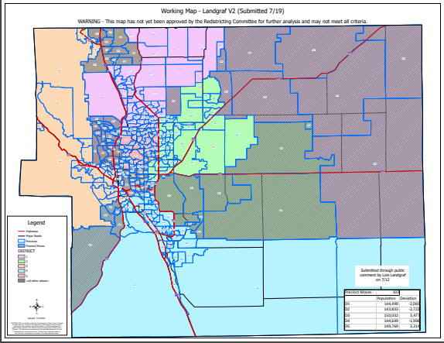
Landgraf V2 Map:

Slide 96
(Landgraf V2) :
Landgraf V2 Map:
SE (30 Suggested Precincts) consolidated into one district? | NO
Powers as Eastern boundary for Commissioner District 5 | YES
Fountain / Fort Carson / Security / Widefield / Hanover together? | YES
Landgraf V2 Map: Submitted through public comment 7/18.

Slide 97
2nd Criteria - Communities of Interest & Compactness
(Landgraf V2)
COMMUNITIES OF INTEREST & COMPACTNESS (Southeast Colorado Springs):
Southeast Colorado Springs (Precincts): | Commissioner District:
137 | 3
169 | 3
180 | 3
182 | 3
184 | 3
185 | 3
187 | 3
190 | 5
193 | 2
194 | 2
199 | 3
601 | 3
605 | 3
COMMUNITIES OF INTEREST & COMPACTNESS (Southeast Colorado Springs):
Southeast Colorado Springs (Precincts): | Commissioner District:
609 | 3
610 | 3
611 | 3
612 | 4
614 | 3
615 | 4
616 | 4
619 | 3
620 | 2
621 | 4
622 | 4
623 | 3
624 | 4
COMMUNITIES OF INTEREST & COMPACTNESS (Southeast Colorado Springs):
Southeast Colorado Springs (Precincts): | Commissioner District:
625 | 4
626 | 3
627 | 3
901 | 3
All 30 Precincts defined as Southeast Colorado Springs are in Commissioner Districts 2, 3, 4, and 5..
The Districts are compact.

Slide 98
MAP 9
(Modified Bremer/Geitner Map 8):

Slide 99
(Map 9) :
Map 9:
SE (30 Suggested Precincts) consolidated into one district? | NO
Powers as Eastern boundary for Commissioner District 5 | YES
Fountain / Fort Carson / Security / Widefield / Hanover together? | NO
MAP 9: Modified Map 8 with specific direction to move Ft. Carson with Fountain, Precincts 112 & 119 back to Commissioner District 3; Precinct 134 back to Commissioner District 5 (all other moves have been made to make the population meet criteria).

Slide 100
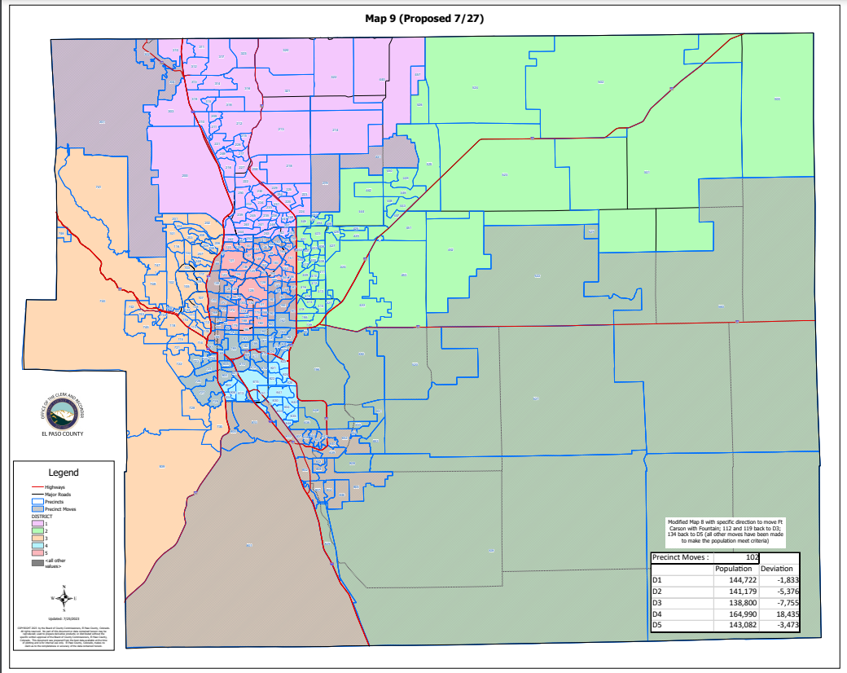
Map 9:

Slide 101
(Map 9)
HOUSE BILL 21-1047:
Map 9:
Overall Range in Deviation: | 4.51%
Total Precincts Moved: | 102 (31.57%)
Total Affected Population: | 243,791
%: | 33.27%
Total Affected Active Voters: | 141,909
%: | 29.35%

Slide 102
(Map 9)
HOUSE BILL 21-1047:
District: | Total Population: | Target Deviation:
1 | 145,942 | -613
2 | 143,155 | -3,400
3 | 149,203 | 2,648
4 | 144,715 | -1,840
5 | 149,758 | 3,203

Slide 103
(Map 9)
Precinct Moves:
DISTRICT: | PRECINCTS ADDED: | PRECINCTS DELETED: | IMPACT:
1 | 219-301-302-304-441 | 134-135-141-145-146-163 | -1
2 | 090-196-520-521-522-527-554-560-636-648-650-651-653-655-809-828-829 | 157-158-159-160-161-162-167-190-191-192-193-194-219-441-620-627 | +1
3 | 632-637-638-639-640-643-644-645-652-654-800-801-802-803-824-805-806-807-808-810 | 087-088-096-122-126-168-169-170-171-172-176-177-189-301-302-304-601-602-605-720-723-724-725-726-727-729 | -6
4 | 087-137-169-192-193-194-601-602-605-609-610-611-612-614-616-619-620-627-720-723-724-725-726-727-729-901 | 090-178-182-183-184-185-187-196-520-521-522-527-554-560-632-636-637-638-639-640-643-644-645-648-650-651-652-653-654-655-800-801-802-803-804-805-806-807-808-809-810-828-829 | -17
5 | 088-096-122-126-134-135-141-145-146-157-158-159-160-161-162-163-167-168-170-171-172-176-177-178-182-183-184-185-187-189-190-191 | 137-609-610-611-612-614-616-619-901 | +23

Slide 104
1st Criteria – Population Equality & VRA
(Map 9) Total Population Racial Ethnicity:
Districts | Total / %: | Hispanic or Latino: | Black: | White: | Asian:
1 | TOTAL: | 14,778 | 3,792 | 111,205 | 6,114
 | %: | 10.13% | 2.6% | 76.2% | 4.19%
2 | TOTAL: | 24,848 | 7,859 | 93,113 | 4,667
 | %: | 17.36% | 5.49% | 65.04% | 3.26%
3 | TOTAL: | 23,928 | 8,331 | 101,396 | 3,611
 | %: | 16.04% | 5.58% | 67.96% | 2.42%
4 | TOTAL: | 41,757 | 14,263 | 72,917 | 4,119
 | %: | 28.85% | 9.86% | 50.39% | 2.85%
5 | TOTAL: | 25,182 | 7,074 | 103,050 | 3,158
 | %: | 16.82% | 4.72% | 68.81% | 2.11%

Slide 105
1st Criteria – Population Equality & VRA
(Map 9) Total Population Racial Ethnicity:
Districts | Total % / Variance: | Hispanic or Latino: | Black: | White: | Asian:
1 | TOTAL: | -0.45 | -0.33 | 0.92 | -0.08
2 | TOTAL: | -0.98 | 0.15 | 0.31 | 0.11
3 | TOTAL: | 3.38 | 2.73 | -7.57 | 0.12
4 | TOTAL: | 3.84 | 0.24 | -2.84 | 0.09
5 | TOTAL: | -5.37 | -2.58 | 8.26 | -0.1

Slide 106
1st Criteria – Population Equality & VRA
(Map 9) Voting Age Population Racial Ethnicity:
Districts | Total / %: | Hispanic or Latino: | Black: | White: | Asian:
1 | TOTAL: | 9,716 | 2,936 | 86,462 | 4,716
 | %: | 6.66% | 2.01% | 59.24% | 3.22%
2 | TOTAL: | 15,362 | 5,781 | 70,386 | 3,779
 | %: | 10.73% | 4.04% | 49.17% | 2.64%
3 | TOTAL: | 16,135 | 6,461 | 82,733 | 2,997
 | %: | 10.81% | 4.33% | 55.45% | 2.01%
4 | TOTAL: | 27,728 | 11,051 | 60,950 | 3,547
 | %: | 19.16% | 7.64% | 42.12% | 2.45%
5 | TOTAL: | 17,423 | 5,685 | 87,710 | 2,794
 | %: | 11.63% | 3.8% | 58.57% | 1.87%

Slide 107
1st Criteria – Population Equality & VRA
(Map 9) Voting Age Population Racial Ethnicity:
Districts | Total % / Variance: | Hispanic or Latino: | Black: | White: | Asian:
1 | TOTAL: | -0.28% | -0.28% | 0.7% | -0.09%
2 | TOTAL: | -0.89% | -0.01% | -1.05% | 0.06%
3 | TOTAL: | 1.71% | 2.01% | -9.06% | 0.03%
4 | TOTAL: | 3.12% | 0.37% | 0.84% | 0.14%
5 | TOTAL: | -3.52% | -1.94% | 7.24% | -0.06%

Slide 108
2nd Criteria - Communities of Interest & Compactness
(Map 9)
COMMUNITIES OF INTEREST & COMPACTNESS (Towns & Cities):
City / Town: | Commissioner District:
Calhan | 2
Cascade | 3
Colorado Springs | 1 – 5
Elbert | 2
Fountain | 2, 3
Green Mtn. Falls | 3
Manitou Springs | 3
Monument | 1
Palmer Lake | 1
Peyton | 2
Ramah | 2
Rush | 2
Yoder | 2
COMMUNITIES OF INTEREST & COMPACTNESS (Military):
Military Installations: | Commissioner District:
USAFA | 1
Fort Carson | 3
Peterson AFB | 2
Schriever SFB | 2
NORAD | 3

Slide 109
2nd Criteria - Communities of Interest & Compactness
(Map 9)
COMMUNITIES OF INTEREST & COMPACTNESS (School Districts):
School District: | Commissioner District:
Academy School District 20 | 1, 3
Big Sandy SD 110J | 2
Calhan SD RJ1 | 2
Cheyenne Mtn. SD 12 | 3, 4
Edison SD 54 | 2
Ellicott SD 22 | 2
Falcon SD 49 | 1, 2
Fountain/Ft. Carson SD 8 | 2, 3, 4
Hanover SD 28 | 2, 3
Harrison SD 2 | 4, 5
Lewis-Palmer SD 38 | 1, 3
Manitou Springs SD 14 | 3
COMMUNITIES OF INTEREST & COMPACTNESS (School Districts):
School District: | Commissioner District:
Miami-Yoder SD 60 | 2
Peyton SD 23 | 2
RE-2 Fremont-Florence SD 39 | 3
Widefield SD 3 | 2, 3, 4
Colorado Springs SD11 | 2, 3, 4, 5

Slide 110
2nd Criteria - Communities of Interest & Compactness
(Map 9)
COMMUNITIES OF INTEREST & COMPACTNESS (Southeast Colorado Springs):
Southeast Colorado Springs (Precincts): | Commissioner District:
137 | 4
169 | 4
180 | 5
182 | 4
184 | 4
185 | 4
187 | 4
190 | 4
193 | 4
194 | 4
199 | 4
601 | 4
605 | 4
COMMUNITIES OF INTEREST & COMPACTNESS (Southeast Colorado Springs):
Southeast Colorado Springs (Precincts): | Commissioner District:
609 | 4
610 | 4
611 | 4
612 | 4
614 | 4
615 | 4
616 | 4
619 | 4
620 | 4
621 | 4
622 | 4
623 | 4
624 | 4
COMMUNITIES OF INTEREST & COMPACTNESS (Southeast Colorado Springs):
Southeast Colorado Springs (Precincts): | Commissioner District:
625 | 4
626 | 4
627 | 4
901 | 4
All 30 Precincts defined as Southeast Colorado Springs are in Commissioner Districts 4, and 5..
The Districts are compact.

Slide 111
3rd Criteria - Political Competitiveness
(Map 9):
District: | DEM: | DEM %: | REP: | REP %: | Total: | Deviation: | Deviation from Current:
US PRESIDENT:
1 | 32,358 | 35.35% | 56,352 | 61.57% | 91,531 | 26.21% | +1.46%
2 | 25,371 | 34.85% | 44,593 | 61.26% | 72,792 | 36.42% | +3.33%
3 | 34,852 | 47.44% | 35,892 | 48.85% | 73,470 | 1.42% | +5.98%
4 | 30,555 | 51.46% | 26,242 | 44.20% | 59,372 | 7.26% | +16.74%
5 | 38,805 | 47.51% | 39,749 | 48.66% | 81,686 | 1.16% | +3.27%

Slide 112
3rd Criteria - Political Competitiveness
(Map 9):

Slide 113
3rd Criteria - Political Competitiveness
(Map 9):
District: | DEM: | DEM %: | REP: | REP %: | Total: | Deviation: | Deviation from Current:
US SENATE:
1 | 26,068 | 34.95% | 46,209 | 61.94% | 74,597 | 27.00% | 1.40%
2 | 19,875 | 36.30% | 32,621 | 59.58% | 54,753 | 23.28% | 2.70%
3 | 27,357 | 49.12% | 26,518 | 47.62% | 55,689 | 1.51% | 4.69%
4 | 21,010 | 53.13% | 16,957 | 42.88% | 39,547 | 10.25% | 14.66%
5 | 29,714 | 49.74% | 27,690 | 46.36% | 59,733 | 3.39% | 2.86%

Slide 114
3rd Criteria - Political Competitiveness
(Map 9):

Slide 115
3rd Criteria - Political Competitiveness
(Map 9):
District: | DEM: | DEM %: | REP: | REP %: | Total: | Deviation: | Deviation from Current:
GOVERNOR:
1 | 29,036 | 38.82% | 44,286 | 59.21% | 74,798 | 20.39% | +1.32%
2 | 21,613 | 39.38% | 31,532 | 57.46% | 54,880 | 18.07% | +2.53%
3 | 29,189 | 52.28% | 25,275 | 45.27% | 55,830 | 7.01% | +4.69%
4 | 22,219 | 56.05% | 16,260 | 41.02% | 39,638 | 15.03% | +14.49%
5 | 31,390 | 52.42% | 27,031 | 45.14% | 59,881 | 7.28% | +2.67%

Slide 116
3rd Criteria - Political Competitiveness
(Map 9):

Slide 117
3rd Criteria - Political Competitiveness
(Map 9):
District: | DEM: | DEM %: | REP: | REP %: | Total: | Deviation: | Deviation from Current:
SECRETARY OF STATE:
1 | 26,059 | 35.15% | 46,164 | 62.26% | 74,147 | 27.12% | +1.28%
2 | 19,727 | 36.24% | 32,713 | 60.10% | 54,430 | 23.86% | +2.63%
3 | 26,839 | 48.52% | 26,786 | 48.42% | 55,318 | 0.10% | +4.62%
4 | 20,451 | 52.07% | 17,293 | 44.03% | 39,276 | 8.04% | +14.22%
5 | 28,915 | 48.79% | 28,389 | 47.90% | 59,264 | 0.89% | +2.48%

Slide 118
3rd Criteria - Political Competitiveness
(Map 9):

Slide 119
3rd Criteria - Political Competitiveness
(Map 9):
District: | DEM: | DEM %: | REP: | REP %: | Total: | Deviation: | Deviation from Current:
EL PASO COUNTY CLERK & RECORDER:
1 | 22,243 | 31.08% | 49,333 | 68.92% | 41,576 | 37.85% | +1.30%
2 | 17,729 | 33.36% | 35,413 | 66.64% | 53,142 | 33.28% | +2.53%
3 | 23,855 | 44.41% | 29,856 | 55.59% | 53,711 | 11.17% | +4.73%
4 | 19,134 | 50.11% | 19,052 | 49.89% | 38,186 | 0.21% | +15.40%
5 | 26,025 | 45.39% | 31,309 | 54.61% | 57,334 | 9.22% | +3.67%

Slide 120
3rd Criteria - Political Competitiveness
(Map 9):

Slide 121
3rd Criteria - Political Competitiveness
(Map 9):
District: | DEM: | DEM %: | REP: | REP %: | Total: | Deviation: | Deviation from Current:
EL PASO COUNTY SHERIFF:
1 | 22,951 | 31.86% | 49,083 | 68.14% | 72,034 | 36.28% | +1.24%
2 | 17,630 | 33.05% | 35,715 | 66.95% | 53,345 | 33.90% | +2.63%
3 | 24,319 | 45.25% | 29,425 | 54.75% | 53,744 | 9.50% | +4.78%
4 | 18,743 | 48.94% | 19,552 | 51.06% | 38,295 | 2.11% | +14.95%
5 | 26,157 | 45.49% | 31,341 | 54.51% | 57,498 | 9.02% | +2.82%

Slide 122
3rd Criteria - Political Competitiveness
(Map 9):

Slide 123
MAP 10
(Modified Map E):

Slide 124
(Map 10) :
Map 10:
SE (30 Suggested Precincts) consolidated into one district? | NO
Powers as Eastern boundary for Commissioner District 5 | NO
Fountain / Fort Carson / Security / Widefield / Hanover together? | YES
MAP 10: Modified Map E with direction to have USAFA in Commissioner District 1 and unite the Southeast 30 Precincts proposed by Senator Exum (all other moves have been made to make the population meet criteria).

Slide 125
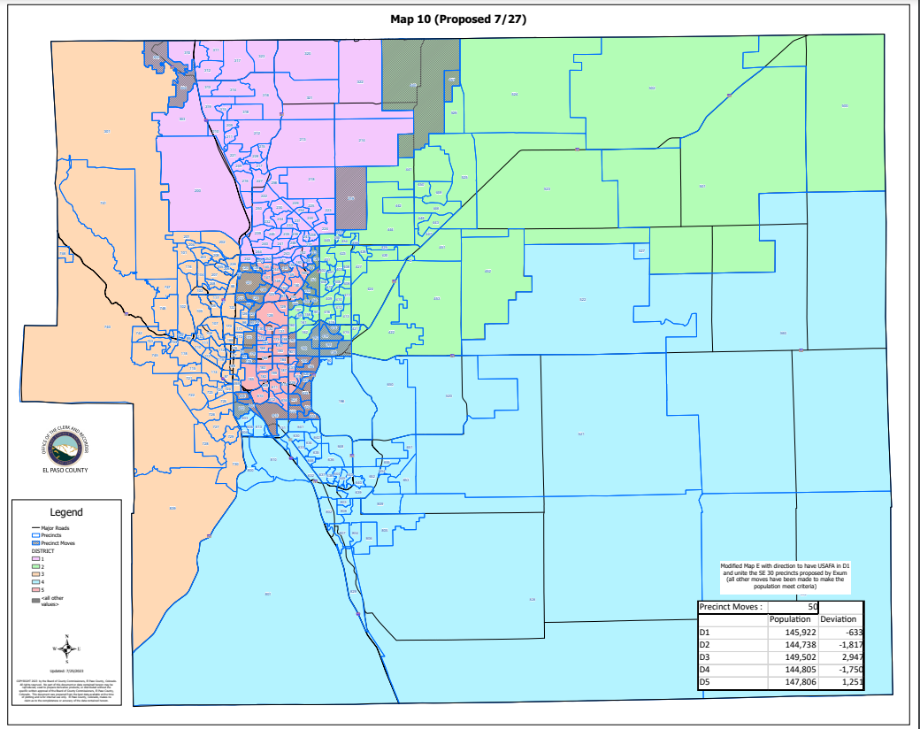
Map 10:

Slide 126
(Map 10)
HOUSE BILL 21-1047:
Map 10:
Overall Range in Deviation: | 3.25%
Total Precincts Moved: | 50 (15.47%)
Total Affected Population: | 116,661
%: | 15.92%
Total Affected Active Voters: | 71,793
%: | 14.85%

Slide 127
(Map 10)
HOUSE BILL 21-1047:
District: | Total Population: | Target Deviation:
1 | 145,922 | -633
2 | 144,738 | -1,817
3 | 149,502 | 2,947
4 | 144,805 | -1,750
5 | 147,806 | 1,251

Slide 128
(Map 10)
Precinct Moves:
DISTRICT: | PRECINCTS ADDED: | PRECINCTS DELETED: | IMPACT:
1 | 219-302-304 | 134-143-145-253-440-457 | -3
2 | 139-151-190-191-192-193-195-195-219-414-418-620-627 | 134-143-153-155-156-164-166-253-440-457 | +3
3 | 092-093-095-097-099-120-121-123-124-127-136-138-173-178-179 | 302-304-601-602-605 | +10
4 | 139-191-192-195-414-418-602 | 615-621-622-923-624-625 | +1
5 | 145-190-193-194-601-605-615-620-621-622-623-624-625-627 | 092-093-095-097-099-120-121-123-124-127-136-138-151-153-155-156-164-166-173-178-179 | -7

Slide 129
1st Criteria – Population Equality & VRA
(Map 10) Total Population Racial Ethnicity:
Districts | Total / %: | Hispanic or Latino: | Black: | White: | Asian:
1 | TOTAL: | 15,156 | 4,079 | 110,409 | 6,186
 | %: | 10.39% | 2.8% | 75.66% | 4.24%
2 | TOTAL: | 22,674 | 6,930 | 98,338 | 4,657
 | %: | 15.67% | 4.79% | 67.94% | 3.22%
3 | TOTAL: | 18,534 | 4,108 | 113,612 | 3,459
 | %: | 12.4% | 2.75% | 75.99% | 2.31%
4 | TOTAL: | 32,055 | 12,548 | 82,556 | 3,890
 | %: | 22.14% | 8.67% | 57.01% | 2.69%
5 | TOTAL: | 42,074 | 13,654 | 76,766 | 3,477
 | %: | 28.47% | 9.24% | 51.94% | 2.35%

Slide 130
1st Criteria – Population Equality & VRA
(Map 10) Total Population Racial Ethnicity:
Districts | Total % / Variance: | Hispanic or Latino: | Black: | White: | Asian:
1 | TOTAL: | -0.19 | -0.13 | 0.38 | -0.03
2 | TOTAL: | -2.67 | -0.55 | 3.21 | 0.07
3 | TOTAL: | -0.26 | -0.1 | 0.46 | 0.01
4 | TOTAL: | -2.87 | -0.95 | 3.78 | -0.07
5 | TOTAL: | 6.28 | 1.94 | -8.61 | 0.14

Slide 131
1st Criteria – Population Equality & VRA
(Map 10) Voting Age Population Racial Ethnicity:
Districts | Total / %: | Hispanic or Latino: | Black: | White: | Asian:
1 | TOTAL: | 9,967 | 3,166 | 85,916 | 4,779
 | %: | 6.83% | 2.17% | 58.88% | 3.28%
2 | TOTAL: | 14,317 | 5,277 | 76,046 | 3,775
 | %: | 9.89% | 3.65% | 52.54% | 2.61%
3 | TOTAL: | 13,412 | 3,411 | 97,609 | 2,978
 | %: | 8.97% | 2.28% | 65.29% | 1.99%
4 | TOTAL: | 20,788 | 9,510 | 64,381 | 3,264
 | %: | 14.36% | 6.57% | 44.46% | 2.25%
5 | TOTAL: | 27,880 | 10,550 | 64,289 | 3,027
 | %: | 18.86% | 7.14% | 43.5% | 2.05%

Slide 132
1st Criteria – Population Equality & VRA
(Map 10) Voting Age Population Racial Ethnicity:
Districts | Total % / Variance: | Hispanic or Latino: | Black: | White: | Asian:
1 | TOTAL: | -0.11% | -0.12% | 0.34% | -0.03%
2 | TOTAL: | -1.73% | -0.4% | 2.32% | 0.03%
3 | TOTAL: | -0.13% | -0.04% | 0.78% | 0.01%
4 | TOTAL: | -1.68% | -0.7% | 3.18% | -0.06%
5 | TOTAL: | 3.71% | 1.4% | -7.83% | 0.12%

Slide 133
2nd Criteria - Communities of Interest & Compactness
(Map 10)
COMMUNITIES OF INTEREST & COMPACTNESS (Towns & Cities):
City / Town: | Commissioner District:
Calhan | 2
Cascade | 3
Colorado Springs | 1, 2, 3, 4, 5
Elbert | 2
Fountain | 4
Green Mtn. Falls | 3
Manitou Springs | 3
Monument | 1
Palmer Lake | 1, 3
Peyton | 2
Ramah | 2
Rush | 4
Yoder | 4
COMMUNITIES OF INTEREST & COMPACTNESS (Military):
Military Installations: | Commissioner District:
USAFA | 1
Fort Carson | 4
Peterson AFB | 2
Schriever SFB | 2
NORAD | 3

Slide 134
2nd Criteria - Communities of Interest & Compactness
(Map 10)
COMMUNITIES OF INTEREST & COMPACTNESS (School Districts):
School District: | Commissioner District:
Academy School District 20 | 1, 3
Big Sandy SD 110J | 2
Calhan SD RJ1 | 2
Cheyenne Mtn. SD 12 | 3
Edison SD 54 | 4
Ellicott SD 22 | 2, 4
Falcon SD 49 | 2
Fountain/Ft. Carson SD 8 | 3, 4
Hanover SD 28 | 4
Harrison SD 2 | 3, 4, 5
Lewis-Palmer SD 38 | 1, 3
Manitou Springs SD 14 | 3
COMMUNITIES OF INTEREST & COMPACTNESS (School Districts):
School District: | Commissioner District:
Miami-Yoder SD 60 | 4
Peyton SD 23 | 2
RE-2 Fremont-Florence SD 39 | 3, 4
Widefield SD 3 | 4
Colorado Springs SD11 | 2, 3, 4, 5

Slide 135
2nd Criteria - Communities of Interest & Compactness
(Map 10)
COMMUNITIES OF INTEREST & COMPACTNESS (Southeast Colorado Springs):
Southeast Colorado Springs (Precincts): | Commissioner District:
137 | 5
169 | 3
180 | 5
182 | 5
184 | 5
185 | 5
187 | 5
190 | 5
193 | 5
194 | 5
199 | 5
601 | 5
605 | 5
COMMUNITIES OF INTEREST & COMPACTNESS (Southeast Colorado Springs):
Southeast Colorado Springs (Precincts): | Commissioner District:
609 | 5
610 | 5
611 | 5
612 | 5
614 | 5
615 | 5
616 | 5
619 | 5
620 | 5
621 | 5
622 | 5
623 | 5
624 | 5
COMMUNITIES OF INTEREST & COMPACTNESS (Southeast Colorado Springs):
Southeast Colorado Springs (Precincts): | Commissioner District:
625 | 5
626 | 5
627 | 5
901 | 5
All 30 Precincts defined as Southeast Colorado Springs are in Commissioner Districts 3, and 5..
The Districts are compact.

Slide 136
3rd Criteria - Political Competitiveness
(Map 10):
District: | DEM: | DEM %: | REP: | REP %: | Total: | Deviation: | Deviation from Current:
US PRESIDENT:
1 | 32,065 | 35.95% | 54,321 | 60.90% | 89,194 | 24.95% | +0.20%
2 | 28,604 | 35.79% | 48,303 | 60.43% | 79,932 | 24.64% | +1.57%
3 | 46,718 | 51.20% | 41,588 | 45.58% | 91,249 | 5.62% | +1.06%
4 | 23,428 | 41.31% | 30,731 | 54.19% | 56,714 | 12.88% | +3.40%
5 | 31,126 | 50.40% | 27,885 | 45.15% | 61,762 | 5.25% | +3.14%

Slide 137
3rd Criteria - Political Competitiveness
(Map 10):

Slide 138
3rd Criteria - Political Competitiveness
(Map 10):
District: | DEM: | DEM %: | REP: | REP %: | Total: | Deviation: | Deviation from Current:
US SENATE:
1 | 26,032 | 35.67% | 44,665 | 61.20% | 72,977 | 25.53% | +0.07%
2 | 22,900 | 37.11% | 36,374 | 58.94% | 61,715 | 21.83% | +1.25%
3 | 37,038 | 52.13% | 31,917 | 44.93% | 71,043 | 7.21% | +1.01%
4 | 16,237 | 43.88% | 19,146 | 51.75% | 37,000 | 7.86% | +3.45%
5 | 21,817 | 52.46% | 17,893 | 43.03% | 41,584 | 9.44% | +3.19%

Slide 139
3rd Criteria - Political Competitiveness
(Map 10):

Slide 140
3rd Criteria - Political Competitiveness
(Map 10):
District: | DEM: | DEM %: | REP: | REP %: | Total: | Deviation: | Deviation from Current:
GOVERNOR:
1 | 28,941 | 39.55% | 42,801 | 58.49% | 73,172 | 18.94% | +0.12%
2 | 24,850 | 40.16% | 35,245 | 56.96% | 61,873 | 16.80% | +1.26%
3 | 39,395 | 55.32% | 30,383 | 42.66% | 71,217 | 12.65% | +0.96%
4 | 17,401 | 46.92% | 18,410 | 49.65% | 37,083 | 2.72% | +3.27%
5 | 22,860 | 54.84% | 17,545 | 54.84% | 41,682 | 12.75% | +2.80%

Slide 141
3rd Criteria - Political Competitiveness
(Map 10):

Slide 142
3rd Criteria - Political Competitiveness
(Map 10):
District: | DEM: | DEM %: | REP: | REP %: | Total: | Deviation: | Deviation from Current:
SECRETARY OF STATE:
1 | 26,007 | 35.86% | 44,657 | 61.57% | 72,527 | 25.71% | +0.12%
2 | 22,672 | 36.99% | 36,484 | 59.52% | 61,295 | 22.53% | +1.30%
3 | 36,293 | 51.47% | 32,280 | 45.78% | 70,515 | 5.69% | +0.98%
4 | 15,937 | 43.31% | 19,389 | 52.69% | 36,801 | 9.38% | +3.20%
5 | 21,082 | 51.05% | 18,535 | 44.88% | 41,297 | 6.17% | +2.80%

Slide 143
3rd Criteria - Political Competitiveness
(Map 10):

Slide 144
3rd Criteria - Political Competitiveness
(Map 10):
District: | DEM: | DEM %: | REP: | REP %: | Total: | Deviation: | Deviation from Current:
EL PASO COUNTY CLERK & RECORDER:
1 | 22,232 | 31.75% | 47,784 | 68.25% | 70,016 | 36.49% | +0.05%
2 | 20166 | 33.78% | 39,536 | 66.22% | 59,702 | 32.44% | +1.70%
3 | 32,217 | 47.21% | 36,019 | 52.79% | 68,236 | 5.57% | +0.87%
4 | 14,624 | 40.62% | 21,381 | 59.38% | 36,005 | 18.77% | +3.58%
5 | 19,747 | 49.38% | 20,243 | 50.62% | 39,990 | 1.24% | +4.31%

Slide 145
3rd Criteria - Political Competitiveness
(Map 10):

Slide 146
3rd Criteria - Political Competitiveness
(Map 10):
District: | DEM: | DEM %: | REP: | REP %: | Total: | Deviation: | Deviation from Current:
EL PASO COUNTY SHERIFF:
1 | 22,884 | 32.49% | 47,553 | 67.51% | 70,437 | 35.02% | +0.02%
2 | 20,186 | 33.69% | 39,737 | 66.31% | 59,923 | 32.63% | +1.35%
3 | 32,972 | 48.22% | 35,401 | 51.78% | 68,373 | 3.55% | +1.17%
4 | 14,331 | 39.84% | 21,644 | 60.16% | 35,975 | 20.33% | +3.26%
5 | 19,427 | 48.32% | 20,781 | 51.68% | 40,208 | 3.37% | +2.83%

Slide 147
3rd Criteria - Political Competitiveness
(Map 10):

Slide 148
CITIZEN SUBMITTED MAP
(Czukas V2):

Slide 149
(Czukas V2) :
Czukas V2:
SE (30 Suggested Precincts) consolidated into one district? | YES
Powers as Eastern boundary for Commissioner District 5 | NO
Fountain / Fort Carson / Security / Widefield / Hanover together? | YES
Czukas V2 Map: Submitted through public 7/24. Precincts 730 and 087 had some blocks that were excluded, they were added to the District the majority of the Precinct was in.

Slide 150
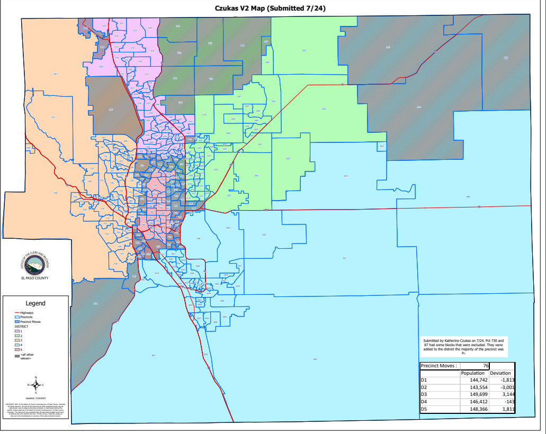
Czukas V2:

Slide 151
(Czukas V2)
HOUSE BILL 21-1047:
Czukas V2:
Overall Range in Deviation: | 4.19%
Total Precincts Moved: | 76 (23.52%)
Total Affected Population: | 175,327
%: | 23.93%
Total Affected Active Voters: | 109,755
%: | 22.70%

Slide 152
(Map Czukas V2)
HOUSE BILL 21-1047:
District: | Total Population: | Target Deviation:
1 | 144,742 | -1,813
2 | 143,554 | -3,001
3 | 149,699 | 3,144
4 | 146,412 | -143
5 | 148,366 | 1,811

Slide 153
(Czukas V2)
Precinct Moves:
DISTRICT: | PRECINCTS ADDED: | PRECINCTS DELETED: | IMPACT:
1 | 140-144-147-164-302-304-445 | 200-213-214-218-253-320-321-322-440-457 | -3
2 | 148-149-150-151-152-153-155-156-165-213-214-218-253-320-321-322-440-457 | 139-157-158-159-160-161-162-167-190-191-192-193-194-195-445-500-501-502-620-627 | -2
3 | 092-093-095-097-099-120-121-123-124-127-136-138-173-178-179-200 | 169-302-304-601-602-605-730-839 | +8
4 | 139-157-158-159-160-161-162-167-191-192-193-194-195-500-501-502-730-839 | 603-604-606-613-615-621-622-623-624-625 | +8
5 | 169-190-601-602-603-604-605-606-613-615-620-621-622-623-624-625-627 | 092-093-095-097-099-120-121-123-124-127-136-138-140-144-147-148-149-150-151-152-153-155-156-164-165-173-178-179 | -11

Slide 154
1st Criteria – Population Equality & VRA
(Czukas V2) Total Population Racial Ethnicity:
Districts | Total / %: | Hispanic or Latino: | Black: | White: | Asian:
1 | TOTAL: | 15,890 | 4,227 | 108,061 | 6,113
 | %: | 10.98% | 2.92% | 74.66% | 4.22%
2 | TOTAL: | 21,808 | 6,452 | 98,962 | 4,530
 | %: | 15.19% | 4.49% | 68.94% | 3.16%
3 | TOTAL: | 18,253 | 4,272 | 113,793 | 3,660
 | %: | 12.19% | 2.85% | 76.01% | 2.44%
4 | TOTAL: | 30,628 | 11,623 | 86,945 | 3,590
 | %: | 20.92% | 7.94% | 59.38% | 2.45%
5 | TOTAL: | 43,914 | 14,745 | 73,920 | 3,776
 | %: | 29.60% | 9.94% | 49.82% | 2.55%

Slide 155
1st Criteria – Population Equality & VRA
(Czukas V2) Total Population Racial Ethnicity:
Districts | Total % / Variance: | Hispanic or Latino: | Black: | White: | Asian:
1 | TOTAL: | 0.4% | -0.01% | -0.62% | -0.05%
2 | TOTAL: | -3.15% | -0.85% | 4.21% | 0.01%
3 | TOTAL: | -0.47% | 0% | 0.48% | 0.14%
4 | TOTAL: | -4.09% | -1.68% | 6.15% | -0.31%
5 | TOTAL: | 7.41% | 2.64% | -10.73% | 0.34%

Slide 156
1st Criteria – Population Equality & VRA
(Czukas V2) Voting Age Population Racial Ethnicity:
Districts | Total / %: | Hispanic or Latino: | Black: | White: | Asian:
1 | TOTAL: | 10,294 | 3,249 | 83,588 | 4,698
 | %: | 7.11% | 2.24% | 57.75% | 3.25%
2 | TOTAL: | 13,732 | 4,828 | 76,443 | 3,676
 | %: | 9.57% | 3.36% | 53.25% | 2.56%
3 | TOTAL: | 13,313 | 3,591 | 98,095 | 3,181
 | %: | 8.89% | 2.4% | 65.53% | 2.12%
4 | TOTAL: | 19,758 | 8,839 | 67,844 | 2,977
 | %: | 13.49% | 6.04% | 46.34% | 2.03%
5 | TOTAL: | 29,267 | 11,407 | 62,271 | 3,291
 | %: | 19.73% | 7.69% | 41.97% | 2.22%

Slide 157
1st Criteria – Population Equality & VRA
(Czukas V2) Voting Age Population Racial Ethnicity:
Districts | Total % / Variance: | Hispanic or Latino: | Black: | White: | Asian:
1 | TOTAL: | 0.17% | -0.05% | -0.79% | -0.06%
2 | TOTAL: | -2.05% | -0.69% | 3.03% | -0.02%
3 | TOTAL: | -0.21% | 0.08% | 1.02% | 0.14%
4 | TOTAL: | -2.55% | -1.23% | 5.06% | -0.28%
5 | TOTAL: | 4.58% | 1.95% | -9.36% | 0.29%

Slide 158
2nd Criteria - Communities of Interest & Compactness
(Czukas V2)
COMMUNITIES OF INTEREST & COMPACTNESS (Towns & Cities):
City / Town: | Commissioner District:
Calhan | 4
Cascade | 3
Colorado Springs | 1, 2, 3, 4, 5
Elbert | 2
Fountain | 4
Green Mtn. Falls | 3
Manitou Springs | 3
Monument | 1
Palmer Lake | 1, 3
Peyton | 2
Ramah | 4
Rush | 4
Yoder | 4
COMMUNITIES OF INTEREST & COMPACTNESS (Military):
Military Installations: | Commissioner District:
USAFA | 3
Fort Carson | 4
Peterson AFB | 4
Schriever SFB | 4
NORAD | 4

Slide 159
2nd Criteria - Communities of Interest & Compactness
(Czukas V2)
COMMUNITIES OF INTEREST & COMPACTNESS (School Districts):
School District: | Commissioner District:
Academy School District 20 | 1, 2, 3
Big Sandy SD 110J | 4
Calhan SD RJ1 | 2, 4
Cheyenne Mtn. SD 12 | 3, 4, 5
Edison SD 54 | 4
Ellicott SD 22 | 4
Falcon SD 49 | 1, 2
Fountain/Ft. Carson SD 8 | 4
Hanover SD 28 | 4
Harrison SD 2 | 3, 5
Lewis-Palmer SD 38 | 1, 2, 3
Manitou Springs SD 14 | 3
COMMUNITIES OF INTEREST & COMPACTNESS (School Districts):
School District: | Commissioner District:
Miami-Yoder SD 60 | 4
Peyton SD 23 | 2
RE-2 Fremont-Florence SD 39 | 4
Widefield SD 3 | 4
Colorado Springs SD11 | 3, 4, 5

Slide 160
2nd Criteria - Communities of Interest & Compactness
(Czukas V2)
COMMUNITIES OF INTEREST & COMPACTNESS (Southeast Colorado Springs):
Southeast Colorado Springs (Precincts): | Commissioner District:
137 | 5
169 | 5
180 | 5
182 | 5
184 | 5
185 | 5
187 | 5
190 | 5
193 | 5
194 | 5
199 | 5
601 | 5
605 | 5
COMMUNITIES OF INTEREST & COMPACTNESS (Southeast Colorado Springs):
Southeast Colorado Springs (Precincts): | Commissioner District:
609 | 5
610 | 5
611 | 5
612 | 5
614 | 5
615 | 5
616 | 5
619 | 5
620 | 5
621 | 5
622 | 5
623 | 5
624 | 5
COMMUNITIES OF INTEREST & COMPACTNESS (Southeast Colorado Springs):
Southeast Colorado Springs (Precincts): | Commissioner District:
625 | 5
626 | 5
627 | 5
901 | 5
All 30 Precincts defined as Southeast Colorado Springs are in Commissioner District 5..
The Districts are somewhat compact.

Slide 161
3rd Criteria - Political Competitiveness
(Czukas V2):
District: | DEM: | DEM %: | REP: | REP %: | Total: | Deviation: | Deviation from Current:
US PRESIDENT:
1 | 33,715 | 37.73% | 52,685 | 58.96% | 89,354 | 21.23% | +3.52%
2 | 28,608 | 34.53% | 51,244 | 61.84% | 82,859 | 27.32% | +4.24%
3 | 45,948 | 51.39% | 40,556 | 45.36% | 89,415 | 6.03% | +1.47%
4 | 23,730 | 39.08% | 34,364 | 56.59% | 60,724 | 17.51% | +8.04%
5 | 29,940 | 52.99% | 23,979 | 42.44% | 56,499 | 10.55% | +8.44%

Slide 162
3rd Criteria - Political Competitiveness
(Map Czukas V2):

Slide 163
3rd Criteria - Political Competitiveness
(Czukas V2):
District: | DEM: | DEM %: | REP: | REP %: | Total: | Deviation: | Deviation from Current:
US SENATE:
1 | 27,266 | 37.72% | 42,688 | 59.05% | 72,286 | 21.33% | +4.27%
2 | 22,701 | 35.35% | 39,103 | 60.88% | 64,226 | 25.54% | +4.96%
3 | 35,893 | 52.25% | 30,785 | 44.82% | 68,693 | 7.44% | +1.24%
4 | 17,170 | 41.70% | 22,225 | 53.98% | 41,174 | 12.28% | +7.86%
5 | 20,994 | 55.33% | 15,194 | 40.05% | 37,940 | 15.29% | +9.04%

Slide 164
3rd Criteria - Political Competitiveness
(Map Czukas V2):

Slide 165
3rd Criteria - Political Competitiveness
(Czukas V2):
District: | DEM: | DEM %: | REP: | REP %: | Total: | Deviation: | Deviation from Current:
GOVERNOR:
1 | 30,073 | 41.49% | 40,932 | 56.48% | 72,474 | 14.98% | +4.08%
2 | 24,848 | 38.57% | 37,877 | 58.79% | 64,423 | 20.22% | +4.68%
3 | 38,141 | 55.39% | 29,333 | 42.60% | 68,853 | 12.79% | +1.09%
4 | 18,388 | 44.58% | 21,431 | 51.96% | 41,243 | 7.38% | +7.92%
5 | 21,997 | 57.84% | 14,811 | 38.94% | 38,034 | 18.89% | +8.95%

Slide 166
3rd Criteria - Political Competitiveness
(Czukas V2):

Slide 167
3rd Criteria - Political Competitiveness
(Czukas V2):
District: | DEM: | DEM %: | REP: | REP %: | Total: | Deviation: | Deviation from Current:
SECRETARY OF STATE:
1 | 27,138 | 37.79% | 42,799 | 59.60% | 71,811 | 21.81% | +4.03%
2 | 22,568 | 35.35% | 39,165 | 61.35% | 63,838 | 26.00% | +4.77%
3 | 35,135 | 51.54% | 31,166 | 45.72% | 68,167 | 5.82% | +1.11%
4 | 16,838 | 41.14% | 22,455 | 54.86% | 40,932 | 13.72% | +7.54%
5 | 20,312 | 53.90% | 15,760 | 41.82% | 37,687 | 12.08% | +8.71%

Slide 168
3rd Criteria - Political Competitiveness
(Czukas V2):

Slide 169
3rd Criteria - Political Competitiveness
(Czukas V2):
District: | DEM: | DEM %: | REP: | REP %: | Total: | Deviation: | Deviation from Current:
EL PASO COUNTY CLERK & RECORDER:
1 | 23,416 | 33.78% | 45,897 | 66.22% | 69,313 | 32.43% | 4.11%
2 | 19,861 | 31.95% | 42,297 | 68.05% | 62,158 | 36.10% | 5.35%
3 | 31,201 | 47.30% | 34,763 | 52.70% | 65,964 | 5.40% | 1.04%
4 | 15,261 | 38.18% | 24,714 | 61.82% | 39,975 | 23.65% | 8.46%
5 | 19,247 | 52.68% | 17,292 | 47.32% | 36,539 | 5.35% | 10.90%

Slide 170
3rd Criteria - Political Competitiveness
(Map Czukas V2):

Slide 171
3rd Criteria - Political Competitiveness
(Czukas V2):
District: | DEM: | DEM %: | REP: | REP %: | Total: | Deviation: | Deviation from Current:
EL PASO COUNTY SHERIFF:
1 | 23,977 | 34.37% | 45,778 | 65.63% | 69,755 | 31.25% | +3.79%
2 | 19,968 | 32.01% | 42,409 | 67.99% | 62,377 | 35.98% | +4.70%
3 | 31,970 | 48.36% | 34,135 | 51.64% | 66,105 | 3.28% | +1.45%
4 | 15,052 | 37.66% | 24,919 | 62.34% | 39,971 | 24.69% | +7.62%
5 | 18,833 | 51.30% | 17,875 | 48.70% | 36,708 | 2.61% | +8.80%

Slide 172
3rd Criteria - Political Competitiveness
(Czukas V2):

Slide 173
CITIZEN SUBMITTED MAP
(Waller-Martinez):

Slide 174
(Waller-Martinez) :
Waller-Martinez:
SE (30 Suggested Precincts) consolidated into one district? | YES
Powers as Eastern boundary for Commissioner District 5 | NO
Fountain / Fort Carson / Security / Widefield / Hanover together? | YES
Waller-Martinez Map: Submitted through public 7/24.

Slide 175
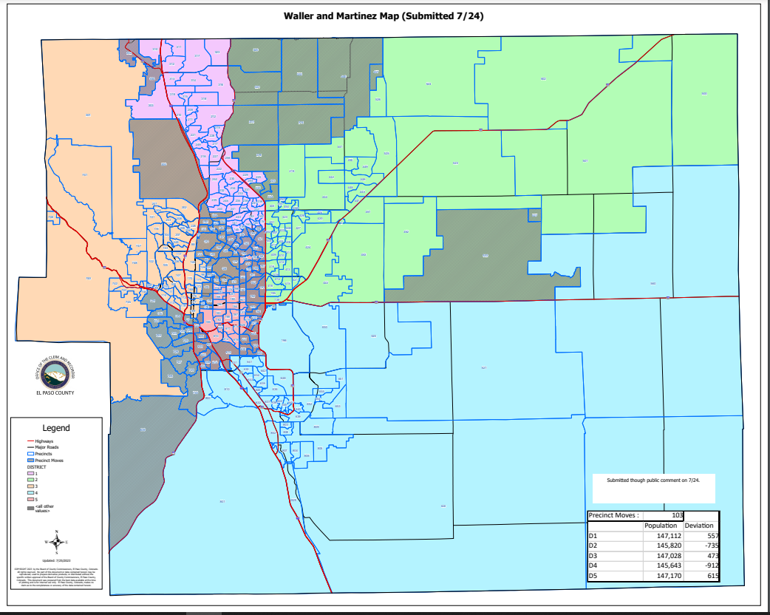
Waller-Martinez:

Slide 176
(Waller-Martinez)
HOUSE BILL 21-1047:
Waller-Martinez:
Overall Range in Deviation: | 1.08%
Total Precincts Moved: | 103 (31.88%)
Total Affected Population: | 233,983
%: | 31.93%
Total Affected Active Voters: | 150,885
%: | 31.20%

Slide 177
(Waller-Martinez)
HOUSE BILL 21-1047:
District: | Total Population: | Target Deviation:
1 | 147,112 | 557
2 | 145,820 | -735
3 | 147,078 | 523
4 | 145,593 | -962
5 | 147,170 | 615

Slide 178
(Waller-Martinez)
Precinct Moves:
DISTRICT: | PRECINCTS ADDED: | PRECINCTS DELETED: | IMPACT:
1 | 144-148-149-150-152-152-153-154-155-156-164-302-304 | 165-200-213-214-218-220-223-224-242-244-251-252-253-320-321-322-440-457- | -5
2 | 090-213-214-218-220-223-224-253-320-321-322-440-457-522-527 | 157-158-159-160-161-162-167-190-191-192-193-194-620-627 | +1
3 | 091-092-093-094-095-097-099-120-121-123-124-125-127-128-129-130-131-132-136-138-140-147-173-178-179-200-242-244-251-252 | 087-114-115-118-169-302-304-601-602-605-720-721-722-723-724-725-726-727-728-729-730-839 | +8
4 | 087-114-115-118-720-721-722-723-724-725-726-727-728-729-730-839 | 090-522-527-603-604-606-613-625-621-622-623-624-625 | +3
5 | 157-158-159-160-161-162-167-169-190-191-192-193-194-601-602-603-604-605-606-613-615-620-621-622-623-624-625-627 | 091-092-093-094-095-097-099-120-121-123-124-125-127-128-129-130-131-132-136-138-140-144-147-148-149-150-151-152-153-154-155-156-164-165-173-178-179 | -9

Slide 179
1st Criteria – Population Equality & VRA
(Waller-Martinez) Total Population Racial Ethnicity:
Districts | Total / %: | Hispanic or Latino: | Black: | White: | Asian:
1 | TOTAL: | 17,068 | 4,371 | 109,489 | 5,709
 | %: | 11.6% | 2.97% | 74.43% | 3.88%
2 | TOTAL: | 22,329 | 6,541 | 99,819 | 4,924
 | %: | 15.31% | 4.49% | 68.45% | 3.38%
3 | TOTAL: | 19,335 | 4,736 | 109,664 | 3,338
 | %: | 13.15% | 3.22% | 74.56% | 2.27%
4 | TOTAL: | 27,972 | 10,959 | 89,771 | 3,860
 | %: | 19.21% | 7.53% | 61.66% | 2.65%
5 | TOTAL: | 43,789 | 14,712 | 72,938 | 3,838
 | %: | 29.75% | 10% | 49.56% | 2.61%

Slide 180
1st Criteria – Population Equality & VRA
(Waller-Martinez) Total Population Racial Ethnicity:
Districts | Total % / Variance: | Hispanic or Latino: | Black: | White: | Asian:
1 | TOTAL: | 1.02% | 0.04% | -0.85% | -0.39%
2 | TOTAL: | -3.03% | -0.85% | 3.72% | 0.23%
3 | TOTAL: | 0.49% | 0.37% | -0.97% | -0.03%
4 | TOTAL: | -5.8% | -2.09% | 8.43% | -0.11%
5 | TOTAL: | 7.56% | 2.7% | -10.99% | 0.4%

Slide 181
1st Criteria – Population Equality & VRA
(Waller-Martinez) Voting Age Population Racial Ethnicity:
Districts | Total / %: | Hispanic or Latino: | Black: | White: | Asian:
1 | TOTAL: | 11,170 | 3,367 | 85,775 | 4,444
 | %: | 7.59% | 2.29% | 58.31% | 3.01%
2 | TOTAL: | 13,897 | 4,888 | 75,992 | 3,905
 | %: | 9.53% | 3.35% | 52.11% | 2.68%
3 | TOTAL: | 13,991 | 3,885 | 94,523 | 2,950
 | %: | 9.51% | 2.64% | 64.27% | 2.01%
4 | TOTAL: | 18,223 | 8,370 | 70,546 | 3,202
 | %: | 12.52% | 5.75% | 48.45% | 2.2%
5 | TOTAL: | 29,083 | 11,404 | 61,405 | 3,322
 | %: | 19.76% | 7.75% | 41.72% | 2.26%

Slide 182
1st Criteria – Population Equality & VRA
(Waller-Martinez) Voting Age Population Racial Ethnicity:
Districts | Total % / Variance: | Hispanic or Latino: | Black: | White: | Asian:
1 | TOTAL: | 0.65% | 0% | -0.23% | -0.29%
2 | TOTAL: | -2.09% | -0.7% | 1.89% | 0.1%
3 | TOTAL: | 0.41% | 0.32% | -0.24% | 0.03%
4 | TOTAL: | -3.52% | -1.52% | 7.17% | -0.11%
5 | TOTAL: | 4.61% | 2.01% | -9.61% | 0.33%

Slide 183
2nd Criteria - Communities of Interest & Compactness
(Waller-Martinez)
COMMUNITIES OF INTEREST & COMPACTNESS (Towns & Cities):
City / Town: | Commissioner District:
Calhan | 2
Cascade | 3
Colorado Springs | 1, 2, 3, 4, 5
Elbert | 2
Fountain | 4
Green Mtn. Falls | 3
Manitou Springs | 3
Monument | 1
Palmer Lake | 1, 3
Peyton | 4
Ramah | 2, 4
Rush | 4
Yoder | 2, 4
COMMUNITIES OF INTEREST & COMPACTNESS (Military):
Military Installations: | Commissioner District:
USAFA | 3
Fort Carson | 4
Peterson AFB | 4
Schriever SFB | 4
NORAD | 4

Slide 184
2nd Criteria - Communities of Interest & Compactness
(Waller-Martinez)
COMMUNITIES OF INTEREST & COMPACTNESS (School Districts):
School District: | Commissioner District:
Academy School District 20 | 1, 2, 3
Big Sandy SD 110J | 2, 4
Calhan SD RJ1 | 4
Cheyenne Mtn. SD 12 | 3, 4
Edison SD 54 | 4
Ellicott SD 22 | 2, 4
Falcon SD 49 | 4
Fountain/Ft. Carson SD 8 | 4
Hanover SD 28 | 4
Harrison SD 2 | 3, 4, 5
Lewis-Palmer SD 38 | 1, 2, 3
Manitou Springs SD 14 | 3, 4
COMMUNITIES OF INTEREST & COMPACTNESS (School Districts):
School District: | Commissioner District:
Miami-Yoder SD 60 | 2, 4
Peyton SD 23 | 2
RE-2 Fremont-Florence SD 39 | 4
Widefield SD 3 | 4
Colorado Springs SD11 | 1, 2, 3, 4, 5

Slide 185
2nd Criteria - Communities of Interest & Compactness
(Waller-Martinez)
COMMUNITIES OF INTEREST & COMPACTNESS (Southeast Colorado Springs):
Southeast Colorado Springs (Precincts): | Commissioner District:
137 | 5
169 | 5
180 | 5
182 | 5
184 | 5
185 | 5
187 | 5
190 | 5
193 | 5
194 | 5
199 | 5
601 | 5
605 | 5
COMMUNITIES OF INTEREST & COMPACTNESS (Southeast Colorado Springs):
Southeast Colorado Springs (Precincts): | Commissioner District:
609 | 5
610 | 5
611 | 5
612 | 5
614 | 5
615 | 5
616 | 5
619 | 5
620 | 5
621 | 5
622 | 5
623 | 5
624 | 5
COMMUNITIES OF INTEREST & COMPACTNESS (Southeast Colorado Springs):
Southeast Colorado Springs (Precincts): | Commissioner District:
625 | 5
626 | 5
627 | 5
901 | 5
All 30 Precincts defined as Southeast Colorado Springs are in Commissioner Districts 5..
The Districts are somewhat compact.

Slide 186
3rd Criteria - Political Competitiveness
(Waller-Martinez):
District: | DEM: | DEM %: | REP: | REP %: | Total: | Deviation: | Deviation from Current:
US PRESIDENT:
1 | 34,492 | 37.81% | 53,700 | 58.86% | 91,231 | 21.05% | +3.70%
2 | 27,772 | 33.76% | 51,541 | 62.65% | 82,265 | 28.89% | +5.82%
3 | 42,937 | 50.78% | 38,678 | 45.74% | 84,563 | 5.04% | +0.47%
4 | 27,107 | 42.93% | 33,479 | 53.02% | 63,145 | 10.09% | +0.62%
5 | 29,633 | 51.40% | 25,430 | 44.11% | 57,647 | 7.29% | +5.18%

Slide 187
3rd Criteria - Political Competitiveness
(Waller-Martinez):

Slide 188
3rd Criteria - Political Competitiveness
(Waller-Martinez):
District: | DEM: | DEM %: | REP: | REP %: | Total: | Deviation: | Deviation from Current:
US SENATE:
1 | 27,806 | 37.92% | 43,131 | 58.82% | 73,322 | 20.90% | +4.70%
2 | 22,072 | 34.52% | 39,434 | 61.67% | 63,941 | 27.15% | +6.57%
3 | 33,873 | 52.06% | 29,073 | 44.68% | 65,064 | 7.38% | +1.18%
4 | 19,574 | 45.12% | 22,220 | 51.22% | 43,381 | 6.10% | +1.69%
5 | 20,699 | 53.61% | 16,137 | 41.79% | 38,611 | 11.82% | +5.57%

Slide 189
3rd Criteria - Political Competitiveness
(Waller-Martinez):

Slide 190
3rd Criteria - Political Competitiveness
(Waller-Martinez):
District: | DEM: | DEM %: | REP: | REP %: | Total: | Deviation: | Deviation from Current:
GOVERNOR:
1 | 30,623 | 41.65% | 41,388 | 56.29% | 73,529 | 14.64% | +4.42%
2 | 24,217 | 37.76% | 38,119 | 59.44% | 64,126 | 21.68% | +6.14%
3 | 35,731 | 54.80% | 28,056 | 43.03% | 65,203 | 11.77% | +0.07%
4 | 21,098 | 48.54% | 21,142 | 48.64% | 43,462 | 0.10% | +0.65%
5 | 21,778 | 56.26% | 15,679 | 40.51% | 38,707 | 15.76% | +5.81%

Slide 191
3rd Criteria - Political Competitiveness
(Waller-Martinez):

Slide 192
3rd Criteria - Political Competitiveness
(Waller-Martinez):
District: | DEM: | DEM %: | REP: | REP %: | Total: | Deviation: | Deviation from Current:
SECRETARY OF STATE:
1 | 27,667 | 37.98% | 43,240 | 59.35% | 72,854 | 21.38% | +4.46%
2 | 21,972 | 34.57% | 39,460 | 62.09% | 63,553 | 27.52% | +6.28%
3 | 33,057 | 51.19% | 29,610 | 45.85% | 64,574 | 5.34% | +0.62%
4 | 19,172 | 44.49% | 22,458 | 52.11% | 43,097 | 7.62% | +1.44%
5 | 20,123 | 52.46% | 16,577 | 43.22% | 38,357 | 9.24% | +5.88%

Slide 193
3rd Criteria - Political Competitiveness
(Waller-Martinez):

Slide 194
3rd Criteria - Political Competitiveness
(Waller-Martinez):
District: | DEM: | DEM %: | REP: | REP %: | Total: | Deviation: | Deviation from Current:
EL PASO COUNTY CLERK & RECORDER:
1 | 23,836 | 33.86% | 46,560 | 66.14% | 70,396 | 32.28% | +4.26%
2 | 19,417 | 31.38% | 42,458 | 68.62% | 61,875 | 37.24% | +6.50%
3 | 29,499 | 47.17% | 33,045 | 52.83% | 62,544 | 5.67% | +0.77%
4 | 17,266 | 41.13% | 24,715 | 58.87% | 41,981 | 17.74% | +2.56%
5 | 18,968 | 51.05% | 18,185 | 48.95% | 37,153 | 2.11% | +7.66%

Slide 195
3rd Criteria - Political Competitiveness
(Waller-Martinez):

Slide 196
3rd Criteria - Political Competitiveness
(Waller-Martinez):
District: | DEM: | DEM %: | REP: | REP %: | Total: | Deviation: | Deviation from Current:
EL PASO COUNTY SHERIFF:
1 | 24,373 | 34.45% | 46,385 | 65.55% | 70,758 | 31.11% | +3.93%
2 | 19,509 | 31.37% | 42,672 | 68.63% | 62,181 | 37.25% | +5.98%
3 | 30,143 | 48.13% | 32,486 | 51.87% | 62,629 | 3.74% | +0.98%
4 | 17,228 | 41.02% | 24,768 | 58.98% | 41,996 | 17.95% | +0.89%
5 | 18,547 | 49.65% | 18,805 | 50.35% | 37,352 | 0.69% | +5.50%

Slide 197
3rd Criteria - Political Competitiveness
(Waller-Martinez):

Slide 198
QUESTIONS

