Slide 1
El Paso County
Commissioner Redistricting
July 10, 2023 @ 5:30pm
Cheyenne Mountain High School
1200 Cresta Rd.
Colorado Springs, CO 80906
Presented By: Steve Schleiker, El Paso County Clerk & Recorder

Slide 2
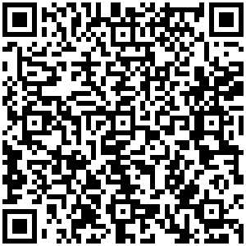
Redistricting (July 10th) Presentation QR Code:

Slide 3
Redistricting Commission
Assigned Tasks from July 6th Meeting:
El Paso County Redistricting Commission Tasks:
Commissioner Stan VanderWerf Map
Commissioner’s Geitner & Bremer Joint Map

Slide 4
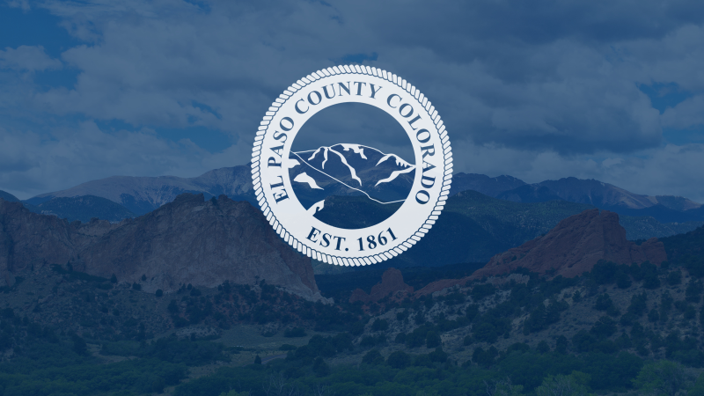
Map Option (7)
Commissioner VanderWerf Summary:

Slide 5
Map Option (7) Summary
HOUSE BILL 21-1047:
Map Option 7 Summary:
Overall Range in Deviation = 4.97%
Total Precinct Moves = 50
Total Affected Population = 123,542 (16.86%)
Total Affected Active Voters = 79,254 (16.39%)

Slide 6
Map Option (7) Summary
1ST Criteria: Population Equality & VRA
Total Population Racial Ethnicity:
District 1 (No Variance +/- 3%)
District 2 (+3.54% White)
District 3 (No Variance +/- 3%)
District 4 (+3.47% White)
District 5 (+5.47% Hispanic or Latino / -6.97% White)
This variance is the change from current.

Slide 7
Map Option (7) Summary
1ST Criteria: Population Equality & VRA
Total Voting Age Racial Ethnicity:
District 1 (No Variance +/- 3%)
District 2 (No Variance +/- 3%)
District 3 (No Variance +/- 3%)
District 4 (No Variance +/- 3%)
District 5 (+3.3% Hispanic or Latino / -5.76% White)
This variance is the change from current.

Slide 8
Map Option (7) Summary
2nd Criteria: Communities of
Interest & Compactness:
The proposed map keeps most municipalities whole within one Commissioner District, except City of Colorado Springs.
Communities of Interest are the 5 Military Installations, Falcon, Southeast Colorado Springs, Monument, Palmer Lake, and the Wildland Urban Interface.
The Districts are sufficiently compact.
Map proposed by Commissioner VanderWerf at the July 6th meeting, adjusted to include all of Precincts 147, 185, 310, and 615.
Districts 1,2, and 4 are under population target deviation to allow for future growth.

Slide 9
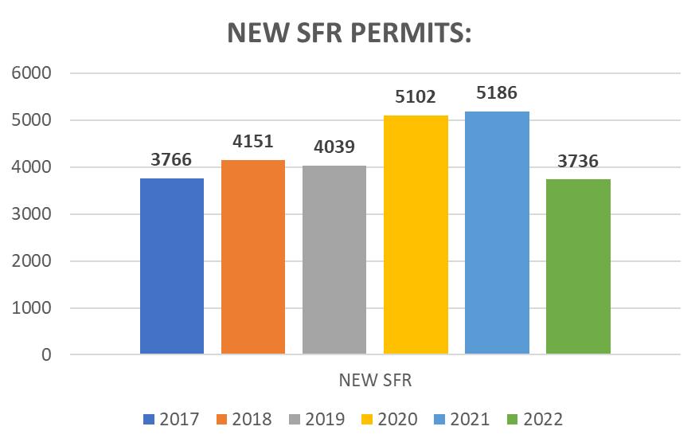
Map Option (7) Summary
2nd Criteria: Communities of
Interest & Compactness:
District: | Total Population: | Target Deviation:
1 | 143,383 | -3,172
2 | 145,831 | -724
3 | 148,339 | 1,784
4 | 144,560 | -1,995
5 | 150,660 | 4,105

Slide 10
Map Option (7) Summary
3rd Criteria: Political Competitiveness:
US PRESIDENT
District: | Deviation from Current:
1 | +1.82%
2 | +1.93%
3 | +4.93%
4 | +4.04%
5 | +9.08%
US SENATE
District: | Deviation from Current:
1 | +2.37%
2 | +1.81%
3 | +5.86%
4 | +3.71%
5 | +9.33%
GOVERNOR
District: | Deviation from Current:
1 | +2.11%
2 | +1.75%
3 | +5.62%
4 | +3.53%
5 | +9.11%
SECRETARY OF STATE
District: | Deviation from Current:
1 | +2.18%
2 | +1.84%
3 | +5.60%
4 | +3.53%
5 | +9.08%
CLERK & RECORDER
District: | Deviation from Current:
1 | +2.31%
2 | +2.42%
3 | +5.59%
4 | +3.88%
5 | +10.16%
SHERIFF
District: | Deviation from Current:
1 | +2.08%
2 | +1.95%
3 | +5.61%
4 | +3.56%
5 | +9.46%

Slide 11
Map Option (8)
Commissioners Bremer & Geitner Summary:

Slide 12
Map Option (8) Summary
HOUSE BILL 21-1047:
Map Option 8 Summary:
Overall Range in Deviation = 4.75%
Total Precinct Moves = 80
Total Affected Population = 191,490 (26.13%)
Total Affected Active Voters = 109,012 (22.54%)

Slide 13
Map Option (8) Summary
1ST Criteria: Population Equality & VRA
Total Population Racial Ethnicity:
District 1 (No Variance +/- 3%)
District 2 (No Variance +/- 3%)
District 3 (-3.34% White)
District 4 (+4.73% Hispanic or Latino / -5.16% White)
District 5 (-4.84% Hispanic or Latino / +7.7% White)
This variance is the change from current.

Slide 14
Map Option (8) Summary
1ST Criteria: Population Equality & VRA
Total Voting Age Racial Ethnicity:
District 1 (No Variance +/- 3%)
District 2 (No Variance +/- 3%)
District 3 (-4.83% White)
District 4 (+3.25% Hispanic or Latino)
District 5 (-3.01% Hispanic or Latino / -7.32% White)
This variance is the change from current.

Slide 15
Map Option (8) Summary
2nd Criteria: Communities of
Interest & Compactness:
The proposed map keeps most municipalities whole within one Commissioner District, except City of Colorado Springs.
Communities of Interest are the 5 Military Installations, Falcon, Southeast Colorado Springs, Monument, Palmer Lake, and the Wildland Urban Interface.
The Districts are sufficiently compact.
Map proposed by Commissioner’s Bremer and Geitner at the July 6th meeting, adjustment to Precincts were made for Precinct splits. Precincts 163, 134, 180, and 181 stayed in their original districts due to population.
Districts 1, and 2 are under population target deviation to allow for future growth. District 5 is underpopulated.

Slide 16
Map Option (8) Summary
2nd Criteria: Communities of
Interest & Compactness:
District: | Total Population: | Target Deviation:
1 | 144,722 | -1,833
2 | 143,129 | -3,426
3 | 150,092 | 3,537
4 | 148,835 | 2,280
5 | 145,995 | -560

Slide 17
Map Option (8) Summary
3rd Criteria: Political Competitiveness:
US PRESIDENT
District: | Deviation from Current:
1 | +0.35%
2 | +3.23%
3 | +7.59%
4 | +11.59%
5 | +0.03%
US SENATE
District: | Deviation from Current:
1 | +0.18%
2 | +2.68%
3 | +8.13%
4 | +11.71%
5 | +0.63%
GOVERNOR
District: | Deviation from Current:
1 | +0.26%
2 | +2.52%
3 | +7.61%
4 | +10.78%
5 | +0.87%
SECRETARY OF STATE
District: | Deviation from Current:
1 | +0.14%
2 | +2.53%
3 | +7.83%
4 | +10.88%
5 | +1.01%
CLERK & RECORDER
District: | Deviation from Current:
1 | +0.27%
2 | +2.47%
3 | +7.97%
4 | +12.31%
5 | +0.08%
SHERIFF
District: | Deviation from Current:
1 | +0.23%
2 | +2.49%
3 | +7.92%
4 | +11.38%
5 | +0.85%

Slide 18
Questions?

Slide 19
Map Option (7)
Supporting Documentation:

Slide 20
Map Option (7) –
Commissioner Stan VanderWerf:
District: | Total Population: | Target Deviation: | Target Deviation %:
County | 732,773
District 1 | 143,383 | -3,172 | -2.16%
District 2 | 145,831 | -724 | -0.49%
District 3 | 148,339 | 1,784 | 1.22%
District 4 | 144,560 | -1,995 | -1.36%
District 5 | 150,660 | 4,105 | 2.8%
Metric: | Data:
TOTAL Population | 732,773
Mean Target Population | 146,555
Mean Deviation | 2,356
Mean % Deviation | 1.61%
Largest (+) Deviation | 4,105
Largest (–) Deviation | -3,172
Overall Range in Deviation | 7,277
Overall Range in Deviation %: | 4.97%

Slide 21
Map Option (7) –
Commissioner Stan VanderWerf:
Map Option 7 Precinct Moves = 50
Districts: | Precincts Added: | Precincts Removed: | Total Impact:
District 1 | (097)(120)(138)(140)(144)(164)(445) (219) | (310)(303)(313)(319)(315)(210)(318)(253) (440)(457) | -2
District 2 | (253)(440)(457)(149)(150)(151)(152) (153)(154)(155)(156)(165)(166) | (445)(219)(190)(193)(194)(620)(627)(191) (192)(195)(139)(418)(414)(415) | -1
District 3 | (310)(303)(313)(319)(315)(210)(318) | (126)(096)(171)(172) | +3
District 4 | (191)(192)(195)(139)(418)(414)(415) | (623)(621)(622)(624)(625)(615) | +1
District 5 | (126)(096)(171)(172)(190)(193)(194) (620)(627)(623)(621)(622)(624)(625) (615) | (097)(120)(138)(140)(144)(164)(149)(150) (151)(152)(153)(154)(155)(165)(166) | 0
TOTAL AFFECTED POPULATION = 123,542 (16.86%) TOTAL AFFECTED ACTIVE VOTERS = 79,254 (16.39%)

Slide 22
Map Option (7) Total Population Racial Ethnicity –
Commissioner Stan VanderWerf:

Slide 23
Map Option (7) Total Population Racial Ethnicity - Commissioner Stan VanderWerf:
Districts | Total % / Variance: | Hispanic or Latino: | Black: | White: | Asian:
1 | Total %: | 11.08% | 3.17% | 74.27% | 4.38%
 | Total Variance from Original: | 0.5% | 0.24% | -1.01% | 0.11%
2 | Total %: | 15.61% | 4.69% | 68.27% | 3.12%
 | Total Variance from Original: | -2.73% | -0.65% | 3.54% | -0.03%
3 | Total %: | 12.07% | 2.72% | 76.14% | 2.4%
 | Total Variance from Original: | -0.59% | -0.13% | 0.61% | 0.1%
4 | Total %: | 22.33% | 8.71% | 56.7% | 2.68%
 | Total Variance from Original: | -2.68% | -0.91% | 3.47% | -0.08%
5 | Total %: | 27.66% | 8.83% | 53.58% | 2.26%
 | Total Variance from Original: | 5.47% | 1.53% | -6.97% | 0.05%

Slide 24
Map Option (7) Voting Age Racial Ethnicity – Commissioner Stan VanderWerf:

Slide 25
Map Option (7) Voting Age Racial Ethnicity – Commissioner Stan VanderWerf:
Districts | Total % / Variance: | Hispanic or Latino: | Black: | White: | Asian:
1 | Total %: | 7.29% | 2.5% | 58.17% | 3.4%
 | Total Variance from Original: | 0.35% | 0.21% | -0.37% | 0.09%
2 | Total %: | 9.93% | 3.56% | 53.15% | 2.53%
 | Total Variance from Original: | -1.69% | -0.49% | 2.93% | -0.05%
3 | Total %: | 8.62% | 2.2% | 64.05% | 2.04%
 | Total Variance from Original: | -0.48% | -0.12% | -0.46% | 0.06%
4 | Total %: | 14.43% | 6.59% | 44.04% | 2.24%
 | Total Variance from Original: | -1.61% | -0.68% | 2.76% | -0.07%
5 | Total %: | 18.45% | 6.86% | 45.57% | 1.97%
 | Total Variance from Original: | 3.3% | 1.12% | -5.76% | 0.04%

Slide 26
Map Option (7) Communities of
Interest & Compactness:
District: | Total Population: | Target Deviation:
1 | 143,383 | -3,172
2 | 145,831 | -724
3 | 148,339 | 1,784
4 | 144,560 | -1,995
5 | 150,660 | 4,105

Slide 27
Map Option (7) Communities of
Interest & Compactness:
The proposed map keeps most municipalities whole within one Commissioner District, except City of Colorado Springs.
Communities of Interest are the 5 Military Installations, Falcon, Southeast Colorado Springs, Monument, Palmer Lake, and the Wildland Urban Interface.
The Districts are sufficiently compact.
Precincts 310, 147, 185, and 615 are all Precincts that were split from original. Staff corrected.
Districts 1,2, and 4 are under population target deviation to allow for future growth.

Slide 28
Map Option (7) Political Competitiveness:
District: | DEM: | DEM %: | REP: | REP %: | Total: | Deviation: | Deviation from Current:
US PRESIDENT:
1 | 31,865 | 36.89% | 51,672 | 59.82% | 86,373 | +22.93% | +1.82%
2 | 29,057 | 35.64% | 49,442 | 60.64% | 81,531 | +25.00% | +1.93%
3 | 43,937 | 48.25% | 44,272 | 48.62% | 91,065 | +0.37% | +4.93%
4 | 22,838 | 40.95% | 30,376 | 54.47% | 55,767 | +13.52% | +4.04%
5 | 34,244 | 53.41% | 27,066 | 42.21% | 64,115 | +11.20% | +9.08%

Slide 29
Map Option (7) Political Competitiveness:
District: | DEM: | DEM %: | REP: | REP %: | Total: | Deviation: | Deviation from Current:
US SENATE:
1 | 25,448 | 36.79% | 41,514 | 60.02% | 69,169 | +23.23% | +2.37%
2 | 23,058 | 36.85% | 37,072 | 59.25% | 62,573 | +22.40% | +1.81%
3 | 35,107 | 48.70% | 34,860 | 48.35% | 72,092 | +0.34% | +5.86%
4 | 15,993 | 43.73% | 18,965 | 51.86% | 36,569 | +8.13% | +3.71%
5 | 24,418 | 55.63% | 17,584 | 40.06% | 43,890 | +15.57% | +9.33%

Slide 30
Map Option (7) Political Competitiveness:
District: | DEM: | DEM %: | REP: | REP %: | Total: | Deviation: | Deviation from Current:
GOVERNOR:
1 | 28,105 | 40.51% | 39,867 | 57.47% | 69,374 | +16.95% | +2.11%
2 | 25,063 | 39.94% | 35,916 | 57.24% | 62,741 | +17.30% | +1.75%
3 | 37,600 | 62.02% | 33,209 | 45.95% | 72,277 | +6.08% | +5.62%
4 | 17,139 | 46.77% | 18,233 | 49.76% | 36,645 | +2.99% | +3.53%
5 | 25,540 | 58.07% | 17,159 | 39.02% | 43,980 | +19.06% | +9.11%

Slide 31
Map Option (7) Political Competitiveness:
District: | DEM: | DEM %: | REP: | REP %: | Total: | Deviation: | Deviation from Current:
SECRETARY OF STATE:
1 | 25,345 | 36.85% | 41,614 | 60.51% | 68,770 | +23.66% | +2.18%
2 | 22,846 | 36.74% | 37,192 | 59.82% | 62,175 | +23.07% | +1.84%
3 | 34,488 | 48.20% | 35,119 | 49.08% | 71,556 | +0.88% | +5.60%
4 | 15,679 | 43.12% | 19,210 | 52.83% | 36,364 | +9.71% | +3.53%
5 | 23,633 | 54.24% | 18,210 | 41.79% | 43,570 | +12.45% | +9.08%

Slide 32
Map Option (7) Political Competitiveness:
District: | DEM: | DEM %: | REP: | REP %: | Total: | Deviation: | Deviation from Current:
EL PASO COUNTY CLERK & RECORDER:
1 | 21,820 | 32.88% | 44,533 | 67.12% | 66,353 | +34.23% | +2.31%
2 | 20,238 | 33.42% | 40,322 | 66.58% | 60,560 | +33.16% | +2.42%
3 | 30,491 | 43.98% | 38,831 | 56.02% | 69,322 | +12.03% | +5.59%
4 | 14,397 | 40.47% | 21,179 | 59.53% | 35,576 | +19.06% | +3.88%
5 | 22,040 | 52.30% | 20,098 | 47.70% | 42,138 | +4.61% | +10.16%

Slide 33
Map Option (7) Political Competitiveness:
District: | DEM: | DEM %: | REP: | REP %: | Total: | Deviation: | Deviation from Current:
EL PASO COUNTY SHERIFF:
1 | 22,387 | 33.52% | 44,397 | 66.48% | 66,784 | 32.96% | 2.08%
2 | 20,289 | 33.39% | 40,476 | 66.61% | 60,765 | 33.22% | 1.95%
3 | 31,136 | 44.84% | 38,308 | 55.16% | 69,444 | 10.33% | 5.61%
4 | 14,109 | 39.69% | 21,441 | 60.31% | 35,550 | 20.62% | 3.56%
5 | 21,879 | 51.63% | 20,494 | 48.37% | 42,373 | 3.27% | 9.46%

Slide 34
Map Option (8)
Supporting Documentation:

Slide 35
Map Option (8) –
Commissioners Bremer & Geitner:
District: | Total Population: | Target Deviation: | Target Deviation %:
County | 732,773
District 1 | 144,722 | -1,833 | -1.25%
District 2 | 143,129 | -3,426 | -2.34%
District 3 | 150,092 | 3,537 | 2.41%
District 4 | 148,835 | 2,280 | 1.56%
District 5 | 145,995 | -560 | -0.38%
Metric: | Data:
TOTAL Population | 732,773
Mean Target Population | 146,555
Mean Deviation | 2,327
Mean % Deviation | 1.59%
Largest (+) Deviation | 3,537
Largest (–) Deviation | 3,426
Overall Range in Deviation | 6,963
Overall Range in Deviation %: | 4.75%

Slide 36
Map Option (8) –
Commissioners Bremer & Geitner:
Map Option 8 Precinct Moves = 80
Districts: | Precincts Added: | Precincts Removed: | Total Impact:
District 1 | (219)(441)(120)(138)(140)(164) | (303)(313)(315)(319)(134)(135)(145) | +1
District 2 | (134)(090)(196)(520)(521)(522)(527) (554)(560)(648)(650)(651)(653)(655) (809)(828)(829) | (219)(441)(192)(193)(194)(620)(627)(157) (158)(159)(160)(161)(162)(167)(190)(191) | +1
District 3 | (303)(313)(315)(319)(603)(604)(606) (613)(800)(801)(810) | (087)(088)(096)(112)(119)(122)(126)(168) (169)(170)(171)(172)(176)(177)(189) | -4
District 4 | (192)(193)(194)(620)(627)(137)(182) (184)(185)(187)(199)(609)(610)(611) (612)(614)(616)(619)(626)(901) | (090)(196)(520)(521)(522)(527)(554)(560) (648)(650)(651)(653)(655)(809)(828)(829) (603)(604)(606)(613)(800)(801)(810) | -3
District 5 | (135)(145)(157)(158)(159)(160)(161) (162)(167)(190)(191)(087)(088)(096) (112)(119)(122)(126)(168)(169)(170) (171)(172)(176)(177)(189) | (120)(138)(140)(164)(137)(182)(184)(185) (187)(199)(609)(610)(611)(612)(614)(616) (619)(626)(901) | +7
TOTAL AFFECTED POPULATION = 191,490 (26.13%) TOTAL AFFECTED ACTIVE VOTERS = 109,012 (22.54%)

Slide 37
Map Option (8) Total Population Racial Ethnicity –
Commissioners Bremer & Geitner:

Slide 38
Map Option (8) Total Population Racial Ethnicity – Commissioners Bremer & Geitner:
Districts | Total % / Variance: | Hispanic or Latino: | Black: | White: | Asian:
1 | Total %: | 10.62% | 2.92% | 75.22% | 4.3%
 | Total Variance from Original: | 0.04% | -0.01% | -0.06% | 0.03%
2 | Total %: | 17.25% | 5.47% | 65.18% | 3.28%
 | Total Variance from Original: | -1.09% | 0.13% | 0.45% | 0.13%
3 | Total %: | 13.89% | 4.23% | 72.19% | 2.61%
 | Total Variance from Original: | 1.23% | 1.38% | -3.34% | 0.31%
4 | Total %: | 29.74% | 10.59% | 48.07% | 2.67%
 | Total Variance from Original: | 4.73% | 0.97% | -5.16% | -0.09%
5 | Total %: | 17.35% | 4.9% | 68.25% | 1.97%
 | Total Variance from Original: | -4.84% | -2.4% | 7.75% | -0.24%

Slide 39
Map Option (8) Voting Age Racial Ethnicity – Commissioners Bremer & Geitner:

Slide 40
Map Option (8) Voting Age Racial Ethnicity – Commissioners Bremer & Geitner:
Districts | Total % / Variance: | Hispanic or Latino: | Black: | White: | Asian:
1 | Total %: | 6.98% | 2.28% | 58.84% | 3.32%
 | Total Variance from Original: | 0.04% | -0.01% | 0.3% | 0.01%
2 | Total %: | 10.71% | 4.04% | 49.3% | 2.66%
 | Total Variance from Original: | -0.91% | -0.01% | -0.92% | 0.08%
3 | Total %: | 9.66% | 3.35% | 59.68% | 2.18%
 | Total Variance from Original: | 0.56% | 1.03% | -4.83% | 0.2%
4 | Total %: | 19.29% | 8.07% | 38.51% | 2.26%
 | Total Variance from Original: | 3.25% | 0.8% | -2.77% | -0.05%
5 | Total %: | 12.14% | 3.97% | 58.65% | 1.76%
 | Total Variance from Original: | -3.01% | -1.77% | 7.32% | -0.17%

Slide 41
Map Option (8) Communities of
Interest & Compactness:
District: | Total Population: | Target Deviation:
1 | 144,722 | -1,833
2 | 143,129 | -3,426
3 | 150,092 | 3,537
4 | 148,835 | 2,280
5 | 145,995 | -560

Slide 42
Map Option (8) Communities of
Interest & Compactness:
The proposed map keeps most municipalities whole within one Commissioner District, except City of Colorado Springs.
Communities of Interest are the 5 Military Installations, Falcon, Southeast Colorado Springs, Monument, Palmer Lake, and the Wildland Urban Interface.
The Districts are sufficiently compact.
Map proposed by Commissioner’s Bremer and Geitner at the July 6th meeting, adjustments to Precincts were made for Precinct splits. Precincts 163, 134, 180, and 181 stayed in their original districts due to population.
Districts 1, and 2 are under population target deviation to allow for future growth. District 5 is underpopulated.

Slide 43
Map Option (8) Political Competitiveness:
District: | DEM: | DEM %: | REP: | REP %: | Total: | Deviation: | Deviation from Current:
US PRESIDENT:
1 | 31,546 | 35.85% | 53,635 | 60.95% | 88,003 | +25.10% | +0.35%
2 | 25,472 | 34.91% | 44,671 | 61.22% | 72,973 | +26.31% | +3.23%
3 | 38,143 | 46.88% | 40,605 | 49.90% | 81,369 | +3.03% | +7.59%
4 | 28,192 | 48.68% | 26,965 | 46.56% | 57,918 | +2.12% | +11.59%
5 | 38,588 | 49.10% | 36,952 | 47.02% | 78,588 | +2.08% | +0.03%

Slide 44
Map Option (8) Political Competitiveness:
District: | DEM: | DEM %: | REP: | REP %: | Total: | Deviation: | Deviation from Current:
US SENATE:
1 | 25,663 | 35.55% | 44,272 | 61.33% | 72,187 | +25.78% | +0.18%
2 | 19,946 | 36.32% | 32,719 | 59.58% | 54,915 | +23.26% | +2.68%
3 | 29,976 | 47.52% | 31,193 | 49.45% | 63,080 | +1.93% | +8.13%
4 | 19,005 | 51.37% | 16,305 | 44.08% | 36,993 | +7.30% | +11.71%
5 | 29,434 | 51.51% | 25,506 | 44.63% | 57,144 | +6.87% | +0.63%

Slide 45
Map Option (8) Political Competitiveness:
District: | DEM: | DEM %: | REP: | REP %: | Total: | Deviation: | Deviation from Current:
GOVERNOR:
1 | 28,478 | 39.36% | 42,459 | 58.68% | 72,352 | +19.32% | +0.26%
2 | 21,685 | 39.40% | 31,625 | 57.46% | 55,403 | +18.06% | +2.52%
3 | 32,265 | 51.00% | 29,676 | 46.91% | 63,268 | +4.09% | +7.61%
4 | 19,982 | 53.91% | 15,785 | 42.59% | 37,064 | +11.32% | +10.78%
5 | 31,037 | 54.17% | 24,839 | 43.35% | 57,300 | +10.82% | +0.87%

Slide 46
Map Option (8) Political Competitiveness:
District: | DEM: | DEM %: | REP: | REP %: | Total: | Deviation: | Deviation from Current:
SECRETARY OF STATE:
1 | 25,623 | 35.72% | 44,259 | 61.70% | 71,731 | +25.98% | +0.14%
2 | 19,816 | 36.60% | 32,790 | 60.07% | 54,587 | +23.77% | +2.53%
3 | 29,472 | 47.05% | 31,426 | 50.17% | 62,643 | +3.12% | +7.83%
4 | 18,435 | 50.16% | 16,709 | 45.47% | 36,750 | +4.70% | +10.88%
5 | 28,645 | 50.50% | 26,161 | 46.12% | 56,724 | +4.38% | +1.01%

Slide 47
Map Option (8) Political Competitiveness:
District: | DEM: | DEM %: | REP: | REP %: | Total: | Deviation: | Deviation from Current:
EL PASO COUNTY CLERK & RECORDER:
1 | 21,876 | 31.59% | 47,373 | 68.41% | 69,249 | +36.82% | +0.27%
2 | 17,797 | 33.39% | 35,500 | 66.61% | 53,297 | +33.22% | +2.47%
3 | 25,975 | 42.80% | 34,719 | 57.20% | 60,694 | +14.41% | +7.97%
4 | 17,411 | 48.56% | 18,442 | 51.44% | 35,853 | +2.88% | +12.31%
5 | 25,927 | 47.26% | 28,929 | 52.74% | 54,856 | +5.47% | +0.08%

Slide 48
Map Option (8) Political Competitiveness:
District: | DEM: | DEM %: | REP: | REP %: | Total: | Deviation: | Deviation from Current:
EL PASO COUNTY SHERIFF:
1 | 22,556 | 32.36% | 47,139 | 67.64% | 69,695 | +35.27% | +0.23%
2 | 17,720 | 33.12% | 35,788 | 66.88% | 53,508 | +33.77% | +2.49%
3 | 26,551 | 43.68% | 34,236 | 56.32% | 60,787 | +12.64% | +7.92%
4 | 16,937 | 47.16% | 18,979 | 52.84% | 35,916 | +5.69% | +11.38%
5 | 26,036 | 47.33% | 28,974 | 52.67% | 55,010 | +5.34% | +0.85%

