Slide 1
2017 Reprecincting & Commissioner Redistricting
Presented by Chuck Broerman, El Paso County Treasurer
Former County Clerk and Recorder

Slide 2
2015 Commissioner District Map

Slide 3
Current District Deviation
District | Population | Deviation | % Deviation
1 | 137,777 | 1,639 | 1.2%
2 | 138,479 | 2,341 | 1.72%
3 | 135,150 | -988 | -0.73%
4 | 134,315 | -1,823 | -1.34%
5 | 134,970 | -1,168 | -0.86%
Deviation under current outline: 3.06%
Optimal district size is 136,138

Slide 4
Current District Deviation

Slide 5
Redistricting Method
Looked to statute for guidance
Met with each Commissioner individually
Incorporated new precinct changes
Outlined internal goals to guide staff
Communities of interest
Minimize impact on our citizens
Notes:
Outline 2015’s goals?
Key features-
Waldo Canyon/Black Forest fire areas
Military installations-support
Geo-Political boundaries
Geographical definitions
Representation of rural areas

Slide 6
Redistricting Method
From past efforts, we learned the interested parties define “communities of interest” as:
Existing political boundaries such as municipal, legislative and school district boundaries
Shared natural events, such as fires and floods
Military installations
Rural and urban areas
Improvement and other special districts

Slide 7
Redistricting Goals
Comply with Colorado Constitution and Revised Statutes
Draw each Commissioner into a district, not draw out declared candidates
Reasonably maintain equal population while anticipating future growth
Minimize disenfranchising/impact on voters
Preserve key features for each district
Preserve reasonable definition of communities of interest
Create districts that were geographically identifiable
Appropriately align representation for areas affected by natural disasters (e.g. Waldo Canyon and Black Forest fires)
Maintain the Board’s previously stated desire to increase representation for Eastern El Paso County

Slide 8
Redistricting Goals
Comply with Colorado Constitution and Revised Statutes
Draw each Commissioner into a district, not draw out declared candidates
Reasonably maintain equal population while anticipating future growth
Minimize disenfranchising/impact on voters
Preserve key features for each district
Preserve reasonable definition of communities of interest
Create districts that were geographically identifiable
Appropriately align representation for areas affected by natural disasters (e.g. Waldo Canyon and Black Forest fires)
Maintain the Board’s previously stated desire to increase representation for Eastern El Paso County

Slide 9
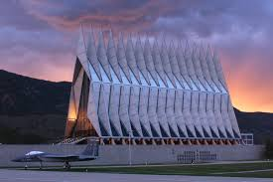
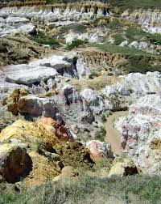
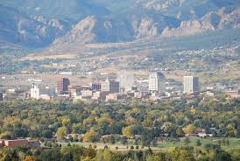
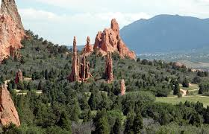
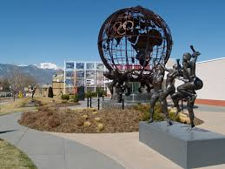
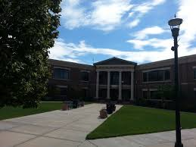
Key District Features
District | Key Features
District 1 | Air Force Academy Black Forest Monument
District 2 | Powers Corridor Eastern Colorado Springs Peterson Air Force Base
District 3 | Western Colorado Springs Downtown Waldo Canyon area NORAD Manitou Springs
District 4 | Fort Carson Schriever Air Force Base Fountain
District 5 | Central Colorado Springs Olympic Training Center
Notes:
Manitou?

Slide 10
Redistricting - Option 3

Slide 11
Redistricting - Option 3 Positives & Negatives
Positives
Statutorily sound
Preserves key district features
Consideration for Waldo Canyon and Black Forest fire effect
Anticipates future growth
Highway 94 boundary alignment for District 4
I-25 boundary for District 3
Maintains increase representation for eastern EPC
5 precinct changes
Negatives
Highest deviation ( 3.5%) however; factors anticipated growth
Notes:
Didn’t understand the last point?

Slide 12
Redistricting - Option 3 Population Deviation
District | Population | Deviation | % Deviation
1 | 134,206 | -1,932 | -1.42%
2 | 134,791 | -1,347 | -0.99%
3 | 136,274 | 136 | 0.1%
4 | 136,355 | 217 | 0.16%
5 | 131,423 | 1,176 | 2.15%
Deviation under current plan: 3.5%
Optimal district size is 136,138

Slide 13
Redistricting - Option 3 Population Distribution
Glenn | Waller | VanderWerf | Gonzalez | Littleton

Slide 14
Public Comment Phase
Held two townhall open house meeting
Had over 200 comments

