Slide 1
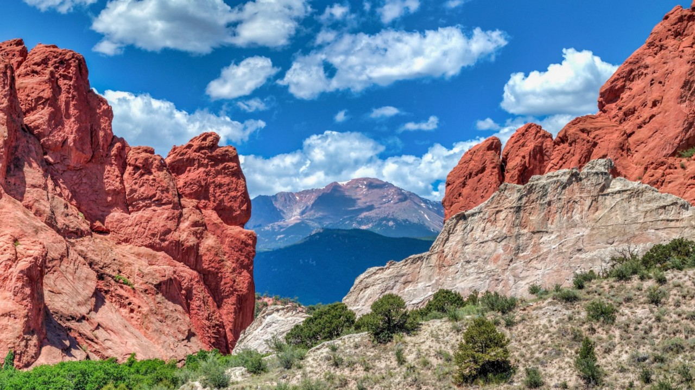
El Paso County
Office of the Coroner
2021 Annual Report
Leon Kelly, M.D.
Coroner/Chief Medical Examiner

Slide 2

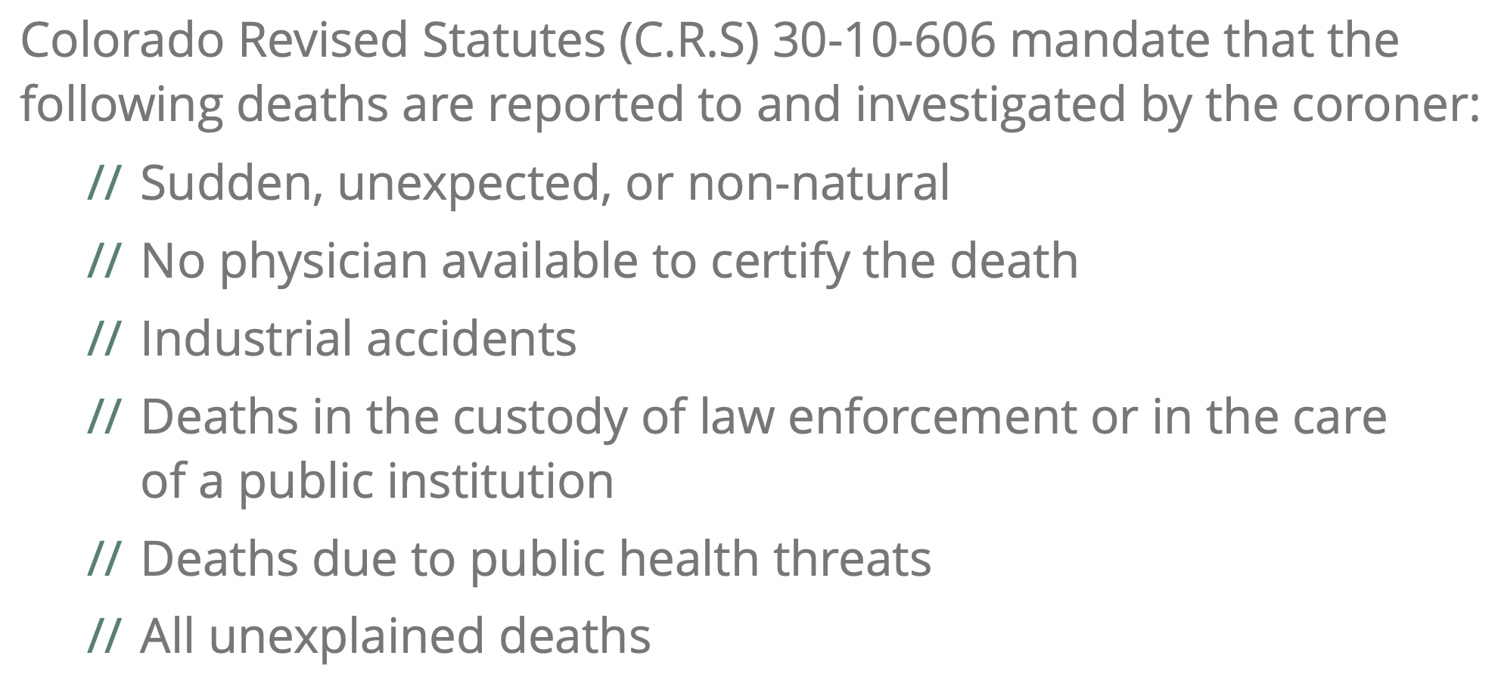
The Role of the Coroner

Slide 3

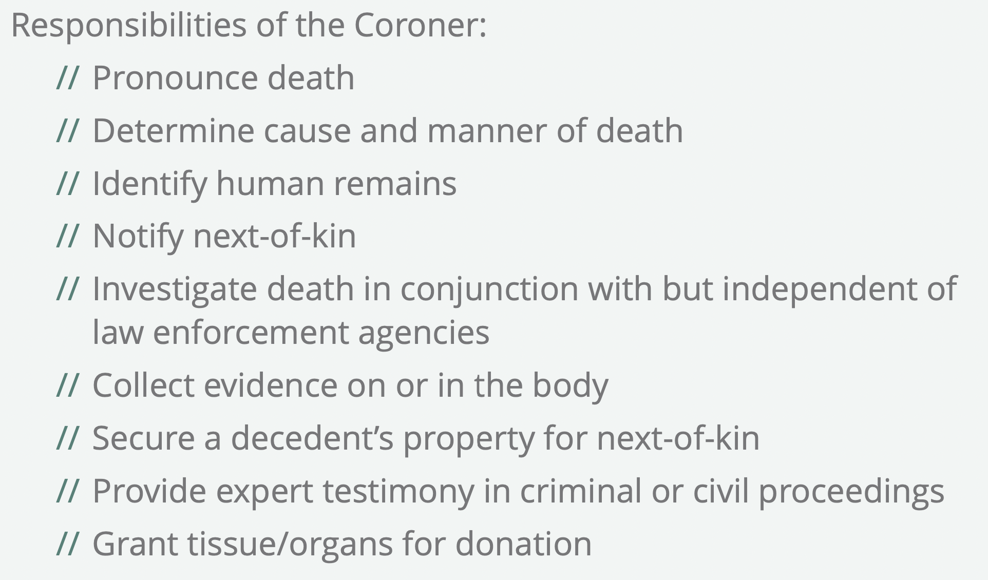

Slide 4
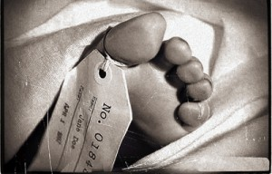
Death Investigation in America
Coroner System
Medical Examiner System
Adopted, Antiquated
Citizen
No meaningful qualifications:
  18 years-old, H.S. diploma
  Non-felon
  Registered voter
Elected
Statutory powers to investigate deaths and issue death certificates
Entirely dependent on forensic pathologist to perform autopsy and determine cause and manner of death
Evolved with advances in medicine, forensics, and law
Board-certified forensic pathologist
Physicians specially trained in the investigation of death and forensic sciences
Appointed from qualified applicants
Statutory powers to investigate deaths and issue death certificates
Has expertise to investigate deaths, perform autopsies, and rule on cause and manner of death

Slide 5
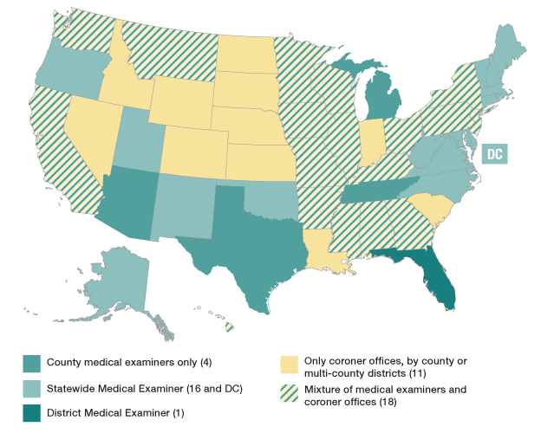
Death Investigation Systems in the U.S.

Slide 6
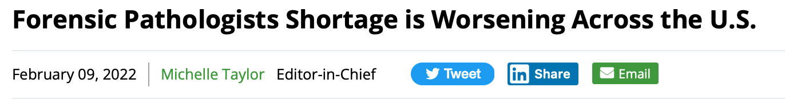
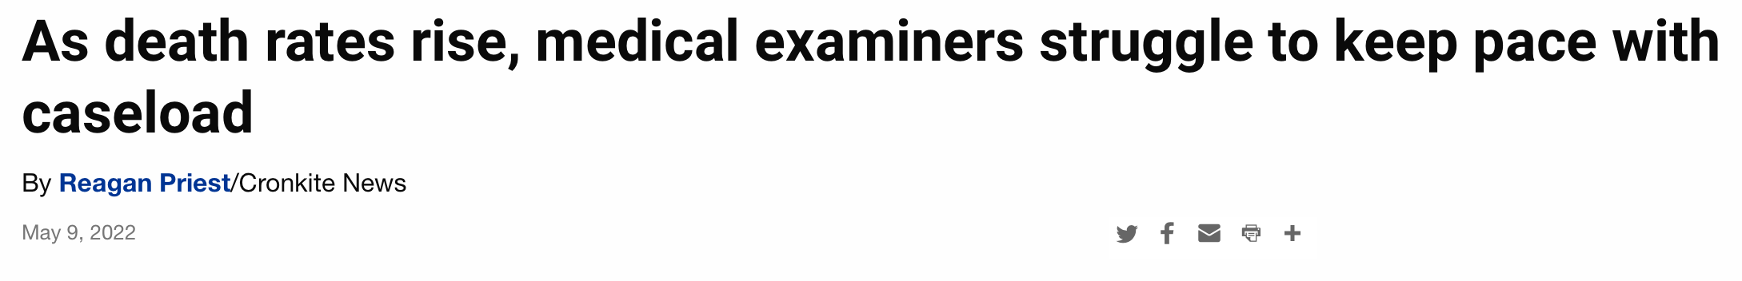

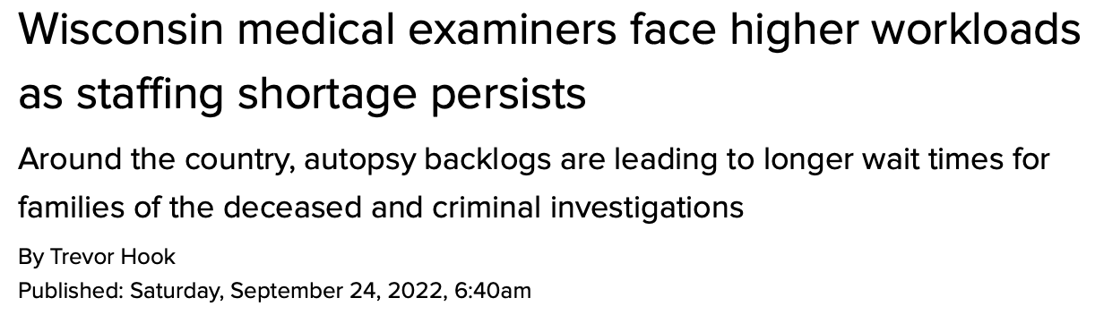
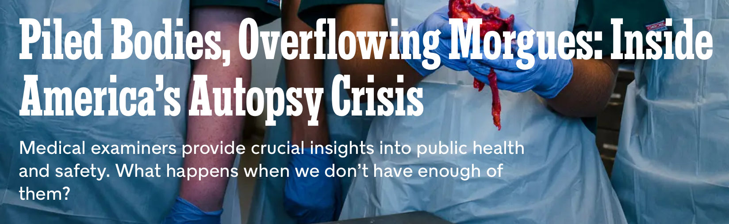

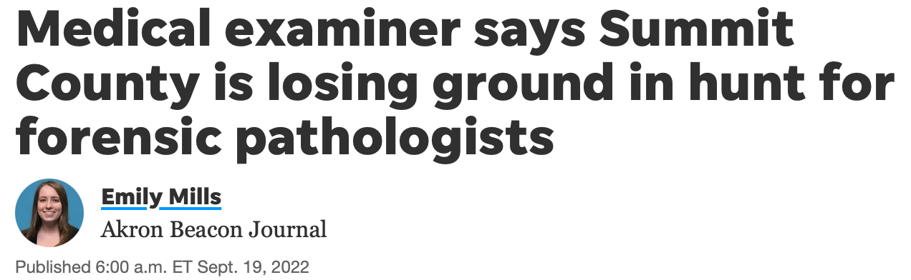
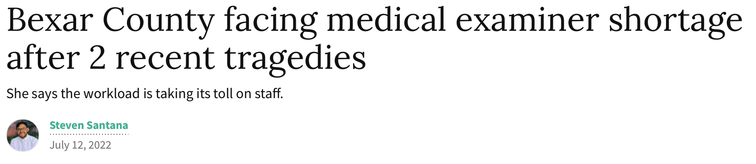
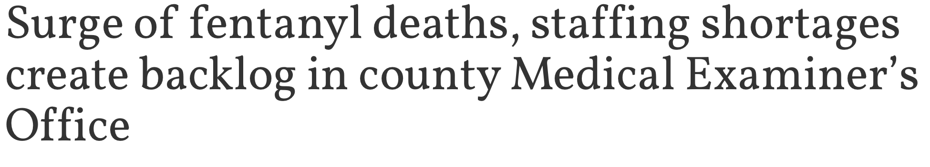
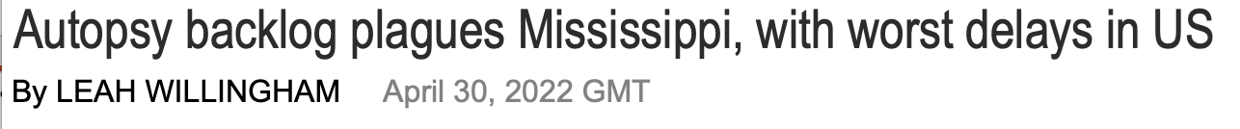
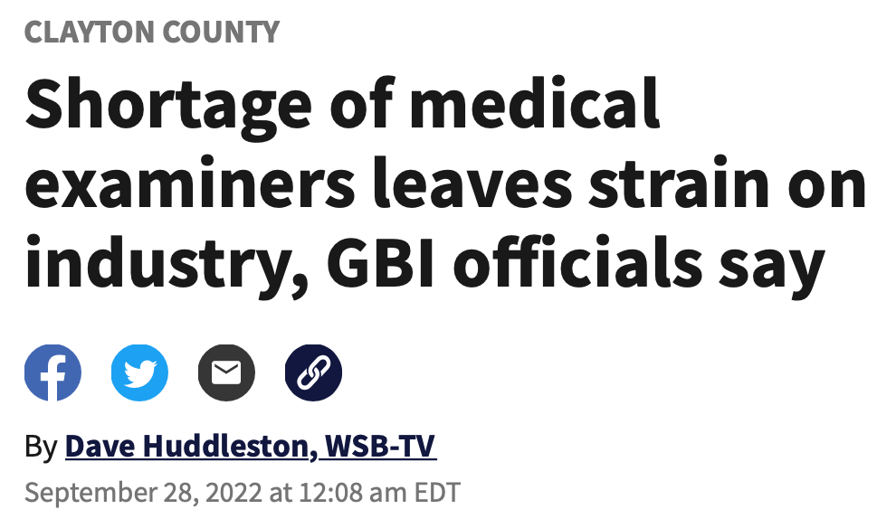
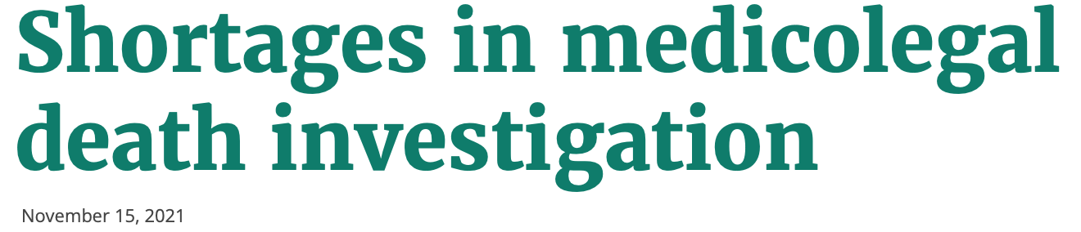
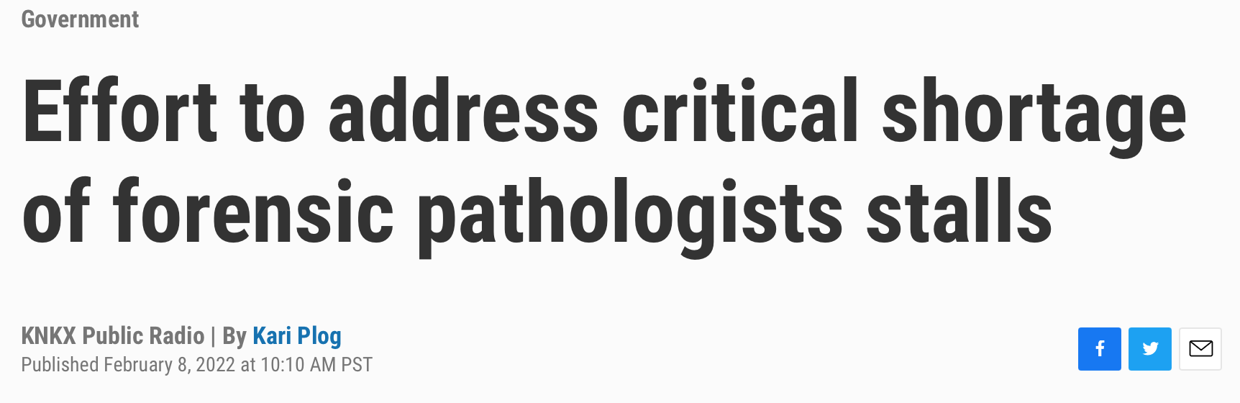
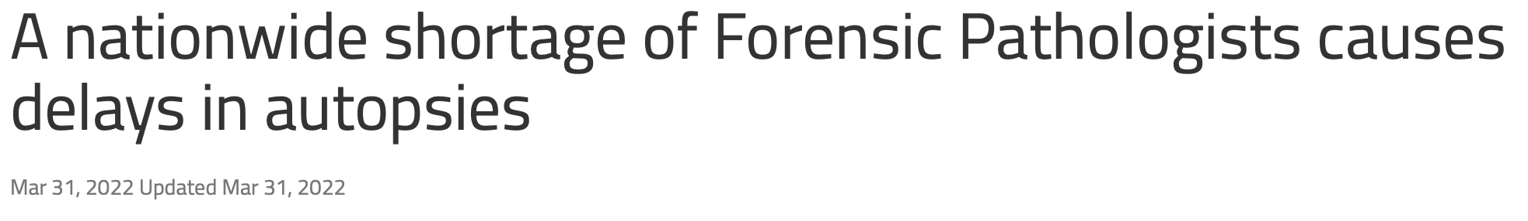

Slide 7
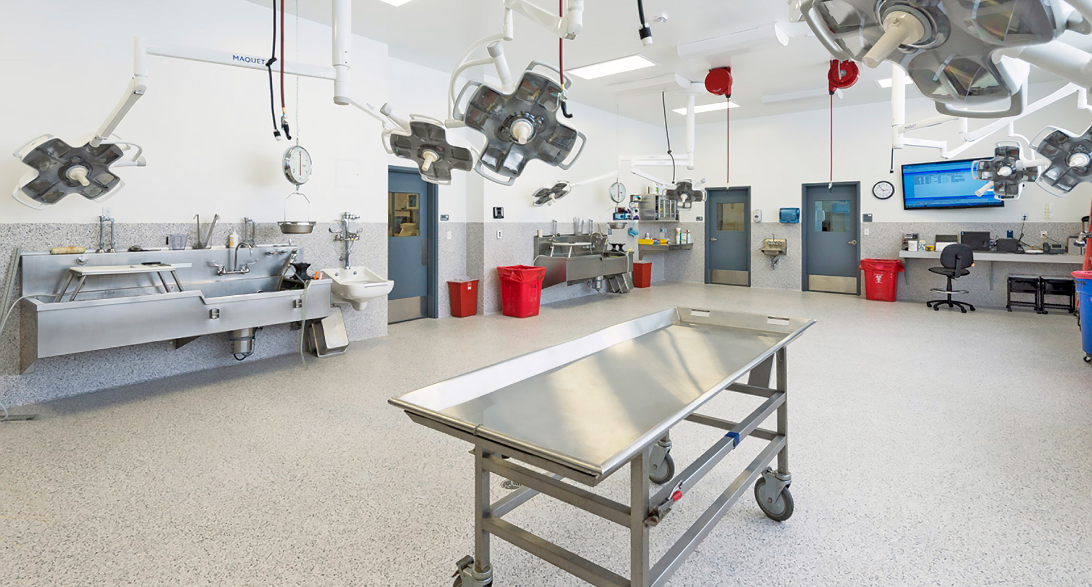
Operating Colorado’s Busiest Coroner’s Office
Elected Coroner/Chief Medical Examiner/Medical Director
Medical Examiners/Forensic Pathologists
Toxicologists
Death Investigators
Histologist
Morgue Technicians

Slide 8
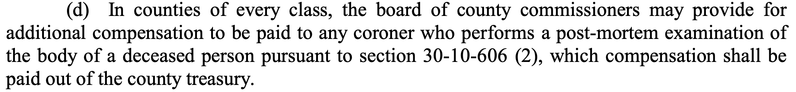
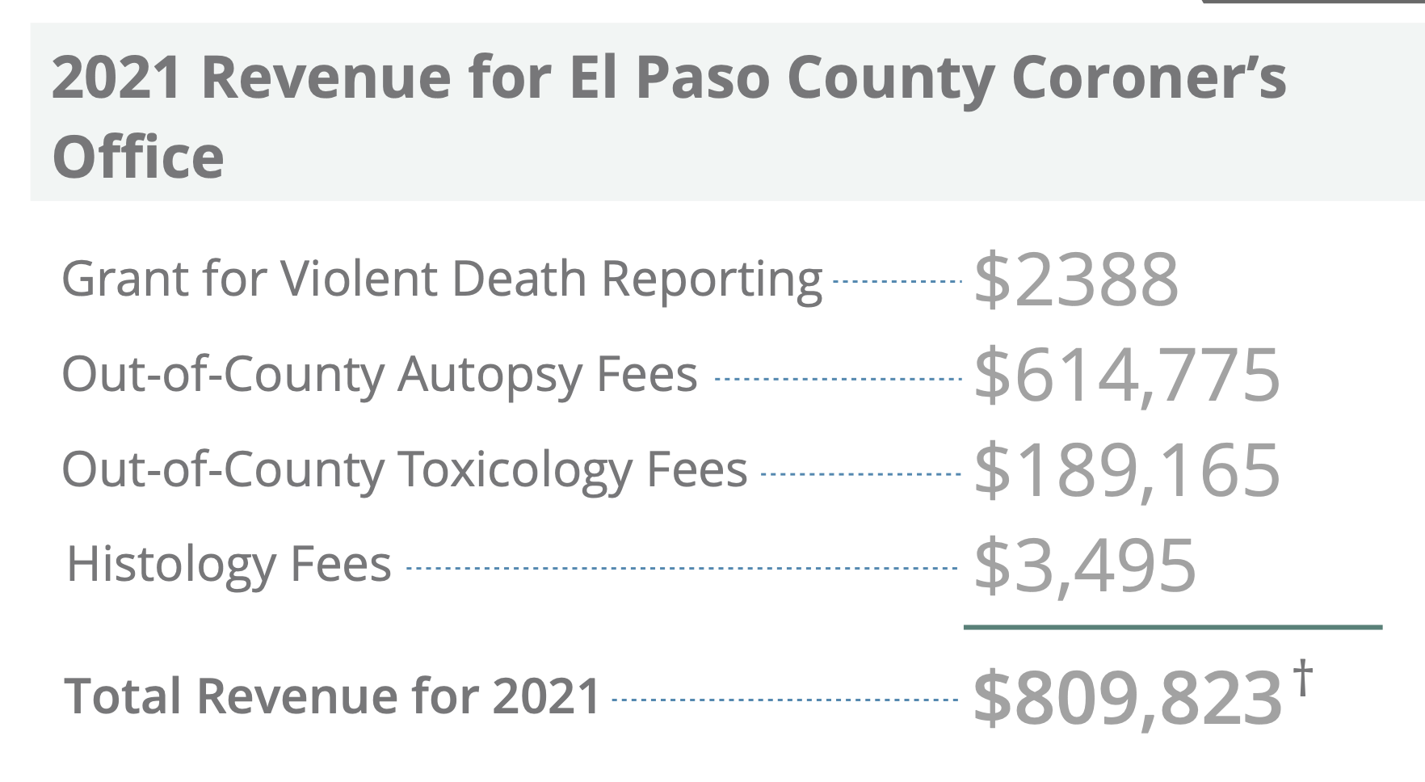
Financial Structure
CRS 30-2-108:
Alternative Compensation Models:
- Dr. Bux transitioned from fee-based in mid 2000’s
Salary model costs $1.2 million in M.E. salaries
Conctract fee model costs ($1500 for 1500 autopsies) of $2.25 million in M.E. salaries
Contract fee model for 2021 compensation of Chief M.E. after 316 autopsies would have been $474K + Coroner

Slide 9
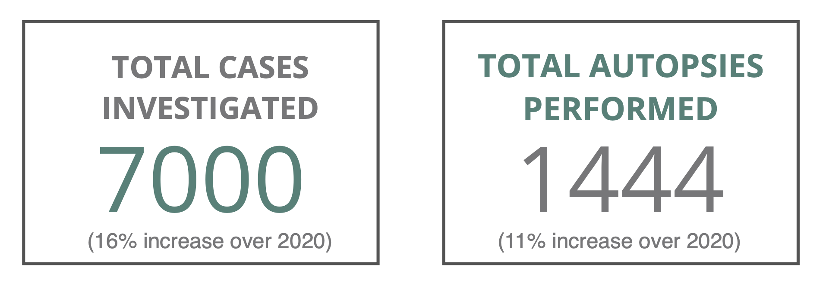

Slide 10
Deaths Investigated by EPCCO

Slide 11
10-Year Autopsy Trends for EPCCO

Slide 12
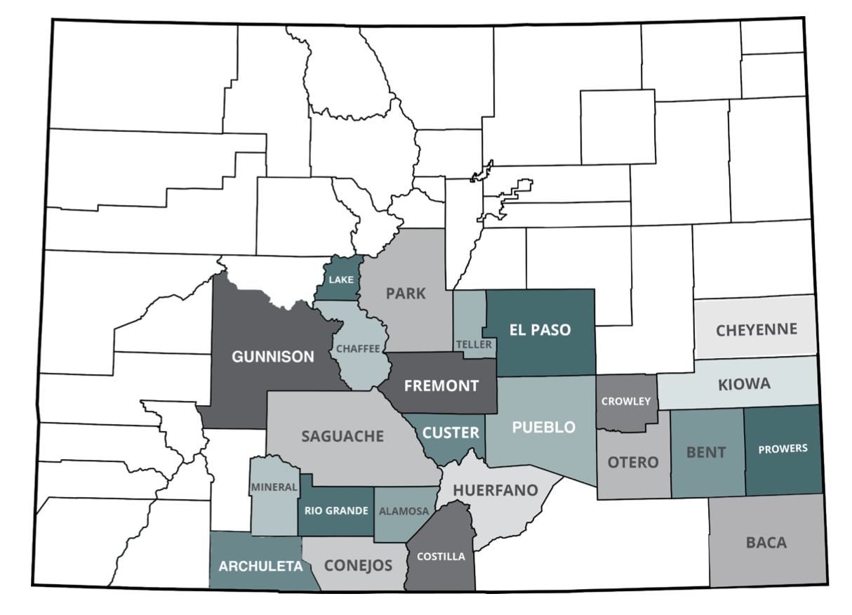
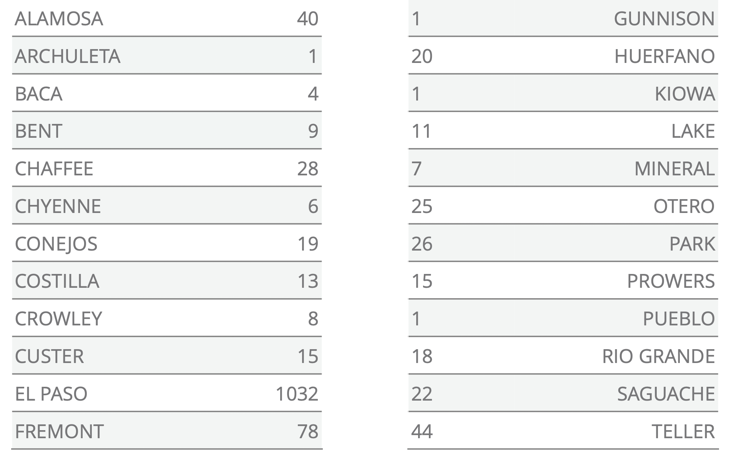
Regional Medical Examiner

Slide 13
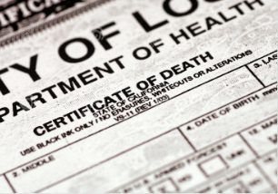
Cause and Manner
Manner
I. Cause
II. Contributor

Slide 14

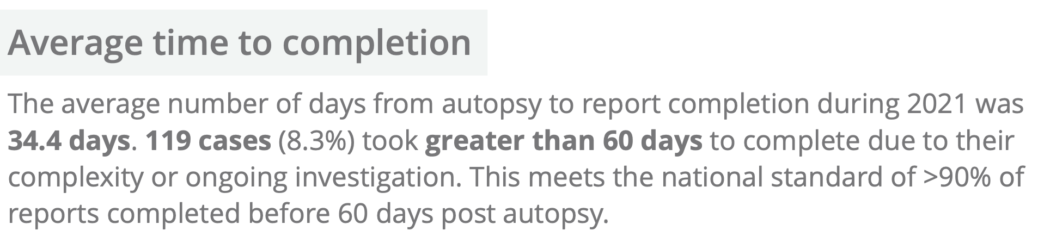

Slide 15
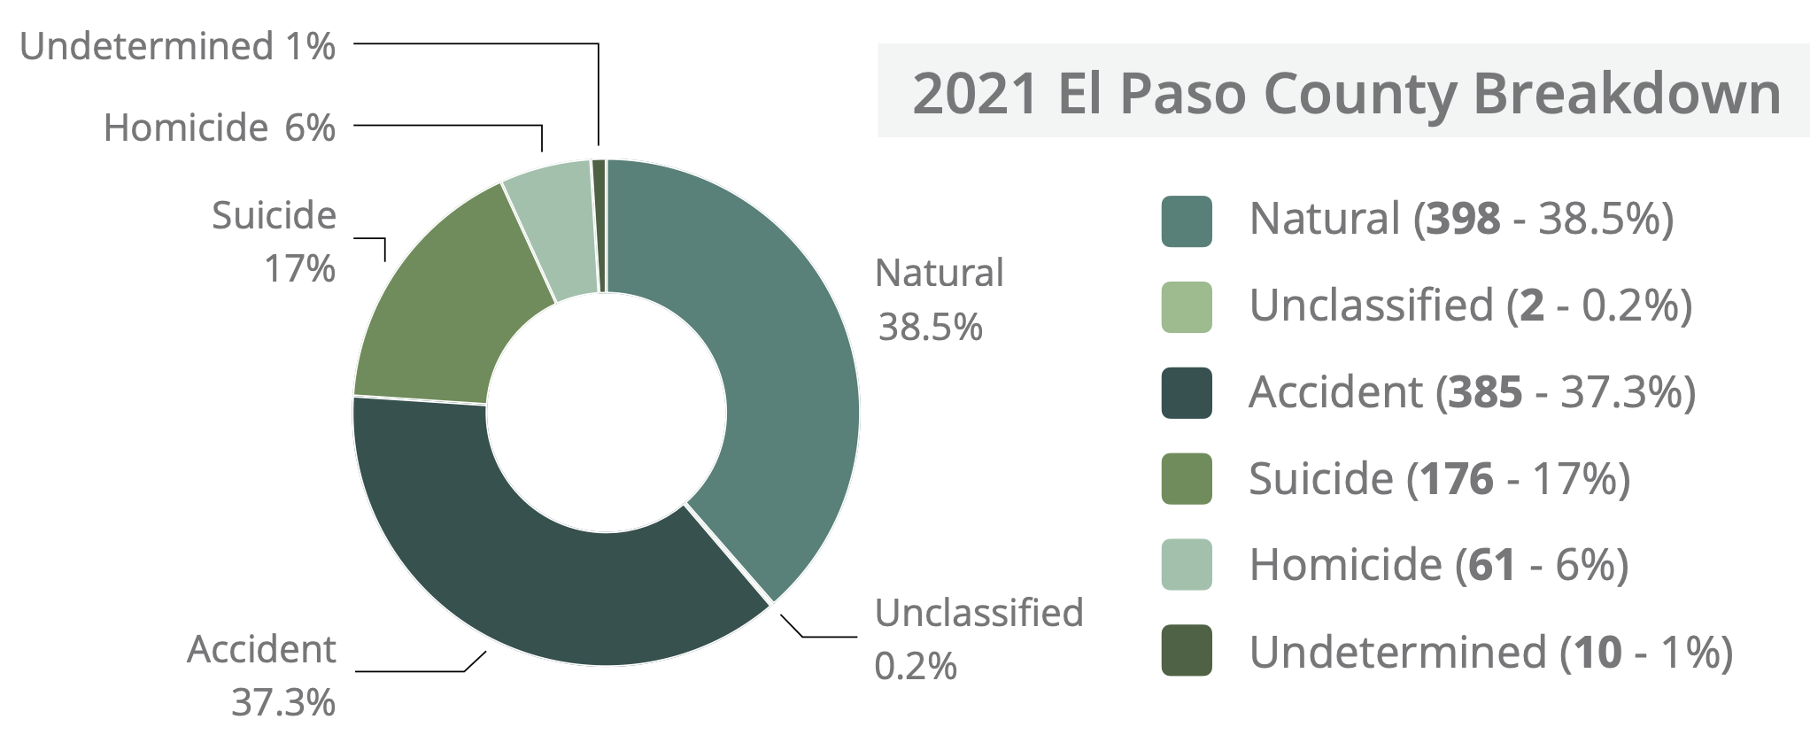

Slide 16
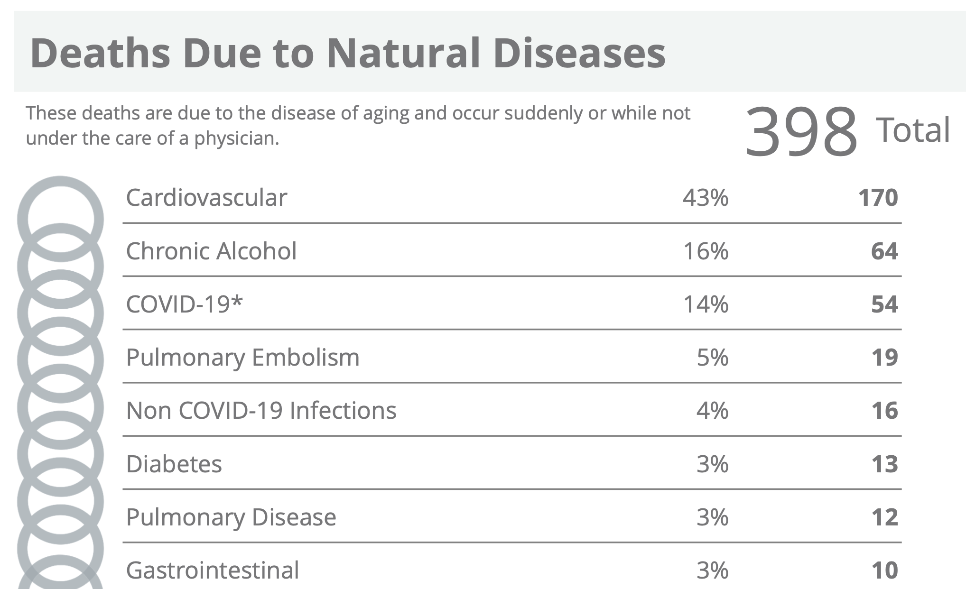
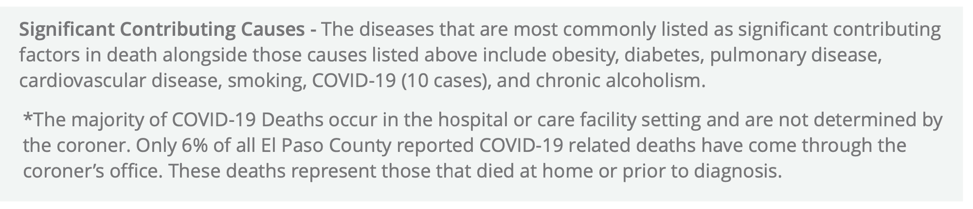

Slide 17
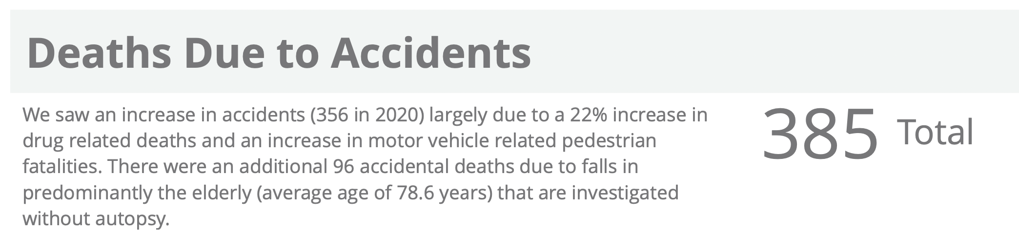
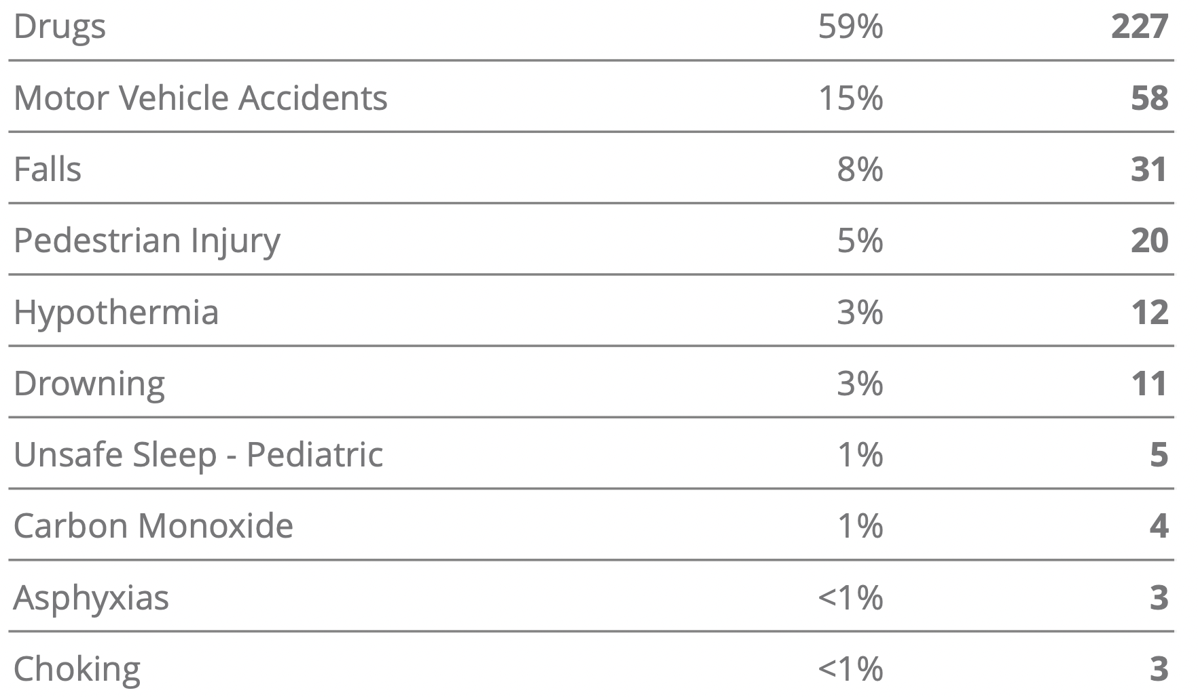
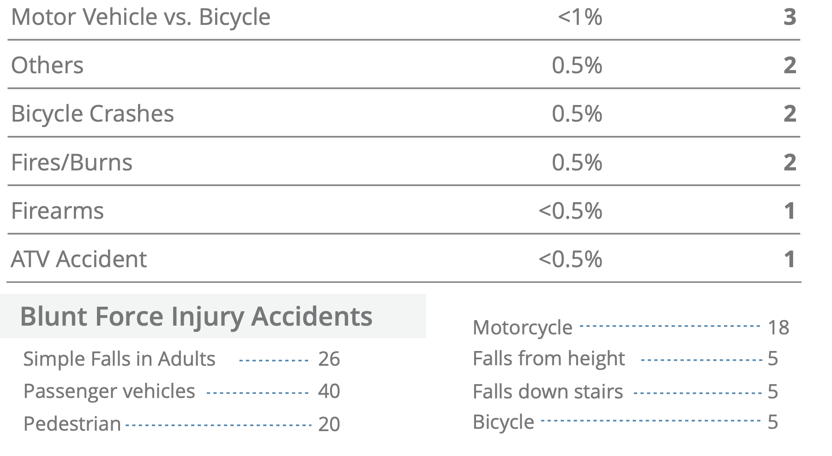

Slide 18
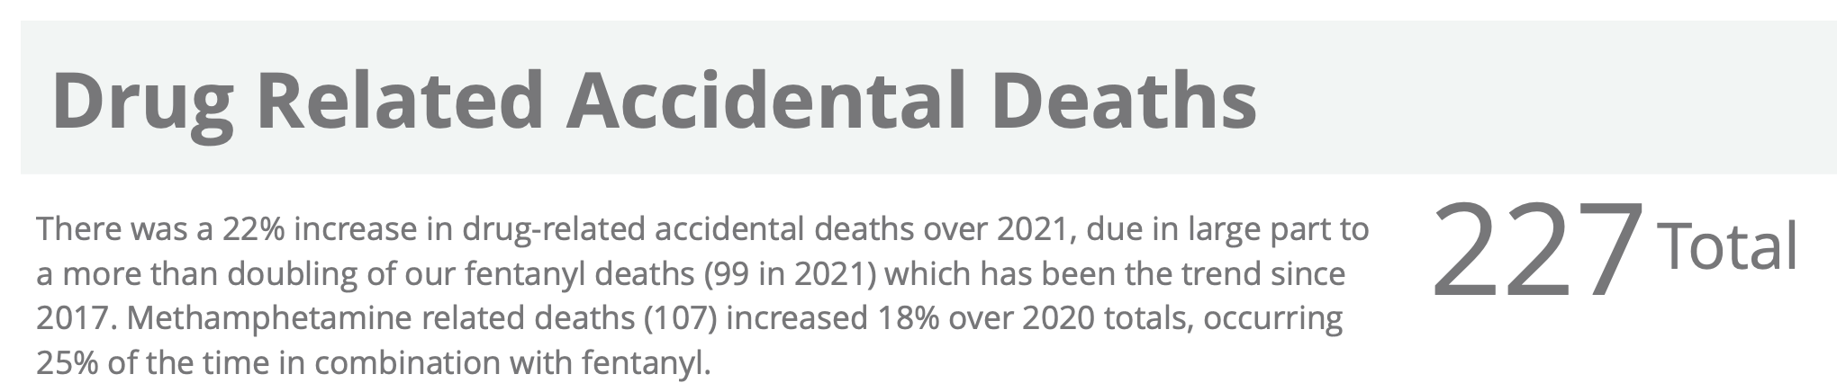
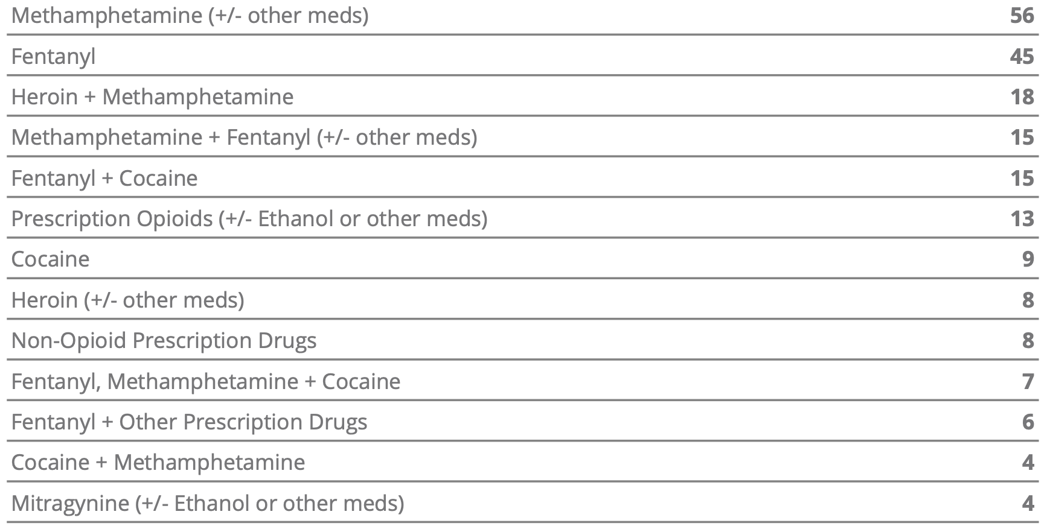
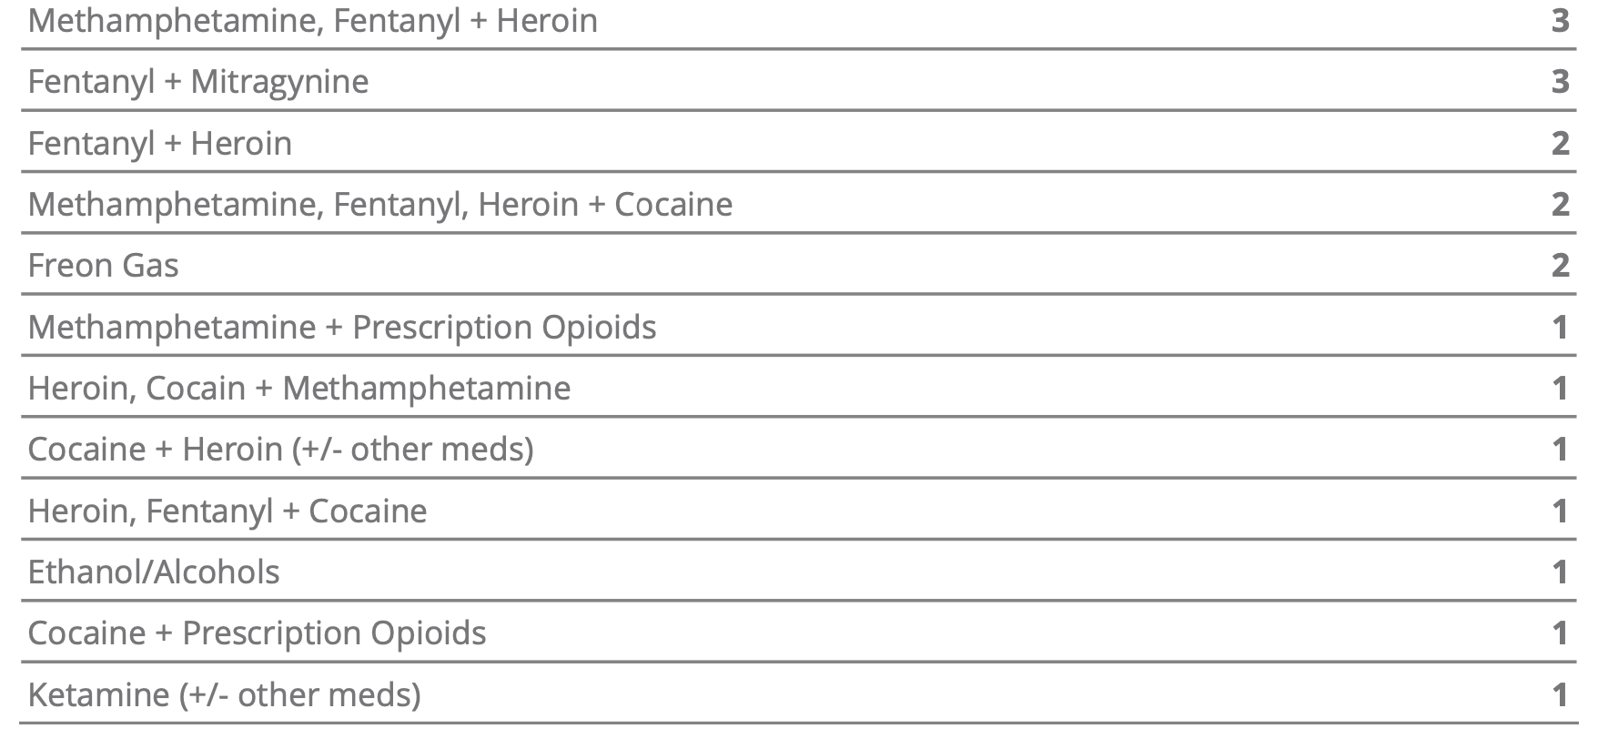

Slide 19
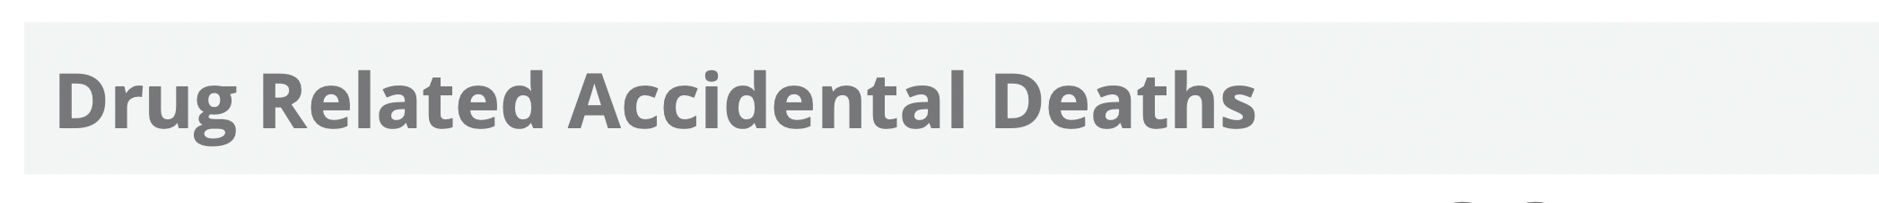
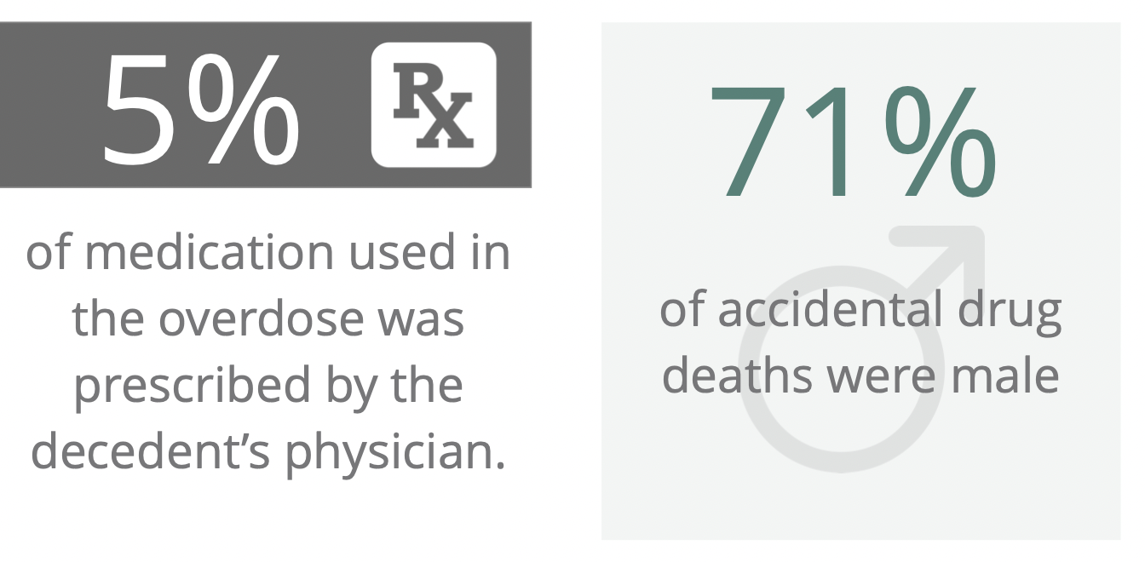
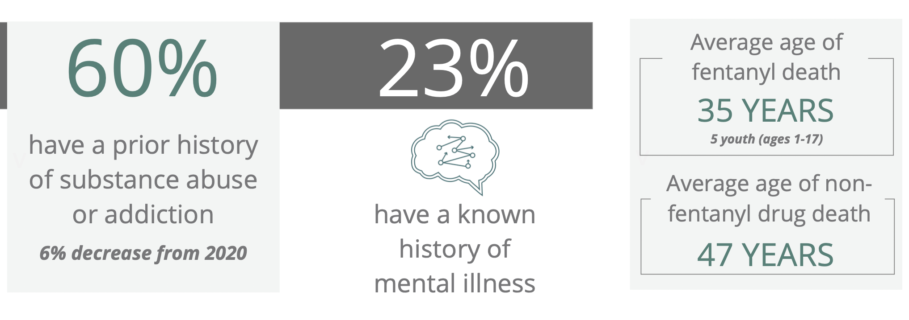
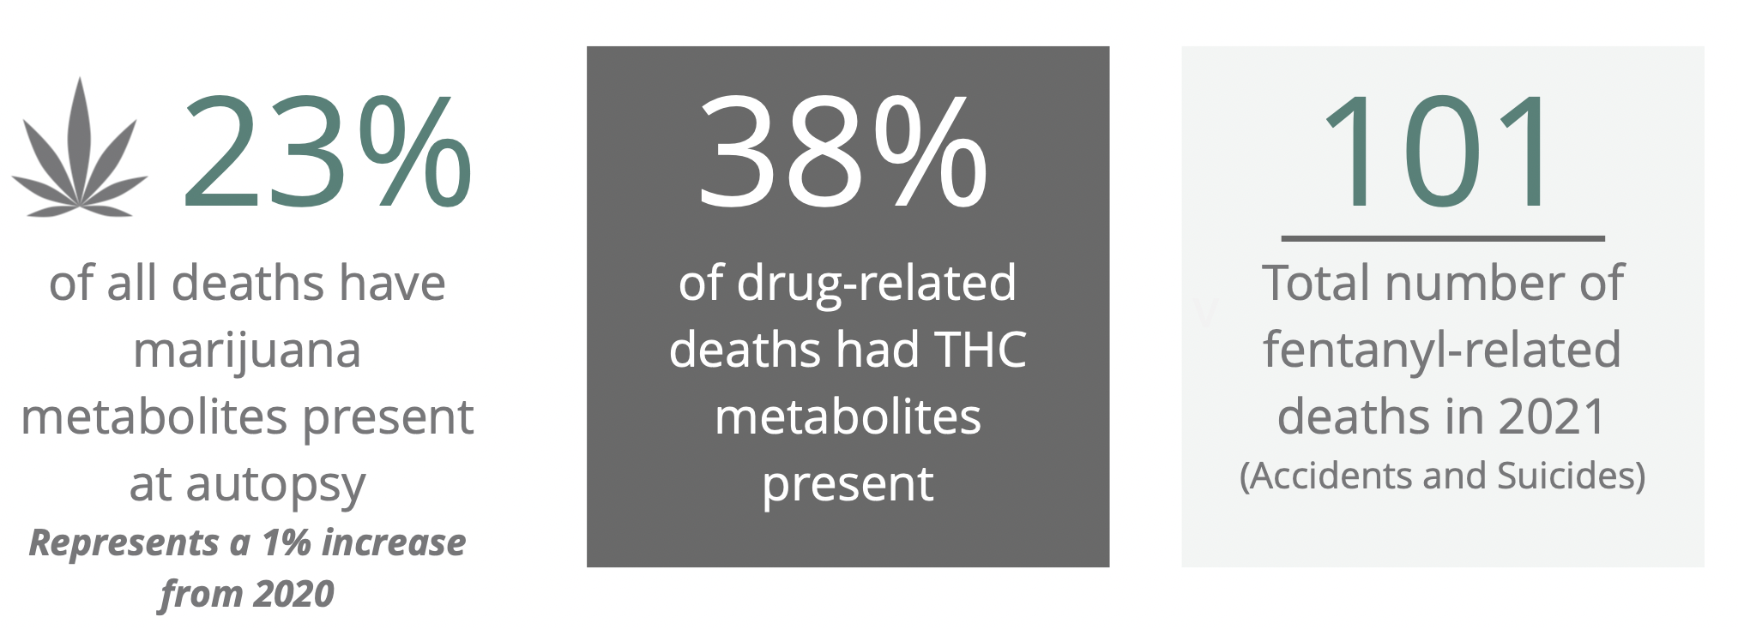
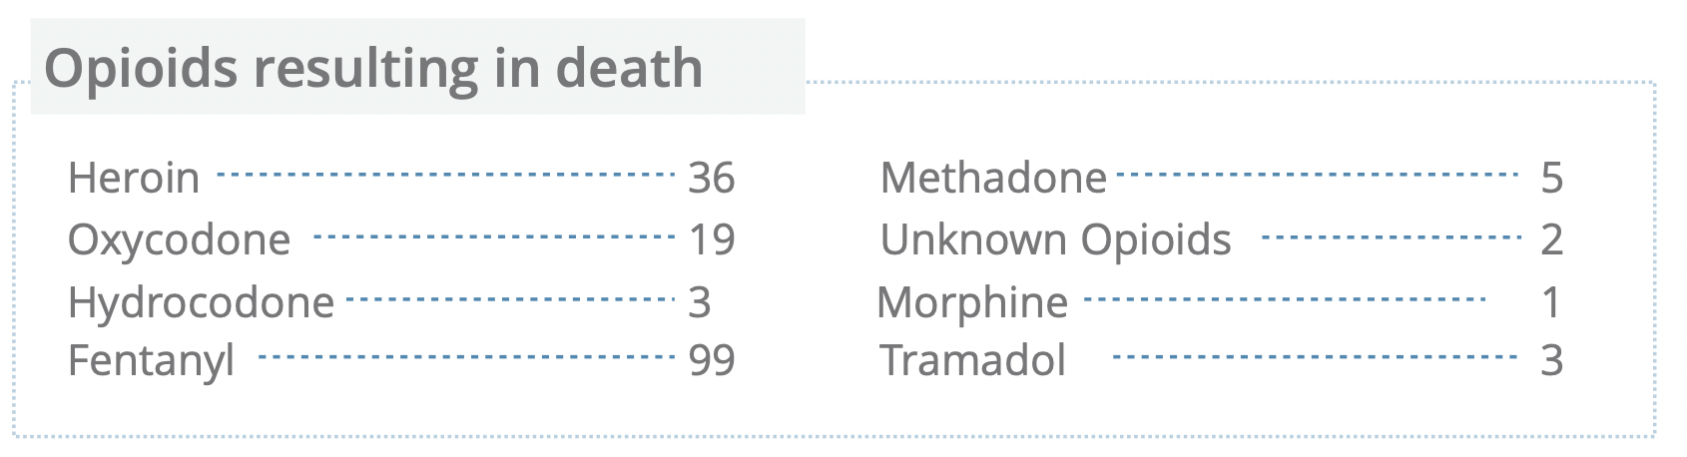

Slide 20
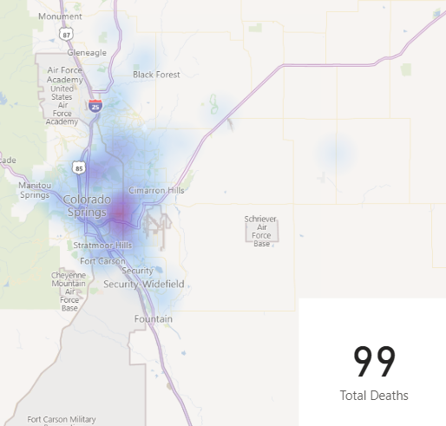
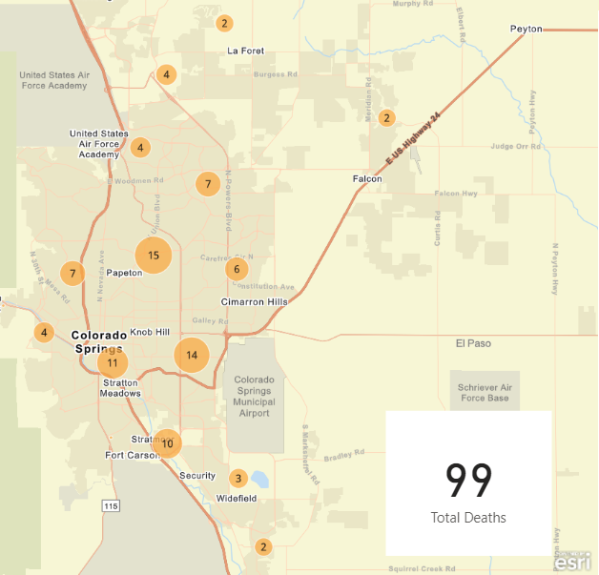
Fentanyl Deaths Geographic Distribution

Slide 21
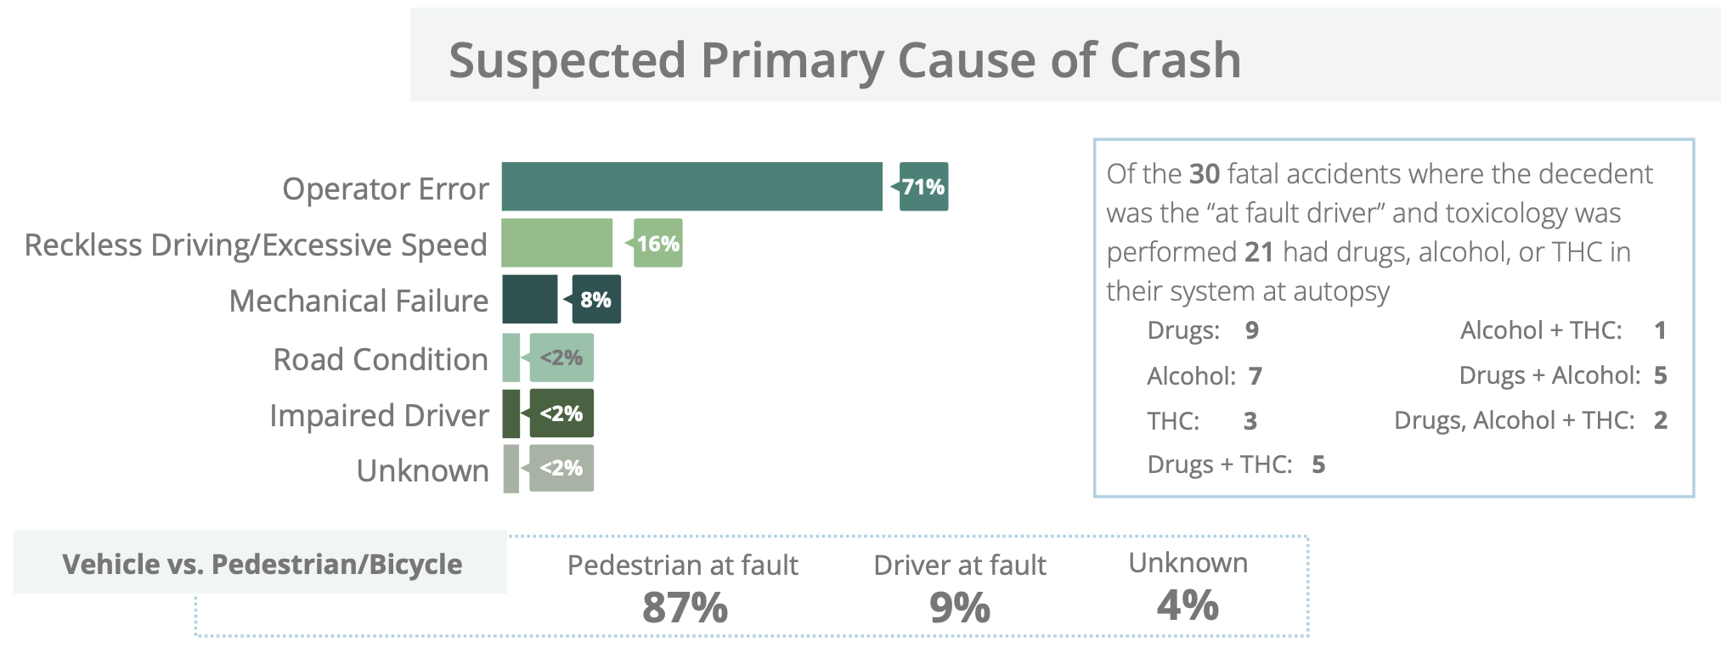
Motor Vehicle Fatalities

Slide 22
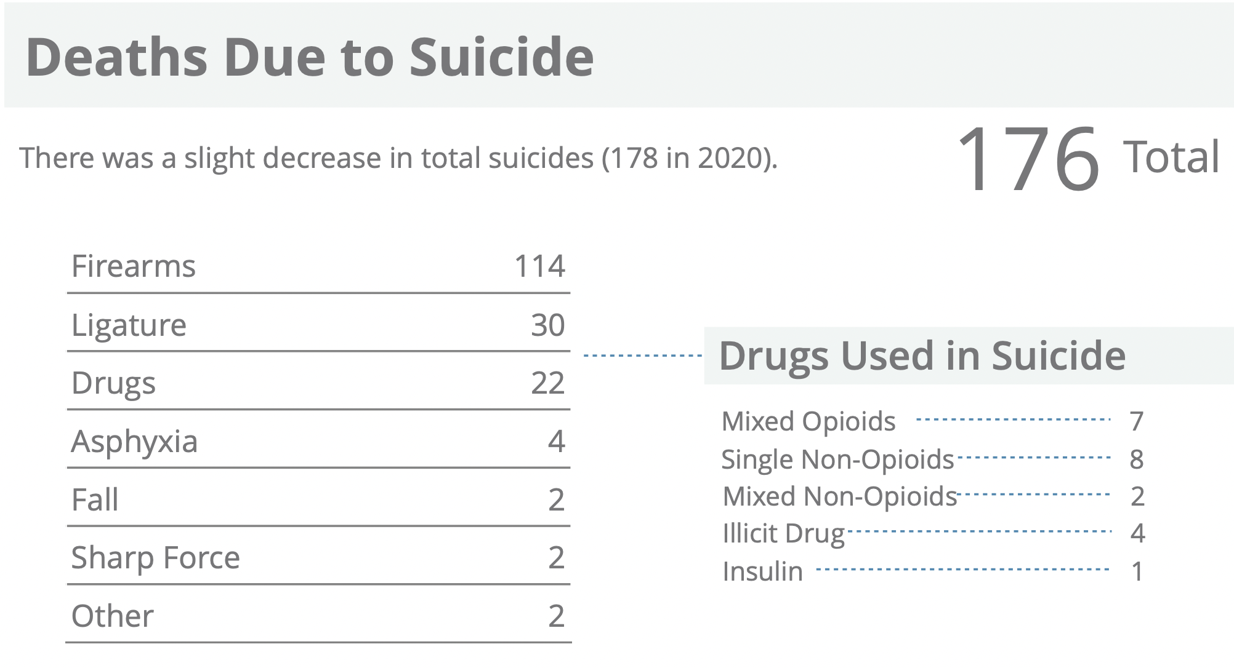

Slide 23
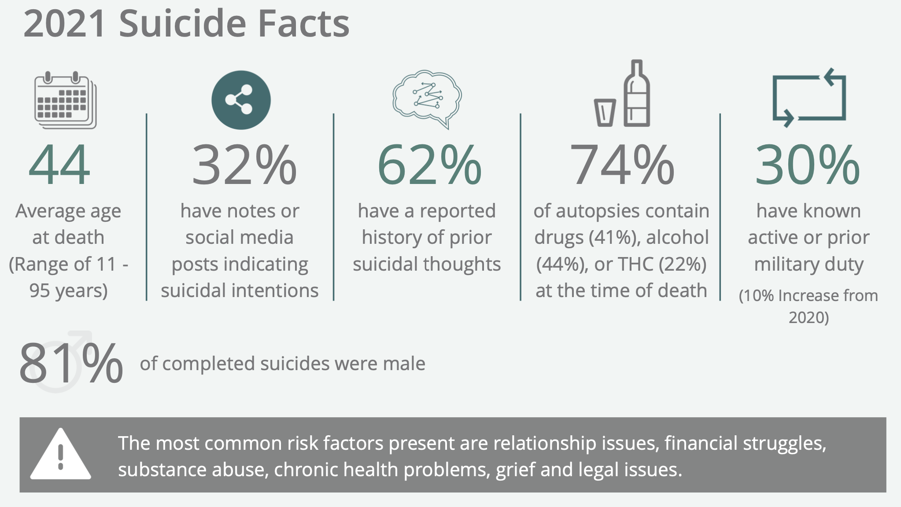

Slide 24
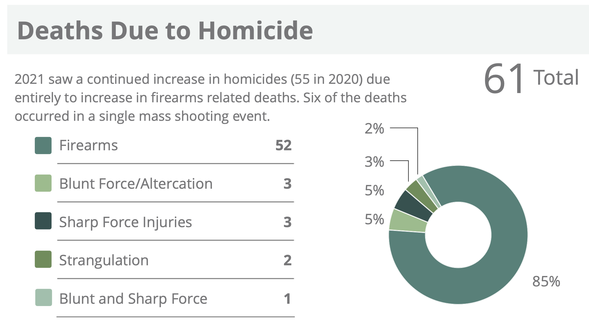

Slide 25
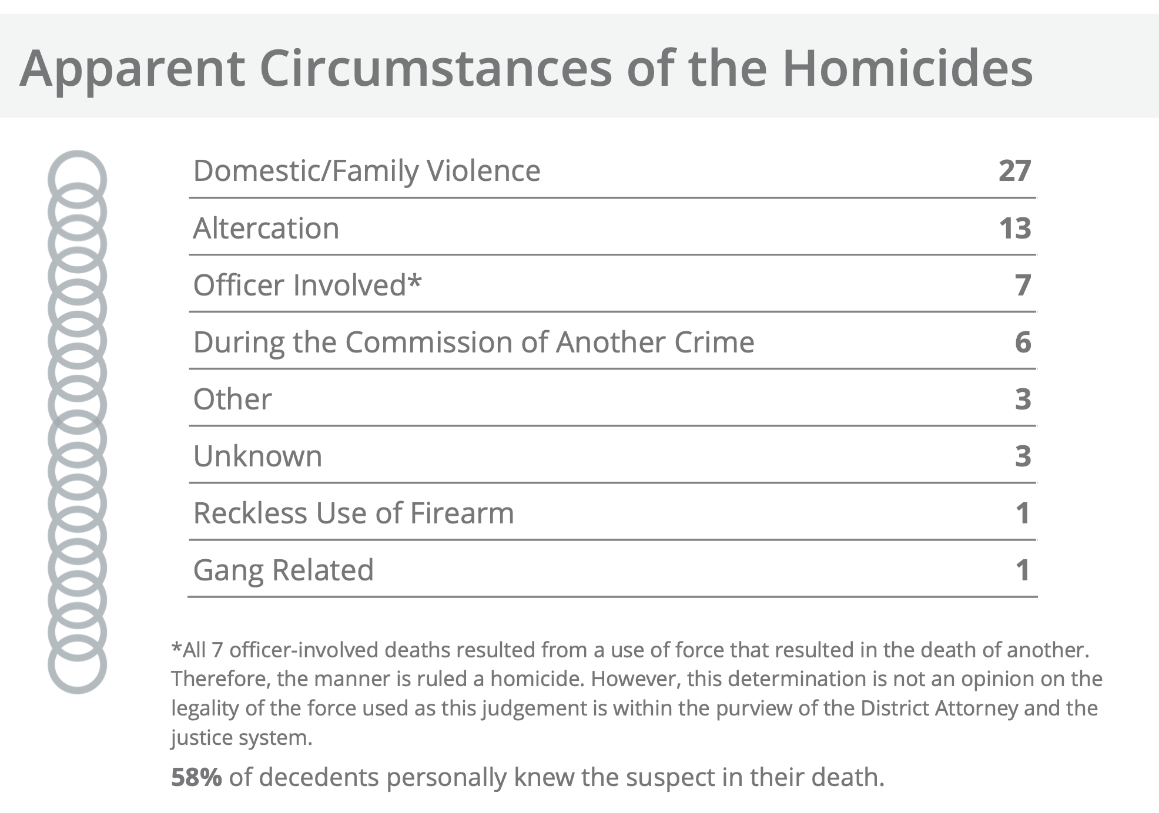

Slide 26
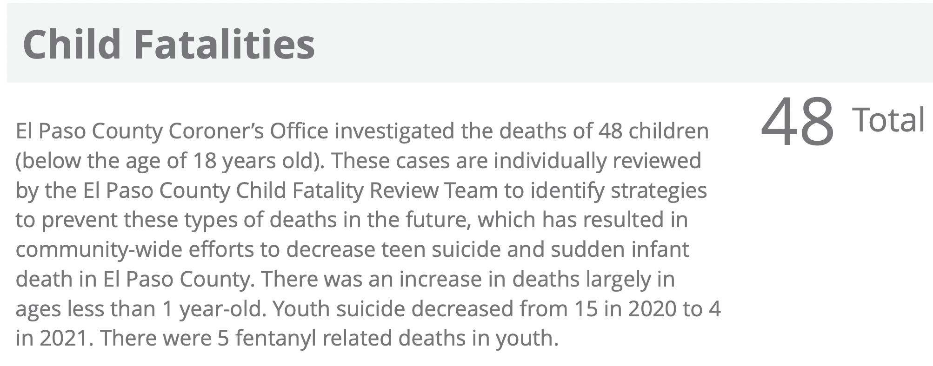

Slide 27
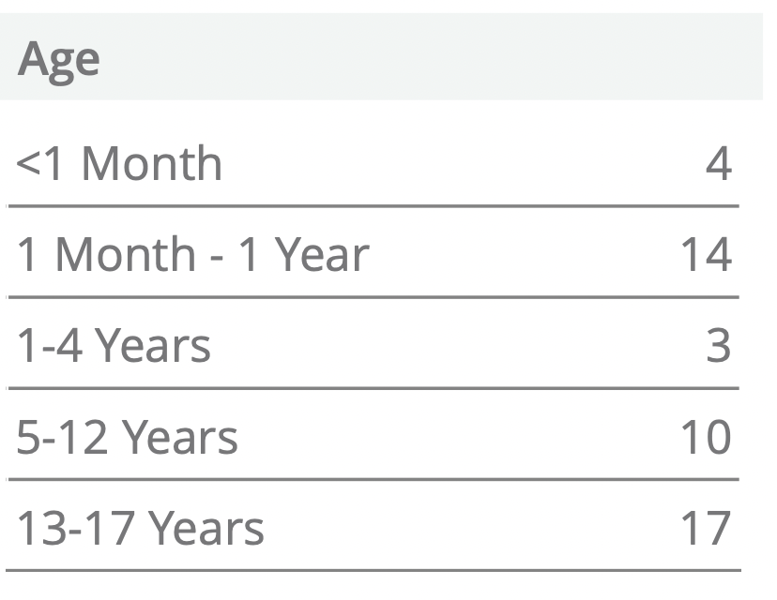
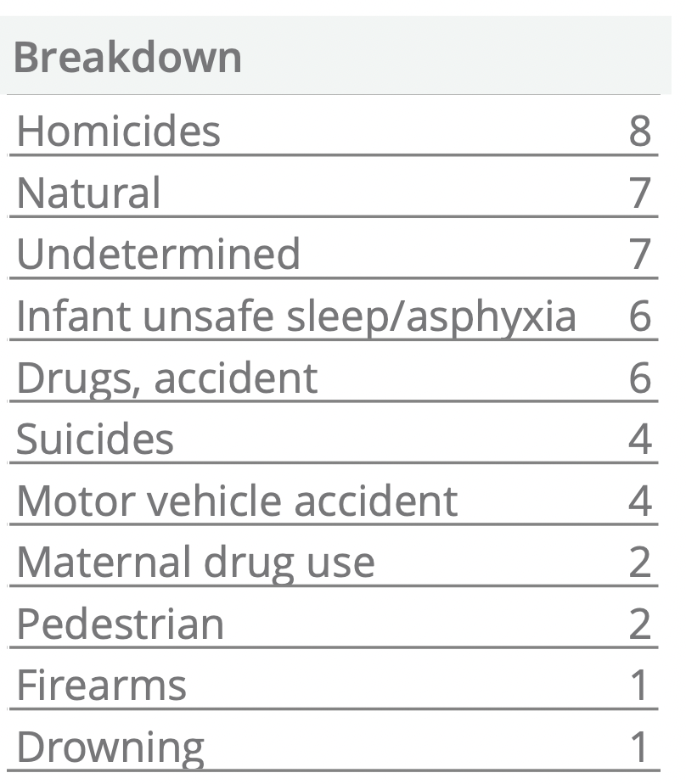
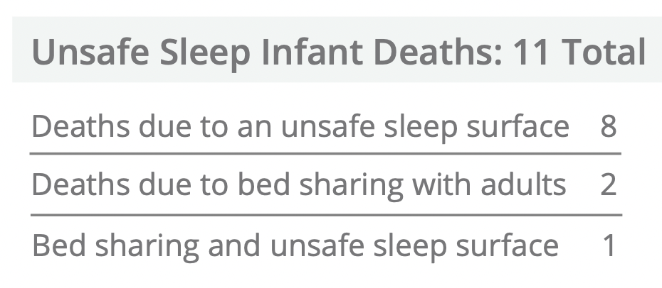

Slide 28



Slide 29





Slide 30


Slide 31





Slide 32


