Slide 1
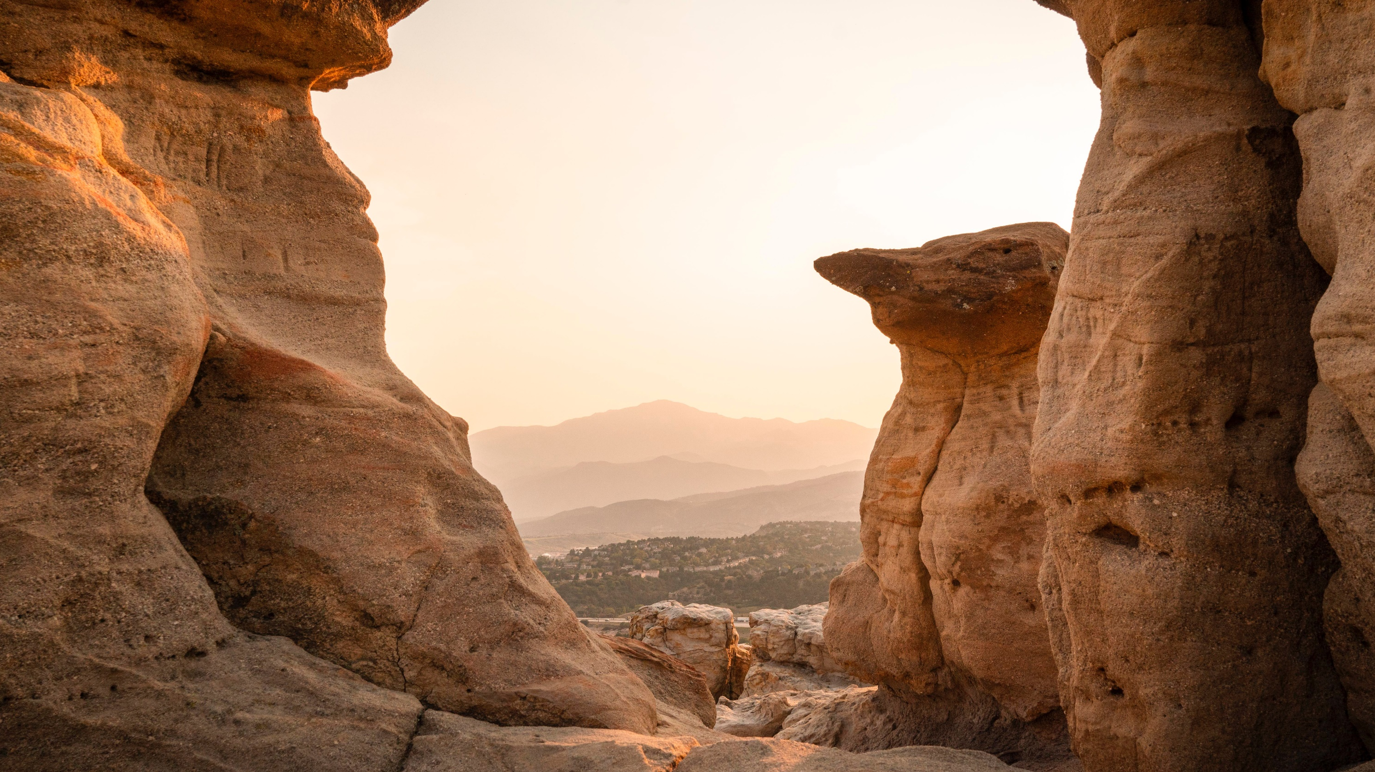

El Paso County Community Development Block Grant Program
2022-2026 Consolidated Plan
2022 Annual Action Plan
Crystal LaTier
Executive Director of Economic Development

Slide 2
Community Development Block Grant (CDBG) Program Overview
El Paso County became an “Entitlement Community” in 2009, qualifying for a direct CDBG allocation from U.S. Department of Housing and Urban Development (HUD)
Purpose: develop viable urban communities by providing decent housing, establishing and maintaining suitable living environments, and expanding economic opportunities, primarily for residents of limited means
El Paso County develops several HUD approved, long range strategic plans for use of this funding
Funds may not be used in city limits of Colorado Springs

Slide 3
CDBG PROGRAM OVERVIEW
Applications for funding are solicited from eligible entities on an annual basis
Community Development Advisory Board, appointed by the Board of County Commissioners, reviews applications and makes funding recommendations
Final approval given by Board of County Commissioners
Projects and activities must be included in an Annual Action Plan and meet goals outlined in the current Consolidated Plan in order to be awarded funding
The 2022-2026 Consolidated Plan and the 2022 Annual Action Plan will be submitted to the U.S. Department of Housing and Urban Development in July 2022

Slide 4
Community development advisory board
District 1 | Rachel Starr
District 2 | Vacant
District 3 | Tiffany Colvert
District 4 | Tamara Estes
District 5 | Robert Null
City of Fountain | Todd Evans
Town of Green Mountain Falls | Tyler Stevens (Chair)
Town of Calhan/Ramah | Cindy Tompkins (Vice Chair)
Town of Palmer Lake | Vacant
City of Manitou Springs | Denise Howell
Town of Monument | Madeline VanDenHoek
  Commissioner Liaison: Commissioner Carrie Geitner
  Staff Liaison: Delilah Porras-Nuevo, Community Development Analyst

Slide 5
Community outreach & engagement
4 public meetings were held
Two public planning meetings were held in January 2022, and two public meetings were held in June 2022 to discuss the draft plans.
21 consultation meetings were conducted
Consultation meetings were conducted with local community organizations and municipalities in El Paso County throughout the planning process.
113 respondents completed the survey
A public survey was distributed online and by paper, which was intended for citizens in the community to provide their feedback.

Slide 6
2022-2026 consolidated plan

Slide 7
Consolidated Plan: 2022-2026 goals
Housing
H1 Goal – Improve access to transportation services and infrastructure, remove impediments to mobility and increase access to opportunities.
H2 Goal – Rehabilitation of pre-existing housing inventory to increase affordable, accessible housing choices.
H3 Goal – Increase fair housing education, outreach, and enforcement.
Homelessness
&
Special Needs
HM1 Goal – Assist in ensuring that homelessness is brief, rare, and non-recurring.
SN1 Goal – Help special needs residents obtain housing and remain housed while living independently as they choose.
SN2 Goal – Reduce accessibility barriers (ADA compliance).
SN3 Goal – Provide for and improve access to services to stabilize living situations and enhance quality of life, particularly for seniors, youth, and special needs populations.
Community
Development
CD1 Goal – Improve infrastructure to foster accessible and livable neighborhoods and improve access to public amenities.
CD2 Goal – Develop or improve facilities that provide services to low- to moderate income residents and specials needs populations.
CD3 Goal – Expand economic opportunities for low- to moderate income residents.

Slide 8
2022-2026 CDBG goals
Housing
H1 - Improve access to transportation services and infrastructure, remove impediments to mobility and increase access to opportunities.
Strategy – Utilize CDBG allocation to annually fund activities related to transportation accessibility which will serve to strengthen regional collaboration and transportation connections that increase access to opportunity.
Final Milestone – The final milestone will be having funded transportation accessibility activities that support 1,000 residents by the end of the 2026 program year.
H2 – Rehabilitation of pre-existing housing inventory to increase affordable, accessible housing choices.
Strategy – Utilize CDBG allocation to annually fund activities that rehabilitate income-eligible, owner-occupied housing and publicly supported housing to increase the number of accessible units.
Final Milestone – The final milestone will be to rehabilitate 25 units by the end of the 2026 CDBG program year.

Slide 9
2022-2026 CDBG goals
Housing
H3 – Increase fair housing education, outreach, and enforcement.
Strategy – El Paso County CDBG staff will regionally coordinate semi-annual fair housing outreach and educational opportunities.
Final Milestone – The final milestone will be to coordinate 10 fair housing events by the end of the 2026 CDBG program year. Additionally, El Paso County will set the goal of increasing participant attendance by 10% each year.

Slide 10
2022-2026 CDBG goals
Homelessness and special needs
HM1 - Assist in ensuring that homelessness is brief, rare, and non-recurring.
Strategy – Utilize CDBG allocation to fund activities that assist eligible residents who are experiencing homelessness.
Final Milestone – The type of assistance may vary depending upon an individual’s position on the homeless continuum, but the final milestone will be assisting at least 500 homeless or those at risk of homelessness by the end of the 2026 program year.
SN1 - Help special needs residents obtain housing and remain housed while living independently as they choose.
Strategy – Utilize CDBG allocation to fund activities that assist special needs residents with housing needs.
Final Milestone – The final milestone will be assisting 50 special needs residents with housing assistance by the end of the 2026 program year.

Slide 11
2022-2026 CDBG goals
Homelessness and special needs
SN2 - Reduce accessibility barriers (ADA compliance).
Strategy – Utilize CDBG allocation to fund activities that reduce accessibility barriers and assist with ADA compliance.
Final Milestone – The final milestone will be providing CDBG assistance to public facility/infrastructure activities that address physical accessibility barriers which assist 1,000 residents by the end of the 2026 program year.
SN3 - Provide for and improve access to services to stabilize living situations and enhance quality of life, particularly for seniors, youth, and special needs populations.
Strategy – Utilize CDBG allocation to provide for and improve access to services to stabilize living situations and enhance quality of life, particularly for seniors, youth, and special needs populations.
Final Milestone – The final milestone will be assisting 1,000 residents (with particular focus on seniors, youth, and special needs populations) by the end of the 2021 program year.

Slide 12
2022-2026 CDBG goals community development
CD1 - Improve infrastructure to foster accessible and livable neighborhoods and improve access to public amenities.
Strategy – Utilize CDBG allocation to improve infrastructure which fosters accessible and livable neighborhoods and improves access to public amenities.
Final Milestone – The final milestone will be providing CDBG assistance to infrastructure activities that assist 1,000 residents in qualifying low to moderate income areas (LMA) by the end of the 2026 program year.
CD2 - Develop or improve facilities that provide services to low- to moderate income residents and special needs populations.
Strategy – Utilize CDBG allocation to develop or improve facilities that provide services to low- to moderate income residents and special needs populations.
Final Milestone – The final milestone will be providing CDBG assistance to public facility activities that provide services to 1,000 low- to moderate income residents by the end of the 2026 program year.

Slide 13
2022-2026 CDBG goals community development
CD3 - Expand economic opportunities for low- to moderate income residents.
Strategy – Utilize CDBG allocation to expand economic opportunities for low- to moderate income residents.
Final Milestone – The final milestone will be assisting 200 residents with employment training by the end of the 2026 program year.

Slide 14
2022 annual action plan

Slide 15
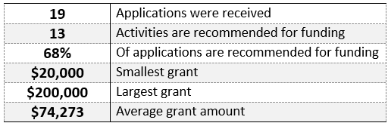
2022 applications
Five Eligible Projects:
PUBLIC SERVICES
PUBLIC FACILITIES
INFRASTRUCTURE
HOUSING
ECONOMIC DEVELOPMENT
2022 Activity Application Stats:

Slide 16
PUBLIC SERVICES
RECOMMENDATIONS

Slide 17
2022 public services activity recommendations
Archway Housing and Services – Increasing Food and Nutrition Security at Fountain Ridge
Funding from the 2022 El Paso County CDBG Program will provide staff to support the supplementary food for families in need through a food bank program.
Proposed Number of Residents Served: 218
Funding Recommendation: $22,153.00
Bring It Home – Freedom Springs
Funding from the 2022 El Paso County CDBG Program will provide supportive services to veterans to include transportation, support groups, nutritional training, and training in personal hygiene and self-care.
Proposed Number of Residents Served: 11
Funding Recommendation: $20,000.00
Envida – Access to Health and Other Services for Rural Seniors
Funding from the 2022 El Paso County CDBG Program will provide transportation for vulnerable populations in rural El Paso County and outlying residents seeking vital services.
Proposed Number of Residents Served: 1,713
Funding Recommendation: $43,153.00

Slide 18
2022 public services activity recommendations
Mt. Carmel Veteran’s Center – Veterans Climb
Funding from the 2022 El Paso County CDBG Program will provide services to prevent homelessness for the Pikes Peak Region’s most at-risk veterans, including promoting sufficiency through intensive case management, employment assistance, and vocational education, while utilizing wraparound support services.
Proposed Number of Residents Served: 85
Funding Recommendation: $38,153.00
Tri-Lakes Cares – Tri-Lakes Cares' Housing and Utilities Assistance
Funding from the 2022 El Paso County CDBG Program will provide emergency services for rent, utilities, or both to families in need.
Proposed Number of Residents Served: 60
Funding Recommendation: $20,000.00
The Place – Street Outreach and Emergency Youth Shelter
Funding from the 2022 El Paso County CDBG Program will provide emergency shelter services and ongoing care for youth aged 15 through 24 who are experiencing homelessness to leave the dangers of street life, reunite with their families, or take steps toward self-sufficiency.
Proposed Number of Residents Served: 25
Funding Recommendation: $20,000.00

Slide 19
Economic development
RECOMMENDATIONS

Slide 20
2022 economic development activity recommendations
Manitou Arts Center – MAC Workforce Training Program
Funding from the 2022 El Paso County CDBG Program will be used to provide free access, programming, and equipment access to 20 individuals for one year.
Proposed Number of Residents Served: 20
Funding Recommendation: $36,000.00

Slide 21
PUBLIC FACILITIES
RECOMMENDATIONS

Slide 22
2022 public Facilities activity recommendations
El Paso County – Community Services Department/Parks
Funding from the 2022 El Paso County CDBG Program will be used to improve Crews Gulch Regional Trail Paving Project in a qualified census tract block group in the EPC unincorporated area of Widefield.
Proposed Service Area: EPC unincorporated area of Widefield
Funding Recommendation: $145,000.00
Town of Calhan – ADA Improvements
Funding from the 2022 El Paso County CDBG Program will be used to replace the playground equipment and surfacing to be ADA compliant and accessible.
Proposed Service Area: Town of Calhan
Funding Recommendation: $100,000.00

Slide 23
infrastructure
RECOMMENDATIONS

Slide 24
2022 infrastructure activity recommendations
City of Fountain – Bonita Drive ADA Sidewalks
Funding from the 2022 El Paso County CDBG Program will be used to build ADA sidewalks, curbs, and gutters in a qualified census tract block group in the City of Fountain’s Bonita Dr. neighborhood.
Proposed Service Area: City of Fountain
Funding Recommendation: $129,574.00
City of Manitou Springs – Duclo ADA Improvements
Funding from the 2022 El Paso County CDBG Program will be used to build ADA sidewalks in a qualified census tract block in the City of Manitou Springs.
Proposed Service Area: City of Manitou Springs
Funding Recommendation: $200,000.00
Town of Monument – Beacon Lite Rd and SH 105 ADA Improvements
Funding from the 2022 El Paso County CDBG Program will address ADA accessibility issues along Beacon Lite Road in Monument.
Proposed Service Area: Town of Monument
Funding Recommendation: $99,330.00

Slide 25
housing
RECOMMENDATIONS

Slide 26
2022 HOUSING activity recommendations
Brothers Redevelopment – Homeowner Rehabilitation Program
Funding from the 2022 El Paso County CDBG Program will be used to assist eligible homeowners with single family rehabilitation that focuses on addressing architectural barriers and/or addressing rehabilitation of items that pose a direct threat to health and safety.
Proposed Number of Households Served: 9
Funding Recommendation: $92,191.00

Slide 27
2022 summary of funding recommendations

