Slide 1
HOUSING FOR ALL Missing Middle Report
June 7, 2022
Board of County Commissioners

Slide 2
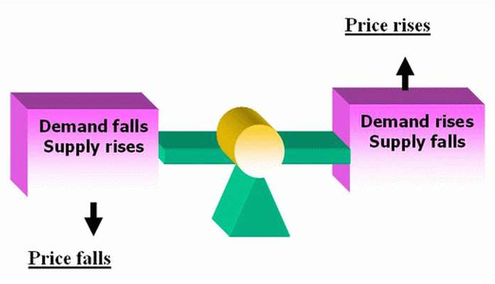
Challenge – Limited Housing Stock
Majority of housing stock is privately owned and subject to premarket forces.
Housing challenge will only get worse if no action is taken.
The Missing Middle - Income Earners are priced out

Slide 3
Why CHAT? Community Housing Affordability Taskforce
CHAT was formed because concerned, sitting government and business leaders recognized the housing challenges our community is up against.
Convened more than 20 meetings over the last year
Partnered with the Affordable Housing Collaborative subcommittees / over 100 meetings
Held 6 housing forums / over 625 attendees
Sponsored polling
Researched reports and studies
Participated in the Chamber DC Fly – in / housing tract
Commissioned a housing affordability plan for the missing middle income earners

Slide 4
Who Is CHAT?
Community Housing Affordability TaskForce Members
Housing & Building Association of Colorado Springs
Colorado Springs Chamber and EDC
Apartment Association of Southern CO
Downtown Partnership
Pikes Peak Association of REALTORS
Affordable Housing Collaborative
City of Colorado Springs Planning & Community Development

Slide 5
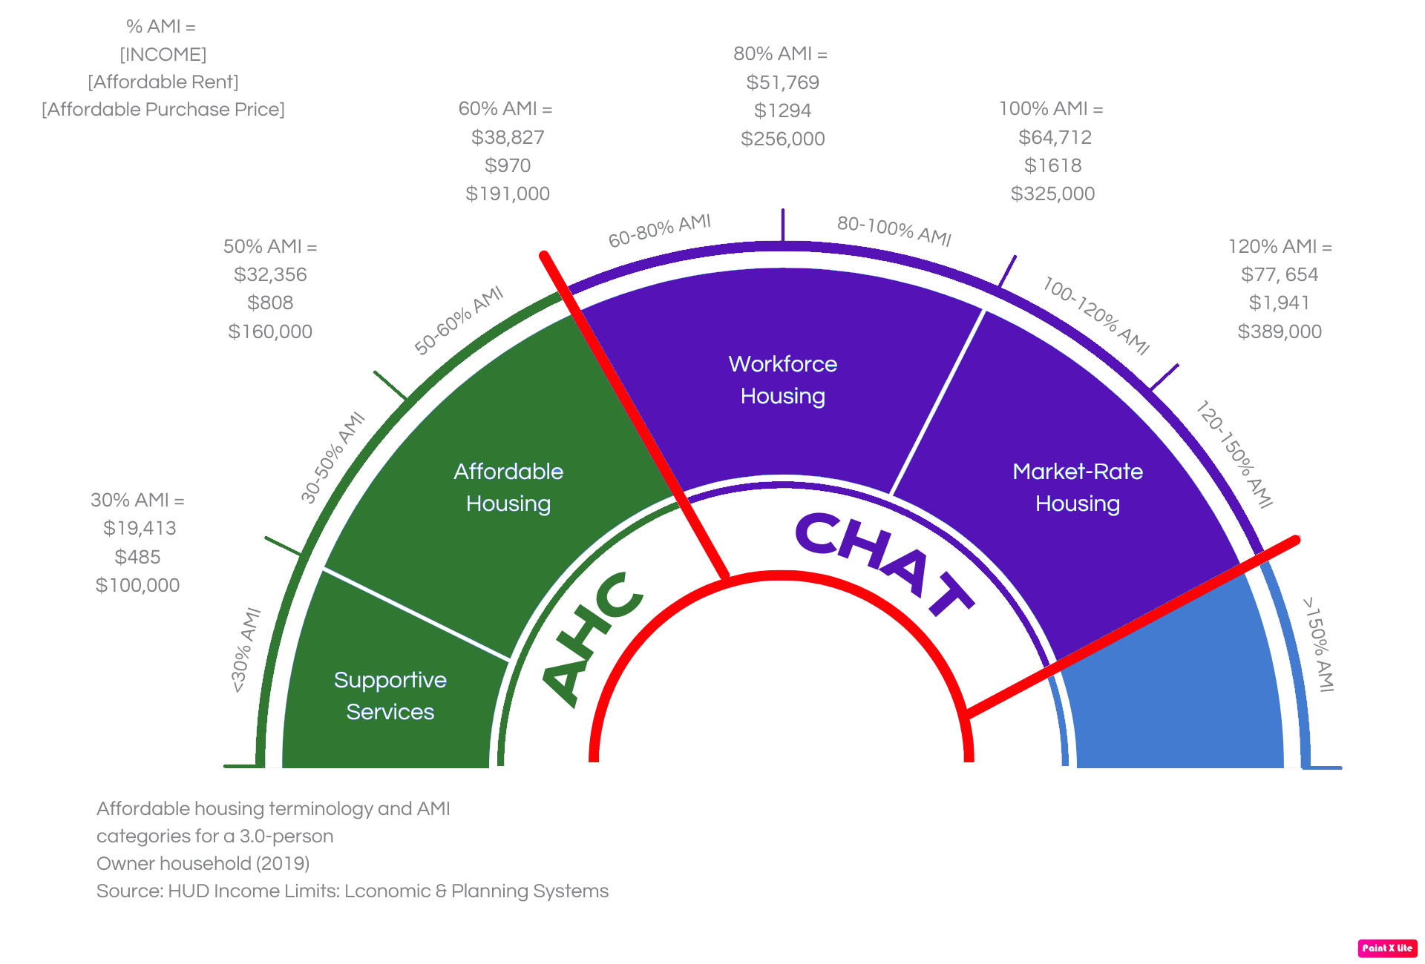
Missing Middle Definition
People who fall between 60 - 150% of AMI who, given their income, increasingly struggle to afford adequate housing within the existing housing inventory.

Slide 6
Who are the People?
“The American dream is about being able to lay roots, be involved in the community, have a place where kids can grow up and play outside and have the opportunity for them to have a career path here in their future. Colorado Springs offers all of that. The trick is for middle and upper middle-class families to be able to afford it.”
Kimberly and her husband Erin Gooch moved to Colorado Springs three-and-a-half years ago from Fort Rucker, AL
“Aging in place is critical, AARP says 98% of people want to age in place, and homeownership is critical to make that happen. We have a 2:1 ratio of homeowners to renters, those who own their own home have more security as they are aging.”
Dayton Romero of Silver Key helps seniors with financial assistance and navigation
“Prices are out of reach, homeownership is becoming out of reach. It is extremely expensive to live in Colorado Springs, I own a business, I have grown up here, my husband and I both have stable jobs and we can’t afford to live here, and when all you can do is work to pay the bills and nothing else. It’s demoralizing, especially when there are other places that I could live that are more affordable. Elected officials need to make affordability a number one priority.”
Allison was born and raised in Colorado Springs; she and her husband returned in 2021

Slide 7
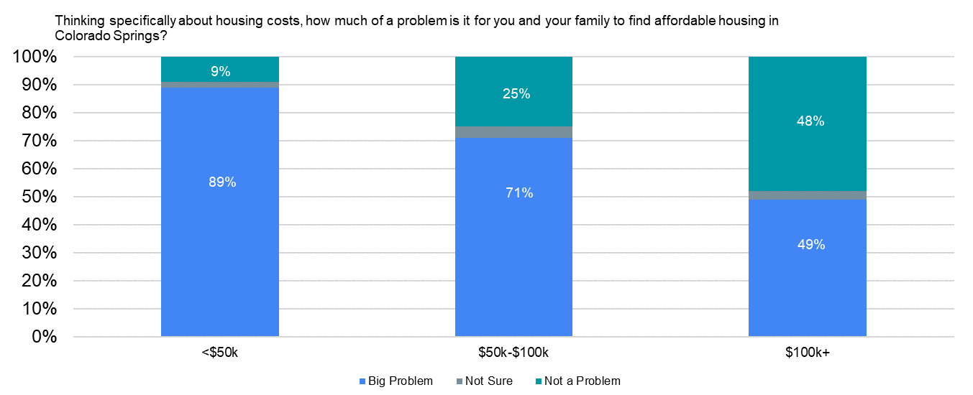
Polling Tells the Broad Story
“What is telling is that those in the “missing middle” (AMI 60-150), or household incomes of $50,000 - $100,000, believe housing costs are a big problem at 71%. Even voters making over $100,000 believe housing costs are a big problem, 49%.”

Slide 8
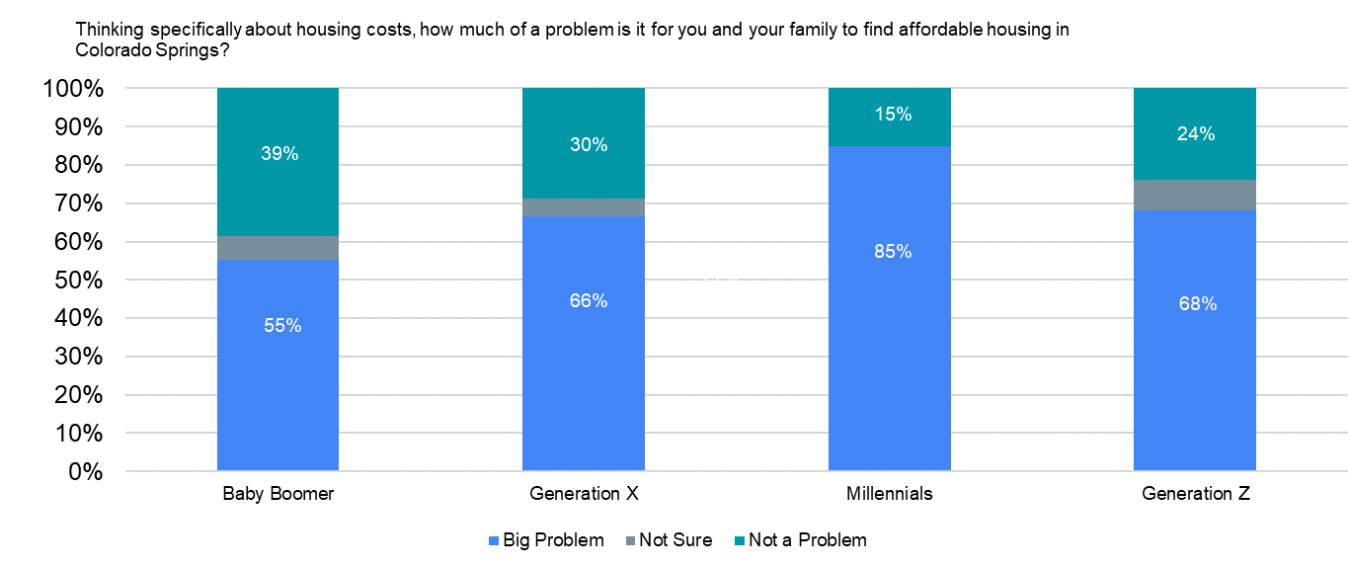
Polling by Generation
ages 58-67 ages 42-57 ages 26-41 ages 10-25

Slide 9
Market Statistics
SNAPSHOT of Inventory from PPAR at 9:30 a.m., Monday, June 6
The American Dream of Home Ownership: 3 Bed/2 Bath/2 Car
Homes Available Total
$1-250,000 2
Chateau @ Antelope Ridge $680 per month HOA dues
To Qualify for a 5.25% Loan requires:
10% down
$4000 per month income
less than $600 debt
$250,000-350,000 11
2 in Chateau @ Antelope Ridge $680 per month HOA dues
4 Modular homes in Yoder
Loan Requirements:
10% Down
$5200 per month income
Less than $600 debt
$350,000-500,000 32
Median total Square Feet :1625
Median Price: $425,000
Loan Requirements:
10% down
$7000 per month income
less than $600 debt

Slide 10
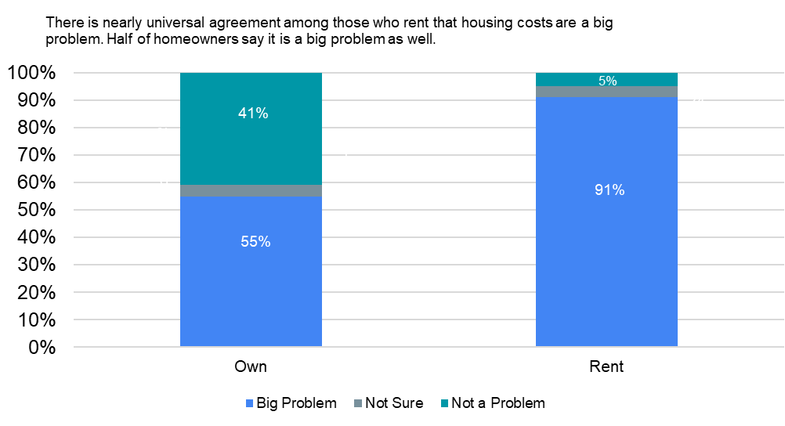
Rentals
2022 Colorado Springs Chamber & EDC Poll

Slide 11
Challenge Easily Explained in 112 seconds
Notes:
All Housing is good housing and here’s a short video that explains that.
https://www.youtube.com/watch?v=EQGQU0T6NBc

Slide 12
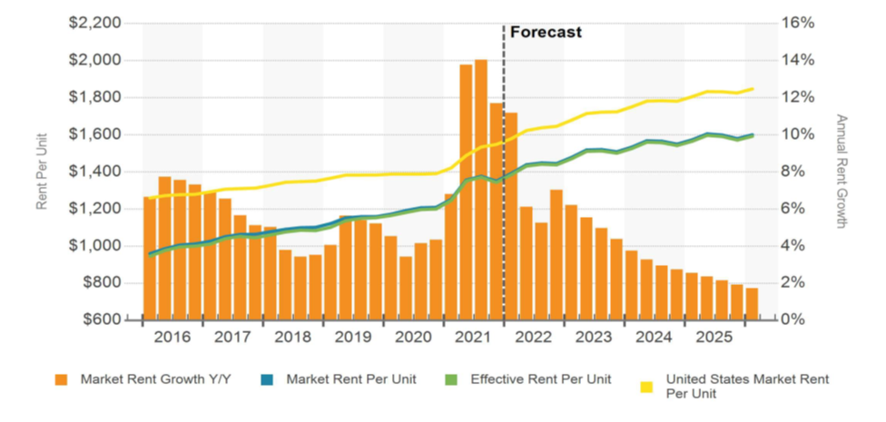
Rentals
Rentals are an important component of the solution
Demand is high and as a result rents are high;
Millennials and older Gen Z’s - are not buying, they are renting (our children, grandkids, recent college graduates and even our seniors);
Net migration from Denver to Colorado Springs, short commute, high pay, less cost;
As home prices continue rising buyers are even less likely to afford to buy;
With current supply, rent continues to rise due to demand;
All Housing is Good Housing – We Need More Homes

Slide 13
For Rent Developments Targeting “Missing Middle”
Mosaica & Kaleidos - Hancock Expressway and S. Circle Drive & S. Murray Blvd respectfully
373 for rent apartments total
1, 2, 3, 4 - bedroom units
Maintain rents as low as possible
Minimum annual rent increases to cover increased operating cost
Own for 10 years to control rents
No government subsidies used to minimize red tape and development delays
Minimal amenities
Expected Rents between 100% - 120% of AMI; bedroom starting at $1,600 per month 1
Increased Construction Cost
2020 - $44 million; 2022 - $66 million
Materials & Labor only - no increase in general contractor fee, development fee, or return to investors
Developer and General Contractor have fought to decrease cost via design, working with CSU and making alternative product selection working with subcontractors and suppliers.
Increases in cost require a larger construction loan and therefore a larger debt payment. As a result, rents, our source of income, was forced to increase to cover the increased cost.
If you take out a larger mortgage you must have a larger income to make your monthly payments.

Slide 14
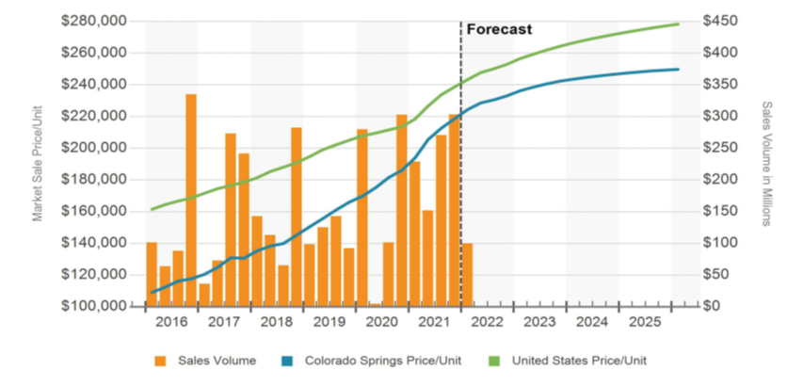
The Facts Behind the Problem
Price per unit for purchased units and additional cost to bring them to code.
2020 Census data

Slide 15
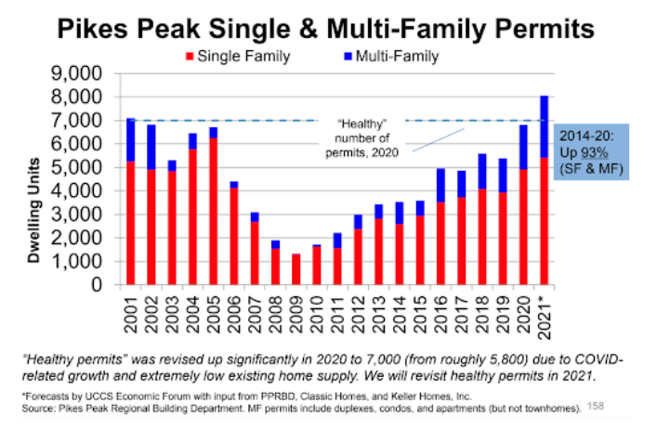
Reality
Missing Middle pinch
Since 2008 recession pace of building fell below the need
National problem - 5,000,000 units need
State problem – 225,000 units needed
Local problem - 12,135 units needed*
Rental and homeownership: 280,000 total households; 95,000 are renting
2020 Census data
*Southern Colorado Economic Forum- Dr. Tatiana Bailey

Slide 16
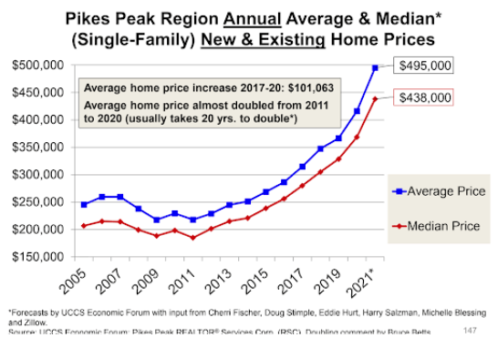
Why is this Happening?
Work from anywhere phenomenon - COVID related move ins
Millennial household / family creation
Short term rentals
Strong economy
Baby Boomers retiring to Pikes Peak Region
NIMBYism

Slide 17
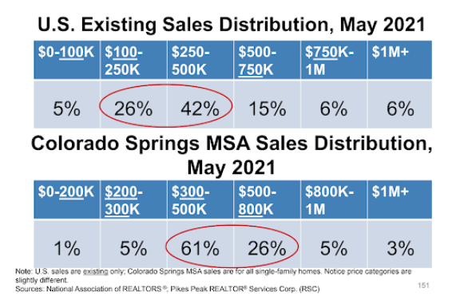
We Need Solutions
Can’t do anything – YES, WE CAN
Can’t build our way out – HAVE TO (This is the ONLY way out and here’s why)
Middle income families are being priced out
Young people are struggling to find affordable housing
Jobs unfilled and companies thinking twice about moving here
Move to YIMBY - Community education on the need and benefits of enough housing

Slide 18
Our Ideas at the Federal Level
Lobby for a 40-year mortgage
Work on lumber and other tariffs
Practical consideration of energy and electrical codes – need vs. cost
Expedited environmental regulation reviews - i.e., wetlands

Slide 19
Our Ideas at the State Level
Advocate for:
Construction defect reform
Regulatory of cost to housing
ARPA funds
Increase Tax Credits
Homestead Transferability
Practical consideration of energy and electrical codes – need vs. cost

Slide 20
Our Ideas at the Local Level
EPC Master Plan- allow more density and flexibility
Community Development Block Grant (CDBG) Program/Consolidated Plan -Continue to Implement and expand identified strategies
Support annexations, especially of enclaves/near enclaves
Encourage and empower infill and high-density projects- mostly in COS
Need more built lots/units
Review plans quicker (not less quality - more quantity)
Identify land for product – City, County, School Districts, CS Utilities
Code review and change – modular, 20 code changes today
Ensure fee increases are studied and reviewed for the cost to housing
Housing fiscal note to all new fees and ordinances
Review parking minimums
Encourage new codes that allow for the market to change and evolve
Collaborate and draft legislation for state-level ideas

Slide 21
Closing
Questions?
Thank you
Contact Marla Novak,
HBA VP of Government Affairs marla@cshba.com

