Slide 1
6210 Luther Road
BoCC June 28, 2022

Slide 2
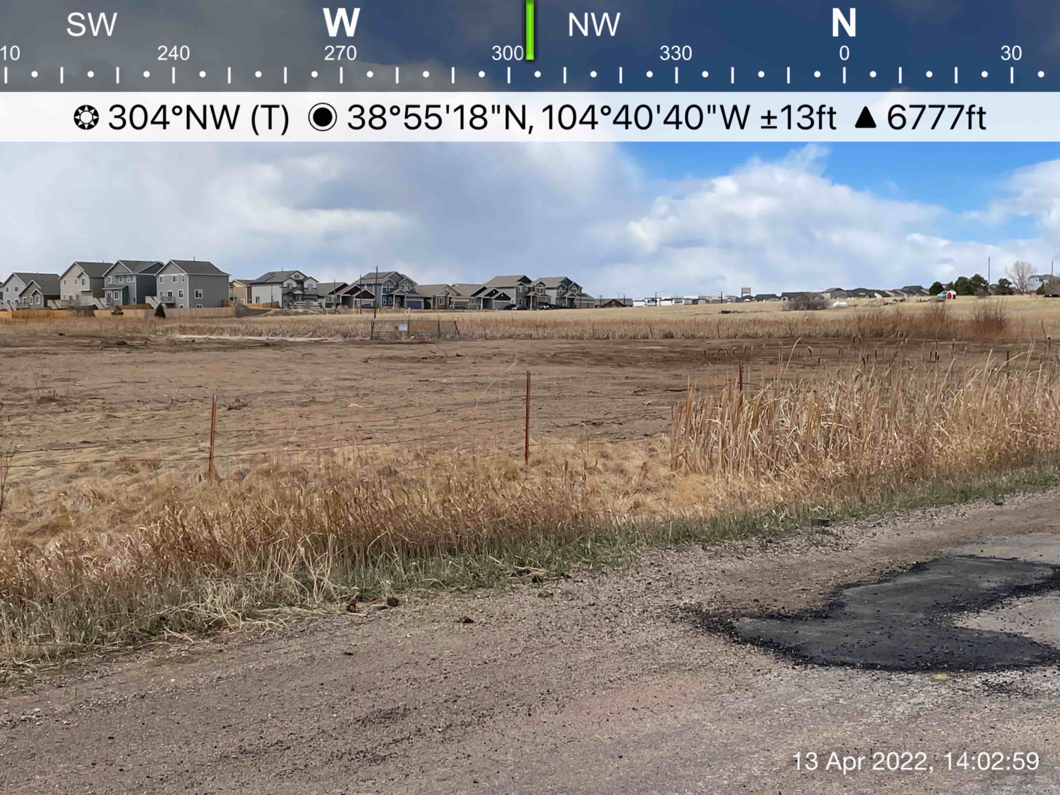

Slide 3
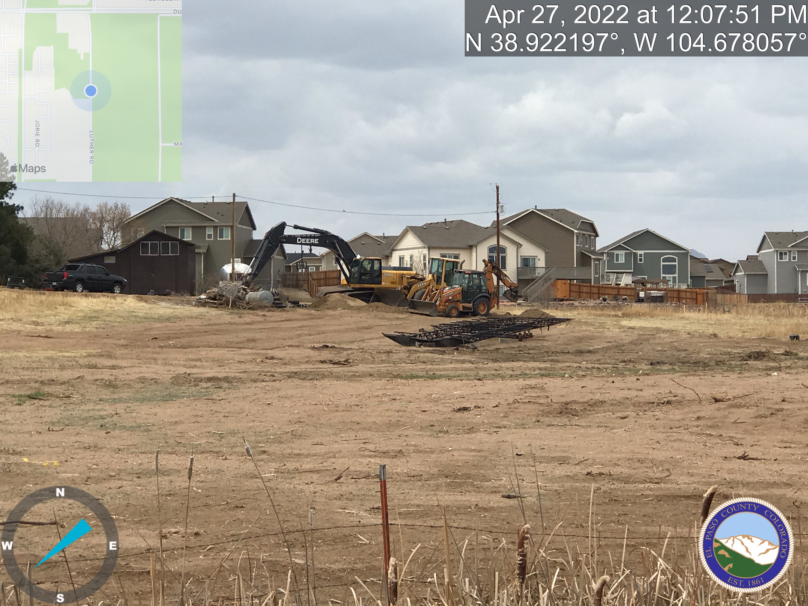

Slide 4
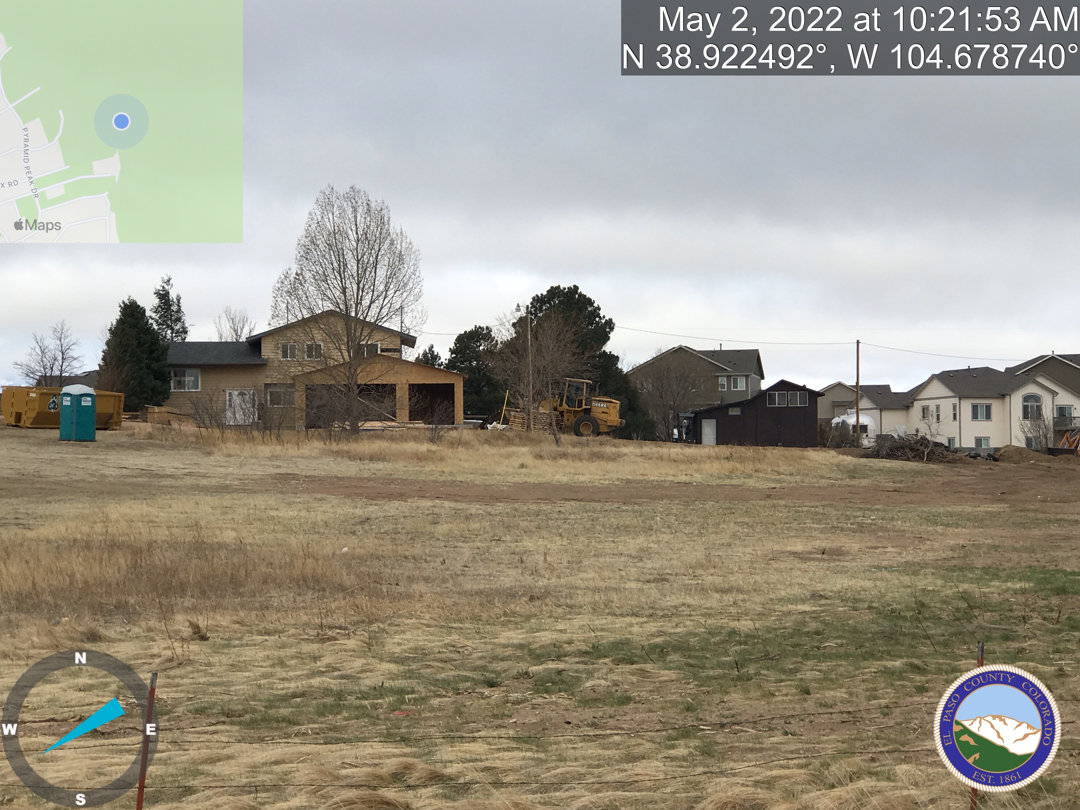

Slide 5
