Slide 1
Board of County Commissioners
Proposed CORA Policy Changes

Slide 2
CORA History
C.R.S. 30-11-101(1)(e) and 30-11-107(1)(e) authorizes the Board of County Commissioners to set policies related to handling and managing CORA.
This authority was exercised on July 1, 2014 through Resolution No. 14-241 and on January 14, 2020 through Resolution No. 20-20.
The policy establishes transparency, public access to documents, which department is responsible for fielding requests, and the amount charged for research and retrieval.
Today’s Resolution recommends changes to better align our policy with area local governments and enhance the public’s access to records.
Staff will now make updates to this policy on an annual basis.

Slide 3
POLICY Changes
Staff is recommending the following changes to the policy adopted in Resolution No. 20-20:
Decrease the amount charged to a requestor from $33.58 to $29.95 per hour.
Increase the number of complimentary hours given to a requestor from one to two hours.
Align the name of the Department receiving requests from “Public Information Office” to “Communications”.

Slide 4
COUNTY Elected Officials
The County is required to display which offices have adopted the policy on the county’s webpage. If you vote to accept this, the following offices have agreed to align with this policy:
Assessor
Clerk and Recorder
Coroner
District Attorney
Surveyor
Treasurer

Slide 5
Other Changes

Slide 6
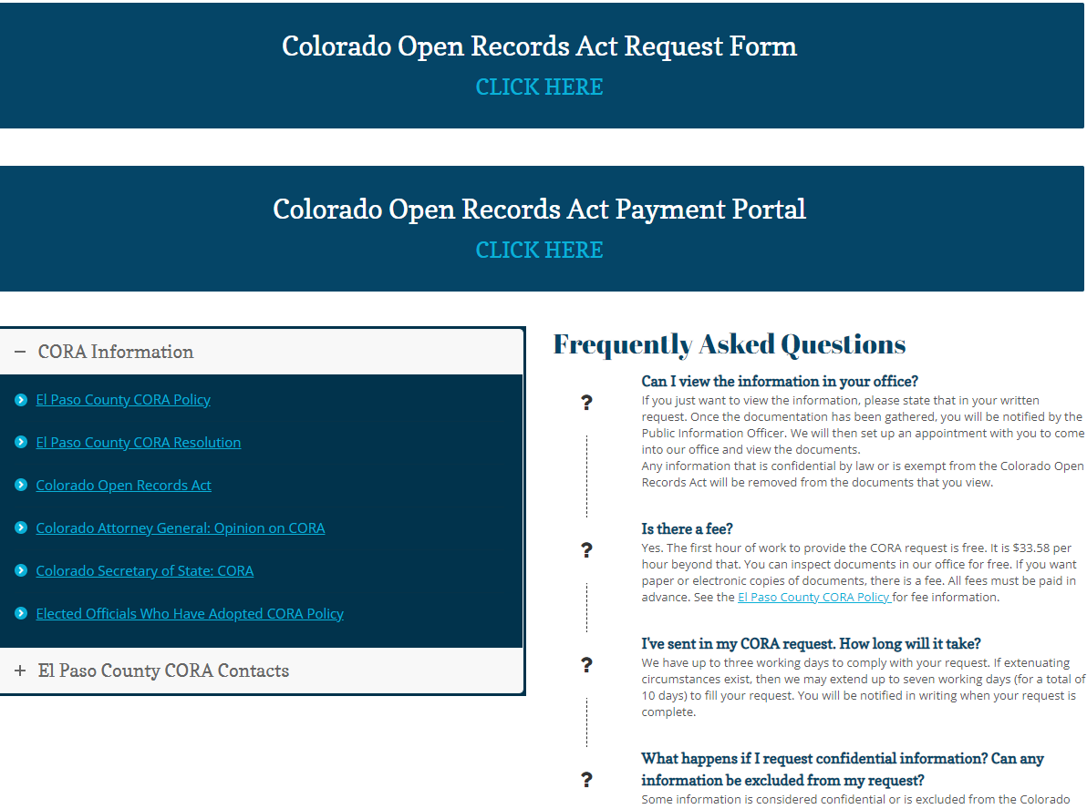
ONLINE CONVENIENCE
Requestors can request documents and pay online

Slide 7
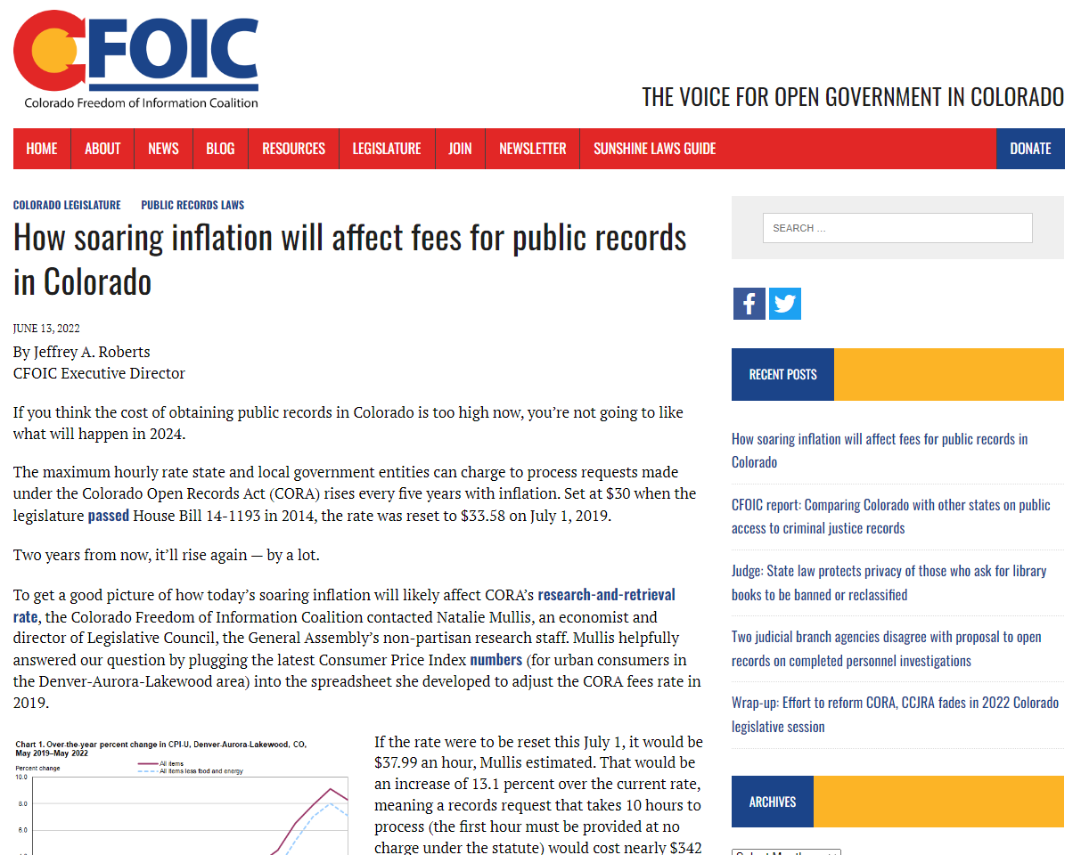
ANSWERING Why

Slide 8
Ryan Parsell
Ryan Parsell- Government Affairs
ryanparsell@ElPasoCo.com | 719.520.6540
Michael Madsen
Open Records Specialist- Communications Department
michaelmadsen@ElPasoCo.com 719.520.6403

