Slide 1
Chuck Broerman
El Paso County Clerk and Recorder
June 28, 2022

Slide 2
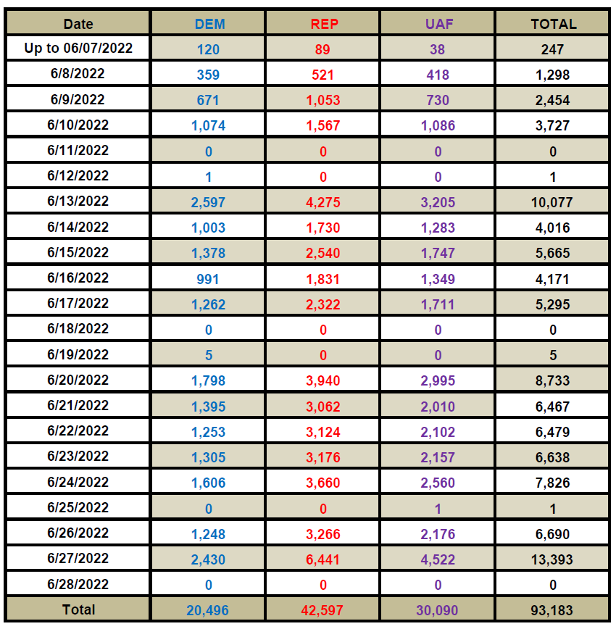
2022 Primary Election Ballot Returns

Slide 3
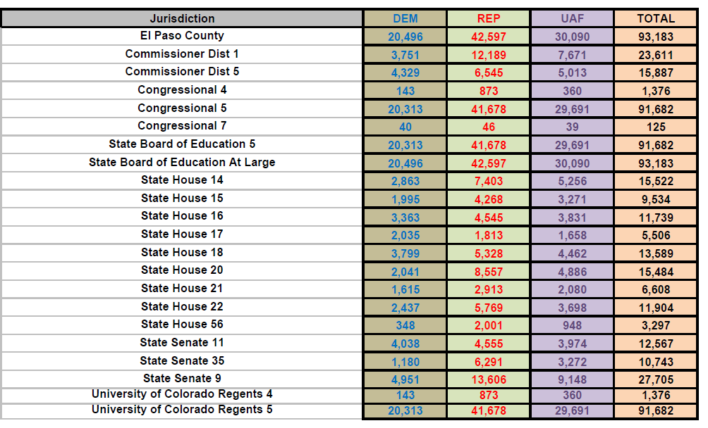
2022 Primary Election Ballot Returns by District

Slide 4
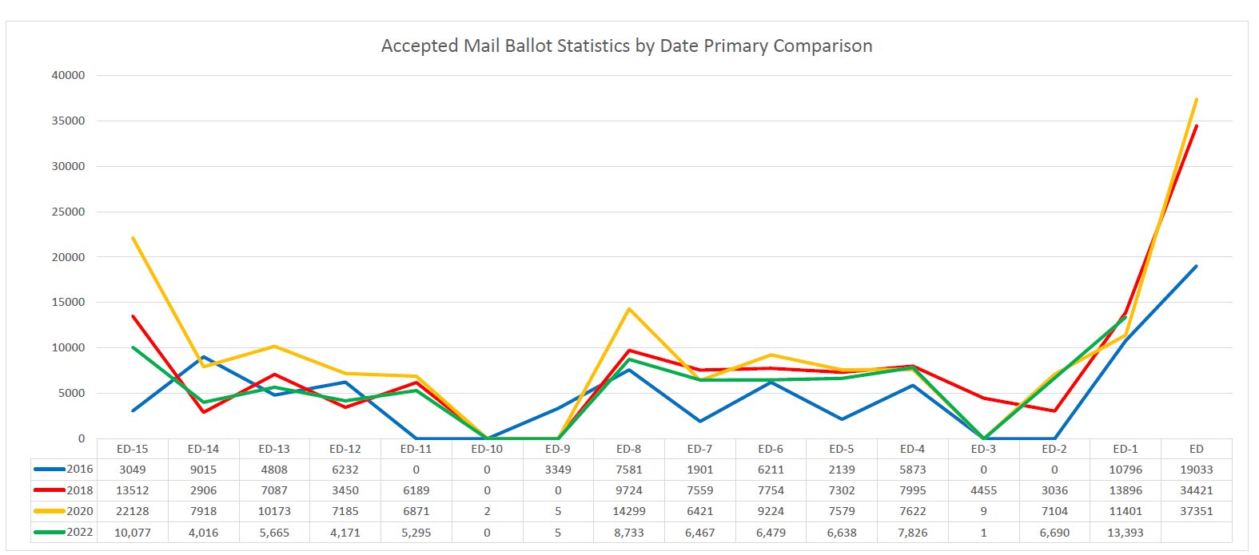

Slide 5
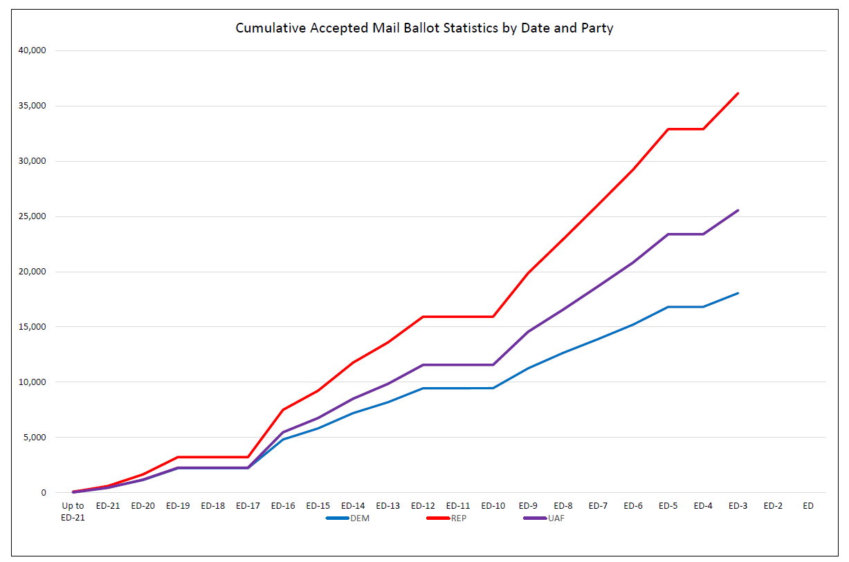

Slide 6
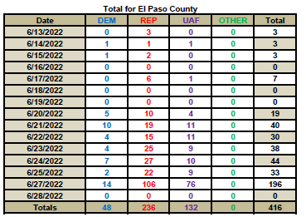
2022 Primary Election In Person Voters

Slide 7
Unaffiliated Voter Return
25, 232 Unaffiliated Voters Ballot Return
61.5% Returned a Republican Party Ballot
38.5% Returned a Democratic Party Ballot

Slide 8
Election Reminders
Ballots Must be Received by 7:00 p.m.
Utilize one of the 39 Secure 24/7 ballot drop boxes located throughout El Paso County
Full list can be found on your ballot instructions or EPCVotes.com
Sign your ballot back of envelope consistently
Unaffiliated Voters: You can vote and return only one ballot, not both political parties’ ballots.

Slide 9
Voter Service and Polling Centers Open Until 7:00 p.m., Today
North (EPC Clerk’s Office)
Southeast (EPC Clerk’s Office)
Fort Carson (EPC Clerk’s Office) Enter Gate 1
Centennial Hall (Downtown)
Main Office at Citizens Service Center
Fountain Library
Manitou Springs City Hall
Town of Monument – Town Hall
Woodmen Hills Metropolitan District – Community Center West
If it is necessary to receive in-person service, Voter Service and Polling Centers (VSPCs) are open to:
Register to vote
Update your voter registration information
Request a replacement ballot
Vote on an ADA accessible ballot marking device
Drop off your voted mail ballot
Vote in person on a paper ballot

Slide 10
Election Night Result Release
Results will be available on the Colorado Secretary of State’s Election Night Reporting Systems website at GoVoteColorado.Gov
First result release is expected to happen around 7:30 p.m.
If Vote Centers have long lines at 7:00 p.m. all voters will be allowed to vote, and results will not be released until the very last person at each location has voted.
Tune to the El Paso County Clerk and Recorder’s Facebook and Twitter pages to follow election day/night updates.

Slide 11
Election Recounts
There are two ways in which a recount is triggered in Colorado
The total votes that separate any winner on any ballot issue or in any candidate race is less than 0.5%. Under this circumstance, the Colorado Secretary of State shall order a recount within 25 days (C.R.S. 1-10.5-101(b)).
Any “interested party” may request a recount of a vote for an election to which they were a party.
An interested party is defined by (C.R.S. 1-10.5-106(1)): means the candidate, political party or political organization of such candidate, any petition representative identified pursuant to section 1-40-113 for a ballot issue or ballot question, the governing body that referred a ballot question or ballot issue to the electorate or the agent of an issue committee.

Slide 12
Election Recounts Continued
Who pays for a recount? If the recount is triggered due to a vote differential of less than 0.5% between any ballot contests, the certifying entity that certified the ballot contest, is responsible for the fees (C.R.S. 1-10.5-101(b)).
If the recount comes at the request of an interested party, the interested party is responsible for the expense of the recount (C.R.S. 1-10.5-101(b)) provided the results of the recount do not change the outcome of the election. If the recount does reverse the outcome of the election, or if the recount shows that a recount should have automatically been triggered, the cost of the recount will be refunded to the interested party (C.R.S. 1-10.5-106(2)).
Colorado Secretary of State Rule 10.9.6
If all losing candidates who received enough votes to trigger a mandatory recount submit letters of withdrawal to the DEO in accordance with section 1-4-1001, C.R.S., the DEO must immediately notify the county clerk and the county clerk need not conduct the recount.

Slide 13
2022 Primary Election Questions
Call 575-VOTE or 575-8683
Email elections@elpasoco.com
Visit our website EPCVotes.com

