Slide 1
Chuck Broerman
El Paso County Clerk and Recorder
June 21, 2022

Slide 2
Voter Service and Polling Centers (VSPC’s)
Opening June 20, 2022
North (EPC Clerk’s Office)
Southeast (EPC Clerk’s Office)
Fort Carson (EPC Clerk’s Office) Enter Gate 1
Centennial Hall (Downtown)
If it is necessary to receive in-person service, Voter Service and Polling Centers (VSPCs) are open to:
Register to vote
Update your voter registration information
Request a replacement ballot
Vote on an ADA accessible ballot marking device
Drop off your voted mail ballot
Vote in person on a paper ballot

Slide 3
Additional VSPC’s Opening
Opening June 27, 2022
Town of Monument (Town Hall)
Fountain Library
Manitou Springs City Hall
Woodmen Hills Metropolitan District (Community Center West)

Slide 4
Election Reminders
Too late to return your ballot via USPS
Utilize one of the 39 Secure 24/7 ballot drop boxes located throughout El Paso County
Full list can be found on your ballot instructions or EPCVotes.com
Sign your ballot back of envelope consistently
Sign-up for BallotTrax by visiting GoVoteColorado.gov to track your ballot

Slide 5
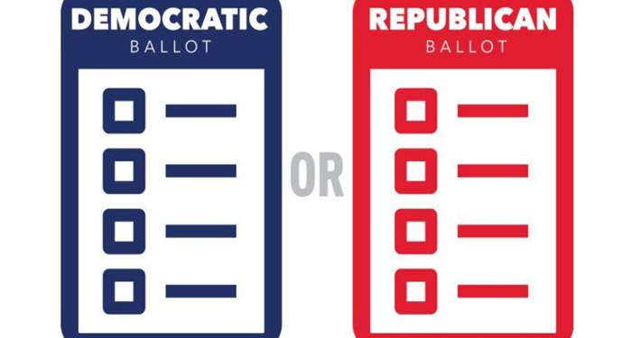
Election Reminders
Unaffiliated Voters: You can vote and return only one ballot, not both political parties’ ballots.

Slide 6
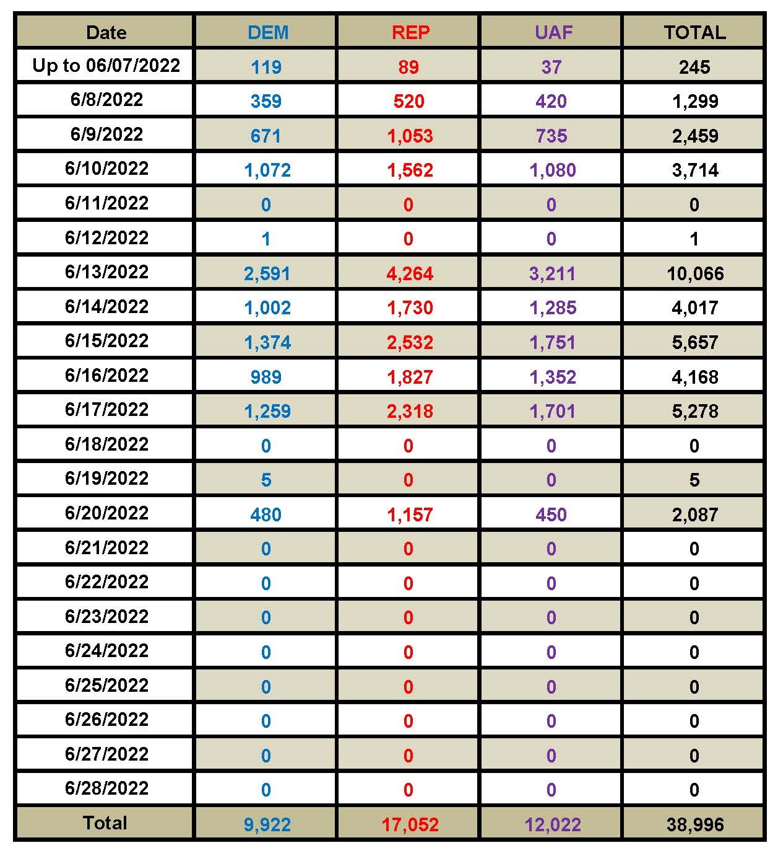
2022 Primary Election Ballot Returns

Slide 7
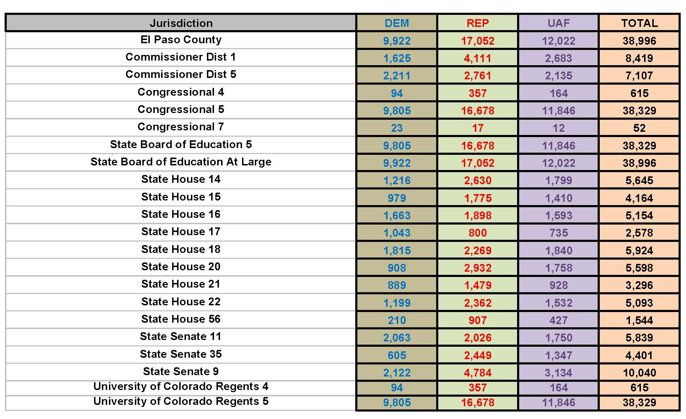
2022 Primary Election Ballot Returns by District

Slide 8
Hand Counts
Not permissible by law
2020 General election features 12.3 million contest to be tabulated
Hand Counts are typically inaccurate and prone to errors. Studies have determined that the average hand count is in error on average of 2%
Cost ~$1.25 a ballot ($350k-$600k an election)
Time: 3 to 5 weeks
Staff and Election judges-

Slide 9
2022 Primary Election Questions
Call 575-VOTE or 575-8683
Email elections@elpasoco.com
Visit our website EPCVotes.com

