Slide 1
PPCoC 3-Year Strategic Plan – Call to Action
El Paso County BoCC
June 14, 2022

Slide 2
Continuum of Care Purpose
Promote communitywide commitment to the goal of ending homelessness;
Provide funding for efforts to quickly rehouse homeless individuals and families while minimizing the trauma and dislocation caused to homeless individuals, families, and communities by homelessness;
Promote access to and effect utilization of mainstream programs by homeless individuals and families; and
Optimize self-sufficiency among individuals and families experiencing homelessness
Notes:
The Continuum of Care is governed by the Code of Federal Regulations: 24 CFR Part 578 Continuum of Care Program

Slide 3
PPCoC Governing Board Participation
Required PPCoC Board Members:
Homeless / formerly homeless person
Education / McKinney Vento representative
Veteran or Veteran service agency representative
Emergency Solutions Grant (ESG) Program funded agency
Public Housing Authority representative – Ex-Officio
Domestic Violence Agency representative
Representatives from El Paso County agencies
El Paso County Department of Human Services
El Paso County Economic Development Department
El Paso County Housing Authority
El Paso County Sheriff’s Office, Detention Division

Slide 4
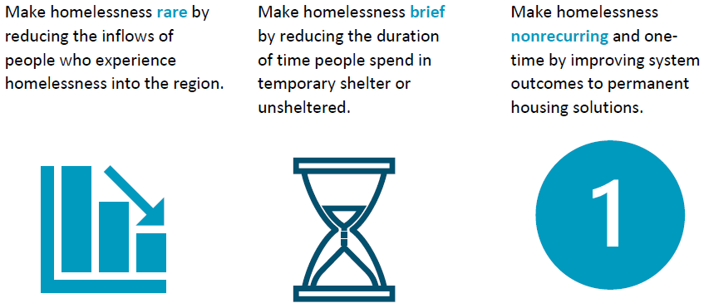
PPCoC 3-Year Strategic Plan - Goals

Slide 5
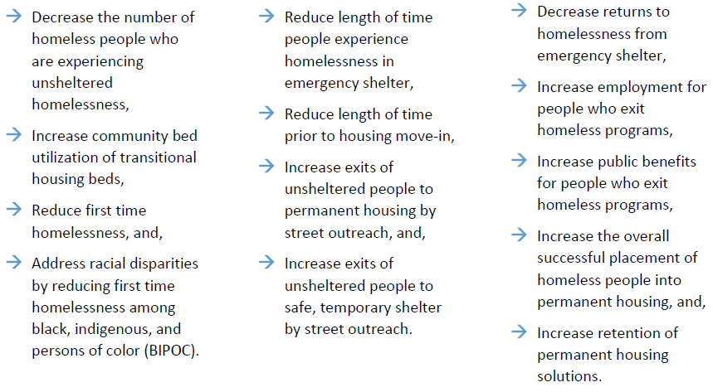
Rare Brief One-time
Notes:
Homeless Diversion training

Slide 6
Objective 1.1: Decrease the unsheltered homelessness for the Point in Time by 10%.
Actions | Responsible Party | Strategic Activities
Create a flexible community fund and leverage existing funding sources | City of Colorado Springs | Creation of community flex fund and leverage existing funding sources (TANF, CDBG, mainstream resources, etc.)
 | El Paso County
 | Private funders
 | Pikes Peak Veteran Housing Fund
 | Community Health Partnership
Develop best practices for street outreach to connect to Emergency Shelter providers and CE Housing services | Emergency Shelters providers | Conduct trainings and develop best practices for community street outreach
 | CSPD HOT
 | CSFD HOP
 | Street Outreach providers
 | El Paso County Sheriff’s Office
Promote Emergency Shelter bed availability | Emergency Shelter providers | Increase utilization of emergency shelter beds
 | City of Colorado Springs
 | CoC Board - Communication Strategy
Coordinate discharge planning with institutions | Emergency Shelter providers | System mapping of discharge planning
 | Community Health Partnership
 | Foster care system
 | Assisted living/skilled nursing facilities
 | Hospitals/health care facilities
 | Criminal justice institutions

Slide 8
Objective 1.3: Achieve a 15% reduction in First Time Homelessness
Actions | Responsible Party | Strategic Activities
Promote Homeless Diversion and Prevention funds | CoC Board - Communication Strategy | Message availability of homeless diversion and prevention funds publicly
 | Coordinated Entry System
 | Public funders (City of COS, DOLA)
 | Community Health Partnership
Develop stronger relationships between service providers and landlords through landlord engagement | Housing Navigation service providers | Established meetings held between service providers and landlords and educational events to inform landlords of available resources
 | Landlords and property managers
 | Community Health Partnership
 | Apartment Association of Southern Colorado
 | Landlord incentive funders (public and private)
Partner with community providers offering financial assistance and relief to low-income households | CHP | Newly formed partnerships with agencies addressing poverty
 | Pikes Peak United Way
 | El Paso County Department of Human Services
 | Faith-based organizations (such as Catholic Charities of Central Colorado)
 | Community non-profits (such as Tri-Lakes Cares)

Slide 10
Objective 2.3: Increase exits to permanent housing from street outreach by 5%
Actions | Responsible Party | Strategic Activities
Increase referral connections to local service providers through street outreach | Street Outreach providers | Increase number of referral services in HMIS by street outreach providers
 | Regional Care Coordinators for Health First Colorado Medicaid
 | El Paso County DHS
 | Behavioral health providers
Use of Diversion funds and creating policies and procedures to connect service providers to flexible funds | Community Health Partnership | Adoption of homeless diversion funds targeted for unsheltered homeless
 | Private funders
 | Public funders (City of COS, DOLA, El Paso County)
Support City of Colorado Springs and El Paso County in prioritizing affordable housing construction and rehabilitation | CoC Board | Provide recommendations to the City of Colorado Springs and other funders/developers on new funding, construction, and rehabilitation
 | City of COS/El Paso County
 | Housing development partners
 | CHFA
 | State Department of Local Affairs
Improve storing of household essential documents in HMIS to help with timely housing placements | Street Outreach providers | Create a checklist of housing documents and increase utilization of HMIS for storing
 | El Paso County DHS
 | Coordinated Entry System
 | HMIS Lead

Slide 12
Objective 2.4: Increase exits into temporary/Institutions from street outreach by 10%
Actions | Responsible Party | Strategic Activities
Coordinate discharge with criminal justice institutions | Criminal justice institutions | Setup data sharing agreements to coordinate discharge planning
 | Office of Behavioral Health | Setup data sharing agreements to coordinate discharge planning
 | Coordinated Entry System | Setup data sharing agreements to coordinate discharge planning
 | CSPD HOP Program | Setup data sharing agreements to coordinate discharge planning
Coordinate discharge with healthcare institutions | Hospitals | Setup meetings and trainings to discuss data sharing agreements with healthcare partners
 | Recuperative care clinics
 | Coordinated Entry System
 | Regional Health First Colorado Medicaid providers
Create connections to Emergency Shelter providers | Street outreach providers | Increase bed utilization for emergency shelters by encouraging unsheltered homeless to stay in ES
 | Public service providers
 | CoC Board - Communication Strategy
 | Emergency shelter providers
Create connections to Transitional Housing providers | Street outreach providers | Increase bed utilization for TH by utilizing referral connections to TH
 | Public service providers
 | CoC Board - Communication Strategy
 | Transitional Housing providers

Slide 14
Q and A

