Slide 1
El Paso County Board of County Commissioners
2022 Annual Road Maintenance Program
Jack Ladley, Deputy Director
Department of Public Works
Tuesday, 24 May 2022

Slide 2
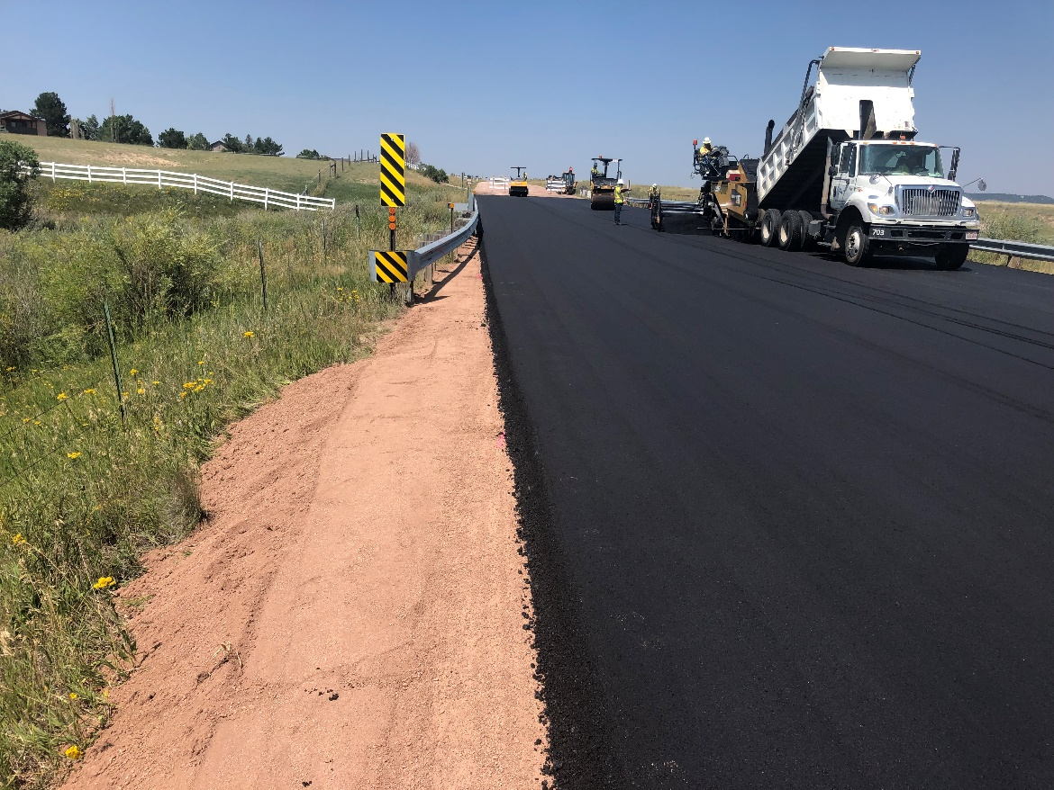
El Paso County Highway System
Paved Road System: 1,157 centerline miles
Gravel Road System: 1,052 centerline miles
Total Highway System: 2,214 centerline miles

Slide 3
Planning Process for Roadway Resurfacing
Use Pavement Management System to compile Draft List of roadways based on PQI and other indicators
Utilize cost effectiveness ratio to rank segments and treatments.
Perform conflict check against:
Proposed capital, development and utility projects.
Assess potential impacts, including:
Traffic and Access – constructability, detours/closures, lane reductions, sequencing, proximity to schools, residents, and businesses.
Materials – pricing, lead times, supply chain issues.
Scheduling – working days, priority locations, and weather considerations.
Finalize Draft List.
Present to Highway Advisory Commission for Review and Endorsement.
Submit Resolution to Board of County Commissioners.

Slide 4
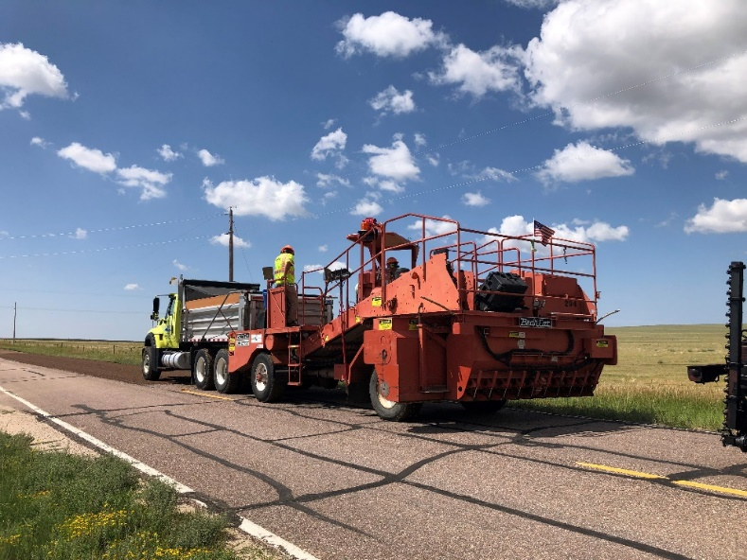
2022 Annual Roadway Maintenance Program
Treatment Coverage:
Chip Seal ~ 35.00 centerline miles
Paving ~ 28.76 centerline miles
Gravel ~ 49.19 centerline miles
Dust Abatement ~ 107 centerline miles

Slide 5
2022 Chip Seal Program
2022 Chip Seal
Street Name | From | To | CL Mile | Lane Mile
Brittinger Wy | Capital Dr | Riverwalk Py | 0.10 | 0.21
Brookings Dr | US Hwy 24 | Meadowbrook Py | 0.16 | 0.33
Bucolo Av | Notre Wy | Notre Wy | 0.66 | 1.31
Campstool Dr | CS CL | Pronghorn Meadows | 0.29 | 0.59
Capital Dr | Constitution Ave | Genoa Dr (end) | 0.63 | 1.27
Capital Dr | Constitution Ave | Colorado Tech Dr | 0.57 | 1.14
Christy Ct | Meadowbrook Py | Pinyon Jay Dr | 0.33 | 0.65
Colorado Tech Dr | Velliquette Ln | Riverwalk Py | 0.20 | 0.39
Colorado Tech Dr | Reed Grass Wy | Reed Grass Wy | 0.24 | 0.48
Curtis Rd | CO 94 | Falcon Hwy | 5.99 | 11.97
Dewhirst Dr | Parsonage Ln | Parsonage Ln | 0.41 | 0.82
February Dr | Bucolo Av | Bucolo Av | 0.11 | 0.23
Guinness Wy | Bucolo Av | Bucolo Av | 0.14 | 0.28
Hames Dr | Pinyon Jay Dr | Meadowbrook Py | 0.22 | 0.44
Hannah Ridge Dr | Constitution Ave | Reed Grass Wy | 0.55 | 1.11
Headgate Ln | Springside Dr | Christy Ct | 0.29 | 0.58
Irish Dr | Bucolo Av | Bucolo Av | 0.14 | 0.28
Jeanette Wy | Pinyon Jay Dr | Meadowbrook Py | 0.26 | 0.51
Jones Rd | Curtis Rd | Peyton Hwy | 4.98 | 9.95
Klein Pl | Streambank Dr | End | 0.11 | 0.22
Lattern Ct | Woodpark Dr | Hames Dr | 0.06 | 0.13
Lillian Wy | Velliquette Ln | Silver Meadow Ci | 0.17 | 0.33
Lupan Dr | Pinyon Jay Dr | End | 0.14 | 0.27
Maddee Wy | Silver Meadow | Colorado Tech Dr | 0.06 | 0.11
Meadowbrook Py | Marksheffel Rd | Constitution Av | 1.29 | 2.58
Meridian Rd | Blaney Rd | Falcon Hwy | 3.01 | 6.01
Notre Wy | Bucolo Av | Riverwalk Py | 0.19 | 0.37
Nyala Dr | Campstool Dr | Roan Dr | 0.14 | 0.27
Parsonage Ln | Dewhirst Dr | Dewhirst Dr | 0.40 | 0.80
Pinyon Jay Dr | Woodpark Dr | Christy Ct | 0.81 | 1.62
(cont’d)
Street Name | From | To | CL Mile | Lane Mile
Postrock Dr | Tee Post Ln | Brookings Dr | 0.17 | 0.35
Pronghorn Meadows Ci | Antelope Ridge Dr | Sonoran Dr | 0.57 | 1.14
Red Granite Lp | Capital Dr | Capital Dr | 0.39 | 0.79
Reed Grass Wy | Colorado Tech Dr | Colorado Tech Dr | 0.67 | 1.33
Riverwalk Py | Postrock Dr | End | 0.57 | 1.15
Roan Dr | Pronghorn Meadows Ci | Pronghorn Meadows | 0.31 | 0.63
Sable Dr | Roan Dr | Sonoran Dr | 0.09 | 0.17
Sage Grouse Ln | Pinyon Jay Dr | Woodpark Dr | 0.48 | 0.95
Sheringham Dr | Meadowbrook Py | Dewhirst Dr | 0.08 | 0.17
Silver Meadow Ci | End | Brittinger Wy | 0.43 | 0.86
Siskin Ln | Christy Ln | Meadowbrook Py | 0.08 | 0.15
Sonoran Dr | Pronghorn Meadows Ci | Roan Dr | 0.20 | 0.40
Springside Dr | Meadowbrook Py | Constitution Av | 0.38 | 0.76
Streambank Dr | End | End | 0.18 | 0.37
Tee Post Ln | Meadowbrook Py | End | 0.14 | 0.29
Tennis Ln | Bucolo Av | Bucolo Av | 0.14 | 0.28
Traces Ln | Christy Ct | Meadowbrook Py | 0.08 | 0.16
Velliquette Ln | Silver Meadow Ci | February Dr | 0.20 | 0.39
Walton Dr | Meadowbrook Py | Dewhirst Dr | 0.09 | 0.18
Waynoka Pl | Waynoka Rd | CS CL | 0.19 | 0.38
Waynoka Rd | Palmer Park Bd | Powers Bd | 1.11 | 2.22
Woodpark Dr | Brookings Dr | Pinyon Jay Dr | 0.69 | 1.38
Slocum Rd | Hwy 94 | Jones Rd | 4.00 | 8.00
Peyton Hwy | US 24 | Safe Landing Dr | 1.11 | 2.22
 |  | Totals | 35.00 | 69.97

Slide 6
2022 Maintenance Paving Program
2022 Paving
Street Name | From | To | CL Mile | Lane Mile
County Line Rd | Palmer Lake CL | 2000' E of Indi Dr | 1.27 | 2.54
Baptist Rd | Struthers Rd | End Divided | 3.24 | 6.48
Woodmen Rd E (EB & WB) | Meridian Rd N | US 24 | 0.82 | 1.64
Woodmen Rd E (EB & WB) | Meridian Rd | CS CL | 2.34 | 4.68
Stapleton Dr | Meridian Rd | Eastonville Rd | 1.45 | 2.90
Shoup Rd | Glenridge Ln | Black Forest Rd | 1.45 | 2.90
Fontaine Bd | Security Bd | 100' W/O Amherst St | 0.24 | 0.48
Conrad St | Terminal Av | Galley Rd | 0.36 | 0.72
Fontaine Bd | Kokomo St | Fountain Mesa Rd | 1.09 | 2.18
Enoch Rd | CO 94 | AFB Gate | 1.51 | 3.01
Milam Rd | Old Ranch Rd | Burgess Rd | 1.01 | 2.02
Syracuse St | School Entrance | Fay Dr | 0.29 | 0.59
Gleneagle Dr | Westchester Dr | Baptist Rd | 2.20 | 4.40
Fontaine Bd | Powers Bd | Fountain CL | 0.49 | 0.98
Falcon Hwy | Mccandish | J D Johnson Rd | 6.50 | 13.00
Murphy Rd | Meridian Rd N | Eastonville Rd | 1.98 | 3.96
Fountain Av | US Hwy 24 | Chipita Park Rd | 0.33 | 0.66
Judge Orr Rd | US Hwy 24 | Curtis Rd | 1.37 | 2.74
Silver Nell Dr (Added) | Steppler Rd | 1300' W/O Abert Ranch Dr | 0.82 | 1.64
 |  | Totals | 28.76 | 57.52

Slide 7
2022 Gravel Program
2022 Gravel
Street Name | From | To | CL Mile | Lane Mile
Black Forest Rd | County Line Rd | Walker Rd | 2.40 | 4.80
Walker Rd | Black Forest Rd | Campbell Rd | 1.50 | 3.00
Elk Creek Dr | End | End | 2.00 | 4.00
Green Meadow Dr | Forest Green Dr | Cul De Sac | 1.06 | 2.12
Spritwood Loop | Murphy Rd | Murphy Rd | 1.41 | 2.82
Bar X Rd | Hodgen Rd | Walker Rd | 2.00 | 4.00
West Spencer Rd | Elbert Rd | McKissick Pavement | 1.25 | 2.50
South Blaney Rd | Hoofbeat Rd | Meridian Rd | 1.40 | 2.80
McFerran Rd | Black Forest Rd | Hungate Rd | 0.77 | 1.54
Tobin Rd | Black Forest Rd | Thomas Rd | 0.90 | 1.80
Paint Mine Rd | Calhan Hwy | Funk Rd | 3.00 | 6.00
Murr Rd | Jones Rd | Kevins View | 1.00 | 2.00
Wagon Train Loop | Murr Rd | Sage Crest Rd | 1.23 | 2.46
Blue Stallion Dr | Wagon train Loop | Sage Crest Rd | 0.48 | 0.96
Honeydew Ct | Wagon train Loop | Cul De Sac | 0.09 | 0.18
Sage Crest Rd | Broken Arrow Dr | Broken Arrow Dr | 3.16 | 6.32
Broken Arrow Dr | Slocum Rd | Sage Crest Rd | 0.65 | 1.30
Red Hawk Ct | Broken Arrow Dr | Cul De Sac | 0.08 | 0.16
Prairie View Dr | Sage crest Rd | Sage Crest Rd | 0.35 | 0.70
Feather Ridge Dr | Jones Rd | Broken Arrow Dr | 0.60 | 1.20
Black Water Ct | Sage Crest Rd | Cul De Sac | 0.07 | 0.14
Rosebud Ln | Jones Rd | Sage Crest Rd | 0.06 | 0.12
Calhan Hwy South | Hwy 94 | Sanborn Rd | 2.90 | 5.80
Rush Rd | Geick Rd | Truckton Rd | 2.70 | 5.40
Drennan Rd | Peyton Hwy | Ellicott Hwy | 4.00 | 8.00
Log Rd | Hwy 94 | McDaniels Rd | 1.00 | 2.00
Antelope Dr | Golden Eagle Dr | McDaniels Rd | 0.80 | 1.60
Yoder Rd | Fossinger Rd | Sheer Rd | 4.00 | 8.00
Big Springs Rd | Baggett Rd | Calhan Hwy | 5.00 | 10.00
S Meridian Rd | Drennan Rd | Draft Horse Rd | 1.00 | 2.00
Draft horse Rd | S Meridian Rd | Lone Feather Rd | 0.26 | 0.52
Lone Feather Rd | Drennan Rd | Draft Horse Rd | 1.00 | 2.00
Mockingbird Ln | Lone Feather Rd | Drennan Rd | 1.07 | 2.14
 |  | Totals | 49.19 | 98.38

Slide 8
2022 Dust Abatement Program

Slide 9
Questions?

