Slide 1
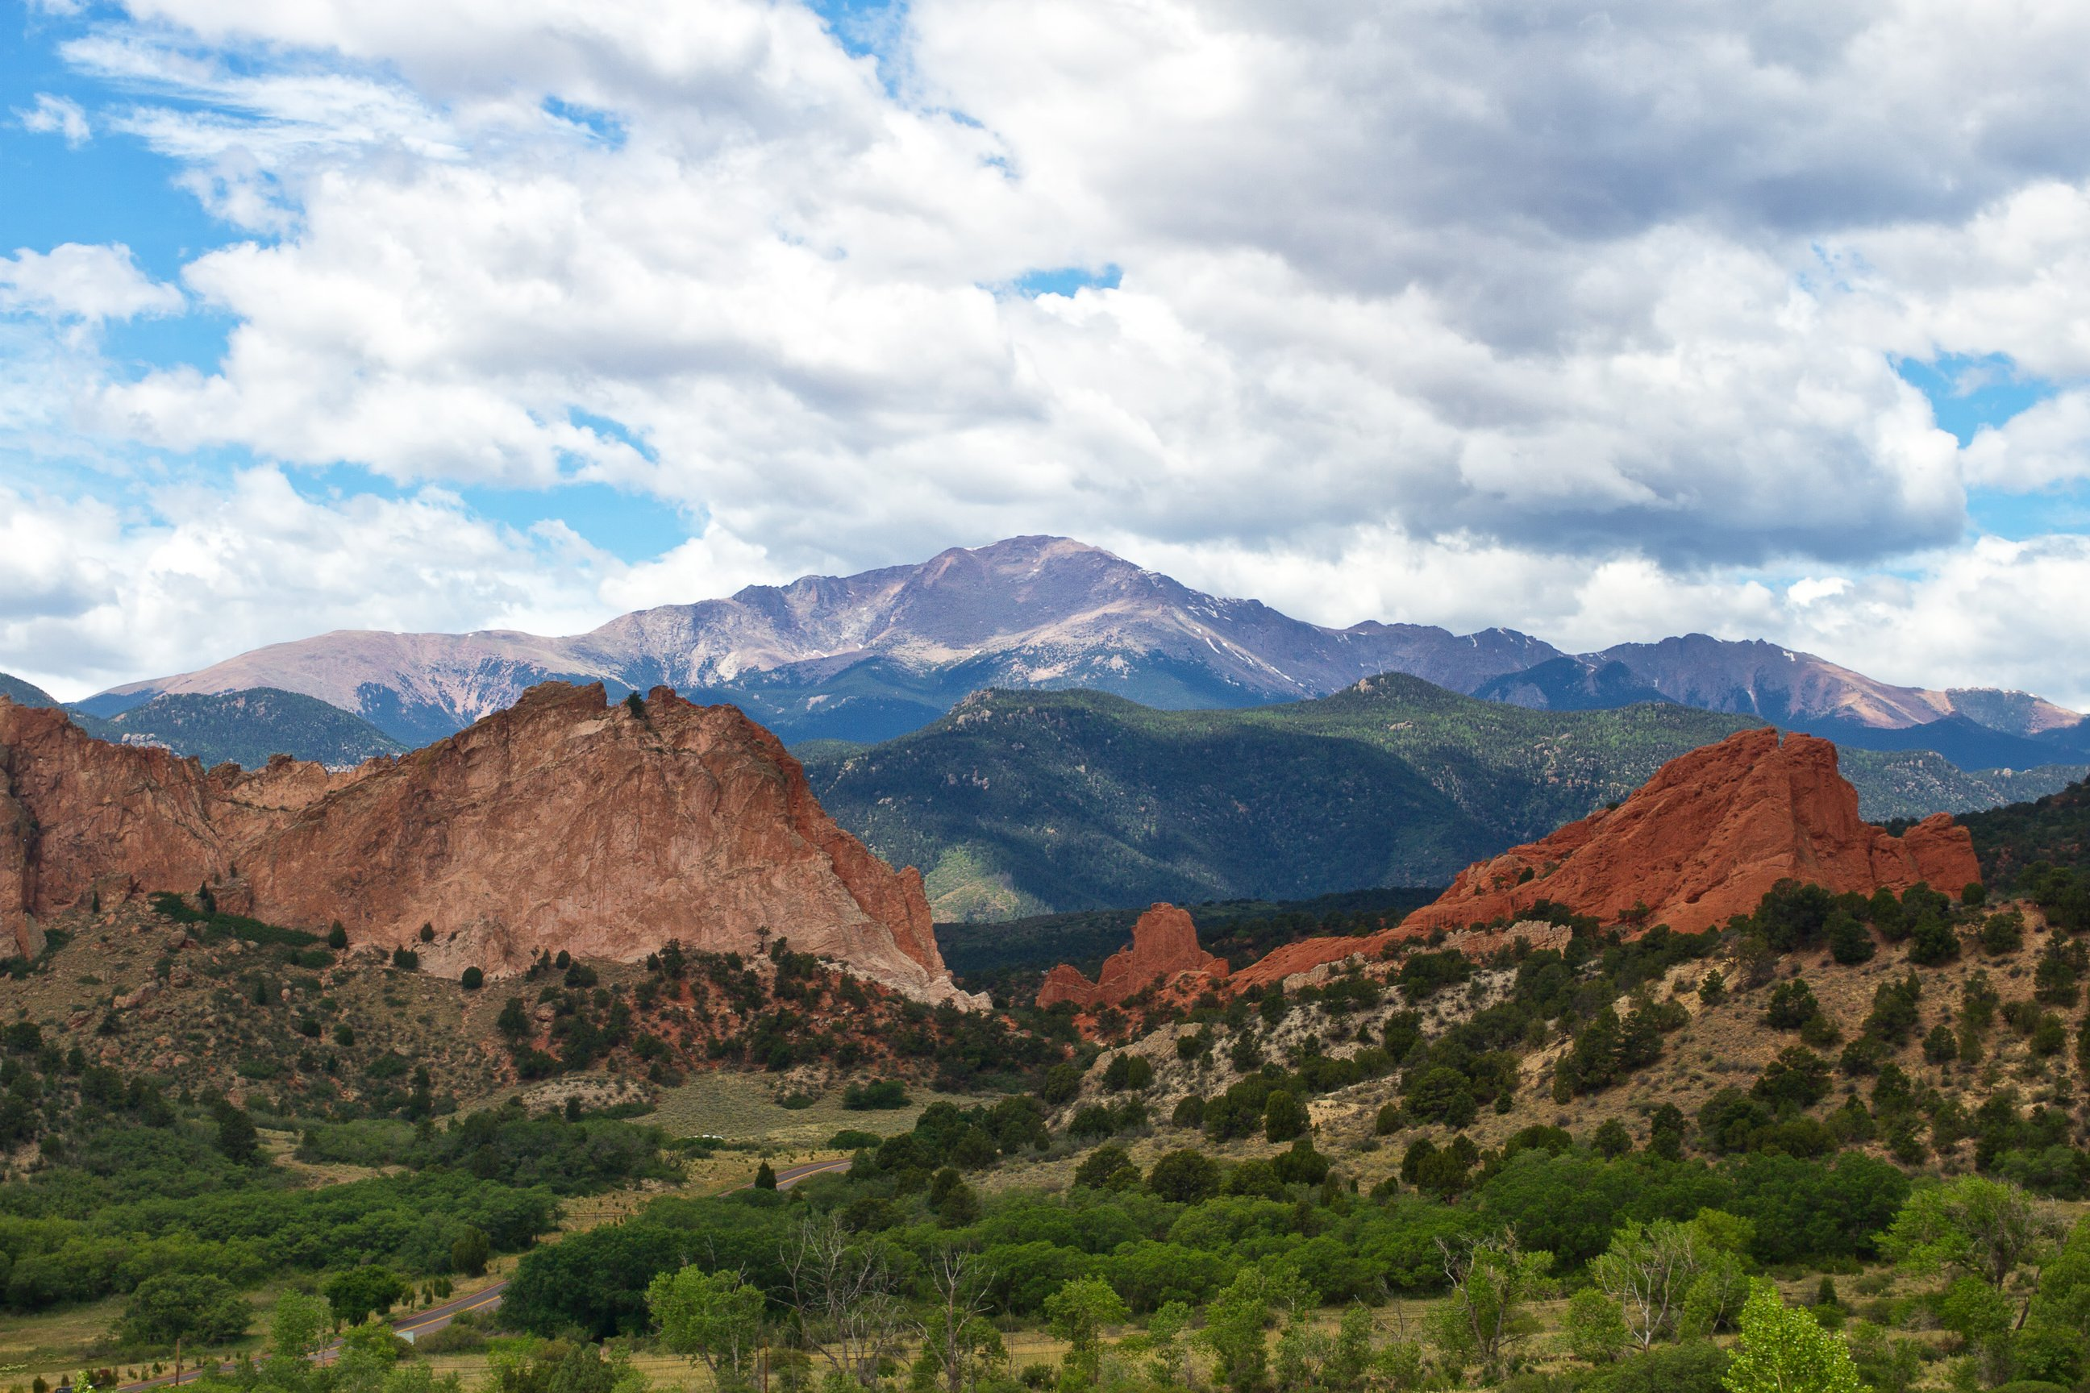

2022 Public Safety’s Dedicated 0.23%
Sales and Use Tax Report March 2022
Nikki Simmons, CPA, CPFO
Chief Financial Officer
Financial Services Department
May 24, 2022

Slide 2

Historical Sales Tax Collections
(Collected by Colorado Department of Revenue)
Public Safety’s 0.23%
March 2022
Financial Services Department

Slide 3
Historical Use Tax on Automobiles
(Collected by Clerk and Recorder)
Public Safety’s 0.23%
April 2022
Financial Services Department

Slide 4
Historical Sales Tax Collections
(Collected by Pikes Peak Regional Building Department and EPC)
Public Safety’s 0.23%
April 2022
Financial Services Department

Slide 5
Historical Sales and Use Tax Tax Collections
(All Components)
Public Safety’s 0.23%
March 2022
Financial Services Department

Slide 6
Sales & Use Tax
(All Components)
Public Safety’s 0.23%
March 2022
Financial Services Department

Slide 7
Sales & Use Tax
(All Components)
Budget to Actual Public Safety’s 0.23%
March 2022
Financial Services Department

Slide 8

Questions?

