Slide 1
City Gate 2.0
EPC Property and Sales Tax TIF Request
Coordinated by El Paso County Economic Development
May 3, 2022

Slide 2
City Gate 2.0
Urban Renewal Area
Located in Commissioner District 3
The plan area consists of 13 parcels on 11.63 acres of land and are owned by the City Gate Apartments ownership group
Development will take place in three phases
Total of 61 efficiency units, 187 studios, 627 one-bedrooms, and 307 two-bedrooms
Monthly rental prices will range from $1,290 to $2,955, and the sizes will range from 329 SF to 1,061 SF for all units
Approximately 12,000 SF of retail floor area in each building

Slide 3
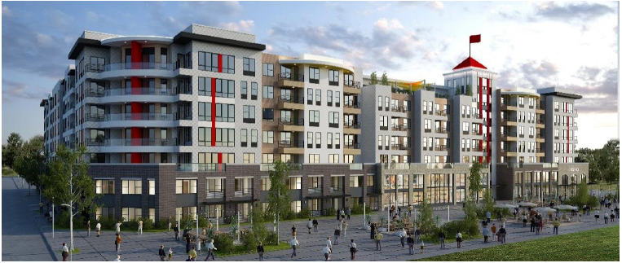
Phase 1 Rendering
Project Renderings

Slide 4
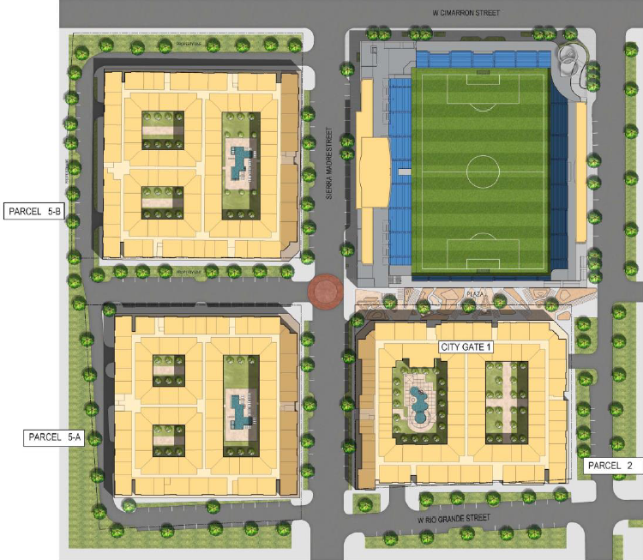
Site Plan
Humphreys & Partners Architects, L.P.
Project
Renderings

Slide 5
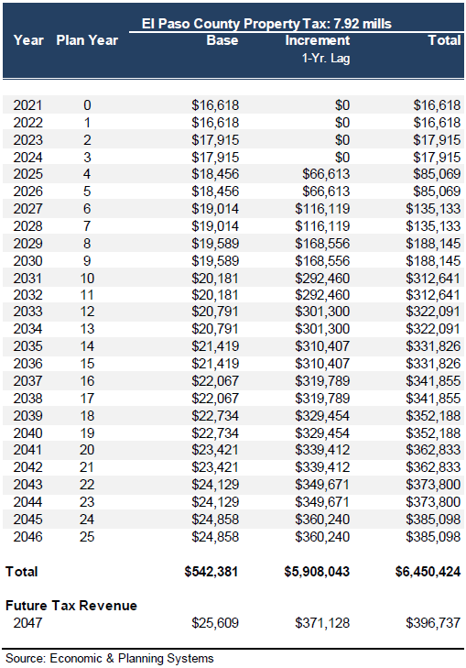
City Gate 2.0
Property Tax Request
(EPS Report)
The county’s share of the current property tax base is approximately $16,618
Projected to generate approximately $542,381 in base property tax over the 25-year period
Projected to generate approximately $5,908,043 in property tax increment over the 25-year period
After 25 years, the County’s share of property tax revenues will increase to approximately $396,737 annually due to the new development
Source: EPS Report

Slide 6
City Gate 2.0
Property Tax Request
Requesting 100% percent of the County’s property tax mill levy
Slightly different calculation than EPS due to projected mill levies
EPC property tax increment is projected to generate approximately $7.2 million over 25 years
Source: El Paso County Financial Services Department

Slide 7
City Gate 2.0
Sales Tax Request
Originally requested 100% of the County’s 1% sales tax revenues
Request was reduced to 87.5% of the County’s 1% sales tax revenues
The sales revenue is anticipated to be approximately $342 million over 25 years
The cumulative sales tax revenue for all taxing entities is projected to be $28M over 25 years (EPS)
EPC sales tax increment is projected to generate approximately $3.0 million over 25 years (87.5% of $3.4 million 1% sales tax)
Source: El Paso County Financial Services Department

Slide 8
Conclusion on Impact
EPC Financial Impacts
Total TIF requested over 25 years is estimated to be $10,146,432
Approximately 0.1% of County’s tax base over those 25 years
Year 25 amounts represent 0.072% of County’s estimated TABOR base
No Specific Ownership Tax impact, as no Metro District has been proposed for this area
Source: El Paso County Financial Services Department

Slide 9
Conclusion on Impact
EPC Impacts
The City of Colorado Springs will be responsible for the majority of services, so the County should have minimal financial exposure
El Paso County will generate a significant amount of property and sales tax revenues upon the conclusion of the TIF in 2047
The project will help develop blighted land that will have a positive impact on the surrounding properties and downtown
Summit Economics projects that property management and retail, along with indirect and induced impacts, will create 142 total jobs annually with $5.2 million in labor income, and roughly $8 million annually will be added to the local GDP
Summit Economics also projects that over ten years of construction, approximately 400 jobs will be created annually with $24 million in labor income and over $30 million added to the local GDP

Slide 10
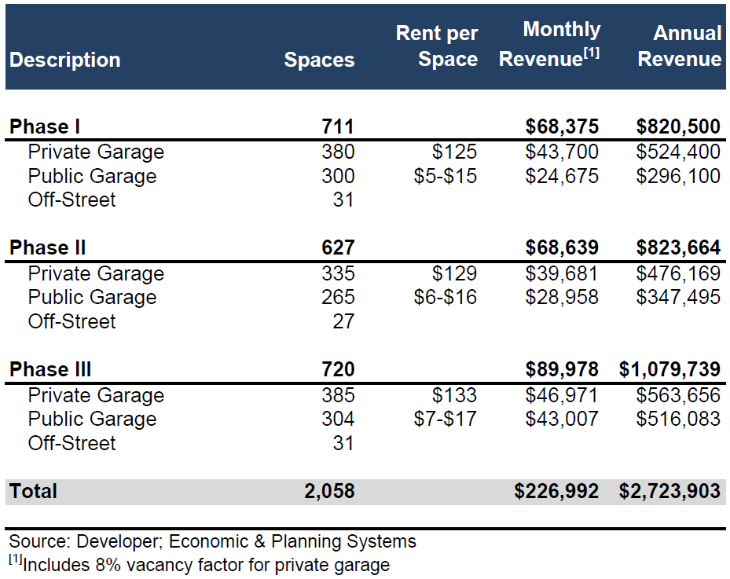
Conclusion on Impact
Community Impacts
Phase I will include 711 parking spaces
Phase II will include 627 parking spaces
Phase III will include 720 parking spaces
Total number of parking spaces will be 2,058
  869 structured parking garage spaces for public use
  1,100 structured parking garage spaces for residents only
  89 off-street parking spaces
There will be a mix of parking garage spaces and off-street parking

Slide 11
Conclusion on Impact
Community Impacts
Public improvements, some of which include:
  Two pedestrian plazas featuring public art, seating, and event spaces
  An enhanced intersection at Sierra Madre and Moreno consisting of raised crosswalks, enhanced plantings and landscaping, and modern street lighting
  Street improvements along Sierra Madre, Rio Grande, and Sahwatch
  Address inadequate pedestrian lighting and sidewalks with safety improvements along Sierra Madre, Rio Grande, and Sahwatch
  Installation, construction, or reconstruction of potable and non-potable water connection, electric and gas utilities along Moreno, Sierra Madre, Sahwatch and Rio Grande
  Epicenter buildout with a variety of design choices intended to expand the actual and visual area of the street intersections
The addition of 37,000 square feet of retail opportunity

