Slide 1
Board of County Commissioners Meeting Update
Chuck Broerman
El Paso County Clerk and Recorder
March 15, 2022

Slide 2
Ballot Audit & Review Tool
Our office prides itself on transparency, therefore, we are leading the way in innovative solutions in providing election services via a virtual government for our constituents. This is one of several initiatives the Clerk’s office has offered to ensure confidence and trust of the election process and the confirmation of results for the 2020 General Election and 2021 Coordinated Election
This Ballot Image Audit and Review tool allows the public to view, sort, filter, and download ballot images from the 2021 Coordinated Election
Cast Vote Record available to the public for viewing
Allows citizens to be their own "Citizen Auditor" of elections

Slide 3
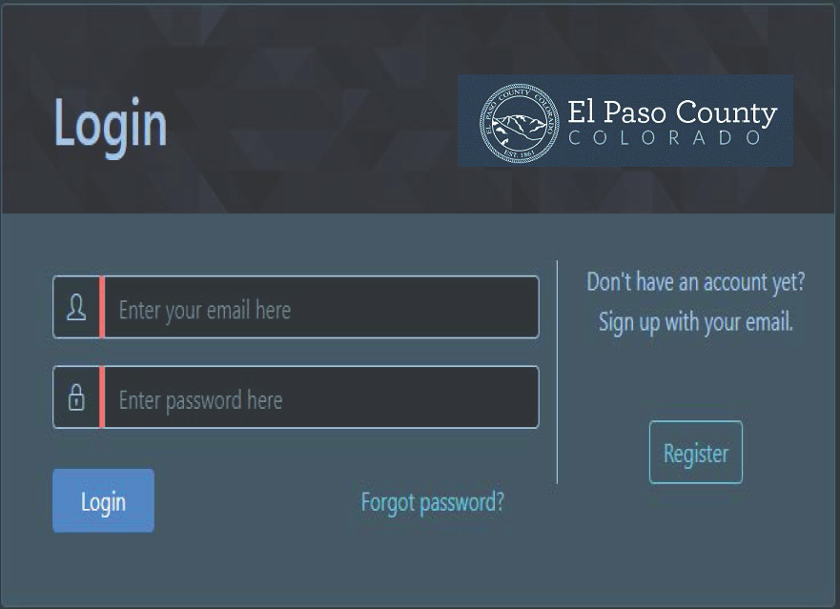
New users will need to create an account by providing a valid email address and create a password to gain access to the tool
El Paso County Ballot Audit and Review

Slide 4
Ballot Audit & Review Tool: Election Selection View

Slide 5
Ballot Audit and Review Tool: Ballot Standard View

Slide 6
Ballot Audit & Review Tool: Ballot Audit Mark View

Slide 7
Ballot Audit & Review Tool: Ballot Adjudication View

Slide 8
Employee of the Year: Bridget Roe
We would like to congratulate Bridget Roe on being named Employee of the Year for the exemplary efforts she has shown in the Clerk to the Board Department.
May 2021 proved to be challenging with a new CTB manager, the largest appeal year for the Board of Equalization and combined with a new software system. Bridget stepped up immediately and without hesitation handled all the daily tasks, all while she was planning her wedding. During 2021 CTB received 7 new liquor licenses. Bridget processed more than half which allowed her to become more familiar with the new license processes. She became more knowledgeable, researched the liquor code and liquor laws, moved forward to make processes more streamlined. Bridget was promoted to Specialist in November. She has proven her relevant knowledge and the ability to take on additional responsibility with minimal direction.
An associate in the County Attorney’s Office noted, “Bridget has been stellar in her position at the Clerk to the Board’s Office since she started with the County. She is responsive, efficient, and extremely friendly. I always know that when I ask Bridget for assistance, she will be helpful and timely in providing information. It’s a pleasure to work with her.”

Slide 9
Questions?

