Slide 2
Notes:
***Replace with video from local hard drive**

Slide 3
Children Served Through June 2018
El Paso County
Children Served – 2,071
Requests Met – 788
Est. Economic Impact – 589k
% Requests Met – 67%

Slide 4
Children Served Through Oct. 2021
El Paso
County
Children Served – 11,268
Requests Met – 4,455
Est. Economic Impact – 3.5 mil
% Requests Met – 73%
Notes:
Since last meeting
9,197 kids served
230 kids per month avg (over 7 per day)

Slide 5
Children Served Through Oct. 2021
Statewide
Children Served – 13,471
Requests Met – 5,328
Est. Economic Impact 3.9 mil
% Requests Met – 73%

Slide 6
Examples of Recent Needs Met
Formula was provided for a 6 month old boy who recently tested positive for COVID. The boy and his 5 year old brother are being cared for by their aunt. request 73911
Two churches partnered together to proved bunk beds, winter clothing and a stroller for three children that were recently placed in kinship care. It was a 5 month old boy, 3 year old girl and 5 year old girl. request 73533
“Child has been returned home and mom is trying to get some help with buying her daughter winter clothes, coats and boots. Mom is working but struggles financially. Her daughter has grown a lot since the last year and doesn't have winter clothes. Child has her own specific style and would love to be able to pick out her clothes. She loves pink and unicorns.” A $150 gift card was provided. request 72935

Slide 7
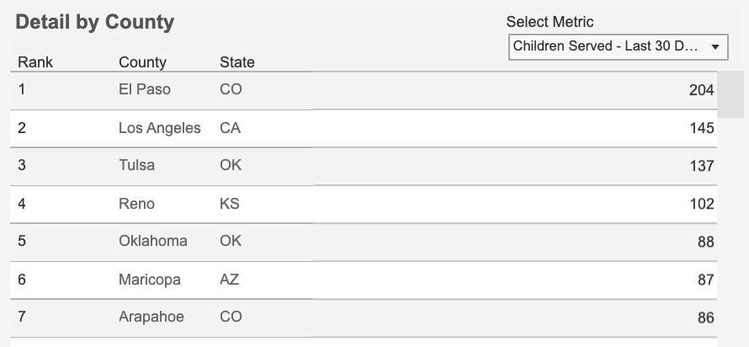

Slide 8
Partner Agencies

