Slide 1
2021 Coordinated Election Update
Chuck Broerman
El Paso County Clerk and Recorder
November 16, 2021

Slide 2
2021 Coordinated Election Ballot Returns
2019
178,989 ballots cast
2017
153,832 ballots cast
171,356 ballots returned
Record number of ballot returns on Election Day
Over 64,000
Past Coordinated Ballot Returns

Slide 3
Colorado Secretary of State’s Office Election Night Reporting System Error
A Statement from El Paso County Clerk and Recorder Chuck Broerman
[Colorado Springs, Colo. – November 2, 2021] The El Paso County Elections Department has many safeguards in place to ensure the accuracy and validity of the vote totals when they are reported to the public. While uploading our first results of the evening with the bipartisan canvass board, who are appointed by the two major political parties, we discovered there was an issue with the card cast totals matching the figure that would have been reported by the Colorado Secretary of State’s (SOS) Election Night Reporting system.
It is of the utmost importance that any results reported by the El Paso County Clerk and Recorder’s Office are 100% accurate. The Election staff and bipartisan canvass board reviewed and approved all results by verifying the accuracy twice before publishing. The delay in results was due to an abundance of caution and we are confident our safeguards work.
While the SOS Office has corrected this issue on their Election Night Reporting System, we look forward to hearing updates from them regarding the root cause of the issue and learn what may have transpired with the Election Night Reporting system.

Slide 4
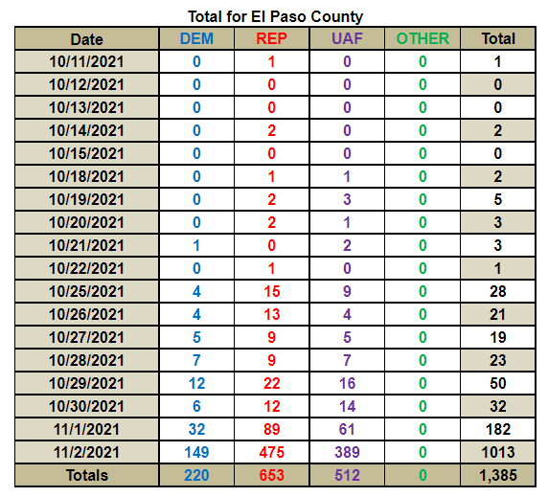
Voter Service and Polling Centers In-Person Voting

Slide 5
Risk Limiting Audit
Began the RLA Monday (11/15/2021)
Audit approximately 565 ballots
Proposition 119
Colorado Springs School District 11 Director - 2 Year Term
Open to the public to view via glass windows
A post-election audit that gives a statistical level of confidence that the outcome of an election is correct
This confidence level is the minimum level of confidence meaning an election that passes an audit with a risk limit of 3%, the confidence in tabulation accuracy is 97% or above
Bipartisan audit team enters the votes on randomly selected paper ballots into a system that compares to the digital record of results

Slide 6
Automatic Recount COLORADO SPRINGS SCHOOL DISTRICT 11 BALLOT ISSUE 4B
Triggered automatic recount with 9 vote difference
November 26, last day for School District 11 to waive the recount
November 29 & 30 – Logic and Accuracy Testing
December 1, 2021, first day recount will begin

Slide 7
Past Recounts
Have conducted several recounts using the current election management system
All results from the recounts substantiated what the original Official Election Results showed
2017 Coordinated Election
Academy School District 20 Board of Directors
Karin Reynolds – 13,181
Thomas LaValley – 11,121
Doug Lundberg – 10,369
William H. Temby – 10,349
Eric S. Davis – 8,011
2018 Primary Election
County Commissioner District 4
Paid recount, not automatic
2019 Coordinated Election
City of Manitou Springs Ballot Issue 2D
Yes – 1035
No - 1030
Stratmoor Hills Sanitation District Ballot Issue 6F
Yes – 470
No - 468

Slide 8
Questions? 719-575-8683 EPCVotes.com

