Slide 1
Election Integrity Report
Chuck Broerman
El Paso County Clerk and Recorder
November 2, 2021

Slide 2
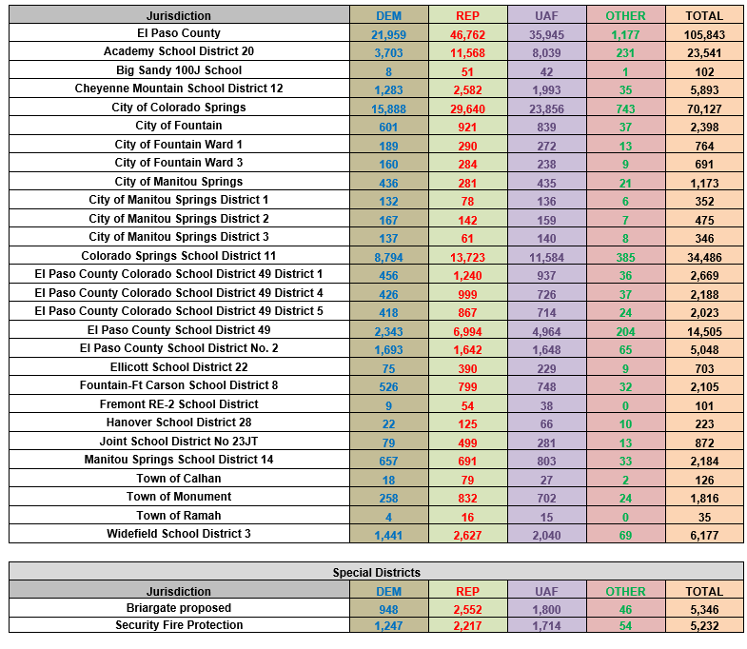
Returns 2021 Coordinated Election

Slide 3
Transparency and Trust
“Our office prides itself on transparency, therefore, we are leading the way in innovative solutions in providing election services via a virtual government for our constituents,” said Chuck Broerman, Clerk and Recorder.”
This report features several initiatives the Clerk’s office has offered to ensure confidence and trust in the election process as well as proposed election integrity measures, we plan to implement

Slide 4
What We’ve Done
The Clerk and Recorder's Election staff and I have answered several thousand phone calls and emails and met with a number of groups regarding the election and our election security practices.
Hosted and participated in local and statewide Election Town Hall meetings and Election Tours
Testified before the Legislative Audit Committee

Slide 5
Ballot Security (pre-election)
Conduct L&A (Logic and Accuracy test)
All ballot counting equipment is tested that will be used for the Coordinated Election.
Central Count Optical Scanners, Voter Service and Polling Center electronic marking devices.
The L&A test consists of three components:
System Function Test
This test verifies that the election was programmed correctly by county staff in the Election Management System (EMS).
Hardware Function Test
This test ensures that all of the EMS hardware that will be used in the election functions properly.
Integrity Check
The final part requires the bipartisan Testing Board to select a sample of a minimum of 25 blank ballots each to vote as they choose. The Testing Board makes a hand tally of these ballots to check against the machine count after they are tabulated on a scanner of their choosing. This test is as expansive as the Testing Board chooses to make it in an effort to achieve the highest confidence in the EMS vote tabulation.

Slide 6
Ballot Security (post-election)
Risk Limiting Audit
A post-election audit that gives a statistical level of confidence that the outcome of an election is correct
This confidence level is the minimum level of confidence meaning an election that passes an audit with a risk limit of 4%, the confidence in tabulation accuracy is 96% or above
Bipartisan audit team enters the votes on randomly selected paper ballots into a system that compares to the digital record of results

Slide 7
Third-Party Election Audit Extending Assurance to our Voters
Contracted with ClearAudit to perform a post-election 100% parallel audit.
ClearAudit is the only audit system in the country that is capable of comparing digital images from other election system vendors and tabulating the results.
ClearAudit has utilized the scanned digital images of our ballots and conducted an 100% audit.

Slide 8
Analysis- Statement from ClearAudit
“The ClearAudit product is one-of-a-kind because Clear Ballot is the only company capable of reading another company’s ballots, which makes it the only truly independent analysis of results. El Paso County provided Dominion Voting Systems’ scanned ballot images to Clear Ballot, and Clear Ballot was able to tabulate the votes, and then run a thorough comparison of the Dominion system’s results against their own. Having an independent analysis is the best way to boost voter confidence, and no other product in the country can provide the same level of assurance as ClearAudit. In multiple states where audits are mandated, Clear Ballot dominates the market because they have a higher standard of transparency and independence. They have a third of Florida and were just approved to complete recounts, 80% of New York, Maryland, Vermont, and have entered 3 new states with ClearAudit since the 2020 election (Colorado, and audit pilots in New Hampshire and South Carolina), because this is exactly the kind of checks and balances system that voters are demanding. I want El Paso County voters to know that we will use the best technology available to ensure their ballots are counting accurately, and that means going with this system."

Slide 9
Implemented Audit Tool
Allows citizens to view, sort, filter and download over 383,ooo ballot images
El Paso County Ballot Audit and Review
Made Cast Vote Record available to the public for viewing
Made paper ballots available for public inspection in two-hour increments by appointment
Made over 383,ooo ballot images available to citizens to view and tabulate on their own
6,000 ballot images sample available for download on Clerk & Recorder’s website
Remainder can be received on a thumb-drive due to file size

Slide 10
Bipartisan Efforts & Partnerships
El Paso County Republican Party Chair and El Paso County Democratic Party appointed representatives to the El Paso County Canvass Board, Testing Board and the RLA Board for each election
Clerk and Recorder’s Office hires hundreds of Election Judges appointed by the El Paso County Republican Party and Democratic Party and utilized them for:
Pre-election Posting
Post-election Audits
Mail Ballot Signature Verification
Ballot Processing procedure
Ballot Adjudication Station
Ballot Tabulation process
by doing so ensures no political party, individual, or foreign actor could insert fraudulent ballots into the process or sway the tabulation in their favor
Hosted individual political party meetings for elation planning purposes

Slide 11
Looking Forward
While the steps local officials have taken to ensure the accuracy of the election process are admirable, there are reforms the state legislature could embrace which would enhance the integrity of the elections system and restore trust in the process.
The State can fund and support platforms that would make ballot images available for easy online inspection at no cost
Institute additional audits of signature verification judges to enhance accountability at this critical step
Use Voter Registration Audits and enhance the accuracy of voter registration files by validating information against other data, such as the Social Security Administration, Colorado Department of Revenue, federal immigration information, and other similar resources
Expanded secure 24/7 ballot return boxes that allow voters to return their ballot without relying on the U.S. Postal Service for access
Ensure proper funding levels for election operations, security enhancements, and other innovations

Slide 12
4th Judicial District Attorney Partnership
The Clerk and Recorder’s Office has referred a small number of possible criminal violations to the 4th Judicial District Attorney’s Office to investigate potentially illegal voter activity.
In a further commitment to election integrity and as a ground-breaking collaboration between offices, the Clerk and Recorder and the 4th Judicial District Attorney’s Office has recently agreed to jointly fund and support a full-time position within the District Attorney’s Office to investigate and prosecute voter fraud.

Slide 13
Questions?

