Slide 1
2022 Budget Presentation El Paso County Public Health
Susan Wheelan, MBA
Public Health Director
October 21, 2021

Slide 2
El Paso County Public Health
Mission
Our mission is to promote and protect public health and environmental quality across El Paso County through people, prevention and partnerships
Vision
Our vision is for all El Paso County residents to live in thriving communities where every person has the opportunity to achieve optimal health

Slide 3
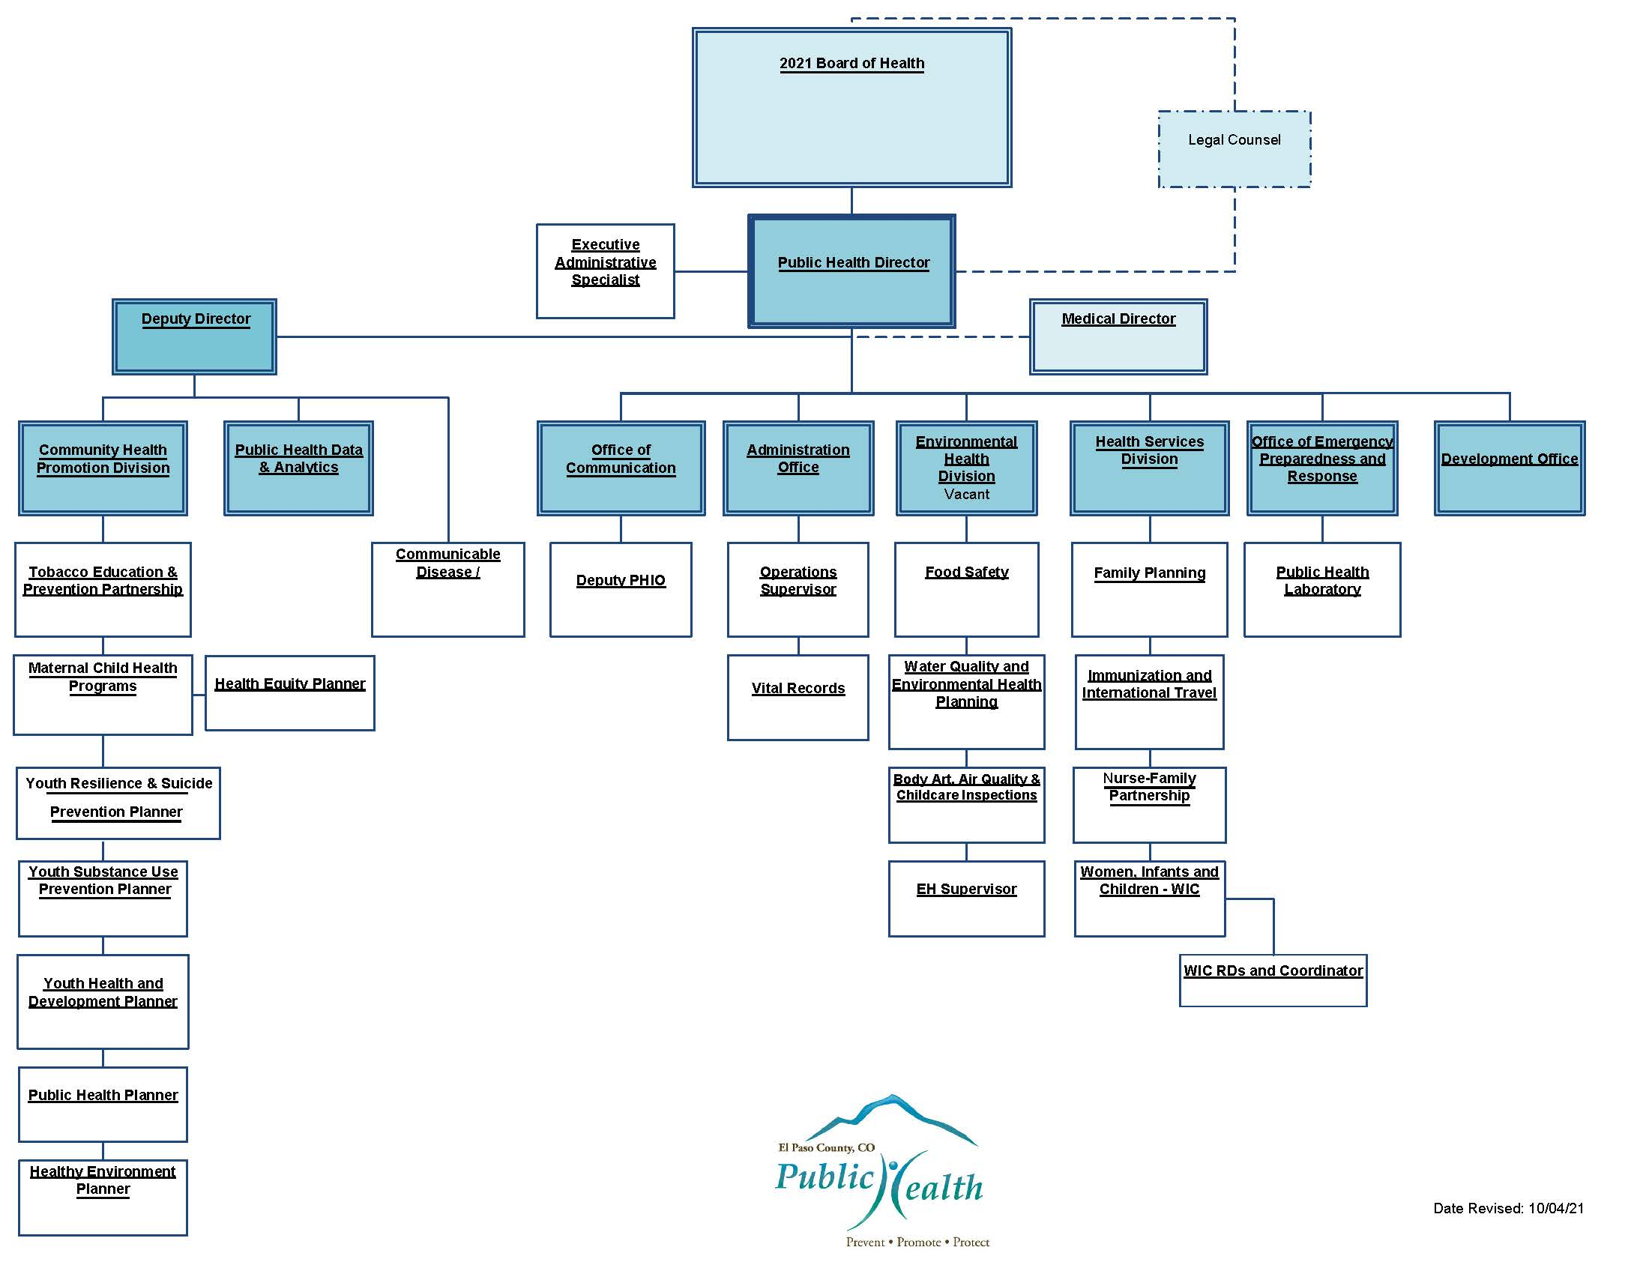
Organizational Chart

Slide 4
Governance—Board of Health
Dr. James Terbush, President
Doris Ralston, Vice President
Susan Wheelan, Secretary to the Board
Longinos Gonzalez, Jr., El Paso County Commissioner
Cami Bremer, El Paso County Commissioner
Dave Donelson, Colorado Springs City Council
Sam Gieck, Fountain City Council
Dr. Richard Vu, Matthews-Vu Medical Group
Ted Collas, Colorado Springs Fire Department Chief (Retired)
Kari Kilroy, UCHealth

Slide 5
Mandates/State Statutes Required
Colorado Public Health Act Title 25, Article 1 of Colorado Revised Statutes
Assessment, Planning, and Communication
Communicable Disease Prevention, Investigation, & Control
Emergency Preparedness and Response
Environmental Health
Prevention and Population Health Promotion
Vital Records and Statistics (Birth and Death Certificates)
Administration and Governance

Slide 6
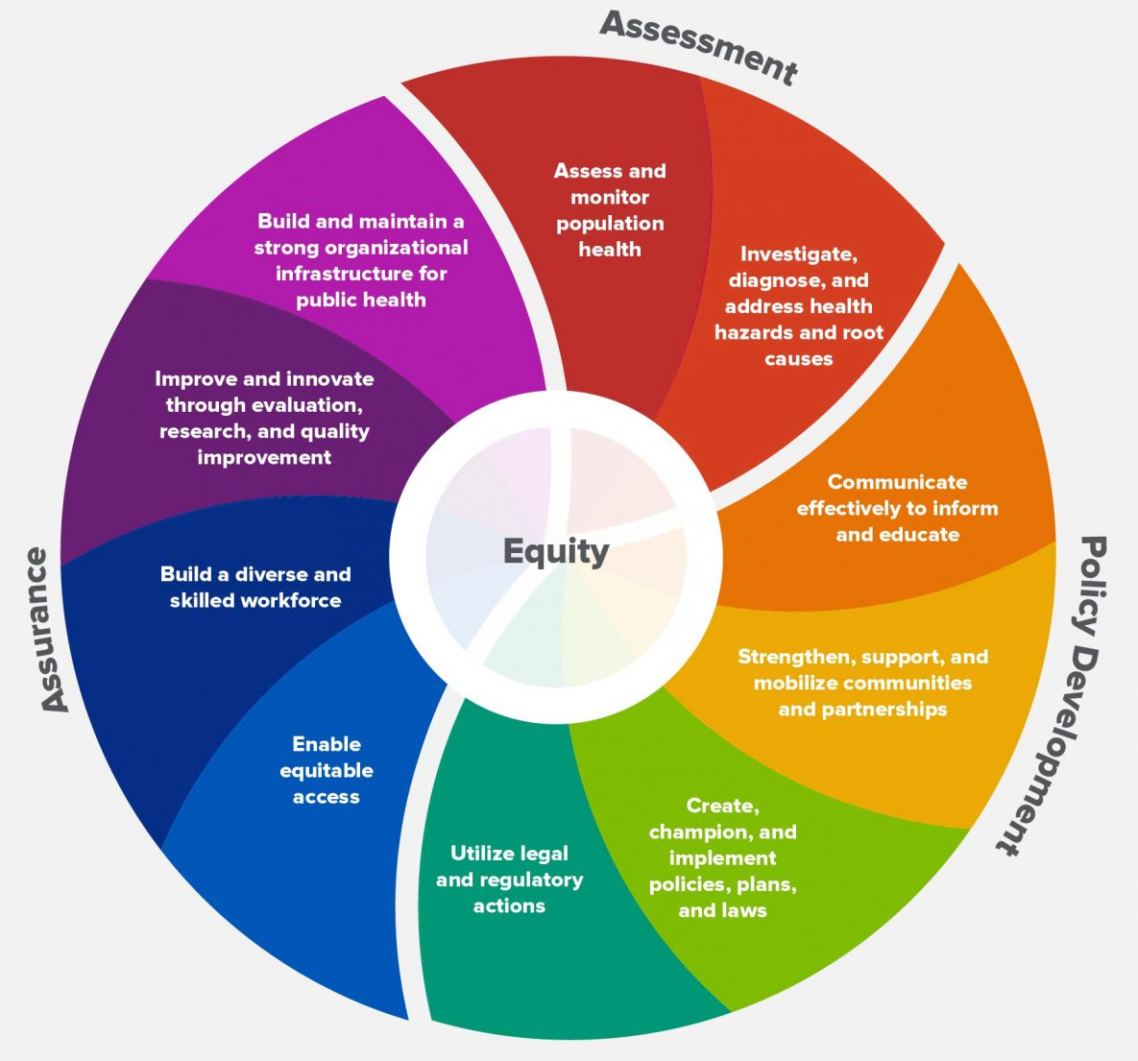
Mandates/State Statutes Required
Colorado Public Health Act Title 25, Article 1 of Colorado Revised Statutes
The 10 Essential Public Health Services
Provides a framework for public health to protect and promote the health of all people in all communities
Promotes policies, systems, and services that enable optimal health and seeks to remove obstacles and systemic and structural barriers

Slide 7
Mandates/State Statutes Required
Colorado Public Health Act Title 25, Article 1 of Colorado Revised Statutes
Required duties of all local public health agencies:
Complete a community health assessment
Create community health improvement plan
Advise the local board of health on public policy issues necessary to protect public health and the environment
Child Fatality Review Team

Slide 8
Strategic Plan Goals 2021
El Paso County Strategic Goal #5: Strive to ensure a safe, secure, resilient, and healthy community
Enhance El Paso County Public Health involvement in the transportation, land use, and environmental planning processes
Expand carbon monoxide and radon awareness, outreach, and detection
Develop a public outreach campaign to provide information on outdoor air pollution, source of pollutants, and corrective actions
Notes:
Implemented multiple public awareness campaigns during 2017-2021 to include paid radio ads in English and Spanish, paid social media ads, news releases promoting Radon Action Month, community events pairing education with free radon test kits, and more

Slide 9
Strategic Plan Goals 2021
El Paso County Strategic Goal #5: Strive to ensure a safe, secure, resilient, and healthy community
Implement a “Communities That Care” model to assess and implement prevention strategies to reduce youth substance abuse
Convene community partners to implement strategies to reduce teen suicide
Continue to actively support the El Paso County Community Health Improvement Plan
Support community efforts to combat substance abuse
Reduce foodborne illness through increased food worker education and expanding compliance efforts of food safety standards at retail food establishments
Notes:
“Communities That Care” (CTC) model
Teen Advisory Board awarded National Association of Counties award for innovative youth programs
Continues to see success with increased parent and community member engagement
Awarded Drug Free Communities grant to target prevention efforts for marijuan and prescription drug use
Convene community partners to implement strategies to reduce teen suicide
Since the inception of the Youth Suicide Prevention Workgroup, it has expanded to include more than 90 community partners to achieve collect impact
Youth suicides saw a 47% reduction in 2019; following an increase in 2020, there are currently three youth suicides to date in 2021
Continue to actively support the El Paso County Community Health Improvement Plan
El Paso County Public Health worked with commuinty partners in 2020-2021 to implement a survey to collect primary data from community members who have experience substance use, mental health, or co-occurring disorders. The results will allow us to examine patterns that can help inform future policies, interventions, and local initiatives
Support community efforts to combat substance abuse
Reduce foodborne illness through increased food worker education

Slide 10
Strategic Plan Goals 2021
El Paso County Strategic Goal #5: Strive to ensure a safe, secure, resilient, and healthy community
Participate in efforts to prevent water contamination and if warranted, support mitigation efforts with community stakeholders
Test the public health pandemic disease response plan, including points of distribution and update plan as warranted
Notes:
In 2021, extensive testing of the point of distribution (POD) plan with numerous COVID-19 PODs successfully executed at El Paso County Public Health South and multiple community locations

Slide 11
Ongoing Critical Needs Positions
Ten critical needs positions
Administrative (one)
Epidemiologist (one)
Chief Data Scientific Strategist (one)
Public Health Nurse (one)
Health Equity Planner (one)
Emergency Preparedness and Response Coordinator (one)
Youth Resilience and Suicide Prevention Planner (one)
Youth Health and Development Planner (one)
Environmental Health Specialists (two)

Slide 12
Ongoing Critical Needs Positions
Administrative
Supporting the shift to virtual operations during COVID-19 response by:
Mobilizing staff to work effectively in a hybrid virtual environment and with expanded teams
Maintaining and enhancing streamlined intra- and inter-agency communication
Implementing new processes and protocols to assure successful agency operations in a remote atmosphere
Provides support to increase efficiencies, in coordination with technical staff, to convene and collaborate with large, multidisciplinary groups
Includes expanding support for schools, Child Fatality Review Team, Youth Suicide Prevention Workgroup, behavioral health initiatives, and data and analytics

Slide 13
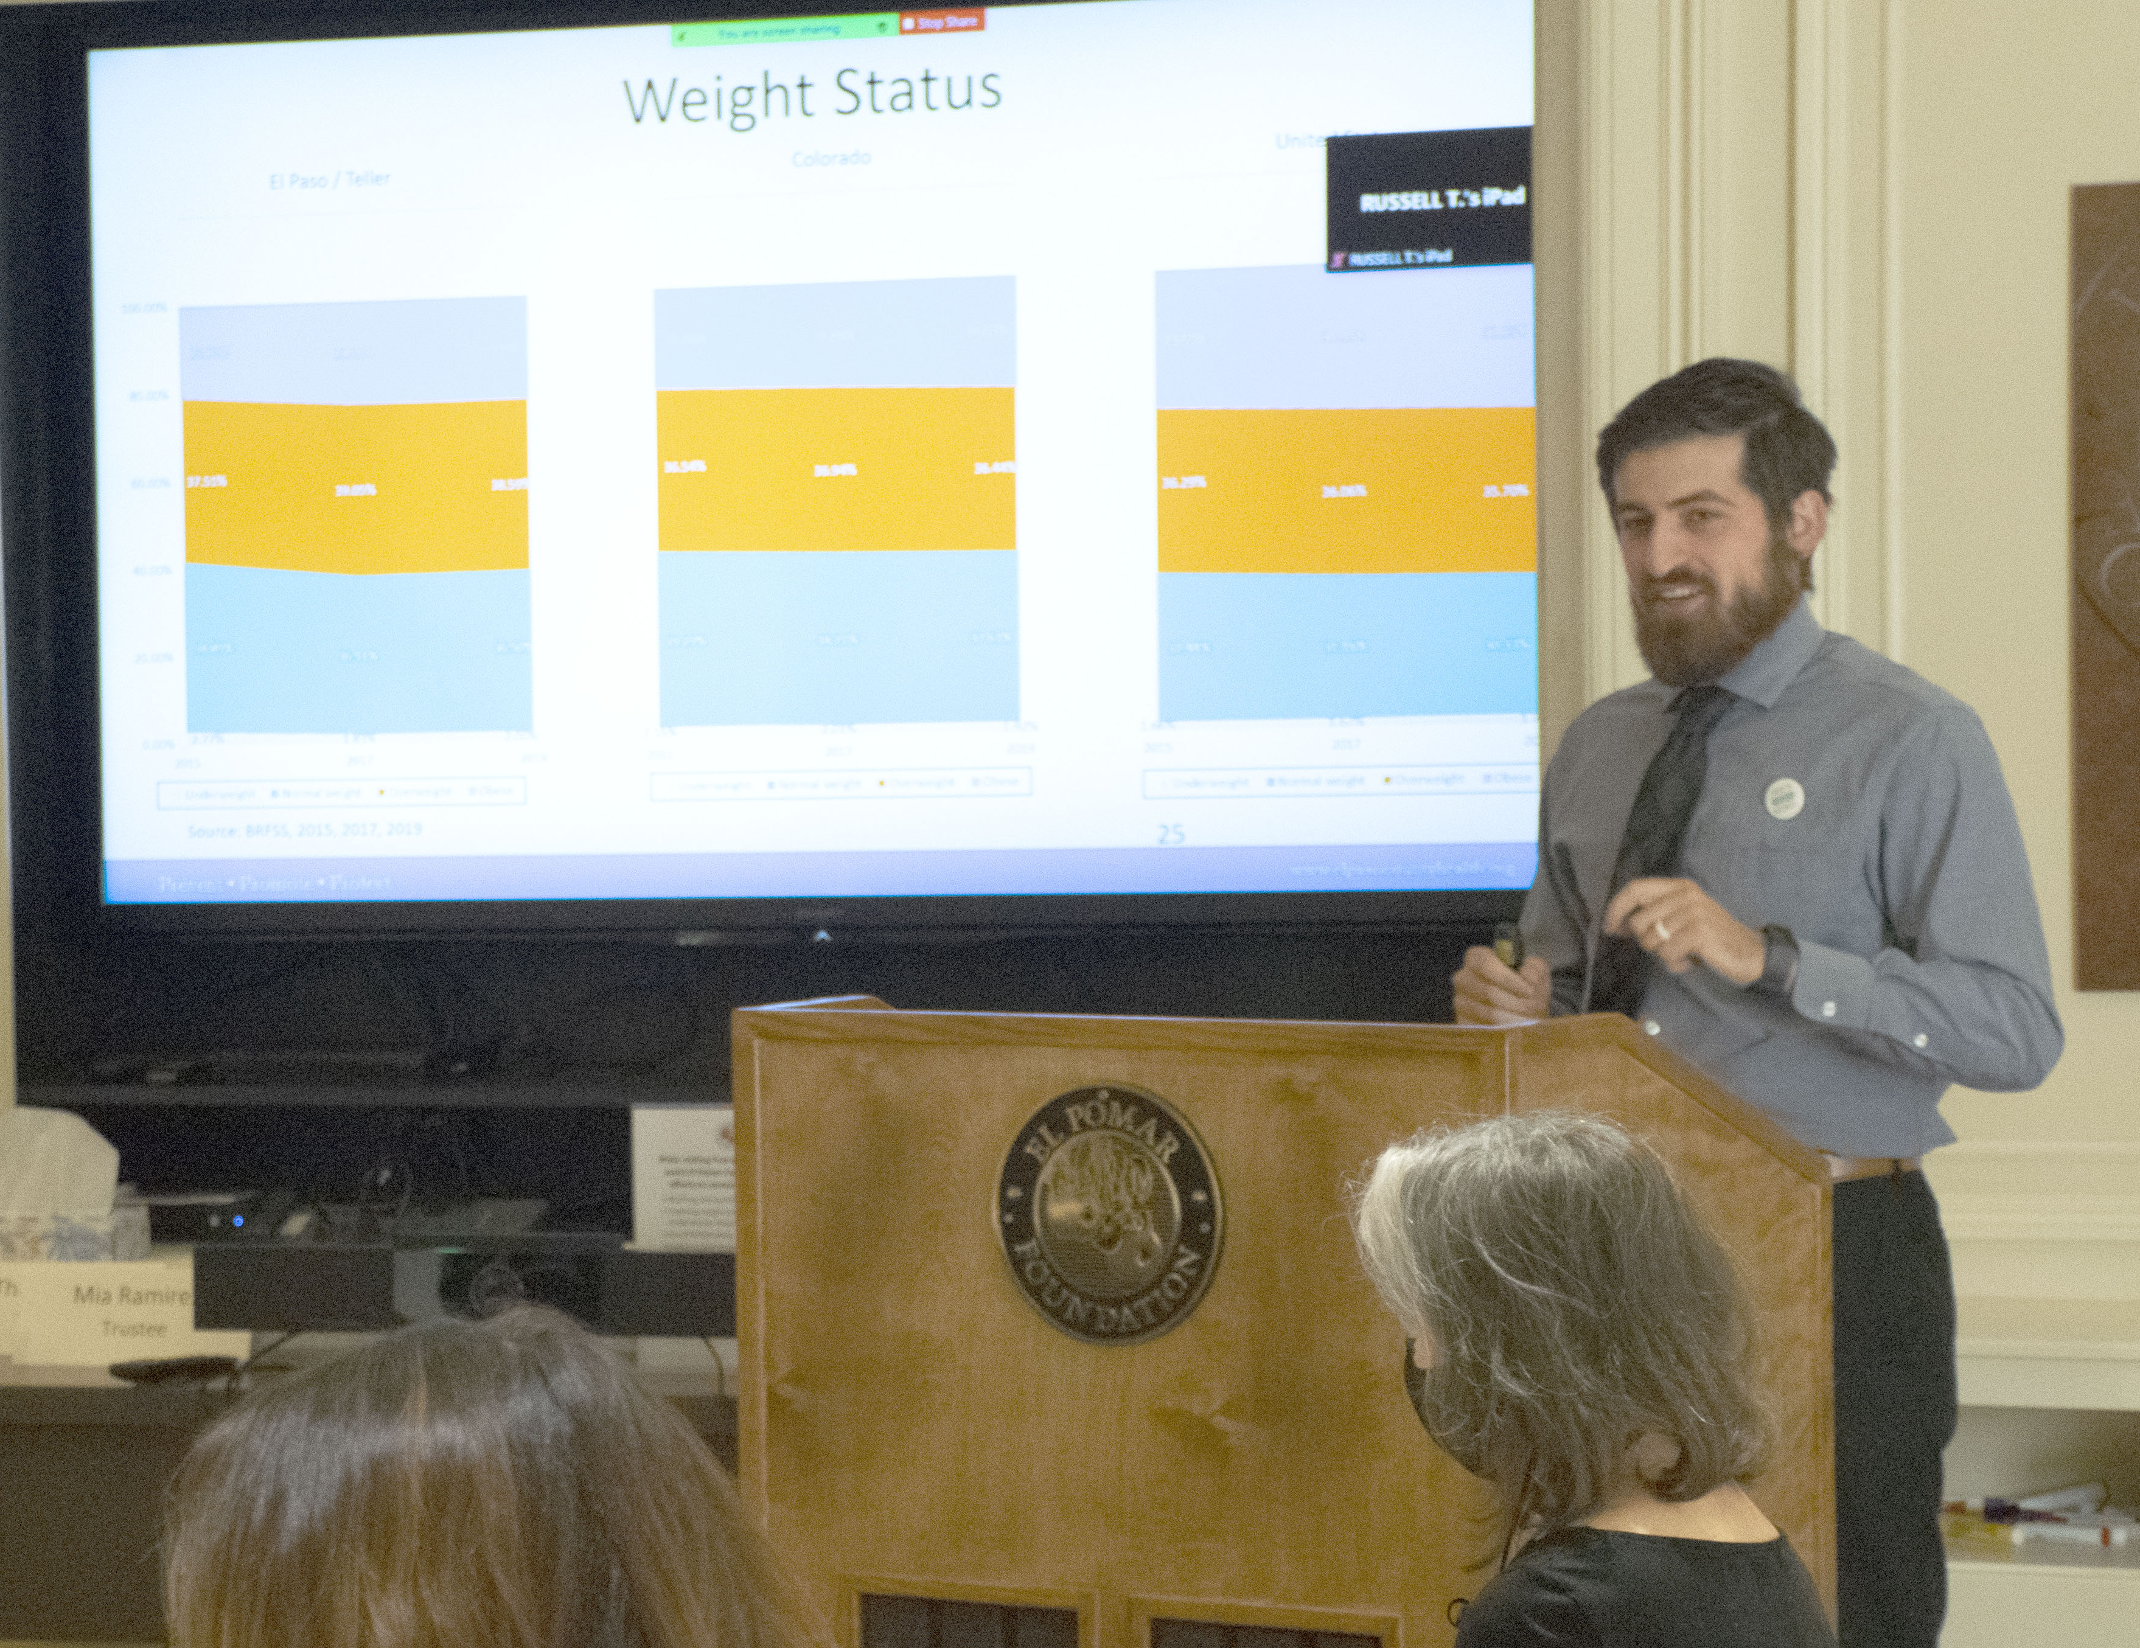
Ongoing Critical Needs Positions
Chief Data Scientific Strategist and Epidemiologist
Increasing access to hyper-local, real-time, transparent and accurate data and trends
Dashboard is a resource for the public and partners – consistently the top viewed page on the Public Health website
Since the COVID-19 dashboard launched in April 2020, there have been 1,954,525 total pageviews
Credible research webpage with peer-reviewed literature and journal articles on emerging topics
Children and youth data COVID-19 data brief keeps partners and public informed about disease trends among this age group
Epidemiologist presents El Paso and Teller County data and metrics at a Colorado Springs Health Foundation Board Retreat on Sept. 24, 2021

Slide 14
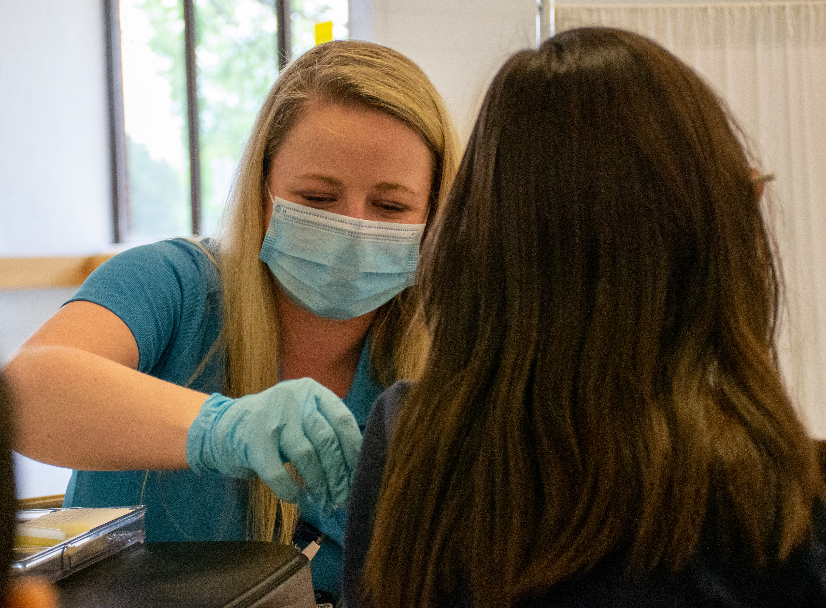
Ongoing Critical Needs Positions
Public Health Nurse
This position supports 18 long-term care facilities (of a total of approximately 70 long-term care facilities in El Paso County), providing technical assistance to help mitigate the spread of COVID-19 among most vulnerable populations, assisting them with outbreaks, educating staff on guidance, and collecting data
Provides support to long-term care facilities in planning and implementation of booster shot clinics
As vaccination lead for many clinics at El Paso County Public Health South, oversees vaccination logistics in the vaccine administration area
Manages vaccine deployment for Operation House Call
Plans, prepares, and executes back-to-school vaccination clinics at several schools and community events
Public Health nurse working with families to provide routine childhood vaccines at the Annual Backpack Bash

Slide 15
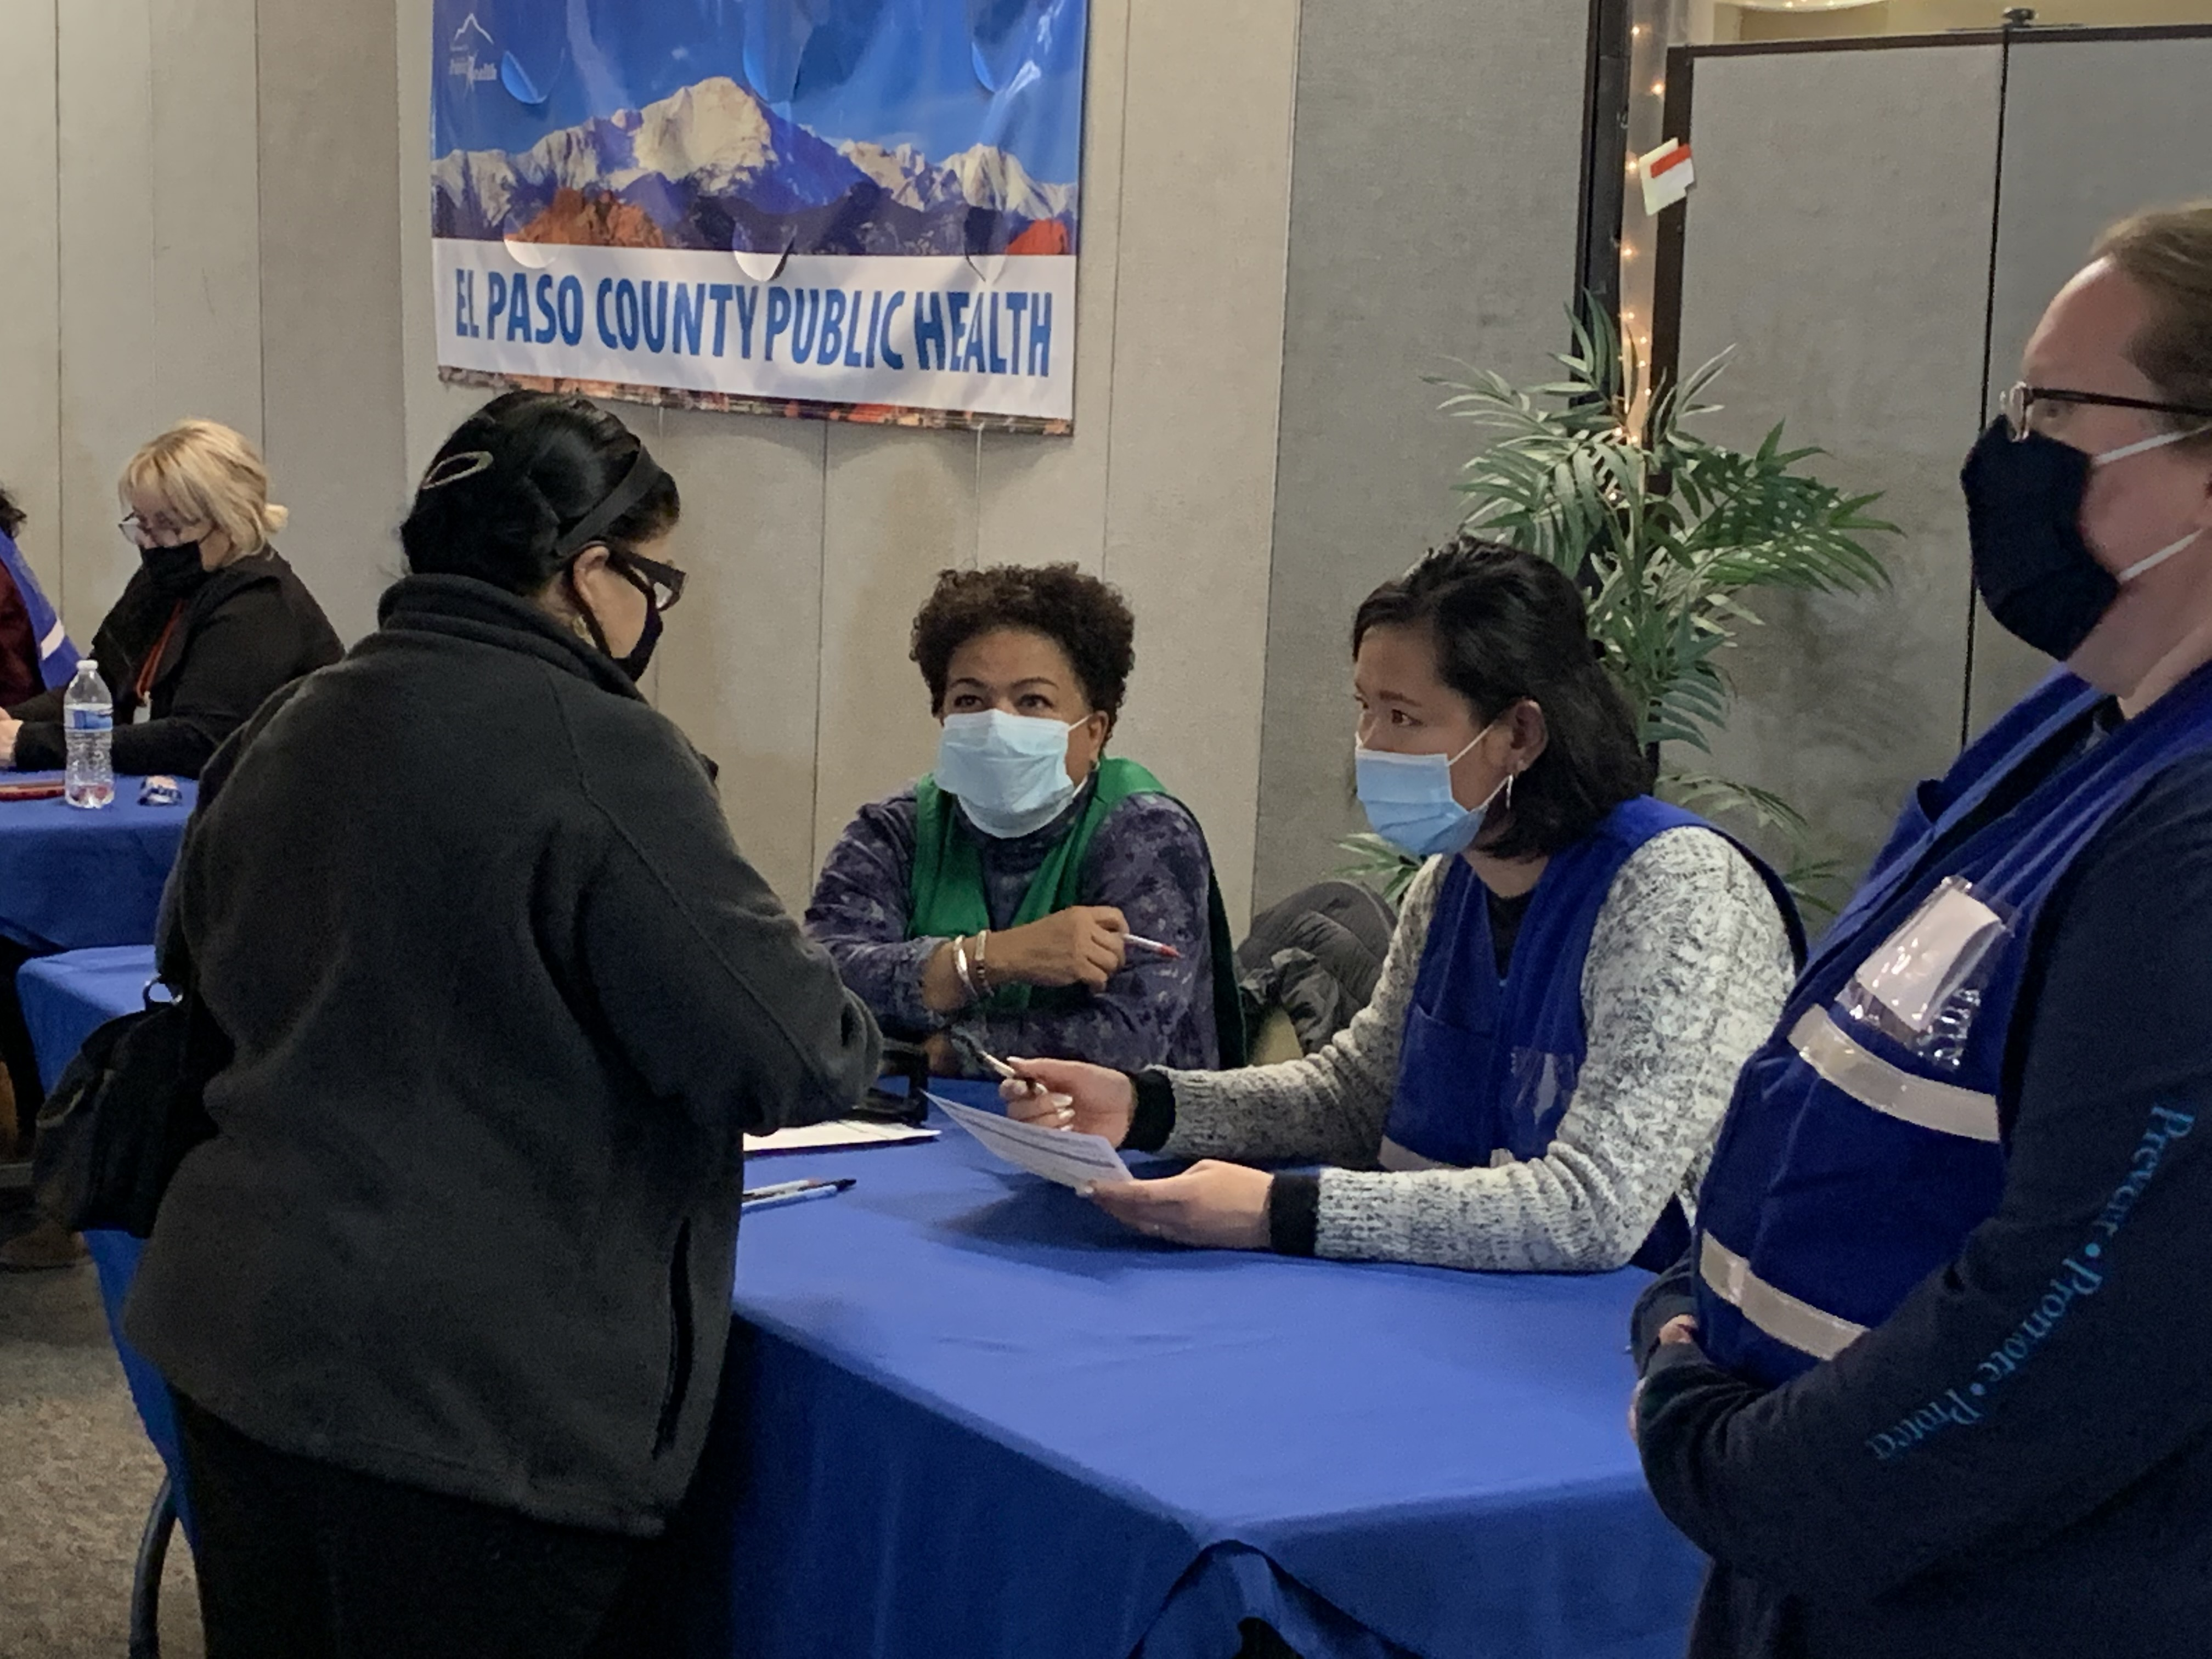
Ongoing Critical Needs Positions
Health Equity Planner
Vital role in coordinating vaccine equity clinics throughout El Paso County, with more than 140 events across 30 community-based partners
Community health centers, faith-based organizations, homeless services, agencies serving LGBTQ youth, agencies serving individuals with disabilities, and more
Facilitates the translation and creation of culturally relevant outreach materials in Spanish for large multi-media vaccination campaign
Includes ads for Spanish radio and television, social media, print, outdoor, website, and more
Actively coordinates with senior-living organizations to provide information on vaccine phases, availability and resources
Health Equity Planner checks individuals in at a COVID-19 vaccine clinic at El Paso County Public Health South

Slide 16
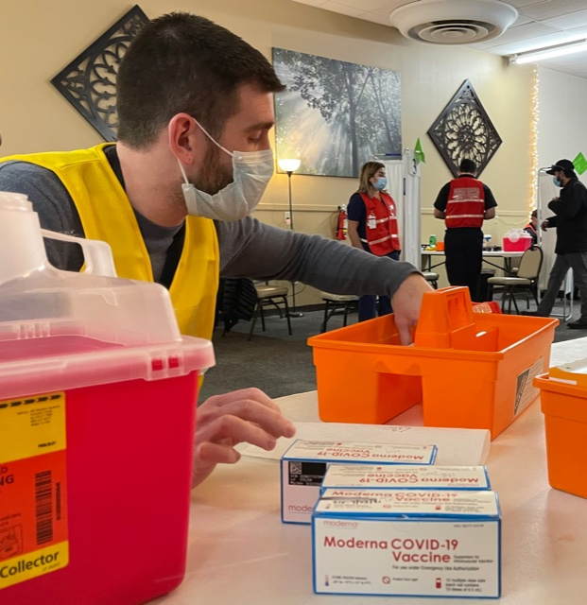
Ongoing Critical Needs Positions
Emergency Preparedness and Response (EPR) Coordinator
Serves as point of dispending (POD) manager for high-volume testing sites at El Paso County Public Health South
Develops POD floor plans to support access and functional needs and promote efficient flow and process for the public
39 POD events at EPCPH South from February – October 2021, resulting in approximately 20,000 doses administered
Spearheading the implementation of PrepMod, which allows for real-time scheduling of vaccine appointments
This enhances convenience for the public, in addition to streamlining capacity and staffing logistics and coordination on the back end
EPR Coordinator preps vaccine supplies at COVID-19 vaccine POD at El Paso County Public Health South

Slide 17
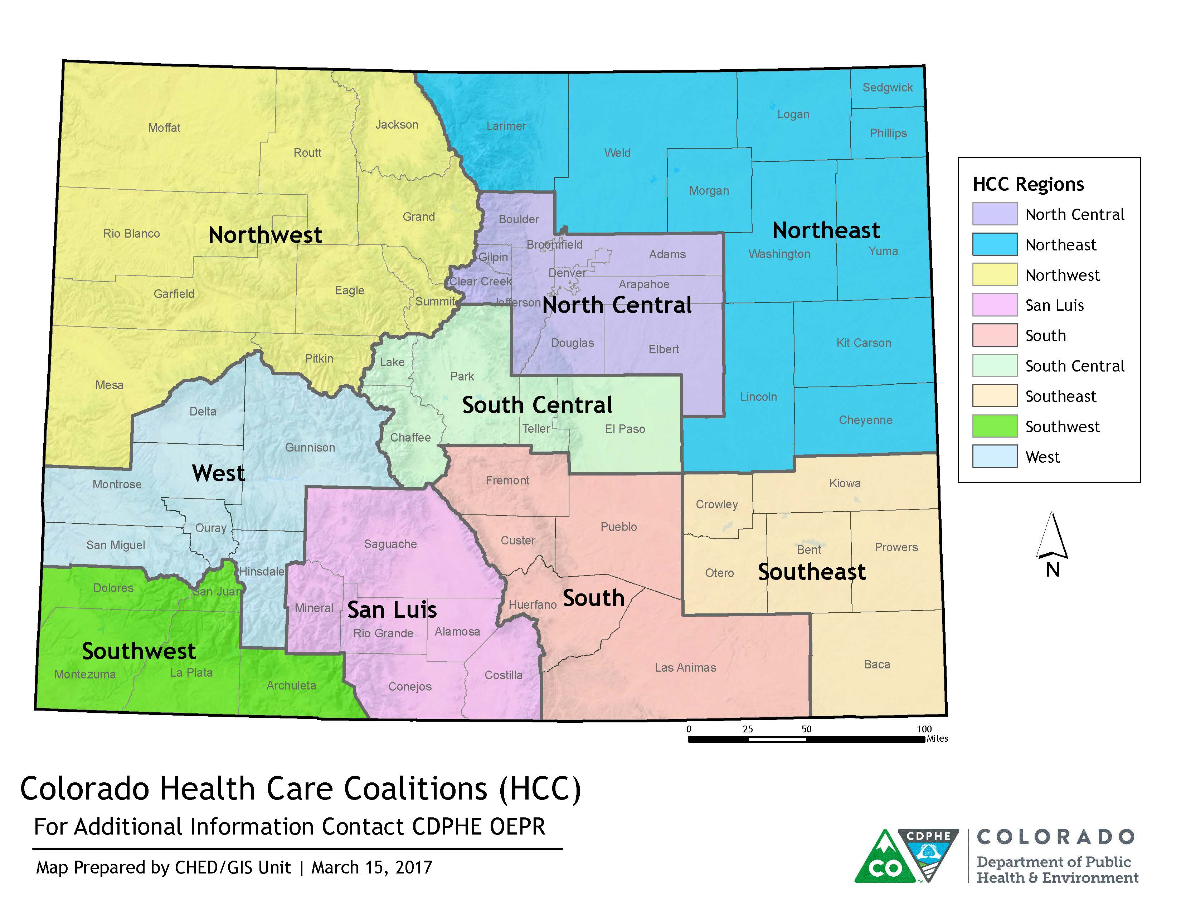
Ongoing Critical Needs Positions
El Paso County Public Health's Emergency Preparedness and Response Program serves a five-county region

Slide 18
Ongoing Critical Needs Positions
Youth Health and Wellness Staff
Youth Suicide Prevention Workgroup convenes more than 90 community partners to address youth suicide with a collective impact model
In January 2021, proactively hosted a youth panel on connectedness and support during the pandemic
Prioritizing case review of all 2020 youth suicide fatalities in the Child Fatality Review Team to identify prevention opportunities sooner and operationalize solutions
To date in 2021, there are three youth suicides in El Paso County per Coroner's Office data
Updating needs assessment and gap analysis to strengthen the focus of the Community Action Plan
Working toward universal release of information form to enhance communication and coordination of care among youth-serving agencies for youth who are at risk for suicide
Expansion of local parent-informed resources on youth suicide and mental health issues
Youth panel in January 2021 on connectedness and support during the pandemic
Notes:
Youth suicides by year:
2014: 7
2015: 14
2016: 15
2017: 13
2018: 7
2019: 9
2020: 16
2021: 3 to date

Slide 19
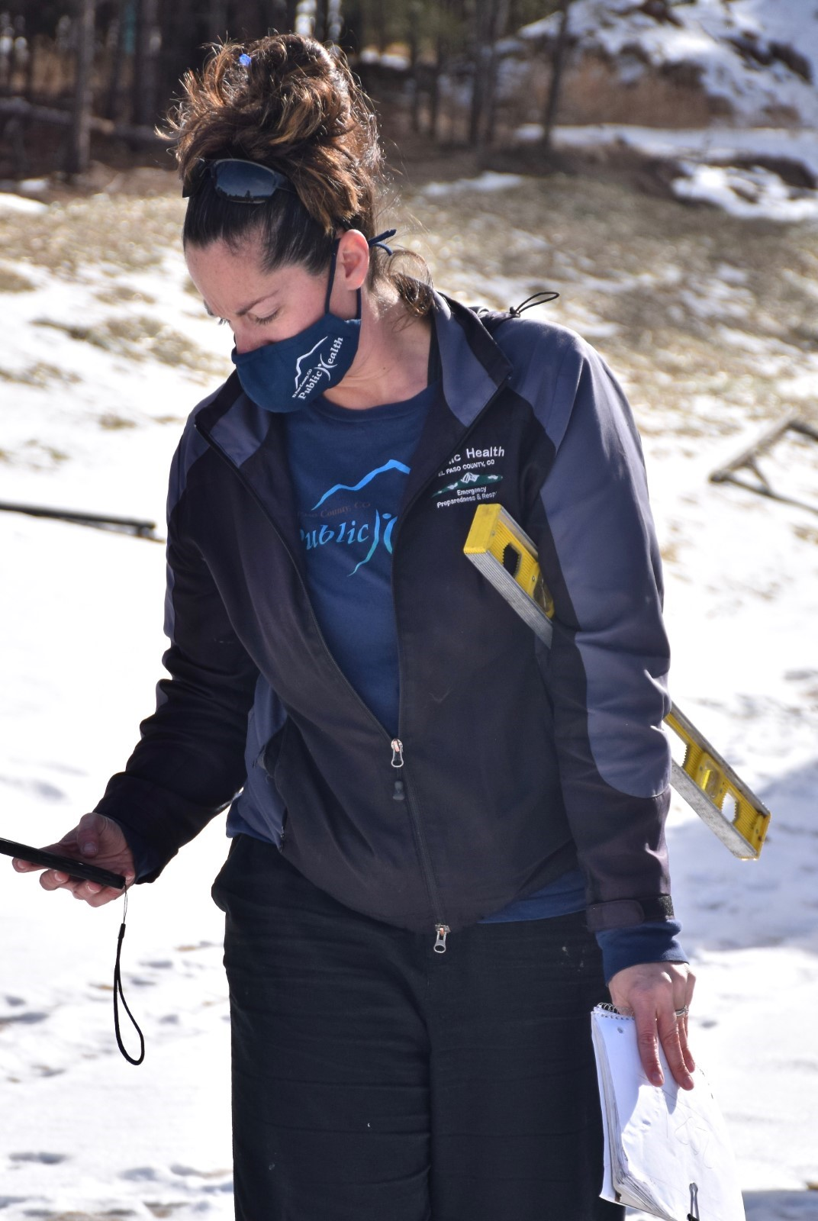
Public Health Infrastructure Ongoing Critical Needs Positions
Environmental Health Specialists
Consistent increase over past five years in permitting and licensing activities associated with Water Quality programs
Onsite wastewater treatment systems (OWTS) continue to grow in El Paso County
Since 2016, El Paso County Public Health has routinely issued one of the highest number of OWTS construction permits in the state
Approximately 34,400 active OWTS systems, translating to roughly 11 million gallons of wastewater being treated daily
Water Quality Program Manager in the field performing an OWTS inspection
Notes:
Provide critical support to businesses and homeowners to meet the needs of increased demands in permitting and licensing activities associated with water quality and food safety programs

Slide 20
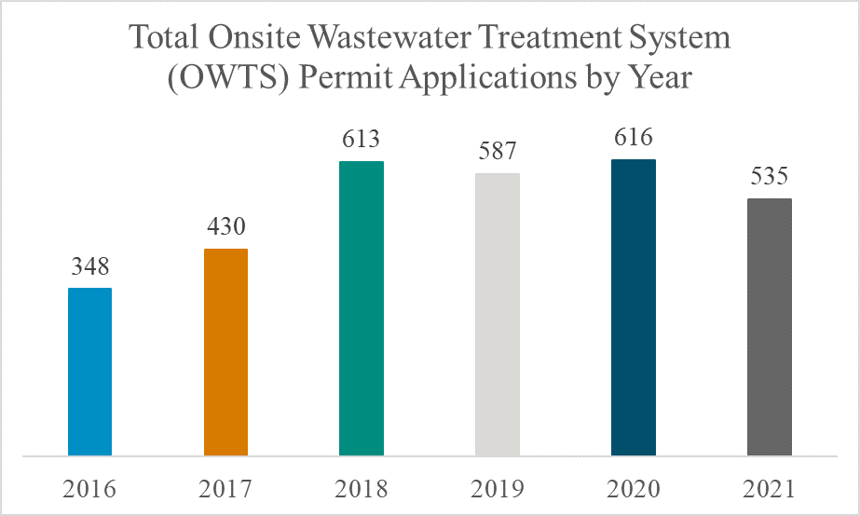
Public Health Infrastructure Ongoing Critical Needs Positions
*
*Not a full year of data

Slide 21
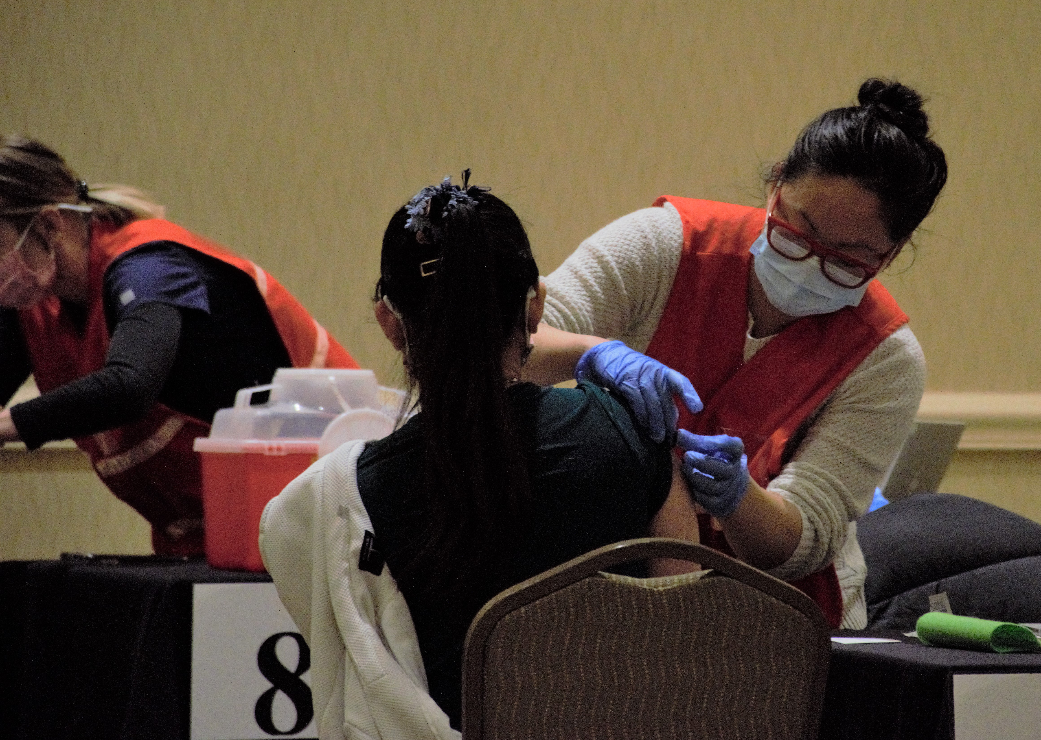
Public Health Infrastructure Ongoing Critical Needs Positions
Environmental Health Specialists
Supporting businesses during the pandemic
Working with Colorado Springs Downtown Partnership to offer COVID-19 vaccine clinic for restaurant workers
El Paso County Board of Health waives 2021 license fees for full-service retail food establishments, bars and taverns
El Paso County Public Health currently licenses and inspects over 2,800 retail food establishments (RFE), an 11% increase since 2016
Despite challenges posed by the pandemic, 2021 represents an all-time high number of licensed RFEs in El Paso County
Public Health and the Downtown Partnership of Colorado Springs team up to offer COVID-19 vaccines at a clinic for restaurant workers

Slide 22
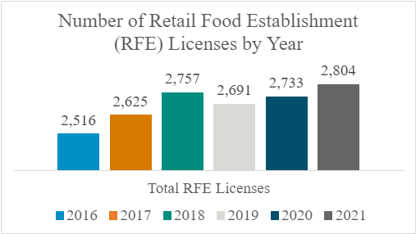
Public Health Infrastructure Ongoing Critical Needs Positions
*
*Not a full year of data

Slide 23
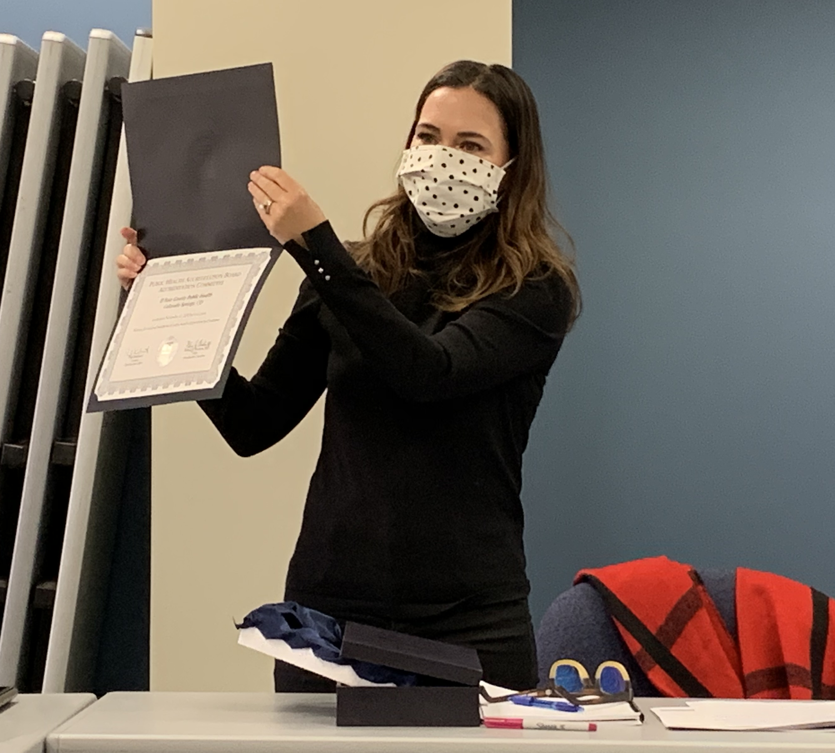
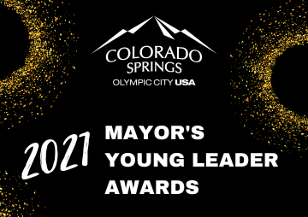

Slide 24
Awards, Recognitions and Accolades
Regional Recovery Council receives national recognition for pandemic recovery program innovation from the National Association of County and City Health Officials (NACCHO)
El Paso County Public Health receives bronze award from NACCHO's 2021 Innovative Practice Awards for the efforts to support data-based dialogue during the COVID-19 pandemic
El Paso County Public Health receives 2021 Distinguished Budget Presentation Award from the Government Finance Officers Association
Stephen Goodwin, chief data scientific strategist, receives the Award for Technical Innovation in Public Health from the Colorado Public Health Association
Fadi Youkhana, epidemiologist, recognized as Pikes Peak United Way's Person of the Week in February
Kristi Durbin, immunization program manager, a finalist in the Mayor's Young Leader Award

Slide 25
Awards, Recognitions and Accolades
In 2021, El Paso County Public Health received Certificate of Achievement for Excellence in Financial Reporting for 2019 Financial Annual Report
Communities That Care (CTC) received a 2021 Achievement Award for its program, "Teen Advisory Board: Amplifying Youth Voice in the Community" from the National Association of Counties (NACo)
El Paso County Public Health's Women, Infants and Children (WIC) program receives the 2021 Premiere Level Breastfeeding Award of Excellence for exemplary breastfeeding support and practice
Joyce Salazar, community outreach coordinator, selected as one of the 2021 Women of Influence through the Colorado Springs Business Journal
Three El Paso County Public Health abstracts were selected through a competitive process to be presented at the annual Council of State and Territorial Epidemiologists (CSTE) conference. The abstracts covered the topics of hepatitis A outbreak response, botulism, and sexually transmitted infections

Slide 26
Budgetary Highlights
El Paso County's population has increased from 599,060 in 2008 to an estimated 748,098 in 2022, a 25% increase
Health departments that serve 500,000 to 999,999 have an average of 269 employees; we have 158 on-going FTEs with an additional 70 FTEs temporarily funded with restricted COVID-19 specific grants
Need capacity to respond to emerging issues such as deployment of personnel in response to COVID-19 pandemic
Many grants are restricted and time limited

Slide 27
Budgetary Challenges Historical Staffing

Slide 28
Base Budget and Critical Needs
2019-2023 Critical Needs funding phased over five years
Continued support for meeting the increasing demand for public health protections, services, and emergencies
Increased safety by addressing emerging health issues
Continued support by Board of Health to utilize savings during the phase-in of county support to address unmet needs
As part of the five-year road-map, received ongoing critical need funding of $200k in 2019, no increase in 2020, and $250k in 2021; currently that is $450k in ongoing funding
Requesting additional county support of $150k in 2022 as part of the five-year roadmap

Slide 29
Questions?

