Slide 1
2022 Budget Presentation Economic Development
Crystal LaTier, Executive Director
October 21, 2021

Slide 2
Organizational Chart
Executive Director of Economic Development
Economic Development Project Manager
Enterprise Zone Administrator
Community Development Analyst
Business Incentives Analyst
Housing Analyst
Economic Development Coordinator
SBDC Executive Director
SBDC Program Manager
SBDC Grant and Contract Coordinator
SBDC Administrative and Program Assistant

Slide 3
Operations
Mission:
In El Paso County, Colorado, we take a holistic approach to Economic Development. Our office is uniquely tasked with serving an ever-growing region with ever-changing needs. We navigate our dynamic economic landscape with a focused approach, by offering diverse incentives for businesses and leveraging federal and state resources for housing and community development. Our goal is to assist in creating a robust, diversified, and equitable economic ecosystem

Slide 4
Operations
The department focuses on three main areas:
Business Incentives
Community Initiatives
Housing

Slide 5
Operations
Business Incentive components include:
Enterprise Zone
Business Loan Fund
Commercial Aeronautical Zone
Opportunity Zones
Special Initiatives that Assist with Business Development
Host Agency to the Small Business Development Center (SBDC)

Slide 6
Operations
Community Initiative components include:
Community Development Block Grant Program (CDBG)
Enterprise Zone Contribution Projects
Non-Profit Bonds

Slide 7
Operations
Housing components include:
El Paso County Housing Authority
Housing Trust Fund
Single Family “Turnkey Plus” Program
Multifamily Mortgage Bond Program
Fair Housing

Slide 8
Operations
COVD-19 Operational Pivots and Innovative Programming:
Pikes Peak Enterprise Zone Business Relief Fund
501(c)4/6 Relief Program (2 Rounds)
El Paso County Regional Business Relief Fund (2 Rounds)
Community Development Block Grant- CV Funding
New SBDC Partnerships
The programs above denote an investment of nearly $30M in federal funding that has been programmed and deployed to economic and community initiatives to assist with recovery within our region

Slide 9
Mandates/State Statutes Required
Federal:
The Opportunity Zone Program was implemented through the 2017 Tax Cuts and Jobs Act and must adhere to various sections of the Internal Revenue Code which are still under review
The Community Development Block Grant Program is governed by the U.S. Housing and Community Development Act of 1974
The Small Business Development Center is governed by the U.S. Small Business Act
Private Activity Bonds must adhere to requirements identified by the Internal Revenue Code
The Department of the Treasury (Treasury) Office of Inspector General (OIG) is responsible for monitoring and oversight of the receipt, disbursement, and use of Coronavirus Relief Fund (CRF) payments as authorized by Title VI of the Social Security Act, as amended by Title V of Division A of the Coronavirus Aid, Relief, and Economic Security Act (CARES Act)/ American Rescue Plan

Slide 10
Mandates/State Statutes Required
State:
The Enterprise Zone and Commercial Aeronautical Zone are governed by the Colorado Urban and Rural Enterprise Zone Act
Private Activity Bonds must also adhere to various sections of the Colorado County and Municipality Revenue Bond Act
The El Paso County Housing Authority is governed by C.R.S. 29-4-503

Slide 11
Strategic Plan Goals, Operating Indicators, Capital Projects
Encourage the growth of existing businesses and recruitment of new businesses
Support and advocate for a strong federal presence and related businesses
Promote a positive community vision which is attractive to businesses and employees
Expand tourism opportunities and emphasize its impact on the economy
Promote a variety of housing options/opportunities and the region’s neighborhoods
Programmatic Strategic Goals

Slide 12
Budgetary Highlights
Through partnerships and administration of federal and state programming, the Economic Development Department continues to operate effectively and efficiently through funding support from:
Community Development Block Grant Program
El Paso County Housing Authority
Enterprise Zone
Updated PAB Issuance Fee Structure Revenue
Small Business Administration

Slide 13
Base Budget and Critical Needs
One-time Critical Need Request- $4,500,000
Year | Base Budget
2021 | $278,422
2022 | $278,422 + $4,500,000= $4,778,422
2022 Critical One-time Need Request for External Programming of $4,500,000

Slide 14
Critical Need Program # 1: Housing Trust Fund
One-time Critical Need Request: $3,000,000
A revolving loan fund which provides funding to agencies with experience in the design and administration of innovative programs that address the housing needs in El Paso County.
Development of new, affordable, accessible housing units (high priority)
Preservation of existing, affordable, accessible housing units (high priority)
Low interest gap financing
$200,000 - $500,000 at 1-3% interest
$5 million provided to a total of 10 projects over the last 5 years

Slide 15
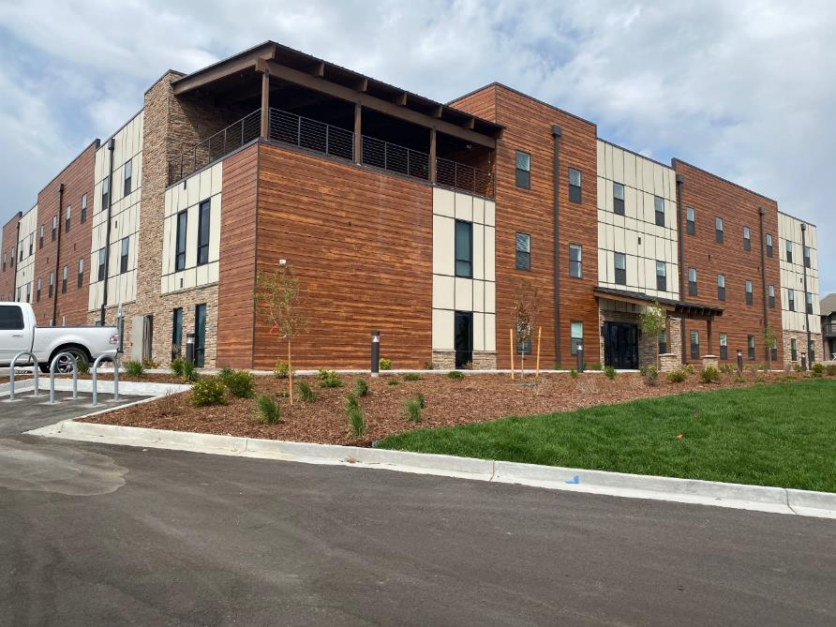
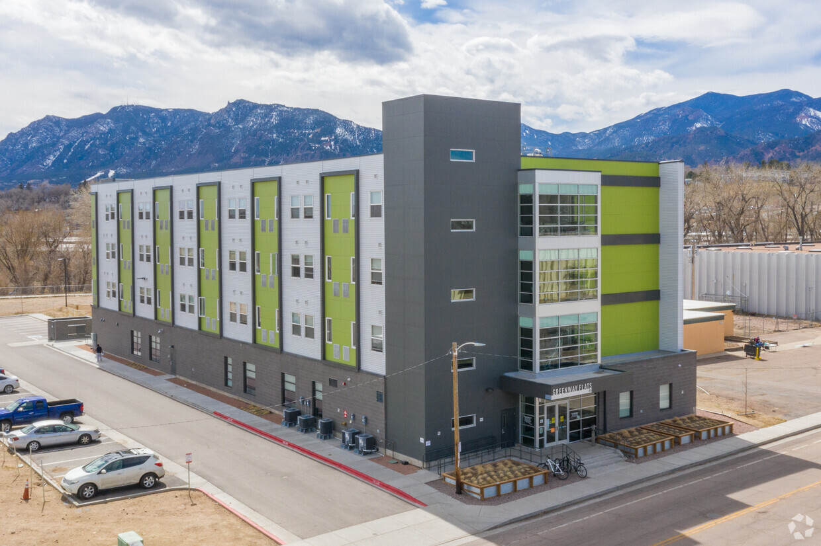
Housing Trust Fund Projects-In Service
Traditions
180 Units; $1,300,000 HTF
Open – Late 2018
Rocky Mtn Apartments
18 Units; $200,000 HTF
Open – June 2020
Freedom Springs
50 Units; $500,000 HTF
Open – September 2020
Greenway Flats
65 Units; $500,000 HTF
Open – July 2019

Slide 16
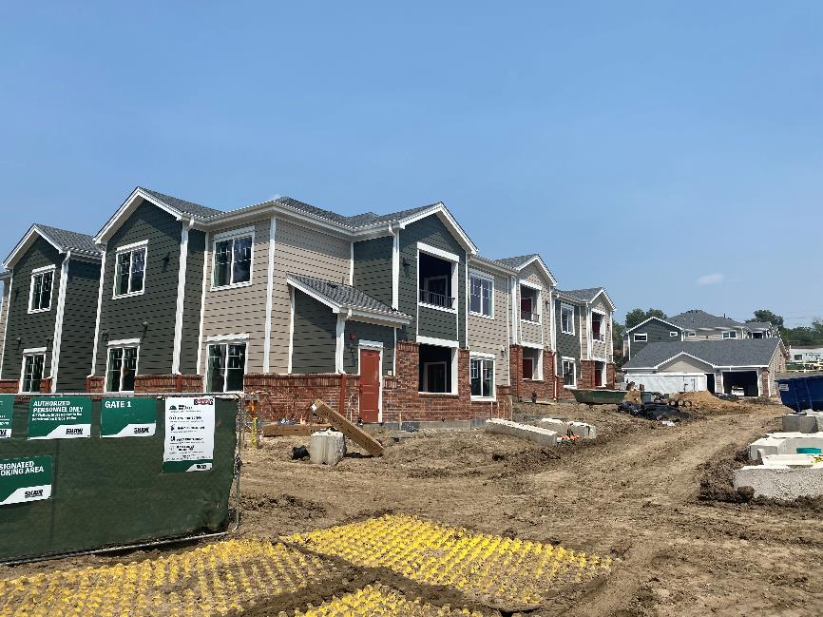
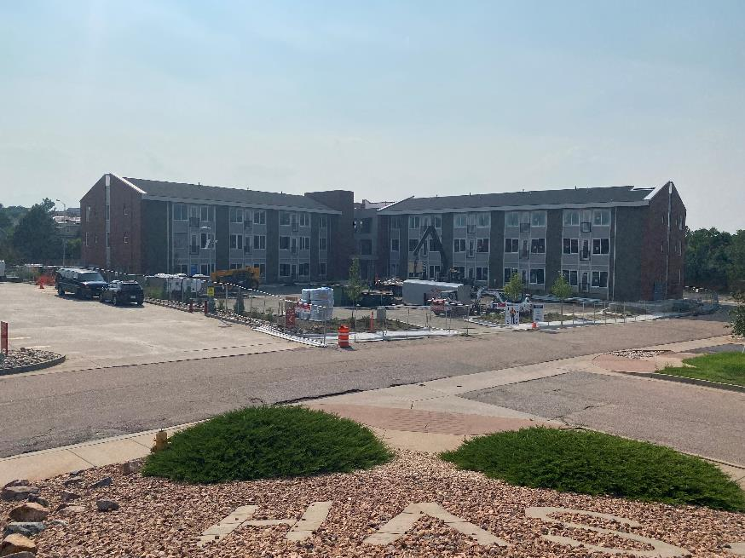
Housing Trust Fund Projects-Under Development
Shooks Run
40 Units; $500,000 HTF
Close – Sept 2020
Villas at Mesa Ridge
60 Units; $350,000 HTF
Close – Oct 2020
Academy Heights
200 Units; $300,000 HTF
Close – March 2021
Greenway Flats
54 Units; $575,000 HTF
Close – July 2020

Slide 17
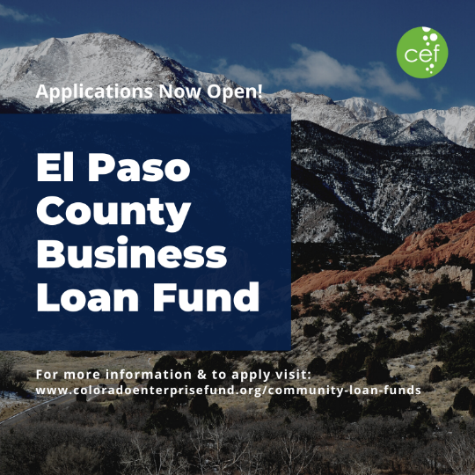
Critical Need Program # 2: Business Loan Fund
One-time Critical Need Request: $1,500,000
What is the BLF?
Revolving loan fund for private, for-profit businesses/start-ups
Re-launched earlier this year
Administered in partnership with Colorado Enterprise Fund
Low interest gap financing
Loan Parameters
Loan sizes: $5,000 - $50,000
No more than 500 employees, Maximum gross revenue of $5M or less
Interest rates: fixed rates (depending on loan size and term)
Eligible Uses
Financing of fixed assets, supplies and inventory, working capital, minor renovations, business acquisition

Slide 18
Questions?

