Slide 1

2022 Budget Presentation
Office of the Coroner
Leon Kelly, M.D.
October 19th, 2021

Slide 2
Organizational Chart
Coroner/Chief Medical Examiner/Medical Director
Deputy Chief Medical Examiner
Chief Toxicologist
Chief Death Investigator
Office Administrator
Histologist
Toxicologists x 3
Death Investigators x 9
Administrative Deputy Coroner
Morgue Supervisor
Autopsy Technicians:
2 full-time
3 part-time
Medical Examiners (3 full, 1 part-time)
Part time admin assistant
Available FTE=26
Filled FTE=25

Slide 3
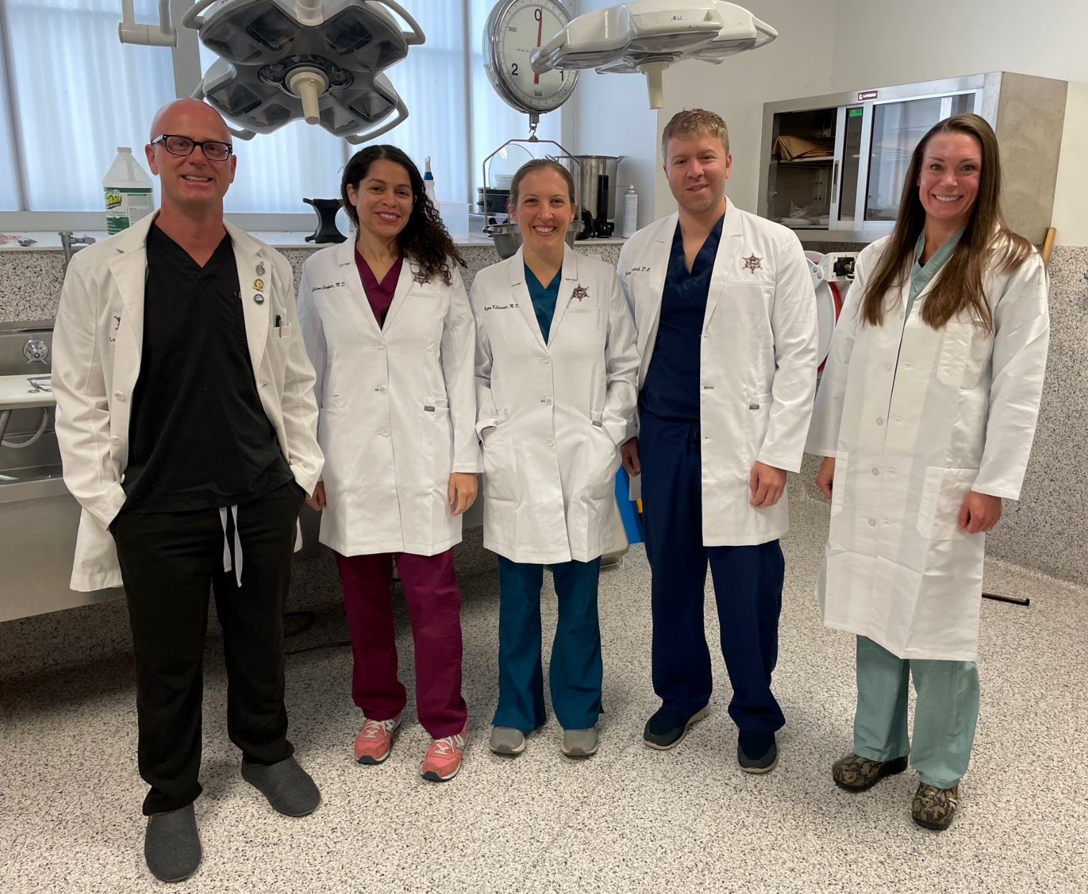

Medical Examiners
Office of the Coroner

Slide 4
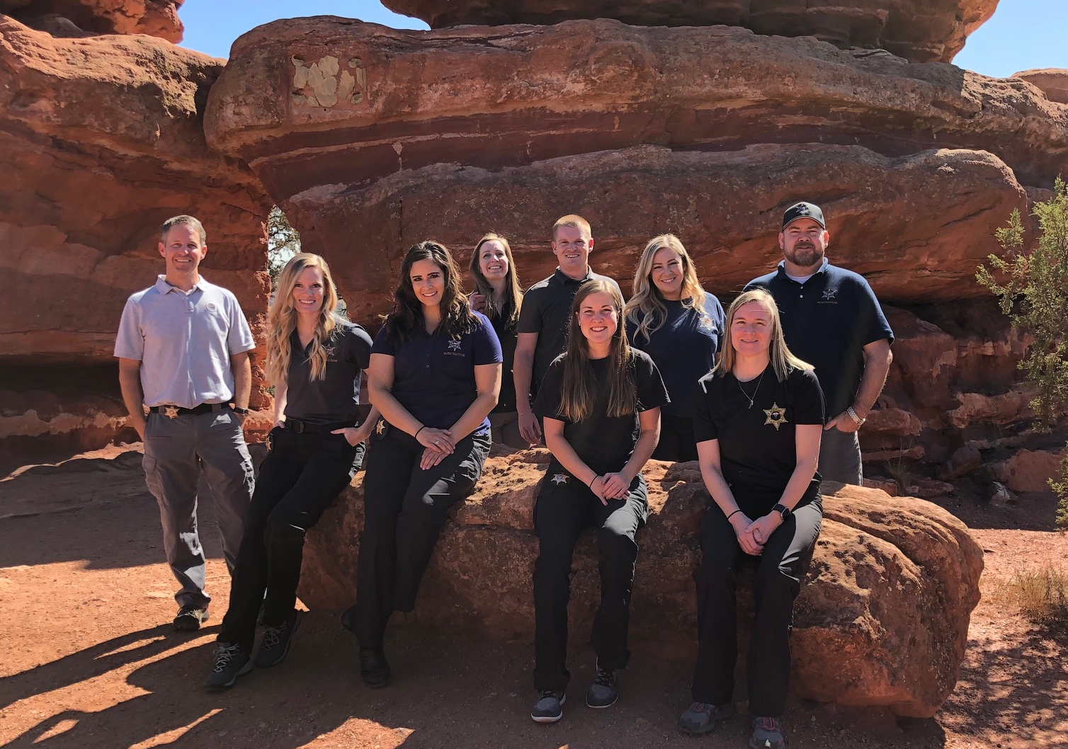
Death Investigators
Office of the Coroner

Slide 5
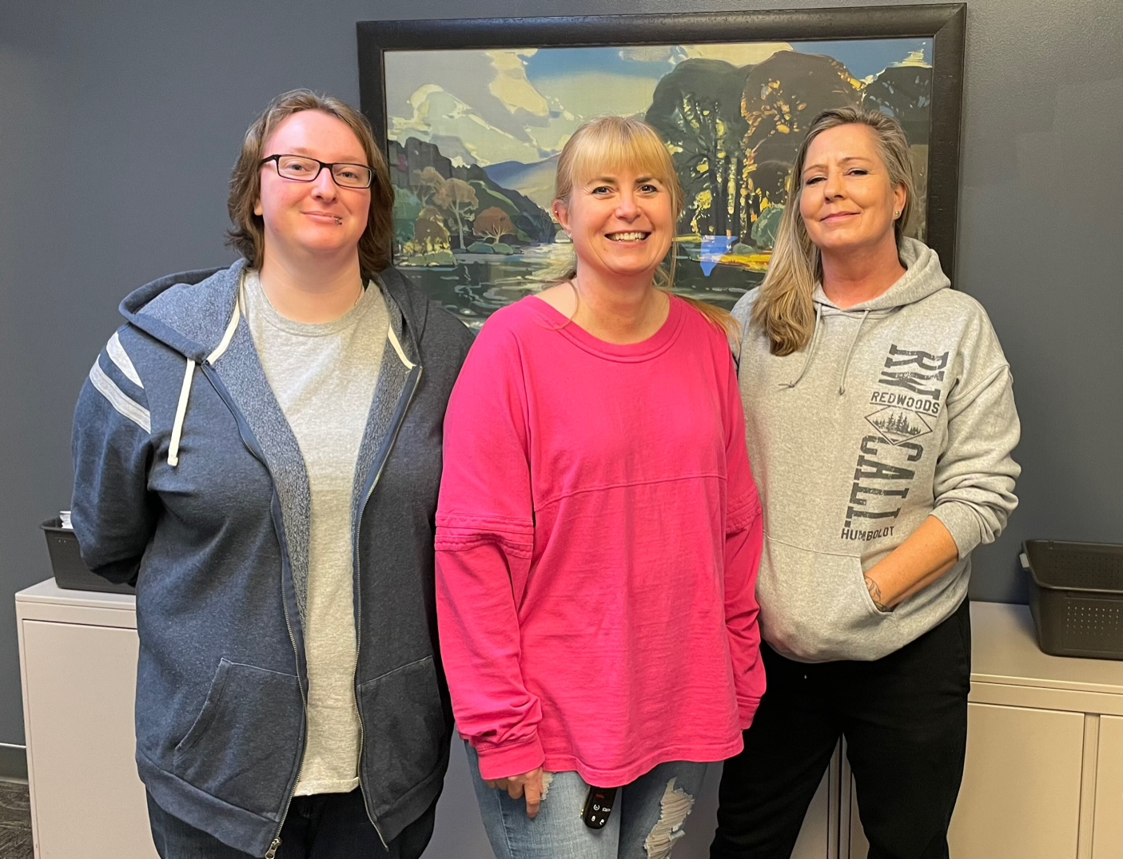
Administrative
Office of the Coroner

Slide 6
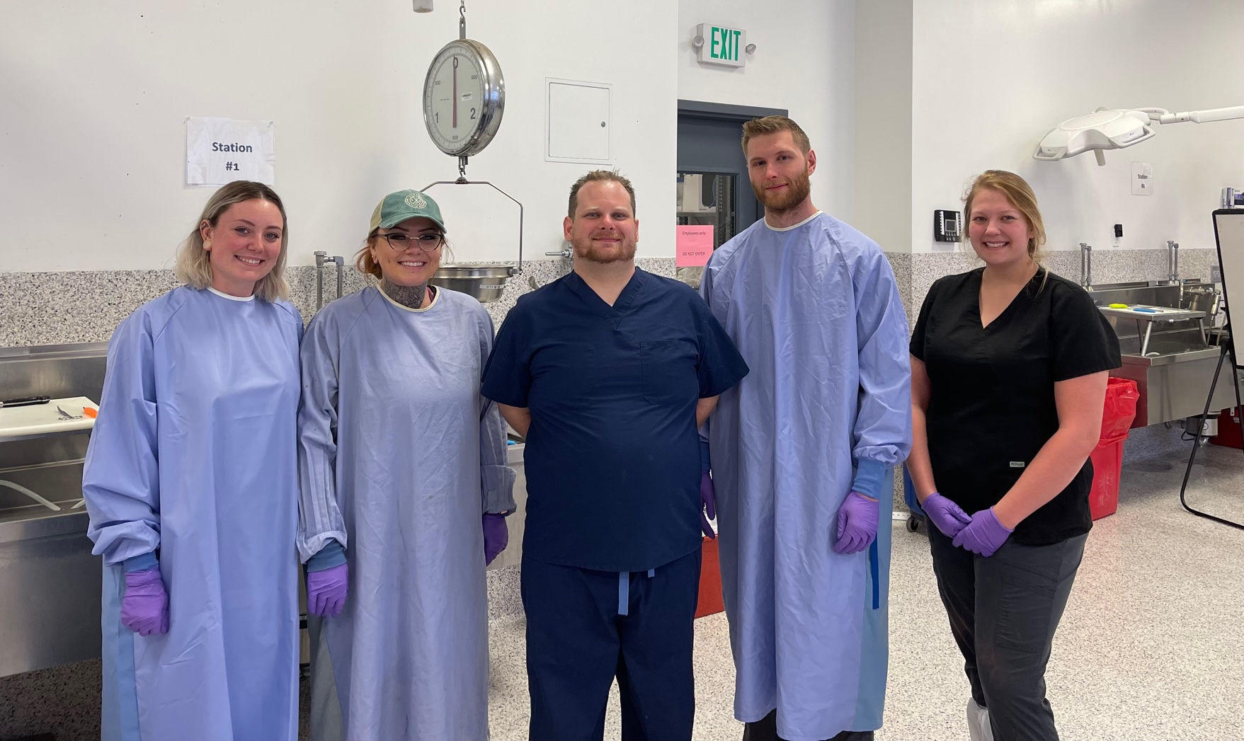
Autopsy Technicians
Office of the Coroner

Slide 7
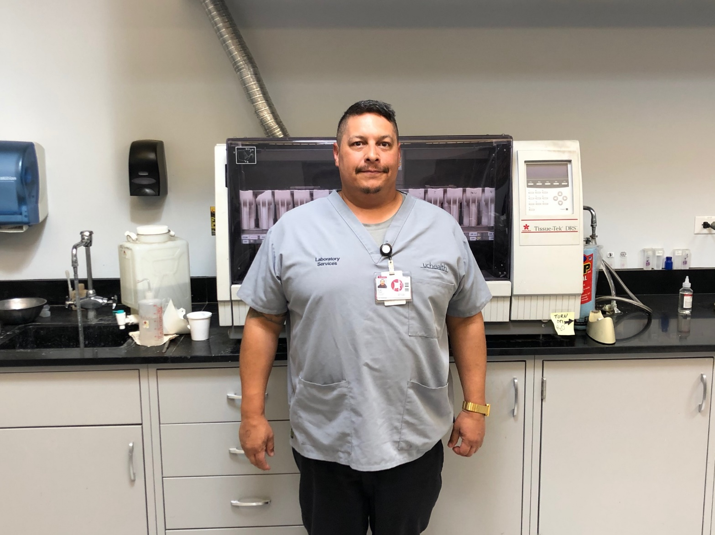
Histology
Office of the Coroner

Slide 8
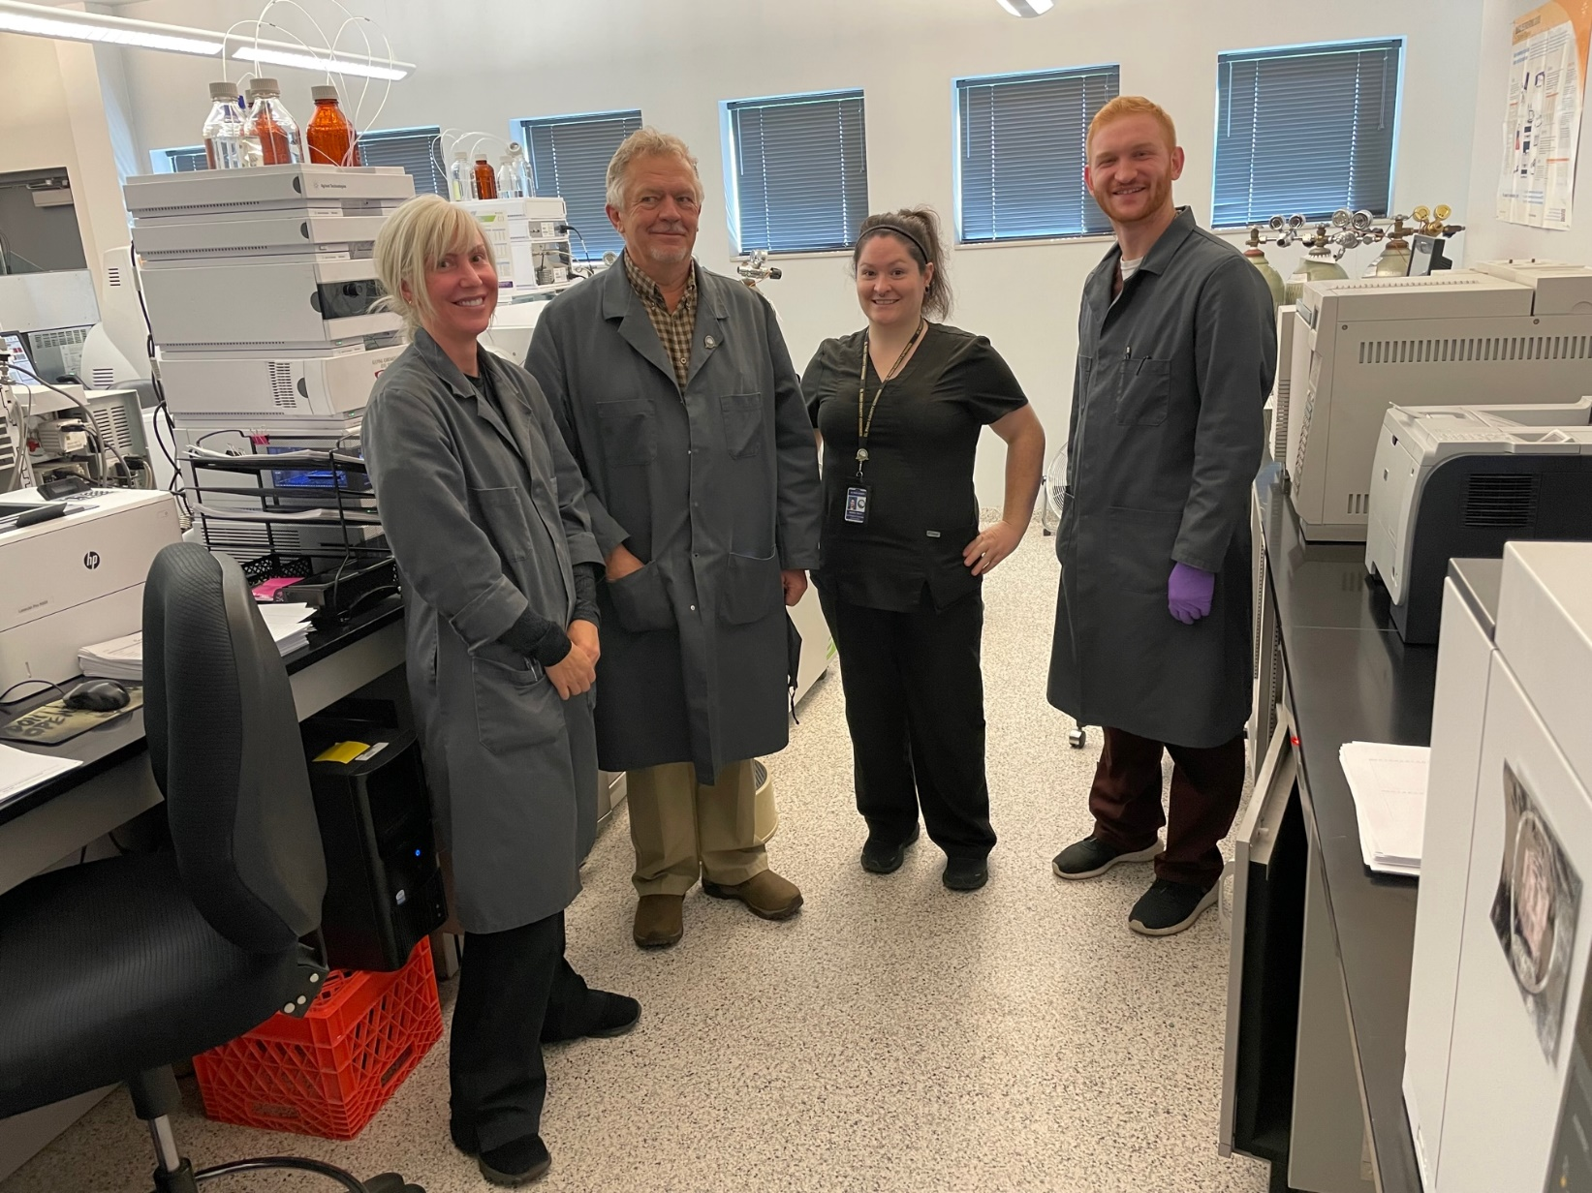
Toxicology
Office of the Coroner

Slide 9
CRS: 30-10-606
The Coroner shall… make all proper inquiry respecting the cause and manner of death of any person in his/her jurisdiction who has died under any of the following circumstances:
  From external violence, unexplained cause, or under suspicious circumstances
  Where no physician is in attendance or where though in attendance, the physician is unable to certify the cause of death
  From thermal, chemical, or radiation injury
  From disease which may be hazardous or contagious or which may constitute a threat to the health of the general public
  While in custody of law enforcement officials or while incarcerated in a public institution
  When the death was sudden and happened to a person who was in good health
  From an industrial accident
Office of the Coroner

Slide 10
CRS: 30-10-606
Statutory Responsibilities:
    Rule CAUSE and MANNER of death
    Pronouncement of death
    Identify the decedent
    Determination of how injury occurred
    Collect evidence from body used to prove or disprove an individual’s guilt or innocence
    Confirm or deny the account of how the death occurred
    Document any natural disease
    Determine or exclude other contributory or causative factors to the death
    Provide expert testimony in criminal and civil proceedings
    Grant or deny tissue for harvest
Office of the Coroner

Slide 11
10-Year Autopsy Trends

Slide 12
Deaths Investigated

Slide 13
Strategic Plan Goals, Operating Indicators, Capital Projects
Continue to assist Public Health, El Paso County agencies and leadership, regional hospitals, and non-profits in our ongoing efforts on COVID-19, fentanyl/substance abuse, child fatalities, and suicide prevention
Deployment of updated/upgraded VertiQ Medical Examiner Laboratory information system
    Funded with unspent and re-appropriated funds
    Cloud hosting allowing the termination of outdated county servers and remote access
Recruitment, hiring, and training for currently or soon to be unfilled positions
  Chief Toxicologist, Deputy toxicologist, 2 Medicolegal Death Investigators, morgue staff.
Office of the Coroner

Slide 14
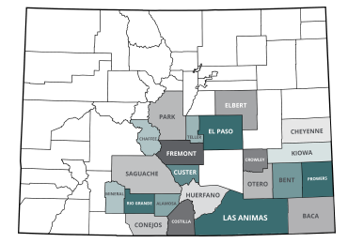

Slide 15
Budgetary Highlights

Slide 16
Base Budget and Critical Needs
2021 Base Budget:
  $3,253,981
    + reappropriated funds from prior salary savings for capital projects:
      $176,163 LIMS upgrade
      $128,000 Toxicology equipment
No critical needs identified for 2022
Future possible needs 2023 and beyond:
  Additional medical examiner and support staff (morgue tech, toxicologist, death investigator)
    Currently at 260 calculated autopsies per medical examiner
    Capital investment in toxicology laboratory to keep pace with drug cases

Slide 17
Questions?

