Slide 1
2022 Budget Presentation District Attorney’s Office
Michael J. Allen, District Attorney
October 21, 2021

Slide 2
4th Judicial District
Attorney’s Office
Mission
Administer justice,
Advocate for victims, and
Partner with law enforcement and the citizens of this community in the deterrence and prevention of crime.

Slide 3
4th Judicial District
Attorney’s Office
Statutory Mandate
CRS §§20-1-101 through 20-1-308

Slide 4
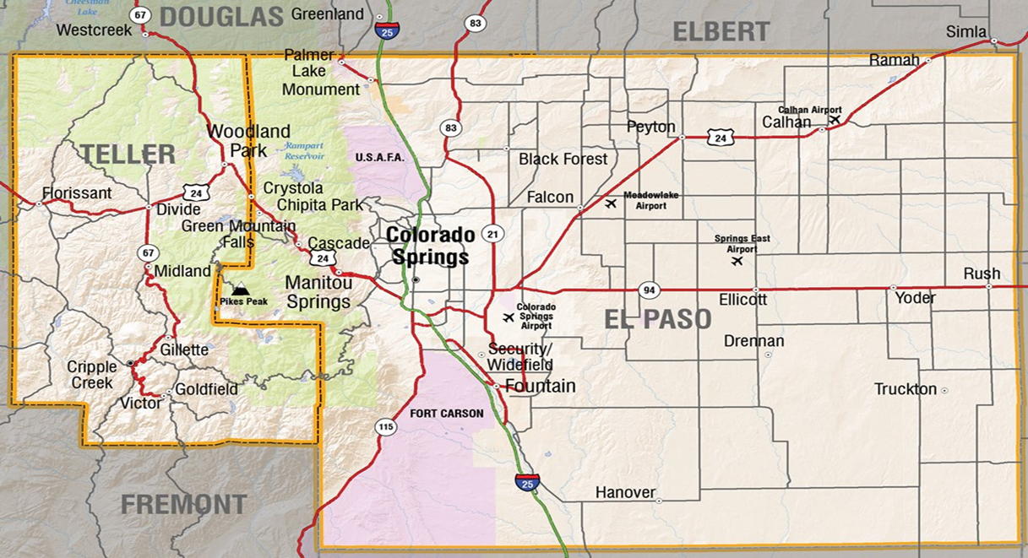
4th Judicial District
Attorney’s Office

Slide 5
4th Judicial District
Attorney’s Office
240 Employees
89 Attorneys
24 sworn Investigators
127 Support Staff
96 volunteers who worked 11,000 hours

Slide 6
4th Judicial District
Attorney’s Office
20 District Court Judges with Felony dockets
11 County Court Judges with Misdemeanor dockets
4 Juvenile District Court Divisions
4 Specialty Courts – DUI Court, Domestic Violence Court, Veterans Trauma Court, Recovery Court (includes Drug and Heals courts)

Slide 7
Partner Agencies
Receives investigations from 22 area law enforcement agencies
4th Judicial District Attorney’s Office

Slide 8
4th Judicial District
Attorney’s Office
Major Assignments
District Court: Felony Cases
County Court: Misdemeanor Cases
Juvenile Division: Juvenile Criminal Cases
Discovery: Provides discovery for 30,000-35,000 criminal cases each year

Slide 9
4th Judicial District
Attorney’s Office
Secondary Assignments
SVU
Economic Crime
Felony Intake
Investigations
Victim Witness
Diversion
Neighborhood Justice Center
Appellate Unit

Slide 10
4th Judicial District
Attorney’s Office
Other Programs:
Not One More
Human Trafficking Diversion
Prescription Drug Diversion
Kids Against Crime
Animal Cruelty
Intelligence Driven Prosecution

Slide 11
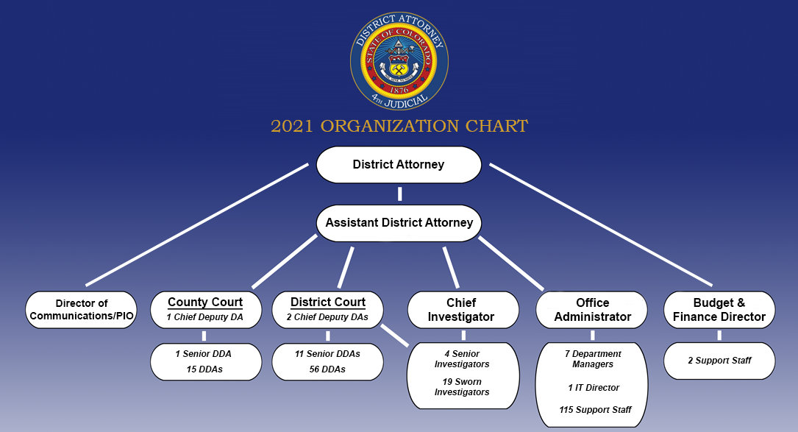

Slide 12
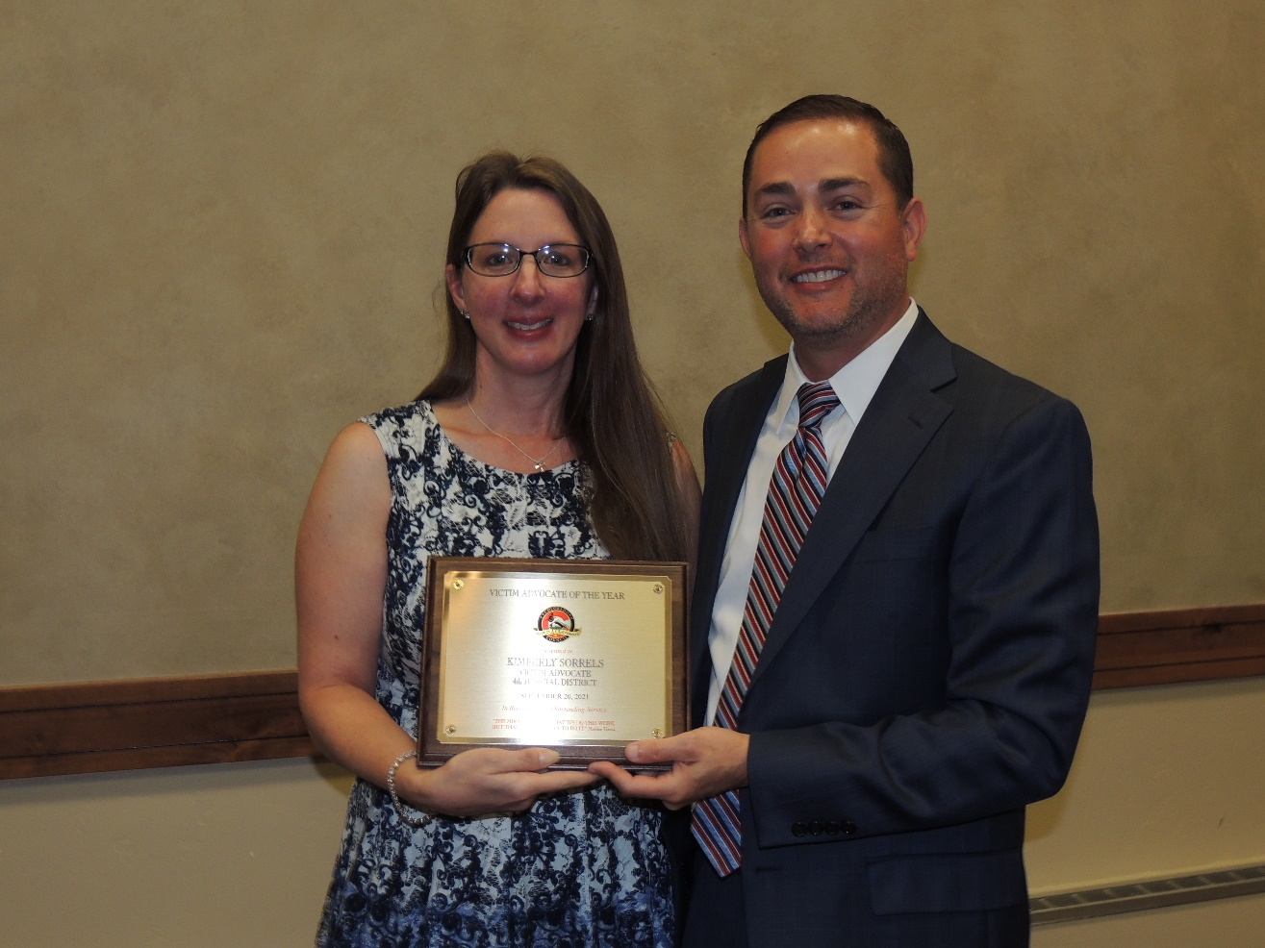
Award Winning Service
2021 CDAC Victim Advocate of the Year:
Kimberly Sorrels

Slide 13
2020 Comparison 5 Largest Judicial Districts
Judicial District | Felony Cases | Juvenile Cases | Traffic Cases | Misd. Cases | Budget | Population | Total Staff
4th- Judicial District | 7,910 | 2,618 | 16,515 | 8,168 | $17,697,037 | 730,395 | 240
2nd- Judicial District | 5,192 | 2,401 |  |  | $29,259,654 | 715,522 | 250
18th- Judicial District | 5,227 | 2,716 | 15,554 | 7,264 | $24,912,610 | 1,011,048 | 230
17th- Judicial District | 4,846 | 1,582 | 12,112 | 5,346 | $24,114,954 | 519,572 | 197
1st- Judicial District | 4,612 | 1,497 | 9,810 | 6,704 | $25,542,000 | 582,910 | 174

Slide 14
2020 Statistics
32,171 cases were prosecuted by this Office *
$5,699,933 was collected in restitution for victims of crime *
Victim’s Compensation awarded $1,536,408 to victims of crime and their service providers
* For Calendar Year 1/1/2020 thru 12/31/2020
Notes:
14

Slide 15
2020 Statistics
2020
32 Homicide cases filed
5 Homicide Trials
81 Felony jury trials
2021
25 Homicide cases filed
15 Homicide trials to date
85 Felony jury trials, totaling 379 days in trial
The 4th Judicial District was the first to resume trials amidst the COVID-19 pandemic
Notes:
15

Slide 16
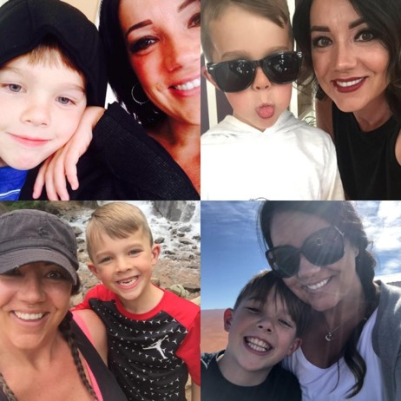
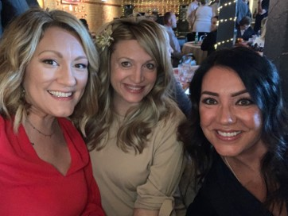
Notable Cases
Victim: Jennifer Young
19CR6848
Trial: June 3, 2021-June 17, 2021
Defendant convicted of Murder in the 2nd degree
Sentenced to 44 years in prison
Honored to have worked closely with family and close friends of Jennifer throughout the prosecution effort
Notes:
16

Slide 17
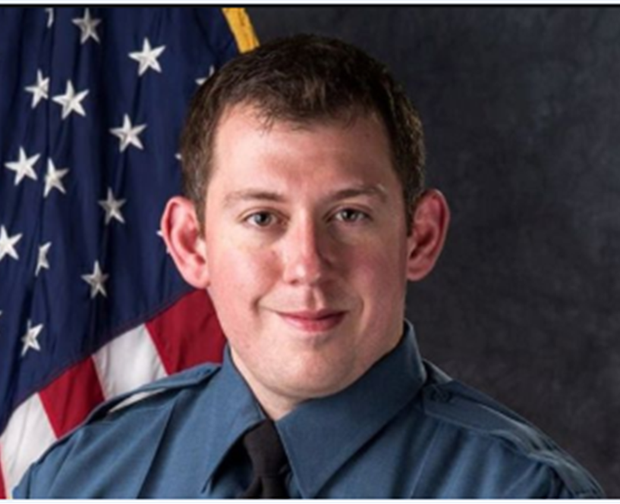
Notable Cases
Victim: Cem Duzel
18CR4614
Trial: May 13, 2021-June 22, 2021
Defendant convicted of Attempted Murder in the 1st Degree
Sentenced to 45 years in prison
Cem is supported by a fantastic family and law enforcement community
Notes:
17

Slide 18
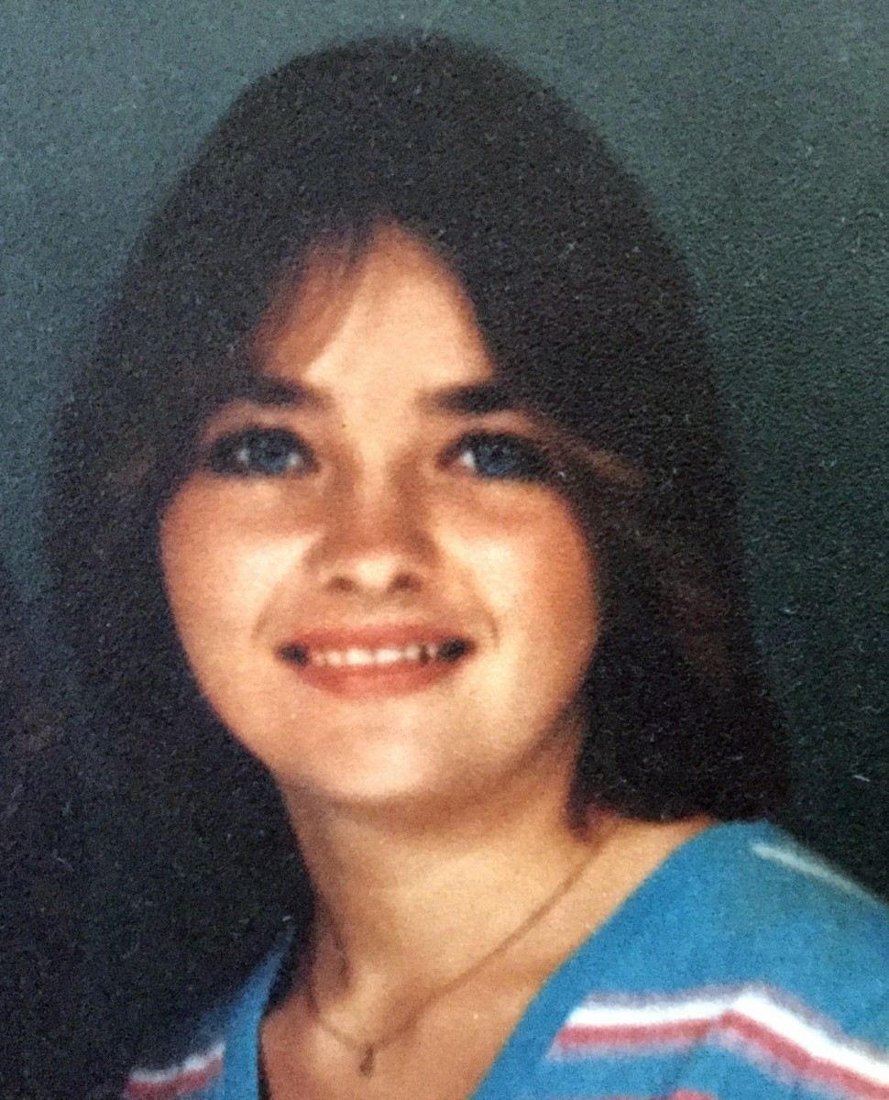
Notable Cases
Victim: Darlene Krashoc
19CR3670
Trial: June 14, 2021-June 25, 2021
Defendant convicted of Murder in the 1st Degree
Sentenced to life in prison without parole
Cold case prosecution 30 years after her murder
Serving in our US Military
Notes:
18

Slide 19
2021 4th Judicial District Attorney’s Office Budget
Personnel $16,802,578 96% Operating $ 731,359 4%
Total $17,533,937

Slide 20
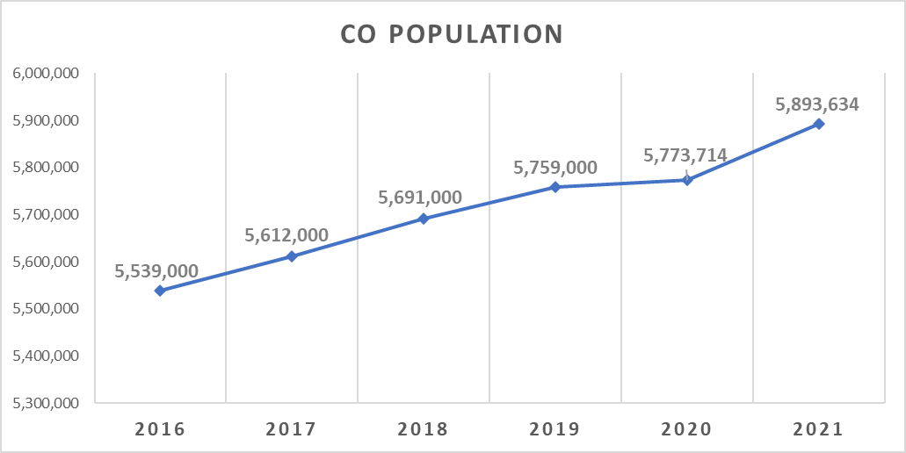
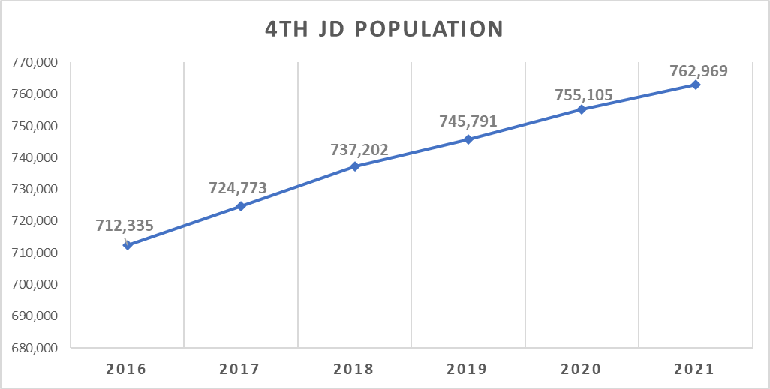
Population Growth 2016-2020
4.2%
5y
6%
5y
+234,714 People
+42,770 People

Slide 21
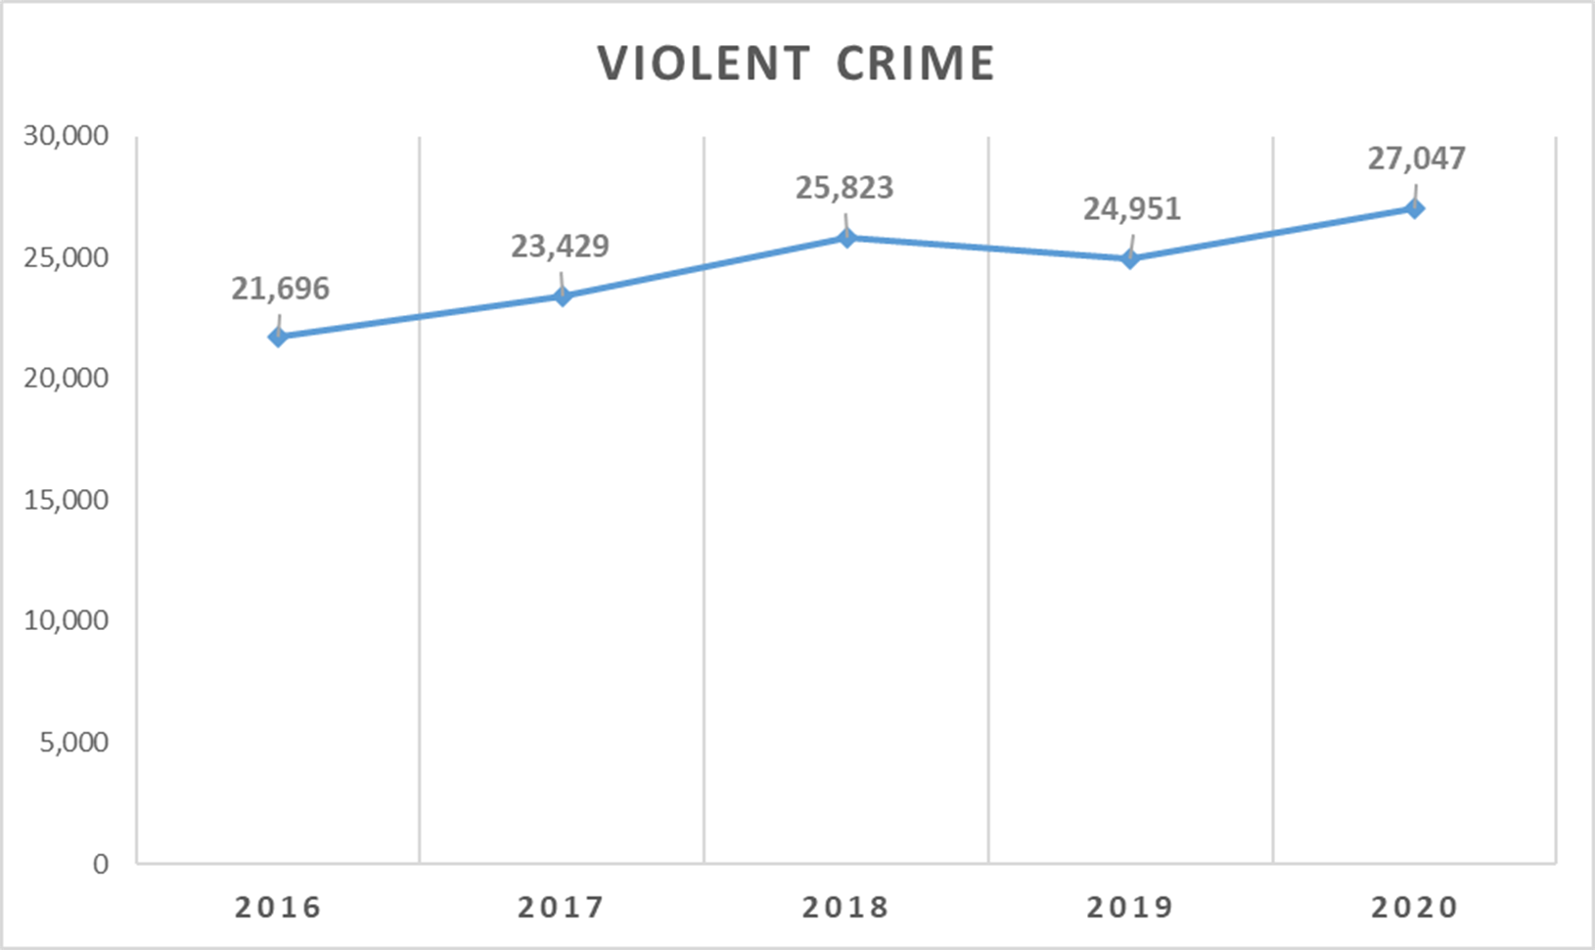
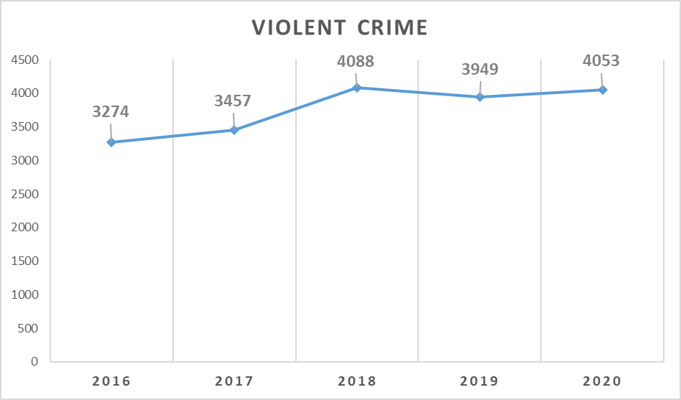
Violent Crime 2016-2020
24.7%
23.8%
24.7%
23.8%
779 CASES
5,351 CASES

Slide 22
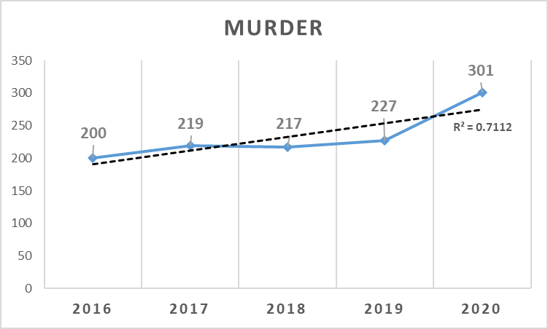
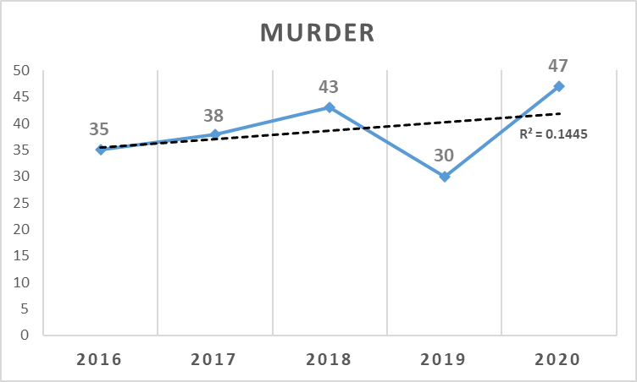
Murder 2016-2020
51%
5y
34%
5y

Slide 23
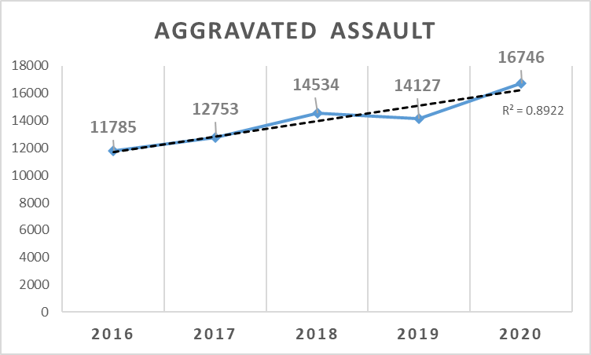
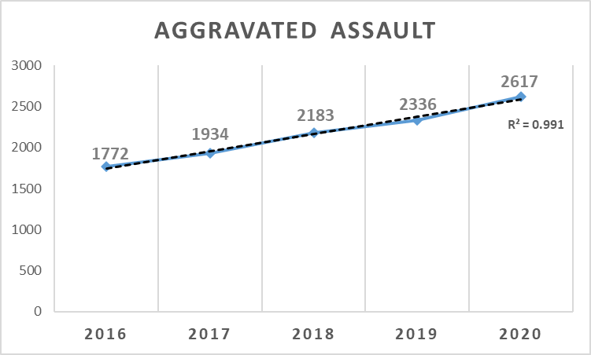
Aggravated Assault 2016-2020
42%
5y
48%
5y

Slide 24
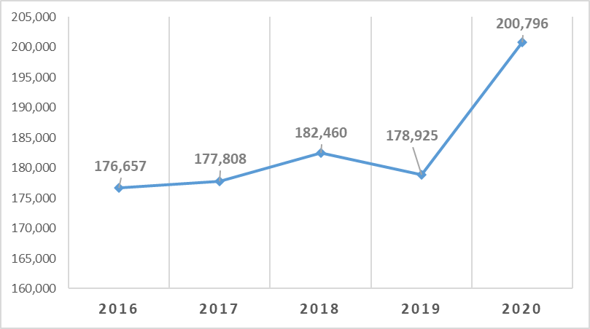
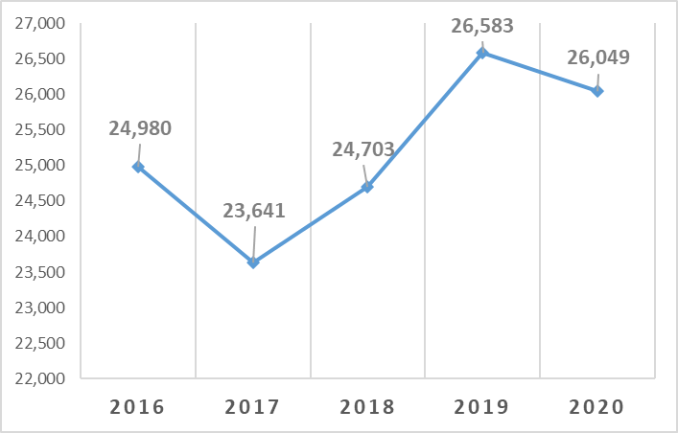
Property Crimes 2016-2020
13.7%
5y
4.3%
5y

Slide 25
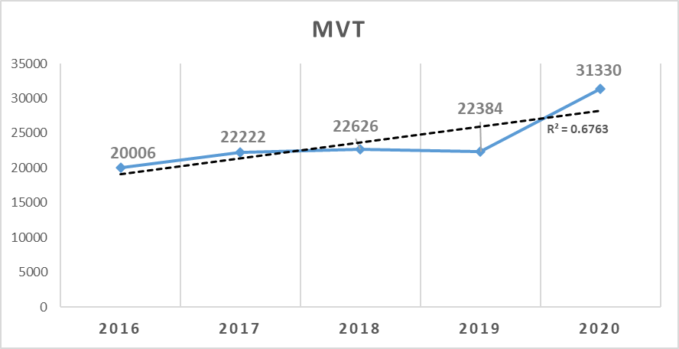
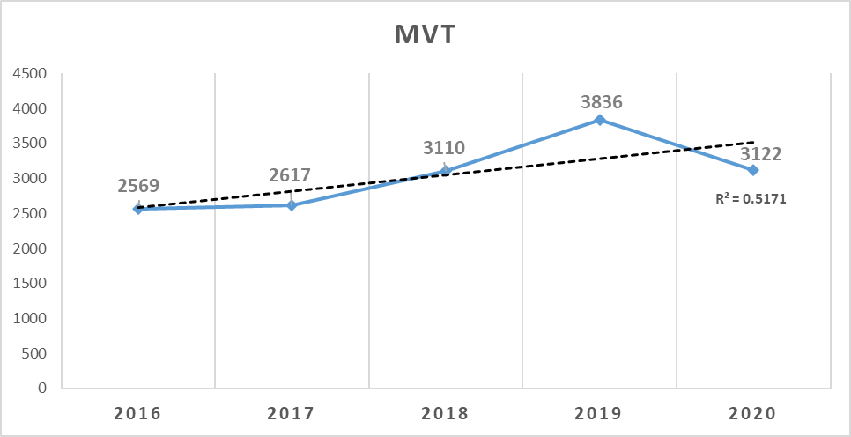
Aggravated Motor Vehicle Theft 2016-2020
57%
5y
22%
5y

Slide 26
Critical Needs
3 Deputy District Attorney positions $251,750
2 Support Staff positions $79,960
Total $331,710

Slide 27
Challenges Ahead
Growing Population
Rising Crime Rates and Legislation
Mental Health Initiative

Slide 28
Questions?

