Slide 1
2021 Budget Report May 2021
Nikki Simmons, CPA, CPFO
County Controller
Financial Services Department
June 29, 2021

Slide 2
Presentation Overview
May 2021 Activity – General Fund Unrestricted (within BoCC Discretion)
May 2021 Activity - Partially Restricted
- Road & Bridge Fund
- Human Services Fund
- Capital Improvement Fund
- Self-Insurance Fund (Risk/Workers’ Compensation & Benefits)
May 2021 Activity - Restricted
- General Fund (Restricted)
- Conservation Trust Fund
- Schools’ Trust Fund
- Household Hazardous Waste Fund
- Local Improvement Districts

Slide 3
Unrestricted Funds May 2021

Slide 4
May 2021 – General Fund (Unrestricted)

Slide 5
May 2021 – General Fund (Unrestricted)

Slide 6
May 2021 – Fire/Flood Projects
Ongoing Projects
Hanson Trail Head $ 1,328,318

Slide 7
Partially Restricted Funds May 2021

Slide 8
May 2021 – Road & Bridge

Slide 9
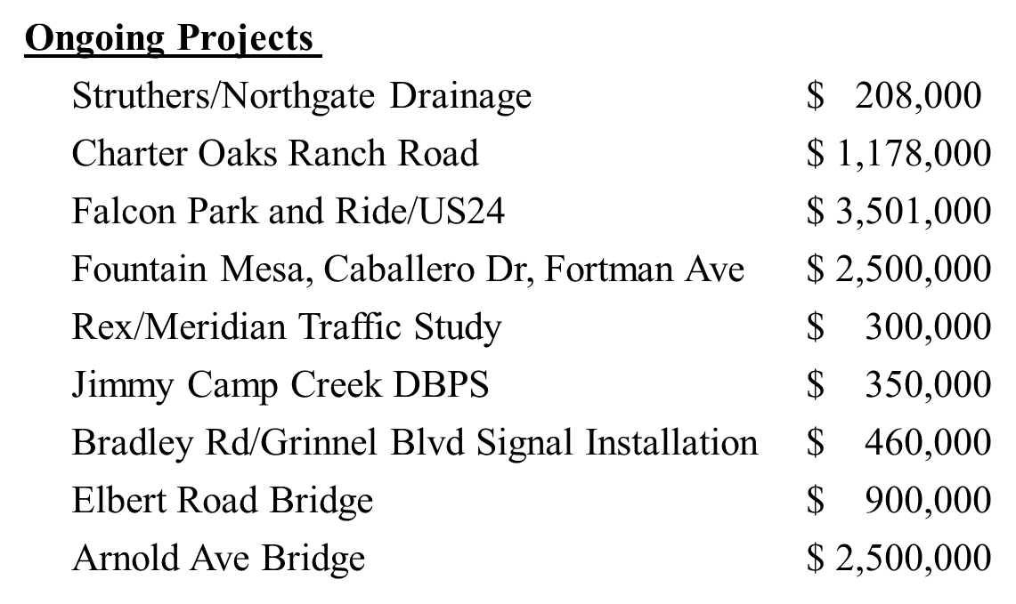
May 2021 – Road & Bridge Projects

Slide 10
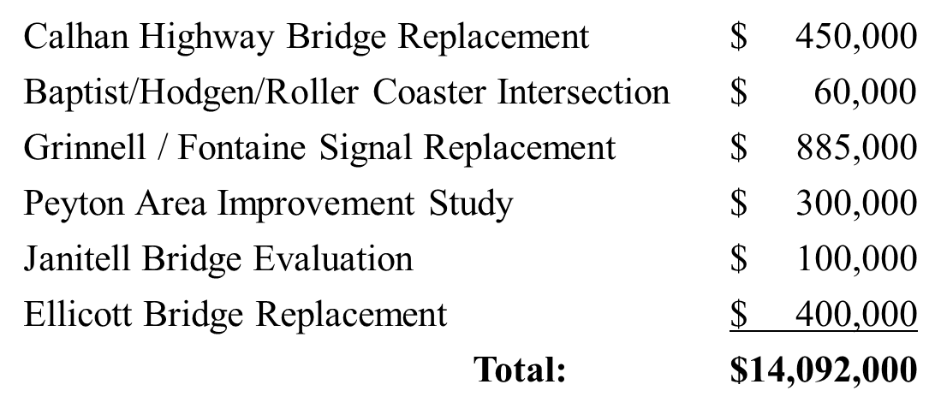
May 2021 – Road & Bridge Projects

Slide 11
May 2021 – Human Services

Slide 12
May 2021 – Capital Improvement

Slide 13
May 2021 – Self Insurance – Risk, Workers’ Compensation & Unemployment

Slide 14
May 2021 – Self Insurance – Health Trust Benefits

Slide 15
Restricted Funds May 2021

Slide 16
May 2021 – General Fund (Restricted)

Slide 17
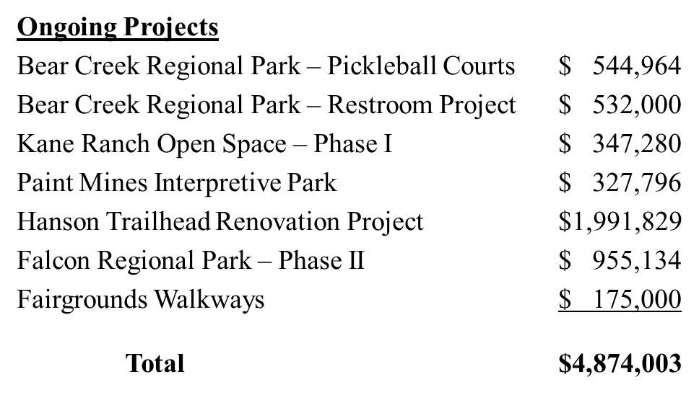
General Fund (Restricted) Community Services/County Parks Projects

Slide 18
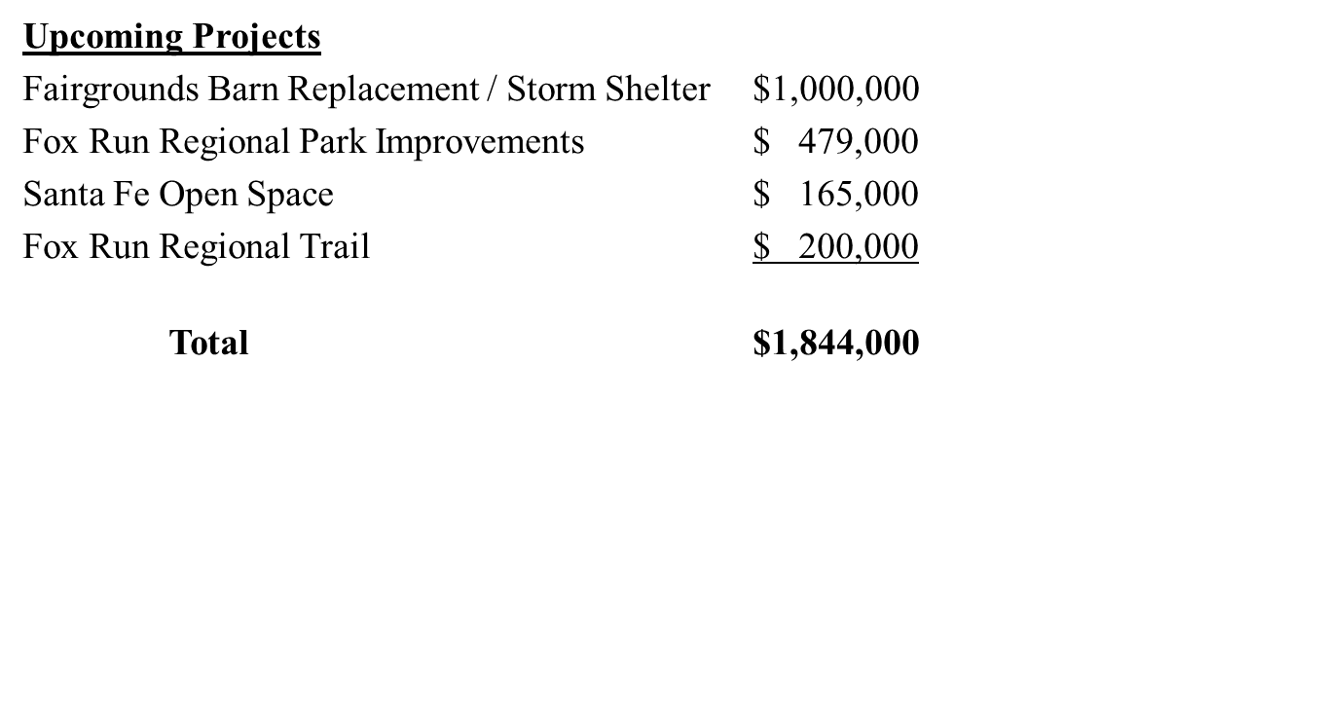
General Fund (Restricted) Community Services/County Parks Projects

Slide 19
May 2021 – Conservation Trust Fund

Slide 20
May 2021 – Schools’ Trust Fund

Slide 21
May 2021 – Household Hazardous Waste Fund

Slide 22
May 2021 – Local Improvement Districts (LIDs*)

Slide 23
Questions?

