Slide 1
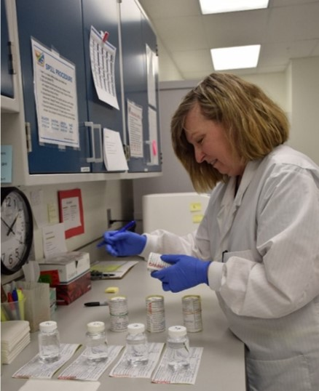
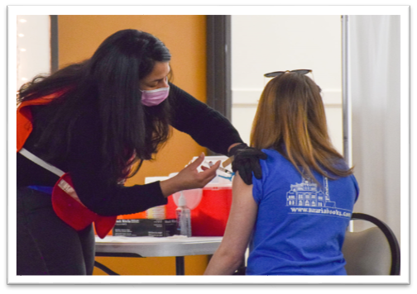
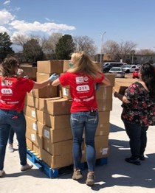
COVID-19 and Vaccination Update El Paso County Board of Commissioners
Presenters: Susan Wheelan, El Paso County Public Health Director; Dr. Robin Johnson, El Paso County Public Health Medical Director; Fadi Youkhana, El Paso County Public Health Epidemiologist; Diana May, El Paso County Attorney
To: El Paso County Board of Commissioners
Date: May 18, 2021

Slide 2
Vaccine Update

Slide 3
Vaccine Campaign Evolution
Through a series of constraints:
Supply
Capacity
Demand

Slide 4
National and State Vaccination Goals
National goal by July 4:
70% of adults with first dose
160 million adults fully vaccinated (approximately 63%)
Statewide goal by July 4:
75% of eligible population with first dose*
50 days to go and we're now at 50.7% vaccinated
* The Pfizer-BioNTech vaccine has been granted emergency use approval (EUA) from the Food and Drug Administration (FDA) for 12-15-year-olds, which expands our vaccine-eligible population by an estimated 40,582, to 609,441

Slide 5
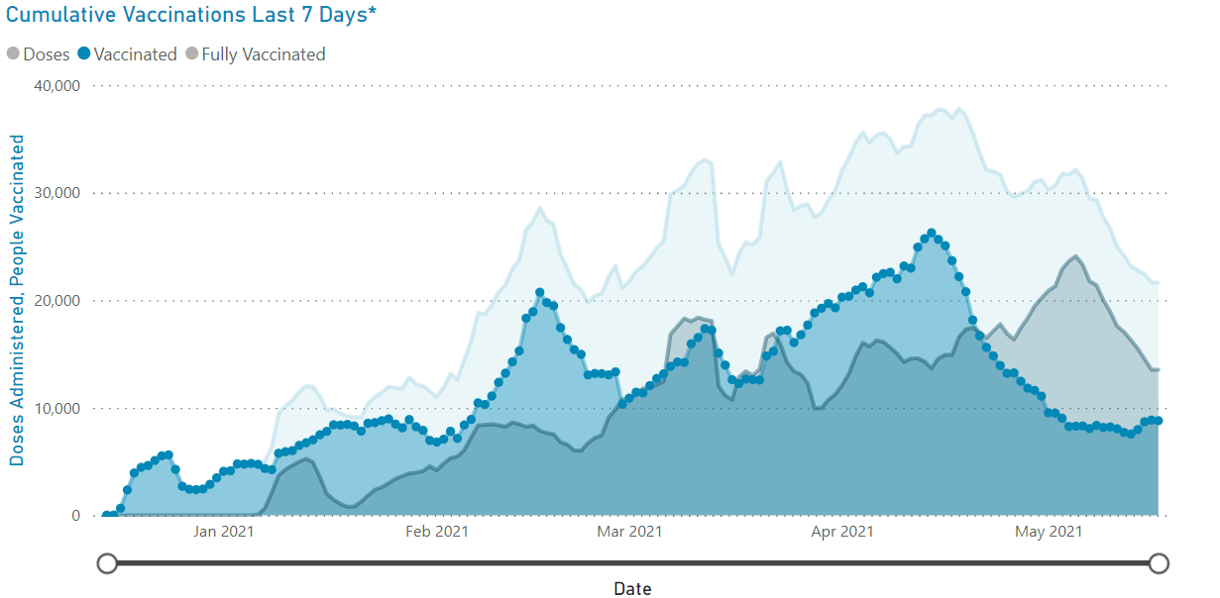
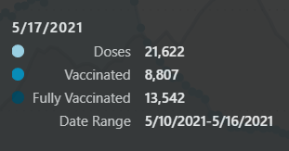
El Paso County Vaccination Activity
Data as of 5/16

Slide 6
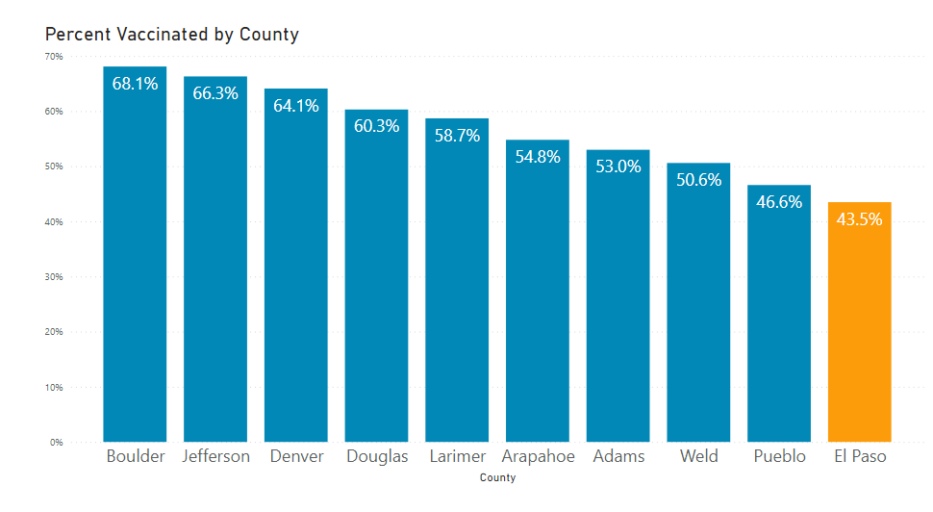
Vaccination Rates in 10 Largest Colorado Counties
With Federal Estimates – 50.7%
Data as of 5/16

Slide 7
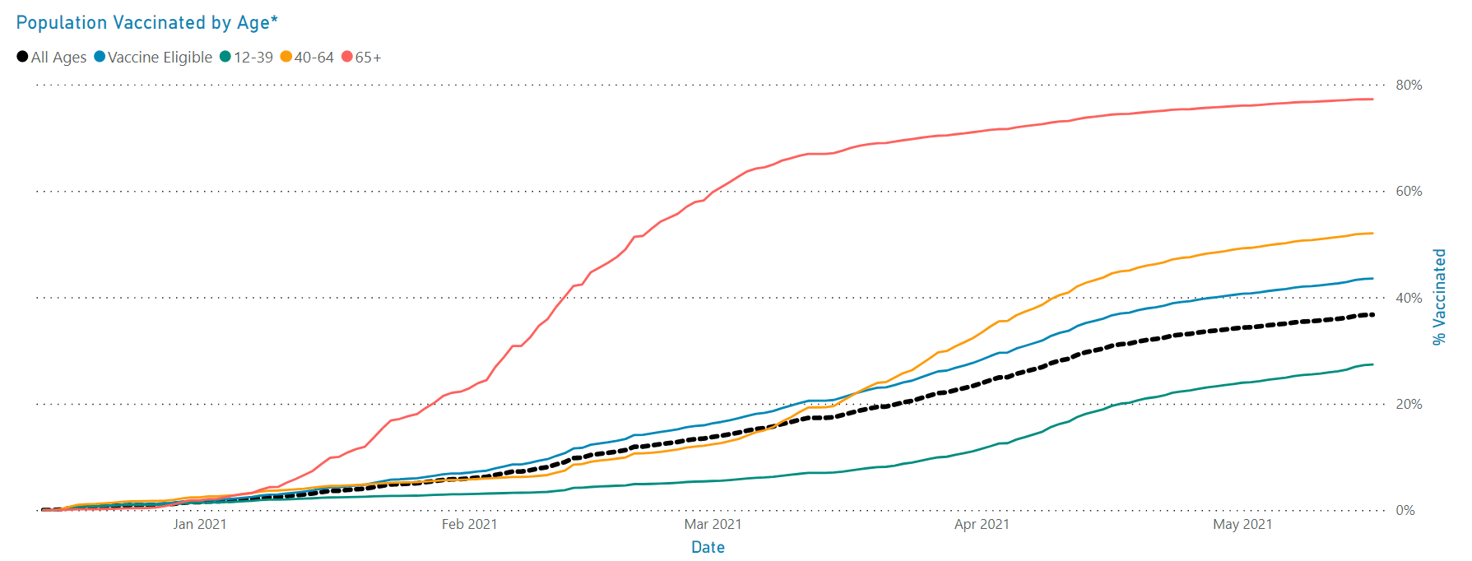
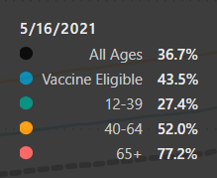
Vaccinations by Age Cohort
Data as of 5/16

Slide 8
Vaccinations by Age Decade
Data as of 5/16

Slide 9
Intervention Strategies
Vaccines are our primary tool going forward – and we see that they are working
With more than 75 percent of the 65+ group vaccinated; the average age of hospitalizations has shifted younger
However, hospitalizations remain elevated due to high incidence
Prevention and mitigation strategies such as social distancing, masking (when inside and in public) and staying home when sick remain important for those that have yet to be vaccinated

Slide 10
Vaccinations vs. COVID-19

Slide 11
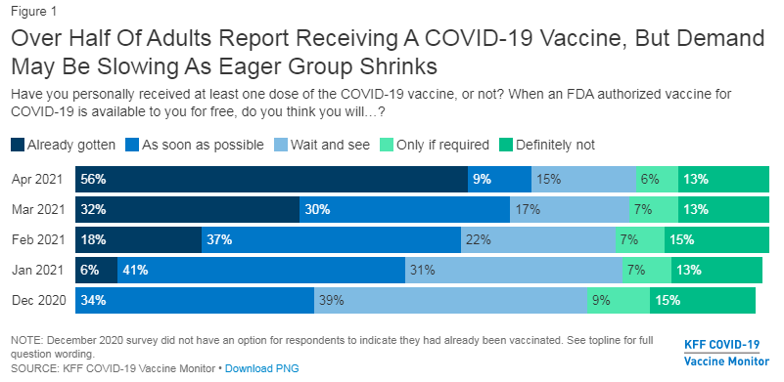
Vaccination Demographics
Source: Kaiser Family Foundation Study

Slide 12
El Paso County Vaccine Consortium
Strategies:
Moving from mass vaccination to mobile and targeted sites/events
Expanding availability, reducing and eliminating barriers
Engaging trusted sources
Community outreach, dialogue
Reaching new people
Notes:
Upcoming Manitou mobile vaccination clinics (in partnership with Nomi):
Wednesday, May 12: Mobile clinic at Memorial Hall (J&J)
Friday, May 14: Mobile clinic at Manitou Springs High School (Pfizer, first dose)

Slide 13
Face Coverings

Slide 14
General Rule
General rule:
Per Governor Polis' Executive Order/Public Health Order, face coverings are not required any longer
Expires on June 1, 2021

Slide 15
Exceptions to the General Rule
If you are unvaccinated or not fully vaccinated, the Executive Order mandates individuals age 11 and older must wear face coverings in the following six settings:
P-12 schools (including extracurricular activities) and childcare centers and services
However, fully vaccinated individuals, including vaccinated children ages 16-18, in a classroom, cohort, or other group of children may remove masks where the teacher(s), caregiver(s), or other staff whose primary responsibility is education or childcare have provided proof of fully completed vaccination to their employer
Colorado Division of Motor Vehicle Offices
Residents, staff, and visitors to congregate care facilities, including nursing facilities, assisted living residences, intermediate care facilities, and group homes; except in situations where removal is authorized by the Centers for Medicare & Medicaid Services
Residents, staff, and visitors to prisons
Residents, staff, and visitors to jails
Personnel in emergency medical and other healthcare settings (including hospitals, ambulance service centers, urgent care centers, non-ambulatory surgical structures, clinics, doctors' offices, and non-urgent care medical structures

Slide 16
Exemptions
Unvaccinated or not fully vaccinated individuals performing the following activities are exempt from the six requirements listed in the previous slide:
Individuals who are hearing impaired or otherwise disabled or who are communicating with someone who is hearing impaired or otherwise disabled and where the ability to see the mouth is essential to communication
Individuals who enter a business or receive services and are asked to temporarily remove a face covering for identification purposes
Individuals who are actively engaged in a public safety role, such as law enforcement officers, firefighters, or emergency medical personnel
Individuals who are officiating or participating in a life rite or religious service where the temporary removal of a face covering is necessary to complete or participate in the life rite or religious service

Slide 17
Additional Exemptions
Individuals who are hearing impaired or otherwise disabled or who are communicating with someone who is hearing impaired or otherwise disabled and where the ability to see the mouth is essential to communication;
Individuals who are seated at a food service establishment;
Individuals who are exercising alone or with others from the individual’s household and a face covering would interfere with the activity;
Individuals who are receiving a personal service where the temporary removal of the face covering is necessary to perform the service;
Individuals who enter a business or receive services and are asked to temporarily remove a face covering for identification purposes;
Individuals who are actively engaged in a public safety role, such as law enforcement officers, firefighters, or emergency medical personnel; and
Individuals who are officiating or participating in a life rite or religious service where the temporary removal of a face covering is necessary to complete or participate in the life rite or religious service;
Individuals who are giving a speech for broadcast or an audience;
Individuals who are alone in a room
Individuals who are hearing impaired or otherwise disabled or who are communicating with someone who is hearing impaired or otherwise disabled and where the ability to see the mouth is essential to communication;
Individuals who are seated at a food service establishment;
Individuals who are exercising alone or with others from the individual’s household and a face covering would interfere with the activity;
Individuals who are receiving a personal service where the temporary removal of the face covering is necessary to perform the service;
Individuals who enter a business or receive services and are asked to temporarily remove a face covering for identification purposes;
Individuals who are actively engaged in a public safety role, such as law enforcement officers, firefighters, or emergency medical personnel; and
Individuals who are officiating or participating in a life rite or religious service where the temporary removal of a face covering is necessary to complete or participate in the life rite or religious service;
Individuals who are giving a speech for broadcast or an audience;
Individuals who are alone in a room

Slide 18
None of these provisions apply to individuals 10 years of age and younger and/or individuals who cannot medically tolerate a face covering
As allowed under state law, owners, operators and managers of any business or service may, at their discretion, continue to require individuals entering or within their locations to wear face coverings or show proof of full vaccination

Slide 19
Public Health Order 20-38
Expires on June 1, 2021

Slide 20
Summary
The “COVID-19 dial” was not renewed
Schools
Outdoor events
Indoor events
Claw back provision

Slide 21
Current State Restrictions
COVID-19 dial was not renewed
Local public health can place local restrictions
El Paso County Public Health has decided to not place local restrictions
State restrictions that remain in effect

Slide 22
Schools
Same
Schools are required to work with local public health on infections/outbreaks
If school fully remote, school cannot have extracurricular activities

Slide 23
Outdoor Events
No restrictions on Outdoor Events

Slide 24
Indoor Gatherings
Indoor Events less than 100 people have no restrictions other than the state face coverings order requirements noted above
Indoor Events between 100 to 500 people must maintain six-foot distancing between nonvaccinated people and unknown vaccinated people and comply with the state face coverings order noted above
Indoor Events over 500 people must obtain a variance from local public health and state public health prior to the event and comply with the state face coverings order noted above
5-Star Certified Businesses and prior approved variances remain in effect

Slide 25
Indoor Gatherings Restrictions do NOT apply to:
a. Places of worship and associated ceremonies;
b. Retail services;
c. Restaurants that have sit-down dining and do not have unseated areas where 100 or more people could gather (such as dance floors or common gathering areas); and
d. School proms and graduations, unless they wish to exceed these thresholds shall be subject to review and approval by local public health agencies in accordance with CDPHE prom and graduation guidance

Slide 26
Claw Back Provision
CDPHE may require counties whose resident hospitalizations threaten to exceed 85 percent of hospital or hospital system capacity to implement additional restrictions to mitigate disease transmission

Slide 27
Questions?

