Slide 1
Saddlehorn Ranch
El Paso County, Colorado
Amended

Slide 2
PROJECT TEAM
Saddlehorn Ranch
Planners/Applicant
William Guman & Associates, Ltd.
Bill Guman, PLA | ASLA
Colorado Springs, CO
Consulting Engineers
JR Engineering, LLC
Mike Bramlett, PE
Colorado Springs, CO
Hydrologists
JDS Hydro-Consultants
Ryan Mangino, PE
Colorado Springs, CO
Geologists
Entech Engineering, LLC
Joe Goode, PE
Colorado Springs, CO
Transportation Engineers
LSC Transportation Consultants, Inc.
Jeff Hodsdon, PE
Colorado Springs, CO
Ecologists
Ecosystem Services, LLC
Jon Dauzvardis, PWS
Grant Gurnee, PWS
Longmont, CO
Surveyors
Clark Surveying
Chris Berumen, PLS
Colorado Springs, CO
Legal | Metro District
Blaire Dickhoner, Esq.
White Bear Ankele Tanaka & Waldron
Denver, CO
Legal | Water
Ryan Farr, Esq.
Monson, Cummins & Shohet, LLC
Colorado Springs, CO
PRELIMINARY PLAN
EL PASO COUNTY BOARD OF COMMISSIONERS
March 23, 2021
Owner | Developer:
Gorilla Capital
Eugene, OR
ROI Property Group, LLC
Napa, CA
Applicant | Presenter:
Colorado Springs, CO
Urban Planning | Community Design | Landscape Architecture | Entitlement Coordination
1

Slide 3
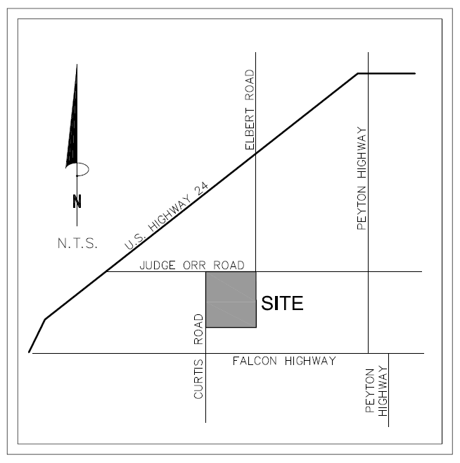
JUDGE ORR ROAD
Saddlehorn Ranch
PROJECT SITE
PRELIMINARY PLAN
VICINITY MAP
CURTIS ROAD
Saddlehorn Ranch (aka 824 Acre Curtis Road Subdivision) property for this Preliminary Plan application is located in El Paso County in Peyton, CO, approximately 12 miles east of downtown Colorado Springs, situated east of Curtis Road and the Town of Falcon, Colorado, and south of Judge Orr Road. The site is bordered by Judge Orr Road on the north and Curtis Road on the west. It is approximately 2-1/2 miles east of CO Highway 24.
2

Slide 4
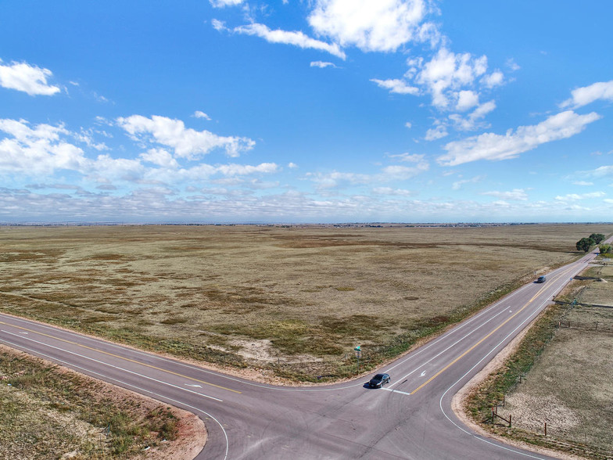
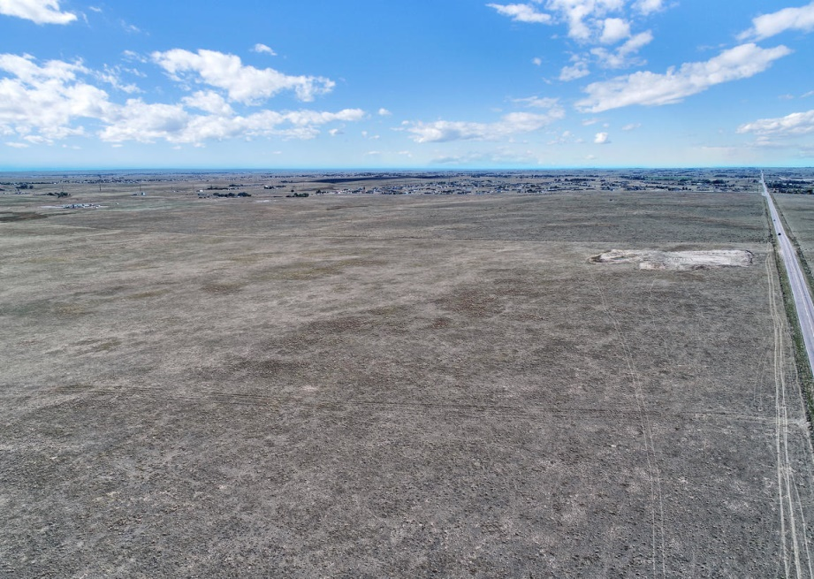
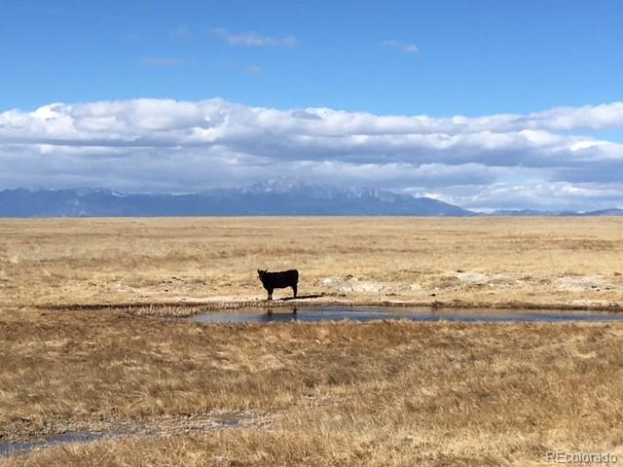
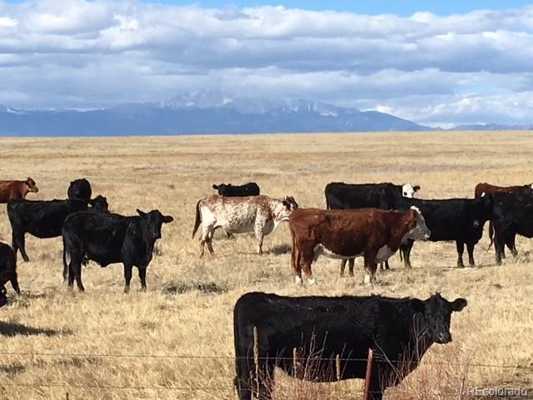
Saddlehorn Ranch
PRELIMINARY PLAN
Saddlehorn Ranch was rezoned from A-35 to RR-2.5 by the County in 2019.
The vacant site is characterized by rolling prairieland bisected by natural floodplains and jurisdictional and non-jurisdictional wetlands in several areas.
All of the site presently remains vacant and undeveloped and is presently used for livestock grazing purposes.
CURTIS ROAD
CURTIS ROAD
JUDGE ORR ROAD
3

Slide 5
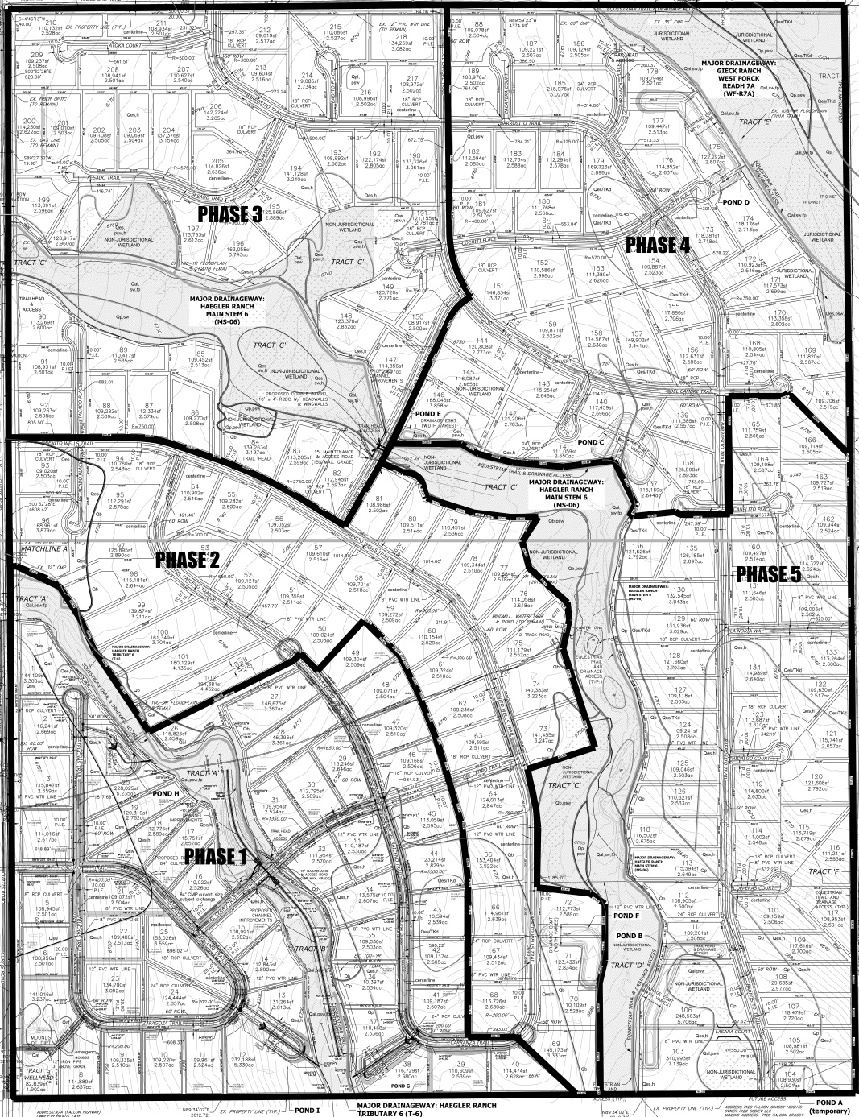
PRELIMINARY PLAN
JUDGE ORR ROAD
Saddlehorn Ranch
PRELIMINARY PLAN
SITE DATA
608+/- acres of the 816-acre site will be developed with up to 218 single family residences on lots each not less than 2.5-acre size.
134 acres (16.4%) is bisected in three distinct areas by jurisdictional and non-jurisdictional wetlands, which are identified on the Preliminary Plan as separate tracts. These areas will be preserved as open space with limited recreational use having a primary emphasis on walking and equestrian trails. None of the proposed 218 residential lots encroaches into any floodplain. All 134 acres of open space will remain as no-build tracts.
CURTIS ROAD
B&W
The Owner and Applicant request approval of a Preliminary Plan for the development of 218 rural residential single family residential lots on approximately 816 acres (e.g. .267 DU/Acre density).
5

Slide 6
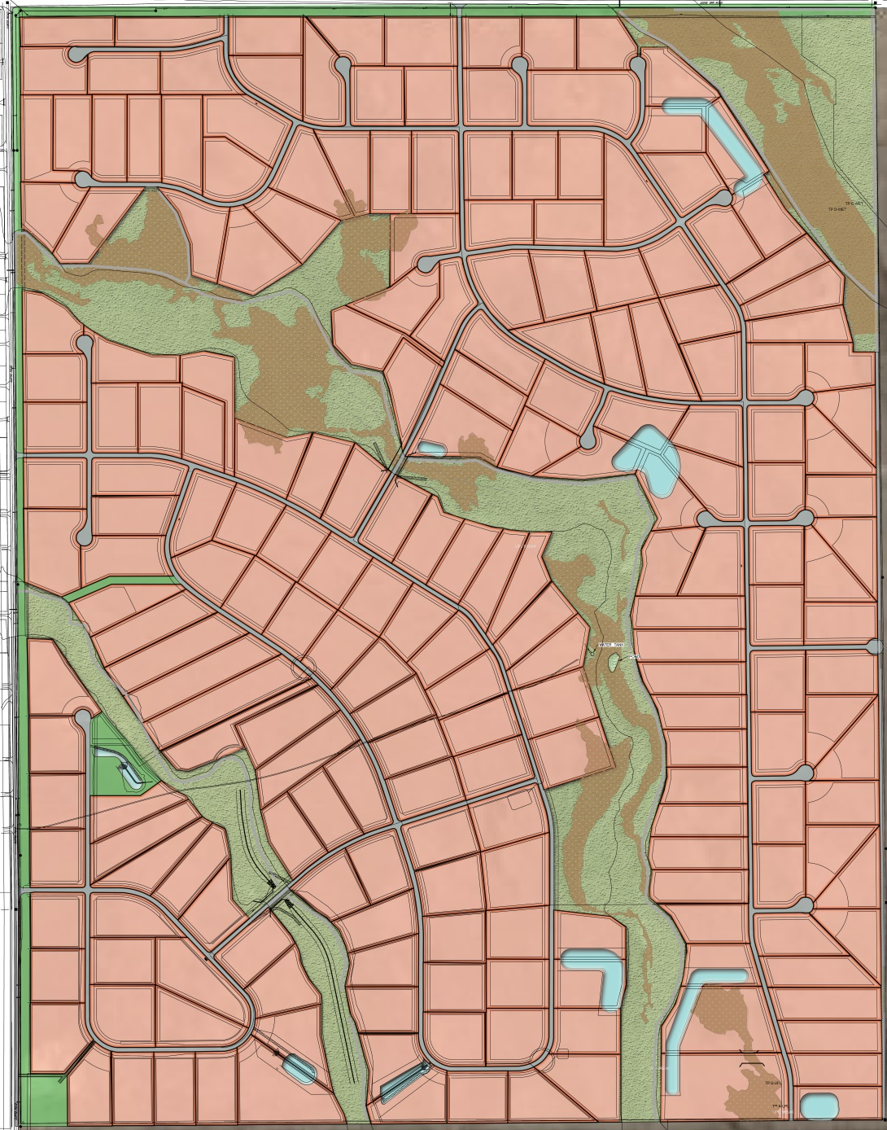
JUDGE ORR ROAD
Saddlehorn Ranch
PRELIMINARY PLAN
PRELIMINARY PLAN
CURTIS ROAD
6

Slide 7
Saddlehorn Ranch
PRELIMINARY PLAN
DEVIATION REQUESTS (ALL 5 APPROVED BY BOARD OF COUNTY COMMISSIONERS AT REGUALR MEETING ON 02/09/21 )
Re. Cul-de-sac length: Deviation request from the standards of or in Section ECM Section 2.3.8 Roadway Terminations for cul-de-sac horizontal design of the Engineering Criteria Manual (ECM) was requested and approved.
Re. Judge Orr Road: Deviation request from the standards of or in section ECM Section 2.2.4 Roadway Functional Classifications of the Engineering Criteria Manual (ECM) was requested and approved.
Re. Cul-de-sac length: Deviation request from the standards of or in Section ECM Section 2.3.8 Roadway Terminations for cul-de-sac horizontal design of the Engineering Criteria Manual (ECM) was requested and approved.
Re. Centerline radius: Deviation request from the ECM criteria for minimum rural centerline radius was requested and approved.
Re. Curtis Road: Deviation request from the standards of or in section ECM Section 2.2.4 Figure 2-4 Figure Rural Minor Arterial of the Engineering Criteria Manual (ECM) was requested and approved.
7

Slide 8
Saddlehorn Ranch
JUSTIFICATION FOR APPROVAL OF PRELIMINARY PLAN
PRELIMINARY PLAN
This request is consistent with the purposes of the EPCLDC including the Falcon/ Peyton Small Area Master Plan.
Goal 6.1 a Encourage patterns of growth and development which complement the regions' unique natural environments and which reinforce community character.
infrastructure needed to serve the new lots, such as new roads, drainage and detention facilities, erosion control, etc. will be constructed as part of this development.
Policy 6.1.3 - Encourage new development which is contiguous and compatible with previously developed areas in terms of factors such as density, land use and access.
Policy 6.1.11 - Plan and implement land development so that it will be functionally and aesthetically integrated within the context of adjoining properties and uses.
The Preliminary Plan with RR-2.5 zoning for the site is harmonious and compatible with the rural character of adjacent and nearby neighborhoods that are also zoned RR-2.5, RR-5, and PUD.
The Preliminary Plan proposed for 218 new single family rural residential lots is compatible with the existing adjacent rural residential lots in the Judge Orr Road and Curtis Road corridors. New lots will be similar in size to existing lots and roads serving the new lots will be compatible with the types of rural roadways in nearby adjacent neighborhoods.
Policy 6.1.14 - Support development which complements the unique environmental conditions and established land use character of each sub-area of the County.
The Applicant proposes to avoid overlot grading across the 816 acre site, and instead will limit grading to roadways and drainage infrastructure in keeping with the established land use character of surrounding sub-areas of the county. Lower density will help to sustain the appearance and unique environmental conditions of adjacent properties.
Policy 6.1.6 - Direct development toward areas where the necessary urban-level supporting facilities and services are available or will be developed concurrently.
Saddlehorn Ranch is proposed as a development of single-family rural residences within a non-urban density area of the Falcon/Peyton community. Utilities and road
8

Slide 9
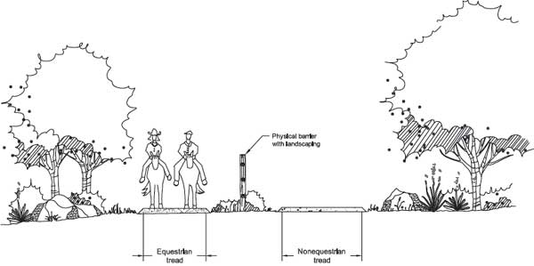
Saddlehorn Ranch
JUSTIFICATION FOR APPROVAL OF PRELIMINARY PLAN
PRELIMINARY PLAN
Goal 6.2
Protect and Enhance Existing and Developing Neighborhoods
The Applicant proposes to incorporate hiking and equestrian trails in the floodplains and in various part of the proposed development to promote non-motorized multi-modal transportation linkages within the development. Ideally, residents might travel by horseback from their home to their neighbor’s home.
Policy 6.2.1 - Fully consider the potential impact of proposed zone changes and development on the integrity of existing neighborhoods.
Policy 6.2.2
Promote the unique identity of neighborhoods through the use of focal points, parks, trails and open spaces, preservation of significant natural features, compatible location and design of mixed uses, and promotion of pedestrian and other non-motorized means of travel.
The Preliminary Plan provides for lower density development that is compatible with the character and use of the non-urban density communities of Falcon/Peyton. Jurisdictional and non-jurisdictional wetlands within the floodplain areas of the site will be preserved as open space no-build areas, which will also lend themselves well toward sustaining the rural nature and character and maintaining the integrity of the surrounding community.
The Owner/Applicant furthermore propose to introduce a new public trail system within Saddlehorn Ranch to include equestrian use to further promote a rural character that is compatible with existing adjacent neighborhoods.
The Owner/Applicant proposes that varying housing types will be developed within the project, including the possible introduction of manufactured housing products to promote attainability by a wider segment of new home buyers.
9

Slide 10
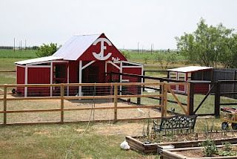
Saddlehorn Ranch
JUSTIFICATION FOR APPROVAL OF PRELIMINARY PLAN
PRELIMINARY PLAN
Goal 6.4 Develop and maintain rural residential areas in a manner which protects their integrity, addresses the carrying capacity of the natural environment and provides for an adequate level of non-urban facilities and services.
The Preliminary Plan design, which includes 2.5 acre home sites and larger expanses of open space (16.4% within the floodplains), ensures that development of this site will remain compatible and contiguous with existing rural residential areas. At .267 DU/Ac, Saddlehorn Ranch is compatible with numerous other subdivisions adjacent to and within a 2-mile radius of the property.
Policy 6.4.3 - Allow rural residential development in those areas with sufficient "carrying capacity" including roadway capacity, water supply, septic suitability, educational facilities and organized structural fire protection.
Policy 6.4.11 - Support planning and regulatory approaches which limit the adverse impacts of grazing on lots of 5 acres and less.
The surrounding area of the Preliminary Plan has sufficient carrying capacity to support the new development with regard to roadway capacity, water supply, septic suitability, educational facilities, and organized structural fire protection. Commitment Letters from entities that would supply this development with essential services have been submitted with this Preliminary Plan application.
Livestock and grazing will be permitted on lots of 5 acres and less but will be limited to recreational animals (horses) and small animals including chickens or goats. Covenants for Saddlehorn Ranch have been drafted and include the following language:
Policy 6.4.4 - Encourage new rural residential subdivisions to be located within or contiguous with existing rural residential areas or to be incorporated as a buffer between higher density and undevelopable areas.
10

Slide 11
Saddlehorn Ranch
JUSTIFICATION FOR APPROVAL OF PRELIMINARY PLAN
PRELIMINARY PLAN
ADHERENCE TO THE FALCON / PEYTON SMALL AREA PLAN
3.3 Residential Areas and Densities
3.3.1 Encourage diversity and variety in housing types, sizes, locations, and prices to meet the needs of existing and new residents.
3.3.2 Promote predictable growth in the housing market that is consistent with the Small Area Master Plan.
3.3.4 Meet the housing needs of as many existing and new residents of differing ages, incomes, and desired living accommodations.
3.1 Land Use
3.1.1 Provide a balance of land uses that respects existing and historical patterns while providing opportunities for future residents and businesses.
3.1.3 Preserve the core rural character of the area.
3.1.4 Provide a variety of different densities of development options.
The Preliminary Plan provides for single-family detached homes on 2.5 acre lots, which is compatible with the RR-2.5 and RR-5 zone districts and current uses within the adjacent areas of the Plan. This lower density of the development, combined with nearly 134 acres of non-jurisdictional and jurisdictional wetlands and floodplain area that are to be preserved in perpetuity as no-build open space parcels also help to preserve the core rural character of the area. A system of equestrian trails proposed throughout the open space parcels also will help to maintain the rural character of the Plan area.
The Preliminary Plan encourages diverse housing types and prices to meet the needs of existing and new residents. The applicant envisions manufactured housing products as an alternate to stick-built tract housing, which will facilitate the development of new homes on 2.5 acre lots that are attainably priced (in comparison to tract subdivisions within the Plan area). This will help to meet the needs of existing and new residents of differing ages and incomes by providing an alternative housing product to that offered elsewhere within the Plan area.
The Preliminary Plan anticipates a finite quantity of 218 homes that can be built on 2.5-acre lots within the 816-acre development, which promotes predictable growth that is consistent with the Plan.
11

Slide 12
Saddlehorn Ranch
JUSTIFICATION FOR APPROVAL OF PRELIMINARY PLAN
PRELIMINARY PLAN
3.4 Facilities and Services (Fire Protection, School Districts, Wastewater Facilities, etc.)
3.4.1 Encourage development in urban areas where adequate public facilities or services exist or can be provided in an efficient manner.
3.4.2 Provide for the efficient provision of public safety in the area.
3.4.3 Encourage the availability of facilities and services within the planning area, close to the residents.
Saddlehorn Ranch will be subject to participation in the El Paso County Road Impact Fee Program.
This project will request annexation into the 10 mil PID. The up-front fees will be per the current 2019 fee schedule for Single Family Detached housing.
Upfront Road Impact fees are due at plat recordation.
Letters of Commitment to Serve all the area within the Preliminary Plan have been provided with this submittal for public safety, gas, and electric. No new facilities for fire protection or schools are proposed or required for this application. The Applicant successfully established the Saddlehorn Ranch Metropolitan District for the creation of a water district that will develop two existing wells (located in the southeast vicinity of the 816 acre site) to facilitate the construction of a central water supply and serve all new homes within the Preliminary Plan area.
3.5.1 Recommend land use patterns that make efficient use of existing transportation infrastructure and limit the cost of future extensions and upgrades.
3.5.2 Mitigate congestion by providing flexibility for areas of higher population densities while protecting lower density areas from the negative effects of traffic.
3.5.5 Enhance the future role of Meadow Lake Airport through the recommendation of compatible land uses.
3.5.6 Balance long term transportation infrastructure needs with current requirements.
3.5 Transportation
El Paso County Road Impact Fee Program
12

Slide 13
Saddlehorn Ranch
JUSTIFICATION FOR APPROVAL OF PRELIMINARY PLAN
PRELIMINARY PLAN
A Traffic Impact Study [TIS] has been prepared and provided with the Preliminary Plan application. The TIS addresses the use of the two major transportation corridors (e.g. Curtis Road and Judge Orr Road) that provide primary access/egress to and from the Preliminary Plan area. No “negative effects” of traffic would be triggered as a result of the need to construct additional major arterial infrastructure; all new roads within the Preliminary Plan area would be a local residential category.
With regard to Meadow Lake Airport, as originally indicated on Page 2 of the Saddlehorn Ranch LOI, the Preliminary Plan area had once before been approved by the County as a PUD development with up to 5,370 urban-density dwelling units on 6,300 acres. This Preliminary Plan application proposes significantly fewer units (e.g. 218) on 2.5 acre lots within the 816-acre site, and would be very compatible with the character and type of residential development that has been allowed to occur immediately adjacent to the Airport. Meadow Lake Airport has indicated no opposition to the Saddlehorn Ranch Preliminary Plan.
3.6 Water Supply
3.6.1 Plan for water resources in a thoughtful way that recognizes the non-renewable nature of water resources in the area, accommodates existing and historical uses, and allows for sustainable, planned growth.
The Applicant has successfully established the Saddlehorn Ranch Metropolitan District which created a water district that will develop two existing wells (located in the southeast vicinity of the 816 acre site) to facilitate the construction of a central water supply that will service all new homes within the Preliminary Plan area. This will allow for sustainable, planned growth as the Preliminary Plan area does not rely on development of numerous new wells as a primary source of water for new residences.
3.7 Parks, Trails, and Open Space
3.7.1 Provide recreational amenities for area residents.
The Preliminary Plan indicates 134 acres of jurisdictional and non-jurisdictional wetlands and floodplains that will remain as no-build open space area. The Owner/Applicant proposes that equestrian trails will be developed for area residents within some of these open spaces. All parks, trails, and open space tracts will be maintained by the Saddlehorn Ranch Metropolitan District, which will be formed and organized prior to the approval of the Final Plat.
13

Slide 14
Saddlehorn Ranch
JUSTIFICATION FOR APPROVAL OF PRELIMINARY PLAN
PRELIMINARY PLAN
3.8 Natural Systems
3.8.1 Preserve important natural features that are critical to the function of natural systems such as watersheds and wildlife corridors.
Water Quality
Saddlehorn Ranch Metropolitan District (SRMD) has sampled both wells for three quarters in 2019.
None of the primary constituents that were tested were above their respective Maximum Contaminant Level (MCL). Only Total Dissolved Solids, a secondary standard, was above its MCL.
Chlorination and filtration to remove Iron and Manganese are planned for this system. This will likely be accomplished via a pressure-sand filtration. Although filtration is not mandatory, it will be done for water taste and aesthetics.
The Preliminary Plan indicates there are 134 acres of jurisdictional and non-jurisdictional wetlands and floodplains that will remain as no-build open space area. These areas will remain as no-build preservation tracts to protect natural watersheds and wildlife corridors.
WATER DEPENDABILITY
Per the Water Resources and Wastewater Report submitted in 2019, Saddlehorn Ranch has the following Supply and Demands:
Water Supply and Demand Summary
LOTS | Total Supply (AF/Year) | Total Demand (AF/Year)
System Certification
Upon completion of construction of the water system, the design engineer will certify that it has been built in general conformance with the appropriate plans specifications (CDPHE, AWWA, IBC, etc.)
Prior to completion of the system, and during the BDR phase, a designated Operator in Responsible Charge (ORC) will be selected and identified.
218 | 198.16 | 146.06
Water Quality
Two wells, an Arapahoe and a Laramie-Fox Hills, have been drilled, screened, cased, and tested for this subdivision. Both well completion reports were done in 2008.
14

Slide 15
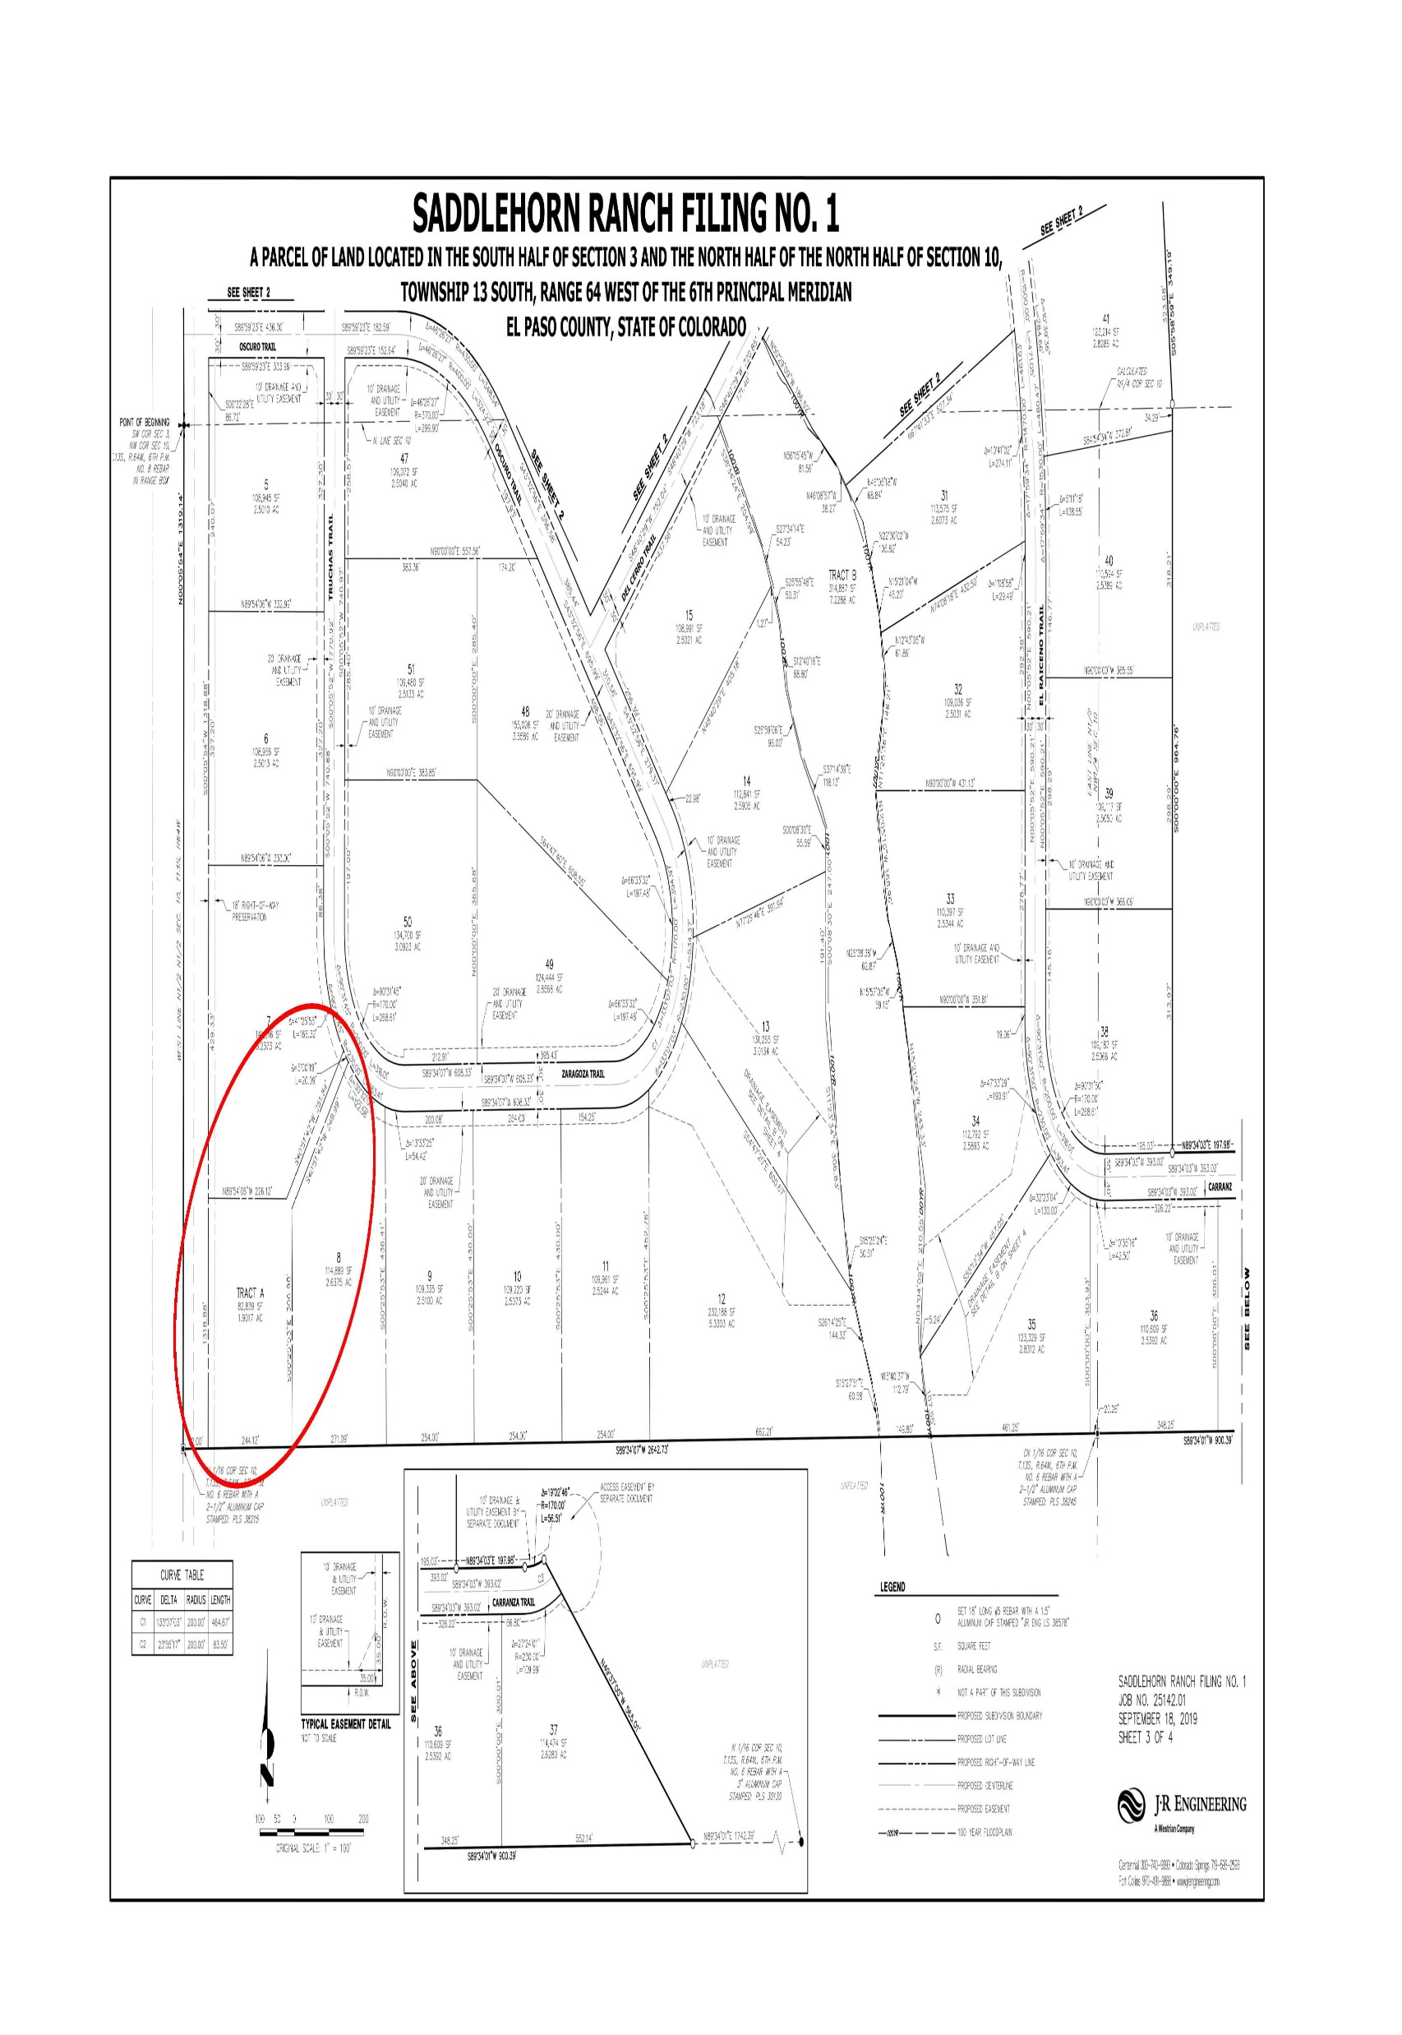
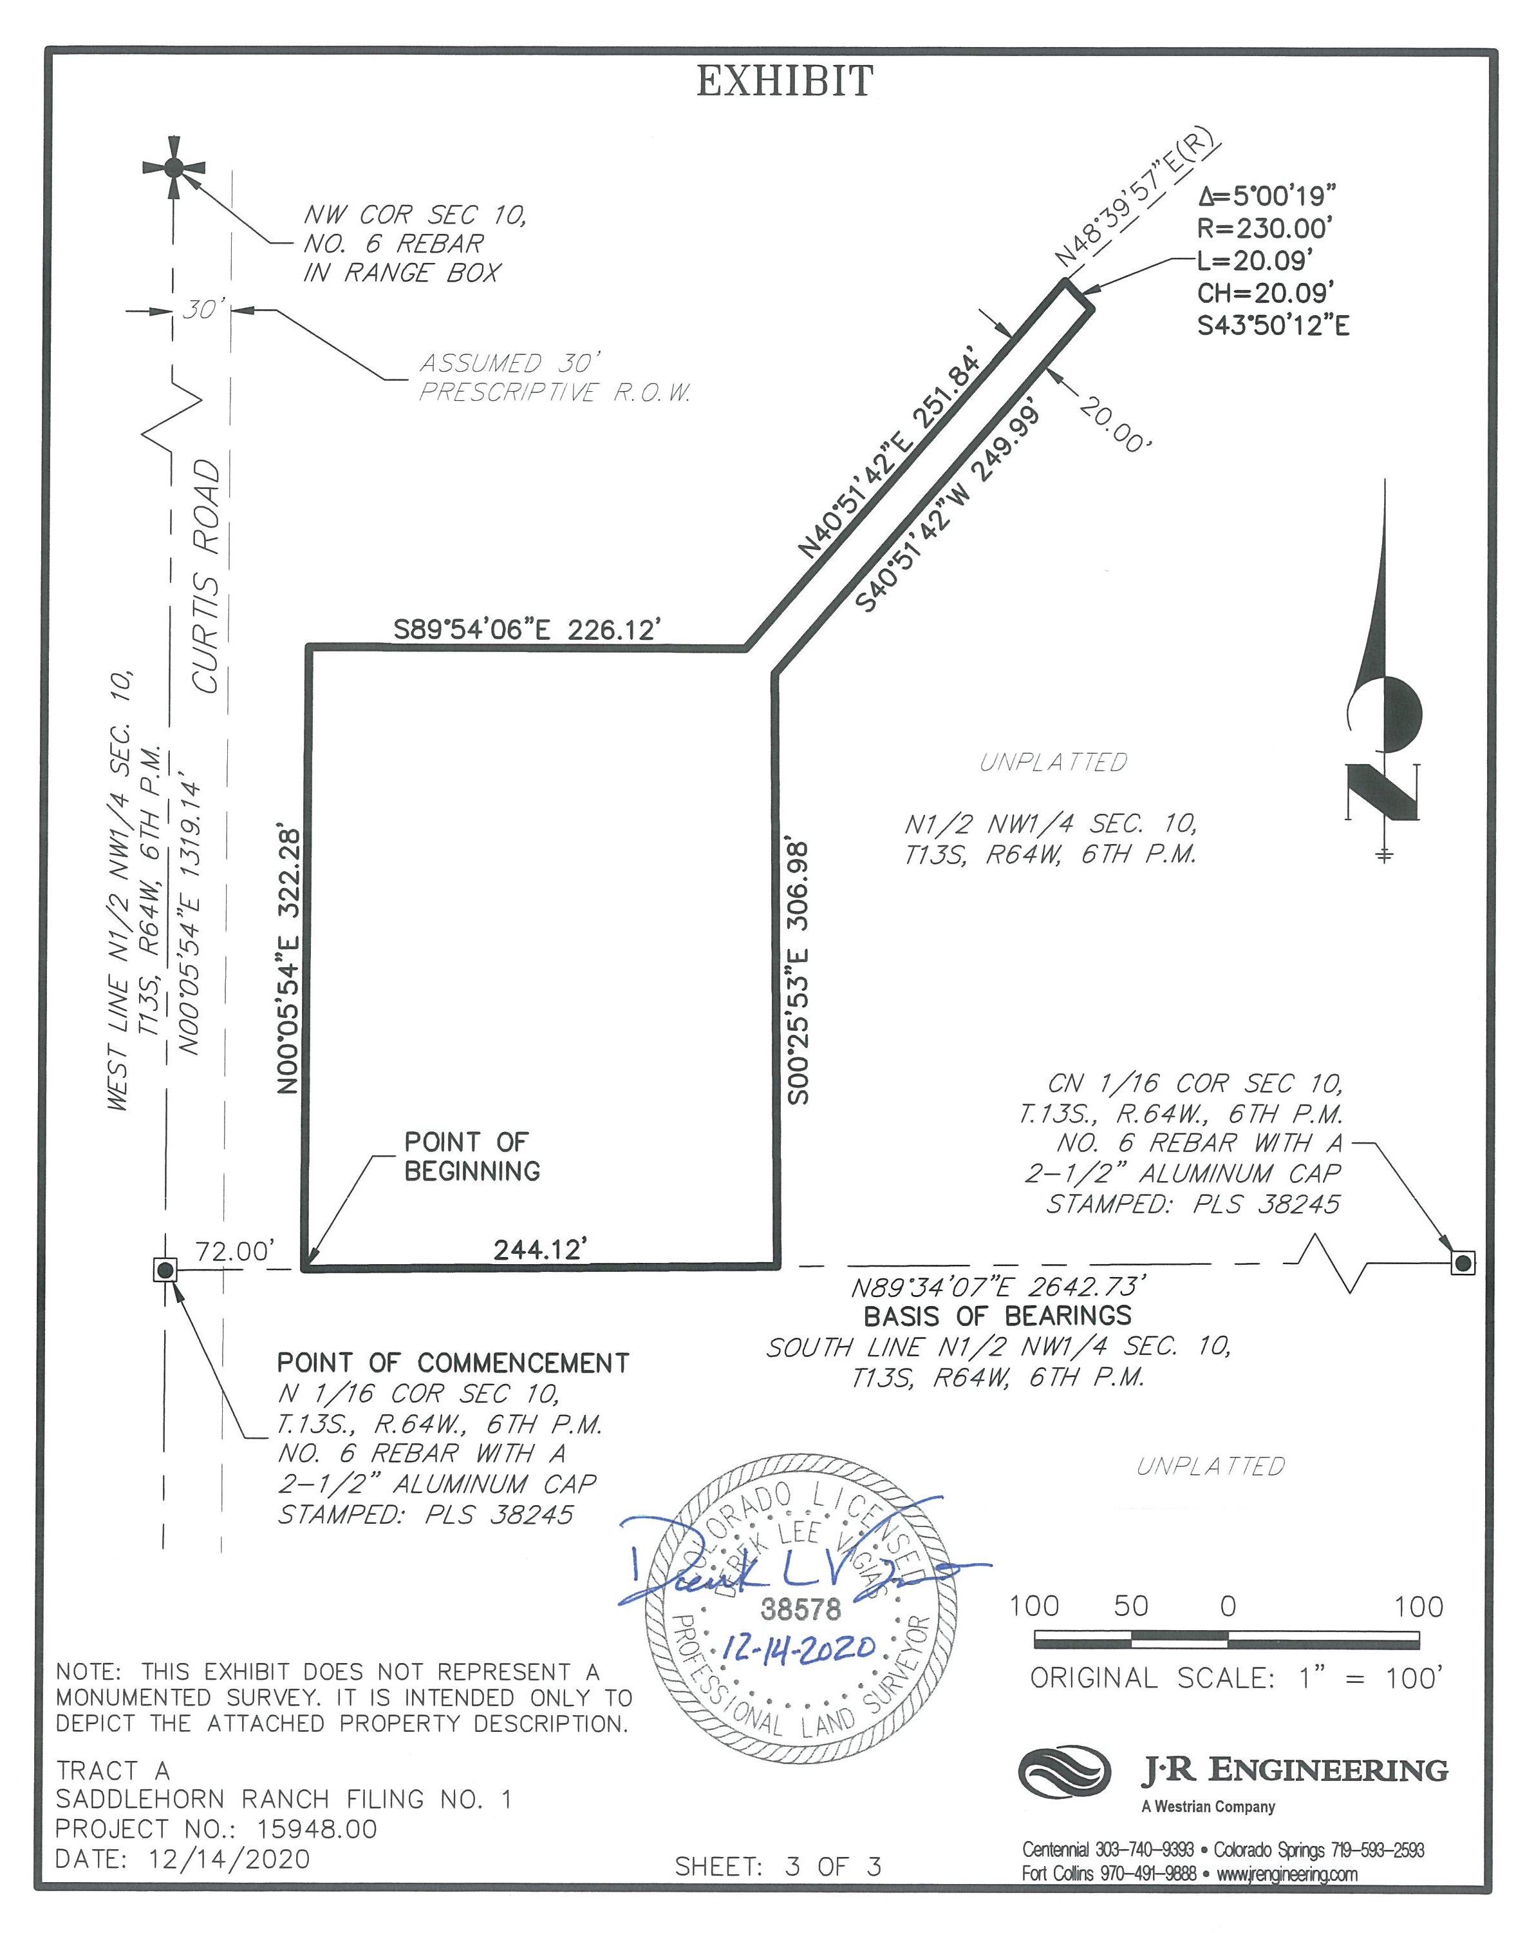
Saddlehorn Ranch
JUSTIFICATION FOR APPROVAL OF PRELIMINARY PLAN
PRELIMINARY PLAN
Proposed Water Treatment Facility Site
15

Slide 16
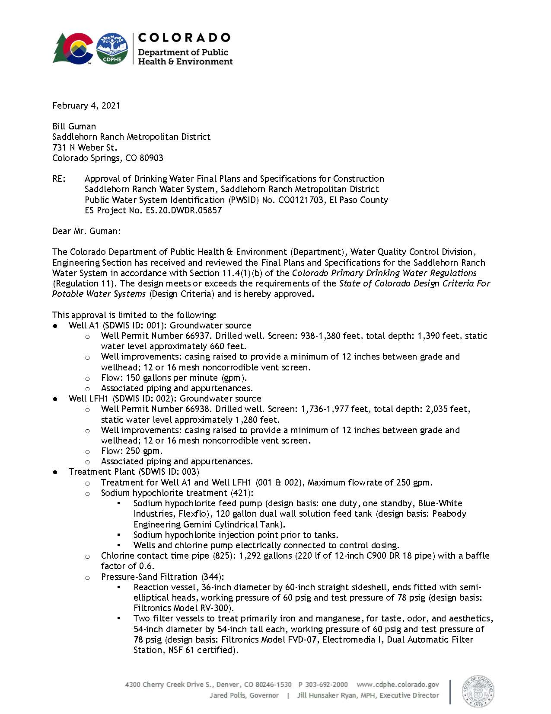
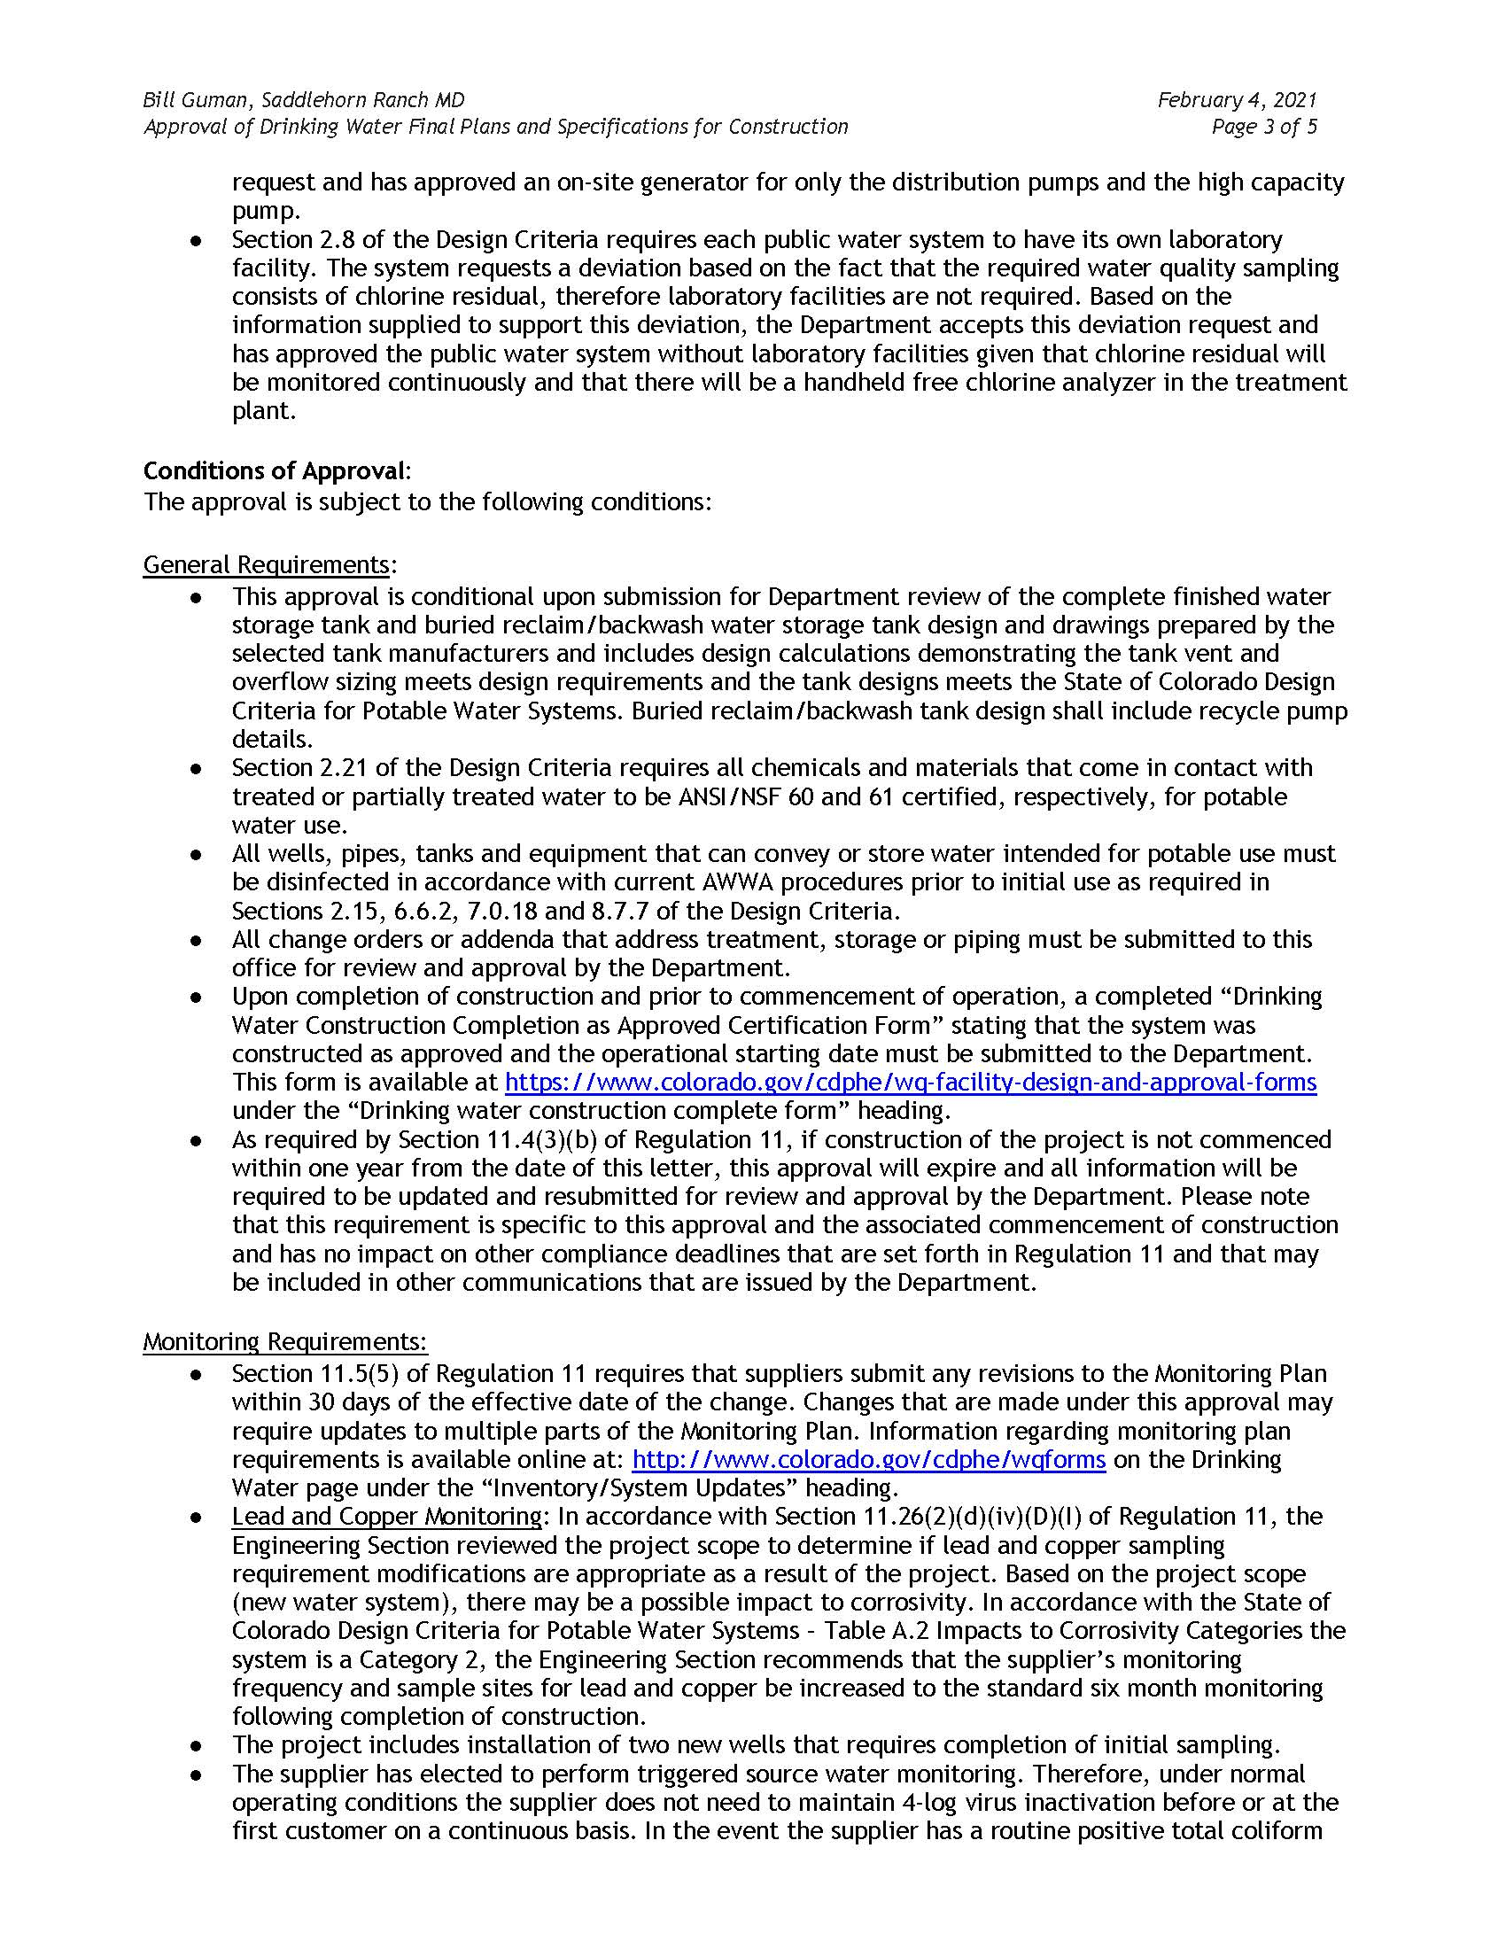
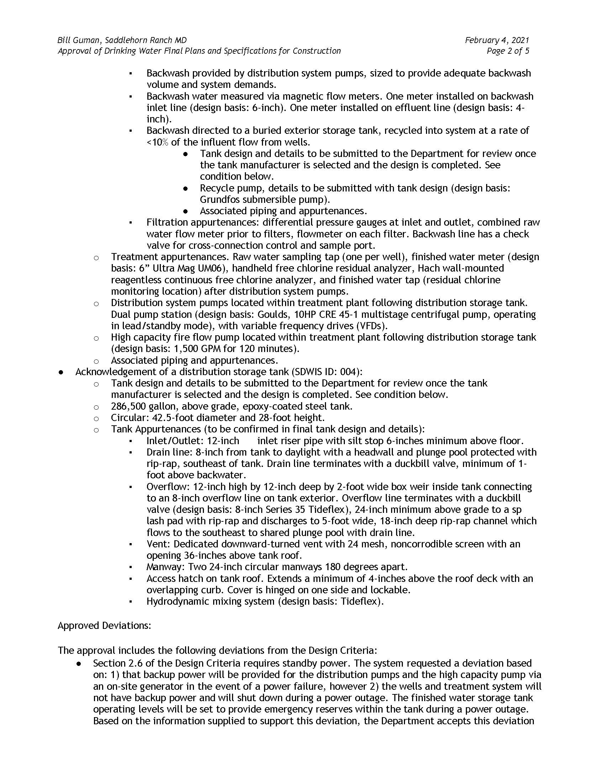
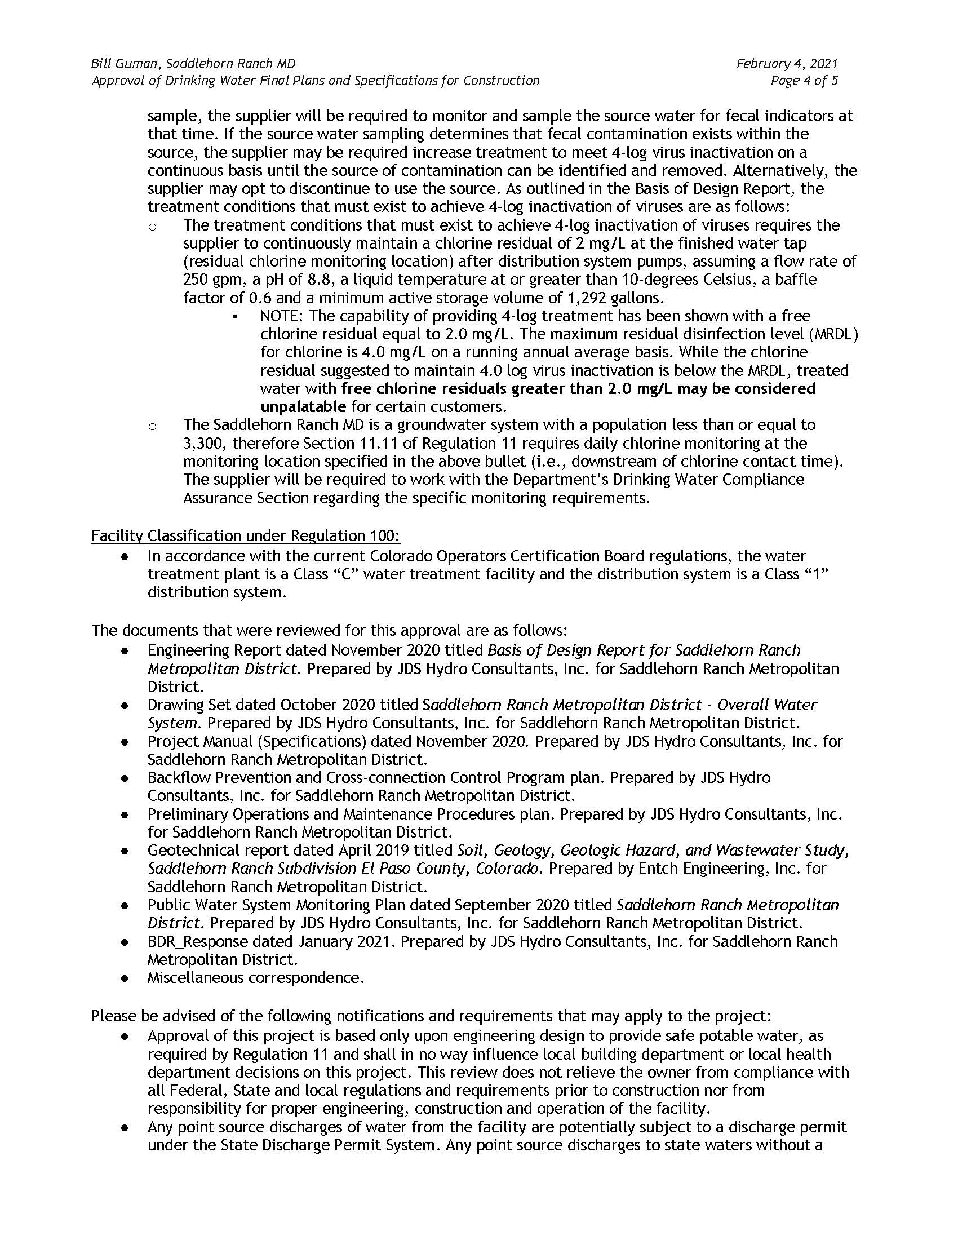
Saddlehorn Ranch
JUSTIFICATION FOR APPROVAL OF PRELIMINARY PLAN
PRELIMINARY PLAN
Approval of Drinking Water and Final Plans and Specification for Water System from CDPHE
County Attorney’s Findings and Conclusion Letter of February 28, 2021
County Attorney’s Findings and Conclusions Letter was received on March 2, 2021. Applicant agrees with Requirements A-H, and will add the following plat note that addresses the State Engineer’s admonition to advise landowners of potential limited water supplies in the Denver Basin:
16

Slide 17
Saddlehorn Ranch
JUSTIFICATION FOR APPROVAL OF PRELIMINARY PLAN
PRELIMINARY PLAN
Meadow Lake Airport Considerations:
Airspace Avigation Easement
Notice of Airport in Vicinity
The Parties are pleased to have also negotiated satisfactory language for an Airspace Avigation Easement. The Applicant has voluntarily agreed to include this Easement Agreement with the title policies for all 218 lots of Saddlehorn Ranch:
At the County Planning Commission hearing of March 4, 2021, the Owner and Applicant of Saddlehorn Ranch agreed to voluntarily place the following language on the Preliminary Plan and Final Plat for Filings 1-5 for recordation:
AIRSPACE AVIGATION EASEMENT
This indenture, made this ___th day of __________, 20__, between _______________ (hereinafter "GRANTOR"), and the Meadow Lake Airport Association (hereinafter "GRANTEE"), provides that:
The GRANTOR for and in consideration of fulfillment of a condition of project approval and other good and valuable consideration, the receipt of which is hereby acknowledged, does hereby grant to the GRANTEE, its successors and assigns, a perpetual and assignable easement in and over that certain parcel of real property more particularly identified and described in Exhibit A attached hereto and made a part hereof (said parcel hereinafter referred to as PARCEL), and a right-of-way for the free and unrestricted passage and flight of aircraft of the class, size and category as is now or hereinafter may be operationally compatible with Meadow Lake Airport, in, through, across and about the airspace above imaginary planes, as such those planes as defined by Part 77 of the Federal Aviation Regulations; Federal Aviation Administration (FAA) Airport Design Advisory Circular (current version); and United States Standard for Terminal Instrument Procedures (TERPS) (current version) over said PARCEL, as described below (hereinafter "Airspace").
This easement shall not apply to restrict improvements constructed on the property below 7023 feet above mean sea level (MSL), or 150 feet above the elevation of the ground elevation.
NOTICE OF AIRPORT IN VICINITY
This property is presently located in the vicinity of Meadow Lake Airport, within what is known as an airport influence area. For that reason, the property may be subject to some of the annoyances or inconveniences associated with proximity to airport operations (for example: noise, vibration, or odors). Individual sensitivities to those annoyances can vary from person to person. You may wish to consider what airport annoyances, if any, are associated with the property before you complete your purchase and determine whether they are acceptable to you.
17

Slide 18
Saddlehorn Ranch
JUSTIFICATION FOR APPROVAL OF PRELIMINARY PLAN
PRELIMINARY PLAN
Airspace Avigation Easement Cont’d.:
5. The right of ingress to, passage within, and egress from said PARCEL, solely for the above stated purposes.
D. GRANTOR, on behalf of itself, its successors and assigns hereby covenants with the GRANTEE, Meadow Lake Airport Association, as follows:
1. GRANTOR, its successors and assigns, will not construct, install, permit or allow any building, structure, improvement, tree, or other object on said PARCEL, to extend into the Airspace, or to constitute an obstruction to air navigation, or to obstruct or interfere with the use of the easement and right-of-way herein granted; and
2. GRANTOR, its successors and assigns, will not hereafter use or permit the use of said PARCEL in such a manner as to create electrical or electronic interference with radio communication or radar operation between any installation upon Meadow Lake Airport and any aircraft.
E. The easement and right-of-way herein granted shall be deemed both appurtenant to and for the direct benefit of that real property which now or hereinafter constitutes Meadow Lake Airport, and shall further be deemed in gross, being conveyed to the GRANTEE for the benefit of the GRANTEE, and any and all
B. The Airspace for avigation easement purposes above said PARCEL consists of the following, further depicted on Exhibit B attached hereto:
all of the air space above the imaginary planes that are described by Part 77 of the Federal Aviation Regulations.
all of the air space above the relevant imaginary planes that are described by the latest version of the FAA Airport Design Advisory Circular (AC 150/5300-13A).
all of the air space above the relevant imaginary planes that are described by the latest version of the United States Standard for Terminal Instrument Procedures (TERPS) as described in the FAA Order 8260.3E
C. The aforesaid easement and right-of-way described in Paragraphs A and B includes but is not limited to:
1. For the use and benefit of the public, the easement and continuing right to fly, or cause or permit the flight by any and all persons or aircraft, of the class, size and category as is now or hereinafter may be operationally compatible with Meadow Lake Airport, in, through, across or about any portion of the Airspace hereinabove described; and
2. The easement and right to cause or create, or permit or allow to be caused or created within the Airspace, such noise, dust, turbulence, vibration, illumination, air currents, fumes, exhaust, smoke and all other effects as may be inherent in the proper operation of aircraft, now known or hereafter used for navigation of or flight in air; and
3. The continuing and perpetual right to keep the Airspace clear of any portions of buildings, structures, or improvements of any and all kinds, and of trees, vegetation, or other objects, which extend into said Airspace; and
4. The right to mark and light, or cause or require to be marked or lighted, as obstructions to air navigation, any and all buildings, structures, or other improvements, and trees or other objects now upon, or that in the future may be upon, said PARCEL, and which extend into the Airspace may be required to mark according to FAA regulations or other regulation(s), rules, or order(s); and
members of the general public who may use said easement or right-of-way, taking off from, landing upon, or operating such aircraft in or about the Meadow Lake Airport or in otherwise flying through said Airspace.
F. This grant of avigation easement shall not operate to deprive the GRANTOR, its successors or assigns, of any rights that it may otherwise have from time to time against any individual or private operator for negligent or unlawful operation of aircraft.
G. It is understood and agreed that these covenants and agreements run with the land and shall be binding upon the heirs, representatives, administrators, executives, successors, and assigns of the GRANTOR, and that for the purposes of this instrument, the PARCEL shall be the servient easement and Meadow Lake Airport shall be the dominant tenement.
H. The avigation easement, covenants and agreements described herein shall continue in effect until the Meadow Lake Airport shall be abandoned or shall cease to be used for public airport purpose, at which time it shall terminate.
I. Grantors agree to waive all damages and claims for damages caused or alleged to be caused by the Grantors violation of any aspect of this easement document.
IN WITNESS WHEREOF, the GRANTOR has hereunto set its/his/her hands and seals this ____th day of __________________, 20___.
GRANTOR
_____________________________
By:
Printed Name:
Title:
IN WITNESS WHEREOF, the GRANTOR has hereunto set its/his/her hands and seals this _____________ day of __________________, 20_____.
18

Slide 19
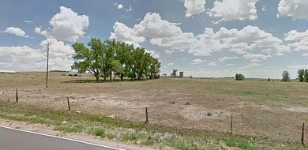
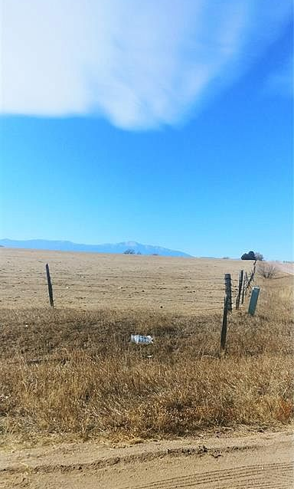
Saddlehorn Ranch
PRELIMINARY PLAN
REQUEST
The Owner and Applicant hereby request approval of a Preliminary Plan with Conditions of Approval, Deviation Requests, and final plat notes with regard to Denver Basin water supplies [as required by the County Attorneys Office], Notice of Airport in Vicinity, and recordation of an Airspace Avigation Easement for the development of 218 rural residential single family residential lots on approximately 816 acres.
19

