Slide 1
Commissioner Update
Chuck Broerman
El Paso County Clerk and Recorder
March 23, 2021

Slide 2
Election Review
Ran a successful election
Record-setting participation
Passed Logic and Accuracy test
Passed a scientific, evidence based forensic audit of our election system after the November Election – the Risk Limiting Audit
Colorado the Gold Standard
Kudos from citizens, organizations

Slide 3
Post Election
Pandemic-How do you ensure the citizens can vote while keeping citizens, election judges and election staff safe.
Others tried to replicate our system in a short time frame
What was seen in other states…
Struggles in some states-
Required modified rules-Absentee, return date, signature/address cures
Voter Registration concerns
Election night reporting/results
Social media
Equipment/software-allegations

Slide 4
Elections-Post Election
Testified before the General Assembly Audit Committee
Electronic Town Hall with County Clerks from Weld and Montrose Counties
Our Election Department and myself have received and spoke to >500 people to discuss the safeguards we have in place in El Paso County and Colorado.
Meetings with interested groups
Made ballots images available-First ~60 batches are available here.
https://clerkandrecorder.elpasoco.com/elections/records-and-results/

Slide 5
Post Election
Georgia hand recount
Results - 495 votes of 5 Million votes
.009% difference between machine count
Antrim County (Michigan) hand count
Results 12 votes difference of 15,700 votes cast
.08% difference between machine count
Maricopa County-Arizona
Hand Count-(Arizona hand count rules)
verified machine count
Forensic Software Audit by two Independent Federally Certified testing companies
Will conduct a full hand recount
Mitre report

Slide 6
Doing more…
Maris poll-40% have concerns about the validity of the election results in 2020
We run transparent, accurate, fair and verifiable elections.
Opinion of a few that we should scrap our $1.4 million for some unsubstantiated claims.
However, I feel we must do more. We have a history of doing more.
100% comparison audit-More expansive than a Risk Limiting Audit
We have performed this type of audit in the past
2013 in the Senate 11 recall election.

Slide 7
Extending Assurance to our Voters
Contracted with Clear Audit to perform a post-election comparison audit.
Clear Audit is the only audit system in the country that is capable of comparing digital images from other election system vendors and tabulating the results.
Clear Audit will utilize the scanned digital images of our ballots and conduct an 100% audit.

Slide 8
ClearAudit Presentation
For El Paso County

Slide 9
ClearAudit Overview
11 Florida Counties
New Hampshire
(Statewide)
Vermont (Statewide)
South Carolina
(Statewide)
33 New York Counties
Maryland (Statewide)

Slide 10
System is utilized in South Carolina(46), New York (33), Florida (11), Maryland (24), Vermont(14) and New Hampshire(10). (105 total)
El Paso County has utilized Clear Audit before- (2013 Senate 11 Recall).
El Paso County would be the first to offer additional audit capabilities in the State of Colorado.

Slide 11
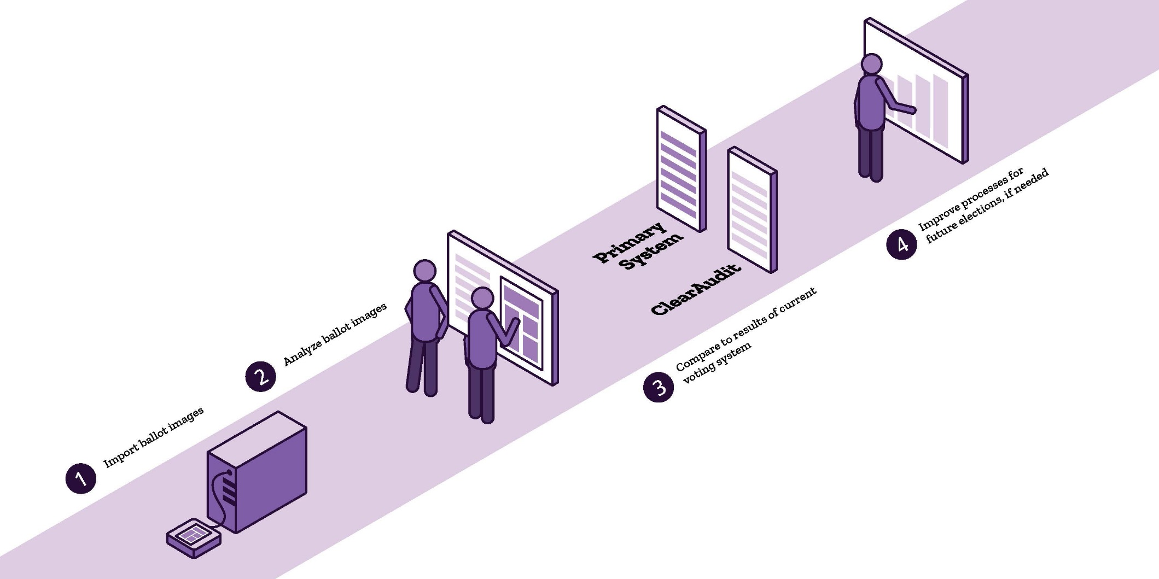
How would it work?
100% AUDIT
Clear Ballot audits 100% of our ballots.
VERSATILITY
Clear Ballot is the only system capable of tabulating other systems’ ballots, providing the only independent comparison of results for purposes of post-election audits.

Slide 12
Video of Clear Audit
Maryland Public Portal on Vimeo
https://vimeo.com/279541641

Slide 13
Analysis
Reports and analysis by the following methods:
Election contest (candidate/issue)
Precinct/ballot style
District

Slide 14
Analysis Results
Our office will be putting up the Clear Audit data on our Election Department website so people can then go look at the ballots and read the reports and analysis.

Slide 15
Questions?

