Slide 1
15,000 postcards mailed to ZIP codes with
the highest unemployment rates

Slide 2
IN-DEMAND SKILLS
IN-DEMAND OCCUPATIONS
15,000
Open Positions
IN-DEMAND BASELINE SKILLS
IN-DEMAND SOFTWARE SKILLS

Slide 3
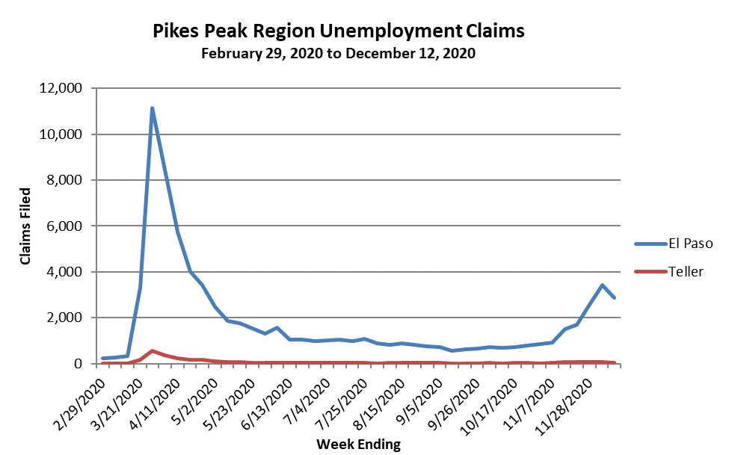
COVID Unemployment Claims
Pikes Peak Region

Slide 4
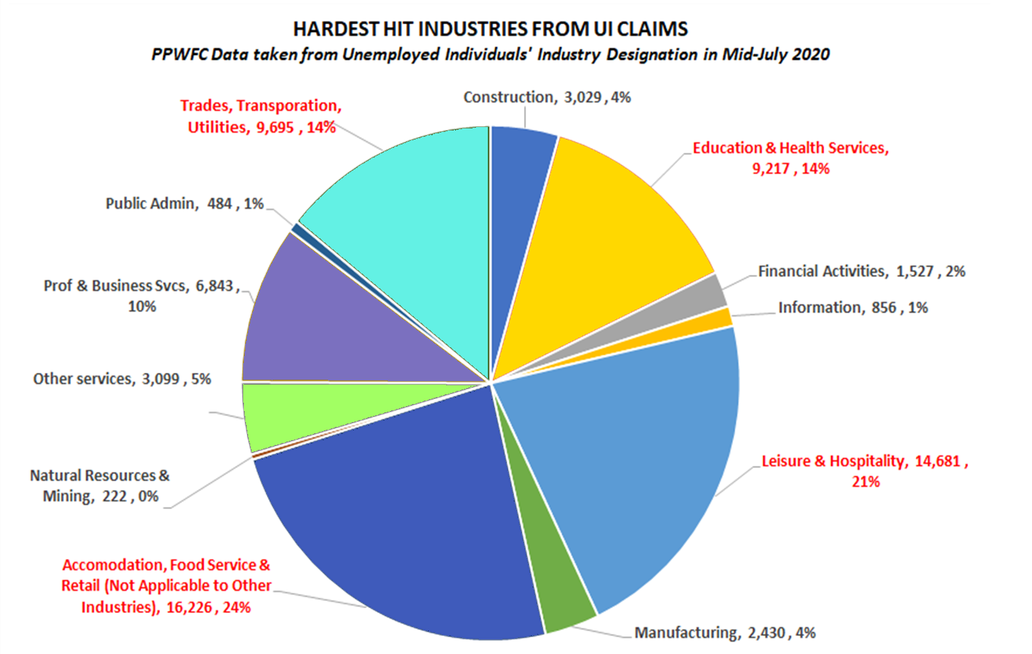
COVID-impacted Industries
Pikes Peak Region

Slide 5
Bridging the Skills Gap with Training Programs
• 69 Business Skills courses
269 courses taken
5,731 skills attained
14,000+ minutes of training
Top Courses – Excel, Access, Business Writing, Email Etiquette
• 23 Career Development courses
391 video views
• 5 Cybersecurity/IT entry-level courses
• Skilled Trades curriculum teaches in-demand trades
• Retail & Hospitality courses
• Basic Soft Skills & Workplace Skills
We established a virtual training platform.
Hundreds of no-cost courses to help displaced workers acquire in-demand skills.

Slide 6
Supporting the Region’s Healthcare Crisis
To prevent furloughs or workforce reductions, PPWFC supported retraining programs for UCHealth & Children’s Hospital
1,273 healthcare workers retrained, redeployed and/or saved from being furloughed or terminated
498 nurses retrained to work in Acute/Critical Care
192 nurses retrained to become Respiratory/Rehabilitation Therapists
452 medical staff trained in Behavioral Health
131 administrative staff trained to manage COVID impacts to healthcare system
“At the peak of the crisis, managing the impact of COVID-19 necessitated the learning of new skills and procedures in real-time, on-the-job training. Thanks to the PPWFC, our newly-trained and upskilled workforce is prepared for another potential surge of COVID-19 cases – ensuring the best care and outcomes for our patients.”
Joel Yuhas, President & Chief Executive Officer - UC Health Southern Colorado Region

Slide 7
Childcare Crisis
PPWFC partnered with
Alliance for Kids & Pikes Peak United Way to assist
over 65 of the region’s key childcare agencies & programs.
For nearly 70% of the children, program-provided lunches/snacks only meals they received during the day
Over 60% of families served have an essential worker in the household
Supporting 376 workers who provided childcare for 1,862 kids
Allowing 1,333 families/parents to work and support their families
Supporting the Region’s
Access to services, technology, digital literacy continues to increase equity gaps during pandemic.
Long-term, pandemic-related mental and behavioral health impacts to children remain concerning.

Slide 8
Retail and Hospitality Sector
Pikes Peak Regional Retail and Hospitality Sector Partnership
Co-chaired by
Cindy Johnson, Vice President of Human Resources, The Broadmoor
Jeffrey Howell, Director of Sales and Marketing, The Lodge at Flying Horse
Supporting the Region’s
Lives Empowered, $4.1 million initiative, funded by Walmart, made possible by Colorado Workforce Development Council
$50,000 grant from Lives Empowered used to bring businesses together to address economic mobility for frontline workers to strengthen the region’s retail and hospitality sector.
With onset of COVID-19, the critical necessity of these “essential” workers has been brought to the forefront.

Slide 9
Supporting the Region’s Future Workforce
Career & Technical Education Programs
Construction
Automotive
Cybersecurity
Participation by 10 school districts at 12 academic locations
634 students enrolled in CICC programs
254 students completed industry-supported construction certifications
5 students completed industry-supported cybersecurity certifications
114 high school seniors graduated from CTE programs to enter workforce, military or further education
61 students participated in Bootcamp Training sessions
4 school districts & Pikes Peak Community College received training software for their automotive technician programs
98 students received post-CTE programming
32 students completed internships

Slide 10
Post-Pandemic Employer Challenges
Even strongest local industry sectors have difficulty maintaining staffing:
Unwillingness to report to work for fear of getting sick
Many workers now prefer remote work
Businesses don't yet understand how to build a corporate culture & monitor productivity
Many businesses don't understand when & how Paycheck Protection Program funds will need to be repaid
Access to childcare & early childhood education remains a significant concern as childcare providers go out of business

Slide 11
Launched Employer Toolkit
S

Slide 12
Forming Next Generation Sector Partnerships
Build regional support team and make the case for a new approach
Space and Defense Sector Partnership
Focus: Our region becomes hub for space & defense education to improve labor supply, talent attraction
Automotive Dealers Sector Partnership
Projected need for 300 additional auto technicians during next five years

Slide 13
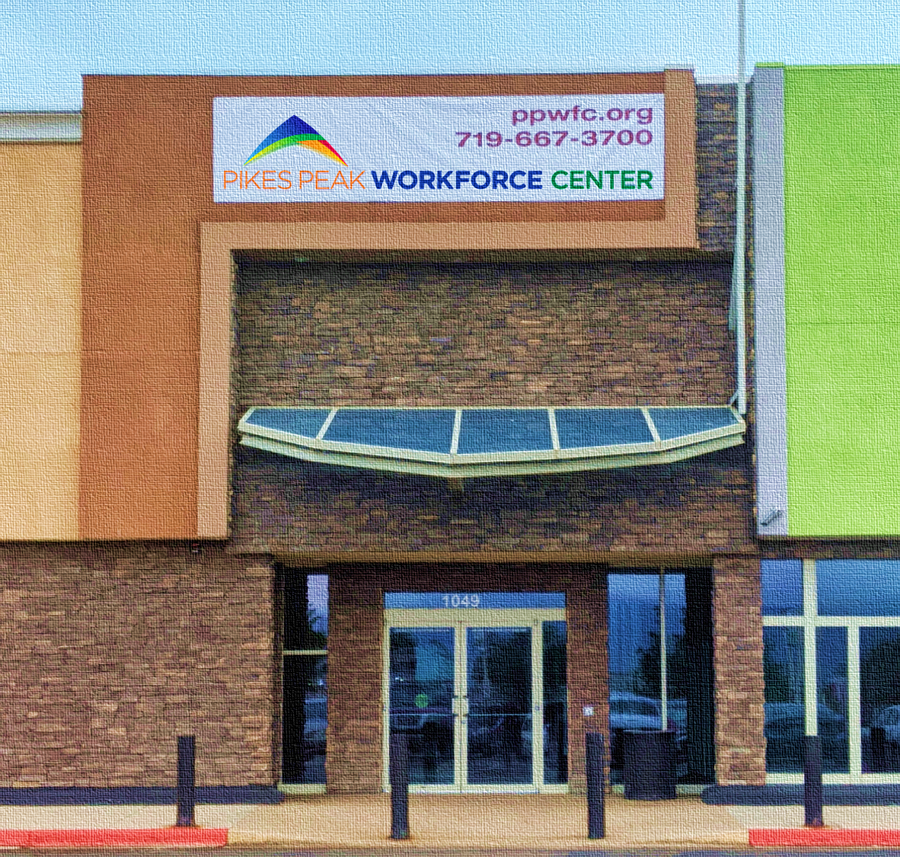
Business Community
We served
2,463 businesses
We held
• 61 hiring events &
• 25% received job offers
11 Community Job Fairs
589 employers with 1,837 job seekers / attendees

