Slide 1
APP-CE-20-002
Mindy Madden
Mike Desmond

Slide 2
Procedure
Staff shall first present the item and provide testimony and evidence to support the PCD Director’s decision to issue an executive determination in this matter.
The appellant(s) shall then be given an opportunity to address the Board and present any testimony and/or evidence. The Board may then ask any final questions of staff or the appellant(s) prior to rendering a decision.
The Board, in considering the testimony and evidence presented by both staff and the appellants shall either:
Move to deny the appeal, thus affirming the decision of the PCD Executive Director; or
Move to approve the appeal, thus overturning the decision of the PCD Executive Director.

Slide 3
Property Information
13875 Judge Orr Road (Parcel No. 43040-01-001)
Located east of the Meadow Lake Airport on the southeast corner of Judge Orr Road and Cessna Drive.
RR-5 (Residential Rural) zoning district
5 acres
Commissioner District 2

Slide 4
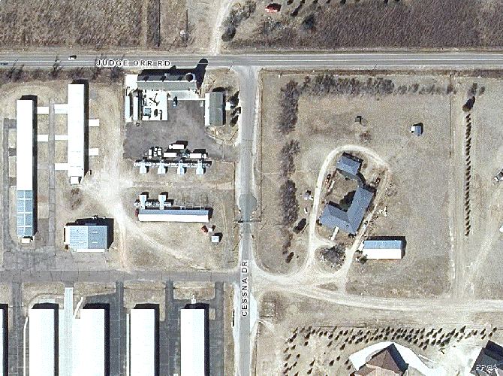
Map

Slide 5
Complaint Received
May 13, 2019
Hello, I have been renting this unit for 7 months at $800 per month. April 26, 2019 a guest of mine stepped on the step and broke it. I advised the landlord and they fixed it . The landlord did not fix the step correctly and I fell and broke my leg and toe. Since then, the landlord has been very hateful and has told me via text I need to fix the step or move out in 30 days. I spoke with the lady that advised me this property is not zoned for the 3 rentals she has here. Additionally, I have asked her to give me fire alarms and to please put lighting so I can see. We have one address/mailbox for all renters here and she pays utilities. She has also advised me that I must keep propane at all times. She said the propane is used for my unit only, but Apollo Propane advised me there was $200 added in December. I did not add any propane on December. Could you please let me know if I am in an illegal rental? If she is responsible for proper lighting? Fire extinguisher? And if the steps that they did fix are safe. I don't believe they are.

Slide 6
Complaint Received
June 23, 2019
Stairs are dangerous, still not fixed properly.. not standard code. I still have no porch light. It is extremely dark when walking to and from my driveway. Walkway to and from driveway has nails sticking up. They have tripped guests. I tried to fix them, but it needs more work than I can do. Extreme hazard. I have not received window screens for windows. Large pile of wood in front of house along with other items vehicles camper etc. No trash receptacles. There are 6 dogs that bark at 6am when they are let out to potty. This wakes up people that have to work and don't have to get up yet. Everyday she allows this. The barking is very loud and irritating. Not quite sure why the lot is being mowed like it is? Ridiculous.

Slide 7
Complaint Received
November 10, 2020
Attached is a letter from the MLAA ref the ongoing Buschman harassment, and I do mean uncivilized harassment. Laura was out again Friday morning screaming at my wife for walking in the easement, although Connie was NOT on her property. This has got to stop! Several good faith remediation offers have made to them, ie; to help clean up their property and decrepit storage building/hangar, create a new driveway off Cessna Drive (before the gate), landscape the taxiway easement, etc. We have received no response from them, other than continued screaming and threats. Never-the-less, they are in violation of single-family zoning, and it appears may not even have a residential well. We respectfully request that the County take immediate action on this. It has gone on way too long.

Slide 8
Complaint Received
November 12, 2020
Good Morning, Thank you for the prompt response. We discussed it, and the Buschman’s latest complaint letter, at this week’s Board of Directors meeting. We would appreciate being kept informed of any developments with respect to the Buschman’s and any inputs that we or the neighbors can make to any further County action or appeal. For what its worth, during the complaint call two weeks ago, Dennis told me he had eight tenants. And there are multiple vehicles on the property every day/night that do not belong to the Buschmans.

Slide 9
Violations
Land Development Code
Table 5-1 Principal Uses
A two-family dwelling is not an allowed use in the RR-5 zoning district
Table 5-2 Accessory Uses
An additional dwelling unit is not an allowed use in the RR-5 zoning district

Slide 10
Enforcement Action
July 3, 2019: Notice of violation issued
March 19, 2019: Executive determination issued
March 25, 2020: Request for appeal received
May 21, 2020: Revised notice of violation issued
December 9, 2020: Revised executive determination issued
December 17, 2020: Request for an appeal received
Staff has spoken with the owner, in person and over the phone, on over a dozen occasions regarding this case. The owner was directed to apply for an Early Assistance (EA) meeting to discuss options to bring the property into compliance. The property owner applied for an EA meeting on August 13, 2019 but did not pay the applicable fees and so an EA meeting was never held.

Slide 11
Additional Information
In July 2019, the owner made claims to Staff that the property was zoned RR-3 (Rural Residential) which allowed for multiple dwelling units when he purchased the property in 1997.
The Code did not allow for multiple dwelling units in the RR-3 zoning district in 1997. The property was not rezoned, but rather the RR-3 zoning district was merely renamed RR-5 (Residential Rural) in 2007.
In May 2020, the owner made claims to Staff that the multifamily dwelling unit was legal nonconforming.
Zoning was established for this area in 1965
Past zoning regulations did not have allowed for a multifamily dwelling.

Slide 12
Recommendation
Staff recommends that the Board deny the appeal and affirm the decision of the PCD Executive Director to issue an executive determination to authorize the OCA to proceed with litigation.
Staff recommends that legal action be stayed if the owner applies for and attends an EA meeting within a timeframe acceptable to the Board and actively progresses through the development application process immediately following the EA meeting.

Slide 13
Questions for Staff?

