Slide 1
Variance of Use Rocky Top Nina Ruiz Elizabeth Nijkamp
VA-18-005

Slide 2
Public input
If you are watching remotely and have not provided a name and a reliable phone number already, please email that information to:
Tracey Garcia at traceygarcia@elpasoco.com

Slide 3
Request
Variance of Use to Legalize an existing:
-Recreation Vehicle Park
-Recreation Camp
NOTE: Automobile and Boat Storage Yard to be removed

Slide 4
Review Criteria
5.3.4 Variance of Use
The strict application of any of the provisions of this Code would result in peculiar and exceptional practical difficulties or undue hardship;
The proposed use is compatible with the surrounding area, harmonious with the character of the neighborhood, not detrimental to the surrounding area, not detrimental to the future development of the area, and not detrimental to the health, safety, or welfare of the inhabitants of the area and County;
The proposed use will be able to meet air, water, odor or noise standards established by the County, State or Federal regulations during construction and upon completion of the project;
The proposed use will comply with all applicable requirements of this Code and all applicable County, State, and federal regulations except those portions varied by this action;
The proposed use will not adversely affect wildlife or wetlands;
The applicant has addressed all off-site impacts;
The site plan for the proposed variance of use will provide for adequate parking, traffic circulation, open space, fencing screening, and landscaping; and/or
Sewer, water, storm water drainage, fire protection, police protection, and roads will be available and adequate to serve the needs of the proposed variance of use as designed and proposed.

Slide 5
Planning Commission
January 7, 2021 (Continued)
Concern regarding screening
Discussion regarding illegal use
Discussion Regarding Legal Nonconforming
February 4, 2021 (Recommended Approval)
Revised request to remove outdoor storage

Slide 6
Public input
If you are watching remotely and have not provided a name and a reliable phone number already, please email that information to:
Tracey Garcia at traceygarcia@elpasoco.com

Slide 7
Applicant Presentation
Owner: G & D Enterprises, Corporation
Representative: Law Office of Debra Eiland, P.C.

Slide 8
Request
Variance of Use to Legalize an existing:
-Recreation Vehicle Park
-Recreation Camp

Slide 9
Vicinity

Slide 10
background
Hotel/Motel Constructed 1947
RVP & Recreation Camp established 1947
Parcel created 1965
Zoned R-T 1967
Zoned C-2 1972
NOV 6/19/18 for expansion of legal nonconforming use & Automobile and Boat Storage Yard

Slide 11
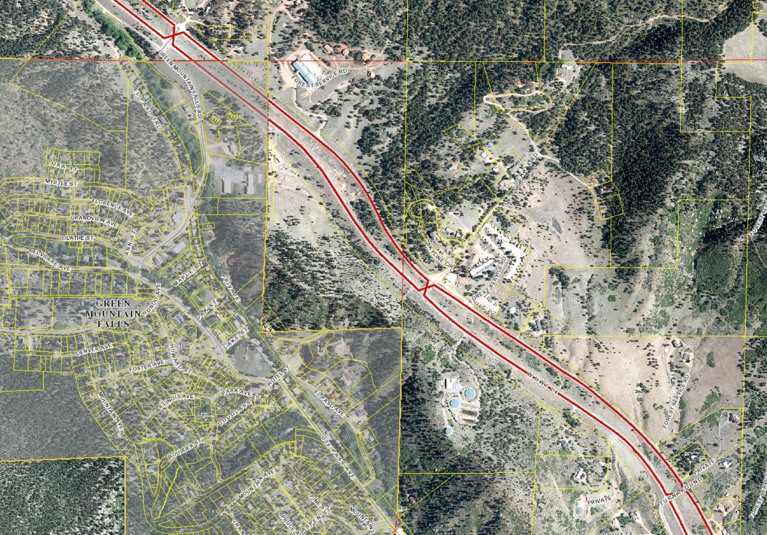
Surrounding Development
Pearson Ministry Church
Colorado Horse Hay

Slide 12
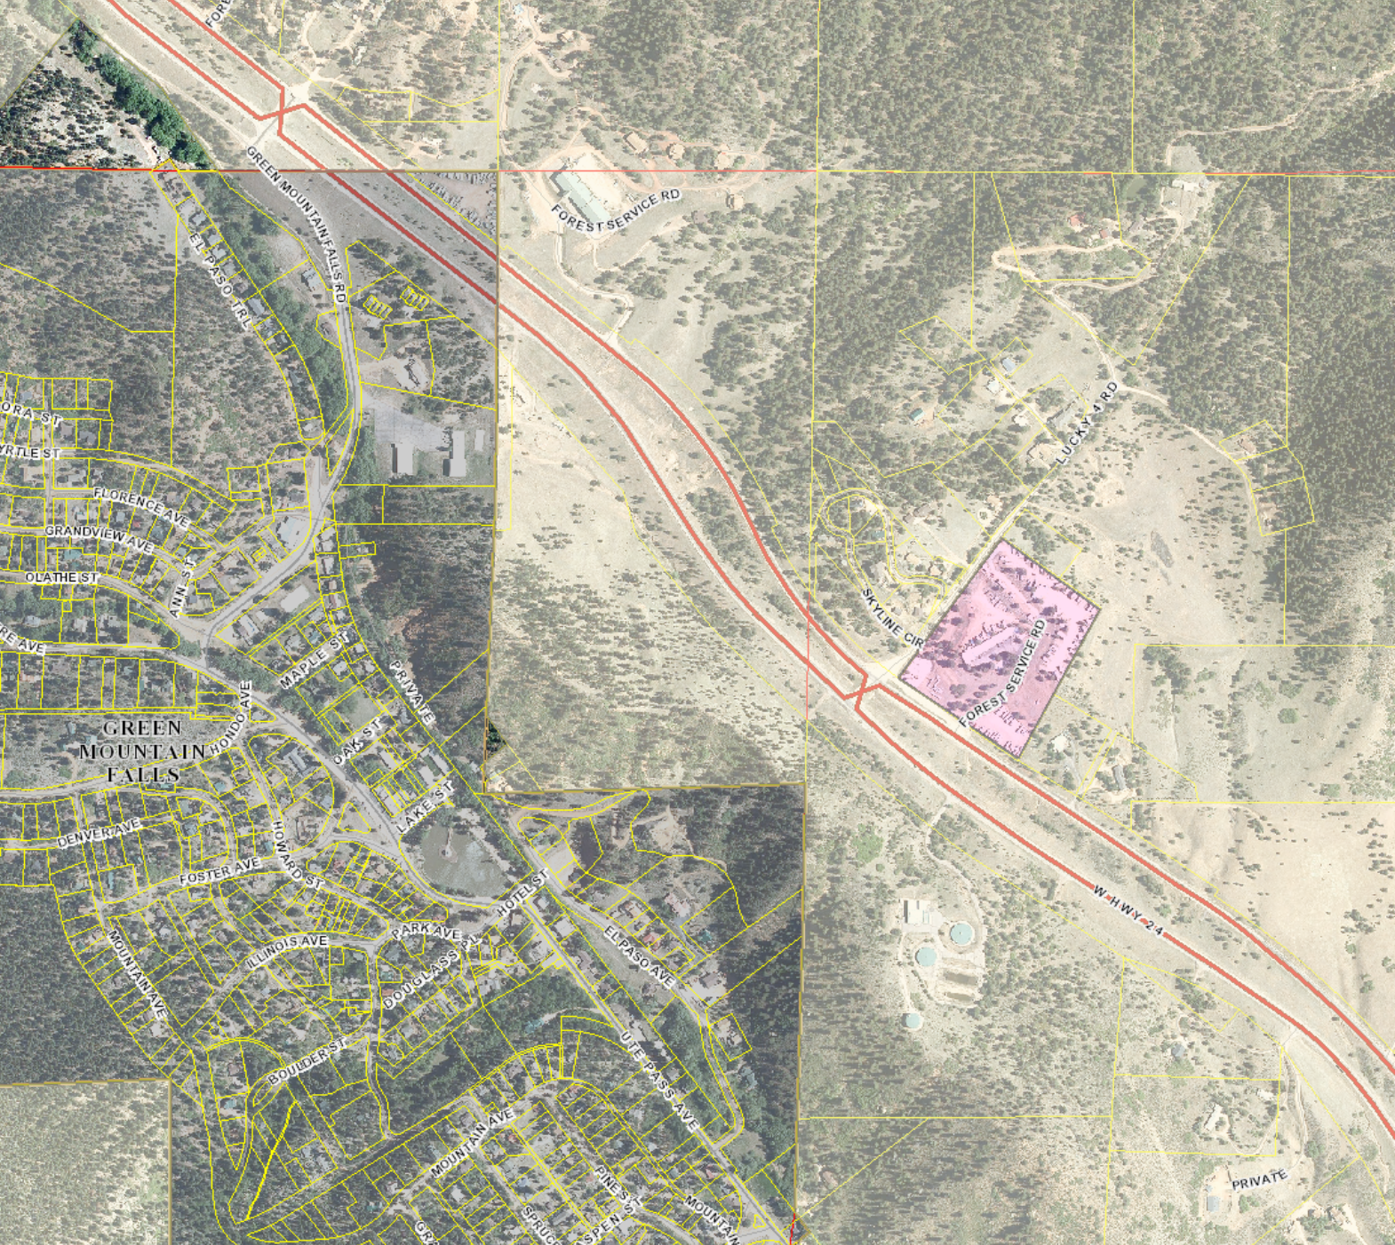
Zoning
R-T
C-2

Slide 13
Transportation
Access from Hwy 24 (CDOT access)
Access permit required prior to site development plan
A traffic study was not required as the proposed variance of use is not expected to generate 100 daily vehicle trips more than the property would be expected to generate currently.
Applicability of the El Paso County Road Impact fee will be determined at the site development plan stage.

Slide 14
Notification
December 22, 2020
9 noticed

Slide 15
Notable Conditions
Within 180 days of variance of use approval, the applicant shall apply for and receive approval of a site development plan. The deadline for receipt of approval of the site development plan may be extended by the PCD Director, at his or her discretion, if the Director finds that the applicant has made a good faith effort to secure such approval.
Prior to site development plan approval, the applicant shall provide the Planning and Community Development Department with evidence that an access permit from the Colorado Department of Transportation (CDOT) has been obtained for the existing access.
No vehicular traffic and/or parking or storage of construction equipment, materials, or supplies shall occur over the existing onsite wastewater treatment system components.

Slide 16
Questions?
Pearson Ministry Church
Colorado Horse Hay

Slide 17
Recreational Vehicle Park

Slide 18
Recreation Camp

Slide 19
1960

Slide 20
1969

Slide 21
1983

Slide 22
1999

Slide 23
2007

Slide 24
2009

Slide 25
2011

Slide 26
2014

Slide 27
2016

Slide 28
2018

