Slide 1
Planning and Community Development Department 2020 Summary of Activity
February 9, 2021
Craig Dossey – Executive Director

Slide 2
Overview
COVID Challenges and Response
Annual Statistics
Master Plan
Water Master Plan Award
Land Development Code (LDC) Amendment
Code Enforcement Abatement Projects
Efforts Moving Forward - 2021 and Beyond
Planning and Community Development 2020 Summary of Activity

Slide 3
COVID Challenges and Response
Sent all staff home on March 16, 2020 to work remotely
Monitors, laptops/tablets, and cell phones deployed (most staff already equipped due to EDARP)
Code Enforcement and Inspections staff home-based (reporting electronically from the field via EDARP – “completed” Feb. 2020!!!)
Inspections continued as a critical function of economic development as a State authorized exemption
All public hearings continued (BOCC, PC, and BOA)
PCD DID NOT STOP WORKING! – all staff continued to work, review applications electronically, and issue permits and approvals (except a short-term shutdown of Code Enforcement field activities pursuant to State Order)
Planning and Community Development 2020 Summary of Activity

Slide 4
Annual Statistics
Major Development Applications 2000 - 2020
(Zoning Actions, Subdivision Actions, Major Commercial Site Plans, etc.)
+45
Average of 22.1 projects per reviewer in 2007 (18 reviewers)
Average of 36.3 projects per reviewer in 2018 (9.5 reviewers)
Average of 42.8 projects per reviewer in 2019 (9.5 reviewers)
Average of 45.7 projects per reviewer in 2020 (10.5 reviewers)
Planning and Community Development 2020 Summary of Activity

Slide 5
Annual Stats - Average Per Month
Major Development Applications 2000 - 2021
(Zoning Actions, Subdivision Actions, Major Commercial Site Plans, etc.)
+23
NOTE:
No month in 2020 was less than the 21 year average, even during a pandemic
If you take out 2020, the difference would be even greater
+20
+14
+16
+16
+13
+9
+12
+1
+8
+1
+7
COVID Onset Months
Planning and Community Development 2020 Summary of Activity

Slide 6
Annual Statistics
Minor Development Applications
Single family residences, driveway permits, minor commercial site plans, etc.
Processed 5,866 minor development applications (Type A and B) compared to 6,065 in 2019 (3% decrease) and 5,825 in 2018
Collected revenue of $645,579 (Type A and B) in 2020 compared to $660,588 in 2019 (2% decrease) and $656,316 in 2018
Planning and Community Development 2020 Summary of Activity

Slide 7
Annual Statistics
Single Family Residences by Jurisdiction
Regional Totals
2014 – 2,518 sfr
2015 – 2,881 sfr (+14%)
2016 – 3,538 sfr (+22%)
2017 – 3,771 sfr (+7%)
2018 – 4,029 sfr (+7%)
2019 – 3,953 sfr (-2%)
2020 – 5,036 sfr (+27%)
Planning and Community Development 2020 Summary of Activity

Slide 8
Inspections Activity
Annual Statistics
Development-related inspections
Public improvement inspections – 1,814 inspections
Driveway inspections – 1,859 (compared to 1,724 in 2019)
Sidewalk inspections – 2,333 (compared to 1,878 in 2019)
Public improvement acceptances
9 final acceptances of developer-constructed public improvements
19 preliminary acceptances of developer-constructed public improvements
Additional 25.1 lane miles accepted for ongoing County maintenance compared to 7.42 lane miles in 2019
68 active projects
Financial assurance
Accepted in 2020: $46,652,879 (2019: $18,227,415 and $27,692,198 in 2018)
Released in 2020: $39,623,540 (2019: $5,472,716 and $20,978,363 in 2018)
A total of 59 releases of financial assurance processed in 2020 (27 in 2019)
Planning and Community Development 2020 Summary of Activity

Slide 9
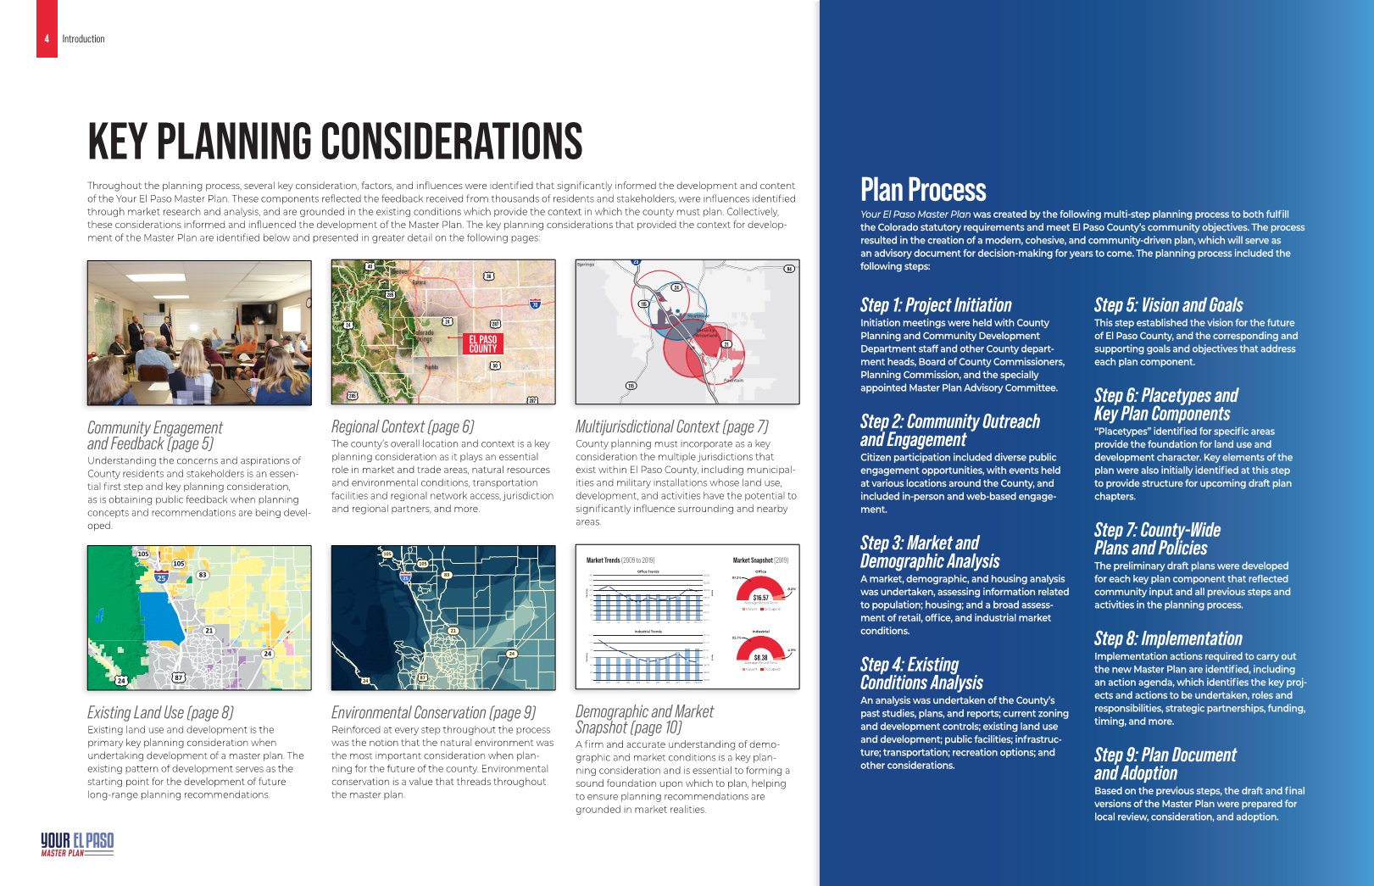
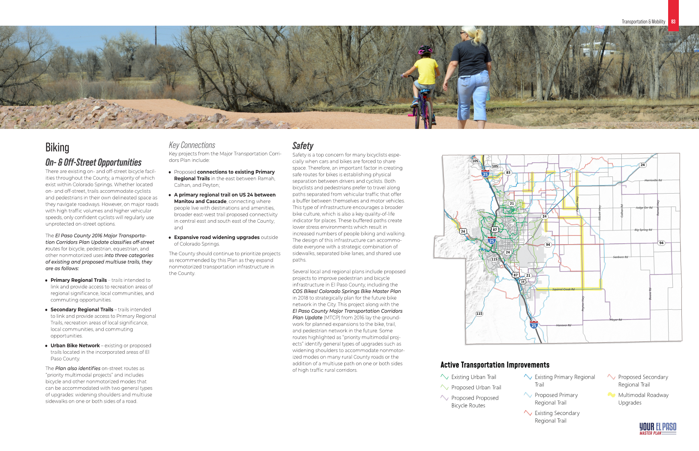
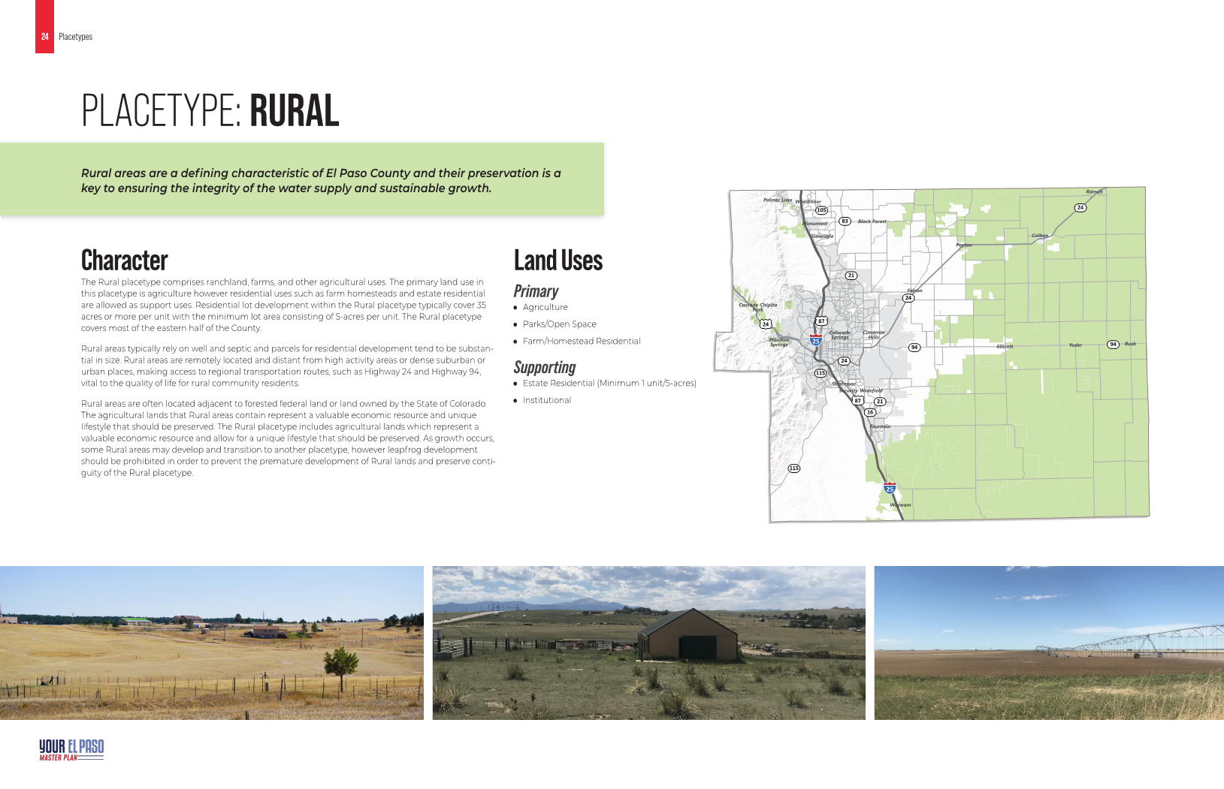
El Paso County Master Plan
Highlights of the Draft Plan
List of Chapters
Introduction
Community Vision
Land Use
Housing & Communities
Economic Development
Transportation & Mobility
Community Facilities
Infrastructure
Military
Recreation and Tourism
Community Health
Environment
Resiliency & Hazard Mitigation
Implementation
Planning and Community Development 2020 Summary of Activity

Slide 10
El Paso County Master Plan
Highlights of the Draft Plan
Chapter 3 - Land Use
Key Areas
“Identifies those areas of the County that are defined by unique localized characteristics having influence on land use and development.”
Areas of Change
“Identifies areas of the County that are anticipated to remain the same, undergo minor changes, or develop in a manner different than they exist today.”
Place Types
“Identifies the different development and land use characteristics for areas of the County that make up the various place types, which serve as the base for long-range planning”
Planning and Community Development 2020 Summary of Activity

Slide 11
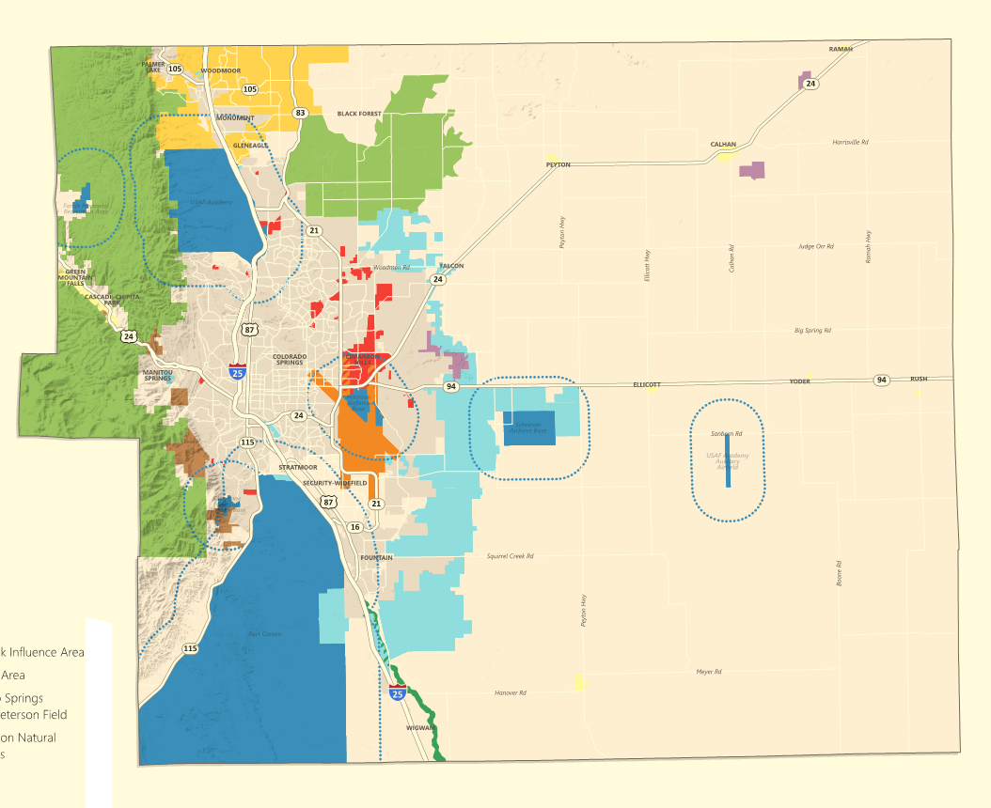
El Paso County Master Plan
Key Areas
Military Installations & 2-Mile Notification Zones
Potential Areas for Annexation
Enclaves or Near Enclaves
Small Towns & Rural Communities
Fountain Creek Watershed Flood Control & Greenway District
Forest Areas
Pikes Peak Influence Area
Tri-Lakes Area
Colorado Springs Airport/Peterson Field
Uncommon Natural Resources
Planning and Community Development 2020 Summary of Activity

Slide 12
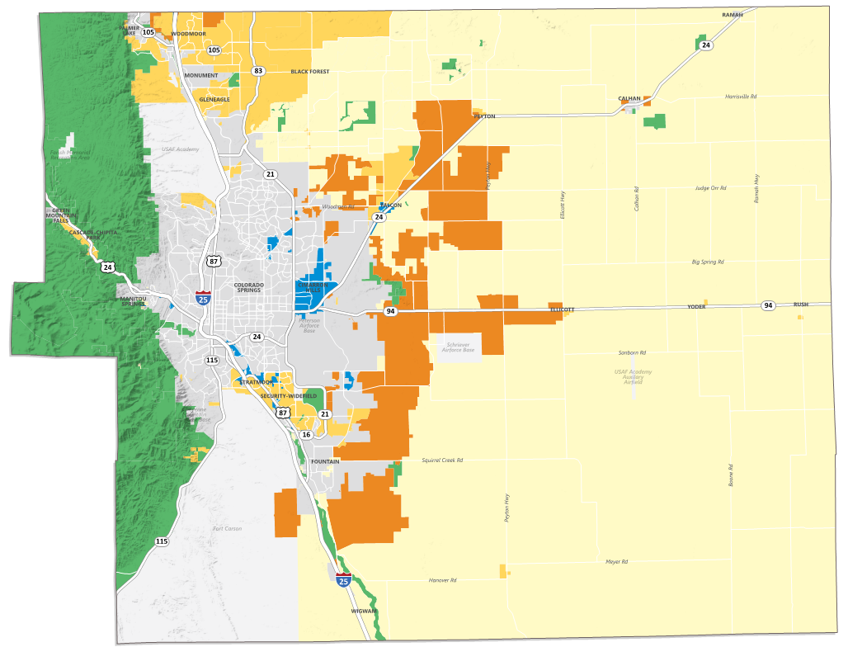
El Paso County Master Plan
Areas of Change
Protected/Conversation Areas
Minimal Change: Undeveloped
Minimal Change: Developed
New Development
Transition
Planning and Community Development 2020 Summary of Activity

Slide 13
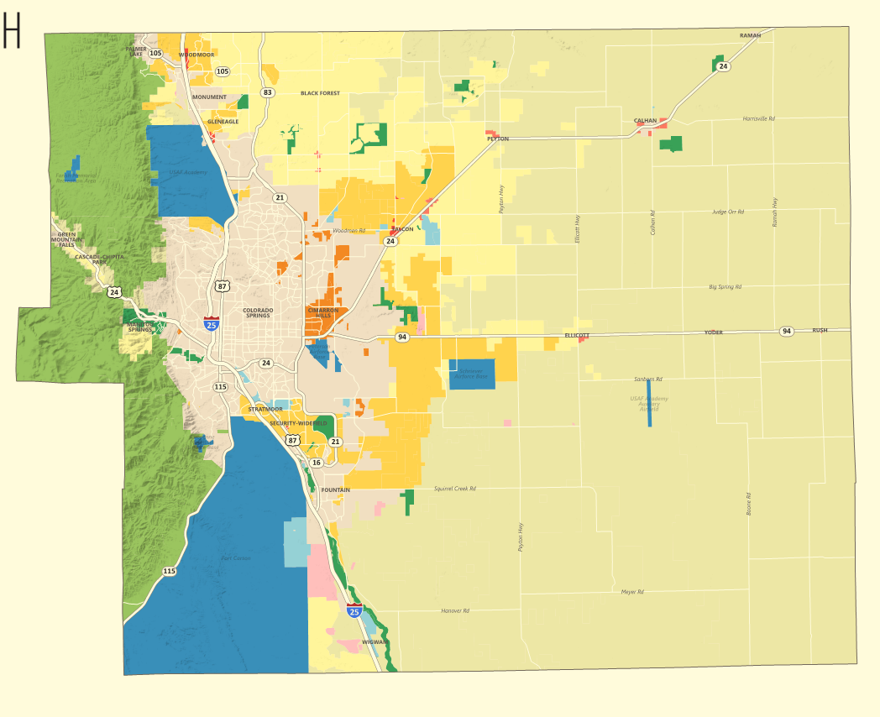
El Paso County Master Plan
Place Types
Rural
Large-Lot Residential
Suburban Residential
Urban Residential
Rural Center
Regional Center
Employment Center
Regional Open Space
Mountain Interface
Military
Utility
Incorporated Area
Planning and Community Development 2020 Summary of Activity

Slide 14
El Paso County Master Plan
2021 Anticipated Schedule
Draft of Master Plan (minus the Implementation chapter) to go to the Advisory Committee this week; to review through February and revised thereafter
EPC Community Engage video “Understanding the County Master Plan” to be released near the end of February (more on EPC Engage coming up!)
Public release of the draft plan scheduled for March
Revisions following public comment period during April
Potential hearings (2) for adoption by Planning Commission May and/or June
Planning and Community Development 2020 Summary of Activity

Slide 15
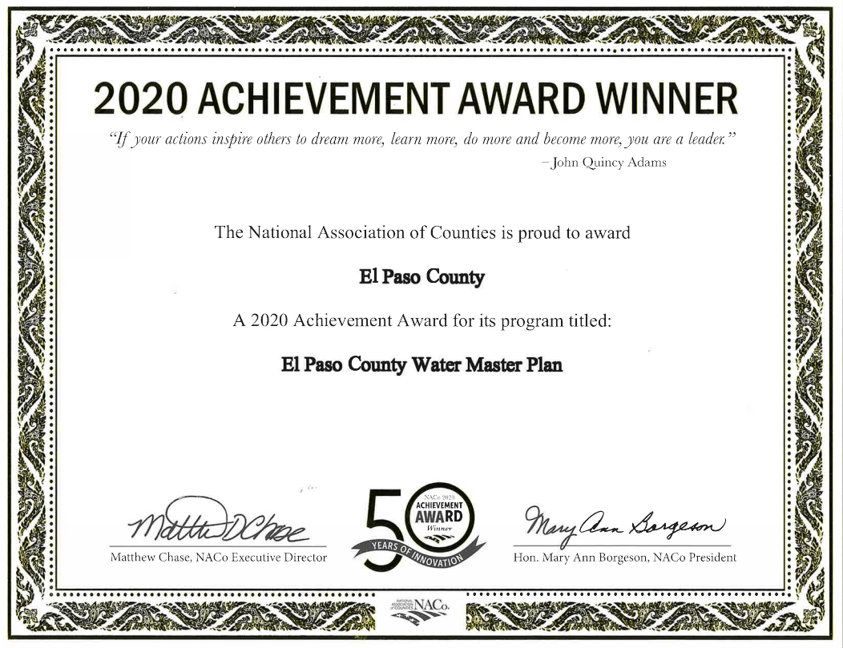
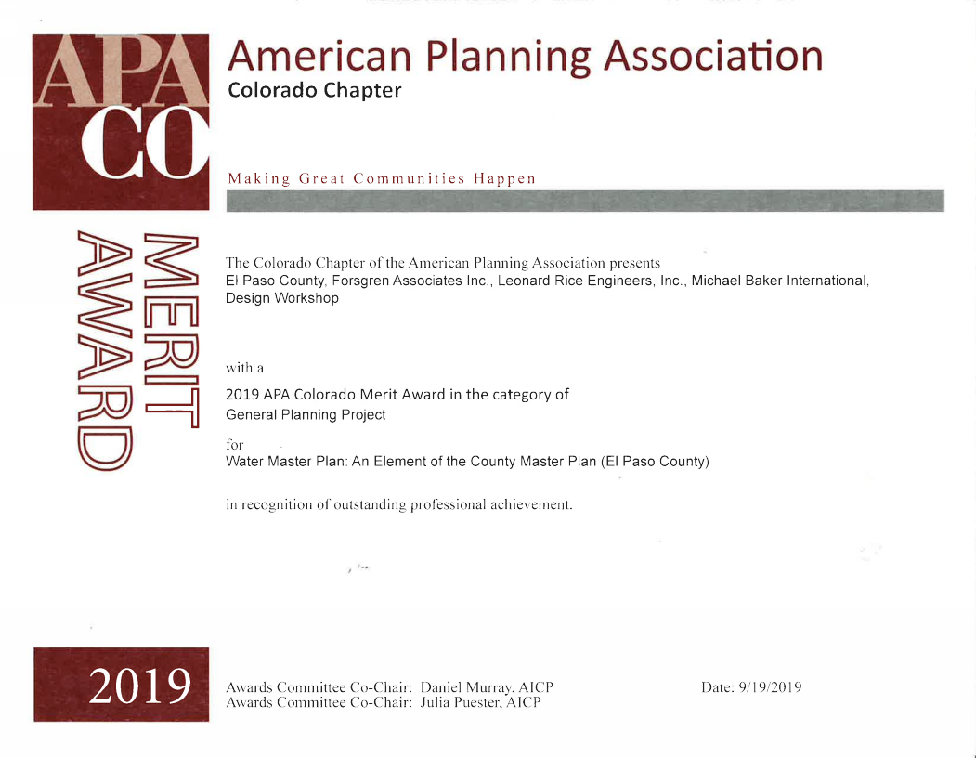
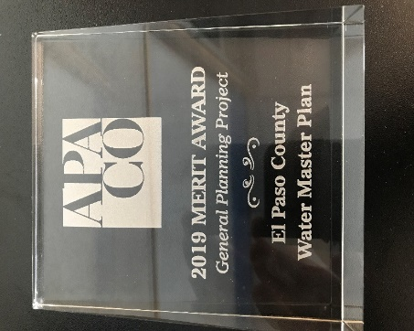
El Paso County Water Master Plan
In 2020, El Paso County received a National Association of Counties Achievement (NACo) Award for the El Paso County Water Master Plan
Previously won a 2019 Merit Award from the Colorado Chapter of the American Planning Association for the El Paso County Water Master Plan.
The awards represented the first awards received by the Department for a County planning project in over 30 years.
Planning and Community Development 2020 Summary of Activity

Slide 16
Land Development Code (LDC)
County Strategic Plan goal:
“Continue to evaluate and modify the existing regulatory framework and procedures for development in an effort to avoid over-regulation to further promote and enhance a business-friendly environment.”
Amendment to LDC to pertaining to Fire Professional reviews of applications:
Processed in 2020, adopted beginning of 2021
Removed “Fire Marshall” and replaced with “Fire Authority”
The addition of the term “Third Party Fire Reviewer”
Revise all occurrences where the authority currently lies with the “Fire Marshall” to instead place such authority with the Board of County Commissioners or PCD Director, where applicable
Specifically seek recommendations from Fire Authority regarding compliance and/or alternatives
Require the report to include an analysis of compliance with applicable Fire Code
Full Land Development Code republished by Municode after a whole suite of amendments in 2019 and available at:
https://library.municode.com/co/el_paso_county/codes/land_development_code
Planning and Community Development 2020 Summary of Activity

Slide 17
Code Enforcement 2020 Summary
Total number of cases: 980
Unfounded/not a violation: 235 (leaving 745 for enforcement)
Top five (3) complaints:
Accumulation of rubbish
Weeds and brush
Inoperable vehicles
Notices of Violation issued: 696
Executive Determinations issued: 113
Requests for an appeal received: 1, which is less than 1% (0.8%)
Cases pending litigation: 98
Cases in litigation: 14
A huge “Thanks!” to Diana May and her incredible staff
Planning and Community Development 2020 Summary of Activity

Slide 18
2020 Summary - Abatements
Properties cleaned up: 8
Costs: $76,507
$33,411 (43%) recovered through payment plans and paid liens
Two active payment plans
Two cleanups paid back in full
Three liens pending
Approximately 400,000 pounds of rubbish and weeds removed
Planning and Community Development 2020 Summary of Activity

Slide 19
Code Enforcement Abatement Projects
2020
Planning and Community Development 2020 Summary of Activity

Slide 20
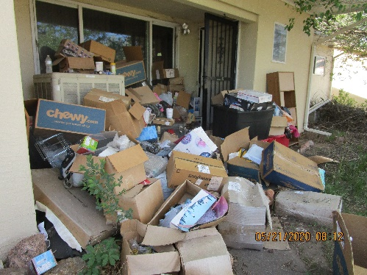
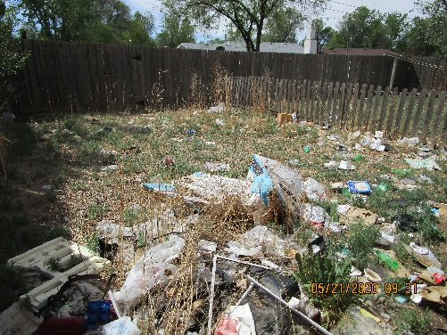
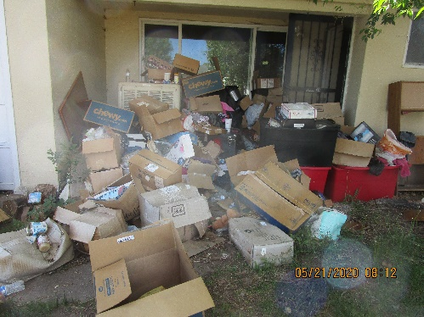
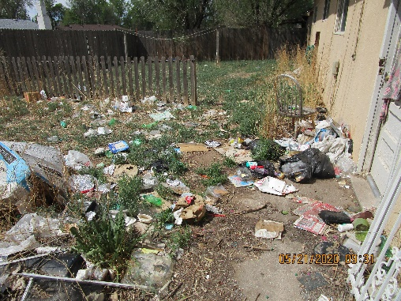
Before
Location: Security Costs: $1,050

Slide 21
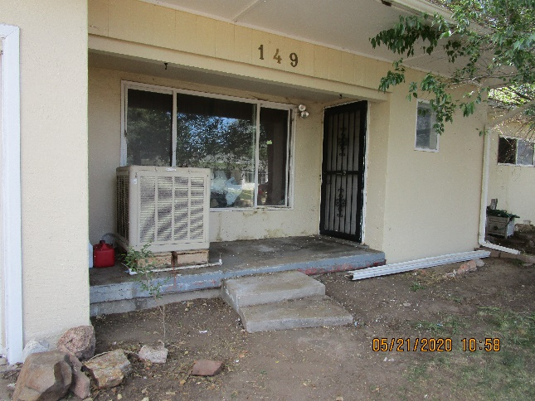
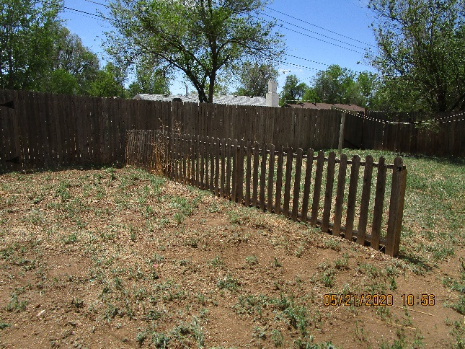
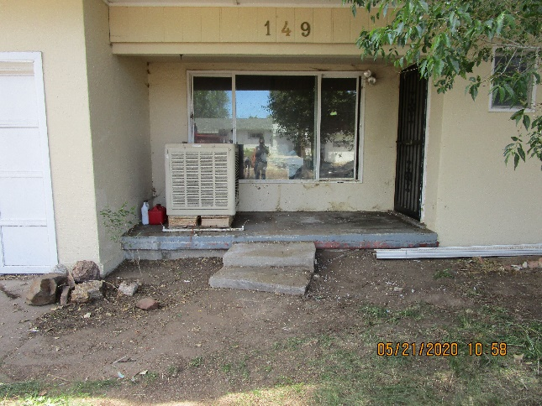
After
Location: Security Costs: $1,050

Slide 22
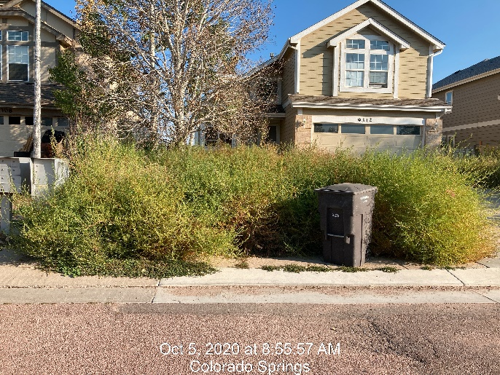
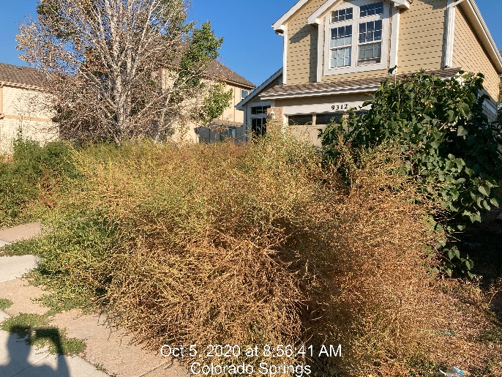
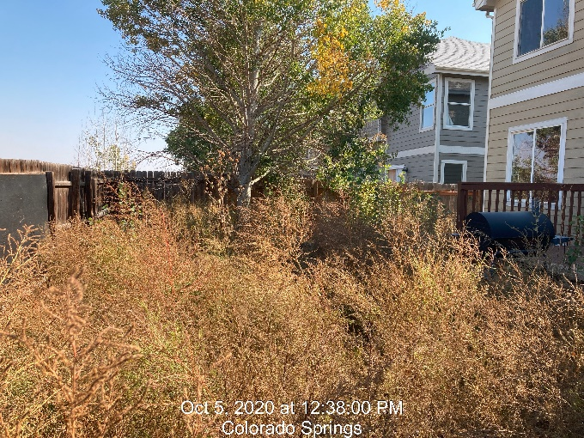
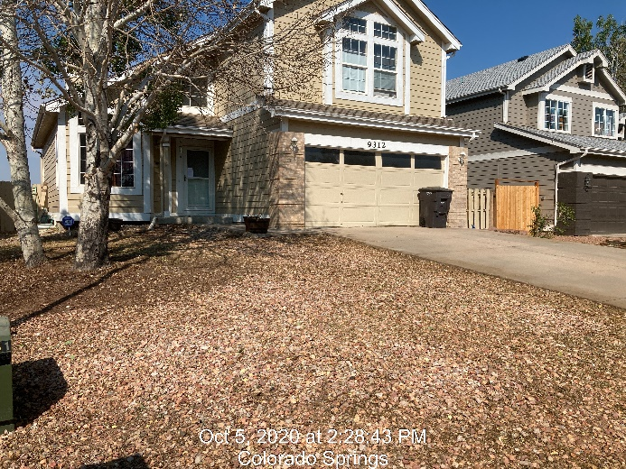
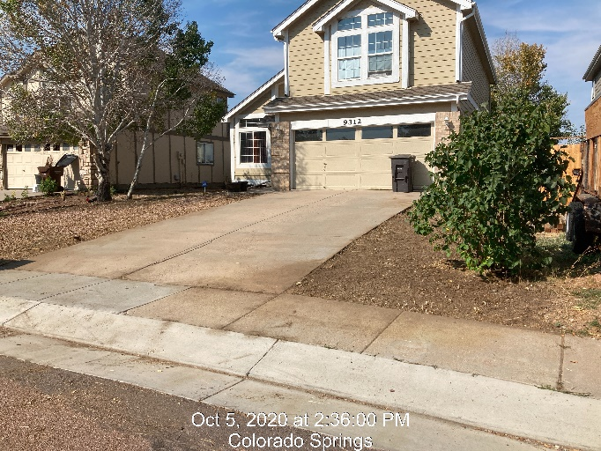
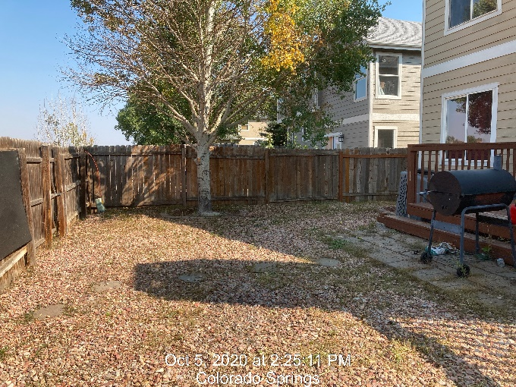
Before
Location: Colorado Centre
Cost: $1,430
After

Slide 23
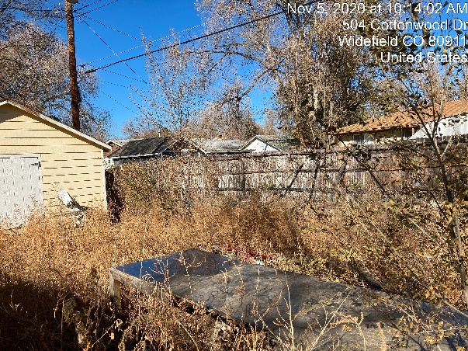
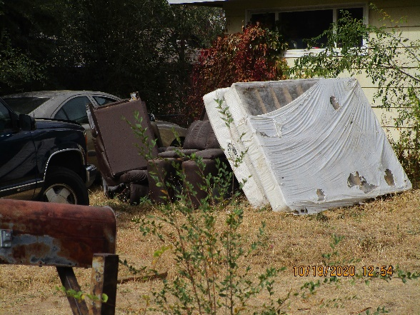
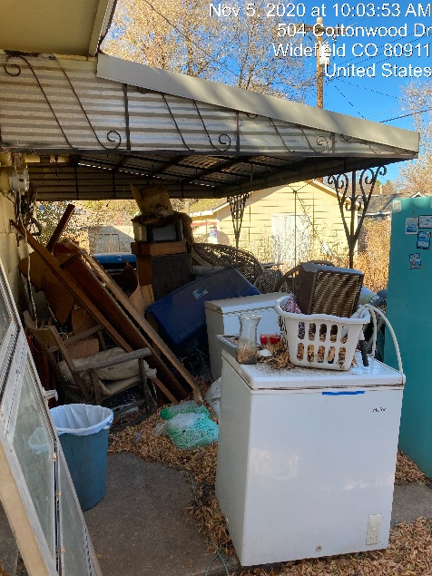
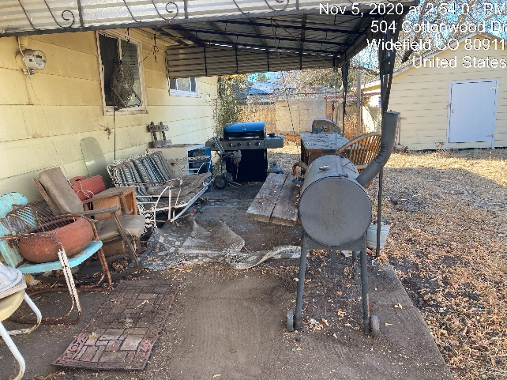
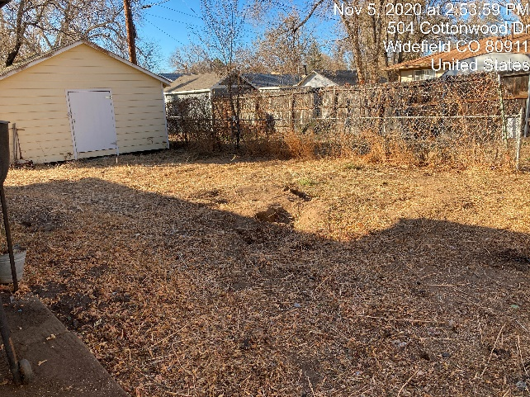
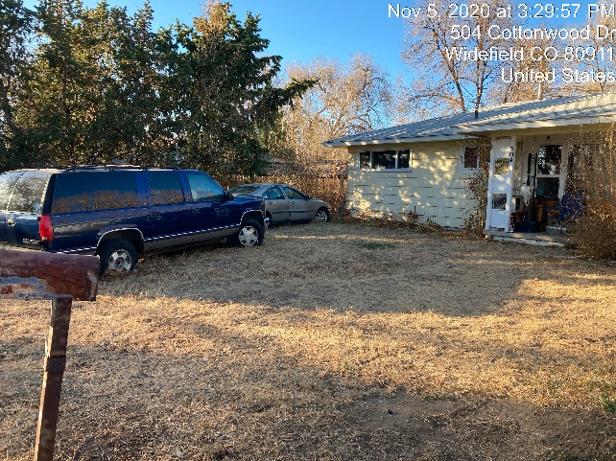
Before
Location: Security Cost: $2,265
After

Slide 24
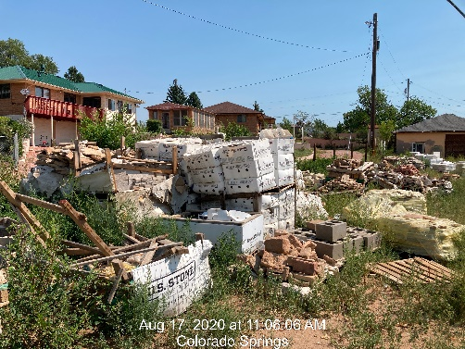
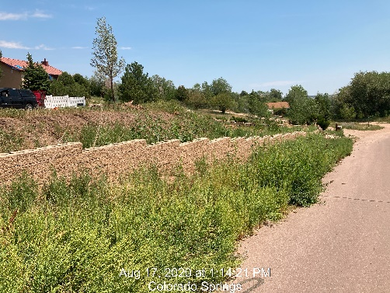
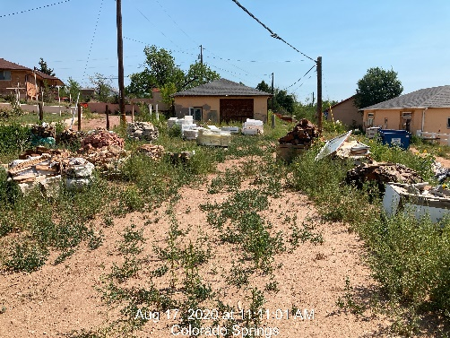
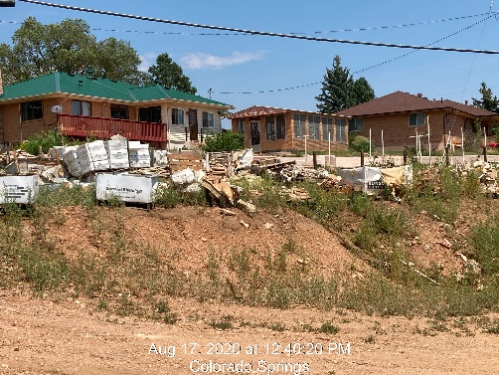
Before
Location: Stratmoor
Hills
Costs: $7,090

Slide 25
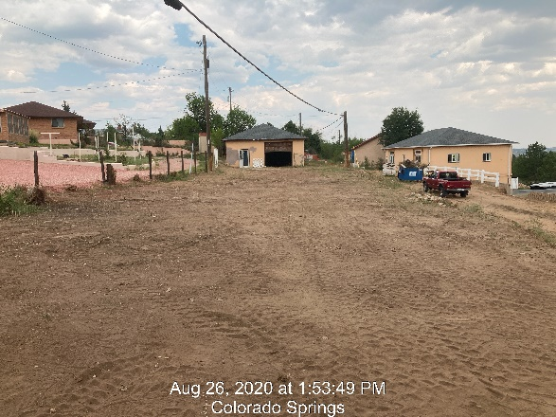
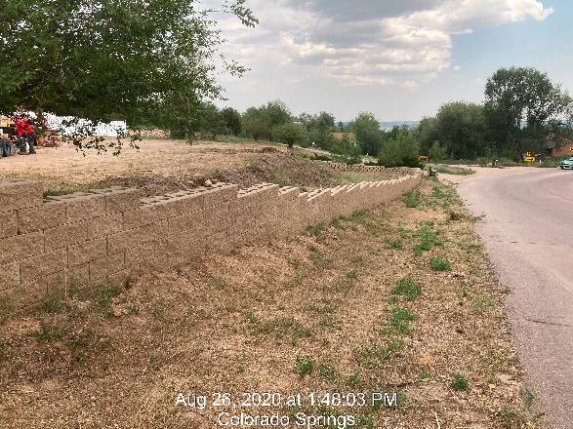
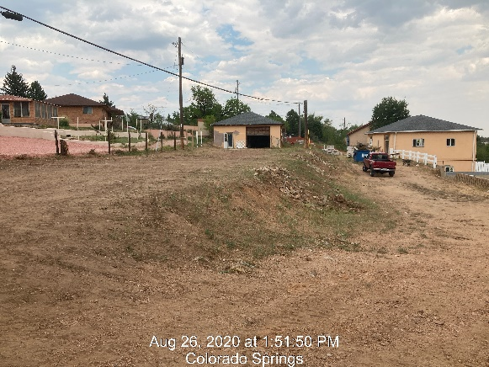
After
Location: Stratmoor
Hills
Costs: $7,090

Slide 26
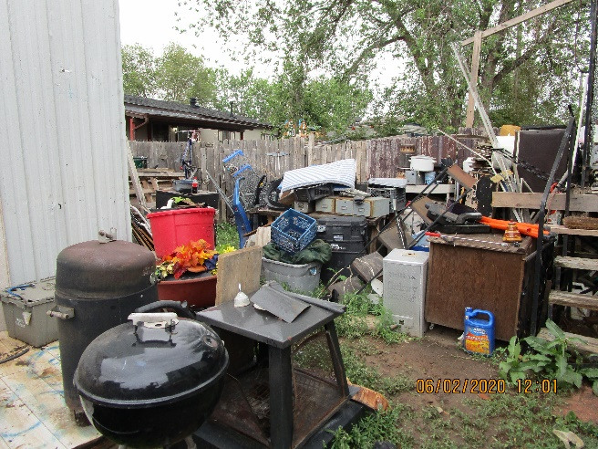
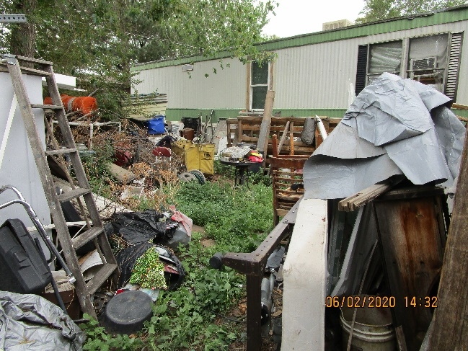
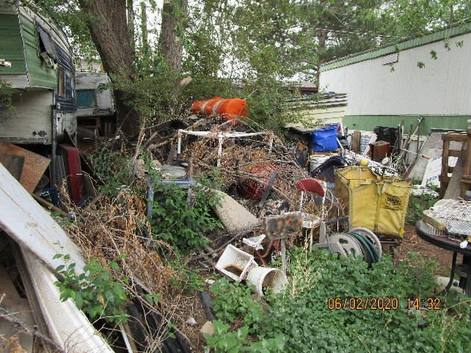
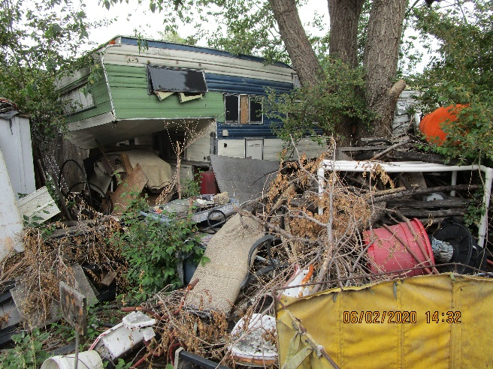
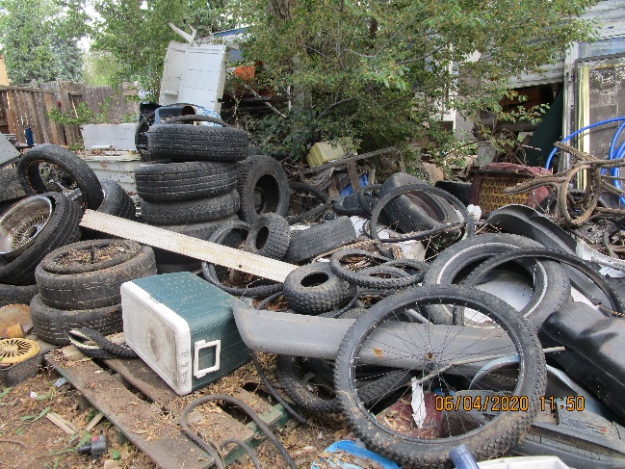
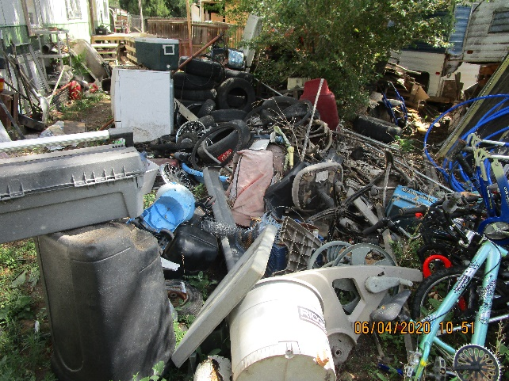
Before
Location: Stratmoor Valley
Cost: $8,140

Slide 27
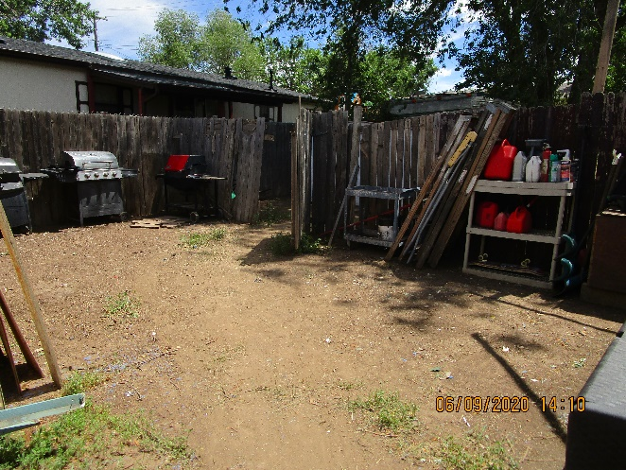
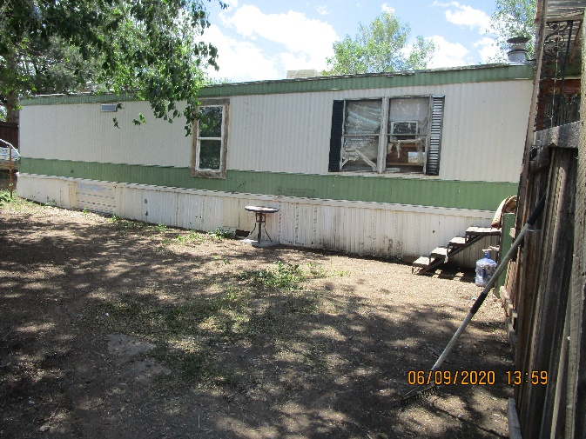
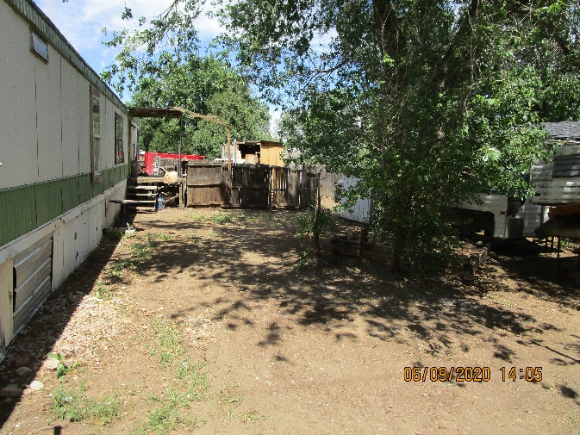
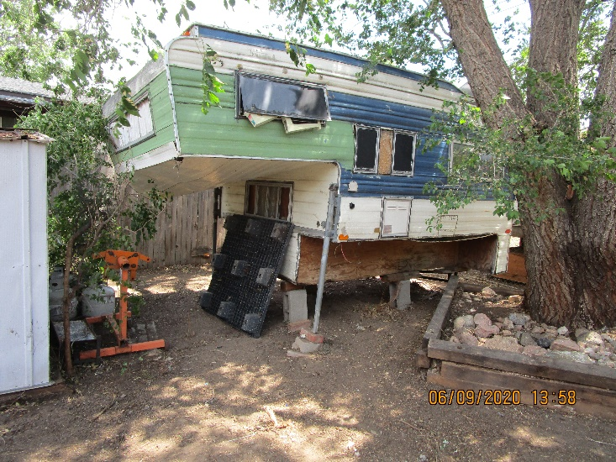
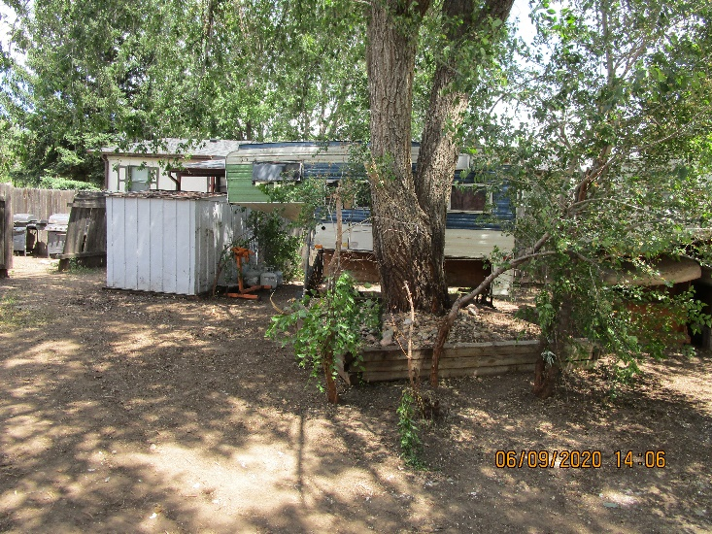
After
Location: Stratmoor
Valley
Cost: $8,140

Slide 28
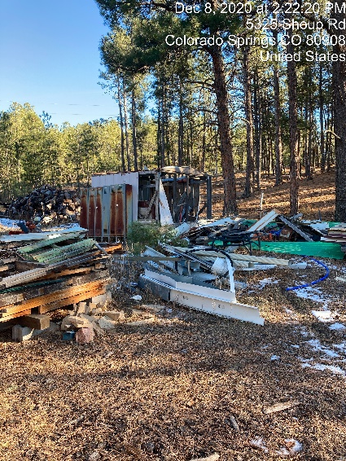
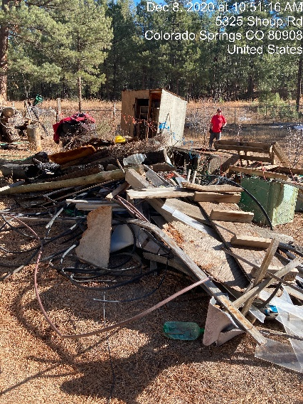
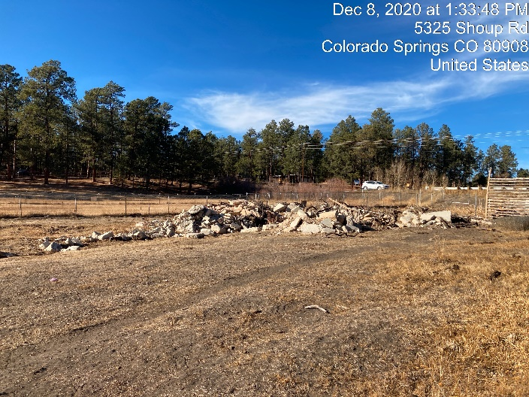
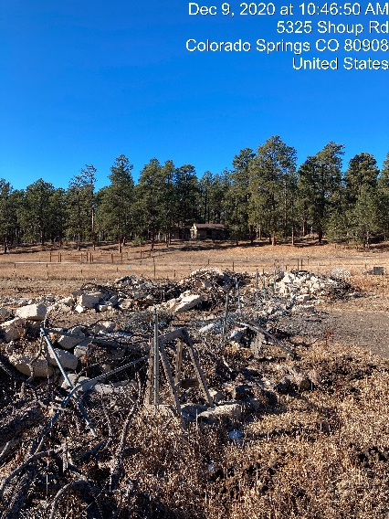
Before
Location: Black Forest
Costs: $25,307

Slide 29
After
Location: Black Forest
Costs: $25,307

Slide 30
Before
Location: Cimarron Hills Costs: $12,445

Slide 31
After
Location: Cimarron Hills
Costs: $12,445

Slide 32
Before
Location: Calhan
Costs: $18,780

Slide 33
After
Location: Calhan
Costs: $18,780

Slide 34
Efforts Moving Forward - 2021 and Beyond
https://planningdevelopment.elpasoco.com/#1608243533403-e7959998-0021
Planning and Community Development 2020 Summary of Activity

Slide 35
Efforts Moving Forward - 2021 and Beyond EPC Engage
A two (2) track concept:
EPC Engage (technical) – targeted industry audience
Understanding the Engineering Criteria Manual (ECM)
The Ins and Outs of Permits and Inspections
Understanding the Water Supply Review Process
EPC Community Engage (general) – public audience
Understanding the County Master Plan
Understanding Code Enforcement (invite HOAs, etc.)
Collaborative effort with Public Works, County Attorney’s Office, PIO and others as appropriate
Planning and Community Development 2020 Summary of Activity

Slide 36
Efforts Moving Forward - 2021 and Beyond
Finalizing and Adopting the new County Master Plan
Updating the Fee Schedule/Cost of Service
Currently based on 2010 recession relief fees
Recalibrating staff time per task per EDARP
Incorporating an increased personnel budget
Incorporating changes to other overhead costs (EDARP, etc.)
The key to ensuring the success of our department is continuing to support and empower our staff to make the difference!
Planning and Community Development 2020 Summary of Activity

Slide 37
Additional Director Comments Special Employee Recognition
Planning and Community Development 2020 Summary of Activity

Slide 38
Jeff Rice Planning and Community Development Department 2020 Employee of the Year
Planning and Community Development 2020 Summary of Activity

Slide 39
Jeff Rice: The “Quiet Leader”
Our senior most engineer
Assigned to the most challenging development projects (SDS, Lorson, Sterling)
Certified Floodplain manager
Member of CASFM-Colorado Association of Stormwater and Floodplain Managers
Member of ASFPM-Association of State Floodplain Management
14+ years with El Paso County – DPW and PCD
Experience working on the private side of land development “in a former life”
Represents the County:
Technical Advisory Committee (TAC) of the Fountain Creek Watershed, Flood Control, and Greenway District
PPACG Joint Land Use Committee implementation subcommittees specific to stormwater, drainage, and transportation
Floodplain mapping updates with CWCB-Colorado Water Conservation Board
Planning and Community Development 2020 Summary of Activity

Slide 40
Jeff Rice: The “Technical Expert”
Collaboration with the Department of Public Works
(Old) Meridian and McLaughlin round-a-bout
Assists on all DBPS updates (Sand Creek and Jimmy Camp Creek, for now)
PCD representative on the Briargate and Stapleton Corridor Study
Coordinates on referrals from the various municipalities
Supports the CRS (Community Rating System—flood plain insurance rating for EPC)
All multijurisdictional coordination of criteria and projects
Dam safety rules update, monitors the changes and coordinate with DPW
MHDF (mile high flood control district) Vol. 3 updates (this is Denver’s SW criteria)
Meridian Road signal design and construction
Floodplain study scope update, GIS
Planning and Community Development 2020 Summary of Activity

Slide 41
Jeff Rice: The “Collaborator”
Phil Stuepfert, HR Green (consultant) says: “We are working with Jeff on our 3,200 unit development and he has been very easy to work with, very stead and solid while dealing with some complex and demanding issues. Jeff is a pleasure to work and deserves this award.”
Jeff Mark, Landhuis Company (developer of Lorson Ranch and other projects) says: “Jeff has an extreme attention to detail and is thorough.”
Doug Stimple, Classic Homes (developer of Flying Horse North, Forest Lakes and many other projets) says: “Jeff is always willing to attempt to work towards finding a path forward when issues arise that require professional discretion and discernment. In land development, such issues are inevitable and Jeff is always accessible and willing to look at solutions that achieve the necessary outcomes for the County and the applicant.”
Planning and Community Development 2020 Summary of Activity

Slide 42
Jeff Rice: The “Teammate”
Comments from County Staff
Planning and Community Development 2020 Summary of Activity

