Slide 1
Rocky Top RV Park & Campground

Slide 2
Use Variance Criteria for Approval

Slide 3
I. The proposed use is compatible with the surrounding area and harmonious with the character of the neighborhood. Not detrimental to: - the surrounding area - the future development of the area - the health, safety, or welfare of the inhabitants

Slide 4
Security & Cleanliness
Mr. Nieman and full-time caretaker living on-site ensure:
Facilities and grounds are kept clean and in good repair.
Grounds are monitored on a regular basis to ensure safety and security.
Campground rules are followed.

Slide 5
Campground Rules
Noise curfew
Generators are not allowed at any time.
Campers advised of campground boundaries and are prohibited from entering neighboring properties.
Speed limit of 10 mph for all vehicles on the premises
Laundry room, showers, washing station, a sanitary sewer dump station for RVs, and regular trash pickup
Bear proof trash receptacles

Slide 6
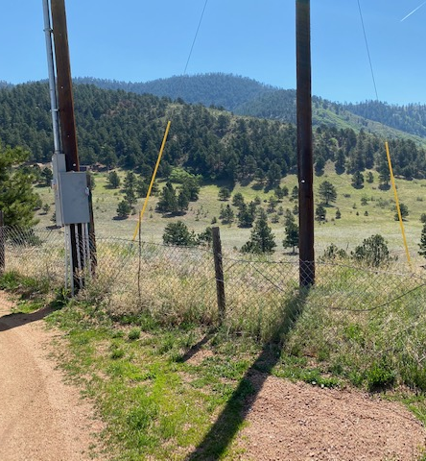
Open Space & Privacy
Western property boundary fenced with a wooden privacy fence provides screening for residences.
Adjoining properties to the north and east are vacant land.
Northern and eastern property boundaries will be screened in next two years with opaque fencing or trees.

Slide 7
II. The proposed use will be able to meet air, water, odor, or noise standards established by County, State, or federal regulations during construction and upon completion of the project.

Slide 8
Site Development Plan & Drainage Report Adjudicated Well Regular Water Quality Testing Onsite wastewater RV dump station Permitted & Inspected OWTS

Slide 9
III. The proposed use will not adversely affect property values in the immediate area.

Slide 10
History
Motel and a storage warehouse built in 1947
RV park/campground built in 1950
Had as many as 72 campsites for trailers and RVs
Property Zoned C-2 in 1972
Mr. Nieman purchased in 2017

Slide 13
Fewer total campsites 60 RV/trailer sites and 8 tent sites
RV park and campground operated in much the same way
Tent sites defined and screened from adjoining properties by 6’ opaque privacy fence.
Signage posted on the fence facing each tent site prohibiting guests from hanging anything on or over the fence.

Slide 14
IV. The proposed use will comply with all regulations of the El Paso County Land Development Code and all County, State and Federal regulations except those portions varied by this action.
V. The proposed use will not adversely affect wildlife or wetlands.

Slide 15
VI. The applicant has addressed all off-site impacts.
RV Storage closed and all RVs removed.
All campground activities will be conducted on-site.
Entry to and exit from Highway 24 and separated a reasonable and safe distance from the Highway by a gravel road.
West property boundary screened by opaque privacy fence.
All lighting will be shielded from neighboring properties and equipped with dusk-to-dawn sensors.

Slide 16
VII. The site plan for the proposed variance of use will provide for adequate parking, traffic circulation, open space, fencing, screening, and landscaping.
VIII. Sewer, water, storm water drainage, fire protection, police protection, and roads will be available and adequate to serve the needs of the proposed variance of use as designed and proposed.

Slide 18
IX. The strict application of any of the provisions of the El Paso County Land Development Code would result in peculiar and exceptional practical difficulties or undue hardship on the owner of the property.

