Slide 1
Proposed Colorado General Assembly Commissioner
Re-Districting Bill
Chuck Broerman
El Paso County Clerk and Record
February 9,2021

Slide 2
Statutory Guidance - Summary
Districts can only be redrawn once every two years
Maintain reasonably equal population
Districts can only be redrawn in odd-numbered years
The submitted proposals are subject to a 30-day public comment period before a vote
All changes must be completed by September 30th

Slide 3
Re-Districting Public process
Public Comment Phase
30 day Public comment period
Held two Town Halls
Published Public Comments
Assembled three maps for considerations of the Board of County Commissioners

Slide 4
Redistricting – Background
Districts were last redrawn in 2017
Continuing growth in the county (> 3.6%), the current deviation has grown significantly since 2017.
District numbers come from population data only – no other data is used to develop the district maps
Notes:
An additional note here – questions have been raised during this process about gerrymandering. Our county has a long history of NOT injecting socioeconomc or racial data into the process of redistricting, and we certainly do not and never intend to use that data as long as we are stewards of the public trust. Our districts are compact rather than spliced for political advantage.

Slide 5
Redistricting Method Recap
Looked at statute for guidance
Incorporated new precinct changes
>2,000 register voters
Outlined internal goals to guide GIS staff
Minimize impact on our citizens
Maintain communities of interest
Follow natural and manmade geographical boundaries

Slide 6
Guidelines
Comply with Colorado Constitution and Revised Statutes
Draw each Commissioner into a district, not draw out declared candidates.
Reasonably maintain equal population while anticipating future growth (1.5 %)
Preserve reasonable definition of communities of interest

Slide 7
Guidelines
Minimize impact on our citizens-minimize disenfranchisement
that can occur when moving a voter from a district that was in the next two years vote in a commissioner district contest to one where they would vote in six years

Slide 8
Communities of Interest
From past efforts, we learned the interested parties define “communities of interest” as:
Existing political boundaries such as municipal, legislative and school district boundaries
Shared natural events, such as fires and floods
Military installations
Rural and urban areas
Improvement and other special districts

Slide 9
Guidelines
Create districts that were geographically identifiable (North, Northeast, Southeast, West and City Central
Appropriately align representation for areas affected by natural disasters (e.g. Waldo Canyon and Black Forest fires)
Maintain the Board’s previously stated desire to increase representation for Eastern El Paso County
Preserve key features for each district

Slide 10
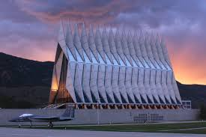
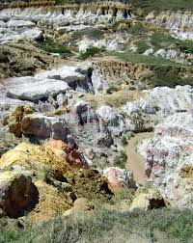
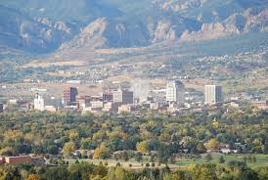
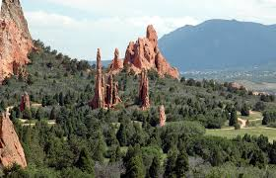
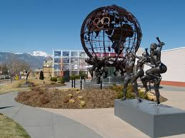
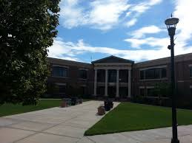
Key District Features
District | Key Features
District 1 | Air Force Academy Black Forest
District 2 | Powers Corridor Eastern Colorado Springs Schriever Air Force Base Peterson Air Force Base
District 3 | Western Colorado Springs Downtown Waldo Canyon area NORAD Manitou
District 4 | Fort Carson Fountain
District 5 | Central Colorado Springs Olympic Training Center
Notes:
Manitou?

Slide 11
Questions
What is the problem this bill is purporting to solve?
Where is there empirical or anecdotal evidence that political gerrymandering is a problem for county commissioners?
Commissioners are best situated and closest to their voting base to understand the unique characteristics for their counties.
Commissioners are voted in by the people to make these types of decisions.

Slide 13
Concerns
Loss of Local Control
Unfunded mandate
Currently a simple process with a small cost impact
Equal Protect issue-?
Singling out a few counties for political reasons
Census data is delayed-July 1st

