Slide 1
El Paso County Variance of Use for G&D Enterprises (Rocky Top Motel & RV Park)
Rocky Top is committed to being a good neighbor. We will operate the business like it has been run since 1950. The only change is the defined tent sites.

Slide 2
We reduced the number of dumpsters from 5 to 3 and made them lockable for bear proofing.

Slide 3
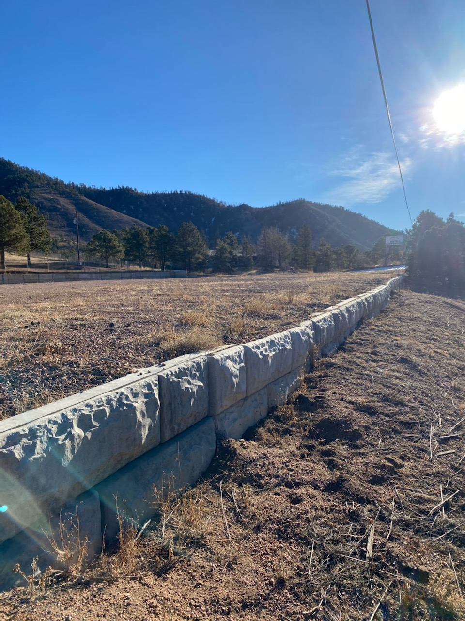
East side RV storage has been vacated.

Slide 4
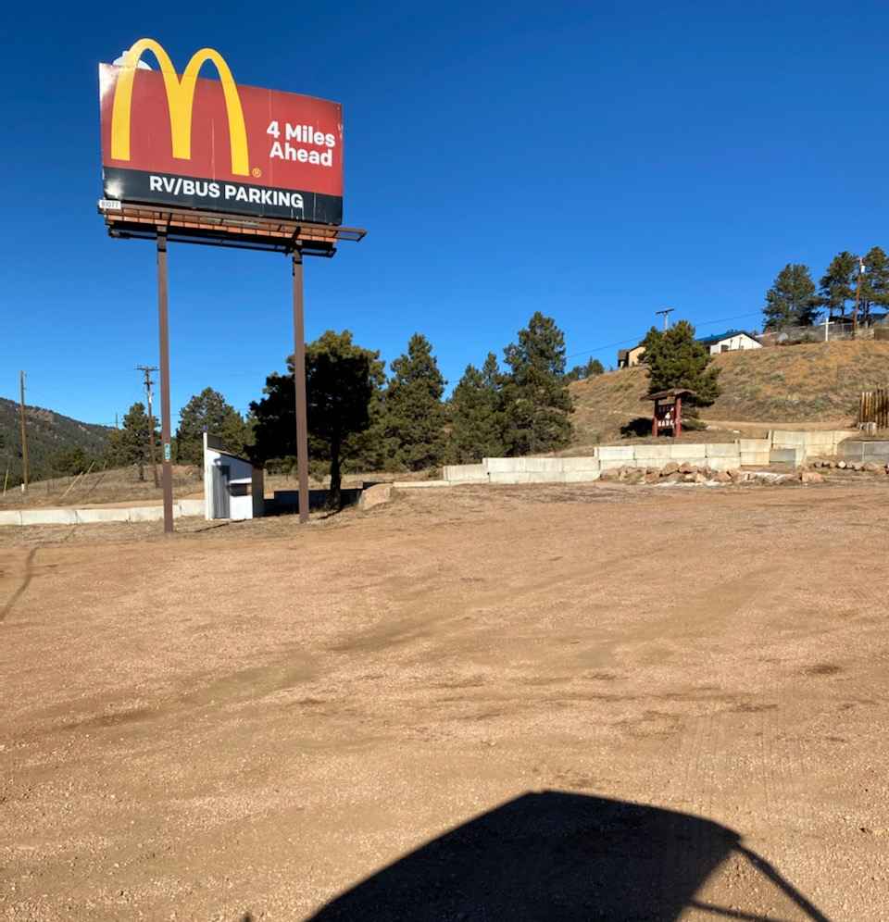
West side RV Storage has been vacated. School bus stop will be dismantled.

Slide 5
New opaque fence started on Northwest corner along Lucky 4 road.

Slide 6
Example of signage used. Similar signs will be added to tent sites to remind guests not to drape towels etc. over the fence.

Slide 7
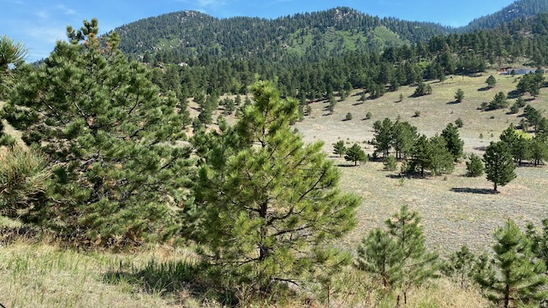

Slide 8
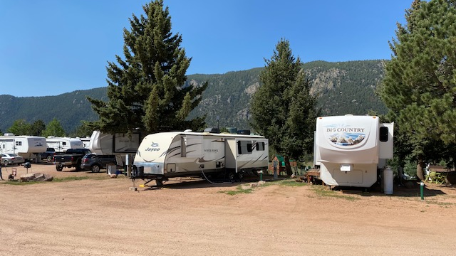

Slide 9
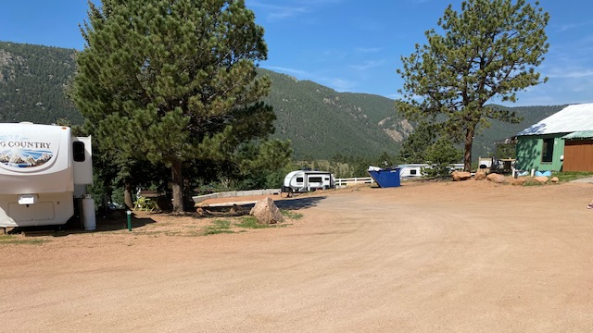

Slide 10
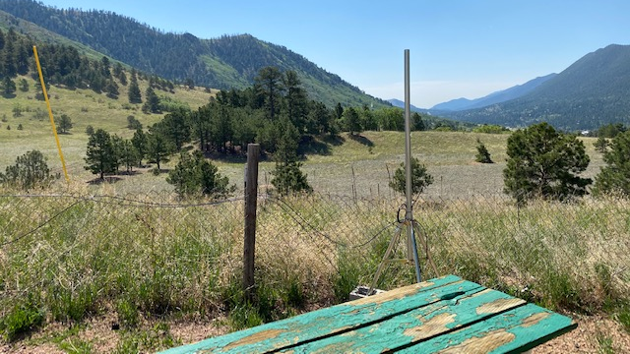

Slide 11
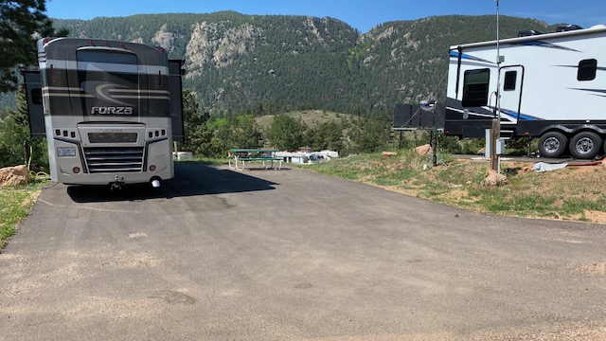

Slide 12
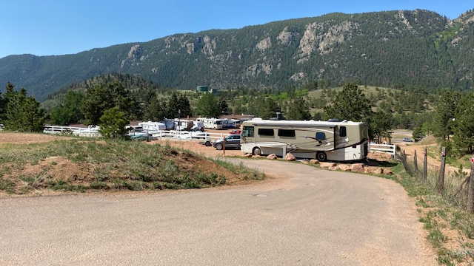

Slide 13
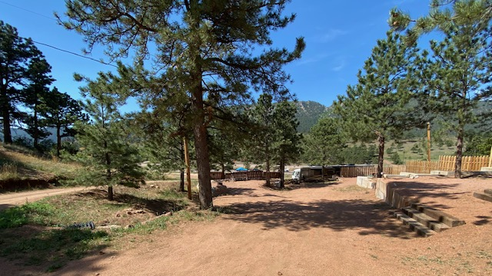

Slide 14
