Slide 1
Chuck Broerman
El Paso County Clerk and Recorder
October 6, 2020

Slide 2
General Election Timeline
Logic & Accuracy Testing on all Election equipment
September 29, 2020
100% accuracy
10,995 ballot combinations tested
Ballots will be sent
October 9, 2020
425,846 ballots
Unaffilated-178,456
Republican-157,634
Democratic-89,756
Canvass date
Week of November 16, 2020, pending Secretary of State
Risk Limiting Audit date
Week of December 14, 2020, pending Secretary of State

Slide 3
Voter Service and Polling Centers
Phase 1 VSPCs open October 12, 2020
Citizens Service Center
Phase 2 VSPC open
Monday-Friday, October 19, 2020, –October 30, 2020, 8:00 a.m. to 5:00 p.m.
Saturday, October 31, 2020, 8:00 a.m. to 5:00 p.m.
Monday, November 2, 2020, 7:00 a.m. to 7:00 p.m. Election Day
Tuesday, November 3, 2020, 7:00 a.m. to 7:00 p.m.
7 additional VSPCs open
North Branch (EPC Clerk’s Office)
Southeast Branch (EPC Clerk’s Office)
Fort Carson (EPC Clerk’s Office)
Centennial Hall
Chapel Hills Mall
Citadel Mall
UCCS

Slide 4
Voter Service and Polling Centers
Phase 3 VSPCs Open- 14 additional locations-last four days of the Election
Friday, October 30, 2020, 8:00 a.m. to 5:00 p.m. Saturday, October 31, 2020, 8:00 a.m. to 5:00 p.m.
Monday, November 2, 2020, 7:00 a.m. to 7:00 p.m.
Election Day, Tuesday, November 3, 2020, 7:00 a.m. to 7:00 p.m.
Phase 4 VSPCs Open- 13 additional locations-last two days of the Election
Monday, November 2, 2020, 7:00 a.m. to 7:00 p.m.
Election Day, Tuesday, November 3, 2020, 7:00 a.m. to 7:00 p.m.

Slide 5
History of Voter Outreach
Voter Service and Polling Centers (VSPC)
2014 – 25 (statutory requirement 23)
2016 – 25 (statutory requirement 23)
2018 – 28 (statutory requirement 25)
2020 – 35 (statutory requirement 32)
152% increase in VSPCs from 2016 General Election

Slide 6
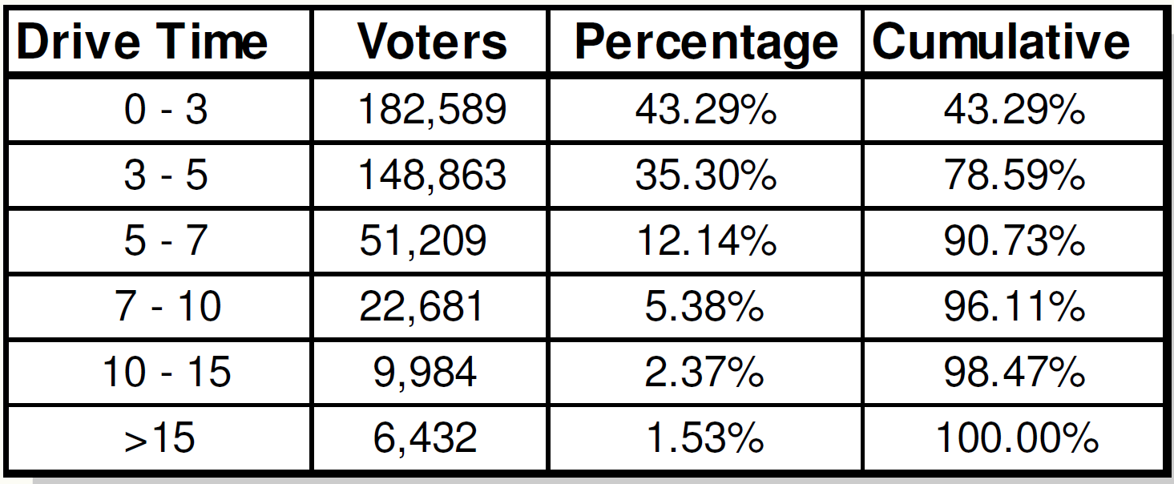
VSPC Approximate Drive Times

Slide 7
VSPC Capacity
Voter Service & Polling Stations Total
316 Intake stations
2018-166
2016-146
216% increase
Print on Demand Printers
2016-24
2018-31
2020-56
208% in equipment capacity
Total Hours of Voting Opportunity
1,487

Slide 8
37 Secure 24-Hour Ballot Drop Boxes Most Recent Boxes Highlighted Below
Broadmoor Towne Center at Southgate
First and Main
Falcon Fire Dept-Station 3 to Station 1
Boot Barn Hall at Bourbon Brothers
Bear Creek Park Community Garden
Colorado Springs Senior Center
Cottonwood Creek Recreational Center
Leon Young Sports Complex
Rocky Mountain Calvary
Vista Grande Baptist Church
Wilson Ranch Pool
Citadel Mall
School District 3 Federal Credit Union

Slide 9
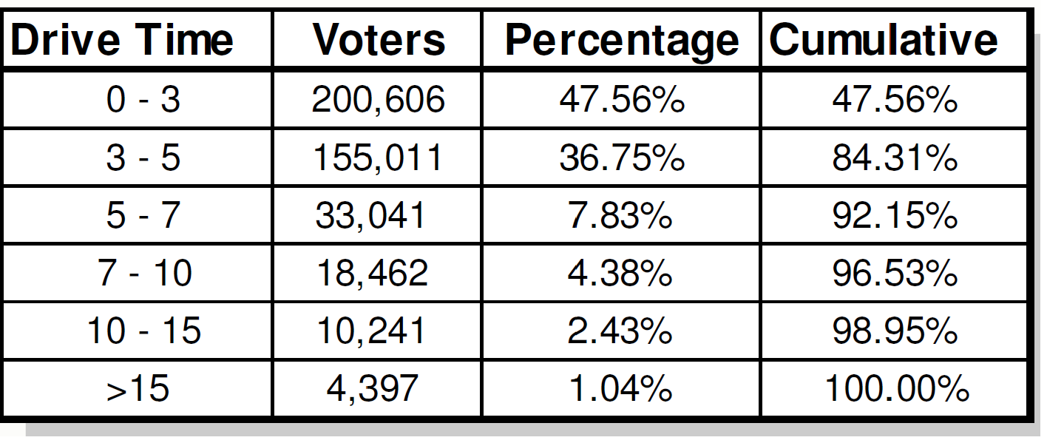
Drop Box Approximate Drive Times

Slide 10
History of Voter Outreach
Secure 24-Hour Drop Box
2012 – 2
2014 – 12
2016 – 15
2018 – 16
2020 - 37
231% increase in drop boxes from 2016 General Election

Slide 11
General Election Important Topics
USPS Mailer – national mailer containing incorrect information for Colorado.
Confidence in USPS
Great Partnership over the past 12 elections
BallotTrax Implementation- Statewide ballot tracking service
September 14, 2020
Voters with an email on file were automatically enrolled
Enroll to receive notification at: https://colorado.ballottrax.net/voter/
TXT2CURE Implementation- Powered by Global Mobile
3 methods to cure a signature discrepancy
Paper Form
Email
Patented smartphone sign solution (TXT2CURE)

Slide 12
Commentary
Most secure voting system in the country
Easy to vote….hard to cheat
Experienced-12 Elections, 1 during a pandemic
Observation
Vote Your Mail Ballot in the Safety and Security of Your Home!

