Slide 1
Crossroads Metropolitan District nos. 1-2
ID-20-001
Kari Parsons

Slide 2
Public input
If you are watching remotely and have not provided a name and a reliable phone number already, please email that information to Tracey Garcia at traceygarcia@elpasoco.com at this time.

Slide 3
Request
A request for approval of a Colorado Revised Statute Title 32 Special Districts service plan with a maximum debt authorization of $52 million, a debt service mill levy of 50 mills for commercial, and an operations and maintenance mill levy of 10 mills, for a total maximum combined mill levy of 60 mills for commercial. The statutory purposes of the Districts include the provision of the following:
1) street improvements and safety protection;
2) design, construction, and maintenance of drainage facilities;
3) design, land acquisition, construction, and maintenance of recreation facilities;
4) mosquito control;
5) design, acquisition, construction, installation, and operation and maintenance of television relay and translation facilities;
6) covenant enforcement; and
7) design, construction, and maintenance of public water and sanitation systems.

Slide 4
Mandatory Criteria for Disapproval
The BoCC shall disapprove the draft service plan unless evidence satisfactory to it of each of the following is presented or, in the BoCC ' s discretion, the BoCC conditionally approves the draft service plan to cause compliance with these criteria (C.R.S. § 32-1-203(2):
There is sufficient existing and projected need for organized service in the area to be served by the proposed special district;
The existing service in the area to be served by the proposed special district is inadequate for present and projected needs;
The proposed special district is capable of providing economical and sufficient service to the area within its proposed boundaries;
The area to be included in the proposed special district has, or will have, the financial ability to discharge the proposed indebtedness on a reasonable basis.

Slide 5
Discretionary Criteria for Disapproval
The BoCC may disapprove the draft service plan if evidence of the following, at the BoCC ' s discretion, is not presented (C.R.S. § 32-1-203(2.5)):
Adequate service is not, or will not be, available to the area through the County or other existing municipal or quasi-municipal corporations, including existing special districts, within a reasonable time and on a comparable basis;
The facility and service standards of the proposed special district are compatible with the facility and service standards of each County within which the proposed special district is to be located and each municipality which is an interested party as defined in C.R.S. § 32-1-204 and this Code;
The proposal is in substantial compliance with the El Paso County Master Plan;
The proposal is in compliance with any duly adopted County regional, or State long-range water quality management plan for the area; or
The creation of the proposed special district will be in the best interests of the area proposed to be served.

Slide 6
Hearing Dates
Planning Commission October 1, 2020
Board of County Commissioner meeting to set date of hearing on October 13, 2020
Board of County Commissioner hearing on October 27, 2020

Slide 7
Applicant
The Equity Group, LLC
Representative: Spencer Fane, P.C.

Slide 8
PUBLIC NOTICE
There are no posting or mailing requirements for hearings before the Planning Commission on Colorado Revised Statutes Title 32 Special District service plans;
PCD staff did post the property on September 9, 2020.
However, there are notice requirements for hearings before the Board of County Commissioners.
The applicant was required to notify all taxing jurisdictions within three (3) miles of the District’s boundaries as required by state statute prior to the Board of County Commissioners hearing.
In addition, published notice provided by County staff in the Shopper Press for the BoCC hearing.

Slide 9
Vicinity map
Meadowbrook Parkway Connection
SITE

Slide 10
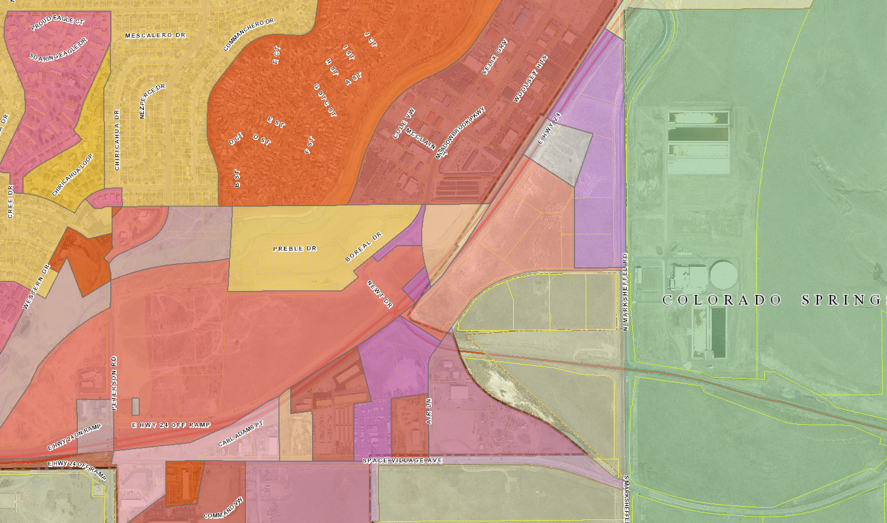
Zone Map

Slide 11
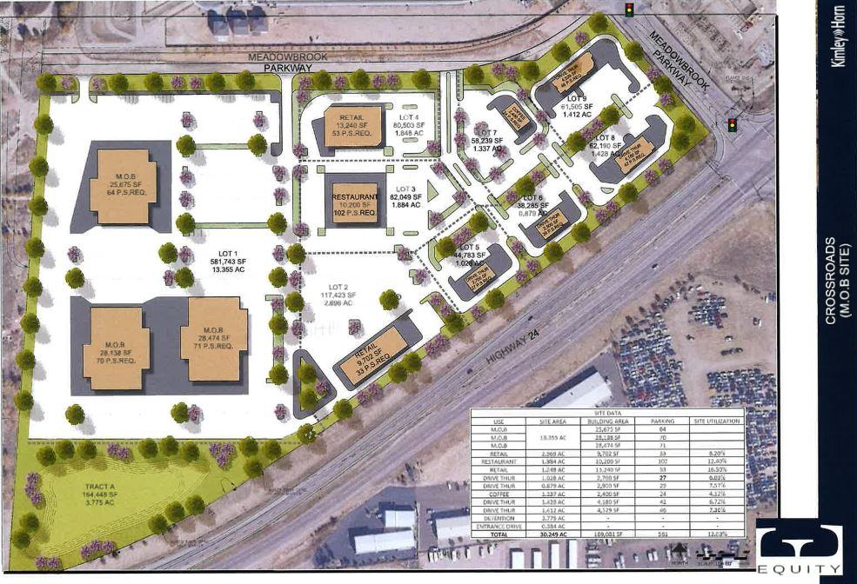
Background
The parcel proposed to be included within the Crossroads Metropolitan District No. 1 and located north of highway 24 is zoned CR (Commercial Regional); no rezone (map amendment) request is anticipated.
North

Slide 12
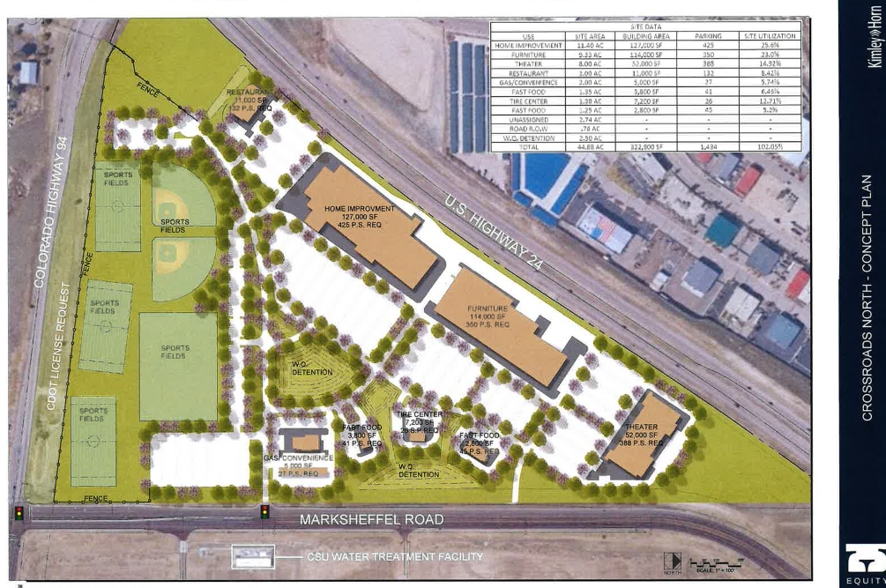
Background Continued
The parcels proposed to be included within the Crossroads Metropolitan District No. 2 are located south of Highway 24, north of Highway 94, and west of Marksheffel Road are zoned CR (Commercial Regional), M (Industrial- Obsolete), I-2 (Industrial), with CAD-O (Commercial Airport District- Overlay).
Approximately 44 acres south of Highway 24, to be placed in District No.2 inclusively, and conceptually depicts the following: 6 acres of detention area; 68 acres of commercial (373,000 commercial building square-feet); and 0.76 acres of public right-of-way.
North

Slide 13
Additional Land map
Meadowbrook Parkway Connection
Sports Park
The additional inclusion area of 19.6 acres is depicted on the conceptual layout as a sports park.

Slide 14
Mill Levy and bonding
The applicant is requesting approval of a maximum combined mill levy cap of 60 mills,
50 mills devoted for commercial debt service, and
10 mills for operations and maintenance.
The Board of County Commissioners policies limit the maximum mills to 60 mills with an additional Special Purpose Mill Levy of 5 mills being allowed if covenant enforcement authority is being proposed.
5 mills for covenant enforcement is NOT requested
Crossroads Metropolitan District Nos. 1-2 may perform covenant enforcement pursuant to their statutory authority.
A maximum debt authorization of $52 million
The period of maturity for any issued debt, not including developer funding agreements, is limited to no more than thirty (30) years without prior approval from the Board of County Commissioners. The applicant is requesting a thirty (30) year period of maturity for any issued debt.

Slide 15
Existing Mill Levies 2020
El Paso County 7.222
El Paso County Road and Bridge 0.330
School District No. 11 51.558
Pikes Peak Library District 3.731
Cimarron Hills Fire Protection District 16.200
Cherokee Metropolitan District zero
TOTAL: 79.041
PROPOSED NEW DISTRICT No. 1 TOTAL: 139.041
PROPOSED NEW DISTRICT No. 2 TOTAL: 122.841 (No fire protection)
*The current assessed rate of 7.15 is a residential rate, if the zoning is approved, and the lots are developed, a new assessment of 29.00 can be assessed to each individual lot. This will be a drastic change in the taxes assessed against each property.

Slide 16
Finance Department analysis
El Paso County Specific Ownership Tax is decreased by $35 in 2024,
El Paso County Specific Ownership Tax is decreased by $507 in 2025, and grows to $3024 in 2028 when fully developed.
Property tax revenues will be approximately $403 in 2024, $6324 in 2025, and grows to $37,691 when fully developed in 2028.
* Information provided by Nikki Simmons, CPA
County Controller
El Paso County Financial Services

Slide 17
Disclosure
Standard Disclosure will be required
Exhibit to service plan
Will be required with subsequent plats
Updates required annually thereafter
To be posted on County web site

Slide 18
Staff Report
Staff report includes analysis of mandatory criteria, and
Sufficient existing and projected need
Existing service is inadequate for present and projected needs
District is capable of providing economical and sufficient service
Financial ability to discharge proposed indebtedness
Discretionary criteria
Adequate service is not or will not be available through other sources
Facility and service standards compatible
Compliance with the Master Plan
El Paso County Policy Plan
El Paso County Water Master Plan
Compliance with water quality management plan
In the best interests of the area to be served

Slide 19
Staff Analysis
A regional connection of Meadowbrook Parkway to Peterson Road is anticipated to be required with this development.
The extension of Cherokee Metropolitan District’s existing water and wastewater infrastructure under Highway 24 and under Highway 94 are also anticipated to be required to serve the development.
The applicant is currently negotiating a long-term lease with the City of Colorado Springs for an additional inclusion area totaling 19.6 acres. Crossroads District No. 2 would be responsible to develop the infrastructure necessary to facilitate the sports park pursuant to the formation of the District..
Pursuant to the analysis and conclusions within the Districts’ financial plan, a summary of which is included as Exhibit D of the service plan, the Districts propose to provide services within the service area in an economic and sufficient manner.
Assuming a direct correlation between the residential growth and commercial growth, the applicant’s anticipated build-out schedule, and absorption rate appear to be consistent with the current market trends..
Applicant has stated it is not be financially feasible for Cherokee Metropolitan District or Meadowbrook Crossing District, to finance construction of the public improvements needed to serve the development due to the additional debt the districts would incur and their limited debt capacity.

Slide 20
Public input
If you are watching remote and have not provided a name and a reliable phone number already, please email that information to Tracey Garcia at traceygarcia@elpasoco.com at this time.

Slide 21
End

