Slide 1

2021 Preliminary Balanced Budget
Nikki Simmons, CPA
County Controller
October 6, 2020

Slide 2
Presentation Overview
Budget Process
2021 Preliminary Balanced Budget
  Revenues
    Property Tax
    Sales Tax
  Expenditures
    Critical Needs
Preliminary Balanced Budget Document

Slide 3
BoCC Discretionary Budget
2008-2021 Population Growth

Slide 4
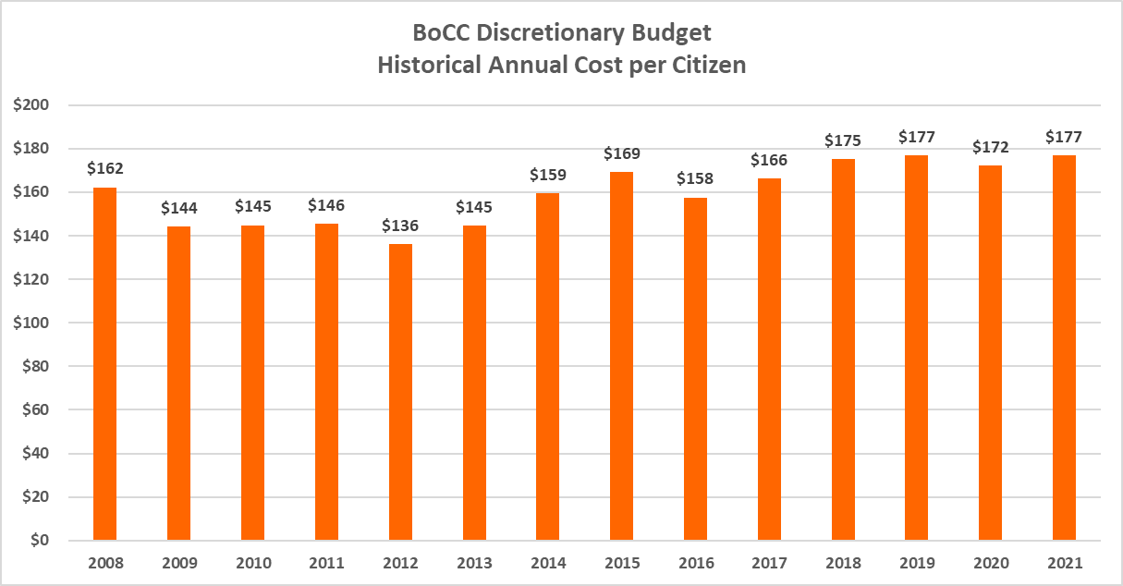
BoCC Discretionary Budget
Historical Annual Cost per Citizen

Slide 5
Budget Process
Compiling the 2021 Budget
Budget Process Policy:
Section 5.2 starts the annual budget process
  Restricted Funds, Partially Restricted Funds and Unrestricted Funds
Section 5.3 – 2021 Budget for Restricted Funds (Completed)
  Road and Bridge Escrow
  Conservation Trust Fund
  Household Hazardous Waste Fund
  Schools Trust Fund
  Local Improvement Districts

Slide 6
Budget Process
Compiling the 2021 Budget
Budget Process Policy:
Section 5.4 – 2021 Budget for Partially Restricted Funds (Completed)
  Community Investment Fund (CIP)
    Ensured funding for Annual Lease Obligations (COPs and Capital Leases)
  Self-Insurance Fund
    Ensured funding for anticipated insurance claims – Health & Risk
    Minor increase in health insurance premiums passed to employees (5% premium increases)
    Includes Reserve for required GASB Fund Balance to address the “Incurred But Not Reported” (IBNR) claims - Actuarially Determined
    Includes Health Plan Trust Board approved changes

Slide 7
Budget Process
Compiling the 2021 Budget
Budget Process Policy:
Section 5.4 – 2021 Budget for Partially Restricted Funds (Completed)
  Department of Human Services
    Ensured funding for statutory county match
    State Fiscal Year 2020/2021 & estimated 2021/2022 Allocations
    Increase in County Match of $300,000
Road and Bridge Fund
    On a multiyear plan to address backlog of road infrastructure
    Additional funds of $905,000 ($750,000 more than planned in last years roadmap)

Slide 8
Budget Process
Compiling the 2021 Budget
Budget Process Policy:
Section 5.5 – 2021 Budget for Unrestricted General Fund (In Process)
Revenue Estimates – Sales and Use Tax:
  Up 7.17% through July 2020 over 2019 (4.5% budgeted increase)
    Up significantly more than projected however we expect it to be close to budget by end of year
    “Retail” is up 16.3% (53% of budgeted revenue)
    “Food services” is down 14% (12% of budgeted revenue)
    “Wholesale trade” is up 29% (5% of budgeted revenue)
    “Accommodations” is down 47% (4% of budgeted revenue)
  The average increase over the last five years is 7.26%
  2020 estimated ending increase of 1.09%
  PBB includes staff recommended increase of 4.50% over 2020 estimate
  2021 Sales and Use Tax preliminary budget is $123.8M

Slide 9
2021 Preliminary Balanced Budget
Sales & Use Tax (1%) Projections (in Millions)

Slide 10
Budget Process
Compiling the 2021 Budget
Budget Process Policy: Section 5.5 (Continued)
Revenue Estimates – Property Tax:
Property Tax revenue increase of 8.52% to $62.5M
  Based on Preliminary Certification of Valuation
  Not a re-assessment year
  Allowable abatement mill of 0.064 mills
  Estimated temporary mill levy reduction of 0.176 mills due to TABOR Property Tax Cap
    Estimated $3.78 for a $300,000 house
  Without temporary reduction, mill levy would be approximately 8.225 mills, with temporary reduction it is estimated at 8.049 mills

Slide 11
Budget Process
Compiling the 2021 Budget
Budget Process Policy: Section 5.5 (Continued)
Revenue Estimates – Property Tax:
Property Tax – TABOR
  In addition to Property Tax Temporary Mill Levy Reduction, 2021 Property Tax bills will have estimated 0.393 mill property tax credit for 2019 TABOR overage of $3,113,796
    Estimated $8.43 for a $300,000 house
Net 2021 Property Tax Revenue after 2019 Refund is $59.4 Million

Slide 12
2021 Preliminary Balanced Budget
Property Taxes – All Funds (in Millions)

Slide 13
2019 Property Tax Per Citizen
10-County Comparison

Slide 14
Budget Process
Compiling the 2021 Budget
Budget Process Policy: Section 5.5 (Continued)
Revenue Estimates – Other Revenue Lines:
    Changes from 2020 budget to 2021 budget:
    Clerk & Recorder Fees - $750k
    Sheriff Fees – ($1.2M)
    Interest Earnings – ($500k)

Slide 15
Budget Process
Compiling the 2021 Budget
Budget Process Policy: Section 5.5 (Continued)
2021 Expenditure Budgets
  Retain 2020 Expenditure Base Budget
  Incorporate critical needs as outlined in the Financial Roadmap including newly submitted 2021 needs
  Increase 2021 Beginning Operational Savings of $14M from departmental underspending and including $10M of CARES reimbursement for law enforcement substantially dedicated to response of Covid-19
  With Strategy Phase of the budget (5.5.3.2), meetings held with Countywide Elected Officials and Department Executive Directors

Slide 16
Budget Process
Compiling the 2021 Budget
Re-evaluated critical needs due to increased service demands, population growth, and mandated pressures
  Additions, deletions, and continuations to the 2020 roadmap were considered
Investment in Human Capital Management
  Recommending 2% allocation of personnel budgets for departments and offices for pay increases as determined by elected officials and directors

Slide 17
Budget Process
Compiling the 2021 Budget
  High Impact Road Safety Projects
    2021 budget maintains the 2020 funding for roads at an $12.05 million increase over 2016 levels and a $3M one-time increase for I-25 Gap project grant match
    Additional increases planned in 2022-2025 roadmap

Slide 18
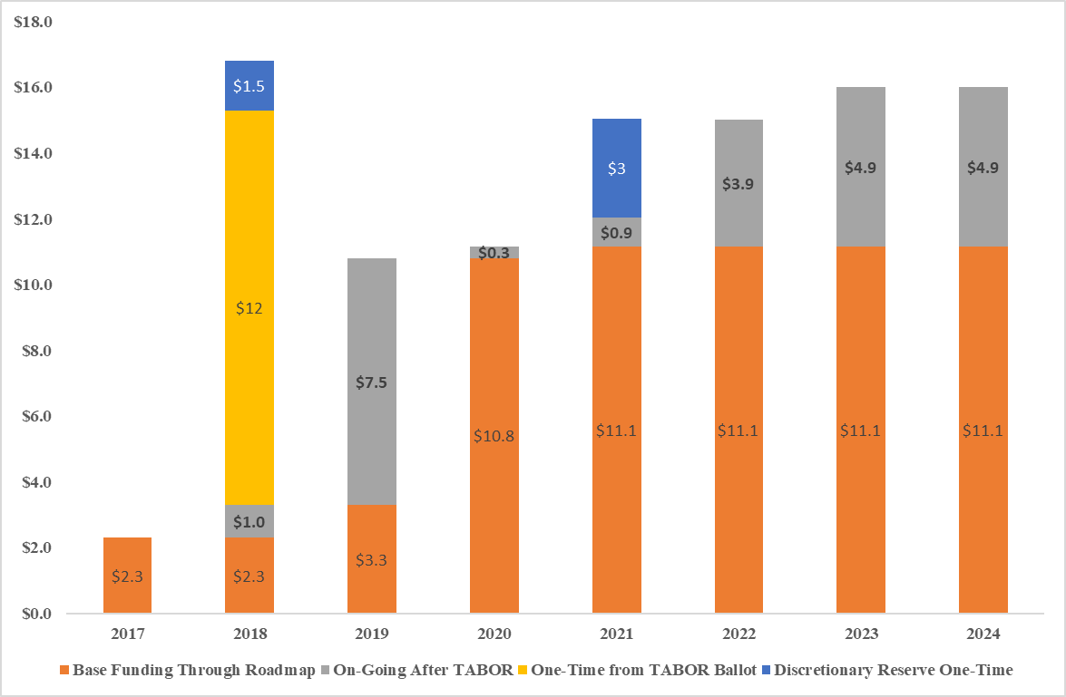
Budget Process
Annual Investment in High Impact Road Safety Projects

Slide 19
Budget Process
Compiling the 2021 Budget
  TABOR Calculation Impacts - PRELIMINARY
    Early estimates (through August) show slightly above TABOR Cap
    TABOR calculation very preliminary – numerous variables can drastically change before finalized in about 6 months:
      CPI Increase – June estimates will change several times by Feb/Mar 2021
      Growth calculation – Using August preliminary – not finalized until December 2020 with final Certification of Valuation
      Sales Tax and Intergovernmental impacts have been increasing
      2020 Roadmap – $3.0M reserved for TABOR overage
    Staff is closely monitoring TABOR revenues

Slide 20
Budget Process
Compiling the 2021 Budget – Emergency Reserve
Proposed Target of $5,000,000 for the Emergency Reserve
  Total County cost/match of 4 disasters in 2012-2014 was $5.3 million
Fully fund remaining $1.975M with the sale of real estate
Not our only reserves
  Minimum fund balance policy
  10% of General Fund Sales Tax, 0.5% Property Tax, and 5% all other revenues
  Minimum Fund Balance of $13 million for 2020
  Estimated TABOR 3% Reserve of $8.2 million

Slide 21
2020-2024 Financial Roadmap (Prior Year)

Slide 22
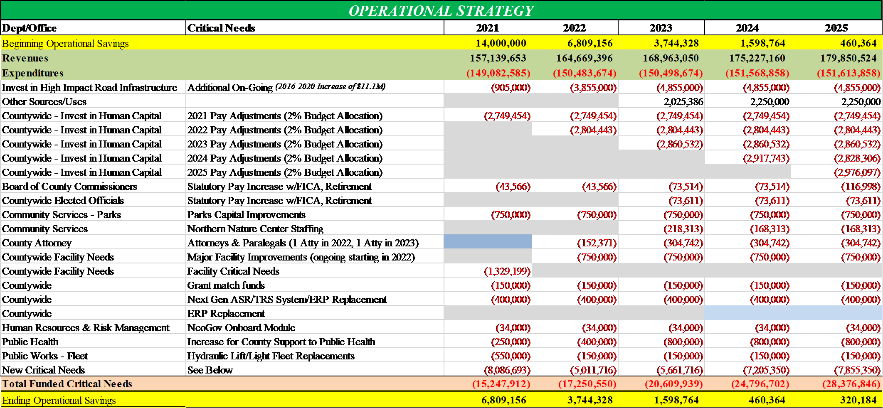
2021-2025 Financial Roadmap Balanced

Slide 23
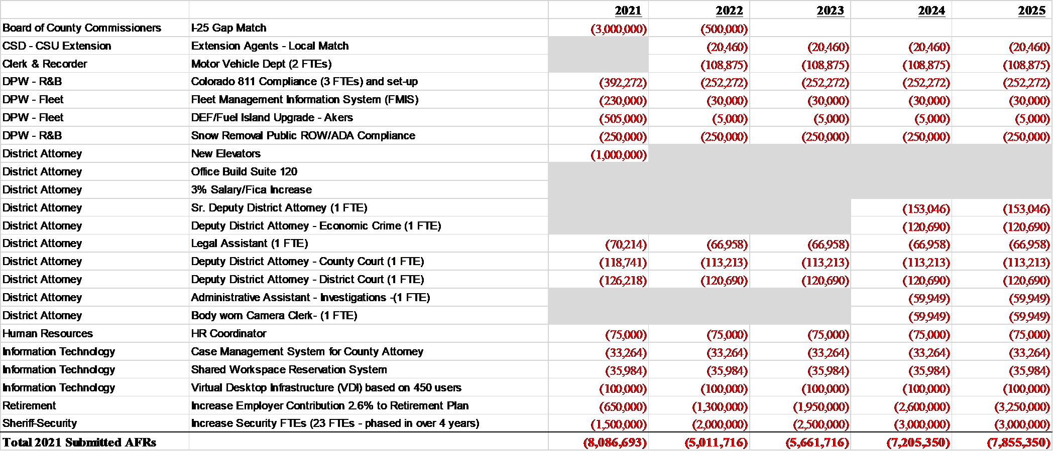
2021 Newly Submitted Critical Needs
Addressed in PBB

Slide 24
Financial Roadmap & The Strategic Plan
The 2021-2025 Financial Roadmap addresses many items in the Strategic Plan:
Goal 1: Maintain and Promote a Financially Sustainable County Government that is Transparent and Effective
  Strategy A – Increase Innovation, Efficiency & Transparency
  Strategy B – Invest in Human Capital
  Strategy C – Allocate Funding Streams Designated for Capital Investment and Operational Needs
  Strategy E – Ensure responsible and Appropriate Use of Local Tax Dollars
Goal 2: Enhance Understanding of Civic Services
  Strategy C – Develop and Implement a Strategic Technology Infrastructure to Engage Citizens

Slide 25
Financial Roadmap & The Strategic Plan
Goal 3: Maintain and Improve the County Transportation System, Facilities, Infrastructure and Technology
  Strategy A – Provide a Safe, Sustainable, Integrated and Efficient Multi-Modal Transportation Infrastructure System
  Strategy C – Provide Maintenance and Facilities Improvements
  Strategy D – Improve and Update the County Park System
Goal 5: Ensure a Safe and Healthy Community
  Strategy A – Support a High Level of Public Safety
  Strategy B – Support a High Level of Community Safety (OEM, Buildings, Community Partnerships)

Slide 26
2021 Budget Process
Preliminary Balanced Budget
Department & Elected Official Budget Strategy Sessions – August 19 and September 9, 2020
  Overview of County Financial Condition and Discussion of Critical Needs
Budget Hearing #1 – October 6, 2020
  Presentation of Preliminary Balanced Budget Document (That’s today!)

Slide 27
2021 Budget Process
Original Adopted Budget
Budget Hearings #2 and #3 – October 20th & October 22nd
  Department/Offices Critical Needs Presentations
  Chief Financial Officer– Updated Revenue Projections & Five-Year Forecast
  Citizen Outreach Group Presentation to BoCC
  Budget Hearing #4 – November 17th
  BoCC Direction on the 2021 Original Adopted Budget
  Budget Hearing #5 – December 8th
  Resolution #1 – 2021 Original Adopted Budget
  Resolution #2 – Certify County mill levy
  Resolution #3 – Authorize the Treasurer to transfer between funds

Slide 28
Presentation of the Preliminary Balanced Budget Document

