Slide 1
2021 Budget Presentation Information Technology
Jeff Eckhart
October 20, 2020

Slide 2
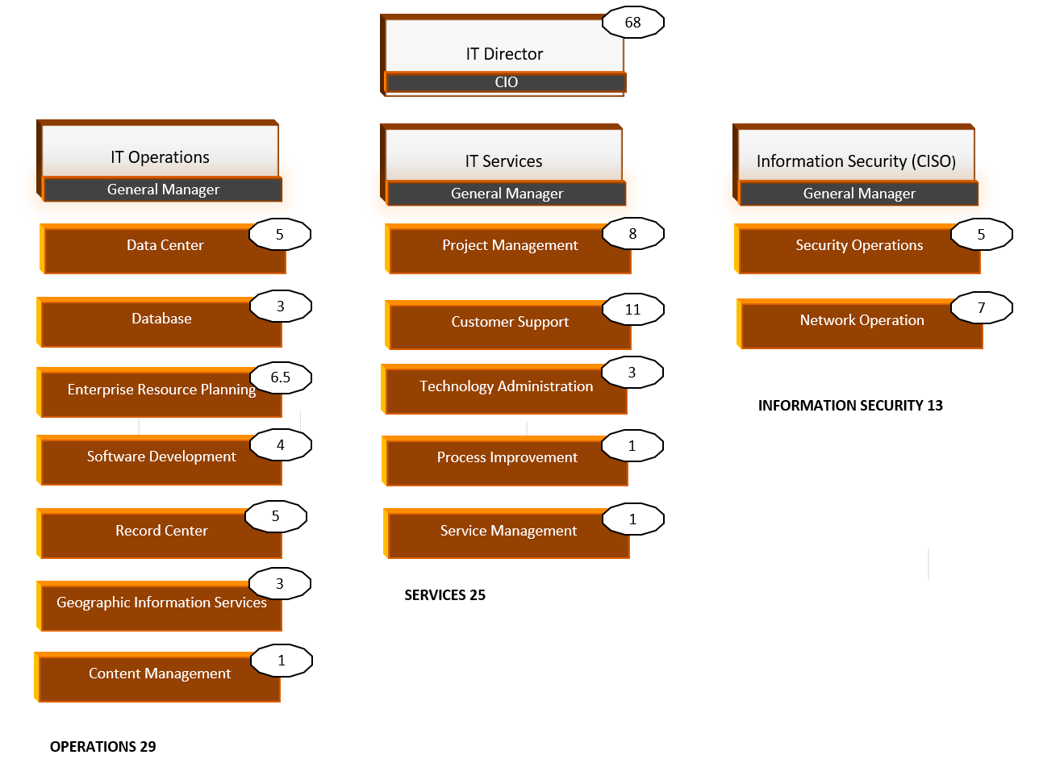
Organizational Chart
Information Technology
Notes:
What three things do you want to highlight on this slide?
Technology services provider to all County business units
Focused on Customer Experience
Highest personnel growth area is Information Security

Slide 3
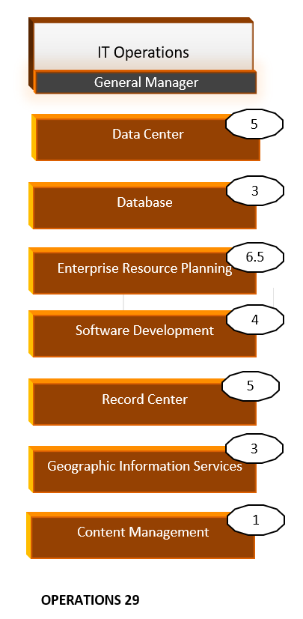
IT Operations
Email | Digital Storage
Application Hosting | Patch Management
Geographic Information System | Countywide Financial / HR System
Database Management | Time & Attendance System
Citizen Request System | Website Management Systems
Information Technology
Notes:
What three things do you want to highlight on this slide?
Our traditional strength and foundational service to County business units
County data centers host a wide range of mission critical County systems for Public Safety, Health & Human Services,
Cloud infrastructure is an ever increasingly share of our infrastructure portfolio with significant growth anticipated

Slide 4
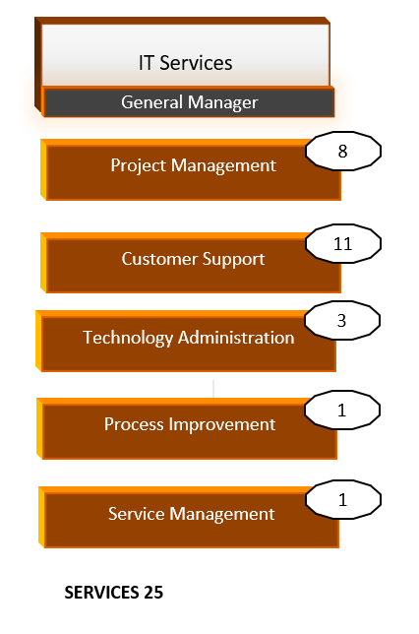
IT Services
Project Management | PC Replacement Program
Call Center / 24 x 7 Support | Inventory Management
Desktop Computer Support | Software License Renewal
Desktop Patch Management | Software License Compliance
Mobile Device Management | Technology Finance / Budget
Information Technology
Notes:
What three things do you want to highlight on this slide?
Improving project management maturity increases our ability to deliver projects on scope, time and budget
Mission critical systems of record for the organizations finances, personnel, geographic assets and information channels
Evolving performance improvement and automation capabilities seeing significant growth

Slide 5
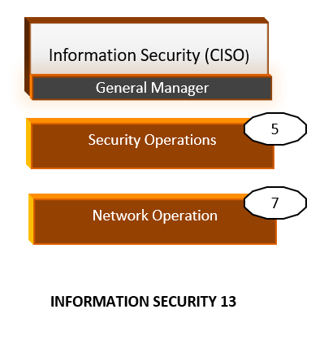
Information Security
Security Operations Center
Network Operations Center
Compliance
Broadband
Information Technology
Notes:
What three things do you want to highlight on this slide?
Formalized group as a result of funded 2019 critical need request – Thank You!
Improving capability to defend the organization and improve operational continuity and resilience
The work is not done and the threats to our information and assets is rapidly expanding

Slide 6
Operational Metrics
2,800
County
Employees
2
Data
Centers
35
Business
Units
25,000
Annual
Service
Requests
12 Elected Officials
10 Departments
3 Appointed Officials
2 Affiliated Agencies
Technology Support
Moves / Adds / Changes
Mobile Device Support
Security Requests
Records Center
49 Networked
Buildings
3,500
Network
Devices
Information Technology
Notes:
What three things do you want to highlight on this slide?
We maintain a single network, phone system, and operational computing assets across a very diverse set of County functions
Our network connects Cripple Creek to Calhan, Fountain to Black Forest, from the State of Colorado to the City of Colorado Springs, and 49 buildings in between
69 dedicated and talented technology professionals I am proud to call my colleagues

Slide 7
Compliance Mandates
Criminal Justice Information Services (CJIS) Security Policy
FBI directive to protect criminal justice and law enforcement information
Health Insurance Portability and Accountability Act (HIPAA)
Federal mandate to protect health related information
Personal Identity Information (Colorado HB 18-1128)
Requires protection of documents containing personal identifying information
Payment Card Industry Data Security Standard (PCI DSS)
Security standards for entities that accept, process, store or transmit credit card information
Information Technology
Notes:
What three things do you want to highlight on this slide?
As data breaches and attacks on governments expand, we are increasingly driven by local, state, and federal information security compliance mandates
2019 saw our first Cyber awareness campaign to educate employees on our duty to protect the digital information of our citizens, employees, and County assets
All signs point to tighter security controls and more mandates, challenging our ability to balance security/compliance with usability and interoperability of County computer systems

Slide 8
Strategic Plan Goals
Goal 3, Strategy B: provide cooperative general technology services through a secure and modern operating infrastructure, current and sustainable software products, innovation and a qualified professional workforce
Develop mobile applications for direct public access to County programs, services and information
Implement a 311 type web-based information system
Implement comprehensive technology security program
Expand fiber optic networks to improve operational continuity through redundancy
Replaced unsupported analog telephone system with next generation network based phone system
Information Technology
Notes:
What three things do you want to highlight on this slide?
The completed strategic plan goals improve our operational maturity and retire the County’s technical debt
The Broadband Strategic Plan completed earlier this year establishes a framework for future improvements to our fiber optic networks through public/private partnerships
Huge strides have been made in improving our security posture through the formalized technology security program

Slide 9
Strategic Plan Goals
Goal 3, Strategy B: provide cooperative general technology services through a secure and modern operating infrastructure, current and sustainable software products, innovation and a qualified professional workforce
Define and implement acceptable use policies for technology systems, devices and operations
Retire legacy software products and transition operations to sustainable software architectures
Design and implement sustainable replacement programs for PCs, software, and technology capital assets
Leverage existing software platforms to enable efficient and interoperable operations
Information Technology
Notes:
What three things do you want to highlight on this slide?
Several of these goals represent continuous improvement and ever increasing operational maturity
All capital assets are managed for full lifecycle replacement through incremental annual investments
County Offices and Departments have been very cooperative in helping us retire legacy software and operating systems

Slide 10
Operational Initiative: Pillars for Success
Strategic planning and forward-looking technology investments prepared us for the unforeseen events and demands of 2020.
While our short-term focus shifted to standing up a remote organization, we continue to be strategic with investments and budget requests with a continuing goal of enabling an agile, resilient, and digital-ready future organization.
Implemented and deployed remote work, collaboration, & telecommunication capabilities
Office 365 implemented countywide
3,500 active users
Microsoft TEAMS implemented countywide
1 million activities since July
Rolled out JABBER and WebEx for efficient communication
Information Technology
Notes:
What three things do you want to highlight on this slide?
Thank you again for funding this critical countywide need last year
This graphic was current as of the due date for this presentation, more groups were migrated this past weekend including all those in the Go/No Go column
We are on track to complete the countywide rollout by the end of the year or early in 1Q of 2021

Slide 11
Operational Initiative: Pillars for Success - continued
Deployed 867 laptops countywide in April and May
Trained county staff on remote technologies in 10 sessions with up to 100 participants each
Upgraded network equipment countywide to enable an extended large-scale remote workforce
Increased Virtual Private Network (VPN) connectivity to provide critical remote access to the County network
Information Technology
Notes:
What three things do you want to highlight on this slide?
Thank you again for funding this critical countywide need last year
This graphic was current as of the due date for this presentation, more groups were migrated this past weekend including all those in the Go/No Go column
We are on track to complete the countywide rollout by the end of the year or early in 1Q of 2021

Slide 12
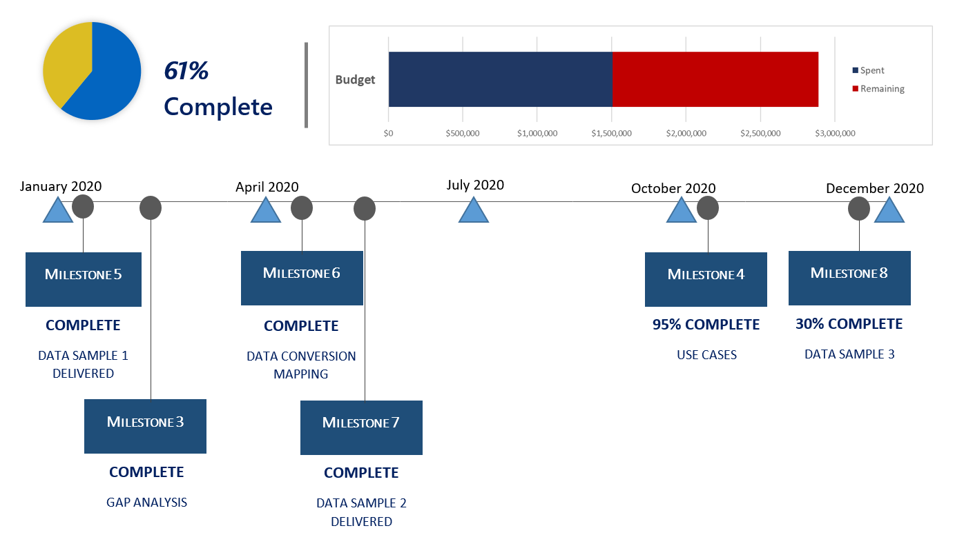
Operational Initiative: Assessor / Treasurer System
Information Technology
Notes:
What three things do you want to highlight on this slide?
This project is a transition from custom, in-house software, to commercial vendor supported products
The project was estimated to take a little over 2 years to complete and is on track to go live in early 2021
The Assessor and Treasurer and their staff have been very supportive of this major effort to retire a significant County technical debt

Slide 13
Base Budget and Critical Needs
2021 On-going Base Budget | Increases | Decreases | 2021 Requested Budget
13,590,528 | 302,439 | 0 | 13,892,967
2021 Critical Needs-On Going
Case Management System for County Attorney 33,264
SmartWork Reservation System 35,984
Virtual Desktop Infrastructure (VDI) 100,000
2% Personnel Increase
Information Technology

Slide 14
Questions?
Information Technology
Information Technology
Notes:
Jeff / team

