Slide 1
2020 General Election Update
Chuck Broerman
El Paso County Clerk and Recorder
October 27, 2020

Slide 2
General Election Ballot Returns
Total Returned in El Paso County (as of 10/26/20)
– 184,414
69,048- Republican Voters
64,011-Unaffiliated Voters
48,745 - Democratic Voters
2,610 – Minor Party Voters

Slide 3
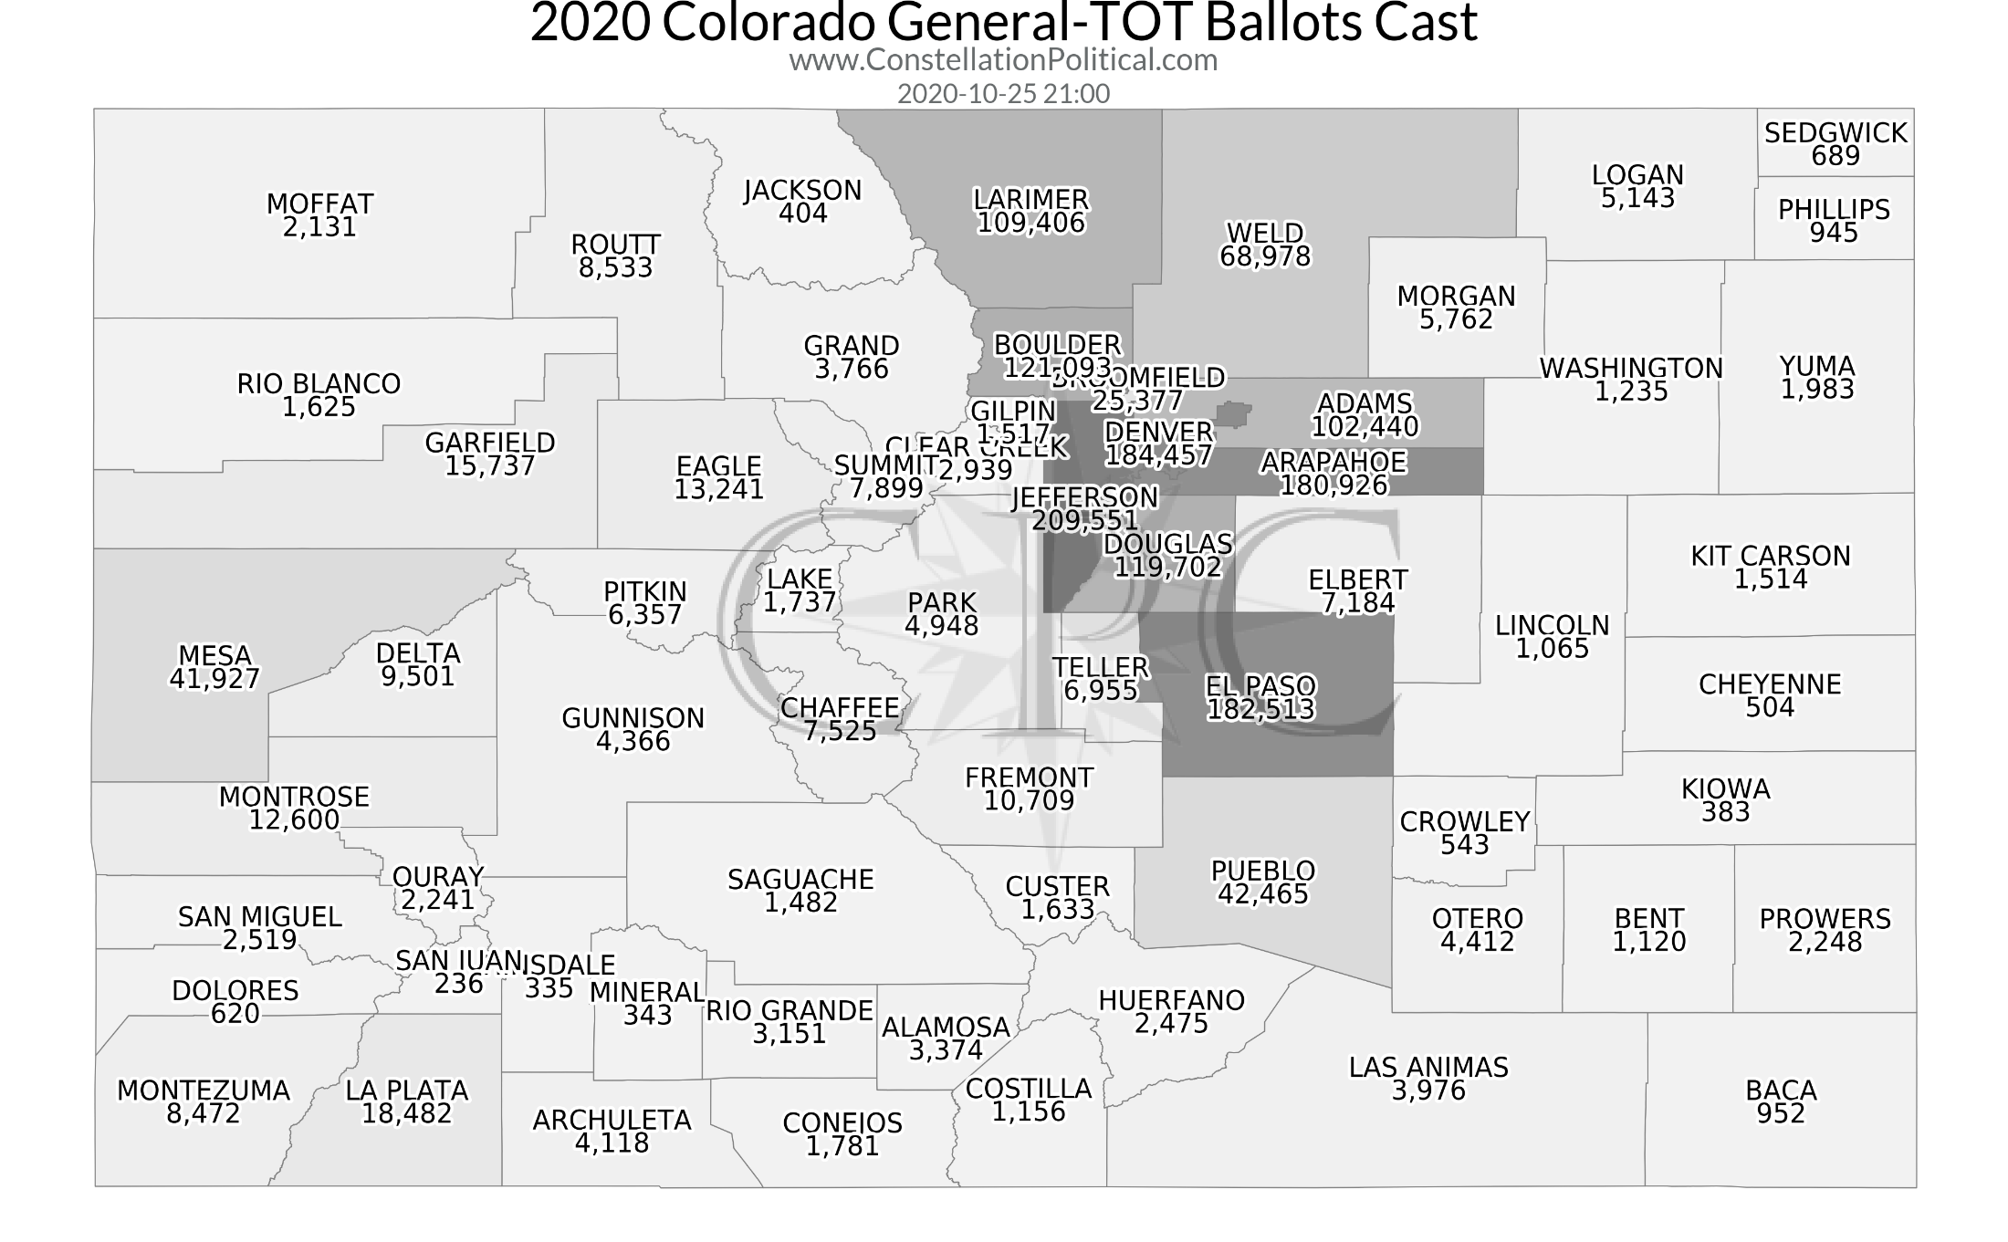

Slide 4
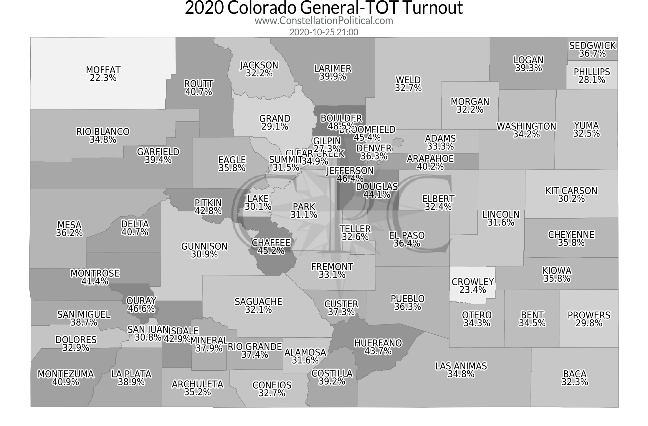

Slide 5
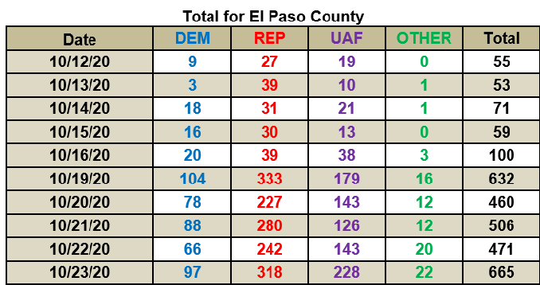
In-person Voting Totals

Slide 6
5 Reasons to Vote Your Mail Ballot
COVID-19 – The Clerk’s staff has strict protocols in place for sanitization of the VSPC. But regardless, in-person voting entails public contact that you can avoid by voting at home.
Cost – The average mail ballot packet costs $2 per voter. That cost escalates to $30 per voter when a voter chooses to vote in person. I ask voters to be fiscally responsible and help contain the election costs that impact you, the taxpayer.
Long Lines and Wait Times – The ballot is long and voting in person takes time. After each voter leaves, the area must be sanitized before the next voter arrives. It is far more convenient and safer for voters to vote their mail ballot at home on their own time.
Colorado’s Model of Voting – Nationally our state is recognized as the Gold Standard of mail ballot voting. Our system is safe – secure – accurate – transparent and verifiable. Voters can have confidence in the integrity of our elections. To date 12 elections have been conducted since the voting model was established in 2013 including the June Primary during the pandemic.
VSPC Services – The primary purposes of a Voter Center are to register new voters, update voter registrations, vote on an ADA ballot marking device, and issue ballots to voters that did not receive one in the mail. If an individual prefers to vote in person, they may come to a Voter Center and receive a paper ballot to vote and deposit, or they can drop their completed mail ballot off in person. All ballots, whether mail ballot or in person are processed in the same manner.

Slide 7
14 Additional Voter Service and Polling Centers Opening Friday
Black Forest Fire Rescue District | Pikes Peak Regional Development
Creekside Success Center | Sand Creek Library
East Library | The Barn-Woodmoor Community Center
El Paso County Public Services Dept. | The Independence Center
Fountain Library | Town of Monument-Town Hall
Library 21c | Victory World Outreach
Manitou Springs City Hall | Zalman Center at Harrison High School
Hours of Operation
Friday, October 30, 2020, 8:00 a.m. to 5:00 p.m.
Saturday, October 31, 2020, 8:00 a.m. to 5:00 p.m.
Monday, November 2, 2020, 7:00 a.m. to 7:00 p.m.
Election Day, November 3, 2020, 7:00 a.m. to 7:00 p.m.

Slide 8
VSPC Capacity 2016 vs. 2020
Number of Voter Centers Open | 25 VSPCs in 2016 | 35 VSPCs in 2020
Ballots Mailed | 405,347 | 430,167
Voter Turnout | 327,755 – 70.1% Turnout | 375,000 Projected-80%
Voted In Person | 13,955 | Can process 32,160 Voters (8 per hour, per intake)
Intake Station | 138 | 335
Hours of Service | 1,236 | 1,487

Slide 9
Questions? 719-575-8683 EPCVotes.com

