Slide 1
2020 General Election Update
Chuck Broerman
El Paso County Clerk and Recorder
October 20, 2020

Slide 2
General Election Ballot Returns
Total Returned in El Paso County (as of 10/19/20)
– 109,621
37,639 -Unaffiliated Voters
37,960 - Republican Voters
32,600 - Democratic Voters
1,956 – Minor Party Voters

Slide 3
Additional Voter Service and Polling Centers Opened Yesterday
7 additional VSPCs open
North Branch (EPC Clerk’s Office)
Southeast Branch (EPC Clerk’s Office)
Fort Carson (EPC Clerk’s Office)
Centennial Hall
Chapel Hills Mall
Citadel Mall
UCCS
Citizens Service Center
Monday-Friday, October 19, 2020, –October 30, 2020, 8:00 a.m. to 5:00 p.m.
Saturday, October 31, 2020, 8:00 a.m. to 5:00 p.m.
Monday, November 2, 2020, 7:00 a.m. to 7:00 p.m. Election Day
Tuesday, November 3, 2020, 7:00 a.m. to 7:00 p.m.

Slide 4
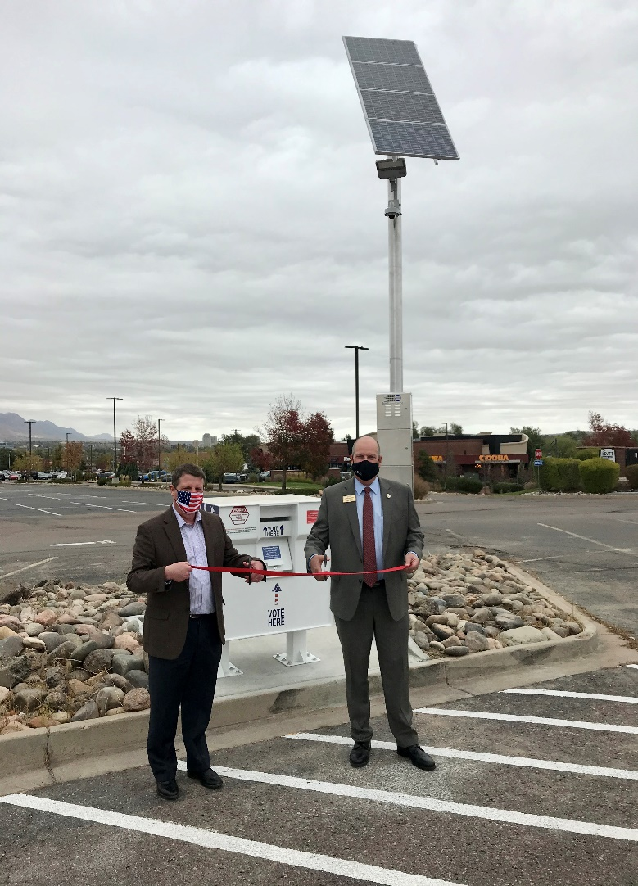
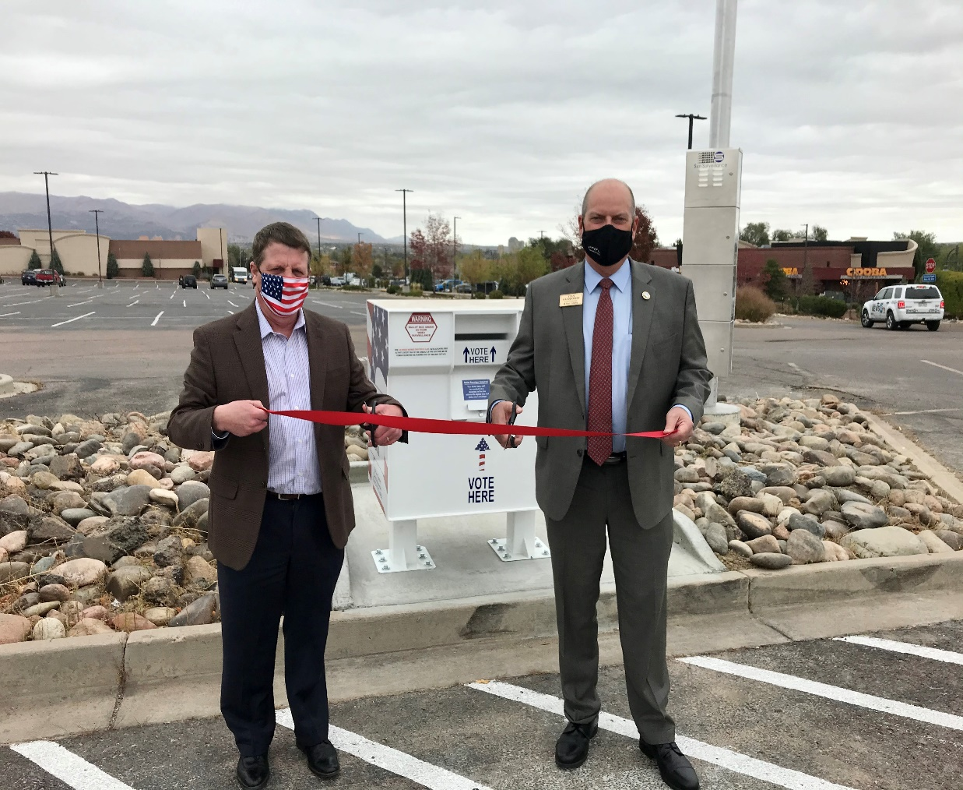
Solar Powered Ballot Drop Box
Ribbon Cutting was held in conjunction with Commissioner VanderWerf
First solar powered box in El Paso County

Slide 5
General Election Important Tips
Vote Your Mail Ballot in the Safety and Security of Your Home!
Option to return in-person to any vote center
Sign the back of your ballot envelope
If returning via USPS affix $0.65 postage
Recommended last day to return by mail, October 26, 2020

Slide 6
Questions? 719-575-8683 EPCVotes.com

