Slide 1
ORGANIZATION OF CROSSROADS METROPOLITAN DISTRICT NOS. 1 & 2
Board of county commissioners
El Paso County, Colorado
October 27, 2020

Slide 2
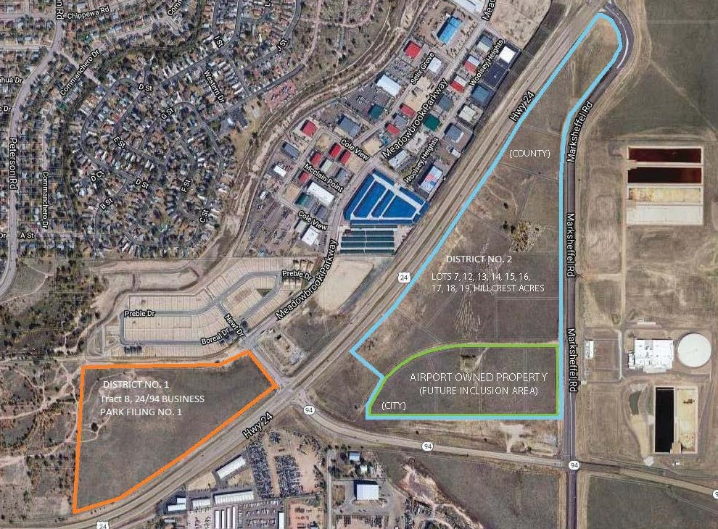
LOCATION

Slide 3
Project Details
Size:
District No. 1 - 29.04 acres
District No. 2 - 41.42 acres
Commercial Development
District No. 1 – 50,000 sq. feet of retail and medical office building
District No. 2 – 323,000 sq. feet of retail, restaurants, and potential sports park

Slide 4
Project Details
Full build out anticipated in four years
Major District No. 1 Public Improvements:
Extension of Meadowbrook Parkway
Installation of roundabout
Large underground water detention facility
Community Park
Major District No. 2 Public Improvements
Redevelopment of Air Lane
Mass over lot grading
Utility Mains
Sports Park

Slide 5
District No. 1 Public Improvement Cost Estimates
Public Improvement | Cost Estimate
Roads, Traffic Safety | $4,050,000
Grading/Erosion | $600,000
Landscaping | $3,700,000
Water | $400,000
Sanitary Sewer | $800,000
Stormwater Detention | $1,000,000
Design/Engineering/Survey/Utility/Permits | $1,525,000
Project/Construction Management | $1,086,750
TOTAL | $15,794,100 (with 20% contingency)

Slide 6
District No. 2 Public Improvement Cost Estimates
Public Improvement | Cost Estimate
Roads, Traffic Safety | $4,450,000
Erosion | $100,000
Landscaping | $3,800,000
Water | $1,000,000
Sanitary Sewer | $1,400,000
Stormwater Detention | $1,600,000
Design/Engineering/Survey/Utility/Permits | $1,825,000
Sports Park | $10,600,000
Project/Construction Management | $2,229,750
TOTAL | $32,405,700 (with 20% contingency)

Slide 7
Need for Crossroads MD Nos. 1 & 2
To support, pay for, and facilitate planning of significant public improvements, including water system, sanitary sewer and storm drainage, streets, roadways, and park and recreation.
The Districts will support both on-site and off-site improvement development as part of a larger master plan.
Financing tools that will be available to the Districts will provide financing for certain critical public improvements that are needed before additional improvements may be constructed.

Slide 8
Need for Crossroads MD Nos. 1 & 2
Formation at this time is also needed to confirm viability of a suitable financing structure to allow the long-term lease of the land for the sports park to proceed
To avoid burdening property outside of the service area with the costs of public improvements.
Nearby districts (Meadowbrook Crossing Metropolitan District, Cherokee Metropolitan District) are not able to finance and construct the needed public improvements.

Slide 9
Financing Plan – Key Characteristics
Maximum Mill Levies:
Combined Mill Levy: 60 mills
Debt Mill Levy: 50 mills
Operations and Maintenance Mill Levy: 10 mills
Maximum Debt Authorization Limitation: $52,000,000 (combined)
Maximum Term of Bonds: 30 years with authority to refund or restructure existing debt (period of maturity of refunded debt must not exceed 30 years from date of issuance thereof)

Slide 10
Statutory Requirements
Compliance with Section 32-1-201 through 209, C.R.S. and El Paso County Special District Policies:
There is sufficient existing and projected need for organized services in the area to be serviced by the proposed Districts.
The existing service in the area to be served by the proposed Districts is inadequate for existing and projected needs.
The proposed Districts are capable of providing economical and sufficient facilities and services to the area within their proposed boundaries.
The area to be included in the proposed Districts has or will have the financial ability to discharge the proposed bond financing on a reasonable basis.

Slide 11
Questions?

