Slide 1
2021 Budget Presentation Community Services Department
Tim Wolken, Executive Director
October 20, 2020

Slide 2
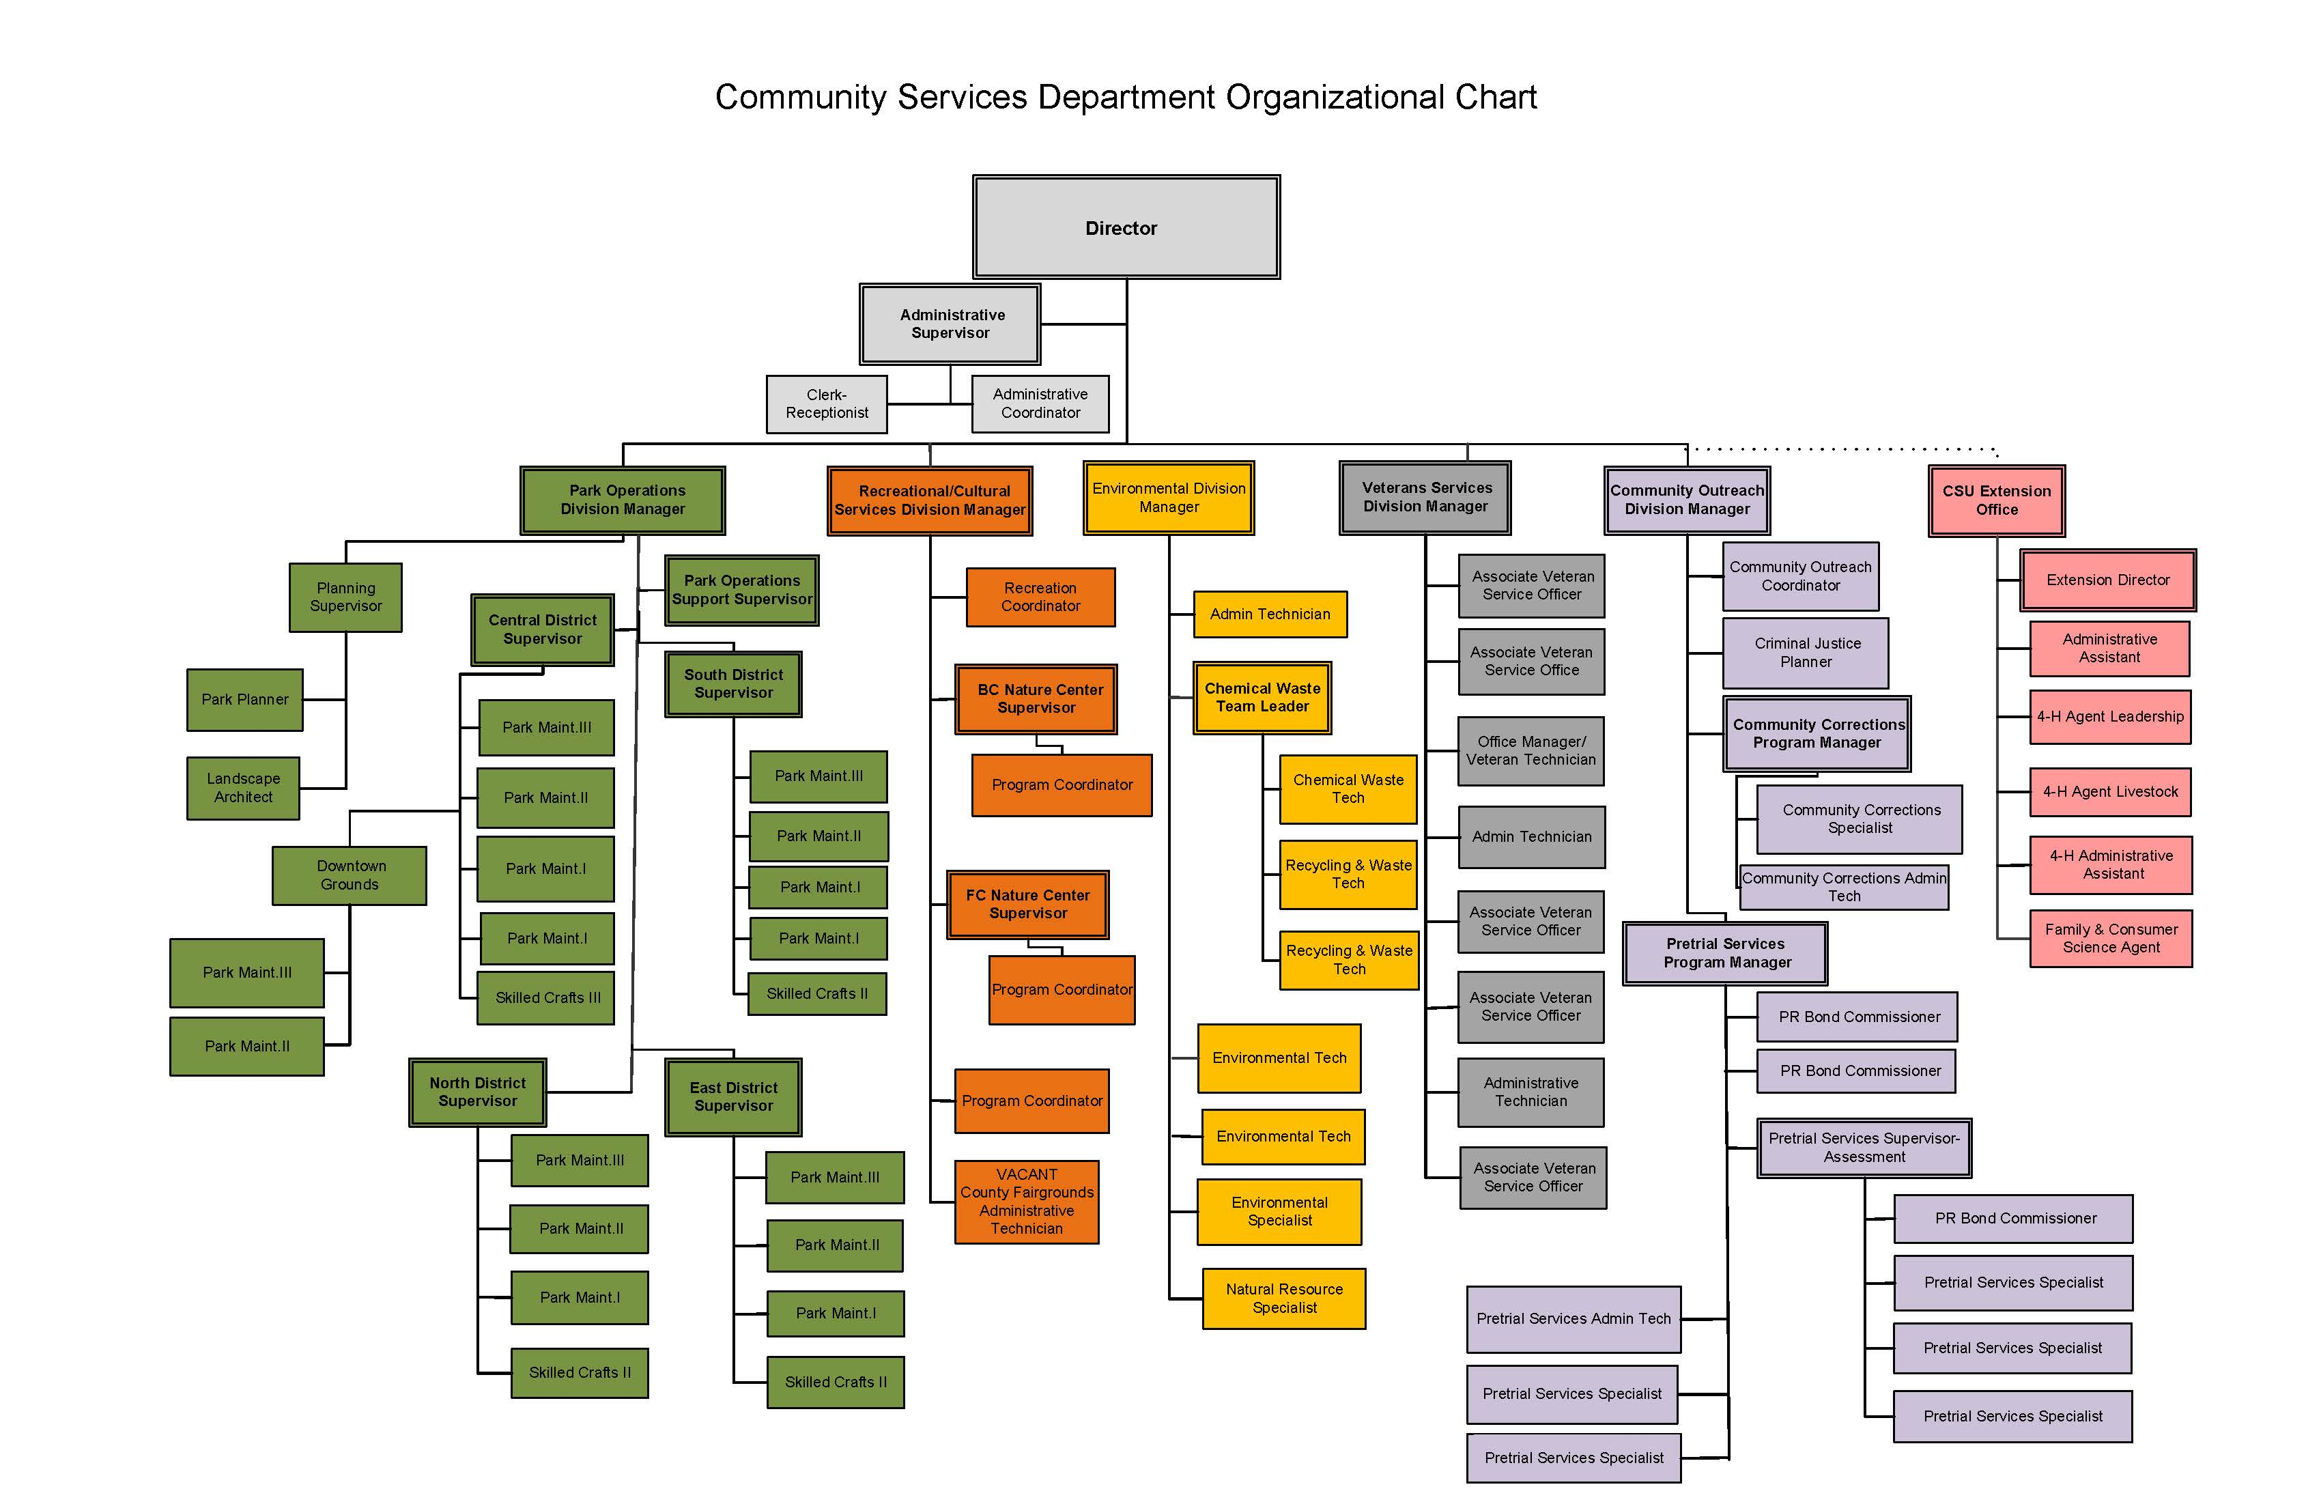

Slide 3
Division Operations
Community Outreach (Christine Burns)
Fundraising
Grant Administration
Marketing / Community Outreach
Justice Services (Pretrial, Community Corrections)
CSU Extension (Jonathan Vrabec)
Community Education Programs
Volunteer Development
4-H Youth Development
Horticulture / Master Gardeners
Recreation / Cultural Services (Todd Marts)
Nature Center Programming / Operations
County Fair / Fairgrounds Operations
Recreation / Special Event Programming
Environmental (Kathy Andrew)
Household Hazardous Waste Facility
Community Cleanups
Noxious Weed Management
Environmental Compliance
Natural Resource Management
Veteran Services (Marshall Bosworth)
Veteran Services / Benefits
Park Operations (Brian Bobeck)
County Parks Maintenance
Reserved Use / Special Events
Landscape Maintenance at County Facilities
Parks, Trails, and Open Space Planning
Parks Capital Projects Management
Long-Range Planning and Special Projects

Slide 4
Financial Overview – Operations
Third Net General Per Capita
Budget Party Funding* Fund Support Tax Support
Veteran Services $ 622,122 $ 29,400 $ 592,722 .81
Administration** $ 2,618,366 $ 486,000 $2,132,366 2.92
Park Operations (lottery fund) $ 1,406,525 $ 1,406,525 $ 0 N/A
Environmental $ 401,180 $ 0 $ 401,180 .55
Solid Waste Fund $ 1,238,000 $ 1,238,000 $ 0 N/A
CSU Extension $ 265,514 $ 0*** $ 265,514 .36
Pretrial Services $ 719,887 $ 77,000 $ 642,887 .88
Community Corrections $ 9,301,934 $ 9,301,934 $ 0 N/A
Useful Public Service $ 66,000 $ 66,000 $ 0 N/A
Total $16,639,528 $12,604,859 $4,034,669 5.52
Percentage of Third-Party Funding Support: 76%
* Program fees, rentals, lottery funds, tipping fees, fundraising, and federal / state funding.
** Administration includes CSD administration, park operations, planning and project management, nature centers, recreation / cultural services programming, County Fair / Fairgrounds, community outreach / grant management / volunteer management, and County buildings landscape services.
*** Our partnership with Colorado State University includes CSU providing approximately $250,000 in direct support for our local office and our local office generates approximately $50,000 in program fees and donations to support ongoing programming at our local office.

Slide 5
Strategic Plan Objectives
Goal #1
Explore opportunities to provide additional dedicated funding sources to support the development and maintenance of parks, trails, and open space
Goal #3
Develop a master plan, secure funding, and construct Kane Ranch Open Space (Phase 1)
Secure funding and construct Falcon Regional Park (Phase 2)
Secure land ownership or easements, secure funding, and complete the following trail projects: Ute Pass Regional Trail, Jackson Creek Regional Trail, Eastonville Regional Trail, Falcon Vista Trail and Fox Run Regional Trail
Update or create master plans for the following sites: Elephant Rock Open Space, Jones Park, Paint Mines Interpretative Park, and Homestead Ranch Regional Park
Goal #4
Pursue grant opportunities and support community events to promote the region's heritage, unique cultures, scenic beauty, wildlife, arts, sporting activities and tourism opportunities

Slide 6
Capital Improvement Projects
Ute Pass Regional Trail Expansion (ongoing)
Hanson Trailhead Renovation (ongoing)
Kane Ranch Open Space – Phase 1 (ongoing)
Bear Creek Regional Park Upgrades (ongoing)
Falcon Regional Park – Phase 2 (ongoing)
Northern Nature Center Plan Development
Justice Services Office Consolidation (2021)
Fox Run Regional Park Improvements (2021)
County Fairgrounds Walkways (2021)
County Fairgrounds Barn Replacement (2021)
Santa Fe Open Space Construction (2021)
Fox Run Regional Trail Construction (2021-22)

Slide 7
Performance Measurements
Household Hazardous Waste Facility annual customers 20,000
Household Hazardous Waste facility customer evaluations 4.0
Annual noxious weed inspections 500
Veteran Services customer evaluations 4.0
Veteran Services monthly office visits 675
Annual County Parks facility reservations 2,000
County Parks facility use customer evaluations 4.0
County Parks fundraising $200,000
County Parks volunteer hours 20,000
County Fair attendance 25,000
Personal Recognizance (PR) Bonds 5,000
CSU Extension consumer education class interactions 5,000
4-H Program participants 600
Nature Center programs 800
Nature Center program participants 25,000

Slide 8
2021 Additional Funding Request
County Parks Capital Improvement Funding - $750,000
It is proposed to provide $750,000 annually to support critical capital improvement projects within the County’s park system.
The funds will be used to address liability concerns, deferred maintenance, approved master plan projects, Americans with Disabilities Act compliance, and grant and fundraising local matches.

Slide 9
2021 Additional Funding Request County Parks Capital Improvement Funds
2003 2020 Percentage
County Population 544,000 730,000 +34%
Park Acreage 5,300 8,000 +51%
Miles of Trails 85 130 +53%
Reserved Park Use 1,750 2,400 +37%
Landscape Maintenance / Bldg 10 13 +30%
Full-Time Staff 41 40 -2%
Volunteer Hours 8,050 30,523 (2019) +279%

Slide 10
2021 Additional Funding Request County Parks Capital Improvement Funds
2003 2020 Percentage
GF Tax Support $2,500,000 $2,136,000 -15%
Loss of Purchasing Power $3,550,000 -42%
Per Capita Tax Support $4.60 $2.92 -36%
Lottery Funds $1,077,152 $1,400,000 +30%
Non-Tax Revenue $142,509 $686,000 +381%
City Parks Tax Support $19,000,000
City Per Capita Tax Support $40.42

Slide 11
2021 Additional Funding Request County Park Capital Improvement Funds
Major Facilities Added Since 2003-04
Rainbow Falls Historic Site (5 acres)
Jones Park (1,200 acres)
Kane Ranch Open Space (400 acres)
Pineries Open Space (1,100 acres)
Santa Fe Open Space (65 acres)
Expanded Ute Pass Regional Trail
County Fairgrounds (40 acres)
Falcon Regional Park (200 acres)
Stratmoor Valley Trailhead (2 acres)
Citizen Service Center
PP Regional Building Department
East DMV Facility

Slide 12
2021 Additional Funding Request County Parks Capital Improvement Funds
Proposed Projects in Approved Master Plans
Northern Nature Center - $1.4 million
Multiple trail projects - $60 - 80K per mile
Open space projects - TBD
County Fairgrounds barn replacements - $600K
Park roads / parking lot upgrades - $1 million
Fox Run Regional Park upgrades - $1 million
Bear Creek Regional Park upgrades - $750,000
Kane Ranch Open Space – Phase 2 - $300,000
Widefield Community Park - $250,000
Rainbow Falls Historic Site bridge - $250K

Slide 13
2021 Additional Funding Request
Current Park Capital Funding Challenges
Lack of ongoing capital investments in the park system has resulted in liability issues and antiquated infrastructure / deferred maintenance
2. Ability to complete approved master plan projects
Lack of funds for grant matches
Lack of County funds being invested in proposed park projects when approaching funders
Significant Americans with Disabilities Act compliance needs
6. Needed playground replacements / upgrades

Slide 14
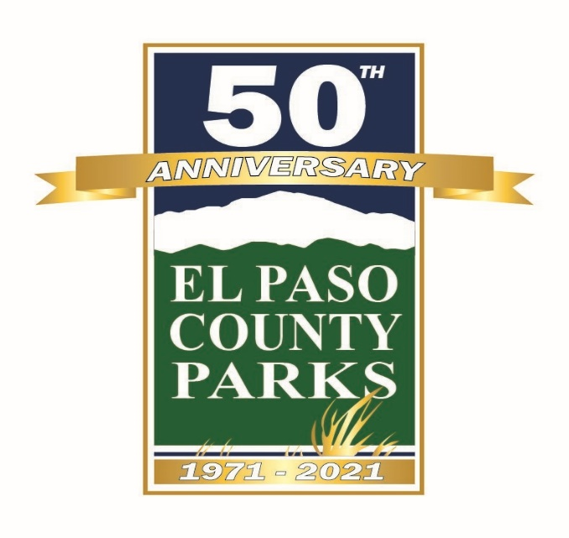
Questions?

