Slide 1
Special Use Muddy Little Cowboys Rad Dickson Jack Patton
AL-19-028
Notes:
Good afternoon commissioners and all people viewing this hearing today. my name is Rad Dickson with el paso county planning here to present you the facts on Muddy Little Cowboys file number AL-19-028. The engineer on the project is out so all questions for the PCD engineering department can be answered by the PCD Engineering Review Manager Elizabeth Nijkamp who is on standby.

Slide 2
Public input
If you are watching remotely and have not provided a name and a reliable phone number already, please email that information to:
Tracey Garcia at traceygarcia@elpasoco.com
Notes:
If you are watching remotely and have not provided a name and a reliable phone number already, please email that information to Tracey Garcia

Slide 3
Overview of Process
Review criteria
Applicant presentation
Staff presentation
Break to call in members of public
Public testimony (allow time between each person to call in the next person)
Break to ensure all members of the public have had an opportunity to speak.
Applicant rebuttal
Discussion and decision
If you are watching remotely and have not provided a name and a reliable phone number already, please email that information to Tracey Garcia at traceygarcia@elpasoco.com at this time.
Notes:
This is for anybody who is watching, I will briefly discuss the overview of the process -
First, we will go over the review criteria, then the Staff presentation, Applicant presentation, Break to call in members of public, Public testimony, Break to ensure all members of the public have had an opportunity to speak, Applicant rebuttal, Discussion and decision.

Slide 4
Review criteria
5.3.2.C of the Land Development Code
The special use is generally consistent with the applicable Master Plan;
The special use will generally be in harmony with the character of the neighborhood, and will generally be compatible with the existing and allowable land uses in the surrounding area;
The impact of the special use does not overburden or exceed the capacity of public facilities and services, or, in the alternative, the special use application demonstrates that it will provide adequate public facilities in a timely and efficient manner;
The special use will not create unmitigated traffic congestion or traffic hazards on the surrounding area, and has adequate, legal access;
The special use will comply with all applicable local, state, and federal laws and regulations regarding air, water, light, or noise pollution;
The special use will not otherwise be detrimental to the public health, safety and welfare of the present or future residents of El Paso County; and/or
The special use conforms or will conform to all other applicable County rules, regulations or ordinances.
Notes:
At this point our county attorney will go over the review criteria.

Slide 5
Planning Commission
August 20, 2020.
The recommendation for approval was granted 9-0
In favor (1)
“This is a great learning opportunity for our community”
In opposition (5)
Potential to lower the neighbor's property value
Issues stated regarding the “Grand Entrance”
Concern with “the ½ acre area of the special use being expanded”
Notes:
Muddy Little Cowboys Ranch went to the Planning Commission on August 20, 2020 and the recommendation for approval was granted with a vote of 9 for and 0 against.

Slide 6
Muddy Little Cowboys Agritainment
Randal Childers (PowerPoint with photos)
Notes:
At this point the applicant will present their project

Slide 7
Public input
Tracey Garcia at traceygarcia@elpasoco.com
Notes:
If you are watching remote and have not provided a name and a reliable phone number already, please email that information to: TracyGarcia@elpasoco.com

Slide 8
Overview of Process
Review criteria
Applicant presentation
Staff presentation
Break to call in members of public
Public testimony (allow time between each person to call in the next person)
Break to ensure all members of the public have had an opportunity to speak.
Applicant rebuttal
Discussion and decision
If you are watching remote and have not provided a name and a reliable phone number already, please email that information to Tracey Garcia at traceygarcia@elpasoco.com at this time.

Slide 9
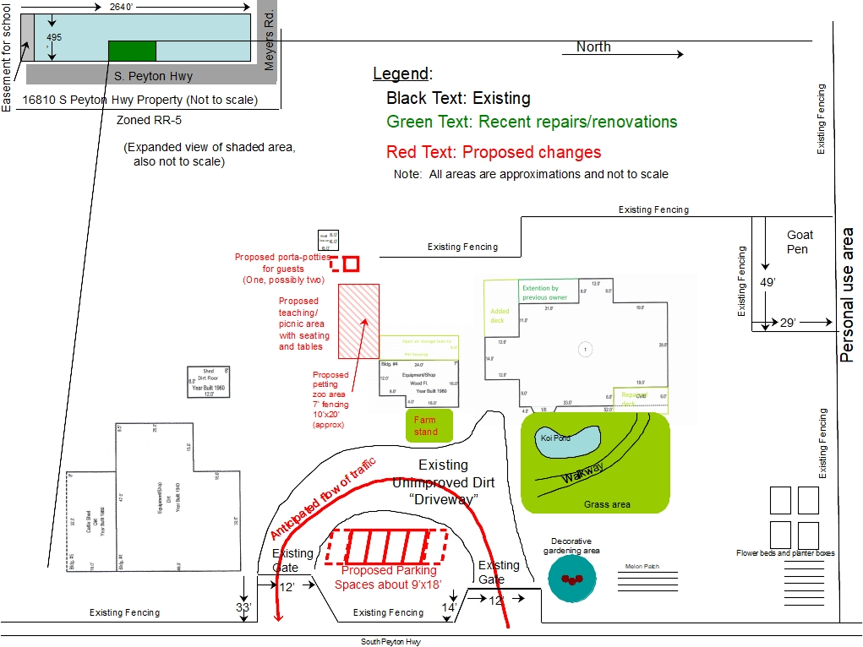
Request
A request for a special use to allow for agritainment within the RR-5, Rural Residential zoning district. Approval of a special use when the parcel is less than 35 acres in size is required. The subject parcel is 30 acre.
Notes:
Here is a preliminary image of site. Approval of a site development plan is required for compliance should this project be approved. approval of special use is required for agritainment in the RR-5 if the site is less than 35 acres, the subject site is 30 acres.

Slide 10
Surrounding development
Notes:
Here you can see the major roads, the property is located on the southwest corner of the intersection of Peyton Highway and Meyers Rd.

Slide 11
Zoning info
A-35
RR-5
Notes:
The property is within the RR-5 Residential Rural zoning district. To the south is Hanover High School. All other surrounding properties are zoned A-35 Agriculture.

Slide 12
Details of the Applicants Agritainment
The applicants Agritainments use has multiple elements as described in the applicant's letter of intent and as shown in the applicants site plan. Those elements are shown below
Fenced area for a petting zoo
A farm stand to sell homemade items and crafts
Teaching area
Koi Pond
Raised garden beds
Entire Agritainment area no more than 1/2 acre. (The overall area of the site will be reviewed during the site development plan phase of the process)
The hours of operation are below
Open April 1 to Sep 30
9 AM - 6 PM Tuesdays through Saturdays
No more than 6 parking stalls
Notes:
Muddy little cowboys is a multi faceted special use with a Fenced area for a petting zoo, A farm stand to sell homemade items and crafts, a Teaching area, Koi Pond, and Raised garden beds. The applicant has stated that they will operate from April 1 until September 30 between the hours of 9am and 6 pm on Tuesdays through Saturdays. They have conveyed that there will be no more than 6 parking stalls and that the agritainment will be no larger than ½ acre. These elements will be enforced during the site plan review.

Slide 13
Background
The 30-acre parcel was legally created by warranty deed on August 6, 1968, prior to El Paso County adoption of subdivision regulations on July 17, 1972.
The property was initially zoned A-4 (Agricultural) on December 22, 1983, when zoning was first established for this area of the County (BoCC Resolution 83-392a). Due to changes in the nomenclature of the Land Development Code, the A-4 zoning district has been renamed to the RR-5 (Residential Rural) zoning district.
Notes:
The parcel was legally created prior to subdivision and was zoned A-4 when zoning was first established in the area of the county. A-4 has since been renamed to RR-5.

Slide 14
Land development code
The existing home and accessory structures meet the 25-foot setback from all property lines,
The structures are under the 30 feet height requirements
Total lot coverages is estimated to be at only 0.38 percent of the total lot area.
Should the special use request be approved, approval of a site development plan will be required prior to initiation of the use.
The site development plan review will include confirmation that all site improvements (existing and proposed) will comply with the dimensional standards included in Chapter 5 as well as the Development Standards of Chapter 6 of the Code
Notes:
the land development code will be enforced during the Site Development plan phase of this project. The current site plan shows conformance with the dimensional standards of the land development code for the RR-5 zoning district.

Slide 15
Policy plan
Goal 6.1 a - Encourage patterns of growth and development which complement the regions' unique natural environments and which reinforce community character.
Goal 6.5 - Encourage the preservation of agricultural uses as an important contributor to the economy and land use character of the County.
Policy 5.1.1 - Encourage economic development that enhances a sense of community, provides vigor to the economy and considers the environment while contributing to the overall health of the County.
Policy 6.4.7 - Accommodate limited very low impact business and other employment uses in rural residential development if these serve to reduce overall levels of traffic in these areas and do not otherwise detract from the desired rural residential character, provided the requisite level of services is or will be available in a timely fashion. These uses should primarily serve the needs of residents.
Policy 6.5.2 - Encourage appropriate opportunities for employment within rural areas.
Notes:
Displayed are a some of the applicable policies a goals form the el paso county policy plan
Goal 6.1 a - Encourage patterns of growth and development which complement the regions' unique natural environments, and which reinforce community character.
The proposed agritainment use is in a rural/agricultural portion of the county and matches its environment in an appropriate manor. The educational focus on gardening and animal husbandry is compatible and complimentary to the neighboring agricultural land uses and the adjacent school

Slide 16
South central comprehensive plan
Position statement 2.A Agriculture - The Areas rural character needs to be preserved.
Position statement 2.B Housing/Commercial/Industrial/Open Space - 4. Commercial and industrial growth, which uses little water, should be encouraged.
Notes:
The south central Plan did not contemplate Agritainment as a future use, however there are a couple of relevant position statements shown above. Staff recommends that this application is generally consistent with the South-Central Comprehensive Plan (1988)

Slide 17
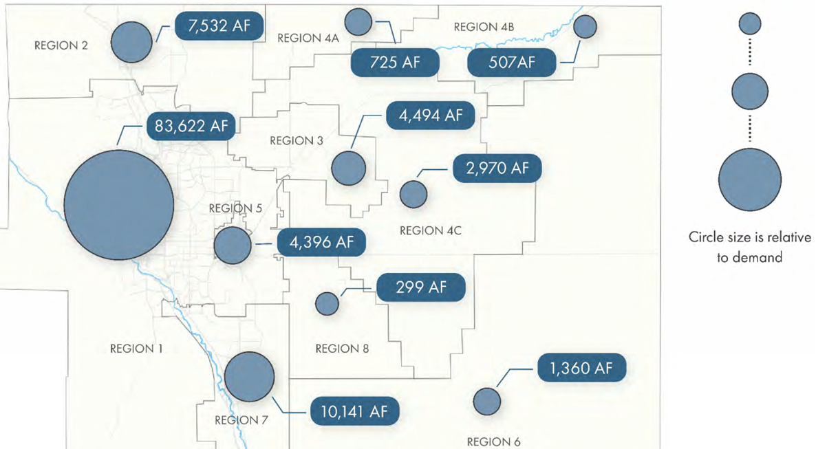
Water Master Plan
The subject parcel is within Region 6 of the El Paso County Water Master Plan (2018). Region 6 contains no growth map and is mostly comprised of agricultural areas that are not projected to experience significant growth by years 2040 or 2060.
Notes:
The proposed project is located within region 6 of the water master plan.
The applicants are currently utilizing a well for the existing single-family residence and agricultural uses on the property. The County has not received a copy of a well permit associated with the property and is currently unable to confirm alignment with the water master plan until the applicant provides legal water information to the county. We have added condition number three to address this.

Slide 18
Conditions of approval
The special use shall be limited to Agritainment as described in the applicants’ letter of intent and as shown on the site plan. Any subsequent addition or modification to the operation or facility beyond that described in the applicants’ letter of intent and as shown on the site plan shall be subject to administrative review, and if it is the opinion of the Planning and Community Development Department Director that it constitutes a substantial increase, then such addition or modification shall be subject to a new special use application.
No structure on the property shall be used for employees or the general public unless a building permit has been granted and the structure is shown on the site development plan.
The applicants shall provide the Planning and Community Development Department a copy of either the well permit or provide the county with a legal source of water.
Notes:
The special use shall be limited to Agritainment as described in the applicants’ letter of intent and as shown on the site plan. Any subsequent addition or modification to the operation or facility beyond that described in the applicants’ letter of intent and as shown on the site plan shall be subject to administrative review, and if it is the opinion of the Planning and Community Development Department Director that it constitutes a substantial increase, then such addition or modification shall be subject to a new special use application.
No structure on the property shall be used for employees or the general public unless a building permit has been granted and the structure is shown on the site development plan.
The applicants shall provide the Planning and Community Development Department a copy of either the well permit or provide the county with a legal source of water prior to approval of the site development plan.

Slide 19
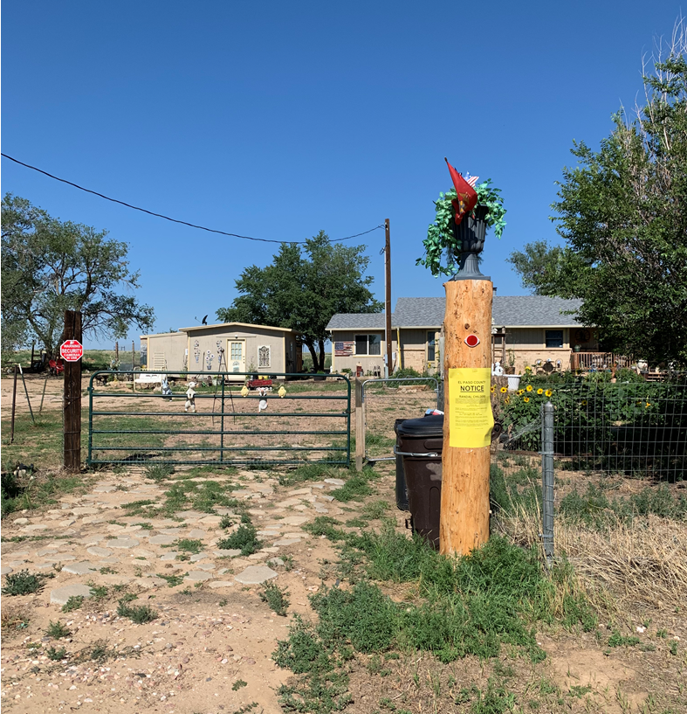
Public Notice
August 11, 2020
9 adjacent property owners were notified
Notes:
9 adjacent property owners were notified on August 11, 2020

Slide 20
Questions
Notes:
I am now available for any questions.

Slide 21
Public input
If you are watching remote and have not provided a name and a reliable phone number already, please email that information to:
Tracey Garcia at traceygarcia@elpasoco.com

Slide 22
Overview of Process
Review criteria
Applicant presentation
Staff presentation
Break to call in members of public
Public testimony (allow time between each person to call in the next person)
Break to ensure all members of the public have had an opportunity to speak.
Applicant rebuttal
Discussion and decision
If you are watching remotely and have not provided a name and a reliable phone number already, please email that information to Tracey Garcia at traceygarcia@elpasoco.com at this time.

