Slide 1
Mayberry 1-8
ID-20-003
Nina Ruiz
Jeff Rice

Slide 2
Public input
If you are watching remotely and have not provided a name and a reliable phone number already, please email that information to:
Tracey Garcia at traceygarcia@elpasoco.com

Slide 3
Overview of Process
Review criteria
Applicant presentation
Staff presentation
Break to call in members of public
Public testimony (allow time between each person to call in the next person)
Break to ensure all members of the public have had an opportunity to speak.
Applicant rebuttal
Discussion and decision
If you are watching remotely and have not provided a name and a reliable phone number already, please email that information to Tracey Garcia at traceygarcia@elpasoco.com at this time.

Slide 4
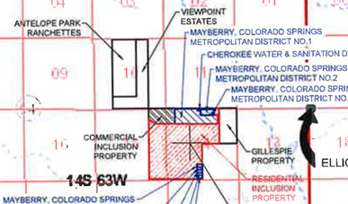
Planning Commission & Staff analysis
September 3, 2020
Consent Item
Regular BoCC
PC and BoCC hearing 1 business day apart
Maximum Debt should be $178,420,000 vs. $164,240,000 for the "Gillespie Inclusion"
Purpose of Amendment: Phasing

Slide 5
Mandatory Criteria for Disapproval
The BoCC shall disapprove the draft service plan unless evidence satisfactory to it of each of the following is presented or, in the BoCC ' s discretion, the BoCC conditionally approves the draft service plan to cause compliance with these criteria (C.R.S. § 32-1-203(2)):
There is sufficient existing and projected need for organized service in the area to be served by the proposed special district;
The existing service in the area to be served by the proposed special district is inadequate for present and projected needs;
The proposed special district is capable of providing economical and sufficient service to the area within its proposed boundaries;
The area to be included in the proposed special district has, or will have, the financial ability to discharge the proposed indebtedness on a reasonable basis.

Slide 6
Discretionary Criteria for Disapproval
The BoCC may disapprove the draft service plan if evidence of the following, at the BoCC ' s discretion, is not presented (C.R.S. § 32-1-203(2.5)):
Adequate service is not, or will not be, available to the area through the County or other existing municipal or quasi-municipal corporations, including existing special districts, within a reasonable time and on a comparable basis;
The facility and service standards of the proposed special district are compatible with the facility and service standards of each County within which the proposed special district is to be located and each municipality which is an interested party as defined in C.R.S. § 32-1-204 and this Code;
The proposal is in substantial compliance with the El Paso County Master Plan;
The proposal is in compliance with any duly adopted County regional, or State long-range water quality management plan for the area; or
The creation of the proposed special district will be in the best interests of the area proposed to be served.

Slide 7
Applicant
Applicant: Colorado Springs Mayberry, LLC
Representative: White, Bear, Ankele, Tanaka & Waldron

Slide 8
Public input
If you are watching remotely and have not provided a name and a reliable phone number already, please email that information to:
Tracey Garcia at traceygarcia@elpasoco.com

Slide 9
Overview of Process
Review criteria
Applicant presentation
Staff presentation
Break to call in members of public
Public testimony (allow time between each person to call in the next person)
Break to ensure all members of the public have had an opportunity to speak.
Applicant rebuttal
Discussion and decision
If you are watching remotely and have not provided a name and a reliable phone number already, please email that information to Tracey Garcia at traceygarcia@elpasoco.com at this time.

Slide 10
Staff Report
Standard staff report template
June 25, 2007 County Special District Policies attached
Complete Service Plan provided as supplemental attachment
Plan follows Model Service Plan as adopted by BoCC on 6/25/2007

Slide 11
Vicinity

Slide 12
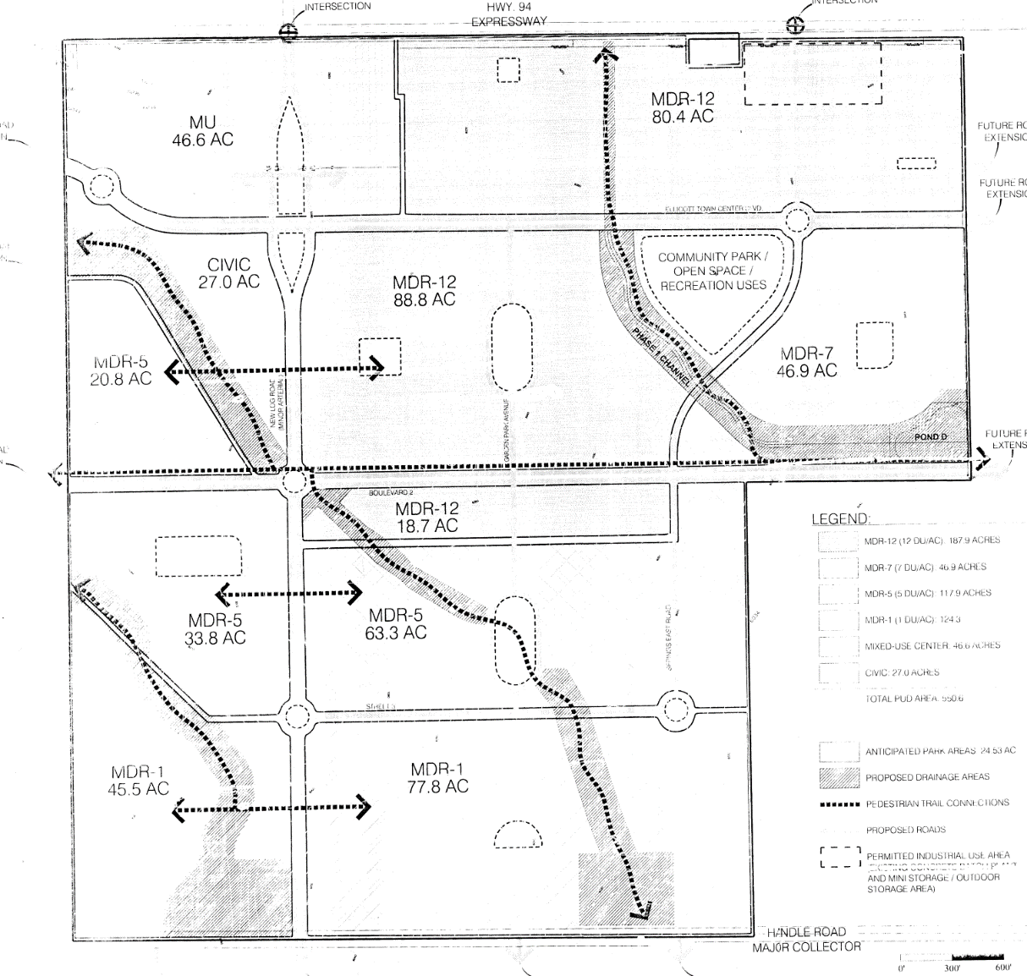
Background
Ellicott Town Center 5/11/06
Ellicott Town Center Metro Approved 6/29/06 (60 mills)
Amendment to District 7/23/19 (60 mills)(2 Districts)

Slide 13
Purposes of the districts
Design, construction, financing, maintenance, and ownership of water and wastewater lines;
Street improvements and safety protection;
Transportation;
Design, construction, financing, and maintenance of drainage facilities;
Design, acquisition, construction, and maintenance of recreation facilities;
Mosquito control;
Covenant enforcement, and
Television relay and translation

Slide 14
Mill Levy and bonding
District 1, 3, 4, 5, 6, 7
50 Mills for debt service
10 Mill for operations
5 Mills for covenant enforcement
Maximum combined 65 Mills
District 2, 8
25 Mills for debt service
10 Mill for operations
5 Mills for covenant enforcement
Maximum combined 40 Mills
$178,420,000 authorized debt

Slide 15
Existing Mill Levies
El Paso County 7.738
El Paso County Road and Bridge .330
School District No. 22 31.863
Pikes Peak Library District 4.000
Ellicott Fire Protection District 9.451
Upper Black Squirrel Creek Ground Water 1.082
TOTAL: 54.460
DISTRICT 1, 3, 4, 5, 6, 7 TOTAL: 119.46
DISTRICT 2, 8 TOTAL: 94.46

Slide 16
Disclosure
Standard Disclosure will be required
Exhibit to service plan
Will be required with subsequent plats
Updates required annually thereafter
To be posted on County web site

Slide 17
Staff Analysis and Issues
Financial Plan
150 houses/year
Based upon military growth
Commercial is dependent upon residential growth
Concern with inability to service debt

Slide 18
Recommended Conditions and Notations
Standard conditions
The Districts shall not be authorized to issue debt until and unless a final plat for property included within the Districts has been filed in the records of the El Paso County Clerk and Recorder’s Office.

Slide 19
Public input
If you are watching remotely and have not provided a name and a reliable phone number already, please email that information to:
Tracey Garcia at traceygarcia@elpasoco.com

Slide 20
Overview of Process
Review criteria
Applicant presentation
Staff presentation
Break to call in members of public
Public testimony (allow time between each person to call in the next person)
Break to ensure all members of the public have had an opportunity to speak.
Applicant rebuttal
Discussion and decision
If you are watching remotely and have not provided a name and a reliable phone number already, please email that information to Tracey Garcia at traceygarcia@elpasoco.com at this time.

Slide 21
Questions?

