Slide 1
Chuck Broerman
El Paso County Clerk and Recorder
September 22, 2020

Slide 2
El Paso County Registered Voters
431,748 active registered voters
88,305 Democratic voters
156,506 Republican Voters
178,001 Unaffiliated Voters
Modeling forecast
Total Projected ~ 80% or 372,402
Projected Mail Ballots – 94% or 350,058
Projected VSPC Turnout- 6% or 22,344
Past General Election return %
2016 – 70.97%
2012 – 68.65%
General Election Stats

Slide 3
Voter Registration
Today is National Voter Registration Day
Verify your voter record is accurate and up-to-date
Register to vote
www.GoVoteColorado.gov

Slide 4
Election Judge Recruitment
500-600 Total Positions Available
$15.50 per hour
COVID-19 Safety procedures implemented
Judge Positions Available
Voter Service and Polling Center Judges
450 recruited- 75 additional judges needed
Judge Positions Filled
Ballot Intake Judges
Signature Review Judges
Pre-processing Judges
Ballot Runners
Tabulation Judges

Slide 5
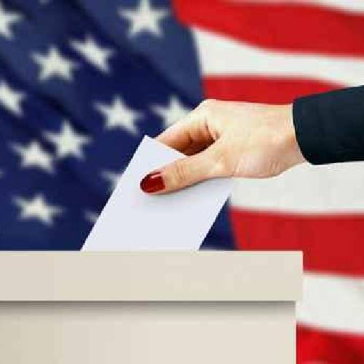
General Election Timeline
UOCAVA Ballots Mailed
September 18, 2020
5,163 sent
1,858 – mailed
3,305 – email
Ballots Mailed
October 9, 2020
37 24/7 Ballot drop boxes open
1 sheet double-sided ballot
$.65 Standard first-class postage needed if returning by USPS
Voter’s needing in-person assistance can visit Citizens Service Center beginning September 21, 2020
Logic & Accuracy Test
September 29, 2020 beginning at 10 a.m.

Slide 6
2020 General Election Questions
Call 575-VOTE or 575-8683
Email elections@elpasoco.com
EPCVotes.com

Slide 7
Motor Vehicle Service
Re-opened Fort Carson September 8, 2020
200 transactions a day
Doing ~ 1300-1500 transactions a day via appointment
70-75% capacity
Full-day Saturday office hours at North Union Town Center branch

Slide 8
Questions?

