Slide 1
Humane Society- Community Service Organization Update January- August 2020

Slide 2
Adoptions
Total- organization wide, YTD 6,985
Pandemic Changes:
Adoption by Appointment
Managing our Lobbies
Queue System

Slide 3
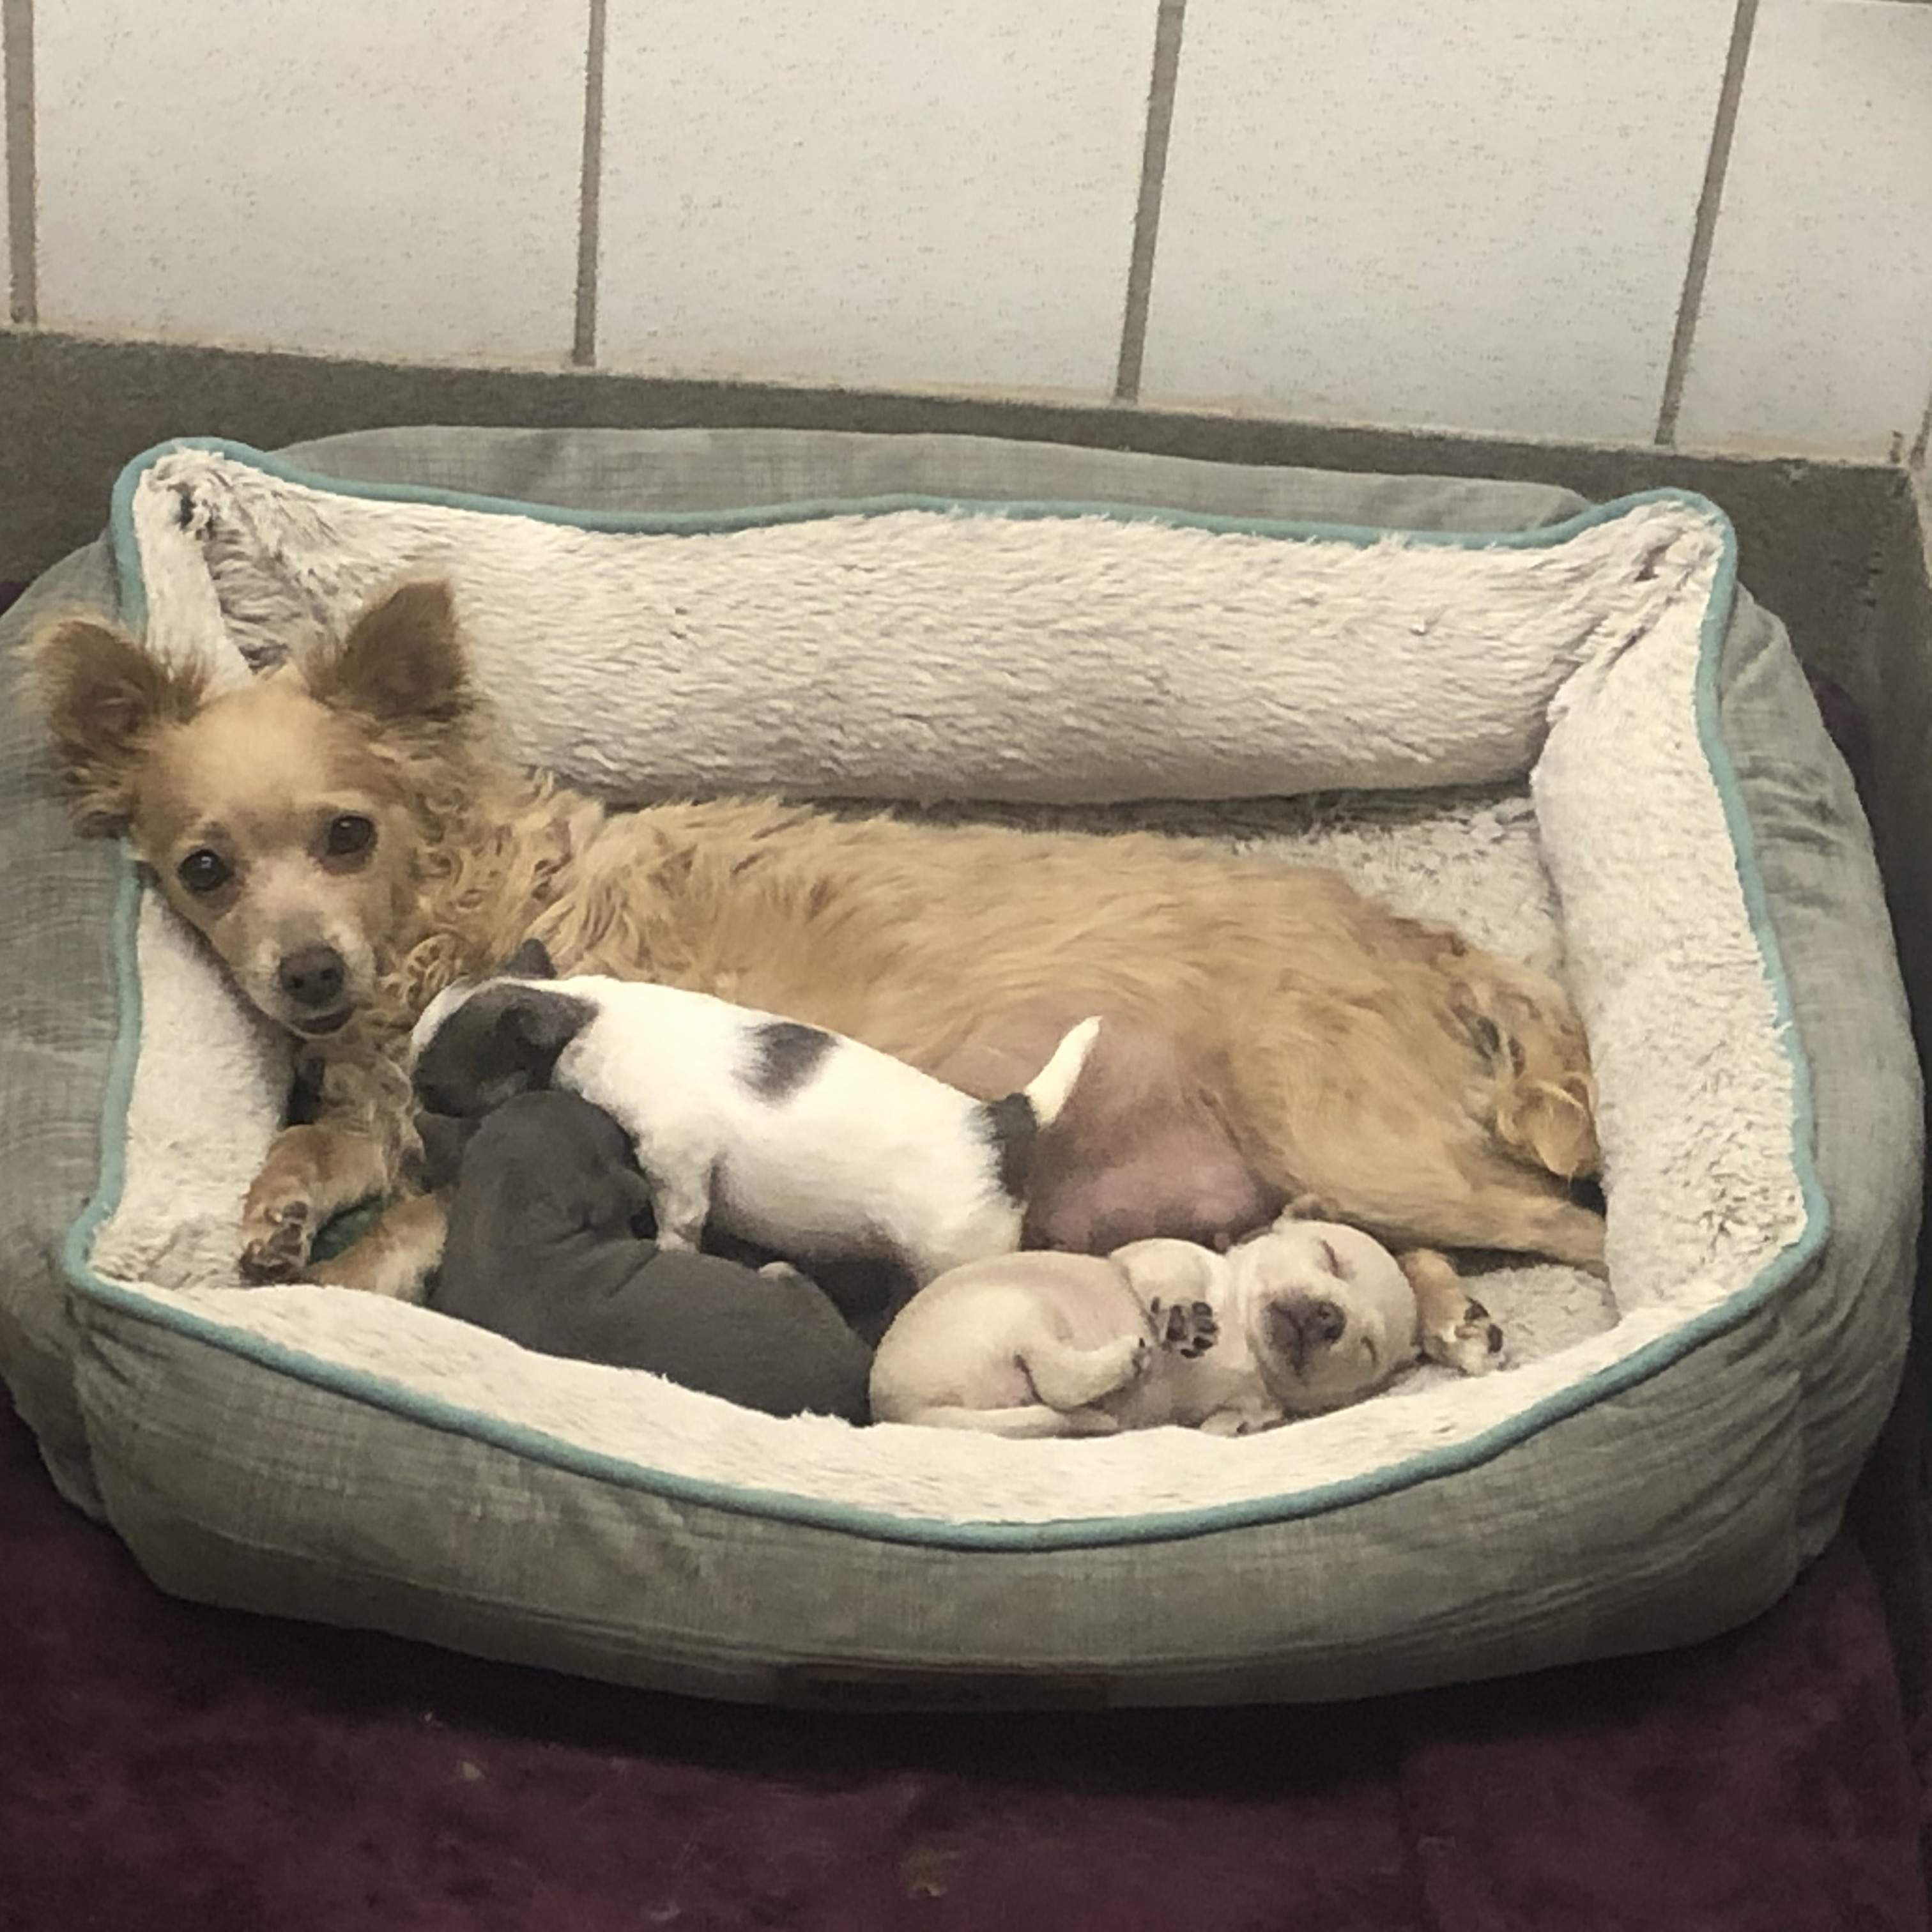
Transfers In From Other Locations
Transfers In YTD- 1,479
Pandemic Changes:
Initially fewer transfers than last year
Fewer adoption candidates
Focus on behavior modification

Slide 4
Foster and Volunteer Hours
2020 Volunteer Hours-59,524
Pandemic Changes:
Fewer volunteers on site initially
300 animals in foster care when the pandemic began
(372 more in foster care YTD)

Slide 5
Humane Education & Events
Camp Whiskers and Wags
Pandemic Changes:
Virtual
234 campers vs. 146 campers
Kids from all over US- not just Pikes Peak Region
Fur Ball
Pandemic Changes:
Virtual
Successful 1- hour event with 10-day silent auction

Slide 6
Spay/Neuter Surgery
Pandemic Changes:
6- week period – no surgeries
PPE and medical supplies donated to local hospitals
Scheduled drop offs and pick ups for public pets
Efficiencies on the mobile unit
Wellness Waggin in Pueblo and Colorado Springs 4 days per week now

Slide 7
Medical Outreach
Medical Services Provided as Surrender Prevention Effort
2109 YTD-50
2020 YTD- 118
Stories very much related to COVID, loss of employment, and inability to pay for veterinary care

Slide 8
Animals Handled YTD El Paso County
El Paso County YTD
Total Number of Animals Handled 2,498 (-236)
Total animal care days 15,368
Protective Custody Impounds 23
Pandemic Changes:
Fewer animals handled
Staff time available for training and development
More time to walk dogs
and do enrichment, behavior work

Slide 9
Animal Law Enforcement Calls for Service YTD- El Paso County
Total Calls for service- 2,151 (-290)
Total Bites- 131 (-14)
Total EPSO assists- 217 (+10)
Within Resolution Area: 150
Outside of Resolution Area: 67
Pandemic Changes
COIVD presents contact challenges with pet owners
On- line complaint system

Slide 10
Animal Law Enforcement Interesting Trends- Overall
Increased Patrols and Dog at Large calls
Increased Warnings and summonses issued
Increase in Severe Bites involving humans- particularly children
Increased Protective Custody length of stay

Slide 11
Summary- 2020 Take -Aways
Fewer animals handled/intakes
Continued strong demand for adoption
Increased medical outreach
Increase in reported bites

Slide 12
Looking Ahead to 2021
Requesting increase in pet license fees to support contracts
Increased Wellness Waggin vaccine and wellness events
Continued focus on surrender prevention through behavior and medical support

Slide 13
Thank You!
Questions?

