Slide 1
skp-20-001 GRANDVIEW RESERVE sketch plan Kari PArsons Jeff Rice

Slide 2
Public input
If you are watching remotely and have not provided a name and a reliable phone number already, please email that information to Tracey Garcia at traceygarcia@elpasoco.com at this time.

Slide 3
Request
A request by 4 Site Investments, LLC, for approval of a 768.2 acre sketch plan which includes the following: 453 acres of urban density single-family residential development ranging from 4-12 dwelling units per acre; 134 acres of rural residential (low density) single-family residential development ranging from 1-2 dwelling units per acre; 127.1 acres of parkland, buffer, and open space; 16.4 acres of commercial; 17 acres of institutional (education and religious institution) land uses; and 20.6 acres of public right-of-way.
The applicant anticipates including the development into the anticipated Grandview Reserve Metropolitan District upon approval of the proposed sketch plan and creation of The Grandview Reserve Special District.
A finding of water sufficiency is not requested nor required at the time of a sketch plan approval.

Slide 4
Notice/ Concerns
The Planning and Community Development Department notified 15 adjoining property owners on August 27, 2020, for the Planning Commission and Board of County Commissioners meetings.
Comments and Concerns
School Site
Drainage (East Fork)

Slide 5
Overview of Process
Review criteria
Applicant presentation
Staff presentation
Break to call in members of public
Public testimony (allow time between each person to call in the next person)
Break to ensure all members of the public have had an opportunity to speak
Applicant rebuttal
Discussion and decision
If you are watching remotely and have not provided a name and a reliable phone number already, please email that information to Tracey Garcia at traceygarcia@elpasoco.com at this time.

Slide 6
Criteria for Approval Sketch plan (LDC 7.2.1.d.1)
In approving a sketch plan, the BOCC shall find that:
The proposed subdivision is in general conformance with the goals, objectives, and policies of the Master Plan;
The proposed subdivision is in conformance with the requirements of this Code;
The proposed subdivision is compatible with existing and proposed land uses within and adjacent to the Sketch Plan area;
The water supply report provides sufficient information to identify probable compliance with the water supply standards, and identifies any need for additional water supplies;
Services are or will be available to meet the needs of the subdivision including roads, police and fire protection, schools, recreation facilities, and utility service facilities;

Slide 7
Criteria for Approval
The soil is suitable for the subdivision;
The geologic hazards do not prohibit the subdivision, or can be mitigated;
The subdivision will not interfere with the extraction of any known commercial mineral deposit [C.R.S. § §34-1-302(1), et seq.];
The design of the subdivision protects the natural resources or unique landforms;
The proposed methods for fire protection are adequate to serve the subdivision; and
The subdivision is appropriate, and the design is based on mitigating the constraints of the topography, soil types, geologic hazards, aggregate resources, environmental resources, floodplain, airplane flight overlays, or other constraints.

Slide 8
Applicant
Owner:
4-Site, LLC
Representative:
HR Green, LLC

Slide 9
Overview of Process
Review criteria
Applicant presentation
Staff presentation
Break to call in members of public
Public testimony (allow time between each person to call in the next person)
Break to ensure all members of the public have had an opportunity to speak
Applicant rebuttal
Discussion and decision
If you are watching remotely and have not provided a name and a reliable phone number already, please email that information to Tracey Garcia at traceygarcia@elpasoco.com at this time.

Slide 10
ZoNING MAP
SITE

Slide 11
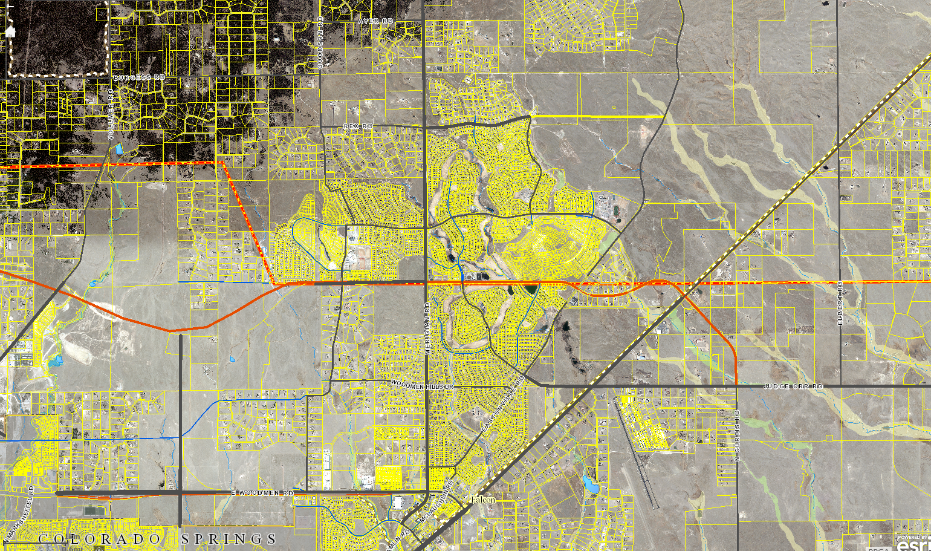
Vicinity map
Latigo
SITE
Paint Brush
Hills
Development
Meridian Ranch
Stapleton Estates
Stapleton-Briargate Corridor
The Sterling Ranch
The Ranch SKP
Banning Lewis
Ranch
The Meadows
Woodmen Hills

Slide 12
background
Woodmen Hills and Meridian Ranch communities which are zoned PUD (Planned Unit Development) and include urban density single-family development located to the west.
Falcon Regional Park and Falcon High School are located to the west of the subject property and reflect the continuous growth in this area of the County.
The Waterbury PUD is located to the south of the property and is planned for urban densities similar to those within the Meridian Ranch and Woodmen Hills developments.
The sketch plan depicts 272.5 acres of medium-density urban single-family residential (four (4) dwelling units per acre) and a 15-foot buffer adjacent to these developments.
The sketch plan also depicts 65.6 acres of medium-high single-family residential development (8 dwelling units per acre.)
114.9 acres of high-density residential development (12 dwelling units per acre) Development is centralized within the sketch plan and proposed to be adjacent to the proposed alignment of Rex Road or Highway 24, an expressway road.

Slide 13
background
A-35 (Agricultural) zoned parcels are located adjacent to the northern property boundary of the subject parcel. The sketch plan depicts 134 acres of rural residential low-density, one-half (1/2) acre single-family lots (1-2 dwelling units per acre) at the northern boundary of the sketch plan. These lots in addition to the 20-foot buffer are intended to provide a transition from the undeveloped agricultural properties to the urban single-family development proposed within the sketch plan area.
Multiple open-space tracts totaling 127.1 acres are depicted throughout the sketch plan and are proposed to include interconnecting park land, trails, and drainage areas. The interconnected open space is proposed to connect to the Rock Island Regional Trail as requested by the EPC Community Services, Parks Division.
A 10.9-acre school site is depicted within the plan separating the low and medium density areas.
The sketch plan also depicts 16.4 acres of commercial land use, which is proposed to be located adjacent to the planned intersection of Rex Road and Highway 24. A 6.9-acre religious institution is depicted at the proposed intersection of Eastonville Road and Rex Road.

Slide 14
Sketch plan

Slide 15
Policy Plan Highlights (1998)
The El Paso County Policy Plan (1998) has a dual purpose; it serves as a guiding document concerning broader land use planning issues, and provides a framework to tie together the more detailed sub-area elements of the County Master Plan.
Policy 6.1.1- Allow for a balance of mutually supporting interdependent land uses, including employment, housing, and services in the more urban and urbanizing areas of the County.
Policy 6.1.3- Encourage new development which is contiguous and compatible with previously developed areas in terms of factors such as density, land use, and access.
Policy 6.1.5 Support the development of-well-planned mixed-use projects which promote all, or most, of the following objectives:
•Maximize the economy and efficiency of land use
•Preserve open space or natural areas
•Integrate employment, housing, shopping, schools and other uses
•Accommodate multi-modal transportation linkages
•Allow for variations in design and character
Policy 6.1.11- Plan and implement land development so that it will be functionally and aesthetically integrated within the context of adjoining properties and uses.
Goal 13.1- Encourage an adequate supply of housing types to meet the needs of County residents.

Slide 16
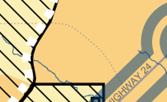
Falcon/Peyton Small Area Master Plan (2008)
The Plan states:
“The primary purpose of this plan is to set forth a framework within which proposed new land uses may be analyzed. This document describes the characteristics and features which are unique to this planning area. The plan is intended to serve as an advisory planning tool to guide future land use decisions.”
The Plan defines “Urban Density” as:
“Parcel sizes are less than 2.5 acres,
typically less than 1 acre. These areas
are served by urban level infrastructure,
including roadways, water distribution,
and wastewater treatment.”
SITE

Slide 17
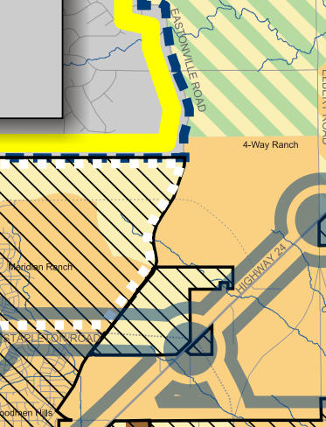
Falcon/Peyton Small Area Master Plan (2008)
4-Way Ranch sub-area
“The 4-Way Ranch area encompasses the historic ranch
parcels currently owned by 4-Way Ranch LLC and the
immediately surrounding parcels to the north and west
of the ranch.”
4.4.4.1 Encourage the acquisition of one
or more additional regional park sites in area,
in coordination with the County Parks
Department and participating landowners.
Specifically encourage current efforts to
locate a new regional park in the 4-Way
Ranch/ Meridian Ranch area
4.4.4.2 Encourage planned coordination of
the development of the 4-Way Ranch parcels.
A development master plan should be developed
to thoughtfully arrange land uses and community
amenities on the ranch parcels and coordinate any
future development of subsections of the historic
4-Way Ranch
SITE

Slide 18
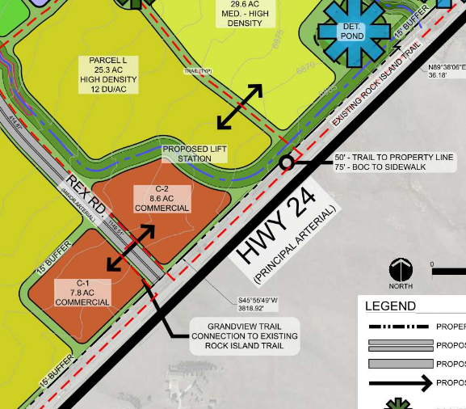
Falcon/Peyton Small Area Master Plan (2008)
Highway 24 Corridor. Section 4.4.5
4.4.5.2 Recognize the importance of Highway 24 as the primary
transportation artery serving the existing and future needs of the area. Maintain options for stringent access control, adequate right-of-way preservation and adjacent land uses which will
complement a higher speed, higher traffic expressway
corridor
4.4.5.3 Maintain the integrity of the
Rock Island Trail Corridor through
the planning area by limiting at-grade
crossings, encouraging compatible adjacent
uses which complement the trail, and
encouraging interconnecting
non-motorized trails and adjacent open space

Slide 19
El Paso County Water Master Plan (2018)
The El Paso County Water Master Plan (2018) has three main purposes; better understand present conditions of water supply and demand; identify efficiencies that can be achieved; and encourage best practices for water demand management through the comprehensive planning and development review processes. Relevant policies are as follows:
Goal 1.1 – Ensure an adequate water supply in terms of quantity, dependability and quality for existing and future development.
Goal 1.2 – Integrate water and land use planning
Goal 3.1 – Promote cooperation among water providers to achieve increased efficiencies on infrastructure.
Policy 5.3.1- Discourage individual wells for new subdivisions with 2.5 acres or smaller average lot sizes, especially in the near-surface aquifers, when there is reasonable opportunity to connect to an existing central system, alternatively, or construct a new central water supply system when the economics of scale to do so can be achieved.
Goal 6.0.11- Continue to limit urban level development to those areas served by centralized services.

Slide 20
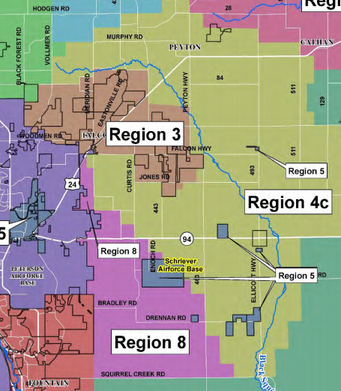
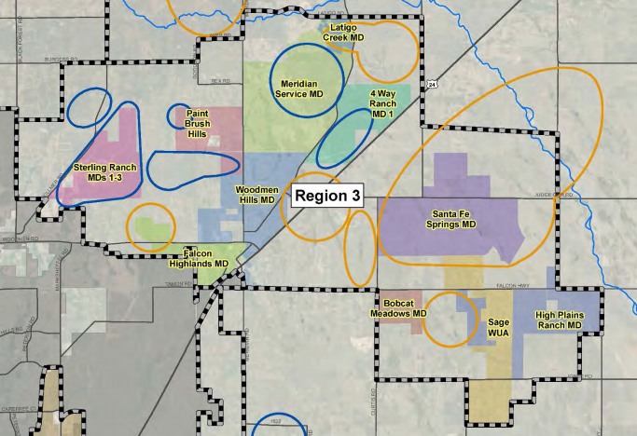
El Paso County Water Master Plan (2018)
The subject property is located within
Region 3, Falcon Area, which is expected
to have increased growth demand by 2040.
Specifically, the Plan states:
“Region 3 contains four growth areas west of
Falcon projected to be completed by 2040.
Other areas of 2040 growth are projected for the
north‐central part of the region west of Highway
24 extending from Falcon to 4-Way Ranch.
North of Falcon along Highway 24, growth is
projected by 2060 on both sides of the
Highway.…
…The other two growth areas will be located on the north and southsides of Falcon Highway directly east of Falcon.”

Slide 21
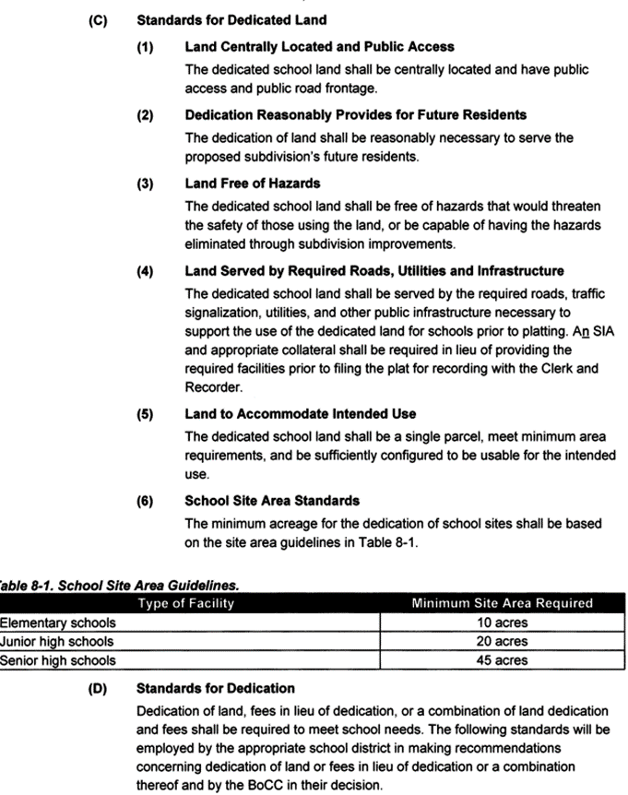
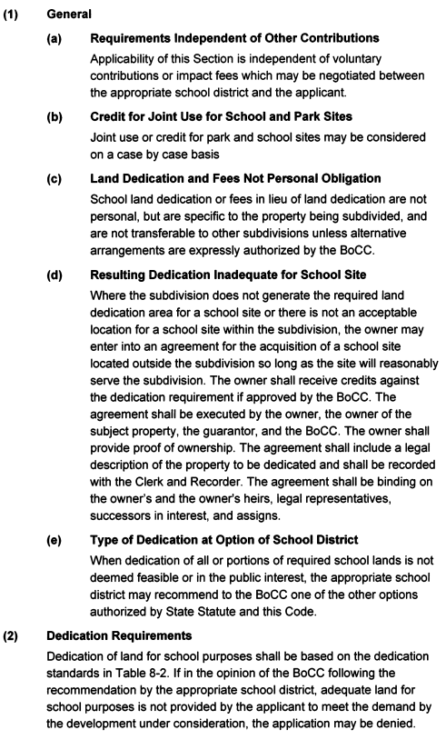
School land dedication & standards
653 SF/DU
$185/DU

Slide 22
Land Development Code Compliance
The sketch plan process allows for review, at a conceptual level, of the feasibility and design characteristics of the proposal based on the standards set forth in the El Paso County Land Development Code (2019), and the review and approval criteria listed above.
The applicant has provided a will-serve letter from the Woodmen Hills Metropolitan District for wastewater services. The Grandview Reserve Metropolitan Districts are proposed to provide water service to the development within the sketch plan area. The Peyton School District has requested a school site within the sketch plan area, which has been depicted on the plan. The Falcon Fire Protection District has provided a will-serve letter. The documentation provided by the applicant demonstrates that services are or will be available to meet the needs of the subdivision as required by the Code.
The request is compatible with the existing land uses in the area. Staff recommends that the request is in compliance with the Code.

Slide 23
Public input
If you are watching remote and have not provided a name and a reliable phone number already, please email that information to Tracey Garcia at traceygarcia@elpasoco.com at this time.

Slide 24
Drainage and Erosion
FEMA floodplains within the property – four drainageways
Natural drainageways, including reaches identified in the draft Geick Ranch DBPS* contain floodplains not regulated by FEMA
Property drains from northwest to southeast
Geick Ranch and Hook and Line Ranch drainage basins
*Neither has an adopted DBPS
Proposing to relocate/improve some portions of drainageways and consolidate drainage in open space tracts
Full spectrum detention/water quality facilities proposed

Slide 25
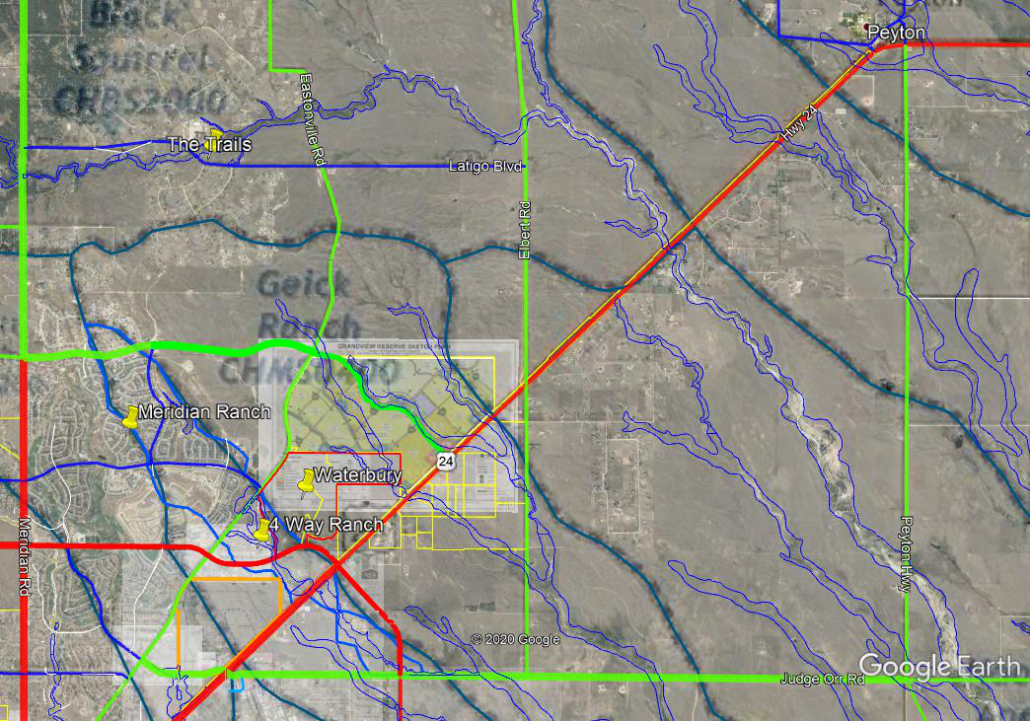
Engineering – Aerial Overlay

Slide 26
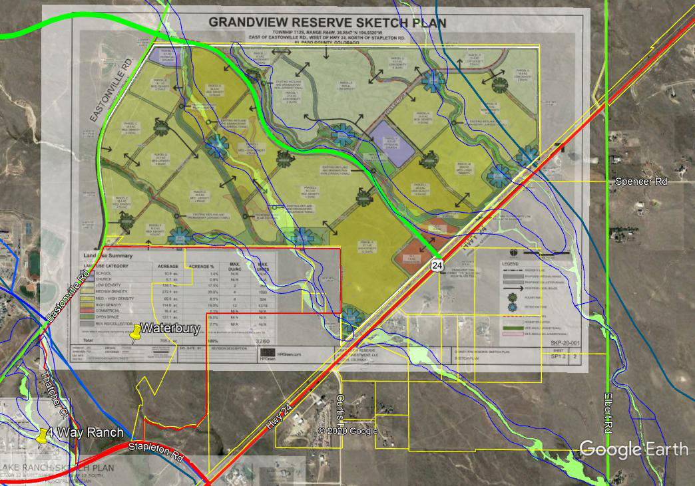
Engineering – Aerial Overlay
Hook and Line
Ranch Basin
Geick Ranch
Basin

Slide 27
Transportation
Access proposed from Eastonville Road, Highway 24 and proposed Rex Road through the site
Connections proposed to properties to the north and south, Elbert Road link
Rex Road is a proposed 4-lane minor arterial west of Eastonville to Meridian Rd
Proposed alignment is generally consistent with the MTCP(not on 2040 plan), Highway 24 Access Control Plan, and CDOT PEL Study
CDOT approval required for slight change of intersection location
Design deviations may apply due to site constraints
Master Traffic Impact Analysis provided
Ultimate road network will be adequate to accommodate the development
Offsite improvements necessary depending on completion by others – to be addressed with rezoning and further defined with subdivision applications
Subject to the El Paso County Road Impact Fee Program
Construction of qualifying improvements is eligible for reimbursement
Rex Road may be added to qualifying improvements list (supported by Staff)

Slide 28
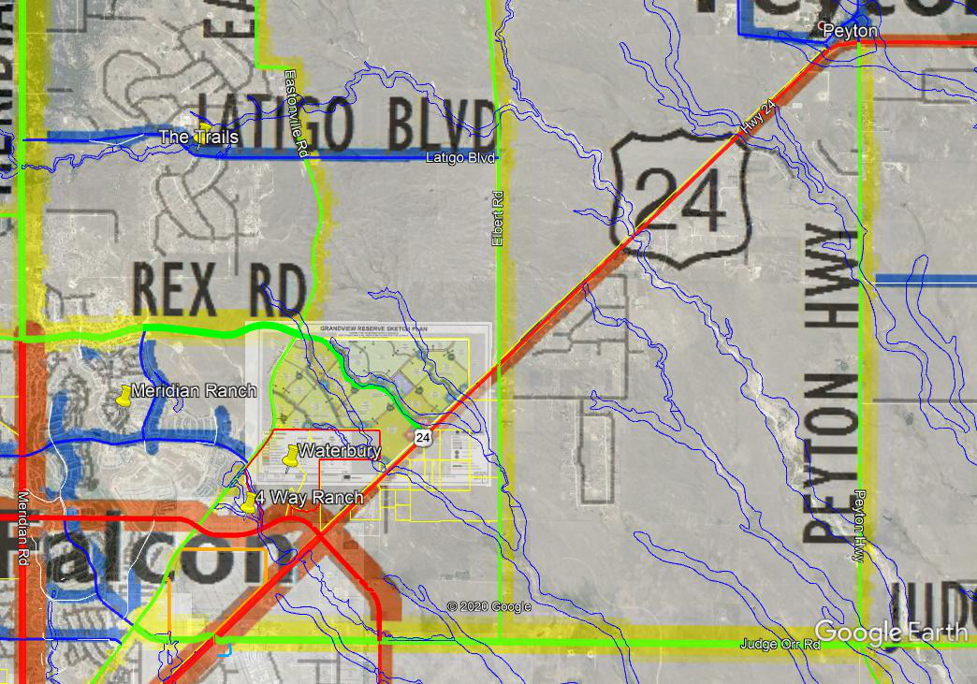
Engineering – Aerial Overlay / MTCP

Slide 29
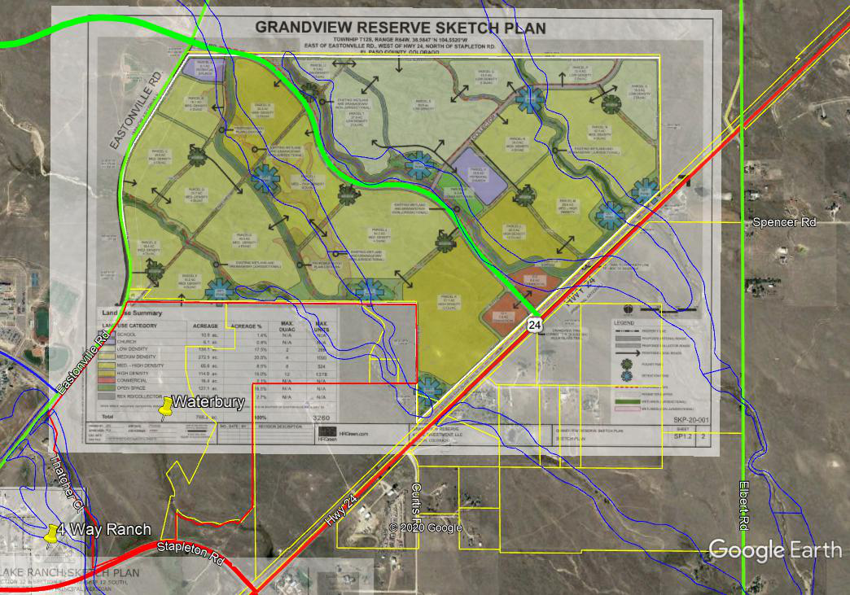
Engineering – Aerial Overlay

Slide 30
Overview of Process
Review criteria
Applicant presentation
Staff presentation
Break to call in members of public
Public testimony (allow time between each person to call in the next person)
Break to ensure all members of the public have had an opportunity to speak.
Applicant rebuttal
Discussion and decision
If you are watching remote and have not provided a name and a reliable phone number already, please email that information to Tracey Garcia at traceygarcia@elpasoco.com at this time.

Slide 31
Aerial With Sketch Plan

Slide 32
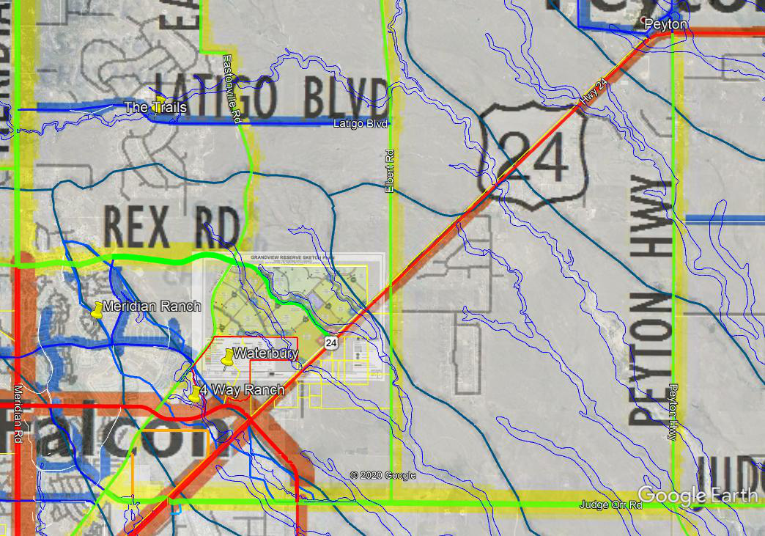
MTCP with Drainage Basins

Slide 33
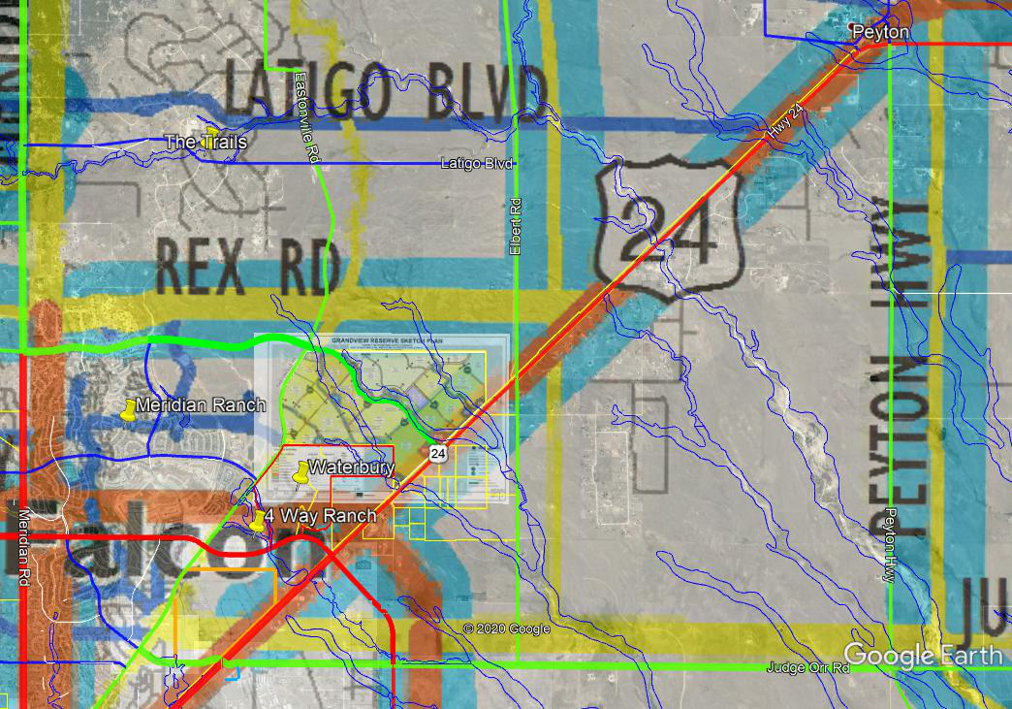
Aerial / 2060 MTCP

